Slide 1
Henry don’t forget to hit record

Slide 2

Intake Interviews:First Contact
with Demos
Facilitators: Dirk Colbry
2025 Virtual Residency, June 24th
Notes:
NOTE: this is an animated slide. When the final animation has been triggered, a small black square appears in the bottom right corner. This is your signal that the next transition will move to a new slide.
Time notes:
Videos: 18 minutes
Chatter: 4 minutes x 5 = 20 minutes
40 minutes ish for rest of slides
Update this slide with your information, the hosts, etc.

Slide 3

CyberAmbassador Project
National Science Foundation Grant (#1730137)
Professional Skills for Interdisciplinary Work
  CyberInfrastructure (CI) Professionals
  STEM (science, technology, engineering, math)
Volunteer Facilitators
  Training is provided
  Open Source Curriculum
Notes:
Briefly explain the history of the CyberAmbassadors project
The CyberAmbassador project was funded by the National Science Foundation (NSF) as a CyberInfrastructure (CI) training grant
The original goal of the project was to develop professional skills training for CI Professionals, who are individuals with expertise in supercomputers and related technologies
The expanded program is designed to help students, faculty, staff and professionals in STEM develop professional skills for success in interdisciplinary work
CyberAmbassador program facilitators are volunteers, typically with a STEM background, who have been trained to present these materials
Participants who are interested in learning more about becoming a facilitator can note that in the evaluation at the end of this session

Slide 4












Partners
Notes:
NOTE: this is an animated slide.
Program History
The CyberAmbassador program is a collaborative effort with national partners
The original grant proposal was developed with support from a number of training and professional associations, with major contributions from:
Campus Champions. A group of 400+ CI Professionals at 200+ US colleges, universities, and other research-focused institutions, who focus on helping researchers use research computing, including large scale and high end computing.
Tau Beta Pi. The Engineering Honor Society offers an Engineering Futures Professional Development that relies on volunteer facilitators to provide professional skills training to hundreds of engineering students and professionals annually.
Additional support came from a range of organizations, training programs, and institutions who assisted with curriculum development, shared evaluation resources, hosted pilot trainings, helped to advertise the CyberAmbassador program, etc.
(You don’t need to explain the following to participants, but the information is provided in case you are curious about all the logos.)
NRMN and CIMER. These national consortiums develop and provide evidence-based training to improve research mentoring, particularly in STEM (science, technology, engineering, math).
The Carpentries. This community of instructors, trainers, maintainers, helpers, and supporters share a mission to teach foundational computational and data science skills to researchers.
XSEDE. This single, virtual system allows scientists to interactively share computing resources, data and expertise. People around the world use these resources and services — things like supercomputers, collections of data and new tools — to improve our planet.
ACI-REF. The Advanced Cyberinfrastructure (ACI) Research and Education Facilitators (ACI-REFs) program brings professional and technical skills training to a broad audience of CI Professionals.
CarCC.org. This consortium focuses on advancing research and education through a national network of campus research computing infrastructures.
ResearchROC. NSF funded project to provide cybersecurity for the nations’s greatest research by making scientific computing resilient to cyberattacks and capable of supporting trustworthy, productive research.

Slide 5
The CyberAmbassador Curriculum
FIRST CONTACT: Communicating with a Purpose
LET’S TALK: Communicating about Problems
IT’S COMPLICATED: Communicating About Complexity
COMMUNICATION
TEAMING UP: Effective Groups and Meetings
SPEAKING UP: Effective Presentation Skills
LEVELING UP: Problem Solving and Decision Making
TEAMWORK
LEADING THE TEAM: Understanding Style and Personality
LEADING THE CHANGE: Equity and Inclusion
LEADING WITH PRINCIPLES: Ethics
LEADERSHIP
Notes:
PREPARATION: you may want to highlight in the slide the content areas that you are covering in this training
Curriculum Overview
The CyberAmbassador curriculum is highly modular and can be easily adapted for different audiences (students, professionals, engineers, scientists, business, etc.)
There are three modules in the communications section (First Contact, Let’s Talk, It’s Complicated)
There are three modules in the teamwork section (Teaming Up, Speaking Up, Leveling Up)
There are three modules in the leadership section (Leading the Team, Leading the Change, Leading with Principles)
The sessions can be completed in any order; however, there is a logical progression of skills in the curriculum design
The Communications modules focus primarily on communications between two people
The Teamwork modules focus primarily on communicating and working effectively in groups of people
The Leadership modules focus primarily on building skills that can be used to improve both individual and group interactions

Slide 6
Best Practices in STEM Education
Constructivism and Socioculturism
Learning is an active process of creating meaning from information and experiences
Learning is most effective when it happens in the context and culture of the learners
Ongoing Research Shows...
Effective professional skills can be taught!
There are common tools (algorithms) that apply across many scenarios
Role playing / rehearsal activities are effective learning tools for developing professional skills
Practice is most effective in context
Notes:
Best Practices in STEM Education
The CyberAmbassador curriculum was designed using best practices in STEM (science, technology, engineering, math) education
The program is designed to support active learning in STEM contexts
There is a great deal of good educational research that indicates that
It is possible to teach effective professional skills
There are tools (algorithms) that can be used to improve communication, teamwork and leadership skills
Activities like role playing or rehearsal can strengthen professional skills
Practice is most effective in context, which is why we customize this training for different audiences
FACILITATION NOTE:
You don’t need to explain the following to participants, but the information is provided in case you are curious about the pedagogy.
The CyberAmbassador curriculum is rooted in two complementary pedagogical approaches (i.e., theories of education or learning) called constructivism and socioculturism
The main idea is that learning is an active process and is best accomplished in the context of the learners
This is why we choose learning activities that match the participants (e.g., taking examples from STEM vs. Business)

Slide 7
Project Impact (as of June 8, 2023)
18,335+ Participants Trained
810+ Participant Certificates Earned
148+ Facilitators Trained
640+ Sessions Completed
Notes:
Briefly explain the history of the CyberAmbassadors project
The CyberAmbassador project was funded by the National Science Foundation (NSF) as a CyberInfrastructure (CI) training grant
The original goal of the project was to develop professional skills training for CI Professionals, who are individuals with expertise in supercomputers and related technologies
The expanded program is designed to help students, faculty, staff and professionals in STEM develop professional skills for success in interdisciplinary work
CyberAmbassador program facilitators are volunteers, typically with a STEM background, who have been trained to present these materials
Participants who are interested in learning more about becoming a facilitator can note that in the evaluation at the end of this session

Slide 8
Agenda
Introduction: What is a good intake interview?
Canned Example Interviews
Wrap Up
Notes:
NOTE: you may need to edit this slide if you are not covering all of these First Contact scenarios (networking, teams, consulting) and/or if you are covering multiple topics in one training and want to leave the evaluation for the very end.
Our agenda for this session starts with an introduction to and definition of what we mean by “First Contact”.
We will look at several different First Contact scenarios in more detail (networking, teams, consulting)
At the end, you will have an opportunity to reflect on what you learn today, and to provide feedback to help us improve future trainings.

Slide 9
Intake Interviews
First meeting you have when you are talking with a new researcher.
You don’t know them (or their problems)
They don’t know you (or your resources)

Slide 10

Chatter
Type your response into the chat window, but WAIT to hit enter
Listen for the countdown
(three, two, one, CHAT!)
Hit enter and watch the responses
scroll through the chat window!
Notes:
ONLINE ADAPTATION - Chatter Instructions
Chatter Setup
If you choose to use the Chatter tool for online trainings, be sure to go through all of the slides, decide where you want to include Chatters, and add Chatter slides as appropriate
Chatter Instructions
Tell participants that you’ll be doing Chatter exercises throughout the training, and explain how this works:
You’ll ask a question
Participants will type their responses into the chat window, but WAIT to hit enter (which posts their answer into the chat)
You’ll give a few moments for participants to type their responses, then do a countdown (three, two, one, CHAT!)
When the countdown ends, everyone hits enter at the same time and all of the responses scroll through the chat window
Notes:
Chatter is a great way to get quick feedback and encourage lively participation in online trainings, particularly when there are large numbers of participants
Often, people feel awkward being the “first” to respond to a question asked during an online training
By asking everyone to type their response but wait before submitting, you are encouraging individual reflection and participation while removing the stress of “going first”
Asking for responses in chat, rather than having participants unmute and respond aloud, gives you more control over the timing of the exercise
You can simply call out a few responses and move on to the next slide
Or, you can use the Chatter response as the basis for more detailed discussion (either in chat or by having participants unmute and speak)
Encouraging participants to engage through chat is an inclusive approach for online trainings, where not everyone may be able to participate by speaking or with video due to a lack of bandwidth, equipment, or a sufficiently private space from which to join the training
Image available free for commercial use without attribution from: https://cdn.pixabay.com/photo/2017/01/31/23/06/communicate-2028004_960_720.png

Slide 11
Chatter
Why are intake interviews important?
Notes:
ONLINE ADAPTATION - Chatter Example 60 seconds typing, 3 minutes discussion
Chatter Setup
Demonstrate how Chatter works with a straightforward question that is easy for participants to answer, but that will provide for a variety of responses
“Where in the world are you zooming from” is often a good demonstration question, as it gives you a sense of who is participating in the training.
You may want to ask a different question depending on your audience and what type of information you’d like to know; for example:
Where do you work or attend school?
What is your major or area of expertise?
What is your current professional status? (undergraduate, graduate student, working professional, retiree)
What is one thing you’re hoping to learn during this training?
Chatter Activity
Display the slide with the Chatter question
Remind participants to type their response into chat but WAIT to hit enter
Give participants a little time to find their chat window and type a response
Give a brief countdown (3, 2, 1, Chat!)
As the responses scroll through the chat window, call out a few examples
Image available free for commercial use without attribution from: https://cdn.pixabay.com/photo/2017/01/31/23/06/communicate-2028004_960_720.png

Slide 12
Opening an Intake Interview
Hi, my name is Loren. I would like to use the HPC for my academic work. How do I get started?
What questions do you ask?
Notes:
Have the participants brainstorm questions. Maybe get someone to write answers on the board.

Slide 13
Effective intake interviews
Identify the problem(s) and start to plan to find solutions
Build a relationship

Slide 14
Good Intake Interviews
(Research Facilitators)
Ask about their research
Avoid Rushing
  (Except tomorrow where we're going quickly on purpose)
Identify the fundamental problem(s) being solved
Work to describe the problem in terms of computing
Ask how they think the problem should be solved
Assess their ability
Identify Assumptions (yours and theirs)

Slide 15
Chatter
What is a question you might ask in an intake interview?
Notes:
ONLINE ADAPTATION - Chatter Example - 60 seconds typing, 3 minutes discussion
Chatter Setup
Demonstrate how Chatter works with a straightforward question that is easy for participants to answer, but that will provide for a variety of responses
“Where in the world are you zooming from” is often a good demonstration question, as it gives you a sense of who is participating in the training.
You may want to ask a different question depending on your audience and what type of information you’d like to know; for example:
Where do you work or attend school?
What is your major or area of expertise?
What is your current professional status? (undergraduate, graduate student, working professional, retiree)
What is one thing you’re hoping to learn during this training?
Chatter Activity
Display the slide with the Chatter question
Remind participants to type their response into chat but WAIT to hit enter
Give participants a little time to find their chat window and type a response
Give a brief countdown (3, 2, 1, Chat!)
As the responses scroll through the chat window, call out a few examples
Image available free for commercial use without attribution from: https://cdn.pixabay.com/photo/2017/01/31/23/06/communicate-2028004_960_720.png

Slide 16
Explain it to me like I am 12.
Useful for both the facilitator and the researcher

Slide 17

Tool: Active Listening
Listen with the goal of truly understanding the speaker
  Pay attention to both words and body language
  Watch for strong emotions (anger, frustration, worry)
Reflect back to the speaker what you heard, using “I” statements
  Correct: “What I understood was…”
  Incorrect: “You said…”
If strong emotions are expressed, acknowledge without judgement
  Correct: “That sounds really frustrating…”
  Incorrect: “Calm down! You’re blowing this completely
  out of proportion…”
Notes:
NOTE: this is an animated slide.
Active listening
Active Listening is a process of paying close attention both to the words that the speaker is using and to their body language
Reflect back to the speaker what you heard, using “I” statements
This framework allows the speaker to clarify misunderstandings without becoming defensive
“I” misunderstood is easier to accept than “you” told me the wrong thing!
If there are strong emotions, acknowledge them without making a judgement
It is critical to acknowledge feelings, even though our tendency might be to ignore them and try to continue the conversation as if the speaker is completely calm
When we ignore others’ feelings, we send a message that they are not important or that we don’t care how they feel
When we acknowledge others’ feelings, we let them know that we are paying attention and understand that this is difficult for them
Image available free for commercial use without attribution from: https://cdn.pixabay.com/photo/2013/07/12/17/13/sitting-151824__480.png

Slide 18

Tool: Reducing Jargon
Before you speak, think about what might be considered jargon?
  What is the disciplinary background of the Listener?
  What is the cultural/language background of the Listener?
  What is the level of expertise of the Listener?
Choose whether to explain or eliminate the jargon
  Explain when understanding the jargon is essential to solving the problem
  Eliminate when the jargon is not essential
Notes:
NOTE: this is an animated slide.
Reducing jargon
As the Speaker, our first tool for communicating about complexity is Reducing Jargon
Before you speak, consider what might be considered jargon within your explanation
Is your listener trained in or familiar with the subject matter or content area?
Do you share a language and culture with the listener?
Is the listener an expert in this area?
Once you’ve identified potential jargon, choose whether to explain or eliminate it
Explain the jargon when understanding is essential to solving the problem
Eliminate the jargon when it is not essential to solving the problem
FACILITATION NOTE:
This brief video may be helpful background information, or might be appropriate to incorporate into the training in some contexts: https://www.youtube.com/watch?v=uAfj9Xq9SiQ
Image available free for commercial use without attribution from: https://cdn.pixabay.com/photo/2013/07/12/19/21/crooner-154618__340.png

Slide 19
Chatter
What are some examples of jargon we use as research facilitators?
Notes:
ONLINE ADAPTATION - Chatter Example 60 seconds typing, 3 minutes discussion
Chatter Setup
Demonstrate how Chatter works with a straightforward question that is easy for participants to answer, but that will provide for a variety of responses
“Where in the world are you zooming from” is often a good demonstration question, as it gives you a sense of who is participating in the training.
You may want to ask a different question depending on your audience and what type of information you’d like to know; for example:
Where do you work or attend school?
What is your major or area of expertise?
What is your current professional status? (undergraduate, graduate student, working professional, retiree)
What is one thing you’re hoping to learn during this training?
Chatter Activity
Display the slide with the Chatter question
Remind participants to type their response into chat but WAIT to hit enter
Give participants a little time to find their chat window and type a response
Give a brief countdown (3, 2, 1, Chat!)
As the responses scroll through the chat window, call out a few examples
Image available free for commercial use without attribution from: https://cdn.pixabay.com/photo/2017/01/31/23/06/communicate-2028004_960_720.png

Slide 20
Tool: Paraphrasing
Use paraphrasing when you are trying to understand a complex problem
  Listen to the speaker carefully
  In your own words, state the parts of the situation you understand (avoid adding jargon!)
  Allow the speaker to confirm, or to clarify, your understanding
Paraphrasing is NOT the same as parroting
  To use an analogy: paraphrasing is a lens,
  while parroting is a mirror

Slide 21
Tool: Ask Clarifying Questions
As the listener, your goal is to understand in order to help solve problems
Use clarifying questions to obtain additional information you need to help
  “What programming language does your software use?”
  “Do you already have an account on our system”
  “Have you ever used this approach before?”

Slide 22
Chatter
What is another clarifying question you could ask during the interview?
Notes:
ONLINE ADAPTATION - Chatter Example 60 seconds typing, 3 minutes discussion
Chatter Setup
Demonstrate how Chatter works with a straightforward question that is easy for participants to answer, but that will provide for a variety of responses
“Where in the world are you zooming from” is often a good demonstration question, as it gives you a sense of who is participating in the training.
You may want to ask a different question depending on your audience and what type of information you’d like to know; for example:
Where do you work or attend school?
What is your major or area of expertise?
What is your current professional status? (undergraduate, graduate student, working professional, retiree)
What is one thing you’re hoping to learn during this training?
Chatter Activity
Display the slide with the Chatter question
Remind participants to type their response into chat but WAIT to hit enter
Give participants a little time to find their chat window and type a response
Give a brief countdown (3, 2, 1, Chat!)
As the responses scroll through the chat window, call out a few examples
Image available free for commercial use without attribution from: https://cdn.pixabay.com/photo/2017/01/31/23/06/communicate-2028004_960_720.png

Slide 23
You can say No without saying No.
Don't say "No, because"; instead say "Yes, if".
Quote from Henry Neeman
  Who got it from Dan Boatright
    Who got it from ??

Slide 24
But what if the request “is not my job”
To be effective for future problems you want to maintain the relationship.
Try to offer a “Soft handoff”
  Find someone who can help.
  Help them use Google or ChatGPT

Slide 25
Closing an Intake Interview
Action items
Follow up times
Notes:
Always - Action items and follow up!

Slide 26
“Fake” Examples
Open up your chat window.
While the videos are playing, “live chat” your thoughts.
  What do you like?
  What don’t you like?
  What listening tools were used?
  Questions you would have asked?
  Questions you have for us?
  Etc.

Slide 27
The story, names, characters, and incidents portrayed in these video production are fictitious. Any relationship to real world people or events is entirety coincidence.

Slide 28
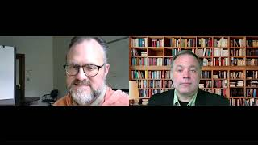
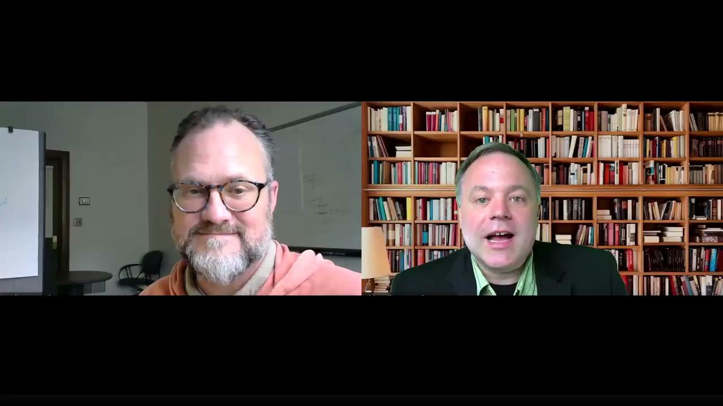
Sanborn Strata Method
Notes:
7:05

Slide 29
Questions
Was this scenario realistic?
Did Jessie (research facilitator) sufficiently understand the problem?
Did Jessie sufficiently understand the research?
Did Jessie solve the problem?
Did Jessie maintain the relationship?
Other thoughts about this scenario?

Slide 30
The story, names, characters, and incidents portrayed in this production are fictitious. Any relationship to real world people or events is entirety coincidence.

Slide 31

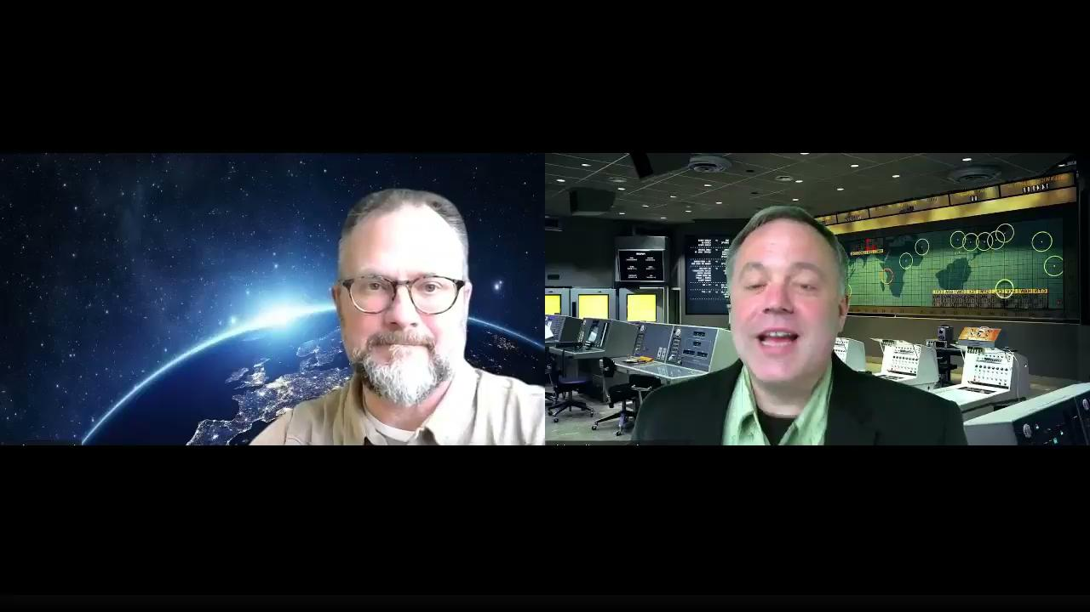
GIS Data - Take 1
5:49
Notes:
6 minutes

Slide 32
Questions
Was this scenario realistic?
Did Jasper (research Facilitator) sufficiently understand the problem?
Did Jasper sufficiently understand the research?
Did Jasper solve the problem?
Did Jasper maintain the relationship?
Other thoughts about this scenario?

Slide 33
The story, names, characters, and incidents portrayed in this production are fictitious. Any relationship to real world people or events is entirety coincidence.

Slide 34
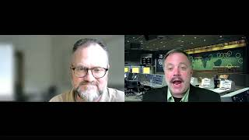
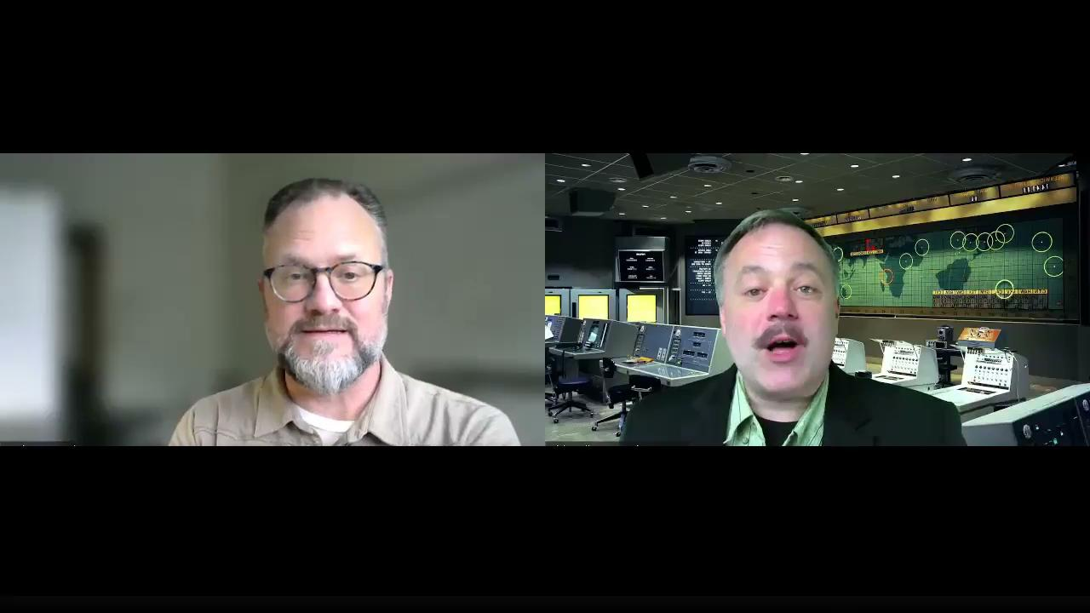
GIS Data - Take 2
4:43
Notes:
5 minutes

Slide 35
Questions
Was this scenario realistic?
Did Jasper (research Facilitator) sufficiently understand the problem?
Did Jasper sufficiently understand the research?
Did Jasper solve the problem?
Did Jasper maintain the relationship?
Other thoughts about this scenario?

Slide 36
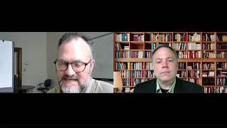
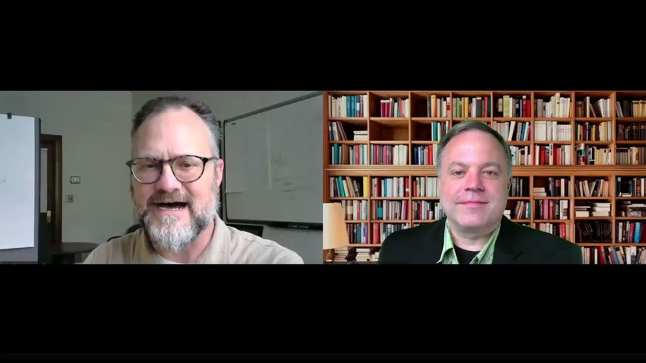
Security Risk
3:55

Slide 37
Questions
Was this scenario realistic?
Did Justin (research Facilitator) sufficiently understand the problem?
Did Justin sufficiently understand the research?
Did Justin solve the problem?
Did Justin per maintain the relationship?
Other thoughts about this scenario?

Slide 38
Okay, this one is real but we only kept the good stuff….

Slide 39


“Real” Intake Interview
8:34

Slide 40
Questions
Was this scenario realistic?
Did Dirk (research Facilitator) sufficiently understand the problem?
Did Dirk sufficiently understand the research?
Did Dirk solve the problem?
Did Dirk maintain the relationship?
Other thoughts about this scenario?

Slide 41
Questions?

Slide 42
Chatter
What strategies do you have for tomorrow's intake interview event?
Notes:
ONLINE ADAPTATION - Chatter Example 60 seconds typing, 3 minutes discussion
Chatter Setup
Demonstrate how Chatter works with a straightforward question that is easy for participants to answer, but that will provide for a variety of responses
“Where in the world are you zooming from” is often a good demonstration question, as it gives you a sense of who is participating in the training.
You may want to ask a different question depending on your audience and what type of information you’d like to know; for example:
Where do you work or attend school?
What is your major or area of expertise?
What is your current professional status? (undergraduate, graduate student, working professional, retiree)
What is one thing you’re hoping to learn during this training?
Chatter Activity
Display the slide with the Chatter question
Remind participants to type their response into chat but WAIT to hit enter
Give participants a little time to find their chat window and type a response
Give a brief countdown (3, 2, 1, Chat!)
As the responses scroll through the chat window, call out a few examples
Image available free for commercial use without attribution from: https://cdn.pixabay.com/photo/2017/01/31/23/06/communicate-2028004_960_720.png

Slide 43
Acknowledgements
The CyberAmbassadors program was developed by Katy Luchini-Colbry and Dirk Colbry, evaluated by Julie Rojewski and Astri Briliyanti, and appreciates the efforts of our many volunteer facilitators. Program materials are protected under a CC BY-NC-SA 4.0 International License. This material is based upon work supported by the National Science Foundation under Grant No. 1730137. Any opinions, findings, and conclusions or recommendations expressed in this material are those of the author(s) and do not necessarily reflect the views of the National Science Foundation.
The CyberAmbassadors program was developed with contributions and feedback from many sources, including:
Teaming Up includes substantial contributions from David Cribbs and Mark Luchini.
Speaking Up is adapted and expanded from Effective Presentation Skills by Tau Beta Pi Engineering Futures.
Leading the Change and Leading with Principles are informed by materials developed for the Entering Mentoring program and provided by cimerproject.org.
Additional sources are noted throughout the materials. Graphics and images are original creations, part of Google apps, or free for commercial use without attribution from pixabay.com. For more information, please contact colbryka@msu.edu.
Notes:
THIS SLIDE MUST BE INCLUDED IN YOUR PRESENTATION, and the text must be included in any handouts or materials you provide to participants.
It is important to acknowledge the people and organizations that contributed to the success of the CyberAmbassador project
You do not need to review this slide in detail with participants; it is sufficient to note that this program was developed with support from the National Science Foundation and many individuals and organizations

