Slide 1
CI User Support
Chris Reidy
Research Facilitation Manager
University of Arizona
Virtual Residency 2025, Monday June 23, 2025

Slide 2
Discussion Topics
Cyber Infrastructure Community
CI Expectations
Classifying Users
HPC Support Teams
Teaching
Conflicts
Resources
Stories
Virtual Residency 2025, Monday June 23, 2025

Slide 3
University of Arizona
Research Technologies
Central IT (UITS)
Teams
Systems team (3)
Facilitators (5)
Secure research (2)
3 clusters – 45,000 cores
HIPAA and CUI clusters
Virtual Residency 2025, Monday June 23, 2025

Slide 4
What is CyberInfrastructure (CI) Anyway?
Components
Computing systems
Data storage
Advanced instruments and repositories
Visualizations environments
High speed networks
People
Purpose
Enable scholarly innovation and discoveries
not otherwise possible
Virtual Residency 2025, Monday June 23, 2025

Slide 5
Differences Between CI and Enterprise IT
Enterprise
Standard functions like finance, payroll
Standard applications – CRM, RDB
Not university specific
Cloud optimized
CI
Focus on users
Non-standard software and uses
Funding structure
Virtual Residency 2025, Monday June 23, 2025
Notes:
Invite attendees to add more

Slide 6
When is CI Valuable
Shared environment for research teams
Avoid closet clusters
Multiply value of funding
Scaling up and scaling out
Reducing the time to science
Virtual Residency 2025, Monday June 23, 2025
Notes:
Invite attendees to add more

Slide 7
The Value of CI User Support
A study done in 2019 by University of Colorado Boulder
determines CI User Support is critical to the operations of any
CI Center. (Knuth et al., 2019)
Improvements in the User Support operations (documentation, trainings, automation & request handling) during 2018 resulted in a 31% increase in allocation requests on systems in 2019
Virtual Residency 2025, Monday June 23, 2025
Notes:
Invite attendees to add more

Slide 8
Expectations – Stakeholders
Typical Roles
CIO, VPR, Provost, President, Governance Committee,
Faculty Senate
Expectations
They want value for what they support
Faculty recruitment
Bring in more funding – R1, prestige
Publications
Graduations
Virtual Residency 2025, Monday June 23, 2025

Slide 9
Expectations – Faculty / PI
Typical Roles
Knows about CI but may or may not use it personally
Researcher
Instructor
Expectations
Reasonable costs
Technology
Immediate access
Available support
Virtual Residency 2025, Monday June 23, 2025

Slide 10
Expectations – Users
Typical Roles
“hands-on”
Researcher or research team member (student, post-doc)
Instructor or learner
Expectations
Reasonable allocations
Technology
24 x 7 support ? highly knowledgeable ?
Virtual Residency 2025, Monday June 23, 2025

Slide 11
Categorizing Users
Three broad categories:
Novice
Intermediate
Advanced
How do you identify them?
History
Rookie mistakes
Their responses
The language used
Virtual Residency 2025, Monday June 23, 2025

Slide 12
Category 1: Novice Users
Characteristics
Little experience with Linux or the command line
May already use Matlab, R or Python
Rarely understand parallelism
Generate 40-50% of requests
Account setup and resources available
Navigating the node types (bastion, login, compute)
Access issues (ssh keys, OnDemand)
Understanding errors
File permissions
Virtual Residency 2025, Monday June 23, 2025

Slide 13
Support for Novice Users
Good documentation with plenty of “Getting Started”
Introductory workshops, in person and online
Office Hours
“Face-to-face” support – Zoom or in-person
Ease of use. Open OnDemand
Ease of use for CLI – modules, scheduler, samples
Software installation assistance
Virtual Residency 2025, Monday June 23, 2025

Slide 14
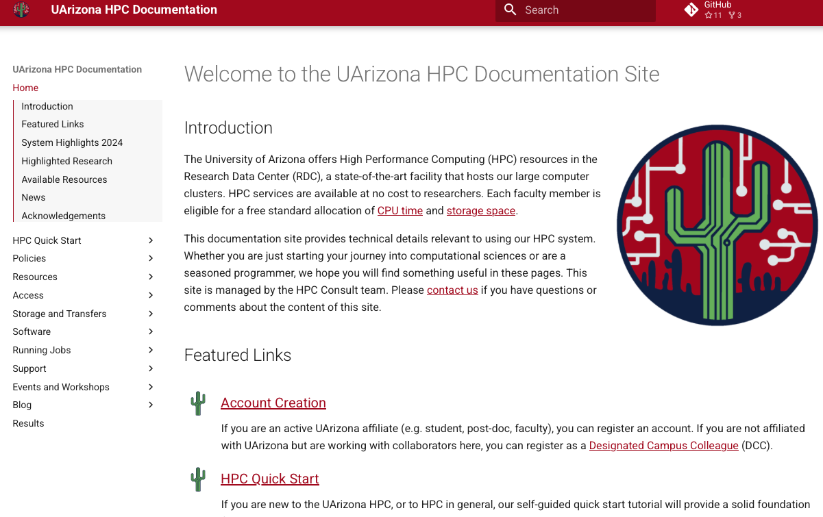
hpcdocs.hpc.arizona.edu

Slide 15
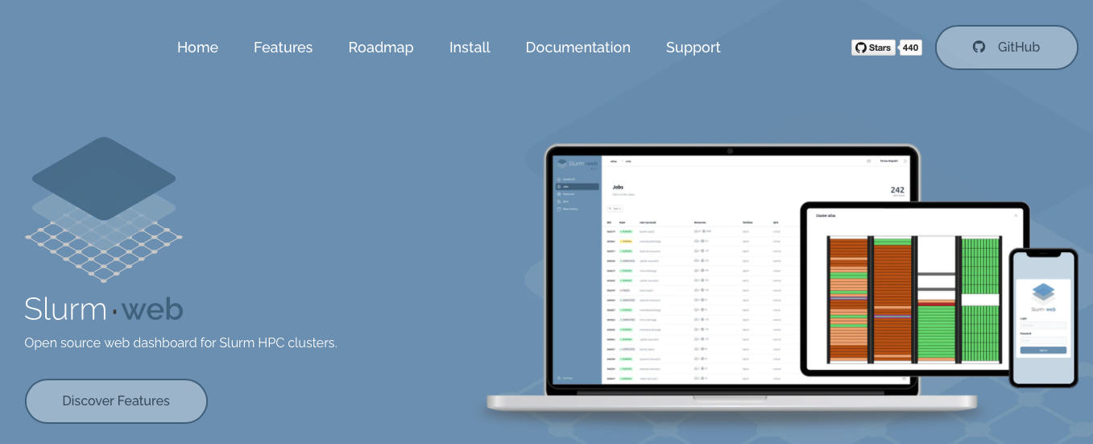
slurm-web.com

Slide 16
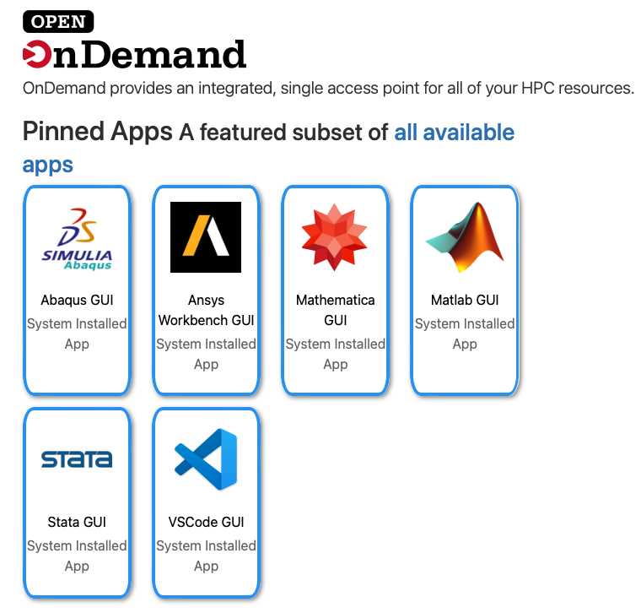
openondemand.org

Slide 17
Category 2: Intermediate Users
Characteristics
Have some experience to run jobs (CLI or OnDemand)
Can often manage file permissions
Problem determination skills
Understand virtual environments for Python, R
Generate 30-40% of requests
Assistance with complex software and environments
Assistance with performance issues
Assistance with migration / versioning
Special requests
Virtual Residency 2025, Monday June 23, 2025

Slide 18
Support for Intermediate Users
Teach them to fish
More complex examples in documentation
Domain specific training or software specific training
Thorough answers
Build enduring relationships
Admit when you don’t know
Support for complex software installations
Virtual Residency 2025, Monday June 23, 2025

Slide 19
Category 3: Advanced Users
Characteristics
May be hands on faculty, research staff postdocs
or advanced students
Technically proficient, parallelism and performance
Develop complex workflows and software upgrades
Organizing data repositories
Generate 10-15% of requests
Assistance with complex software and environments
Assistance with complex or system problems
Special requests
Virtual Residency 2025, Monday June 23, 2025

Slide 20
Support for Advanced Users
Intermediate user support applies also
Treat them as peers
Try to meet regularly
Use them as stakeholder advocates
Ask for pilot project support
Involve them in hardware acquisitions
‘White glove support’
Be flexible. Make small judicious rule exceptions
Virtual Residency 2025, Monday June 23, 2025

Slide 21
HPC Support Teams
My team has 5 FTE (one position vacant)
Virtual Residency 2025, Monday June 23, 2025

Slide 22
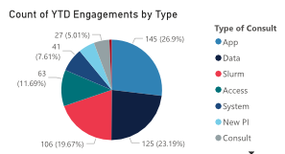
HPC Support Teams
Typical engagements include:
Building software
Onboarding
Training
Problem determination
Data storage
Virtual Residency 2025, Monday June 23, 2025

Slide 23
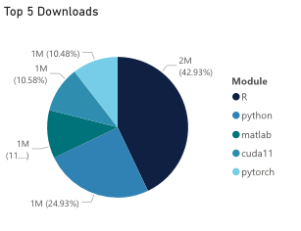
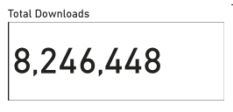
HPC Support Teams
Software engagements:
R and Python
Workflows
GPUs
OS Migration
Virtual Residency 2025, Monday June 23, 2025

Slide 24
HPC Support Teams
My team has 5 FTE (one position vacant)
We meet daily from 9AM to whenever (lunch) on GatherTown
Virtual Residency 2025, Monday June 23, 2025

Slide 25
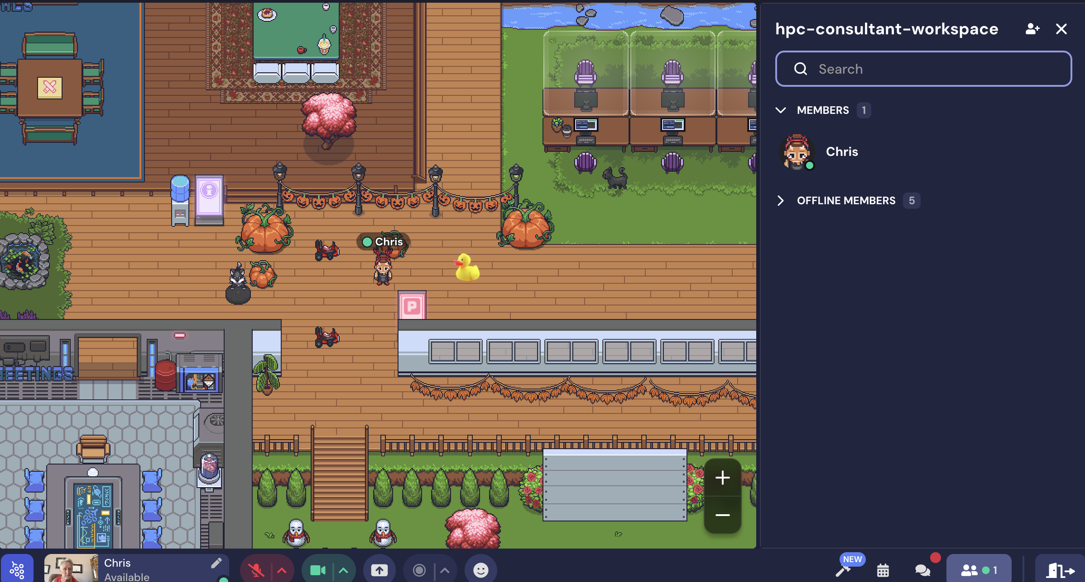
HPC Support Teams
My team has 5 FTE (one position vacant)
We meet daily from 9AM to whenever (lunch) on GatherTown
Virtual Residency 2025, Monday June 23, 2025

Slide 26
HPC Support Teams
My team has 5 FTE (one position vacant)
We meet daily from 9AM to whenever (lunch) on GatherTown
We also use it for weekly Office Hours
Virtual Residency 2025, Monday June 23, 2025

Slide 27
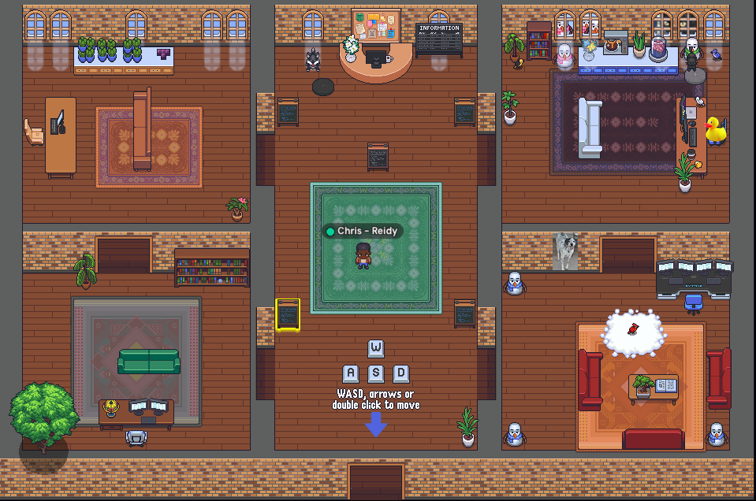
HPC Support Teams
My team has 5 FTE (one position vacant)
We meet daily from 9AM to whenever (lunch) on GatherTown
Virtual Residency 2025, Monday June 23, 2025

Slide 28
HPC Support Teams
My team has 5 FTE (one position vacant)
We meet daily from 9AM to whenever (lunch) on GatherTown
We also use it for weekly Office Hours
We use ServiceNow for ticketing
Virtual Residency 2025, Monday June 23, 2025

Slide 29
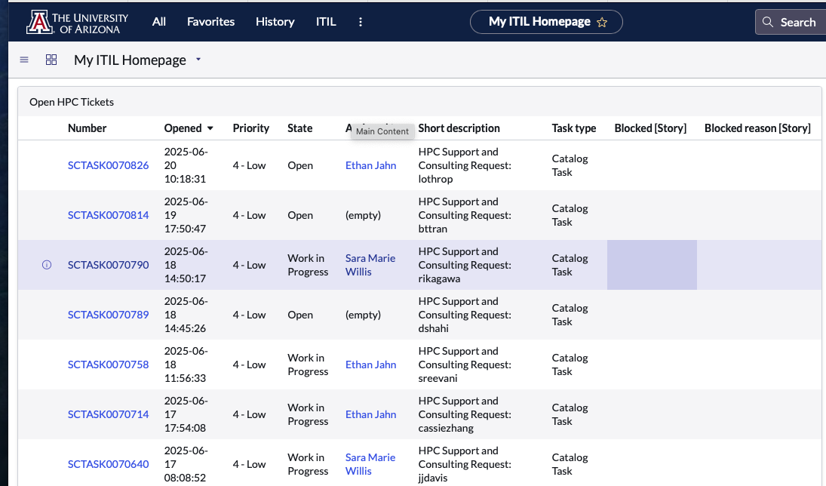
HPC Support Teams
My team has 5 FTE (one position vacant)
We meet daily from 9AM to whenever (lunch) on GatherTown
Virtual Residency 2025, Monday June 23, 2025

Slide 30
HPC Support Teams
My team has 5 FTE (one position vacant)
We meet daily from 9AM to whenever (lunch) on GatherTown
We also use it for weekly Office Hours
We use ServiceNow for ticketing
Our newish Documentation site is proving very effective
Virtual Residency 2025, Monday June 23, 2025

Slide 31
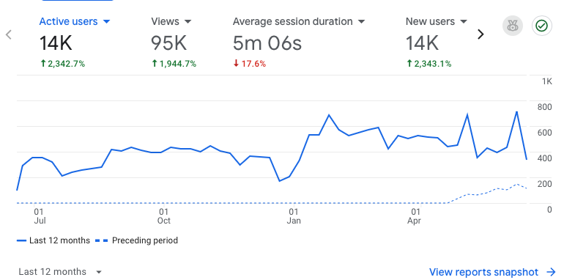
hpcdocs.hpc.arizona.edu

Slide 32
HPC Support Teams
My team has 5 FTE (one position vacant)
We meet daily from 9AM to whenever (lunch) on GatherTown
We also use it for weekly Office Hours
We use ServiceNow for ticketing
Our newish Documentation site is proving very effective
We document our policies
Virtual Residency 2025, Monday June 23, 2025

Slide 33
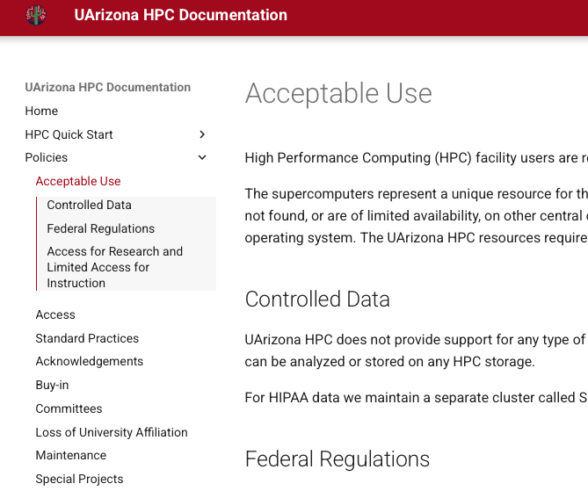
HPC Support Teams
Policies
Virtual Residency 2025, Monday June 23, 2025

Slide 34
HPC Support Teams
My team has 5 FTE (one position vacant)
We meet daily from 9AM to whenever (lunch) on GatherTown
We also use it for weekly Office Hours
We use ServiceNow for ticketing
Our newish Documentation site is proving very effective
We document our policies
Metrics justify your existence to stakeholders
Virtual Residency 2025, Monday June 23, 2025

Slide 35
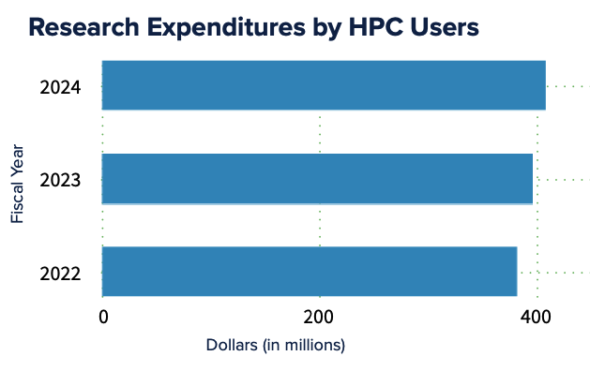
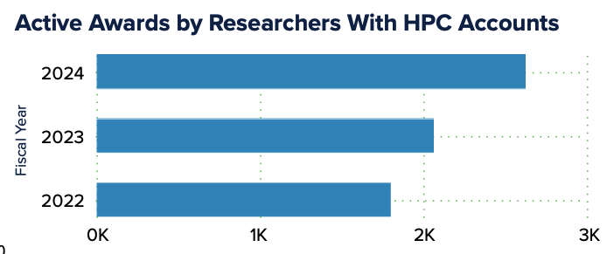
HPC Support Teams
Metrics
https://hpcdocs.hpc.arizona.edu/assets/pdfs/HPC%20FY24%20Metrics.pdf
Virtual Residency 2025, Monday June 23, 2025

Slide 36
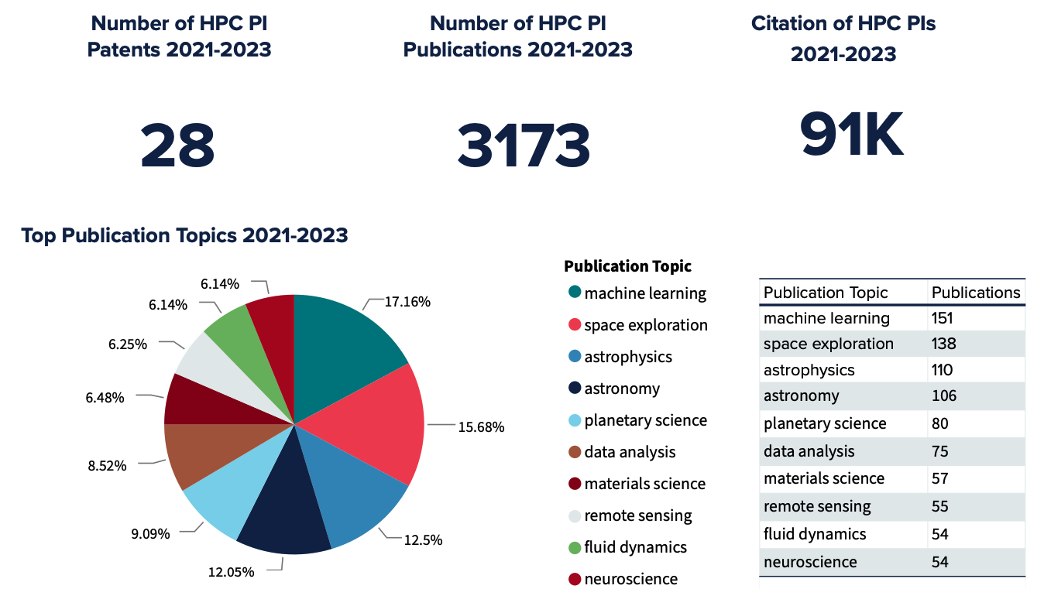
HPC Support Teams
Metrics
https://hpcdocs.hpc.arizona.edu/assets/pdfs/HPC%20FY24%20Metrics.pdf
Virtual Residency 2025, Monday June 23, 2025

Slide 37
HPC Support Teams
Metrics
https://hpcdocs.hpc.arizona.edu/assets/pdfs/HPC%20FY24%20Metrics.pdf
Virtual Residency 2025, Monday June 23, 2025

Slide 38
HPC Support Teams
My team has 5 FTE (one position vacant)
We meet daily from 9AM to whenever (lunch) on GatherTown
We also use it for weekly Office Hours
We use ServiceNow for ticketing
Our newish Documentation site is proving very effective
We document our policies
Metrics justify your existence to stakeholders
Hard Skills and Soft Skills
Virtual Residency 2025, Monday June 23, 2025

Slide 39
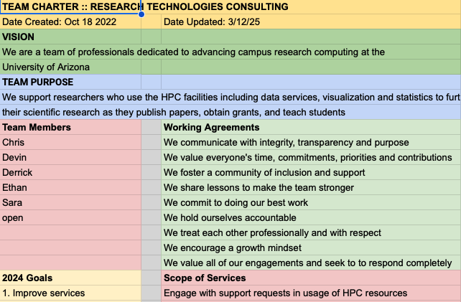
HPC Support Teams
Planning
Team
Charter
Virtual Residency 2025, Monday June 23, 2025

Slide 40
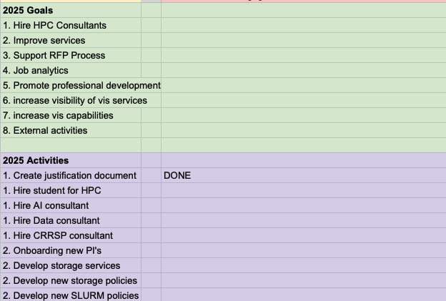
HPC Support Teams
Planning.
Team
Charter
Virtual Residency 2025, Monday June 23, 2025

Slide 41
Teaching
Typical compute experience for new users
Virtual Residency 2025, Monday June 23, 2025

Slide 42
Teaching
The Challenges
Motivation – why is it worth it?
Format – what is the best delivery
Effectiveness – was the gal achieved
Improvement – what could be improved
Skills
Virtual Residency 2025, Monday June 23, 2025

Slide 43
Teaching
Motivations - they must match.
For the facilitator:
Onboarding made easier
Reduce ongoing support
Build relationships
For the user:
Reduce barriers to HPC
Self sufficiency
Virtual Residency 2025, Monday June 23, 2025

Slide 44
Teaching
Formats
HPC workshops
Recordings on YouTube
Consultations
Modality: Zoom or in-person
Guest presentations – Nvidia, Matlab
Virtual Residency 2025, Monday June 23, 2025

Slide 45
Teaching
Effectiveness
Are the user expectations met?
What knowledge do they already have?
Practical
Is there engagement?
Was the pacing adequate?
Was there user feedback?
Was there a check for understanding?
Was time allowed for questions?
Virtual Residency 2025, Monday June 23, 2025

Slide 46
Teaching
Improvement
There is always room for improvement
in anythingwe do.
Self assessment
Feedback
Peer review
Virtual Residency 2025, Monday June 23, 2025

Slide 47
Teaching
Skills
Communication
Listening
Collaboration
Adaptability
Engagement
Empathy
Patience
Virtual Residency 2025, Monday June 23, 2025

Slide 48
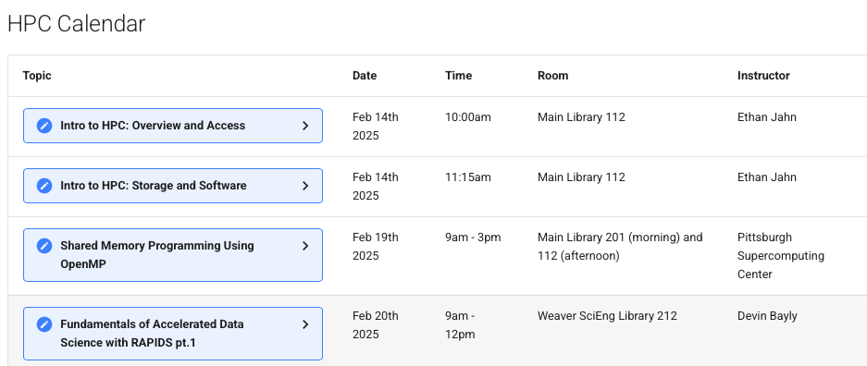
Teaching - in person workshops
Virtual Residency 2025, Monday June 23, 2025

Slide 49
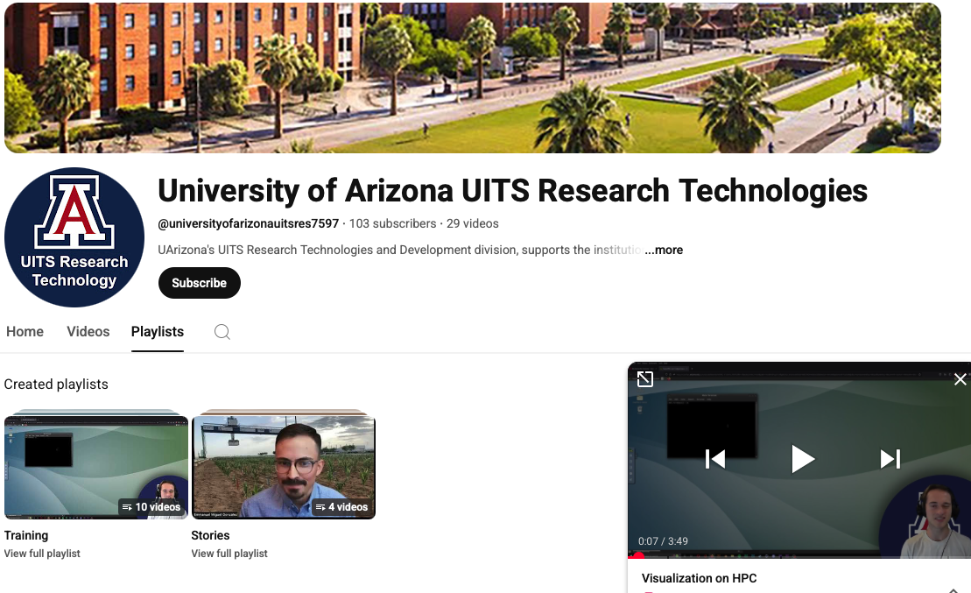
Teaching - YouTube
Virtual Residency 2025, Monday June 23, 2025

Slide 50
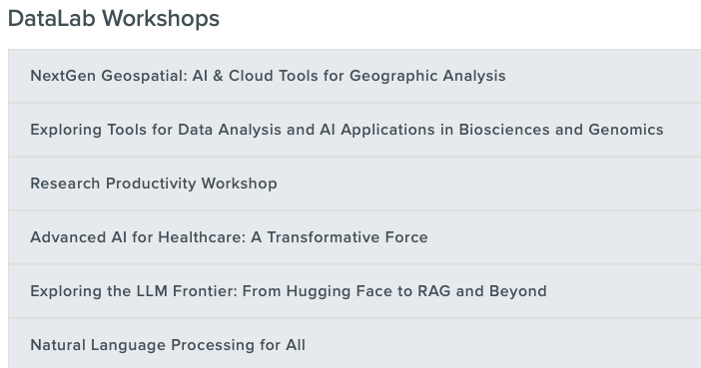
Teaching - partnerships
Virtual Residency 2025, Monday June 23, 2025

Slide 51
Conflict
Conflicts can occur within the
team or with users.
Remain professional
Invoke policies
Preserve relationships
Consult
Virtual Residency 2025, Monday June 23, 2025

Slide 52
Conflict scenarios
A user complains that they cannot get their work done
because someone else is “hogging” the queues.
2. A user reports a system problem. When forwarded to
the sysadmins, they say it is a user problem.
3. A user bypasses the support processes to management
or the systems team.
Virtual Residency 2025, Monday June 23, 2025

Slide 53
Conflict scenario 1
Someone is “hogging” the nodes.
Thoughts:
Are they “hogging” or just very productive?
Is the first user under some pressure?
Are they a ‘busybody’ or a ‘rules monitor’?
Is there a SLURM policy issue?
Virtual Residency 2025, Monday June 23, 2025

Slide 54
Conflict scenario 2
Whose problem is it?
Thoughts:
Do we have systems knowledge?
Why do sysadmins think there is no problem
How to respond to users?
Is there a SLURM policy issue?
Virtual Residency 2025, Monday June 23, 2025

Slide 55
Conflict scenario 3
Bypassing process
Thoughts:
Is there a trust issue?
Are the support policies clear and easy to use?
How to respond?
Virtual Residency 2025, Monday June 23, 2025

Slide 56
External Resources
ACCESS
https://access-ci.org
NAIRR
https://nairrpilot.org
Campus Champions
https://campuschampions.cyberinfrastructure.org
CaRCC
https://carcc.org
Virtual Residency 2025, Monday June 23, 2025

Slide 57
Stories
Using stories to demonstrate value
Stories from the frontlines:
The policy abuser
The endless support requester
The epitome of value
Virtual Residency 2025, Monday June 23, 2025

Slide 58
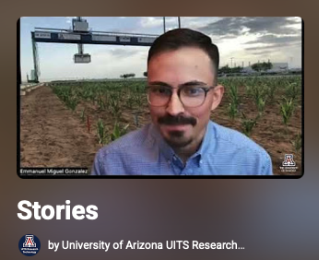
Stories
Using stories to demonstrate value - YouTube
The first-generation student
Virtual Residency 2025, Monday June 23, 2025

Slide 59
Stories
Using stories to demonstrate value - YouTube
The new graduate student
Virtual Residency 2025, Monday June 23, 2025

Slide 60
Stories
Using stories to demonstrate value - YouTube
Recruited faculty – cloud researcher
Virtual Residency 2025, Monday June 23, 2025

Slide 61
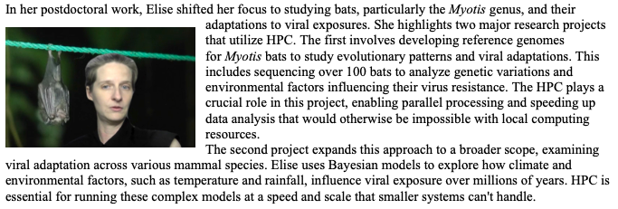
Stories - publishing
Newsletter
“I know that one of the things that people have liked in my new position
was this work I've done using computing and developing computational
methods. And so, I think I would not have this position, or it
would be very different if I hadn't had access to the HPC.”
Virtual Residency 2025, Monday June 23, 2025

Slide 62
Stories - publishing
Central IT Web Site
Virtual Residency 2025, Monday June 23, 2025

Slide 63
Stories - presentations
Virtual Residency 2025, Monday June 23, 2025

Slide 64
The End Fin Ainahaya Owari
Virtual Residency 2025, Monday June 23, 2025

