Slide 1
Academic Life: Tenure, Promotion, & More
University-ese Vocabulary
Tenure – What, How, Why
Why are faculty so …
Pressures on current practices
Data from American Institute of Physics,
NSF, NCES, and AAUP

Slide 2
Open your Chat:
Do you now have, or have you had in the past, an “Academic” position?
(Asst/Assoc/Full Prof., Research Prof., Adjunct/Instructor, Postdoc, etc.)
If so, describe briefly.
If not, what is/are your job title(s)?

Slide 3
Academic Vocabulary Test
Assistant Prof
Associate Prof
Full Professor
Department Chair
Dean
Director
Endowed Prof
Endowed Chair
Emeritus Prof
Regent
Trustee
Grad Assistant
Instructor
President
Chancellor
Provost
Renewable Term Prof
Adjunct Prof
Research Prof
VP, Research
VP, Admin
CIO

Slide 4
President/Chancellor/etc. Provost (Academic VP)
VP Research, VP Admin, CIO, …
Dean (“College”)
Dept. Chair/Director
Trustees Regents …
“Soft” Money
Research Professor
Research Scientist
Renew. Term Prof.
Post Doctoral Researcher
Grad Res Assistant
Instructor
Adjunct Instructor
Endowed Prof/Chair
(Full) Professor
Associate Prof
Assistant Prof
~Renew. Term Prof~
“Hard” Money

Slide 5
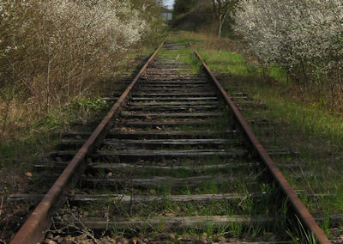
The “Tenure Track”
Chat: Define Academic Tenure

Slide 6
Tenure & Academic Freedom
Tenure … is a means to assure unfettered, unbiased, unencumbered search, verification, and communication of truth by professional scholars and teachers. Tenure is designed to provide faculty members with freedom from political, doctrinaire, and other pressures, restraints, and reprisals which would otherwise inhibit the independent thought and actions in their professional responsibility of search, verification, and communication of truth.
OU Faculty Handbook

Slide 7
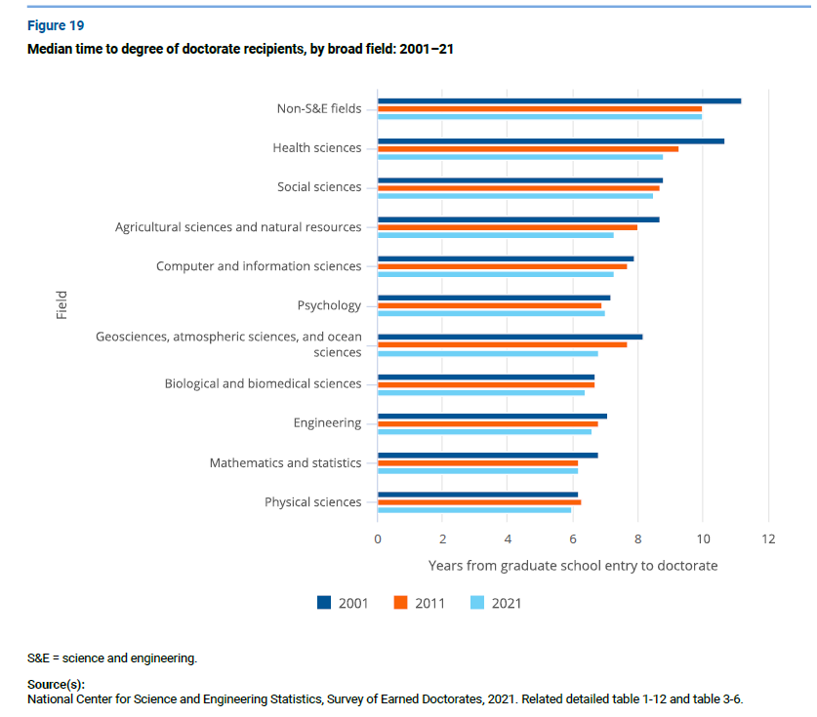
Academic Time-Line: PhD?
Prof
Assoc Prof
Asst Prof
Finish PhD
– Year 6
Graduate School – Year 0

Slide 8
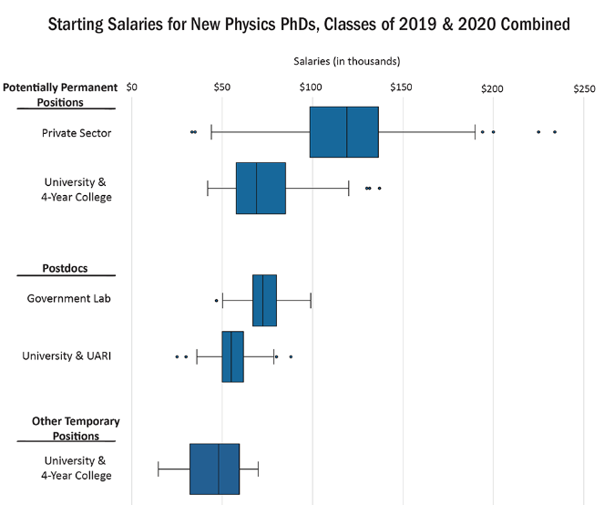
Physics Ph.D. Starting Salaries
Permanent
Postdoc
Temporary
Other
Temporary

Slide 9
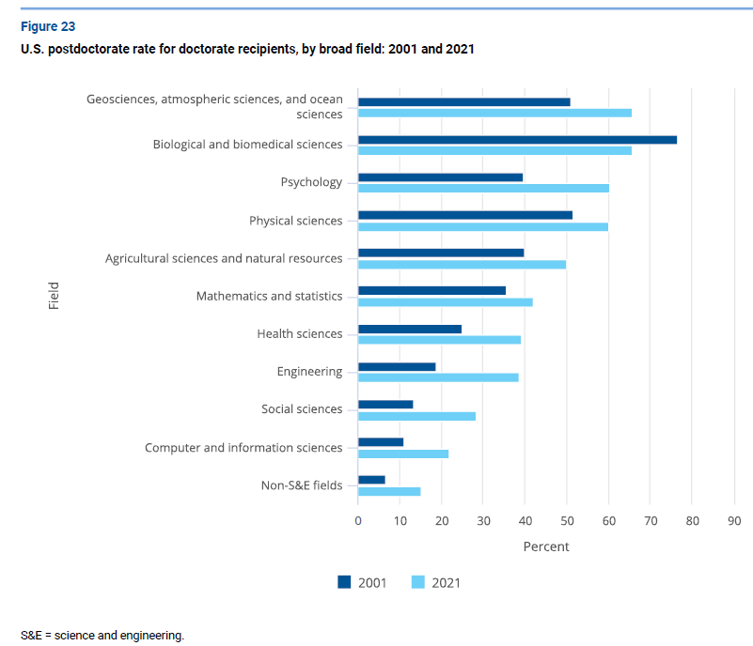
Academic Time-Line: Start Tenure?
Prof
Assoc Prof
Asst Prof
– Year 10
Finish PhD
– Year 6
Graduate School – Year 0

Slide 10
Academic Time-Line: Tenured?
Prof
Associate Prof
– Year 17, Tenured (~40 yr old)
Assistant Prof
– Year 10
Finish PhD
– Year 6
Graduate School – Year 0

Slide 11
The Tenure Decision
New Assistant Professor
(External) Reviews
Six Years of Academic Productivity
Write Life Story
Departmental Vote
Campus Tenure Committee
Dean/College
Provost
President/Regents

Slide 12
“Academic Productivity”
Publications
Money
Patents
Collaborations
Reputation
Talks
Consulting
Student Mentoring
Teaching
Service

Slide 13
“Academic Productivity”
Publications
Money
Patents
Collaborations
Reputation
Talks
Consulting
Student Mentoring
Teaching
Service

Slide 14
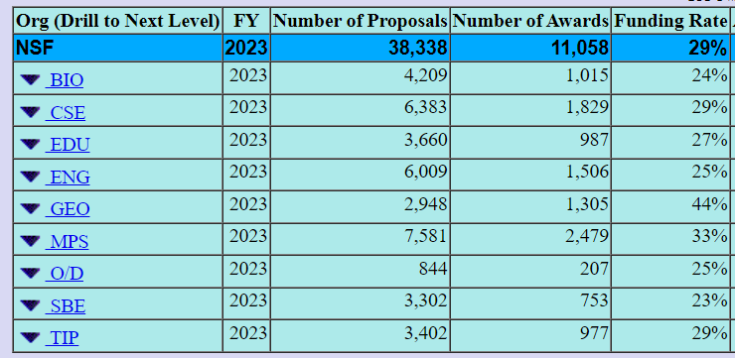
“Academic Productivity”
Publications (5% - 50%)
Money (20 - 40% chance)
NIH : 24%
NEH: 16%

Slide 15
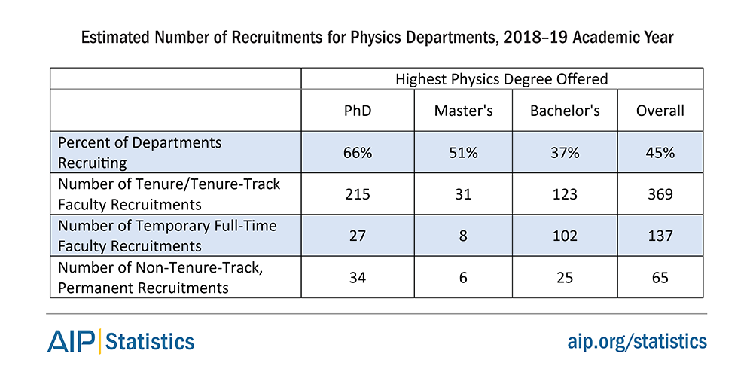
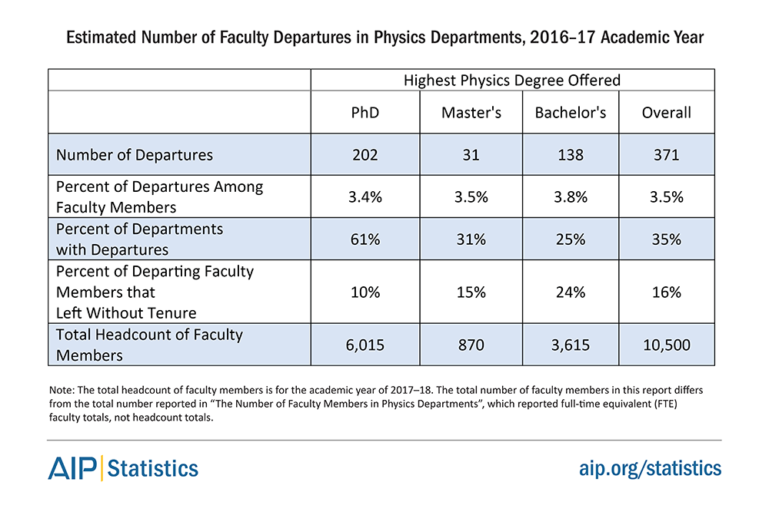
What’s the Need?
~370
2021
~60

Slide 16
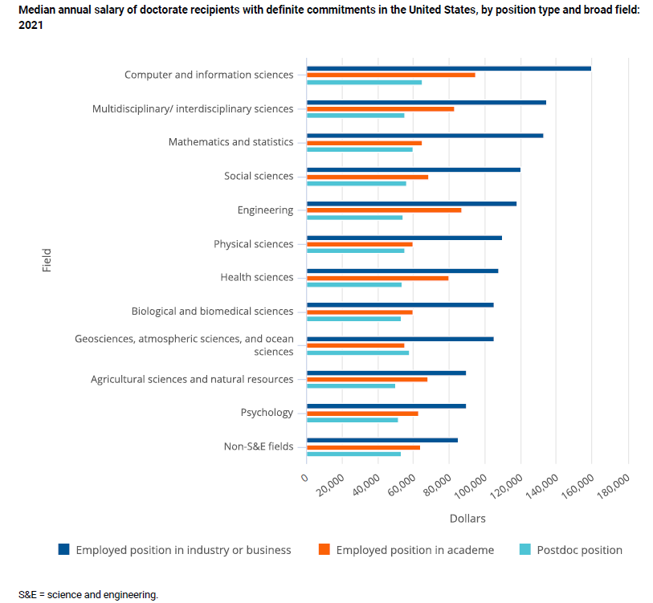
No Tenure, You Leave: Why do this???
NSF, Survey of Earned Doctorates, 2023
Independence, Education/Teaching, Prestige, No Imagination, …

Slide 17
Researchers are Focused!
Measurement of the t-tbar production cross section and top quark mass extraction using dilepton events in p-pbar collisions
To Swear Like a Sailor: Language, Culture, and Meaning in the American Maritime World, 1750 – 1850
Elimination of threading dislocations in as-grown PbSe film on patterned Si(111) substrate using molecular beam epitaxy

Slide 18
Academic Time-Line: “Full”?
Prof
– Year ?
Associate Prof
– Year 17, Tenured
Assistant Prof
– Year 10
Finish PhD
– Year 6
Graduate School – Year 0

Slide 19
After Tenure 1: Promotion
Proven, Established, International Recognition
Like Tenure Process
Assistant Professor
Associate Professor
Full Professor
Almost always with the Tenure Decision

Slide 20
Post-Tenure Academic Productivity
Publications
Money
Books
International Talks
Conference Committees
Collaborations
Disciplinary Service
Public/Professional Service
Leadership
Instruction & Outreach

Slide 21
Endowed Professorships (“Chairs”)
Raise a BUNCH of $$$
Expectation: Bring in A BUNCH of $$$
Steal Someone
Funds may or may not have strings
Set up Fiefdom

Slide 22
Changes? Impacts? Future?

Slide 23
Abrogation of Tenure
Incompetence or Dishonesty
Substantial Failure to Fulfill Duties
Personal Behavior
Failure to Adhere to University Policies
Violations of the Law
Elimination of Academic Unit
Financial Emergency
Post-Tenure Review
Created/Imposed

Slide 24
After Tenure 2: Post Tenure Review (Continuing Production)
5 Year Self Evaluation
Annual Evaluations
Departmental Evaluation
Prof. Dev. Plan
Dean & Provost
Okay for Next 5 Years

Slide 25
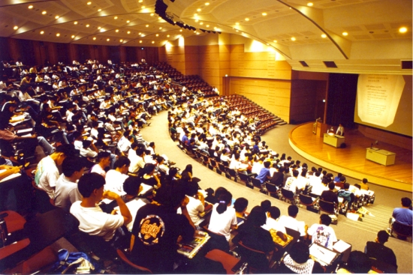
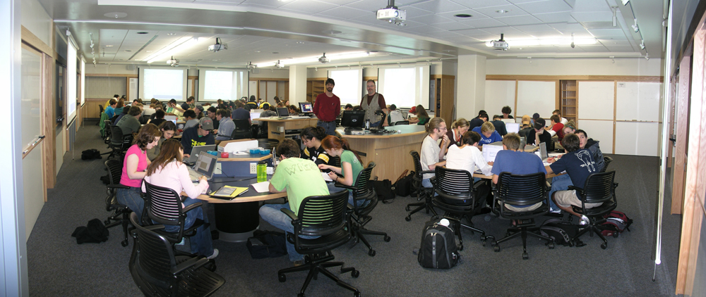
Teaching?
General Dedication
“DBER”: Discipline-Based Education Research
“Professors of Practice”

Slide 26
Abrogation of Tenure
Incompetence or Dishonesty
Substantial Failure to Fulfill Duties
Personal Behavior
Failure to Adhere to University Policies
Violations of the Law
Elimination of Academic Unit
Financial Emergency
Post-Tenure Review
Student Population “Cliff”

Slide 27
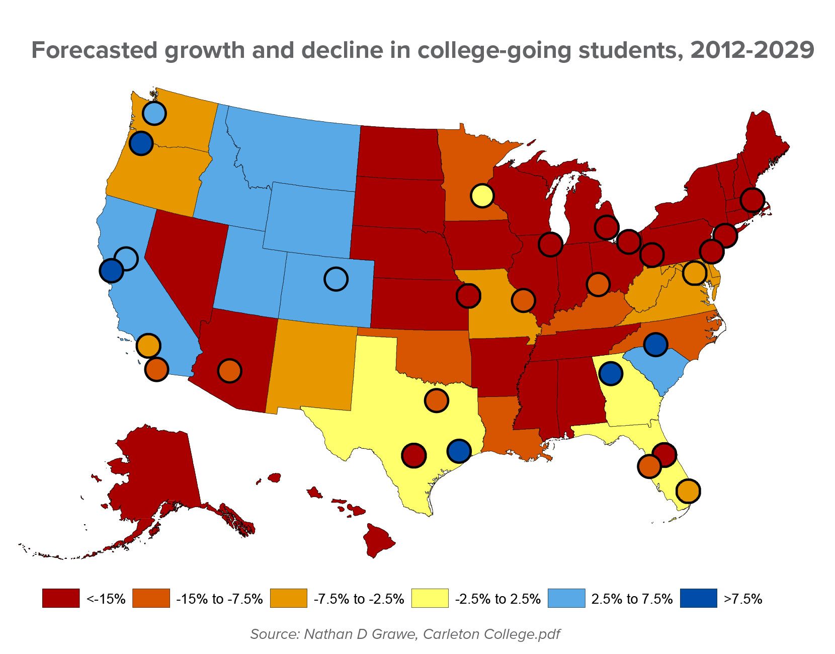
Abrogation of Tenure
Elimination of Academic Unit
Financial Emergency (West Virginia U.)

Slide 28
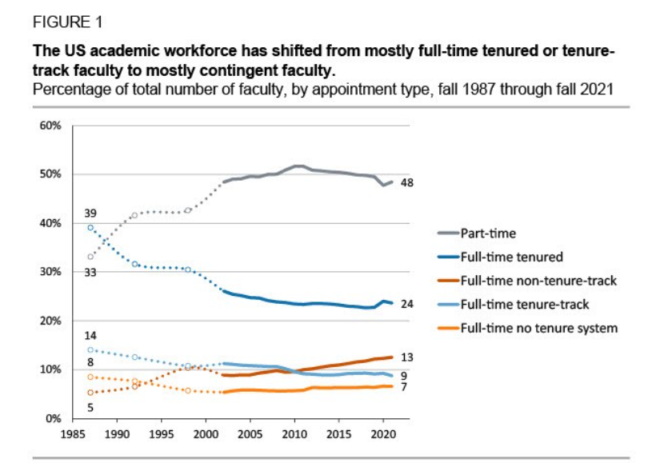
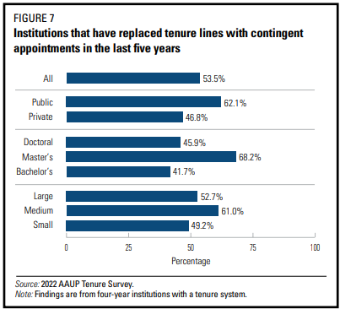
Change in Status: Fewer Tenured
Tenure/Tenure Track: 53% -> 33%
Part-time: 33% -> 48%
Non-Tenured: 13% -> 20%

Slide 29
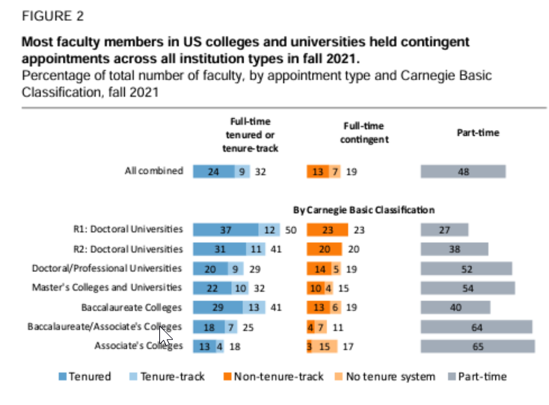
Tenure Numbers
AAUP 2023

Slide 30
Change in Status: Fewer Part Time
National Center for Education Statistics, 2021

Slide 31
Diversity?
National Center for Education Statistics, 2021

Slide 32
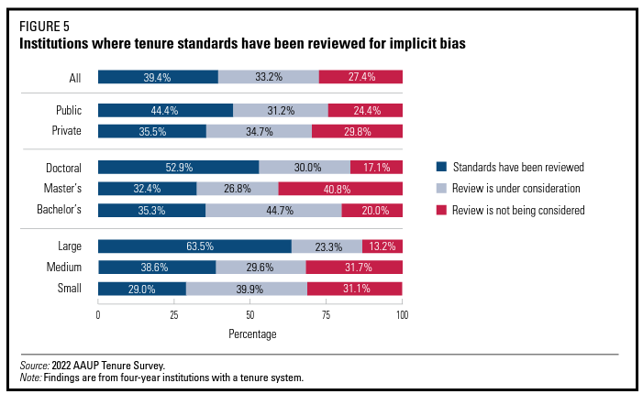
Diversity?
AAUP, 2022

Slide 33
Large Change or Remove Tenure
Florida
Georgia
California
South Carolina
Iowa
Wisconsin
…

Slide 34
Who do you need to watch out for? Who do you need to help?
You can put your answer on the Workshop Google Docs
https://docs.google.com/document/d/138wqMCbrcYX47Z3AXEQZKqyPxV-lj_h8uFcGHRLirEw/edit
Assistant Prof
Associate Prof
Full Professor
Chair
Dean
Director
Endowed Prof
Endowed Chair
Emeritus Prof
Regent
Trustee
Grad Assistant
Instructor
President
Chancellor
Provost
Renewable Term Prof
Adjunct Prof
Research Prof
VP, Research
VP, Admin
CIO

