Slide 1




Supercomputing in Plain English
Multicore Madness
Henry Neeman, University of Oklahoma
Director, OU Supercomputing Center for Education & Research (OSCER)
Assistant Vice President, Information Technology – Research Strategy Advisor
Associate Professor, Gallogly College of Engineering
Adjunct Associate Professor, School of Computer Science
Tuesday April 3 2018

Slide 2
This is an experiment!
It’s the nature of these kinds of videoconferences that FAILURES ARE GUARANTEED TO HAPPEN! NO PROMISES!
So, please bear with us. Hopefully everything will work out well enough.
If you lose your connection, you can retry the same kind of connection, or try connecting another way.
Remember, if all else fails, you always have the phone bridge to fall back on.
PLEASE MUTE YOURSELF.
PLEASE MUTE YOURSELF.
PLEASE MUTE YOURSELF.

Slide 3
PLEASE MUTE YOURSELF
No matter how you connect, PLEASE MUTE YOURSELF, so that we cannot hear you.
At OU, we will turn off the sound on all conferencing technologies.
That way, we won’t have problems with echo cancellation.
Of course, that means we cannot hear questions.
So for questions, you’ll need to send e-mail:
supercomputinginplainenglish@gmail.com
PLEASE MUTE YOURSELF.
PLEASE MUTE YOURSELF.
PLEASE MUTE YOURSELF.

Slide 4
Download the Slides Beforehand
Before the start of the session, please download the slides from the Supercomputing in Plain English website:
http://www.oscer.ou.edu/education/
That way, if anything goes wrong, you can still follow along with just audio.
PLEASE MUTE YOURSELF.
PLEASE MUTE YOURSELF.
PLEASE MUTE YOURSELF.

Slide 5
Zoom
Go to:
http://zoom.us/j/979158478
Many thanks Eddie Huebsch, OU CIO, for providing this.
PLEASE MUTE YOURSELF.
PLEASE MUTE YOURSELF.
PLEASE MUTE YOURSELF.

Slide 6
YouTube
You can watch from a Windows, MacOS or Linux laptop or an Android or iOS handheld using YouTube.
Go to YouTube via your preferred web browser or app, and then search for:
Supercomputing InPlainEnglish
(InPlainEnglish is all one word.)
Many thanks to Skyler Donahue of OneNet for providing this.
PLEASE MUTE YOURSELF.
PLEASE MUTE YOURSELF.
PLEASE MUTE YOURSELF.

Slide 7
Twitch
You can watch from a Windows, MacOS or Linux laptop or an Android or iOS handheld using Twitch.
Go to:
http://www.twitch.tv/sipe2018
Many thanks to Skyler Donahue of OneNet for providing this.
PLEASE MUTE YOURSELF.
PLEASE MUTE YOURSELF.
PLEASE MUTE YOURSELF.

Slide 8
Wowza #1
You can watch from a Windows, MacOS or Linux laptop using Wowza from the following URL:
http://jwplayer.onenet.net/streams/sipe.html
If that URL fails, then go to:
http://jwplayer.onenet.net/streams/sipebackup.html
Many thanks to Skyler Donahue of OneNet for providing this.
PLEASE MUTE YOURSELF.
PLEASE MUTE YOURSELF.
PLEASE MUTE YOURSELF.

Slide 9
Wowza #2
Wowza has been tested on multiple browsers on each of:
Windows 10: IE, Firefox, Chrome, Opera, Safari
MacOS: Safari, Firefox
Linux: Firefox, Opera
We’ve also successfully tested it via apps on devices with:
Android
iOS
Many thanks to Skyler Donahue of OneNet for providing this.
PLEASE MUTE YOURSELF.
PLEASE MUTE YOURSELF.
PLEASE MUTE YOURSELF.

Slide 10
Toll Free Phone Bridge
IF ALL ELSE FAILS, you can use our US TOLL phone bridge:
405-325-6688
684 684 #
NOTE: This is for US call-ins ONLY.
PLEASE MUTE YOURSELF and use the phone to listen.
Don’t worry, we’ll call out slide numbers as we go.
Please use the phone bridge ONLY IF you cannot connect any other way: the phone bridge can handle only 100 simultaneous connections, and we have over 1000 participants.
Many thanks to OU CIO Eddie Huebsch for providing the phone bridge..

Slide 11
Please Mute Yourself
No matter how you connect, PLEASE MUTE YOURSELF, so that we cannot hear you.
(For YouTube, Twitch and Wowza, you don’t need to do that, because the information only goes from us to you, not from you to us.)
At OU, we will turn off the sound on all conferencing technologies.
That way, we won’t have problems with echo cancellation.
Of course, that means we cannot hear questions.
So for questions, you’ll need to send e-mail.
PLEASE MUTE YOURSELF.

Slide 12
Questions via E-mail Only
Ask questions by sending e-mail to:
supercomputinginplainenglish@gmail.com
All questions will be read out loud and then answered out loud.
DON’T USE CHAT OR VOICE FOR QUESTIONS!
No one will be monitoring any of the chats, and if we can hear your question, you’re creating an echo cancellation problem.
PLEASE MUTE YOURSELF.
PLEASE MUTE YOURSELF.

Slide 13
Onsite: Talent Release Form
If you’re attending onsite, you MUST do one of the following:
complete and sign the Talent Release Form,
OR
sit behind the cameras (where you can’t be seen) and don’t talk at all.
If you aren’t onsite, then PLEASE MUTE YOURSELF.

Slide 14
TENTATIVE Schedule
Tue Jan 23: Storage: What the Heck is Supercomputing?
Tue Jan 30: The Tyranny of the Storage Hierarchy Part I
Tue Feb 6: The Tyranny of the Storage Hierarchy Part II
Tue Feb 13: Instruction Level Parallelism
Tue Feb 20: Stupid Compiler Tricks
Tue Feb 27: Multicore Multithreading
Tue March 6: Distributed Multiprocessing
Tue March 13: NO SESSION (Henry business travel)
Tue March 20: NO SESSION (OU's Spring Break)
Tue March 27: Applications and Types of Parallelism
Tue Apr 3: Multicore Madness
Tue Apr 10: NO SESSION (Henry business travel)
Tue Apr 17: High Throughput Computing
Tue Apr 24: GPGPU: Number Crunching in Your Graphics Card
Tue May 1: Grab Bag: Scientific Libraries, I/O Libraries, Visualization

Slide 15
Thanks for helping!
OU IT
  OSCER operations staff (Dave Akin, Patrick Calhoun, Kali McLennan, Jason Speckman, Brett Zimmerman)
  OSCER Research Computing Facilitators (Jim Ferguson, Horst Severini)
  Debi Gentis, OSCER Coordinator
  Kyle Dudgeon, OSCER Manager of Operations
  Ashish Pai, Managing Director for Research IT Services
  The OU IT network team
  OU CIO Eddie Huebsch
OneNet: Skyler Donahue
Oklahoma State U: Dana Brunson

Slide 16
This is an experiment!
It’s the nature of these kinds of videoconferences that FAILURES ARE GUARANTEED TO HAPPEN! NO PROMISES!
So, please bear with us. Hopefully everything will work out well enough.
If you lose your connection, you can retry the same kind of connection, or try connecting another way.
Remember, if all else fails, you always have the phone bridge to fall back on.
PLEASE MUTE YOURSELF.
PLEASE MUTE YOURSELF.
PLEASE MUTE YOURSELF.

Slide 17
Coming in 2018!
Coalition for Advancing Digital Research & Education (CADRE) Conference: Apr 17-18 2018 @ Oklahoma State U, Stillwater OK USA
https://hpcc.okstate.edu/cadre-conference
Linux Clusters Institute workshops http://www.linuxclustersinstitute.org/workshops/
  Introductory HPC Cluster System Administration: May 14-18 2018 @ U Nebraska, Lincoln NE USA
  Intermediate HPC Cluster System Administration: Aug 13-17 2018 @ Yale U, New Haven CT USA
Great Plains Network Annual Meeting: details coming soon
Advanced Cyberinfrastructure Research & Education Facilitators (ACI-REF) Virtual Residency Aug 5-10 2018, U Oklahoma, Norman OK USA
PEARC 2018, July 22-27, Pittsburgh PA USA
https://www.pearc18.pearc.org/
IEEE Cluster 2018, Sep 10-13, Belfast UK
https://cluster2018.github.io
OKLAHOMA SUPERCOMPUTING SYMPOSIUM 2018, Sep 25-26 2018 @ OU
SC18 supercomputing conference, Nov 11-16 2018, Dallas TX USA
http://sc18.supercomputing.org/

Slide 18
Outline
The March of Progress
Multicore/Many-core Basics
Software Strategies for Multicore/Many-core
A Concrete Example: Weather Forecasting

Slide 19
The March of Progress

Slide 20
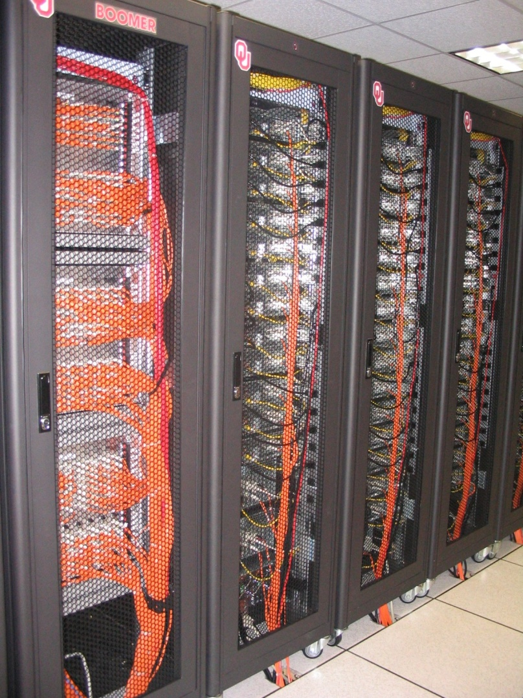

OU’s TeraFLOP Cluster, 2002
10 racks @ 1000 lbs per rack
270 Pentium4 Xeon CPUs, 2.0 GHz, 512 KB L2 cache
270 GB RAM, 400 MHz FSB
8 TB disk
Myrinet2000 Interconnect
100 Mbps Ethernet Interconnect
OS: Red Hat Linux
Peak speed: 1.08 TFLOPs
(1.08 trillion calculations per second)
One of the first Pentium4 clusters!
boomer.oscer.ou.edu

Slide 21

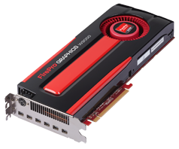
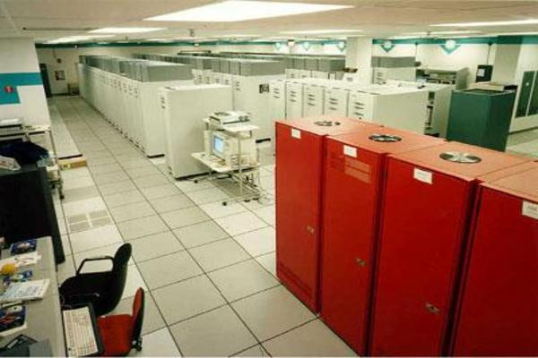
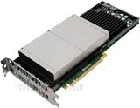
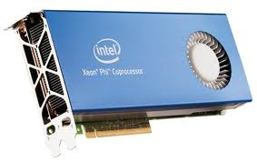
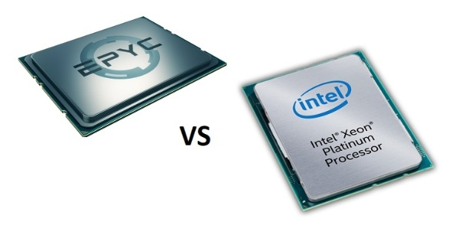
What does 1 TFLOPs Look Like?
2002: Row
2012: Card
1 TFLOPs: trillion calculations per second
1997: Room
AMD FirePro W9000^{[15]}
ASCI RED^{[14]}
Sandia National Lab
NVIDIA Kepler K20^{[16]}
AMD EPYC
CPU
Chip
2017
boomer.oscer.ou.edu
In service 2002-5: 11 racks
Intel Skylake
Intel MIC Xeon PHI^{[17]}
https://www.top500.org/static/media/uploads/.thumbnails/epyc-vs-xeon.jpg/epyc-vs-xeon-742x382.jpg

Slide 22
Moore’s Law
In 1965, Gordon Moore was an engineer at Fairchild Semiconductor.
He noticed that the number of transistors that could be squeezed onto a chip was doubling about every 18 months.
It turns out that computer speed is roughly proportional to the number of transistors per unit area.
Moore wrote a paper about this concept, which became known as “Moore’s Law.”

Slide 23
Moore’s Law in Practice
CPU
log(Speed)
Year

Slide 24
Moore’s Law in Practice
Network Bandwidth
CPU
log(Speed)
Year

Slide 25
Moore’s Law in Practice
Network Bandwidth
CPU
log(Speed)
RAM
Year

Slide 26
Moore’s Law in Practice
Network Bandwidth
log(Speed)
CPU
RAM
1/Network Latency
Year

Slide 27
Moore’s Law in Practice
Network Bandwidth
CPU
log(Speed)
RAM
1/Network Latency
Software
Year

Slide 28
Fastest Supercomputer vs. Moore
2017: 10,649,600 CPU cores,
93,014,600 GFLOPs
(HPL benchmark)
Speed in GFLOPs
GFLOPs
billions of calculations per second
1993: 1024 CPU cores, 59.7 GFLOPs
www.top500.org
Year

Slide 29
The Tyranny of the Storage Hierarchy

Slide 30
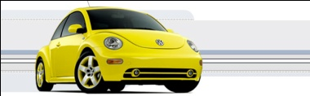
The Storage Hierarchy
Fast, expensive, few
Registers
Cache memory
Main memory (RAM)
Hard disk
Removable media (CD, DVD etc)
Internet
Slow, cheap, a lot
[5]

Slide 31

RAM is Slow
CPU
653 GB/sec
The speed of data transfer
between Main Memory and the
CPU is much slower than the
speed of calculating, so the CPU
spends most of its time waiting
for data to come in or go out.
Bottleneck
15 GB/sec (2.3%)

Slide 32
Why Have Cache?
CPU
Cache is much closer to the speed
of the CPU, so the CPU doesn’t
have to wait nearly as long for
stuff that’s already in cache:
it can do more
operations per second!
46 GB/sec (7%)
15 GB/sec (2.3%)(1%)

Slide 33

Henry’s Laptop
Dell Latitude E5540^{[4]}
Intel Core i3-4010U dual core, 1.7 GHz, 3 MB L3 Cache
12 GB 1600 MHz DDR3L SDRAM
340 GB SATA 5400 RPM Hard Drive
DVD+RW/CD-RW Drive
1 Gbps Ethernet Adapter
http://content.hwigroup.net/images/products/xl/204419/dell_latitude_e5540_55405115.jpg

Slide 34

Storage Speed, Size, Cost
Henry’s Laptop | Registers (Intel Core2 Duo 1.6 GHz) | Cache Memory (L3) | Main Memory (1600MHz DDR3L SDRAM) | Hard Drive | Ethernet (1000 Mbps) | DVD+R (16x) | Phone Modem (56 Kbps)
Speed (MB/sec) [peak] | 668,672^{[6]} (16 GFLOP/s*) | 46,000 | 15,000 ^{[7]} | 100^{[9]} | 125 | 32 ^{[10]} | 0.007
Size (MB) | 464 bytes** ^{[11]} | 3 | 12,288 4096 times as much as cache | 340,000 | unlimited | unlimited | unlimited
Cost ($/MB) | – | $38 [12] | $0.0084 [12] ~1/4500 as much as cache | $0.00003 ^{[12]} | charged per month (typically) | $0.000045 ^{[12]} | charged per month (typically)
* GFLOP/s: billions of floating point operations per second
** 16 64-bit general purpose registers, 8 80-bit floating point registers,
16 128-bit floating point vector registers

Slide 35
Storage Use Strategies
Register reuse: Do a lot of work on the same data before working on new data.
Cache reuse: The program is much more efficient if all of the data and instructions fit in cache; if not, try to use what’s in cache a lot before using anything that isn’t in cache.
Data locality: Try to access data that are near each other in memory before data that are far.
I/O efficiency: Do a bunch of I/O all at once rather than a little bit at a time; don’t mix calculations and I/O.

Slide 36
A Concrete Example
Consider a cluster with Intel Xeon “Skylake” CPUs, model 6138: 20-core, 2.0 GHz (1.3 GHz AVX-512 base frequency), 2666 MHz 6-channel RAM.
The theoretical peak CPU speed is 832 GFLOPs (double precision) per CPU chip, so for a dual chip node, the peak is 1664 GFLOPs.
Each double precision calculation is 2 8-byte operands and one 8-byte result, so 24 bytes get moved between RAM and CPU.
So, in theory each node could consume up to 39,936 GB/sec.
The sustained RAM bandwidth is around 190 GB/sec.
So, even at theoretical peak, any code that does less than around 210 calculations per byte transferred between RAM and cache has speed limited by RAM bandwidth.

Slide 37
Good Cache Reuse Example

Slide 38
A Sample Application
Matrix-Matrix Multiply
Let A, B and C be matrices of sizes
nr × nc, nr × nk and nk × nc, respectively:
The definition of A = B • C is
for r ∈ {1, nr}, c ∈ {1, nc}.

Slide 39
Matrix Multiply: Naïve Version
SUBROUTINE matrix_matrix_mult_naive (dst, src1, src2, &
& nr, nc, nq)
IMPLICIT NONE
INTEGER,INTENT(IN) :: nr, nc, nq
REAL,DIMENSION(nr,nc),INTENT(OUT) :: dst
REAL,DIMENSION(nr,nq),INTENT(IN) :: src1
REAL,DIMENSION(nq,nc),INTENT(IN) :: src2
INTEGER :: r, c, q
DO c = 1, nc
DO r = 1, nr
dst(r,c) = 0.0
DO q = 1, nq
dst(r,c) = dst(r,c) + src1(r,q) * src2(q,c)
END DO
END DO
END DO
END SUBROUTINE matrix_matrix_mult_naive

Slide 40
Performance of Matrix Multiply
Better

Slide 41
Tiling

Slide 42
Tiling
Tile: a small rectangular subdomain of a problem domain. Sometimes called a block or a chunk.
Tiling: breaking the domain into tiles.
Tiling strategy: operate on each tile to completion, then move to the next tile.
Tile size can be set at runtime, according to what’s best for the machine that you’re running on.
Supercomputing in Plain English: Multicore
Tue Apr 3 2018

Slide 43
Tiling Code: F90
SUBROUTINE matrix_matrix_mult_by_tiling (dst, src1, src2, nr, nc, nq, &
& rtilesize, ctilesize, qtilesize)
IMPLICIT NONE
INTEGER,INTENT(IN) :: nr, nc, nq
REAL,DIMENSION(nr,nc),INTENT(OUT) :: dst
REAL,DIMENSION(nr,nq),INTENT(IN) :: src1
REAL,DIMENSION(nq,nc),INTENT(IN) :: src2
INTEGER,INTENT(IN) :: rtilesize, ctilesize, qtilesize
INTEGER :: rstart, rend, cstart, cend, qstart, qend
DO cstart = 1, nc, ctilesize
cend = cstart + ctilesize - 1
IF (cend > nc) cend = nc
DO rstart = 1, nr, rtilesize
rend = rstart + rtilesize - 1
IF (rend > nr) rend = nr
DO qstart = 1, nq, qtilesize
qend = qstart + qtilesize - 1
IF (qend > nq) qend = nq
CALL matrix_matrix_mult_tile(dst, src1, src2, nr, nc, nq, &
& rstart, rend, cstart, cend, qstart, qend)
END DO !! qstart
END DO !! rstart
END DO !! cstart
END SUBROUTINE matrix_matrix_mult_by_tiling
Supercomputing in Plain English: Multicore
Tue Apr 3 2018

Slide 44
Tiling Code: C
void matrix_matrix_mult_by_tiling (
float** dst, float** src1, float** src2,
int nr, int nc, int nq,
int rtilesize, int ctilesize, int qtilesize)
{ /* matrix_matrix_mult_by_tiling */
int rstart, rend, cstart, cend, qstart, qend;
for (rstart = 0; rstart < nr; rstart += rtilesize) {
rend = rstart + rtilesize – 1;
if (rend >= nr) rend = nr - 1;
for (cstart = 0; cstart < nc; cstart += ctilesize) {
cend = cstart + ctilesize – 1;
if (cend >= nc) cend = nc - 1;
for (qstart = 0; qstart < nq; qstart += qtilesize) {
qend = qstart + qtilesize – 1;
if (qend >= nq) qend = nq - 1;
matrix_matrix_mult_tile(dst, src1, src2, nr, nc, nq,
rstart, rend, cstart, cend, qstart, qend);
} /* for qstart */
} /* for cstart */
} /* for rstart */
} /* matrix_matrix_mult_by_tiling */
Supercomputing in Plain English: Multicore
Tue Apr 3 2018

Slide 45
Multiplying Within a Tile: F90
SUBROUTINE matrix_matrix_mult_tile (dst, src1, src2, nr, nc, nq, &
& rstart, rend, cstart, cend, qstart, qend)
IMPLICIT NONE
INTEGER,INTENT(IN) :: nr, nc, nq
REAL,DIMENSION(nr,nc),INTENT(OUT) :: dst
REAL,DIMENSION(nr,nq),INTENT(IN) :: src1
REAL,DIMENSION(nq,nc),INTENT(IN) :: src2
INTEGER,INTENT(IN) :: rstart, rend, cstart, cend, qstart, qend
INTEGER :: r, c, q
DO c = cstart, cend
DO r = rstart, rend
IF (qstart == 1) dst(r,c) = 0.0
DO q = qstart, qend
dst(r,c) = dst(r,c) + src1(r,q) * src2(q,c)
END DO !! q
END DO !! r
END DO !! c
END SUBROUTINE matrix_matrix_mult_tile
Supercomputing in Plain English: Multicore
Tue Apr 3 2018

Slide 46
Multiplying Within a Tile: C
void matrix_matrix_mult_tile (
float** dst, float** src1, float** src2,
int nr, int nc, int nq,
int rstart, int rend, int cstart, int cend,
int qstart, int qend)
{ /* matrix_matrix_mult_tile */
int r, c, q;
for (r = rstart; r <= rend; r++) {
for (c = cstart; c <= cend; c++) {
if (qstart == 0) dst[r][c] = 0.0;
for (q = qstart; q <= qend; q++) {
dst[r][c] = dst[r][c] + src1[r][q] * src2[q][c];
} /* for q */
} /* for c */
} /* for r */
} /* matrix_matrix_mult_tile */
Supercomputing in Plain English: Multicore
Tue Apr 3 2018

Slide 47
Performance with Tiling
Better

Slide 48
The Advantages of Tiling
It allows your code to exploit data locality better, to get much more cache reuse: your code runs faster!
It’s a relatively modest amount of extra coding (typically a few wrapper functions and some changes to loop bounds).
If you don’t need tiling – because of the hardware, the compiler or the problem size – then you can turn it off by simply setting the tile size equal to the problem size.
Supercomputing in Plain English: Multicore
Tue Apr 3 2018

Slide 49
Will Tiling Always Work?
Tiling WON’T always work. Why?
Well, tiling works well when:
the order in which calculations occur doesn’t matter much, AND
there are lots and lots of calculations to do for each memory movement.
If either condition is absent, then tiling won’t help.
Supercomputing in Plain English: Multicore
Tue Apr 3 2018

Slide 50
Multicore/Many-core Basics

Slide 51
What is Multicore?
In the olden days (that is, through the first half of 2005), each CPU chip had one “brain” in it.
Starting the second half of 2005, each CPU chip could have up to 2 cores (brains); starting in late 2006, 4 cores; starting in late 2008, 6 cores; in early 2010, 8 cores; in mid 2010, 12 cores; in 2011, 16 cores (AMD); by 2017, 32 cores (AMD).
Jargon: Each CPU chip plugs into a socket, so these days, to avoid confusion, people refer to sockets and cores, rather than CPUs or processors.
Each core is just like a full blown CPU, except that it shares its socket (and maybe some of its cache) with one or more other cores – and therefore shares its bandwidth to RAM with them.

Slide 52
Dual Core
Core Core

Slide 53
Quad Core
Core Core
Core Core

Slide 54
Oct Core
Core Core Core Core
Core Core Core Core

Slide 55
16-Core
Core Core Core Core
Core Core Core Core

Slide 56
The Challenge of Multicore: RAM
Each socket has access to a certain amount of RAM, at a fixed RAM bandwidth per SOCKET – or even per node.
As the number of cores per socket increases, the contention for RAM bandwidth increases too.
At 2 or even 4 cores in a socket, this problem isn’t too bad. But at 16 or 32 or 64 cores, it can be a huge problem.
So, applications that are cache optimized will get big speedups.
But, applications whose performance is limited by RAM bandwidth are going to speed up only as fast as RAM bandwidth speeds up.
RAM bandwidth speeds up much slower than CPU speeds up.

Slide 57
The Challenge of Multicore: Network
Each node has access to a certain number of network ports, at a fixed number of network ports per NODE.
As the number of cores per node increases, the contention for network ports increases too.
At 2 or 4 cores in a socket, this problem isn’t too bad. But at 16 or 32 or 64 cores, it can be a huge problem.
So, applications that do minimal communication will get big speedups.
But, applications whose performance is limited by the number of MPI messages per second are going to speed up very very little – and may even crash the node.

Slide 58
A Concrete Example:
Weather Forecasting

Slide 59
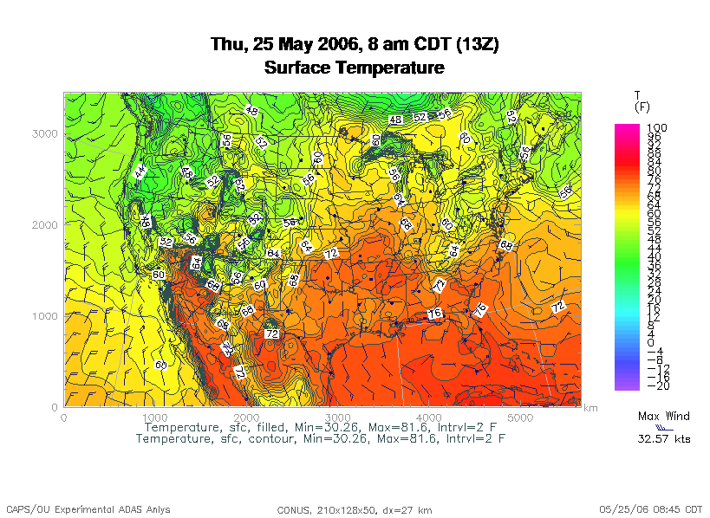
Weather Forecasting
http://www.caps.ou.edu/wx/p/r/conus/fcst/

Slide 60
Weather Forecasting
Weather forecasting is a transport problem.
The goal is to predict future weather conditions by simulating the movement of fluids in Earth’s atmosphere.
The physics is the Navier-Stokes Equations.
The numerical method is Finite Difference.

Slide 61
Cartesian Mesh

Slide 62
Finite Difference
unew(i,j,k) = F(uold, i, j, k, Δt) =
F(uold(i,j,k),
uold(i-1,j,k), uold(i+1,j,k),
uold(i,j-1,k), uold(i,j+1,k),
uold(i,j,k-1), uold(i,j,k+1), Δt)

Slide 63
Ghost Boundary Zones

Slide 64
Virtual Memory

Slide 65

Virtual Memory
Typically, the amount of main memory (RAM) that a CPU can address is larger than the amount of data physically present in the computer.
For example, consider a laptop that can address 16 GB of main memory (roughly 16 billion bytes), but only contains 2 GB (roughly 2 billion bytes).
Supercomputing in Plain English: Multicore
Tue Apr 3 2018

Slide 66
Virtual Memory (cont’d)
Locality: Most programs don’t jump all over the memory that they use; instead, they work in a particular area of memory for a while, then move to another area.
So, you can offload onto hard disk much of the memory image of a program that’s running.
Supercomputing in Plain English: Multicore
Tue Apr 3 2018

Slide 67
Virtual Memory (cont’d)
Memory is chopped up into many pages of modest size (for example, 1 KB – 32 KB; typically 4 KB).
Only pages that have been recently used actually reside in memory; the rest are stored on hard disk.
Hard disk is typically 0.1% as fast as main memory, so you get better performance if you rarely get a page fault, which forces a read from (and maybe a write to) hard disk: exploit data locality!
Supercomputing in Plain English: Multicore
Tue Apr 3 2018

Slide 68
Cache vs. Virtual Memory
Lines (cache) vs. pages (VM)
Cache faster than RAM (cache) vs. RAM faster than disk (VM)
Supercomputing in Plain English: Multicore
Tue Apr 3 2018

Slide 69
Virtual Memory
Every CPU family today uses virtual memory, in which disk pretends to be a bigger RAM.
Virtual memory capability can’t be turned off (though you can turn off the ability to swap to disk).
RAM is split up into pages, typically 4 KB each.
Each page is either in RAM or out on disk.
To keep track of the pages, a page table notes whether each table is in RAM, where it is in RAM (that is, physical address and virtual address are different), and some other information.
So, a 4 GB physical RAM would need over a million page table entries – and a 32 GB physical RAM as on Schooner would need over 32M page table entries.

Slide 70
Why Virtual Memory is Slow
When you want to access a byte of memory, you have to find out whether it’s in physical memory (RAM) or virtual memory (disk) – and the page table is in RAM!
A page table of a 32 million entries can’t fit in, for example, the 25 MB cache L3 cache on Schooner CPU chips – and even if it could, that wouldn’t leave much cache for application data.
So, each memory access (load or store) is actually 2 memory accesses: the first for the page table entry, and the second for the data itself.
This is slow!
And notice, this is assuming that you don’t need more memory than your physical RAM.

Slide 71
The Notorious T.L.B.
To speed up memory accesses, CPUs today have a special cache just for page table entries, known as the Translation Lookaside Buffer (TLB).
The size of TLBs varies from 64 entries to 1024 entries, depending on chip families. At 4 KB pages, this means that the size of cache covered by the TLB varies from 256 KB to 4 MB.
Some TLBs allow large pages (1 MB to a few GB) – but the operating systems often provide poor or no support.

Slide 72
The T.L.B. on a Current Chip
On Intel Haswell, specifically E5-2650 v3 (e.g., on Schooner):
L3 cache size is 25 MB, shared among 10 cores.
L2 cache size is 256 KB per core (dedicated to that core).
Page size can be 4 KB or 2 MB/4 MB or 1 GB.
Data TLB (DTLB) per core is:
  64 entries for 4 KB pages, covering 256 KB per core, OR
  32 entries for 2 MB/4 MB pages, covering 128 MB per core, OR
  4 entries for 1 GB pages, covering 4 GB per core.
DTLB is 4-way set associative.
Shared TLB (STLB), containing a second level of both instruction and data TLB, for the whole chip is:
  1024 entries for 4 KB or 2 MB pages, covering 4 MB or 2 GB.
A page table failure can cause a delay of hundreds of cycles.
(This information is from [13].)

Slide 73
The T.L.B. on a Recent Chip
On Intel Haswell, specifically E5-2650 v3 (e.g., on Schooner):
L3 cache size is 25 MB, shared among 10 cores.
L2 cache size is 256 KB per core (dedicated to that core).
Page size can be 4 KB or 2 MB/4 MB or 1 GB.
Data TLB (DTLB) per core is:
  64 entries for 4 KB pages, covering 256 KB per core, OR
  32 entries for 2 MB/4 MB pages, covering 128 MB per core, OR
  4 entries for 1 GB pages, covering 4 GB per core.
Mesh: At 100 vertical levels of 150 single precision variables, 2 MB is a 5 x 5 horizontal domain – almost nothing but ghost zones!
If your OS and compiler support 2 MB pages, then your TLB can support a 186 x 186 horizontal domain -- but your L3 cache can only support 20 x 20.

Slide 74
Software Strategies for Weather Forecasting on Multicore/Many-core

Slide 75
Tiling NOT Good for Weather Codes
Weather codes typically have on the order of 150 3D arrays used in each timestep (some transferred multiple times in the same timestep, but let’s ignore that for simplicity).
These arrays typically are single precision (4 bytes per floating point value).
So, a typical weather code uses about 600 bytes per mesh zone per timestep.
Weather codes typically do 5,000 to 10,000 calculations per mesh zone per timestep.
So, the ratio of calculations to data is less than 20 to 1 – much less than the ~210 to 1 needed (on 2017 hardware).

Slide 76
Weather Forecasting and Cache
On current weather codes, data decomposition is per process. That is, each process gets one subdomain.
As CPUs speed up and RAM sizes grow, the size of each processor’s subdomain grows too.
However, given RAM bandwidth limitations, this means that performance can only grow with RAM speed – which increases slower than CPU speed.
If the codes were optimized for cache, would they speed up more?
First: How to optimize for cache?

Slide 77
How to Get Good Cache Reuse?
Multiple independent subdomains per processor.
Each subdomain fits entirely in L3 cache.
Each subdomain’s page table entries fit entirely in the TLB.
Expanded ghost zone stencil (ghost zones on each side) allows multiple timesteps before communicating with neighboring subdomains.
Parallelize along the Z-axis as well as X and Y.
Use higher order numerical schemes.
Reduce the memory footprint as much as possible.
Coincidentally, this also reduces communication cost.

Slide 78
Cache Optimization Strategy: Tiling?
Would tiling work as a cache optimization strategy for weather forecasting codes?

Slide 79
Multiple Subdomains Per Core
Core 0
Core 2
Core 3
Core 1

Slide 80
Why Multiple Subdomains?
If each subdomain fits in cache, then the CPU can bring all the data of a subdomain into cache, chew on it for a while, then move on to the next subdomain: lots of cache reuse!
Oh, wait, what about the TLB? Better make the subdomains smaller! (So more of them.)
But, doesn’t tiling have the same effect?

Slide 81
Why Independent Subdomains?
Originally, the point of this strategy was to hide the cost of communication.
When you finish chewing up a subdomain, send its data to its neighbors non-blocking (MPI_Isend).
While the subdomain’s data is flying through the interconnect, work on other subdomains, which hides the communication cost.
When it’s time to work on this subdomain again, collect its data (MPI_Waitall).
If you’ve done enough work, then the communication cost is zero.

Slide 82
Expand the Array Stencil
If you expand the array stencil of each subdomain beyond the numerical stencil, then you don’t have to communicate as often.
When you communicate, instead of sending a slice along each face, send a slab, with extra stencil levels.
In the first timestep after communicating, do extra calculations out to just inside the numerical stencil.
In subsequent timesteps, calculate fewer and fewer stencil levels, until it’s time to communicate again – less total communication, and more calculations to hide the communication cost underneath!

Slide 83
An Extra Win!
If you do all this, there’s an amazing side effect: you get better cache reuse, because you stick with the same subdomain for a longer period of time.
So, instead of doing, say, 5000 calculations per zone per timestep, you can do 15,000 or 20,000.
So, you can better amortize the cost of transferring the data between RAM and cache.
Downside: ratio of ghost zone RAM use to computed zone RAM use gets worse.
  But RAM is cheap.

Slide 84
Old Algorithm (F90)
DO timestep = 1, number_of_timesteps
CALL receive_messages_nonblocking(subdomain, timestep)
CALL calculate_entire_timestep(subdomain, timestep)
CALL send_messages_nonblocking(subdomain, timestep)
END DO

Slide 85
Old Algorithm (C)
for (timestep = 0;
timestep < number_of_timesteps; timestep++) {
receive_messages_nonblocking(subdomain, timestep);
calculate_entire_timestep(subdomain, timestep);
send_messages_nonblocking(subdomain, timestep);
} /* for timestep */

Slide 86
New Algorithm (F90)
DO timestep = 1, number_of_timesteps, extra_stencil_levels
DO subdomain = 1, number_of_local_subdomains
CALL receive_messages_nonblocking(subdomain, timestep)
DO extra_stencil_level = 0, extra_stencil_levels - 1
CALL calculate_entire_timestep(subdomain,
timestep + extra_stencil_level)
END DO
CALL send_messages_nonblocking(subdomain,
timestep + extra_stencil_levels)
` END DO
END DO

Slide 87
New Algorithm (C)
for (timestep = 0;
timestep < number_of_timesteps;
timestep += extra_stencil_levels) {
for (subdomain = 0;
subdomain < number_of_local_subdomains; subdomain++) {
receive_messages_nonblocking(subdomain, timestep);
for (extra_stencil_level = 0;
extra_stencil_level < extra_stencil_levels;
extra_stencil_level++) {
calculate_entire_timestep(subdomain,
timestep + extra_stencil_level);
} /* for extra_stencil_level */
send_messages_nonblocking(subdomain,
timestep + extra_stencil_levels);
} /* for subdomain */
} /* for timestep */

Slide 88
Higher Order Numerical Schemes
Higher order numerical schemes are great, because they require more calculations per mesh zone per timestep, which you need to amortize the cost of transferring data between RAM and cache. Might as well!
Plus, they allow you to use a larger time interval per timestep (dt), so you can do fewer total timesteps for the same accuracy – or you can get higher accuracy for the same number of timesteps.

Slide 89
Parallelize in Z
Most weather forecast codes parallelize in X and Y, but not in Z, because gravity makes the calculations along Z more complicated than X and Y.
But, that means that each subdomain has a high number of zones in Z, compared to X and Y.
For example, a 1 km CONUS run will probably have 100 zones in Z (25 km at 0.25 km resolution).

Slide 90
Multicore/Many-core Problem
Most multicore chip families have relatively small cache per core (for example, 1 - 4 MB per core at the highest/slowest cache level) – and this problem seems likely to remain.
Small TLBs make the problem worse: a few MB per core rather than 10-30 MB, for small page size VM.
So, to get good cache reuse, you need subdomains of no more than a few MB.
If you have 150 3D variables at single precision, and 100 zones in Z, then your horizontal size will be 5 x 5 zones – just enough for your stencil!

Slide 91
What Do We Need?
We need much bigger caches!
  But that depends on transistor siz, which is becoming harder and harder to shrink.
TLB must be big enough to cover the entire cache.
It’d be nice to have RAM speed increase as fast as core counts increase, but let’s not kid ourselves.
Keep this in mind when we get to GPGPU!

Slide 92
TENTATIVE Schedule
Tue Jan 23: Storage: What the Heck is Supercomputing?
Tue Jan 30: The Tyranny of the Storage Hierarchy Part I
Tue Feb 6: The Tyranny of the Storage Hierarchy Part II
Tue Feb 13: Instruction Level Parallelism
Tue Feb 20: Stupid Compiler Tricks
Tue Feb 27: Multicore Multithreading
Tue March 6: Distributed Multiprocessing
Tue March 13: NO SESSION (Henry business travel)
Tue March 20: NO SESSION (OU's Spring Break)
Tue March 27: Applications and Types of Parallelism
Tue Apr 3: Multicore Madness
Tue Apr 10: NO SESSION (Henry business travel)
Tue Apr 17: High Throughput Computing
Tue Apr 24: GPGPU: Number Crunching in Your Graphics Card
Tue May 1: Grab Bag: Scientific Libraries, I/O Libraries, Visualization

Slide 93
Thanks for helping!
OU IT
  OSCER operations staff (Dave Akin, Patrick Calhoun, Kali McLennan, Jason Speckman, Brett Zimmerman)
  OSCER Research Computing Facilitators (Jim Ferguson, Horst Severini)
  Debi Gentis, OSCER Coordinator
  Kyle Dudgeon, OSCER Manager of Operations
  Ashish Pai, Managing Director for Research IT Services
  The OU IT network team
  OU CIO Eddie Huebsch
OneNet: Skyler Donahue
Oklahoma State U: Dana Brunson

Slide 94
This is an experiment!
It’s the nature of these kinds of videoconferences that FAILURES ARE GUARANTEED TO HAPPEN! NO PROMISES!
So, please bear with us. Hopefully everything will work out well enough.
If you lose your connection, you can retry the same kind of connection, or try connecting another way.
Remember, if all else fails, you always have the phone bridge to fall back on.
PLEASE MUTE YOURSELF.
PLEASE MUTE YOURSELF.
PLEASE MUTE YOURSELF.

Slide 95
Coming in 2018!
Coalition for Advancing Digital Research & Education (CADRE) Conference: Apr 17-18 2018 @ Oklahoma State U, Stillwater OK USA
https://hpcc.okstate.edu/cadre-conference
Linux Clusters Institute workshops http://www.linuxclustersinstitute.org/workshops/
  Introductory HPC Cluster System Administration: May 14-18 2018 @ U Nebraska, Lincoln NE USA
  Intermediate HPC Cluster System Administration: Aug 13-17 2018 @ Yale U, New Haven CT USA
Great Plains Network Annual Meeting: details coming soon
Advanced Cyberinfrastructure Research & Education Facilitators (ACI-REF) Virtual Residency Aug 5-10 2018, U Oklahoma, Norman OK USA
PEARC 2018, July 22-27, Pittsburgh PA USA
https://www.pearc18.pearc.org/
IEEE Cluster 2018, Sep 10-13, Belfast UK
https://cluster2018.github.io
OKLAHOMA SUPERCOMPUTING SYMPOSIUM 2018, Sep 25-26 2018 @ OU
SC18 supercomputing conference, Nov 11-16 2018, Dallas TX USA
http://sc18.supercomputing.org/

Slide 96
Thanks for your attention!
Questions? www.oscer.ou.edu

Slide 97
References
[1] Image by Greg Bryan, Columbia U.
[2] “Update on the Collaborative Radar Acquisition Field Test (CRAFT): Planning for the Next Steps.”
Presented to NWS Headquarters August 30 2001.
[3] See http://hneeman.oscer.ou.edu/hamr.html for details.
[4] http://www.dell.com/
[5] http://www.vw.com/newbeetle/
[6] Richard Gerber, The Software Optimization Cookbook: High-performance Recipes for the Intel Architecture. Intel Press, 2002, pp. 161-168.
[7] RightMark Memory Analyzer. http://cpu.rightmark.org/
[8] ftp://download.intel.com/design/Pentium4/papers/24943801.pdf
[9] http://www.seagate.com/cda/products/discsales/personal/family/0,1085,621,00.html
[10] http://www.samsung.com/Products/OpticalDiscDrive/SlimDrive/OpticalDiscDrive_SlimDrive_SN_S082D.asp?page=Specifications
[11] ftp://download.intel.com/design/Pentium4/manuals/24896606.pdf
[12] http://www.pricewatch.com/
[13] https://en.wikichip.org/wiki/intel/microarchitectures/haswell_(client)

