Slide 1
Supercomputing in Plain English Grab Bag: Scientific Libraries, I/O Libraries, Visualization
Henry Neeman, University of Oklahoma
Director, OU Supercomputing Center for Education & Research (OSCER)
Assistant Vice President, Information Technology – Research Strategy Advisor
Associate Professor, Gallogly College of Engineering
Adjunct Associate Professor, School of Computer Science
Tuesday May 1 2018

Slide 2
This is an experiment!
It’s the nature of these kinds of videoconferences that FAILURES ARE GUARANTEED TO HAPPEN! NO PROMISES!
So, please bear with us. Hopefully everything will work out well enough.
If you lose your connection, you can retry the same kind of connection, or try connecting another way.
Remember, if all else fails, you always have the phone bridge to fall back on.
PLEASE MUTE YOURSELF.
PLEASE MUTE YOURSELF.
PLEASE MUTE YOURSELF.

Slide 3
PLEASE MUTE YOURSELF
No matter how you connect, PLEASE MUTE YOURSELF, so that we cannot hear you.
At OU, we will turn off the sound on all conferencing technologies.
That way, we won’t have problems with echo cancellation.
Of course, that means we cannot hear questions.
So for questions, you’ll need to send e-mail:
supercomputinginplainenglish@gmail.com
PLEASE MUTE YOURSELF.
PLEASE MUTE YOURSELF.
PLEASE MUTE YOURSELF.

Slide 4
Download the Slides Beforehand
Before the start of the session, please download the slides from the Supercomputing in Plain English website:
http://www.oscer.ou.edu/education/
That way, if anything goes wrong, you can still follow along with just audio.
PLEASE MUTE YOURSELF.
PLEASE MUTE YOURSELF.
PLEASE MUTE YOURSELF.

Slide 5
Zoom
Go to:
http://zoom.us/j/979158478
Many thanks Eddie Huebsch, OU CIO, for providing this.
PLEASE MUTE YOURSELF.
PLEASE MUTE YOURSELF.
PLEASE MUTE YOURSELF.

Slide 6
YouTube
You can watch from a Windows, MacOS or Linux laptop or an Android or iOS handheld using YouTube.
Go to YouTube via your preferred web browser or app, and then search for:
Supercomputing InPlainEnglish
(InPlainEnglish is all one word.)
Many thanks to Skyler Donahue of OneNet for providing this.
PLEASE MUTE YOURSELF.
PLEASE MUTE YOURSELF.
PLEASE MUTE YOURSELF.

Slide 7
Twitch
You can watch from a Windows, MacOS or Linux laptop or an Android or iOS handheld using Twitch.
Go to:
http://www.twitch.tv/sipe2018
Many thanks to Skyler Donahue of OneNet for providing this.
PLEASE MUTE YOURSELF.
PLEASE MUTE YOURSELF.
PLEASE MUTE YOURSELF.

Slide 8
Wowza #1
You can watch from a Windows, MacOS or Linux laptop using Wowza from the following URL:
http://jwplayer.onenet.net/streams/sipe.html
If that URL fails, then go to:
http://jwplayer.onenet.net/streams/sipebackup.html
Many thanks to Skyler Donahue of OneNet for providing this.
PLEASE MUTE YOURSELF.
PLEASE MUTE YOURSELF.
PLEASE MUTE YOURSELF.

Slide 9
Wowza #2
Wowza has been tested on multiple browsers on each of:
Windows 10: IE, Firefox, Chrome, Opera, Safari
MacOS: Safari, Firefox
Linux: Firefox, Opera
We’ve also successfully tested it via apps on devices with:
Android
iOS
Many thanks to Skyler Donahue of OneNet for providing this.
PLEASE MUTE YOURSELF.
PLEASE MUTE YOURSELF.
PLEASE MUTE YOURSELF.

Slide 10
Toll Free Phone Bridge
IF ALL ELSE FAILS, you can use our US TOLL phone bridge:
405-325-6688
684 684 #
NOTE: This is for US call-ins ONLY.
PLEASE MUTE YOURSELF and use the phone to listen.
Don’t worry, we’ll call out slide numbers as we go.
Please use the phone bridge ONLY IF you cannot connect any other way: the phone bridge can handle only 100 simultaneous connections, and we have over 1000 participants.
Many thanks to OU CIO Eddie Huebsch for providing the phone bridge..

Slide 11
Please Mute Yourself
No matter how you connect, PLEASE MUTE YOURSELF, so that we cannot hear you.
(For YouTube, Twitch and Wowza, you don’t need to do that, because the information only goes from us to you, not from you to us.)
At OU, we will turn off the sound on all conferencing technologies.
That way, we won’t have problems with echo cancellation.
Of course, that means we cannot hear questions.
So for questions, you’ll need to send e-mail.
PLEASE MUTE YOURSELF.

Slide 12
Questions via E-mail Only
Ask questions by sending e-mail to:
supercomputinginplainenglish@gmail.com
All questions will be read out loud and then answered out loud.
DON’T USE CHAT OR VOICE FOR QUESTIONS!
No one will be monitoring any of the chats, and if we can hear your question, you’re creating an echo cancellation problem.
PLEASE MUTE YOURSELF.
PLEASE MUTE YOURSELF.

Slide 13
Onsite: Talent Release Form
If you’re attending onsite, you MUST do one of the following:
complete and sign the Talent Release Form,
OR
sit behind the cameras (where you can’t be seen) and don’t talk at all.
If you aren’t onsite, then PLEASE MUTE YOURSELF.

Slide 14
TENTATIVE Schedule
Tue Jan 23: Storage: What the Heck is Supercomputing?
Tue Jan 30: The Tyranny of the Storage Hierarchy Part I
Tue Feb 6: The Tyranny of the Storage Hierarchy Part II
Tue Feb 13: Instruction Level Parallelism
Tue Feb 20: Stupid Compiler Tricks
Tue Feb 27: Multicore Multithreading
Tue March 6: Distributed Multiprocessing
Tue March 13: NO SESSION (Henry business travel)
Tue March 20: NO SESSION (OU's Spring Break)
Tue March 27: Applications and Types of Parallelism
Tue Apr 3: Multicore Madness
Tue Apr 10: NO SESSION (Henry business travel)
Tue Apr 17: High Throughput Computing
Tue Apr 24: GPU: Number Crunching in Your Graphics Card
Tue May 1: Grab Bag: Scientific Libraries, I/O Libraries, Visualization

Slide 15
Thanks for helping!
OU IT
OSCER operations staff (Dave Akin, Patrick Calhoun, Kali McLennan, Jason Speckman, Brett Zimmerman)
OSCER Research Computing Facilitators (Jim Ferguson, Horst Severini)
Debi Gentis, OSCER Coordinator
Kyle Dudgeon, OSCER Manager of Operations
Ashish Pai, Managing Director for Research IT Services
The OU IT network team
OU CIO Eddie Huebsch
OneNet: Skyler Donahue
Oklahoma State U: Dana Brunson

Slide 16
This is an experiment!
It’s the nature of these kinds of videoconferences that FAILURES ARE GUARANTEED TO HAPPEN! NO PROMISES!
So, please bear with us. Hopefully everything will work out well enough.
If you lose your connection, you can retry the same kind of connection, or try connecting another way.
Remember, if all else fails, you always have the phone bridge to fall back on.
PLEASE MUTE YOURSELF.
PLEASE MUTE YOURSELF.
PLEASE MUTE YOURSELF.

Slide 17
Coming in 2018!
Linux Clusters Institute workshops http://www.linuxclustersinstitute.org/workshops/
Introductory HPC Cluster System Administration: May 14-18 2018 @ U Nebraska, Lincoln NE USA
Intermediate HPC Cluster System Administration: Aug 13-17 2018 @ Yale U, New Haven CT USA
Great Plains Network Annual Meeting: details coming soon
Advanced Cyberinfrastructure Research & Education Facilitators (ACI-REF) Virtual Residency Aug 5-10 2018, U Oklahoma, Norman OK USA
PEARC 2018, July 22-27, Pittsburgh PA USA
https://www.pearc18.pearc.org/
IEEE Cluster 2018, Sep 10-13, Belfast UK
https://cluster2018.github.io
OKLAHOMA SUPERCOMPUTING SYMPOSIUM 2018, Sep 25-26 2018 @ OU
SC18 supercomputing conference, Nov 11-16 2018, Dallas TX USA
http://sc18.supercomputing.org/

Slide 18
Outline
Scientific Computing Pipeline
Scientific Libraries
I/O Libraries
Scientific Visualization

Slide 19
Scientific Computing Pipeline
Real World
Physics
Mathematical Representation (continuous)
Numerical Representation (discrete)
Algorithm
Implementation (program)
Port (to a specific platform)
Result (run)
Analysis
Verification
Thanks to Julia Mullen of MIT Lincoln Lab for this concept.

Slide 20
Five Rules of Scientific Computing
Know the physics.
Control the software.
Understand the numerics.
Achieve expected behavior.
Question unexpected behavior.
Thanks to Robert E. Peterkin for these.

Slide 21
Scientific Libraries

Slide 22
Preinvented Wheels
Many simulations perform fairly common tasks; for example, solving systems of equations:
Ax = b
where A is the matrix of coefficients, x is the vector of unknowns and b is the vector of knowns.

Slide 23
Scientific Libraries
Because some tasks are quite common across many science and engineering applications, groups of researchers have put a lot of effort into writing scientific libraries: collections of routines for performing these commonly-used tasks (for example, linear algebra solvers).
The people who write these libraries know a lot more about these things than we do.
So, a good strategy is to use their libraries, instead of trying to write our own.

Slide 24
Solver Libraries
Probably the most common scientific computing task is solving a system of equations
Ax = b
where A is a matrix of coefficients, x is a vector of unknowns, and b is a vector of knowns.
The goal is to solve for x.

Slide 25
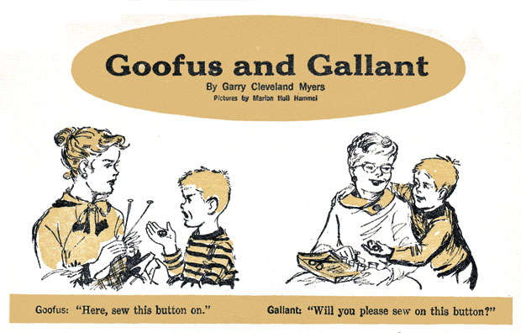
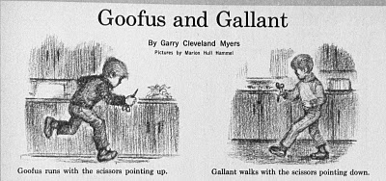
Solving Systems of Equations
Don’ts:
Don’t invert the matrix (x = A⁻¹b). That’s much more costly than solving directly, and much more prone to numerical error.
Don’t write your own solver code. There are people who devote their whole careers to writing solvers. They know a lot more about writing solvers than we do.

Slide 26
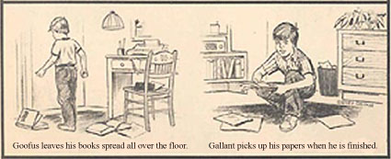
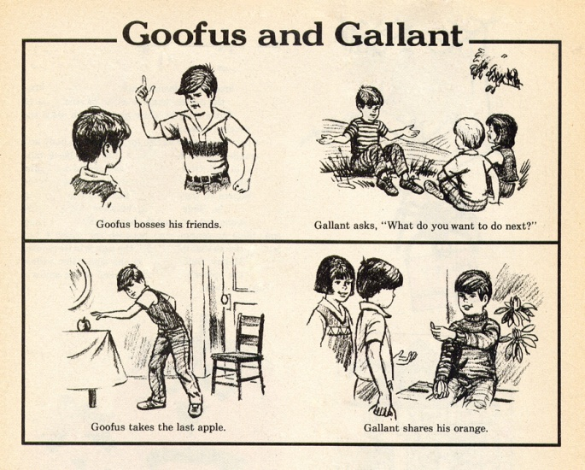
Solving Do’s
Do’s:
Do use standard, portable solver libraries.
Do use a version that’s tuned for the platform that you’re running on, if available.
Do use the information that you have about your system of equations to pick the most efficient solver.

Slide 27
All About Your Matrix
If you know things about your matrix, you might be able to use a more efficient solver.
Symmetric: a_{i,j} = a_{j,i}
Positive definite: x^{T}Ax > 0 for all x ≠ 0 (for example, if all eigenvalues are positive)
Banded:
zero
except
on the
bands
Tridiagonal:
0
and …
0

Slide 28
Sparse Matrices
A sparse matrix is a matrix that has mostly zeros in it. “Mostly” is vaguely defined, but a good rule of thumb is that a matrix is sparse if more than, say, 90-95% of its entries are zero. (A non-sparse matrix is dense.)

Slide 29
Linear Algebra Libraries
BLAS ^{[1],[2]}
ATLAS^{[3]}
LAPACK^{[4]}
ScaLAPACK^{[5]}
PETSc^{[6],[7],[8]}

Slide 30
BLAS
The Basic Linear Algebra Subprograms (BLAS) are a collection of low-level linear algebra routines:
Level 1: Vector-vector (for example, dot product)
Level 2: Matrix-vector (for example, matrix-vector multiply)
Level 3: Matrix-matrix (for example, matrix-matrix multiply)
Many linear algebra packages, including LAPACK, ScaLAPACK and PETSc, are built on top of BLAS.
Most supercomputer vendors have versions of BLAS that are highly tuned for their platforms.

Slide 31
ATLAS
The Automatically Tuned Linear Algebra Software package (ATLAS) is a self-tuned version of BLAS (it also includes a few LAPACK routines).
When it’s installed, it tests and times a variety of approaches to each routine, and selects the version that runs the fastest.
ATLAS is substantially faster than the generic version of BLAS.
And, it’s FREE!

Slide 32
Goto BLAS
Several years ago, a new version of BLAS was released, developed by Kazushige Goto (then at UT Austin, now at Intel).
http://en.wikipedia.org/wiki/Kazushige_Goto
This version is unusual, because instead of optimizing for cache, it optimizes for the Translation Lookaside Buffer (TLB), the special little cache that often is ignored by software developers.
Goto realized that optimizing for the TLB would be more efficient than optimizing for cache.

Slide 33
Platform-specific BLAS
Many platforms have their own version of BLAS that’s highly tuned for that platform:
Intel Math Kernel Library*
AMD Core Math Library*
IBM Engineering & Scientific Subroutine Library*
Oracle Sun Performance Library*
cuBLAS
* Includes routines other than BLAS.

Slide 34
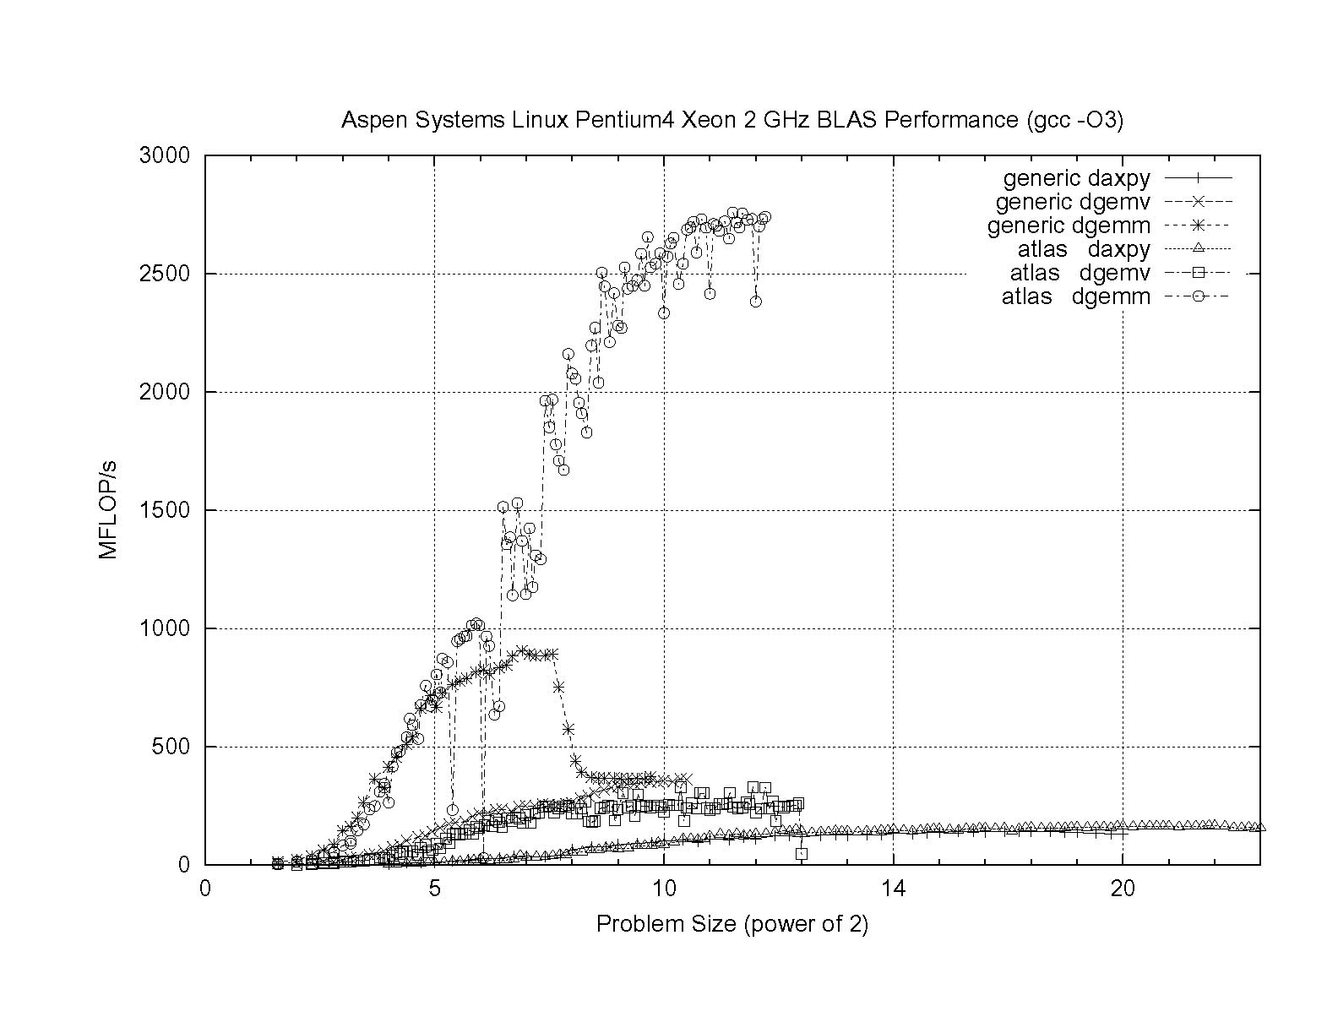
ATLAS vs. Generic BLAS
BETTER
ATLAS DGEMM: 2.76 GFLOP/s = 69% of peak
Generic DGEMM: 0.91 GFLOP/s = 23% of peak
DGEMM: Double precision GEneral Matrix-Matrix multiply
DGEMV: Double precision GEneral Matrix-Vector multiply

Slide 35
LAPACK
LAPACK (Linear Algebra PACKage) solves dense or special-case sparse systems of equations depending on matrix properties such as:
Precision: single, double
Data type: real, complex
Shape: diagonal, bidiagonal, tridiagonal, banded, triangular, trapezoidal, Hesenberg, general dense
Properties: orthogonal, positive definite, Hermetian (complex), symmetric, general
LAPACK is built on top of BLAS, which means it can benefit from tuned BLAS version.

Slide 36
LAPACK Example
REAL,DIMENSION(numrows,numcols) :: A
REAL,DIMENSION(numrows) :: B
REAL,DIMENSION(numcols) :: X
INTEGER,DIMENSION(numrows) :: pivot
INTEGER :: row, col, info, numrhs = 1
DO row = 1, numrows
B(row) = …
END DO
DO col = 1, numcols
DO row = 1, numrows
A(row,col) = …
END DO
END DO
CALL sgesv(numrows, numrhs, A, numrows, pivot, &
& B, numrows, info)
DO col = 1, numcols
X(col) = B(col)
END DO

Slide 37
LAPACK: A Library and an API
LAPACK is a library that you can download for free from the Web:
www.netlib.org
But, it’s also an Application Programming Interface (API): a definition of a set of routines, their arguments, and their behaviors.
So, anyone can write an implementation of LAPACK.

Slide 38
It’s Good to Be Popular
LAPACK is a good choice for non-parallelized solving, because its popularity has convinced many supercomputer vendors to write their own, highly tuned versions.
The API for the LAPACK routines is the same as the portable version from NetLib, but the performance can be much better, via either ATLAS or proprietary vendor-tuned versions.
Also, some vendors have shared memory parallel versions of LAPACK.

Slide 39
LAPACK Performance
Because LAPACK uses BLAS, it’s about as fast as BLAS.
For example, DGESV (Double precision General SolVer) on a 2 GHz Pentium4 using ATLAS gets 65% of peak, compared to 69% of peak for Matrix-Matrix multiply.
In fact, an older version of LAPACK, called LINPACK, is used to determine the top 500 supercomputers in the world.

Slide 40
ScaLAPACK
ScaLAPACK is the distributed parallel (MPI) version of LAPACK. It actually contains only a subset of the LAPACK routines, and has a somewhat awkward Application Programming Interface (API).
Like LAPACK, ScaLAPACK is also available from
www.netlib.org.

Slide 41
PETSc
PETSc (Portable, Extensible Toolkit for Scientific Computation) is a solver library for sparse matrices that uses distributed parallelism (MPI).
PETSc is designed for general sparse matrices with no special properties, but it also works well for sparse matrices with simple properties like banding and symmetry.
It has a simpler, more intuitive Application Programming Interface than ScaLAPACK.

Slide 42
Pick Your Solver Package
Dense Matrix
Serial: LAPACK
Shared Memory Parallel: threaded LAPACK
Distributed Parallel: ScaLAPACK
Sparse Matrix: PETSc

Slide 43
I/O Libraries

Slide 44
I/O Challenges
I/O presents two important challenges to scientific computing:
Performance
Portability
The performance issue arises because I/O is much more time-consuming than computation, as we saw in the “Storage Hierarchy” session.
The portability issue arises because different kinds of computers can have different ways of representing real (floating point) numbers.

Slide 45
Storage Formats
When you use a PRINT statement in Fortran or a printf in C or output to cout in C++, you are asking the program to output data in human-readable form:
x = 5
PRINT *, x
But what if the value that you want to output is a real number with lots of significant digits?
1.3456789E+23

Slide 46
Data Output as Text
1.3456789E+23
When you output data as text, each character takes 1 byte.
So if you output a number with lots of digits, then you’re outputting lots of bytes.
For example, the above number takes 13 bytes to output as text.
Jargon: Text is sometimes called ASCII (American Standard Code for Information Interchange).

Slide 47
Output Data in Binary
Inside the computer, a single precision real number (Fortran REAL, C/C++ float) typically requires 4 bytes, and a double precision real number (DOUBLE PRECISION or double) typically requires 8.
That’s less than 13 bytes.
Since I/O is very expensive, it’s better to output 4 or 8 bytes than 13 or more.
Happily, Fortran, C and C++ allow you to output data as binary (internal representation) rather than as text.

Slide 48
Binary Output Problems
When you output data as binary rather than as text, you output substantially fewer bytes, so you save time (because I/O is very expensive) and you save disk space.
But, you pay two prices:
Readability: Humans can’t read binary.
Portability: Different kinds of computers have different ways of internally representing numbers.

Slide 49
Binary Readability: No Problem
Readability of binary data isn’t a problem in scientific computing, because:
You can always write a little program to read in the binary data and display its text equivalent.
If you have lots and lots of data (that is, MBs or GBs), you wouldn’t want to look at all of it anyway.

Slide 50
Binary Portability: Big Problem
Binary data portability is a very big problem in scientific computing, because data that’s output on one kind of computer may not be readable on another, and so:
You can’t output the data on one kind of computer and then use them (for example, visualize, analyze) on another kind.
Some day the kind of computer that output the data will be obsolete, so there may be no computer in the world that can input it, and thus the data are lost.

Slide 51
Portable Binary Data
The HPC community noticed this problem some years ago, and so a number of portable binary data formats were developed.
The two most popular are:
HDF (Hierarchical Data Format) from the National Center for Supercomputing Applications:
http://www.hdfgroup.org/
NetCDF (Network Common Data Form) from Unidata:
http://www.unidata.ucar.edu/software/netcdf

Slide 52
Advantages of Portable I/O
Portable binary I/O packages:
give you portable binary I/O;
have simple, clear APIs;
are available for free;
run on most platforms;
allow you to annotate your data (for example, put into the file the variable names, units, experiment name, grid description, etc).
Also, both HDF and netCDF support distributed parallel I/O.

Slide 53
Scientific Visualization

Slide 54
Too Many Numbers
A typical scientific code outputs lots and lots of data.
For example, the ARPS weather forecasting code, running a 5 day forecast over the continental U.S. with a resolution of 1 km horizontal and 0.25 km vertical outputting data for every hour would produce about 10 terabytes (10¹³ bytes).
No one can look at that many numbers.

Slide 55
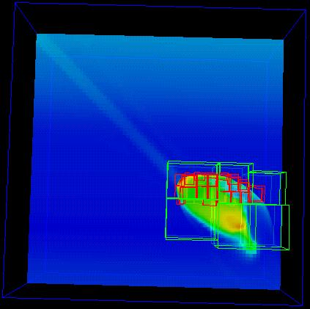
A Picture is Worth …
… millions of numbers.
This is Comet Shoemaker-Levy 9, which hit Jupiter in 1994; the image is from 35 seconds after hitting Jupiter’s inner atmosphere.^{[9]}

Slide 56
Types of Visualization
Contour lines
Slice planes
Isosurfaces
Streamlines
Volume rendering
… and many others.
Note: Except for the volume rendering, the following images were created by Vis5D.^{[10]}

Slide 57
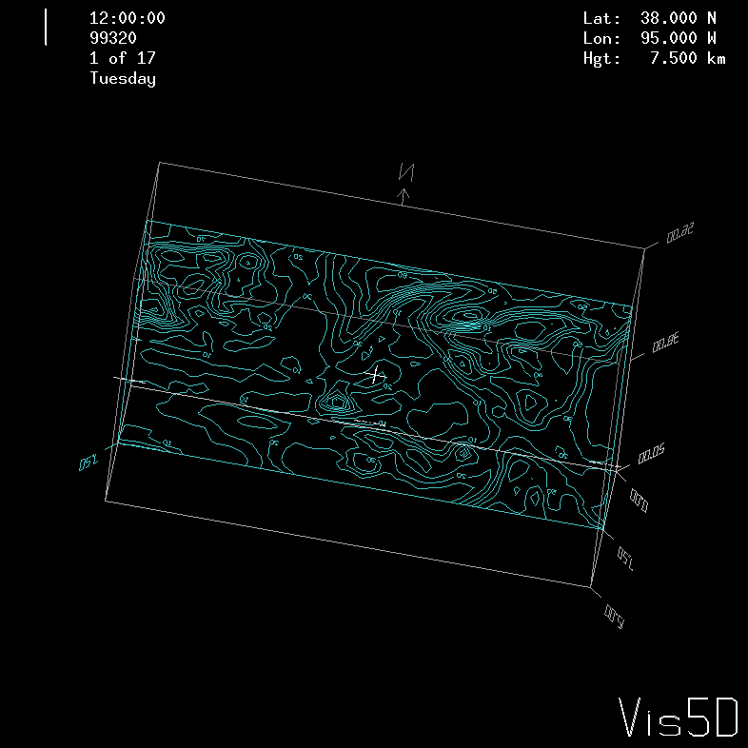
Contour Lines
This image shows contour lines of relative humidity. Each contour line represents a single humidity value.

Slide 58
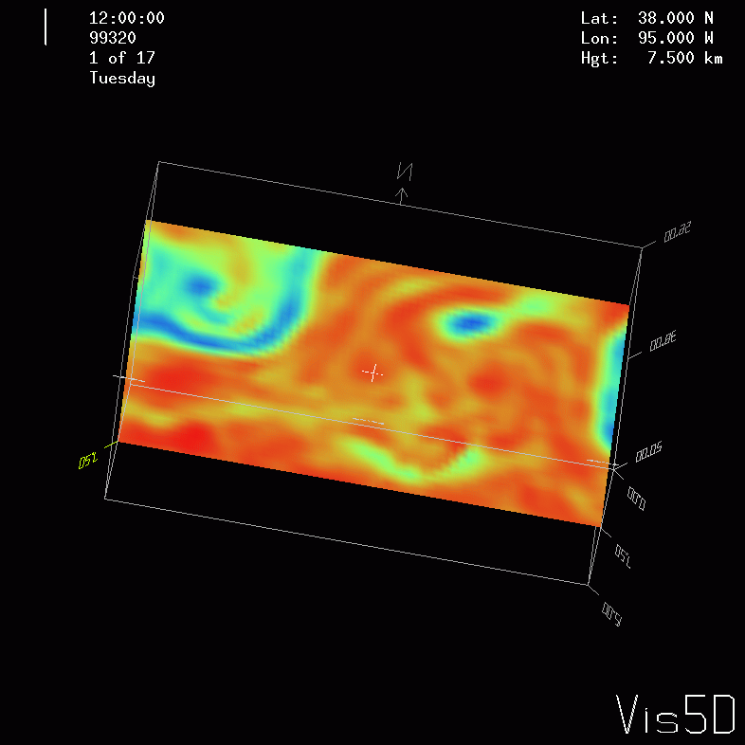
Slice Planes
A slice plane is a single plane passed through a 3D volume. Typically, it is color coded by mapping some scalar variable to color (for example, low vorticity to blue, high vorticity to red).

Slide 59
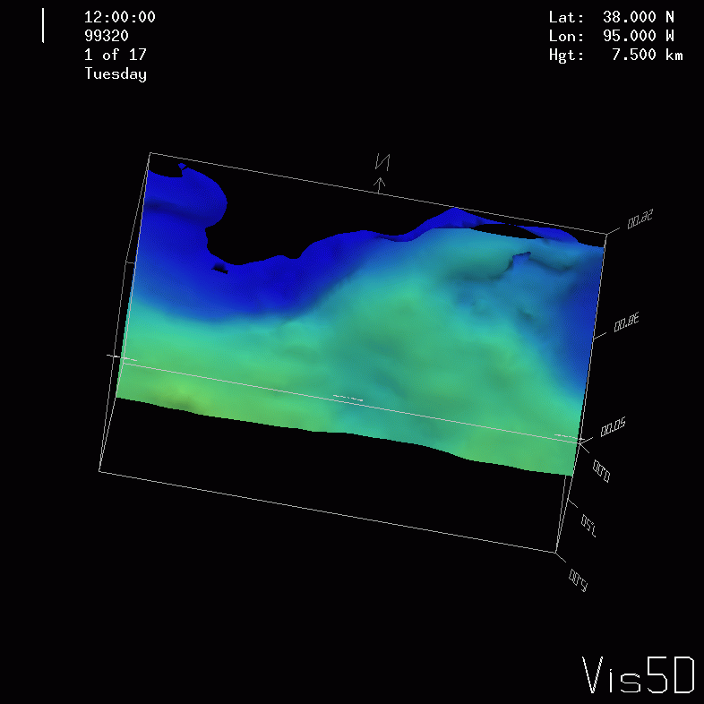
Isosurfaces
An isosurface is a surface that has a constant value for some scalar quantity. This image shows an isosurface of temperature at 0º Celsius, colored with pressure.

Slide 60
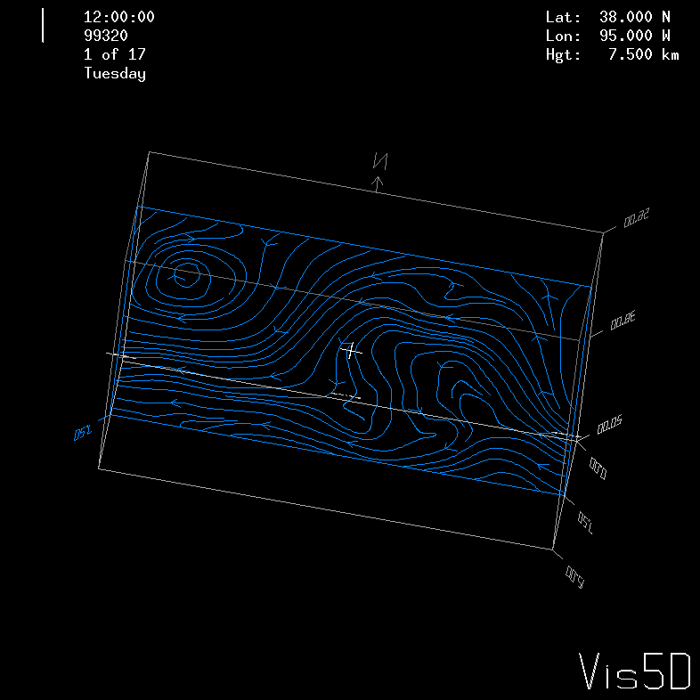
Streamlines
A streamline traces a vector quantity (for example, velocity).

Slide 61
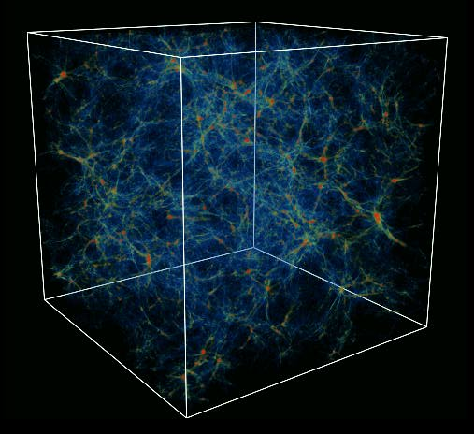
Volume Rendering
A volume rendering is created by mapping some variable (for example, energy) to color and another variable (for example, density) to opacity.
This image shows the overall structure of the universe.^{[11]}
Notice that the image looks like thick colored smoke.

Slide 62
Thanks for your attention! Questions? www.oscer.ou.edu

Slide 63
Thanks for helping!
OU IT
OSCER operations staff (Dave Akin, Patrick Calhoun, Kali McLennan, Jason Speckman, Brett Zimmerman)
OSCER Research Computing Facilitators (Jim Ferguson, Horst Severini)
Debi Gentis, OSCER Coordinator
Kyle Dudgeon, OSCER Manager of Operations
Ashish Pai, Managing Director for Research IT Services
The OU IT network team
OU CIO Eddie Huebsch
OneNet: Skyler Donahue
Oklahoma State U: Dana Brunson

Slide 64
This is an experiment!
It’s the nature of these kinds of videoconferences that FAILURES ARE GUARANTEED TO HAPPEN! NO PROMISES!
So, please bear with us. Hopefully everything will work out well enough.
If you lose your connection, you can retry the same kind of connection, or try connecting another way.
Remember, if all else fails, you always have the phone bridge to fall back on.
PLEASE MUTE YOURSELF.
PLEASE MUTE YOURSELF.
PLEASE MUTE YOURSELF.

Slide 65
Coming in 2018!
Linux Clusters Institute workshops http://www.linuxclustersinstitute.org/workshops/
Introductory HPC Cluster System Administration: May 14-18 2018 @ U Nebraska, Lincoln NE USA
Intermediate HPC Cluster System Administration: Aug 13-17 2018 @ Yale U, New Haven CT USA
Great Plains Network Annual Meeting: details coming soon
Advanced Cyberinfrastructure Research & Education Facilitators (ACI-REF) Virtual Residency Aug 5-10 2018, U Oklahoma, Norman OK USA
PEARC 2018, July 22-27, Pittsburgh PA USA
https://www.pearc18.pearc.org/
IEEE Cluster 2018, Sep 10-13, Belfast UK
https://cluster2018.github.io
OKLAHOMA SUPERCOMPUTING SYMPOSIUM 2018, Sep 25-26 2018 @ OU
SC18 supercomputing conference, Nov 11-16 2018, Dallas TX USA
http://sc18.supercomputing.org/

Slide 66
References
[1] C. L. Lawson, R. J. Hanson, D. Kincaid, and F. T. Krogh, Basic Linear Algebra Subprograms for FORTRAN Usage, ACM Trans. Math. Soft., 5 (1979), pp. 308--323.
[2] http://www.netlib.org/blas/
[3] http://math-atlas.sourceforge.net/
[4] E. Anderson, Z. Bai, C. Bischof, S. Blackford, J. Demmel, J. Dongarra, J. Du Croz, A. Greenbaum, S. Hammarling, A. McKenney, D. Sorensen, LAPACK Users' Guide, 3rd ed, 1999. http://www.netlib.org/lapack/
[5] L. S. Blackford, J. Choi, A. Cleary, E. D'Azevedo, J. Demmel, I. Dhillon, J. Dongarra, S. Hammarling, G. Henry, A. Petitet, K. Stanley, D. Walker, R. C. Whaley, ScaLAPACK Users' Guide, 1997. http://www.netlib.org/scalapack/
[6] S. Balay, K. Buschelman, W. D. Gropp, D. Kaushik, L. Curfman McInnes and B. F. Smith, PETSc home page, 2001. http://www.mcs.anl.gov/petsc
[7] S. Balay, W. D. Gropp. L. Curfman McInnes and B. Smith, PETSc Users Manual, ANL-95/11 - Revision 2.1.0, Argonne National Laboratory, 2001.
[8] S. Balay, W. D. Gropp, L. Curfman McInnes and B. F. Smith, "Efficient Management of Parallelism in Object Oriented Numerical Software Libraries", in Modern Software Tools in Scientific Computing, E. Arge, A. M. Bruaset and H. P. Langtangen, editors, Birkhauser Press, 1997, 163-202.
[9] http://hneeman.oscer.ou.edu/hamr.html
[10] http://www.ssec.wisc.edu/~billh/vis5d.html
[11] Image by Greg Bryan, MIT.

