Slide 1
Supercomputing in Plain English GPGPU: Number Crunching in Your Graphics Card
Henry Neeman, University of Oklahoma
Director, OU Supercomputing Center for Education & Research (OSCER)
Assistant Vice President, Information Technology – Research Strategy Advisor
Associate Professor, Gallogly College of Engineering
Adjunct Associate Professor, School of Computer Science
Tuesday April 24 2018

Slide 2
This is an experiment!
It’s the nature of these kinds of videoconferences that FAILURES ARE GUARANTEED TO HAPPEN! NO PROMISES!
So, please bear with us. Hopefully everything will work out well enough.
If you lose your connection, you can retry the same kind of connection, or try connecting another way.
Remember, if all else fails, you always have the phone bridge to fall back on.
PLEASE MUTE YOURSELF.
PLEASE MUTE YOURSELF.
PLEASE MUTE YOURSELF.

Slide 3
PLEASE MUTE YOURSELF
No matter how you connect, PLEASE MUTE YOURSELF, so that we cannot hear you.
At OU, we will turn off the sound on all conferencing technologies.
That way, we won’t have problems with echo cancellation.
Of course, that means we cannot hear questions.
So for questions, you’ll need to send e-mail:
supercomputinginplainenglish@gmail.com
PLEASE MUTE YOURSELF.
PLEASE MUTE YOURSELF.
PLEASE MUTE YOURSELF.

Slide 4
Download the Slides Beforehand
Before the start of the session, please download the slides from the Supercomputing in Plain English website:
http://www.oscer.ou.edu/education/
That way, if anything goes wrong, you can still follow along with just audio.
PLEASE MUTE YOURSELF.
PLEASE MUTE YOURSELF.
PLEASE MUTE YOURSELF.

Slide 5
Zoom
Go to:
http://zoom.us/j/979158478
Many thanks Eddie Huebsch, OU CIO, for providing this.
PLEASE MUTE YOURSELF.
PLEASE MUTE YOURSELF.
PLEASE MUTE YOURSELF.

Slide 6
YouTube
You can watch from a Windows, MacOS or Linux laptop or an Android or iOS handheld using YouTube.
Go to YouTube via your preferred web browser or app, and then search for:
Supercomputing InPlainEnglish
(InPlainEnglish is all one word.)
Many thanks to Skyler Donahue of OneNet for providing this.
PLEASE MUTE YOURSELF.
PLEASE MUTE YOURSELF.
PLEASE MUTE YOURSELF.

Slide 7
Twitch
You can watch from a Windows, MacOS or Linux laptop or an Android or iOS handheld using Twitch.
Go to:
http://www.twitch.tv/sipe2018
Many thanks to Skyler Donahue of OneNet for providing this.
PLEASE MUTE YOURSELF.
PLEASE MUTE YOURSELF.
PLEASE MUTE YOURSELF.

Slide 8
Wowza #1
You can watch from a Windows, MacOS or Linux laptop using Wowza from the following URL:
http://jwplayer.onenet.net/streams/sipe.html
If that URL fails, then go to:
http://jwplayer.onenet.net/streams/sipebackup.html
Many thanks to Skyler Donahue of OneNet for providing this.
PLEASE MUTE YOURSELF.
PLEASE MUTE YOURSELF.
PLEASE MUTE YOURSELF.

Slide 9
Wowza #2
Wowza has been tested on multiple browsers on each of:
Windows 10: IE, Firefox, Chrome, Opera, Safari
MacOS: Safari, Firefox
Linux: Firefox, Opera
We’ve also successfully tested it via apps on devices with:
Android
iOS
Many thanks to Skyler Donahue of OneNet for providing this.
PLEASE MUTE YOURSELF.
PLEASE MUTE YOURSELF.
PLEASE MUTE YOURSELF.

Slide 10
Toll Free Phone Bridge
IF ALL ELSE FAILS, you can use our US TOLL phone bridge:
405-325-6688
684 684 #
NOTE: This is for US call-ins ONLY.
PLEASE MUTE YOURSELF and use the phone to listen.
Don’t worry, we’ll call out slide numbers as we go.
Please use the phone bridge ONLY IF you cannot connect any other way: the phone bridge can handle only 100 simultaneous connections, and we have over 1000 participants.
Many thanks to OU CIO Eddie Huebsch for providing the phone bridge..

Slide 11
Please Mute Yourself
No matter how you connect, PLEASE MUTE YOURSELF, so that we cannot hear you.
(For YouTube, Twitch and Wowza, you don’t need to do that, because the information only goes from us to you, not from you to us.)
At OU, we will turn off the sound on all conferencing technologies.
That way, we won’t have problems with echo cancellation.
Of course, that means we cannot hear questions.
So for questions, you’ll need to send e-mail.
PLEASE MUTE YOURSELF.

Slide 12
Questions via E-mail Only
Ask questions by sending e-mail to:
supercomputinginplainenglish@gmail.com
All questions will be read out loud and then answered out loud.
DON’T USE CHAT OR VOICE FOR QUESTIONS!
No one will be monitoring any of the chats, and if we can hear your question, you’re creating an echo cancellation problem.
PLEASE MUTE YOURSELF.
PLEASE MUTE YOURSELF.

Slide 13
Onsite: Talent Release Form
If you’re attending onsite, you MUST do one of the following:
complete and sign the Talent Release Form,
OR
sit behind the cameras (where you can’t be seen) and don’t talk at all.
If you aren’t onsite, then PLEASE MUTE YOURSELF.

Slide 14
TENTATIVE Schedule
Tue Jan 23: Storage: What the Heck is Supercomputing?
Tue Jan 30: The Tyranny of the Storage Hierarchy Part I
Tue Feb 6: The Tyranny of the Storage Hierarchy Part II
Tue Feb 13: Instruction Level Parallelism
Tue Feb 20: Stupid Compiler Tricks
Tue Feb 27: Multicore Multithreading
Tue March 6: Distributed Multiprocessing
Tue March 13: NO SESSION (Henry business travel)
Tue March 20: NO SESSION (OU's Spring Break)
Tue March 27: Applications and Types of Parallelism
Tue Apr 3: Multicore Madness
Tue Apr 10: NO SESSION (Henry business travel)
Tue Apr 17: High Throughput Computing
Tue Apr 24: GPU: Number Crunching in Your Graphics Card
Tue May 1: Grab Bag: Scientific Libraries, I/O Libraries, Visualization

Slide 15
Thanks for helping!
OU IT
OSCER operations staff (Dave Akin, Patrick Calhoun, Kali McLennan, Jason Speckman, Brett Zimmerman)
OSCER Research Computing Facilitators (Jim Ferguson, Horst Severini)
Debi Gentis, OSCER Coordinator
Kyle Dudgeon, OSCER Manager of Operations
Ashish Pai, Managing Director for Research IT Services
The OU IT network team
OU CIO Eddie Huebsch
OneNet: Skyler Donahue
Oklahoma State U: Dana Brunson

Slide 16
This is an experiment!
It’s the nature of these kinds of videoconferences that FAILURES ARE GUARANTEED TO HAPPEN! NO PROMISES!
So, please bear with us. Hopefully everything will work out well enough.
If you lose your connection, you can retry the same kind of connection, or try connecting another way.
Remember, if all else fails, you always have the phone bridge to fall back on.
PLEASE MUTE YOURSELF.
PLEASE MUTE YOURSELF.
PLEASE MUTE YOURSELF.

Slide 17
Coming in 2018!
Linux Clusters Institute workshops http://www.linuxclustersinstitute.org/workshops/
Introductory HPC Cluster System Administration: May 14-18 2018 @ U Nebraska, Lincoln NE USA
Intermediate HPC Cluster System Administration: Aug 13-17 2018 @ Yale U, New Haven CT USA
Great Plains Network Annual Meeting: details coming soon
Advanced Cyberinfrastructure Research & Education Facilitators (ACI-REF) Virtual Residency Aug 5-10 2018, U Oklahoma, Norman OK USA
PEARC 2018, July 22-27, Pittsburgh PA USA
https://www.pearc18.pearc.org/
IEEE Cluster 2018, Sep 10-13, Belfast UK
https://cluster2018.github.io
OKLAHOMA SUPERCOMPUTING SYMPOSIUM 2018, Sep 25-26 2018 @ OU
SC18 supercomputing conference, Nov 11-16 2018, Dallas TX USA
http://sc18.supercomputing.org/

Slide 18
Outline
What is GPGPU?
GPU Programming
Digging Deeper: CUDA on NVIDIA
CUDA Thread Hierarchy and Memory Hierarchy
CUDA Example: Matrix-Matrix Multiply

Slide 19
What is GPGPU?

Slide 20
Accelerators
No, not this ....
http://gizmodo.com/5032891/nissans-eco-gas-pedal-fights-back-to-help-you-save-gas

Slide 21
Accelerators
In HPC, an accelerator is hardware component whose role is to speed up some aspect of the computing workload.
In the olden days (1980s), supercomputers sometimes had array processors, which did vector operations on arrays, and PCs sometimes had floating point accelerators: little chips that did the floating point calculations in hardware rather than software.
More recently, Field Programmable Gate Arrays (FPGAs) allow reprogramming deep into the hardware.

Slide 22
Why Accelerators are Good
Accelerators are good because:
they make your code run faster.

Slide 23
Why Accelerators are Bad
Accelerators are bad because:
they’re expensive (though often cheaper per unit of computing speed);
they can be hard to program;
your code on them may not be portable to other accelerators, so the labor you invest in programming them can have a very short half-life.

Slide 24
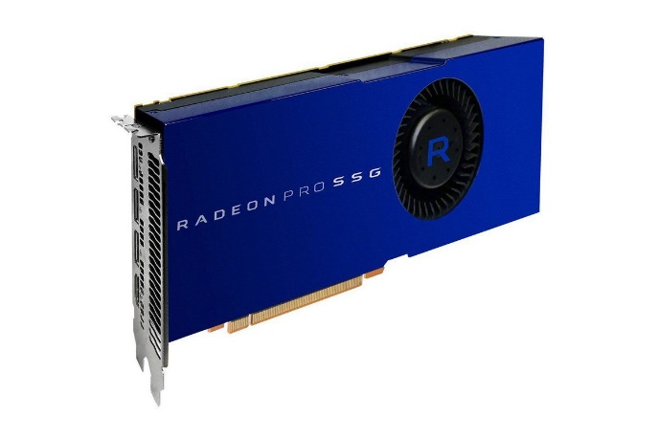
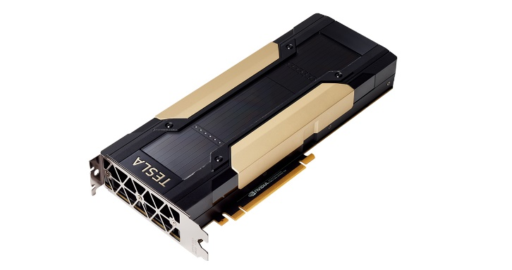
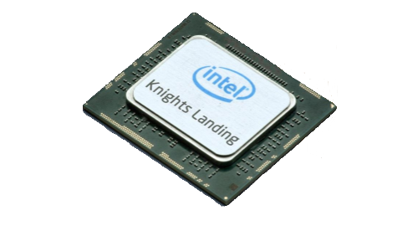
The King of the Accelerators
The undisputed champion of accelerators is:
the graphics processing unit.
https://www.amd.com/en/products/professional-graphics/radeon-pro-ssg
https://www.nvidia.com/en-us/data-center/tesla-v100/
https://www.xcelerit.com/computing-benchmarks/insights/benchmarks-intel-xeon-phi-knl-vs-broadwell-cpu/

Slide 25
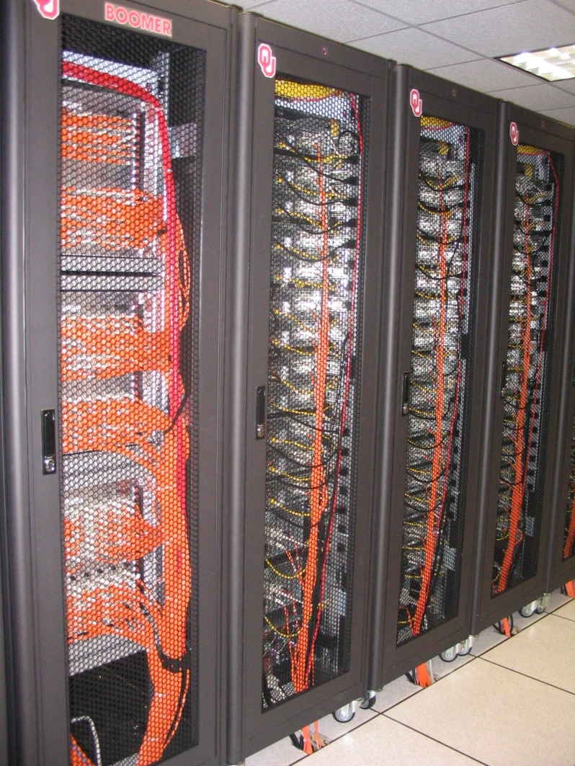
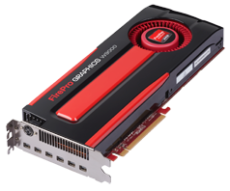
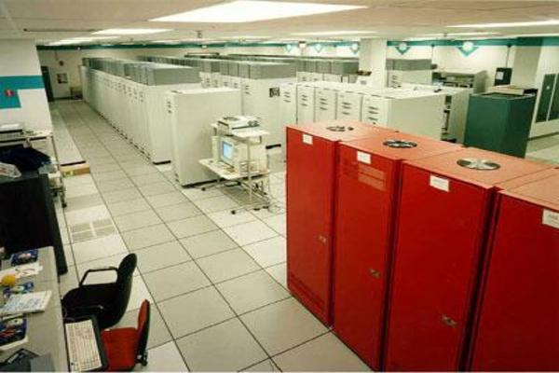
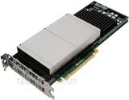
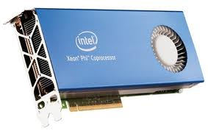
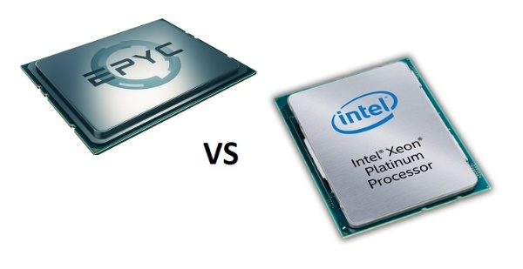
What does 1 TFLOPs Look Like?
2002: Row
2012: Card
1 TFLOPs: trillion calculations per second
1997: Room
AMD FirePro W9000^{[14]}
ASCI RED^{[13]}
Sandia National Lab
NVIDIA Kepler K20^{[15]}
AMD EPYC
CPU
Chip
2017
boomer.oscer.ou.edu
In service 2002-5: 11 racks
Intel Skylake
Intel MIC Xeon PHI^{[16]}
https://www.top500.org/static/media/uploads/.thumbnails/epyc-vs-xeon.jpg/epyc-vs-xeon-742x382.jpg

Slide 26
Why GPU?
Graphics Processing Units (GPUs) were originally designed to accelerate graphics tasks like image rendering.
They became very very popular with videogamers, because they’ve produced better and better images, and lightning fast.
And, prices have been extremely good, ranging from three figures at the low end to four figures at the high end.

Slide 27
GPUs are Popular
Chips are expensive to design (hundreds of millions of $$$), expensive to build the factory for (billions of $$$), but cheap to produce.
For example, in calendar year 2017, NVIDIA sold ~$5.7B of GPUs, which was ~80% of their total revenue.
https://marketrealist.com/2017/08/data-center-nvidias-key-growth-driver-fiscal-2018
This means that the GPU companies have been able to recoup the huge fixed costs.

Slide 28
GPUs Do Arithmetic
GPUs mostly do stuff like rendering images.
This is done through mostly floating point arithmetic – the same stuff people use supercomputing for!

Slide 29
GPU Programming

Slide 30
Hard to Program?
In the olden days – that is, until just the last ten years or so – programming GPUs meant either:
using a graphics standard like OpenGL (which is mostly meant for rendering), or
getting fairly deep into the graphics rendering pipeline.
To use a GPU to do general purpose number crunching, you had to make your number crunching pretend to be graphics.
This was hard. So most people didn’t bother.

Slide 31
Easy to Program?
More recently, GPU manufacturers have worked hard to make GPUs easier to use for general purpose computing.
This is known as General Purpose Graphics Processing Units (GPGPU).

Slide 32
Intel MIC
Also known as Xeon Phi.
Not a graphics card.
But, has similar structure to a graphics card, just without the graphics.
Based on x86: can use a lot of the same tools as CPU.
Current series: “Knights Landing” (model numbers 72xx)
Comes in chip form only (not card), for single socket server.
64 to 72 x86 cores, each with 512-bit vector widths (8-way double precision floating point vectors), 2 Fused Multiply-Add units per core, so up to 32 DP floating point calculations per core per cycle.
16 GB MCDRAM @ 400+ GB/sec.
Server can have up to 384 GB RAM @ 102.4 GB/sec.
Peak 2.6624 to 3.4560 TFLOPs per card.
https://en.wikipedia.org/wiki/Xeon_Phi

Slide 33
How to Program a GPU
Proprietary programming language or extensions
NVIDIA: CUDA (C/C++)
OpenCL (Open Computing Language): an industry standard for doing number crunching on GPUs.
OpenACC accelerator directives for NVIDIA and AMD
OpenMP version 4.x includes accelerator and vectorization directives (works well with Intel Xeon Phi).

Slide 34
NVIDIA CUDA
NVIDIA proprietary
Formerly known as “Compute Unified Device Architecture”
Extensions to C to allow better control of GPU capabilities
Modest extensions but major rewriting of the code
Portland Group Inc (PGI) has released a Fortran implementation of CUDA available in their Fortran compiler.
PGI is now part of NVIDIA.

Slide 35
CUDA Example Part 1
// example1.cpp : Defines the entry point for the console application.
//
#include "stdafx.h"
#include <stdio.h>
#include <cuda.h>
// Kernel that executes on the CUDA device
__global__ void square_array(float *a, int N)
{
int idx = blockIdx.x * blockDim.x + threadIdx.x;
if (idx<N) a[idx] = a[idx] * a[idx];
}
http://llpanorama.wordpress.com/2008/05/21/my-first-cuda-program/

Slide 36
CUDA Example Part 2
// main routine that executes on the host
int main(void)
{
float *a_h, *a_d; // Pointer to host & device arrays
const int N = 10; // Number of elements in arrays
size_t size = N * sizeof(float);
a_h = (float *)malloc(size); // Allocate array on host
cudaMalloc((void **) &a_d, size); // Allocate array on device
// Initialize host array and copy it to CUDA device
for (int i=0; i<N; i++) a_h[i] = (float)i;
cudaMemcpy(a_d, a_h, size, cudaMemcpyHostToDevice);
// Do calculation on device:
int block_size = 4;
int n_blocks = N/block_size + (N%block_size == 0 ? 0:1);
square_array <<< n_blocks, block_size >>> (a_d, N);
// Retrieve result from device and store it in host array
cudaMemcpy(a_h, a_d, sizeof(float)*N, cudaMemcpyDeviceToHost);
// Print results
for (int i=0; i<N; i++) printf("%d %f\n", i, a_h[i]);
// Cleanup
free(a_h); cudaFree(a_d);
}

Slide 37
OpenCL
Open Computing Language
Open standard developed by the Khronos Group, which is a consortium of many companies (including NVIDIA, AMD and Intel, but also lots of others)
https://www.khronos.org/opencl/
Initial version of OpenCL standard released in Dec 2008.
Many companies have created their own implementations.
Currently on version 2.2 (released May 12 2017).

Slide 38
OpenCL Example Part 1
// create a compute context with GPU device
context =
clCreateContextFromType(NULL, CL_DEVICE_TYPE_GPU, NULL, NULL, NULL);
// create a command queue
queue = clCreateCommandQueue(context, NULL, 0, NULL);
// allocate the buffer memory objects
memobjs[0] = clCreateBuffer(context,
CL_MEM_READ_ONLY | CL_MEM_COPY_HOST_PTR,
sizeof(float)*2*num_entries, srcA, NULL);
memobjs[1] = clCreateBuffer(context,
CL_MEM_READ_WRITE,
sizeof(float)*2*num_entries, NULL, NULL);
// create the compute program
program = clCreateProgramWithSource(context, 1, &fft1D_1024_kernel_src,
NULL, NULL);
http://en.wikipedia.org/wiki/OpenCL

Slide 39
OpenCL Example Part 2
// build the compute program executable
clBuildProgram(program, 0, NULL, NULL, NULL, NULL);
// create the compute kernel
kernel = clCreateKernel(program, "fft1D_1024", NULL);
// set the args values
clSetKernelArg(kernel, 0, sizeof(cl_mem), (void *)&memobjs[0]);
clSetKernelArg(kernel, 1, sizeof(cl_mem), (void *)&memobjs[1]);
clSetKernelArg(kernel, 2, sizeof(float)*(local_work_size[0]+1)*16, NULL);
clSetKernelArg(kernel, 3, sizeof(float)*(local_work_size[0]+1)*16, NULL);
// create N-D range object with work-item dimensions and execute kernel
global_work_size[0] = num_entries; local_work_size[0] = 64;
clEnqueueNDRangeKernel(queue, kernel, 1, NULL,
global_work_size, local_work_size, 0, NULL, NULL);

Slide 40
OpenCL Example Part 3
// This kernel computes FFT of length 1024. The 1024 length FFT is
// decomposed into calls to a radix 16 function, another radix 16
// function and then a radix 4 function
__kernel void fft1D_1024 (__global float2 *in, __global float2 *out,
__local float *sMemx, __local float *sMemy) {
int tid = get_local_id(0);
int blockIdx = get_group_id(0) * 1024 + tid;
float2 data[16];
// starting index of data to/from global memory
in = in + blockIdx;
out = out + blockIdx;
globalLoads(data, in, 64); // coalesced global reads
fftRadix16Pass(data); // in-place radix-16 pass
twiddleFactorMul(data, tid, 1024, 0);

Slide 41
OpenCL Example Part 4
// local shuffle using local memory
localShuffle(data, sMemx, sMemy, tid, (((tid & 15) * 65) + (tid >> 4)));
fftRadix16Pass(data); // in-place radix-16 pass
twiddleFactorMul(data, tid, 64, 4); // twiddle factor multiplication
localShuffle(data, sMemx, sMemy, tid, (((tid >> 4) * 64) + (tid & 15)));
// four radix-4 function calls
fftRadix4Pass(data); // radix-4 function number 1
fftRadix4Pass(data + 4); // radix-4 function number 2
fftRadix4Pass(data + 8); // radix-4 function number 3
fftRadix4Pass(data + 12); // radix-4 function number 4
// coalesced global writes
globalStores(data, out, 64);
}

Slide 42
OpenACC
Open standard for expressing accelerator parallelism.
Fortran and C.
Similar to OpenMP in structure: uses directives.
If the compiler doesn’t understand the directives, it ignores them, so the same code can work:
with accelerators or without accelerators;
with compilers that do understand OpenACC and with compilers that don’t understand OpenACC.
The OpenACC directives tell the compiler which parts of the code happen in the accelerator (and some details about how to run them in the accelerator).
The parts of the code that don’t have OpenACC directives happen in the regular server CPU/RAM hardware.

Slide 43
OpenACC Compiler Directives
Developed by NVIDIA, Cray, PGI, CAPS
Available in PGI compilers for general cluster user, and in Cray compilers for use on Crays.
Also some less commonly used and experimental compilers.
http://en.wikipedia.org/wiki/OpenACC

Slide 44
OpenACC Example Part 1 (C)
#include <stdio.h>
#include <stdlib.h>
void vecaddgpu( float *restrict r, float *a, float *b, int n )
{
#pragma acc kernels loop copyin(a[0:n],b[0:n]) copyout(r[0:n])
for( int i = 0; i < n; ++i )
r[i] = a[i] + b[i];
}
/* http://www.pgroup.com/doc/openacc_gs.pdf */

Slide 45
OpenACC Example Part 2 (C)
int main( int argc, char* argv[] ){
int n; /* vector length */
float * a; /* input vector 1 */
float * b; /* input vector 2 */
float * r; /* output vector */
float * e; /* expected output values */
int i, errs;
if( argc > 1 ) n = atoi( argv[1] );
else n = 100000; /* default vector length */
if( n <= 0 ) n = 100000;
a = (float*)malloc( n*sizeof(float) );
b = (float*)malloc( n*sizeof(float) );
r = (float*)malloc( n*sizeof(float) );
e = (float*)malloc( n*sizeof(float) );
for( i = 0; i < n; ++i ){
a[i] = (float)(i+1);
b[i] = (float)(1000*i);
}

Slide 46
OpenACC Example Part 3 (C)
/* compute on the GPU */
vecaddgpu( r, a, b, n );
/* compute on the host to compare */
for( i = 0; i < n; ++i ) e[i] = a[i] + b[i];
/* compare results */
errs = 0;
for( i = 0; i < n; ++i ){
if( r[i] != e[i] ){
++errs;
}
}
printf( "%d errors found\n", errs );
return errs;
}

Slide 47
OpenACC Example Part 1 (F90)
module vecaddmod
implicit none
contains
subroutine vecaddgpu( r, a, b, n )
real, dimension(:) :: r, a, b
integer :: n
integer :: i
!$acc kernels loop copyin(a(1:n),b(1:n)) copyout(r(1:n))
do i = 1, n
r(i) = a(i) + b(i)
enddo
end subroutine
end module
! http://www.pgroup.com/doc/openacc_gs.pdf

Slide 48
OpenACC Example Part 2 (F90)
program main
use vecaddmod
implicit none
integer :: n, i, errs, argcount
real, dimension(:), allocatable :: a, b, r, e
character*10 :: arg1
argcount = command_argument_count()
n = 1000000 ! default value
if( argcount = 1 )then
call get_command_argument( 1, arg1 )
read( arg1, '(i)' ) n
if( n <= 0 ) n = 100000
endif
allocate( a(n), b(n), r(n), e(n) )
do i = 1, n
a(i) = i
b(i) = 1000*i
enddo

Slide 49
OpenACC Example Part 3 (F90)
! compute on the GPU
call vecaddgpu( r, a, b, n )
! compute on the host to compare
do i = 1, n
e(i) = a(i) + b(i)
enddo
! compare results
errs = 0
do i = 1, n
if( r(i) /= e(i) )then
errs = errs + 1
endif
enddo
print *, errs, ' errors found'
if( errs ) call exit(errs)
end program

Slide 50
OpenMP 4.x Accelerator Directives
OpenMP’s 4.5 standard was released in 2015.
It has both accelerator directives and vectorization directives.
It’s the lingua franca of the Intel MIC accelerator.

Slide 51
OpenMP Accelerator Example (F90)
! snippet from the hand-coded subprogram...
!dir$ attributes offload:mic :: my_sgemm
subroutine my_sgemm(d,a,b)
real, dimension(:,:) :: a, b, d
!$omp parallel do
do j=1, n
do i=1, n
d(i,j) = 0.0
do k=1, n
d(i,j) = d(i,j)+a(i,k)*b(k,j)
enddo
enddo
enddo
end subroutine
http://www.cac.cornell.edu/education/training/ParallelFall2012/OpenMPNov2012.pdf

Slide 52
Digging Deeper: CUDA on NVIDIA

Slide 53
NVIDIA Tesla
NVIDIA offers a GPU platform named Tesla.
It consists essentially of their highest end graphics card, minus the video out connector.

Slide 54
NVIDIA Tesla V100 Card Specs
5120 GPU cores
1455 GHz turbo clock speed
Double precision (FP64) floating point performance: 117 TFLOPs (32 double precision flop per cycle per core)
Single precision (FP32) floating point performance: 114 TFLOPs (64 single precision flops per cycle per core)
Half precision (FP16) floating point performance: 112 TFLOPs (512 half precision flops per cycle per core)
Internal RAM: 16 GB, 900 GB/sec (vs ~200 GB/sec for regular RAM)
Has to be plugged into a PCIe slot (32 GB/sec per GPU card)
http://www.nvidia.com/content/PDF/Volta-Datasheet.pdf
https://en.wikipedia.org/wiki/Nvidia_Tesla

Slide 55
Compare Top x86 vs NVIDIA V100
Let’s compare the best dual socket x86 server today vs V100.
 | Dual socket, Intel 8180 28-core | NVIDIA Tesla V100 dual cards in an x86 server
Peak DP FLOPs | 3.0464 TFLOPs DP | 14 TFLOPs DP (4.6x)
Peak SP FLOPs | 6.0928 TFLOPs SP | 28 TFLOPs SP (4.6x)
Peak HP FLOPs | N/A | 224 TFLOPs HP
Peak RAM BW | ~200 GB/sec | ~1800 GB/sec (9x)
Peak PCIe BW | N/A | 32 GB/sec
Needs x86 server to be part of? | Is x86 server | Yes
Power/Heat | ~400 W | 2 × 250 W + ~400 W (~2.25x)
Code portable? | Yes | Yes (OpenACC, OpenCL)

Slide 56
Compare Top x86 vs NVIDIA V100
Here are some interesting measures:
 | Dual socket, Intel 8180 28-core | NVIDIA Tesla V100 dual cards in an x86 server
DP GFLOPs/Watt | ~7.6 GFLOPs/Watt | ~15.6 GFLOPs/Watt (~2x)
SP GFLOPS/Watt | ~15.2 GFLOPs/Watt | ~31.1 GFLOPs/Watt (~2x)
DP TFLOPs/sq ft | ~19.3 TFLOPs/sq ft | ~44.3 TFLOPs/sq ft (2.3x)
SP TFLOPs/sq ft | ~38.6 TFLOPs/sq ft | ~88.6 TFLOPs/sq ft (2.3x)
Racks per PFLOP DP | 9 racks/PFLOP DP | 4 racks/PFLOP DP (44%)
Racks per PFLOP SP | 5 racks/PFLOP SP | 2 racks/PFLOP SP (40%)

Slide 57
What Are the Downsides?
You have to rewrite your code into CUDA or OpenCL or PGI accelerator directives (or maybe OpenMP).
CUDA: Proprietary
OpenCL: portable but cumbersome
OpenACC, OpenMP 4.x: portable, but which to choose?

Slide 58
Programming for Performance
The biggest single performance bottleneck on GPU cards today is the PCIe slot:
PCI 3.0 x16: 16 GB/sec
2666 MHz current architectures: up to ~200 GB/sec per server
Accelerator card RAM: 900 GB/sec per card
Your goal:
At startup, move the data from x86 server RAM into accelerator RAM.
Do almost all the work inside the accelerator.
Use the x86 server only for I/O and message passing, to minimize the amount of data moved through the PCIe slot.
NOTE: This DOESN’T apply to current Intel MIC.

Slide 59
Machine Learning on Accelerators

Slide 61
What is Machine Learning?
Machine Learning is the part of Artificial Intelligence (AI) that involves a computer “learning” how to produce a good output, or action, given a set of inputs.
How do humans react when a basketball is heading toward us?
How about a truck?
How do we decide which gallon of milk to buy?
Or where to get the best haircut?
For Machine Learning to be appropriate, there must exist three conditions:
There must exist a large data set of inputs and outputs.
There must be some sort of pattern in the data set.
It must be difficult for humans to discern a mathematical pattern to the data.
If the above three conditions are not met, applying Machine Learning through structured inference learning is futile.

Slide 62
Machine Learning Components
Components of Machine Learning include:
Data for the Machine Learning algorithm
Output (or Decision)
Structured learning component, which is performed by the Machine Learning algorithm to understand the pattern of the Data input to produce Output (or Decision).
The expression that the Machine Learning formulates is called the Mapping Function.
The Mapping Function is used to learn the Target Function, which is the ultimate output of Machine Learning, and presumably is not a function that can be solved perfectly by mathematics.

Slide 63
What Does Machine Learning Give Us?
Machine Learning ultimately provides us an estimate of a predictive model that best generalizes to particular type of data.
The Data used to teach the model is critical. The larger and cleaner the dataset is, the better the estimate of a predictive model will be.
Because the requirements for effective use of Machine Learning, it is not an analysis methodology that is in any way universal.

Slide 64
Machine Learning and GPGPUs
Many Machine Learning algorithms do calculations on fast GPGPUs, using half-precision arithmetic.
Half Precision (less precise) arithmetic can be use because:
learning data sets should be (and are) large;
precision is not nearly as important as the data having a trend, or pattern;
a few inaccurate variables in the learning data should be overwhelmed by data that is accurate.
Using Half Precision data speeds up GPGPUs communications, and therefore the total processing time.
It’s not unusual to find many 4x4 matrix operations in ML code – so it’s easy to map ML code onto rendering hardware.

Slide 65
Why 4x4 matrices?
GPUs were designed to solve 4x4 matrices very fast and in parallel, to serve their original purpose of doing very fast 3D graphics.
Using 4x4 matrices, you can describe rotation, translation (moving things around) and scaling (making things bigger or smaller) at the same time, vital for calculating the “next color” of a pixel.
Programmers writing the linear algebra part of their ML system are rewarded with increased performance if they can translate it to as much 4x4 matrix algebra as possible.
The other parts of ML systems generally involve statistical and probability calculations, which are not nearly as quick on GPUs.

Slide 66
TENTATIVE Schedule
Tue Jan 23: Storage: What the Heck is Supercomputing?
Tue Jan 30: The Tyranny of the Storage Hierarchy Part I
Tue Feb 6: The Tyranny of the Storage Hierarchy Part II
Tue Feb 13: Instruction Level Parallelism
Tue Feb 20: Stupid Compiler Tricks
Tue Feb 27: Multicore Multithreading
Tue March 6: Distributed Multiprocessing
Tue March 13: NO SESSION (Henry business travel)
Tue March 20: NO SESSION (OU's Spring Break)
Tue March 27: Applications and Types of Parallelism
Tue Apr 3: Multicore Madness
Tue Apr 10: NO SESSION (Henry business travel)
Tue Apr 17: High Throughput Computing
Tue Apr 24: GPU: Number Crunching in Your Graphics Card
Tue May 1: Grab Bag: Scientific Libraries, I/O Libraries, Visualization

Slide 67
Thanks for helping!
OU IT
OSCER operations staff (Dave Akin, Patrick Calhoun, Kali McLennan, Jason Speckman, Brett Zimmerman)
OSCER Research Computing Facilitators (Jim Ferguson, Horst Severini)
Debi Gentis, OSCER Coordinator
Kyle Dudgeon, OSCER Manager of Operations
Ashish Pai, Managing Director for Research IT Services
The OU IT network team
OU CIO Eddie Huebsch
OneNet: Skyler Donahue
Oklahoma State U: Dana Brunson

Slide 68
This is an experiment!
It’s the nature of these kinds of videoconferences that FAILURES ARE GUARANTEED TO HAPPEN! NO PROMISES!
So, please bear with us. Hopefully everything will work out well enough.
If you lose your connection, you can retry the same kind of connection, or try connecting another way.
Remember, if all else fails, you always have the phone bridge to fall back on.
PLEASE MUTE YOURSELF.
PLEASE MUTE YOURSELF.
PLEASE MUTE YOURSELF.

Slide 69
Coming in 2018!
Linux Clusters Institute workshops http://www.linuxclustersinstitute.org/workshops/
Introductory HPC Cluster System Administration: May 14-18 2018 @ U Nebraska, Lincoln NE USA
Intermediate HPC Cluster System Administration: Aug 13-17 2018 @ Yale U, New Haven CT USA
Great Plains Network Annual Meeting: details coming soon
Advanced Cyberinfrastructure Research & Education Facilitators (ACI-REF) Virtual Residency Aug 5-10 2018, U Oklahoma, Norman OK USA
PEARC 2018, July 22-27, Pittsburgh PA USA
https://www.pearc18.pearc.org/
IEEE Cluster 2018, Sep 10-13, Belfast UK
https://cluster2018.github.io
OKLAHOMA SUPERCOMPUTING SYMPOSIUM 2018, Sep 25-26 2018 @ OU
SC18 supercomputing conference, Nov 11-16 2018, Dallas TX USA
http://sc18.supercomputing.org/

Slide 70
Thanks for your attention! Questions? www.oscer.ou.edu

Slide 71
Does CUDA Help?
http://www.nvidia.com/object/IO_43499.html

Slide 72
CUDA Thread Hierarchy and Memory Hierarchy
Some of these slides provided by Paul Gray, University of Northern Iowa

Slide 73
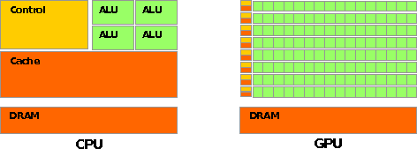
CPU vs GPU Layout
Source: NVIDIA CUDA Programming Guide

Slide 74
Buzzword: Kernel
In CUDA, a kernel is code (typically a function) that can be run inside the GPU.
Typically, the kernel code operates in lock-step on the stream processors inside the GPU.

Slide 75
Buzzword: Thread
In CUDA, a thread is an execution of a kernel with a given index.
Each thread uses its index to access a specific subset of the elements of a target array, such that the collection of all threads cooperatively processes the entire data set.
So these are very much like threads in the OpenMP or pthreads sense – they even have shared variables and private variables.

Slide 76
Buzzword: Block
In CUDA, a block is a group of threads.
Just like OpenMP threads, these could execute concurrently or independently, and in no particular order.
Threads can be coordinated somewhat, using the _syncthreads() function as a barrier, making all threads stop at a certain point in the kernel before moving on en mass. (This is like what happens at the end of an OpenMP loop.)

Slide 77
Buzzword: Grid
In CUDA, a grid is a group of (thread) blocks, with no synchronization at all among the blocks.

Slide 78
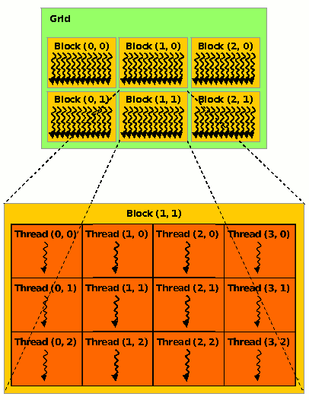
NVIDIA GPU Hierarchy
Grids map to GPUs
Blocks map to the MultiProcessors (MP)‏
Blocks are never split across MPs, but an MP can have multiple blocks
Threads map to Stream Processors (SP)‏
Warps are groups of (32) threads that execute simultaneously
Image Source:
NVIDIA CUDA Programming Guide

Slide 79
CUDA Built-in Variables
blockIdx.x, blockIdx.y, blockIdx.z are built-in variables that returns the block ID in the x-axis, y-axis and z-axis of the block that is executing the given block of code.
threadIdx.x, threadIdx.y, threadidx.z are built-in variables that return the thread ID in the x-axis, y-axis and z-axis of the thread that is being executed by this stream processor in this particular block.
So, you can express your collection of blocks, and your collection of threads within a block, as a 1D array, a 2D array or a 3D array.
These can be helpful when thinking of your data as 2D or 3D.

Slide 80
__global__ Keyword
In CUDA, if a function is declared with the __global__ keyword, that means that it’s intended to be executed inside a GPU.
In CUDA, the term for the GPU is device, and the term for the x86 server is host.
So, a kernel runs on a device, while the main function, and so on, run on the host.
Note that a host can play host to multiple devices; for example, an S2050 server contains 4 C2050 GPU cards, and if a single host has two PCIe slots, then both of the PCIe plugs of the S2050 can be plugged into that same host.

Slide 81
Copying Data from Host to Device
If data need to move from the host (where presumably the data are initially input or generated), then a copy has to exist in both places.
Typically, what’s copied are arrays, though of course you can also copy a scalar (the address of which is treated as an array of length 1).

Slide 82
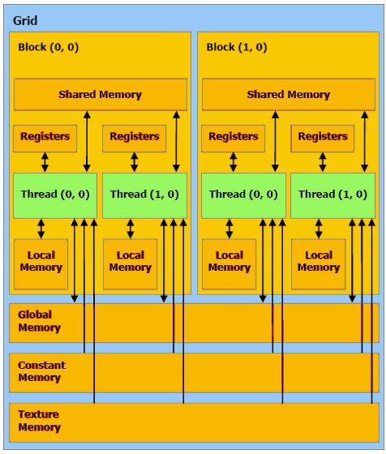
CUDA Memory Hierarchy #1
CUDA has a hierarchy of several kinds of memory:
Host memory (x86 server)
Device memory (GPU)
Global: visible to all threads in all blocks – largest, slowest
Shared: visible to all threads in a particular block – medium size, medium speed
Local: visible only to a particular thread – smallest, fastest

Slide 83
CUDA Memory Hierarchy #2
CUDA has a hierarchy of several kinds of memory:
Host memory (x86 server)
Device memory (GPU)
Constant: visible to all threads in all blocks; read only
Texture: visible to all threads in all blocks; read only

Slide 84
CUDA Example: Matrix-Matrix Multiply
http://developer.download.nvidia.com/compute/cuda/sdk/website/Linear_Algebra.html#matrixMul

Slide 85
Matrix-Matrix Multiply Main Part 1
float* host_A;
float* host_B;
float* host_B;
float* device_A;
float* device_B;
float* device_C;
host_A = (float*) malloc(mem_size_A);
host_B = (float*) malloc(mem_size_B);
host_C = (float*) malloc(mem_size_C);
cudaMalloc((void**) &device_A, mem_size_A);
cudaMalloc((void**) &device_B, mem_size_B);
cudamalloc((void**) &device_C, mem_size_C);
// Set up the initial values of A and B here.
// Henry says: I’ve oversimplified this a bit from
// the original example code.

Slide 86
Matrix-Matrix Multiply Main Part 2
// copy host memory to device
cudaMemcpy(device_A, host_A, mem_size_A,
cudaMemcpyHostToDevice);
cudaMemcpy(device_B, host_B, mem_size_B,
cudaMemcpyHostToDevice);
// setup execution parameters
dim3 threads(BLOCK_SIZE, BLOCK_SIZE);
dim3 grid(WC / threads.x, HC / threads.y);
// execute the kernel
matrixMul<<< grid, threads >>>(device_C,
device_A, device_B, WA, WB);
// copy result from device to host
cudaMemcpy(host_C, device_C, mem_size_C,
cudaMemcpyDeviceToHost);

Slide 87
Matrix Matrix Multiply Kernel Part 1
__global__ void matrixMul( float* C, float* A, float* B, int wA, int wB)
{
// Block index
int bx = blockIdx.x;
int by = blockIdx.y;
// Thread index
int tx = threadIdx.x;
int ty = threadIdx.y;
// Index of the first sub-matrix of A processed by the block
int aBegin = wA * BLOCK_SIZE * by;
// Index of the last sub-matrix of A processed by the block
int aEnd = aBegin + wA - 1;
// Step size used to iterate through the sub-matrices of A
int aStep = BLOCK_SIZE;
// Index of the first sub-matrix of B processed by the block
int bBegin = BLOCK_SIZE * bx;
// Step size used to iterate through the sub-matrices of B
int bStep = BLOCK_SIZE * wB;
// Csub is used to store the element of the block sub-matrix
// that is computed by the thread
float Csub = 0;

Slide 88
Matrix Matrix Multiply Kernel Part 2
// Loop over all the sub-matrices of A and B
// required to compute the block sub-matrix
for (int a = aBegin, b = bBegin;
a <= aEnd;
a += aStep, b += bStep) {
// Declaration of the shared memory array As used to
// store the sub-matrix of A
__shared__ float As[BLOCK_SIZE][BLOCK_SIZE];
// Declaration of the shared memory array Bs used to
// store the sub-matrix of B
__shared__ float Bs[BLOCK_SIZE][BLOCK_SIZE];
// Load the matrices from device memory
// to shared memory; each thread loads
// one element of each matrix
AS(ty, tx) = A[a + wA * ty + tx];
BS(ty, tx) = B[b + wB * ty + tx];
// Synchronize to make sure the matrices are loaded
__syncthreads();

Slide 89
Matrix Matrix Multiply Kernel Part 3
// Multiply the two matrices together;
// each thread computes one element
// of the block sub-matrix
for (int k = 0; k < BLOCK_SIZE; ++k)
Csub += AS(ty, k) * BS(k, tx);
// Synchronize to make sure that the preceding
// computation is done before loading two new
// sub-matrices of A and B in the next iteration
__syncthreads();
}
// Write the block sub-matrix to device memory;
// each thread writes one element
int c = wB * BLOCK_SIZE * by + BLOCK_SIZE * bx;
C[c + wB * ty + tx] = Csub;
}

Slide 90
Would We Really Do It This Way?
We wouldn’t really do matrix-matrix multiply this way.
NVIDIA has developed a CUDA implementation of the BLAS libraries, which include a highly tuned matrix-matrix multiply routine.
(We’ll learn about BLAS next time.)
There’s also a CUDA FFT library, if your code needs Fast Fourier Transforms.

Slide 91
Thanks for your attention! Questions? www.oscer.ou.edu

Slide 92
TENTATIVE Schedule
Tue Jan 23: Storage: What the Heck is Supercomputing?
Tue Jan 30: The Tyranny of the Storage Hierarchy Part I
Tue Feb 6: The Tyranny of the Storage Hierarchy Part II
Tue Feb 13: Instruction Level Parallelism
Tue Feb 20: Stupid Compiler Tricks
Tue Feb 27: Multicore Multithreading
Tue March 6: Distributed Multiprocessing
Tue March 13: NO SESSION (Henry business travel)
Tue March 20: NO SESSION (OU's Spring Break)
Tue March 27: Applications and Types of Parallelism
Tue Apr 3: Multicore Madness
Tue Apr 10: NO SESSION (Henry business travel)
Tue Apr 17: High Throughput Computing
Tue Apr 24: GPU: Number Crunching in Your Graphics Card
Tue May 1: Grab Bag: Scientific Libraries, I/O Libraries, Visualization

Slide 93
Thanks for helping!
OU IT
OSCER operations staff (Dave Akin, Patrick Calhoun, Kali McLennan, Jason Speckman, Brett Zimmerman)
OSCER Research Computing Facilitators (Jim Ferguson, Horst Severini)
Debi Gentis, OSCER Coordinator
Kyle Dudgeon, OSCER Manager of Operations
Ashish Pai, Managing Director for Research IT Services
The OU IT network team
OU CIO Eddie Huebsch
OneNet: Skyler Donahue
Oklahoma State U: Dana Brunson

Slide 94
This is an experiment!
It’s the nature of these kinds of videoconferences that FAILURES ARE GUARANTEED TO HAPPEN! NO PROMISES!
So, please bear with us. Hopefully everything will work out well enough.
If you lose your connection, you can retry the same kind of connection, or try connecting another way.
Remember, if all else fails, you always have the phone bridge to fall back on.
PLEASE MUTE YOURSELF.
PLEASE MUTE YOURSELF.
PLEASE MUTE YOURSELF.

Slide 95
Coming in 2018!
Linux Clusters Institute workshops http://www.linuxclustersinstitute.org/workshops/
Introductory HPC Cluster System Administration: May 14-18 2018 @ U Nebraska, Lincoln NE USA
Intermediate HPC Cluster System Administration: Aug 13-17 2018 @ Yale U, New Haven CT USA
Great Plains Network Annual Meeting: details coming soon
Advanced Cyberinfrastructure Research & Education Facilitators (ACI-REF) Virtual Residency Aug 5-10 2018, U Oklahoma, Norman OK USA
PEARC 2018, July 22-27, Pittsburgh PA USA
https://www.pearc18.pearc.org/
IEEE Cluster 2018, Sep 10-13, Belfast UK
https://cluster2018.github.io
OKLAHOMA SUPERCOMPUTING SYMPOSIUM 2018, Sep 25-26 2018 @ OU
SC18 supercomputing conference, Nov 11-16 2018, Dallas TX USA
http://sc18.supercomputing.org/

Slide 96
Thanks for your attention! Questions? www.oscer.ou.edu

