Slide 1
Debugging,
Profiling and Tuning
Prasad Maddumage
Sr. Research Scientist, HPC Consulting
Corning Inc.
2023 Virtual Residency, June 28

Slide 2
WARNING!
I am NOT an expert, just someone who volunteered to talk about this topic!
This is NOT a lecture!
Please interrupt me during the session when you have questions / comments
I assume you are somewhat familiar with programming under Linux
  Parallel programming experience preferred

Slide 3
Overview
Debugging
  Debugging using Compiler Flags
  Debugger Basics
  gdb
  Serial Debugging with gdb
  Parallel (MPI) Debugging
    Parallel Debugging with gdb
    Interactive Parallel Debugging with gdb
    Non-interactive Parallel Debugging with gdb
    Totalview and DDT
  CUDA Debugging with gdb
  Intel Inspector
  Language Specific Debuggers
Profiling and Tuning
  Profiling
    GNU Profiler - gprof
    TAU
    Intel Tools
    Profiling Python and R
  Tuning Applications
    Use Compiler Flags
    MAQAO
    Try Different Compilers
    Use Performance Optimized Libraries

Slide 4
Debugging
Detecting and removing of existing and potential errors (‘bugs’) in a software that can cause it to behave unexpectedly or crash. To prevent incorrect operation of a software
  Syntax errors, segmentation faults (invalid memory access), I/O errors, ...
Debugger : A tool that helps you debug (it doesn’t debug for you)
  CLI (Command Line Interface) based
    write/printf, gdb, valgrind (memory issues), …
    Effectively pinpoint problems, works with serial/parallel codes
    Need to remember commands, not user friendly
  GUI (Graphical User Interface) debuggers
    TotalView, DDT, Intel Inspector, ...
    Powerful and user friendly
  ChatGPT
Analyze 15%
Testing 35%
Design 20%
Coding 30%

Slide 5
Debugging
  Debugging using Compiler Flags
  Debugger Basics
  gdb
  Serial Debugging with gdb
  Parallel (MPI) Debugging
    Parallel Debugging with gdb
    Interactive Parallel Debugging with gdb
    Non-interactive Parallel Debugging with gdb
    Totalview and DDT
  CUDA Debugging with gdb
  Intel Inspector
  Language Specific Debuggers
Profiling and Tuning
  Profiling
    GNU Profiler - gprof
    TAU
    Intel Tools
    Profiling Python and R
  Tuning Applications
    Use Compiler Flags
    MAQAO
    Try Different Compilers
    Use Performance Optimized Libraries

Slide 6
Using Compiler Flags
Compilers can help debugging without a debugger
Almost all debuggers require the code to be compiled with -g flag
There are other compiler flags that can identify potential issues
  During compile time
  During runtime
May not be as reliable as using a debugger
  Vendor dependent
  Version dependent

Slide 7
Using Compiler Flags – Compile time
-Wall : (gnu, Intel - C/C++), -warn all (Intel - Fortran)
  Detect uninitialized variables
  Find unused parameters (variables, functions, labels, ...)
  Implicit function declaration in C /C++ (declare before use a function)
-Wextra : (gnu) enables extra warning flags in addition to -Wall
  -Wall -Wextra : detects unused but set variables
-Werror : (gnu) compilation stops at warnings
  Treat warnings as errors
-Wuninitialized : (gnu) Warn at compiling time if a variable is used without first being initialized
  -check-uninit , -check unint (Intel) Runtime checking of undefined variables

Slide 8
Using Compiler Flags – Runtime
-g : embed debug information to the binary (parts of the source itself)
-fcheck=bounds : (gfortran) check array indices are within the declared range
  -check bounds / -CB (Intel)
-fcheck=all : (gfortran) checks for invalid modification of loop iteration variables, memory allocation, bounds, etc

Slide 9
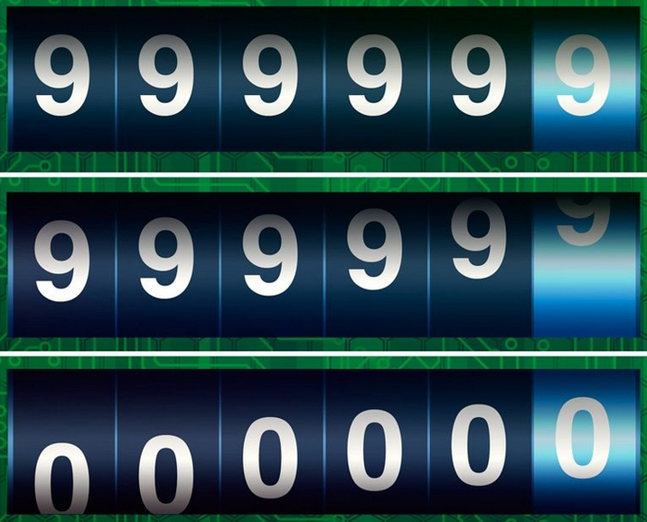
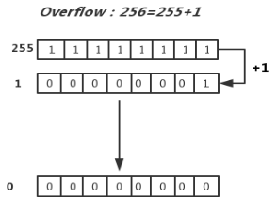

Using Compiler Flags – Runtime
-ftrapv : (gnu C/C++)detects integer overflow and abort the program
Odometer analogy
-ffpe-trap=invalid,zero,... : (gfortran, gcc by default) detects and aborts the program
  invalid: invalid floating point operation √-1
  zero: division by zero
  overflow: overflow in a floating point operation
  underflow: underflow in a floating point operation etc

Slide 10
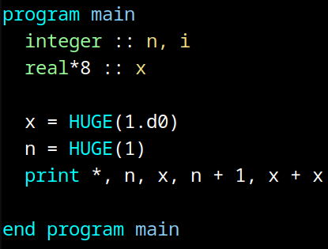
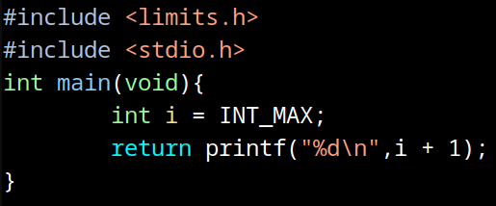
Using Compiler Flags
$ gfortran -o oflow oflow.f90
$ ./oflow
2147483647 1.7976931348623157E+308 -2147483648 Infinity
$ gfortran -ffpe-trap=overflow -o oflow oflow.f90
$ ./oflow
Program received signal SIGABRT: Process abort signal.
...
Aborted (core dumped)
$ gcc -o oflow_c oflow.c
$ ./oflow_c
-2147483648
$ gcc -ftrapv -o oflow_c oflow.c
$ ./oflow_c
Aborted (core dumped)

Slide 11
Debug support from MPI Compilers
Setting certain environment variables enable MPI to output information helpful for debugging applications during runtime
Open MPI
  mpi_param_check : If true, checks MPI function values for illegal values such as NULL
  mpi_abort_delay : If nonzero, prints hostname and process ID of the process invoked MPI_ABORT
MVAPICH2
  MV2_DEBUG_SHOW_BACKTRACE : Show backtrace when a process fails on errors like Segmentation fault, Bus error, Illegal Instruction, Abort etc
-g flag is not needed for these to work

Slide 12
Debugging
  Debugging using Compiler Flags
  Debugger Basics
  gdb
  Serial Debugging with gdb
  Parallel (MPI) Debugging
    Parallel Debugging with gdb
    Interactive Parallel Debugging with gdb
    Non-interactive Parallel Debugging with gdb
    Totalview and DDT
  CUDA Debugging with gdb
  Intel Inspector
  Language Specific Debuggers
Profiling and Tuning
  Profiling
    GNU Profiler - gprof
    TAU
    Intel Tools
    Profiling Python and R
  Tuning Applications
    Use Compiler Flags
    MAQAO
    Try Different Compilers
    Use Performance Optimized Libraries

Slide 13
Debugger Basics
Debugger: Program that helps you run a software in a controlled way to help you find and fix bugs
Breakpoint: Pauses execution of processes
  Unconditional: always pause
  Conditional: pauses only if a condition is satisfied
  Evaluation: pause and execute a code fragment when reached
Watchpoint: monitors a variable and pauses execution when its value changes
Backtrace: List of function calls currently active in a process
Frame: (stack frame) Contains arguments given to a function, its local variables, and the address at which the function is executing
  There is always one or more frame(s) associated with a running program

Slide 14
Debugging
  Debugging using Compiler Flags
  Debugger Basics
  gdb
  Serial Debugging with gdb
  Parallel (MPI) Debugging
    Parallel Debugging with gdb
    Interactive Parallel Debugging with gdb
    Non-interactive Parallel Debugging with gdb
    Totalview and DDT
  CUDA Debugging with gdb
  Intel Inspector
  Language Specific Debuggers
Profiling and Tuning
  Profiling
    GNU Profiler - gprof
    TAU
    Intel Tools
    Profiling Python and R
  Tuning Applications
    Use Compiler Flags
    MAQAO
    Try Different Compilers
    Use Performance Optimized Libraries

Slide 15
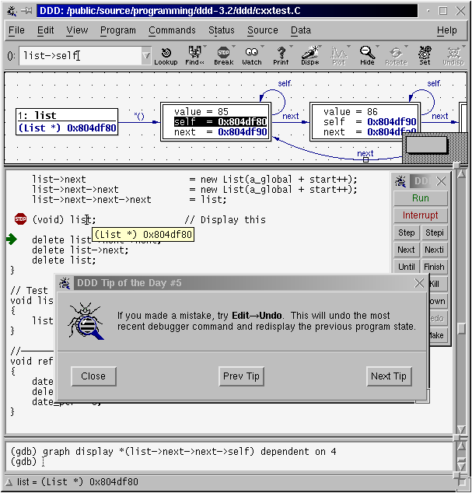
gdb
gdb is the GNU project debugger
Supports C, C++, Fortran, Assembly, Go, OpenCL, etc
Capabilities
  Start a program
  Make a program stop on specified conditions
  Examine the program once its stopped
  Change variable values of a program while its running to examine the effect (on bugs)
Terminal based (text only) debugger
  The GUI front end of gdb is DDD (Data Display Debugger)
  Latest version of DDD was released on 05/10/2023. However, the previous release was in 2009!
    Not worked as intended in most new systems until last month

Slide 16
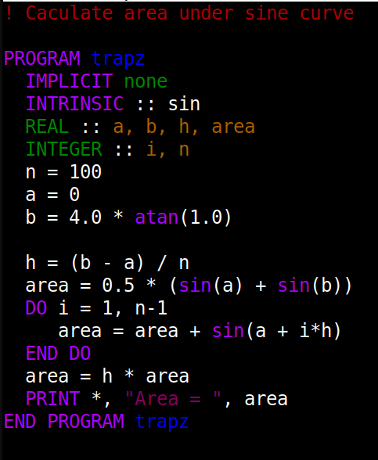
Serial debugging with gdb
$ gfortran trap.f90 -g -o trap
$ gdb trap
Breakpoint 2, trapz () at trap.f90:15
15 area = area + sin(a + i*h)
(gdb) p area
$4 = -4.37113883e-08
(gdb) continue
Continuing.
Breakpoint 2, trapz () at trap.f90:15
15 area = area + sin(a + i*h)
(gdb) p area
$5 = 0.0314107165
(gdb) clear
Deleted breakpoint 2
(gdb) c
Continuing.
Area = 1.99983561
[Inferior 1 (process 13270) exited normally]
(gdb) q
(gdb) break 13
Breakpoint 1 at 0x11de: file trap.f90, line 13.
(gdb) break 15
Breakpoint 2 at 0x1234: file trap.f90, line 15.
(gdb) run
13 area = 0.5 * (sin(a) + sin(b))
(gdb) print a
$1 = 0
(gdb) p area
$2 = -209808
(gdb) next
14 DO i = 1, n-1
(gdb) p area
$3 = -4.37113883e-08
(gdb) continue
Continuing.
1
2
3
4
5
6
7
8
9
10
11
12
13
14
15
16
17
18
19

Slide 17
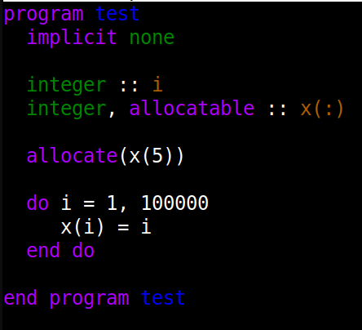
Serial debugging with gdb
(gdb) run
Starting program:
Program received signal SIGSEGV, Segmentation fault.
0x00005555555552bc in test () at test.f90:10
10 x(i) = i
(gdb) backtrace
#0 0x00005555555552bc in test () at test.f90:10
(gdb) frame 0
#0 0x00005555555552bc in test () at test.f90:10
10 x(i) = i
(gdb) print i
$1 = 30141
(gdb) print x
$2 = (1, 2, 3, 4, 5)

Slide 18
Useful gdb Commands
break location / thread thread# / if condition
clear function/breakpoint … : Remove all or selected breakpoints
step count : Pause the program after executing a count number of source line(s). Stops at each line of any functions called within a line
next count : Same as step but does not stop when inside a function
skip function / file : Prevent gdb from running a function or source file

Slide 19
Useful gdb Commands
reverse-step : Run the program backward until it reaches the start of a different source line
list : Print lines (at line #, function, before/after last line, …)
set var variable=value : Change a variable value during the debugging session
info locals : Display the local variable values in the current frame

Slide 20
Core Dump Analysis
A core dump is a file containing part of the application’s memory when the process terminates unexpectedly
  Core dumps may be produced on-demand (eg: by a debugger) or automatically upon termination (crash)
A core file can be opened and examined using gdb
  OR
  Use bt / frame / list / info locals / print etc to pin point the cause
gcore can create a manual core dump of any process
$ gdb program_name
(gdb) core core_dump_name
$ gdb -e program_name -c core_dump_name
$ gcore -o core_file_name process_id

Slide 21
$ gdb oflow /var/lib/apport/coredump/core._oflow.1000.b92dc8f9-2041-46b6-a112-455c25153497.53671.5260506
GNU gdb (Ubuntu 13.1-2ubuntu2) 13.1
...
Enable debuginfod for this session? (y or [n]) n
Debuginfod has been disabled.
...
Core was generated by `./oflow'.
Program terminated with signal SIGABRT, Aborted.
#0 __pthread_kill_implementation (no_tid=0, signo=6, threadid=<optimized out>) at ./nptl/pthread_kill.c:44
…
(gdb) bt
#0 __pthread_kill_implementation (no_tid=0, signo=6, threadid=<optimized out>) at ./nptl/pthread_kill.c:44
#1 __pthread_kill_internal (signo=6, threadid=<optimized out>) at ./nptl/pthread_kill.c:78
...
#5 0x000055b66343c1e1 in __addvsi3 ()
#6 0x000055b66343c189 in main () at oflow.c:5
(gdb) frame 6
#6 0x000055b66343c189 in main () at oflow.c:5
5 return printf("%d\n",i + 1);
(gdb) q

Slide 22
Debugging
  Debugging using Compiler Flags
  Debugger Basics
  gdb
  Serial Debugging with gdb
  Parallel (MPI) Debugging
    Parallel Debugging with gdb
    Interactive Parallel Debugging with gdb
    Non-interactive Parallel Debugging with gdb
    Totalview and DDT
  CUDA Debugging with gdb
  Intel Inspector
  Language Specific Debuggers
Profiling and Tuning
  Profiling
    GNU Profiler - gprof
    TAU
    Intel Tools
    Profiling Python and R
  Tuning Applications
    Use Compiler Flags
    MAQAO
    Try Different Compilers
    Use Performance Optimized Libraries

Slide 23
Parallel (MPI) Debugging
High Performance Computing (HPC) involves using more than a single node to solve a problem
  A common way to do this is using MPI (Message Passing Interface)
  MPI programs often need to be debugged in a cluster environment
Using gdb
  Attach gdb to each process of an already running job
  Interactive job with all or some ranks run under gdb (interactive debugging)
  Submit a batch job so that all or some ranks run under gdb (non-interactive)
TotalView and DDT
  GUI debuggers are user friendly and offer convenience
  Expensive!

Slide 24
Parallel Debugging with gdb
Attach to already running job
  OR
  Need to login (ssh) to the compute node and find the process id first
    Use top (-u to display processes for a given user)
  After attaching, any gdb command can be used
  Interactive debugging
  Can only debug one (misbehaving) process at a time
gdbserver is used to remotely debug applications
  Command line interface (CLI) only, no GUI
  This is left as an advanced topic
$ gdb program_name
$ gdb> attach process_id
$ gdb program_name process_id

Slide 25
Interactive Parallel Debugging with gdb
Requires X11 forwarding support from scheduler
  If set up, use --x11 flag with SLURM or -X with PBS when making a reservation
$ salloc -n 2 --x11
$ export MPIGDB="xterm -e gdb –args"
$ mpirun $MPIGDB mpi_trap

Slide 26
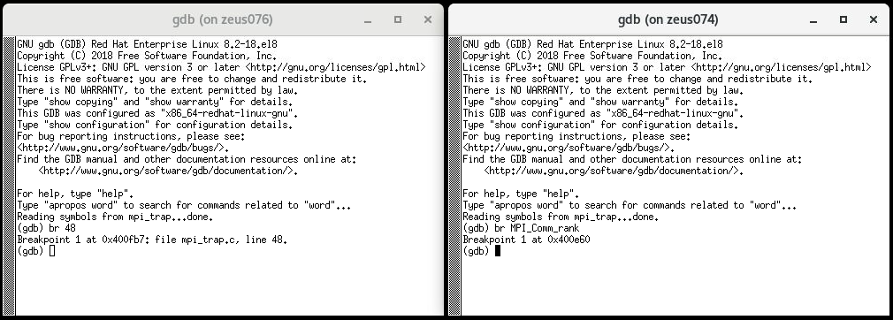
Interactive parallel debugging with gdb
(on node076)
(on node074)

Slide 27
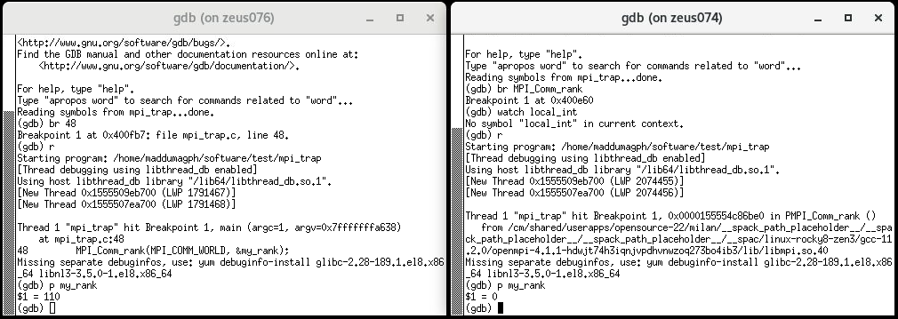
Interactive parallel debugging with gdb
(on node076)
(on node074)

Slide 28
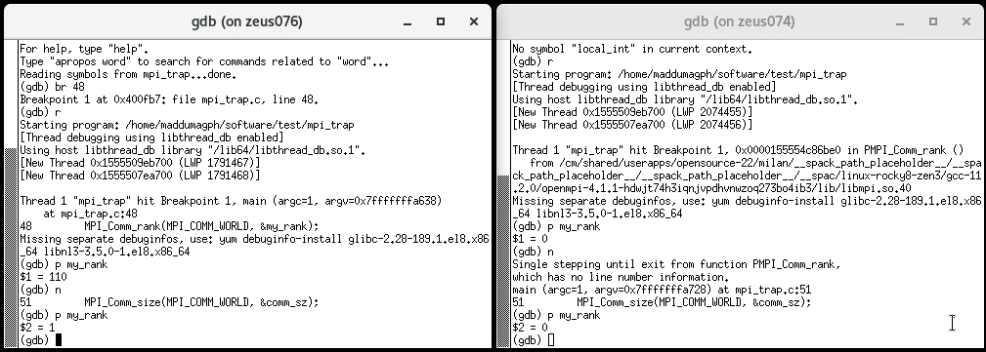
Interactive parallel debugging with gdb
(on node076)
(on node074)

Slide 29
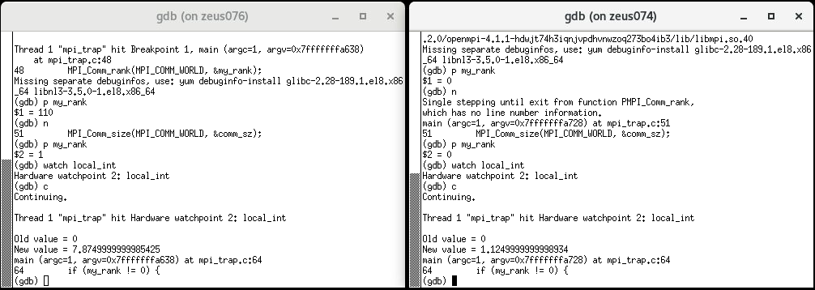
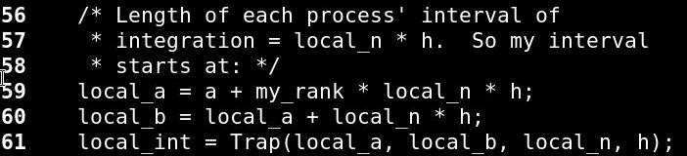
Interactive parallel debugging with gdb
(on node076)
(on node074)

Slide 30
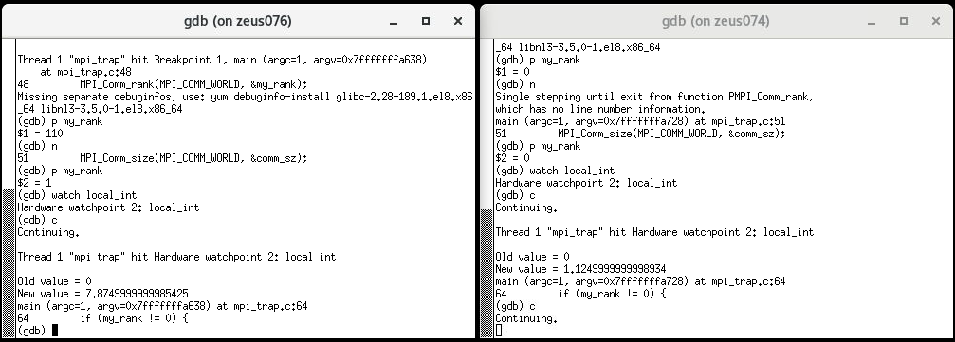
Interactive parallel debugging with gdb
(on node076)
(on node074)

Slide 31
Debugging
  Debugging using Compiler Flags
  Debugger Basics
  gdb
  Serial Debugging with gdb
  Parallel (MPI) Debugging
    Parallel Debugging with gdb
    Interactive Parallel Debugging with gdb
    Non-interactive Parallel Debugging with gdb
    Totalview and DDT
  CUDA Debugging with gdb
  Intel Inspector
  Language Specific Debuggers
Profiling and Tuning
  Profiling
    GNU Profiler - gprof
    TAU
    Intel Tools
    Profiling Python and R
  Tuning Applications
    Use Compiler Flags
    MAQAO
    Try Different Compilers
    Use Performance Optimized Libraries

Slide 32
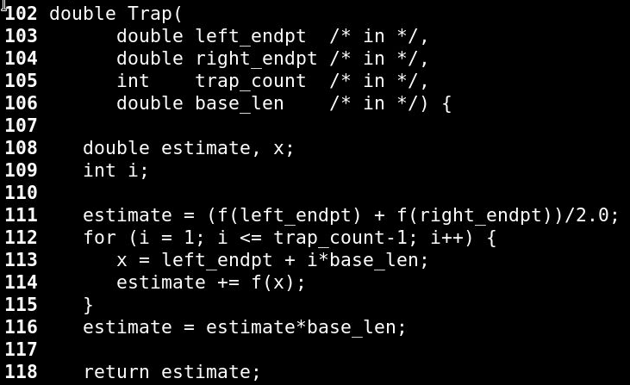
Non-interactive Parallel Debugging with gdb
No special scheduler setup is necessary
Need to wait until end of the run to find results
mpirun -np 4 gdb --batch -q -x commands.txt mpi_trap
break Trap
run
print my_rank
info locals
continue

Slide 33
Non-interactive Parallel Debugging with gdb
Breakpoint 1 at 0x40116b: file mpi_trap.c, line 111.
Breakpoint 1 at 0x40116b: file mpi_trap.c, line 111.
Breakpoint 1 at 0x40116b: file mpi_trap.c, line 111.
Breakpoint 1 at 0x40116b: file mpi_trap.c, line 111.
…
Thread 1 "mpi_trap" hit Breakpoint 1, Trap (left_endpt=0.74999999999999989, right_endpt=1.4999999999999998, trap_count=25000000, base_len=2.9999999999999997e-08) at mpi_trap.c:111
Thread 1 "mpi_trap" hit Breakpoint 1, Trap (left_endpt=2.25, right_endpt=3, trap_count=25000000, base_len=2.9999999999999997e-08) at mpi_trap.c:111
…
111 estimate = (f(left_endpt) + f(right_endpt))/2.0;
111 estimate = (f(left_endpt) + f(right_endpt))/2.0;
…
$1 = 2
estimate = 0
x = 2.0740954862918865e-317
i = 0
$1 = 3
estimate = 0
x = 2.0740954862918865e-317
i = 0
…
break Trap
run
print my_rank
info locals
continue

Slide 34
Debugging
  Debugging using Compiler Flags
  Debugger Basics
  gdb
  Serial Debugging with gdb
  Parallel (MPI) Debugging
    Parallel Debugging with gdb
    Interactive Parallel Debugging with gdb
    Non-interactive Parallel Debugging with gdb
    Totalview and DDT
  CUDA Debugging with gdb
  Intel Inspector
  Language Specific Debuggers
Profiling and Tuning
  Profiling
    GNU Profiler - gprof
    TAU
    Intel Tools
    Profiling Python and R
  Tuning Applications
    Use Compiler Flags
    MAQAO
    Try Different Compilers
    Use Performance Optimized Libraries

Slide 35
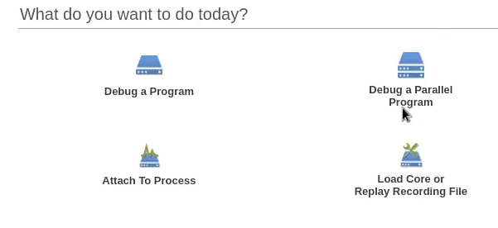
Totalview
Debugging and analyzing serial and parallel programs
Both a GUI and command line interface
Memory debugging features
Graphical visualization of array data
Comprehensive built-in help system
Recording and replaying running programs
Sessions Manager for managing and loading debugging sessions
$ totalview -args mpirun -np number_of_processes program_name

Slide 36
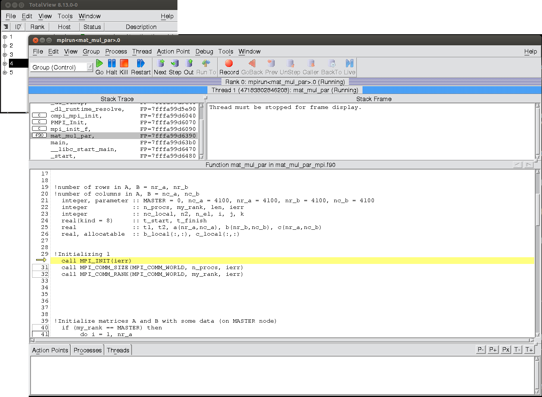
TotalView
Process barrier: point to synchronize all processes or threads
Able to check variable values in different ranks without logging in to that rank
Batch (non-interactive) debugging using tvscript
Debugging on a remote host
    Connect to TotalView server running on a remote system
CUDA debugger
Reverse debugging
    ReplayEngine records all program’s activities to be reviewed later
Stacktrace
Breakpoint

Slide 37
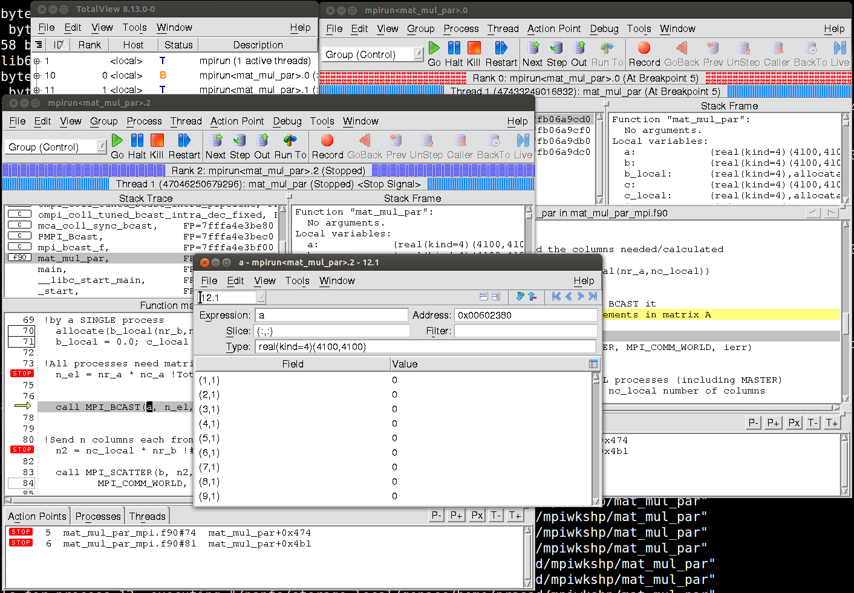
TotalView
What’s happening on each rank
Visualize multidimensional arrays

Slide 38
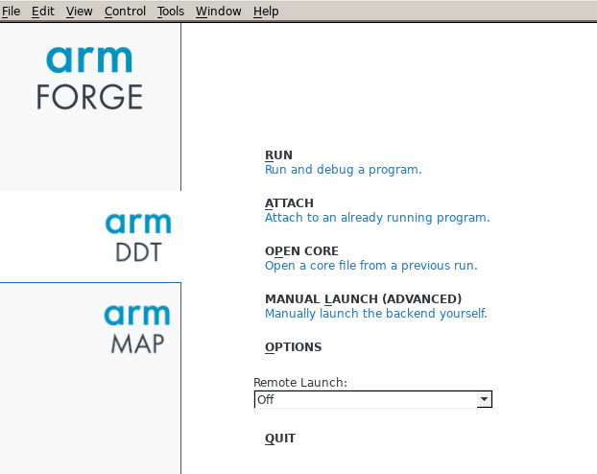
DDT
CLI and GUI support
Interactive and batch debugging
Attach to an already running program
Open core dump files
Memory debugging
Remote debugging
CUDA debugging
Python debugging

Slide 39
Debugging
  Debugging using Compiler Flags
  Debugger Basics
  gdb
  Serial Debugging with gdb
  Parallel (MPI) Debugging
    Parallel Debugging with gdb
    Interactive Parallel Debugging with gdb
    Non-interactive Parallel Debugging with gdb
    Totalview and DDT
  CUDA Debugging with gdb
  Intel Inspector
  Language Specific Debuggers
Profiling and Tuning
  Profiling
    GNU Profiler - gprof
    TAU
    Intel Tools
    Profiling Python and R
  Tuning Applications
    Use Compiler Flags
    MAQAO
    Try Different Compilers
    Use Performance Optimized Libraries

Slide 40
CUDA Debugging with gdb
CUDA-GDB
  NVIDIA tool for debugging CUDA applications on Linux
  Can debug both GPU and CPU code simultaneously
  CUDA commands in addition to gdb commands
  MPI is supported
  Breakpoints supported on GPU and both breakpoints and watchpoints on CPU
    Breakpoints can be set by symbolically (function name), line number, memory address, conditional, and kernel entry
  Can switch between threads and inspect program execution
  Stepping works by advancing all active threads in the warp of focus
  Remote debugging is possible
  GPU core dump is supported
$ nvcc -g -G foo.cu -o foo
$ pgfortran -g -Mcuda=nordc foo.cuf -o foo

Slide 41
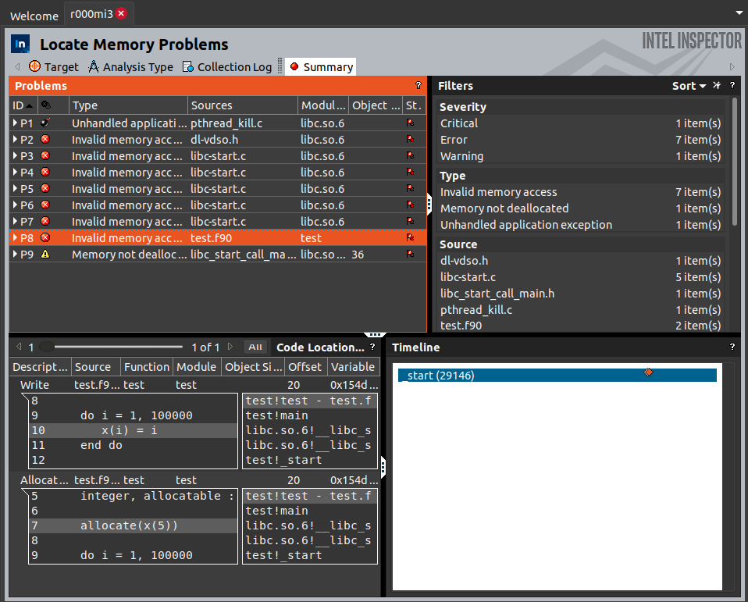
Intel Inspector
Detect memory leaks
  Locate memory problems
Locate deadlocks and data races
GUI (inspxe-gui) and cli (inspxe-cl) versions
Works with serial and mpi applications
CLI version results can be visualized with GUI later
NOT a complete debugger
Free!
srun -n8 inspxe-cl -collect mi3
-r my_results my_mpi_app

Slide 42
Debugging
  Debugging using Compiler Flags
  Debugger Basics
  gdb
  Serial Debugging with gdb
  Parallel (MPI) Debugging
    Parallel Debugging with gdb
    Interactive Parallel Debugging with gdb
    Non-interactive Parallel Debugging with gdb
    Totalview and DDT
  CUDA Debugging with gdb
  Intel Inspector
  Language Specific Debuggers
Profiling and Tuning
  Profiling
    GNU Profiler - gprof
    TAU
    Intel Tools
    Profiling Python and R
  Tuning Applications
    Use Compiler Flags
    MAQAO
    Try Different Compilers
    Use Performance Optimized Libraries

Slide 43
Language Specific Debuggers
Python: pdb
  Interactive debugging: use python -m pdb source.py
  Batch/ interactive debugging: use breakpoint() or pdb.set_trace()in source code or python prompt
    Need to import pdb for pdb.set_trace()
  Interactive source debugger
  Supports breakpoints and single stepping at the source line level
  Inspection of stack frames, source code listing
R
  In RStudio
    Set breakpoints in RStudio or put browser() at the line you want to break
    This causes R to enter the debug mode
      Can check current variable stack, traceback the execution, and more

Slide 44
Python Debugging
$ python3 -m pdb convert.py
> /home/prasad/Downloads/convert.py(1)<module>()
-> temp = input("Temperature : (e.g., 45F): ")
(Pdb) n
Temperature : (e.g., 45F): 75F
> /home/prasad/Downloads/convert.py(2)<module>()
-> degree = int(temp[:-1])
(Pdb) p degree
*** NameError: name 'degree' is not defined
(Pdb) n
> /home/prasad/Downloads/convert.py(3)<module>()
-> i_convention = temp[-1]
(Pdb) p degree
75
(Pdb) b 10
Breakpoint 1 at /home/prasad/Downloads/convert.py:10
(Pdb) l
3 i_convention = temp[-1]
4
5 if i_convention.upper() == "C":
6 result = int(round((9 * degree) / 5 + 32))
7 o_convention = "Fahrenheit"
8 -> elif i_convention.upper() == "F":
9 result = int(round((degree - 32) * 5 / 9))
10 B o_convention = "Celsius"
11 else:
12 print("Input proper convention.")
13 quit()
temp = input("Temperature : (e.g., 45F): "
degree = int(temp[:-1])
i_convention = temp[-1]
if i_convention.upper() == "C":
result = int(round((9 * degree) / 5 + 32))
o_convention = "Fahrenheit"
elif i_convention.upper() == "F":
result = int(round((degree - 32) * 5 / 9))
o_convention = "Celsius"
else:
print("Input proper convention.")
quit()
print("Temperature in ", o_convention, " is ", result)
r(eturn) | Continue until current function return
c(ontinue) | Continue until next breakpoint
j(ump) line_no | Next line to be executed (useful for breaking out of loops)
w(here) | Print the current position and stack trace
a(rgs) | Print args of the current function
q(uit) | Quit pdb

Slide 45
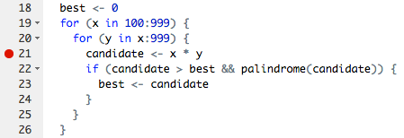
R debugging
RStudio breakpoint
Click left of line number
OR
Press Shift+F9 at the line
Variable values, stacktrace, etc are accessible through Rstudio once program pauses
g <- function(b) {
if (b < 0) {
browser()
}
h(b)
}
g <- function(b) {
browser()
h(b)
}
> rescale <-function(x) {
+ rng <- range(x)
+ browser()
+ (x - rng[1]) / (rng[2] - rng[1])
}
> rescale(c(0,5,10))
Called from: rescale(c(0, 5, 10))
Browse[1]> rng
[1] 0 10
Browse[1]> x
[1] 0 5 10
Browse[1]> s
debug at #4: (x - rng[1])/(rng[2] - rng[1])
Browse[2]> c
[1] 0.0 0.5 1.0
breakpoint
conditional breakpoint
where | Print stack trace of all active function calls
c(ont) | Exit browser, execute the next statement
f | Finish execution of current loop or function
n | Evaluate next line, step over any function calls
s | Evaluate next line, step into any function calls
Q | Exit browser and current evaluation and return to the top-level prompt

Slide 46
Debugging
  Debugging using Compiler Flags
  Debugger Basics
  gdb
  Serial Debugging with gdb
  Parallel (MPI) Debugging
    Parallel Debugging with gdb
    Interactive Parallel Debugging with gdb
    Non-interactive Parallel Debugging with gdb
    Totalview and DDT
  CUDA Debugging with gdb
  Intel Inspector
  Language Specific Debuggers
Profiling and Tuning
  Profiling
    GNU Profiler - gprof
    TAU
    Intel Tools
    Profiling Python and R
  Tuning Applications
    Use Compiler Flags
    MAQAO
    Try Different Compilers
    Use Performance Optimized Libraries

Slide 47
Profiling and Tuning
HPC emphasizes on performance of software
  Being bug-free is not enough
  Should be able to get maximum performance from the hardware
Software can be tuned to increase efficiency
  Different compilers, compiler flags (-O2, -O3 etc)
  Better algorithms
  Using optimized libraries
Profiling helps find which part(s) a program should be tuned
  Software profiling: Dynamic code analysis where a program's behavior is investigated using the data collected during program execution
    CPU/memory utilization, frequency of function calls, I/O, MPI library usage, hardware counters, etc.
  Identify bottlenecks
Profilers
  gprof, TAU (Tuning and Analysis Utilities), Intel tools

Slide 48
Debugging
  Debugging using Compiler Flags
  Debugger Basics
  gdb
  Serial Debugging with gdb
  Parallel (MPI) Debugging
    Parallel Debugging with gdb
    Interactive Parallel Debugging with gdb
    Non-interactive Parallel Debugging with gdb
    Totalview and DDT
  CUDA Debugging with gdb
  Intel Inspector
  Language Specific Debuggers
Profiling and Tuning
  Profiling
    GNU Profiler - gprof
    TAU
    Intel Tools
    Profiling Python and R
  Tuning Applications
    Use Compiler Flags
    MAQAO
    Try Different Compilers
    Use Performance Optimized Libraries

Slide 49
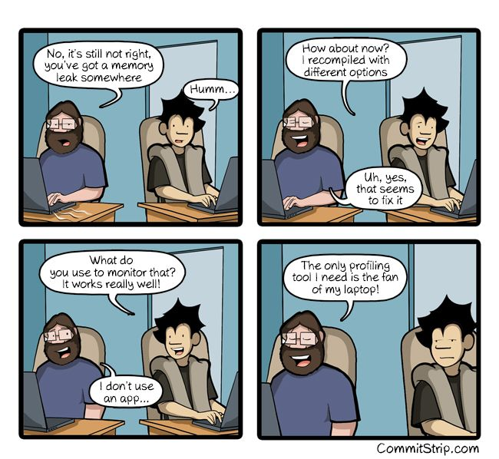

Slide 50
GNU Profiler - gprof
Terminal based profiler
Already exist in most linux distributions
Produces flat profile and a call graph
  Flat profile: A breakdown of time spent on each function call
  Call graph: In what order each subroutine / function was called
Can profile serial as well as parallel applications
$ export GMON_OUT_PREFIX='gmon.out-'
$ mpicc thermal_mpi.f -pg -o thermal_mpi
$ mpirun thermal_mpi
$ gprof -s thermal_mpi gmon.out-*
$ gfortran thermal.f -pg -o thermal
$ ./thermal
$ gprof thermal
Flat profile:
Each sample counts as 0.01 seconds.
% cumulative self self total
time seconds seconds calls s/call s/call name
44.10 9.04 9.04 86150709 0.00 0.00 energy_
34.08 16.04 6.99 13893157 0.00 0.00 update_
19.75 20.09 4.05 771898 0.00 0.00 sumit_
Call graph (explanation follows)
granularity: each sample hit covers 4 byte(s) for 0.05% of 20.51 seconds
Index % time self children called name
0.03 20.45 1/1 main [2]
[1] 99.9 0.03 20.45 1 MAIN__ [1]
0.13 20.08 771780/771780 move_ [3]
0.16 0.00 771897/771897 locate_ [7]

Slide 51

TAU (Tuning and Analysis Utilities)
Integrated performance toolkit
  Instrumentation, measurement, analysis, visualization
  Performance data management and data mining
  20+ year project actively developed by Univ. of Oregon, LANL, Julich
Open source and FREE
Works with or without recompiling code
  Dynamic instrumentation (without recompile) provides limited information
Uses PAPI to measure hardware counters (cache, FLOPS, ...)
Serial, parallel, GPU profiling capability
Works with Fortran, C, C++, UPC, Java, Python
Low performance overhead (can be compensated runtime)
Complicated and steep learning curve

Slide 52
TAU
Instrumentation
  Source code instrumentation using pre-processors and compiler scripts
    Instrumentation: Adding code to collect performance, behavior, and resource usage of a program (manually or automatically)
  Wrapping external libraries (I/O, MPI, Memory, CUDA, OpenCL, pthread, ...)
  Rewriting the binary
Measurement
  Direct: interval events, Indirect: collect samples to profile statement execution
  Per-process storage of performance data
    TAU creates one profile file per process in a single location
    Profile file names look like, profile.0.0.0, profile.1.0.0, ...
  Throttling and runtime control of low-level events
Analysis
  2D and 3D visualization of profile data using pprof and paraprof
  Trace conversion & display in external visualizers such as Jumpshot

Slide 53
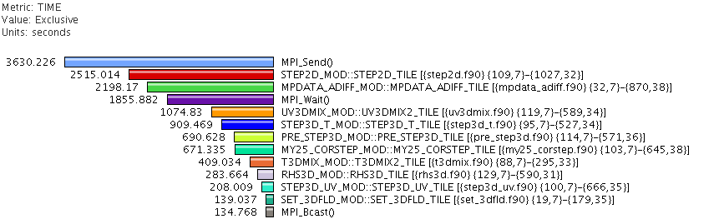
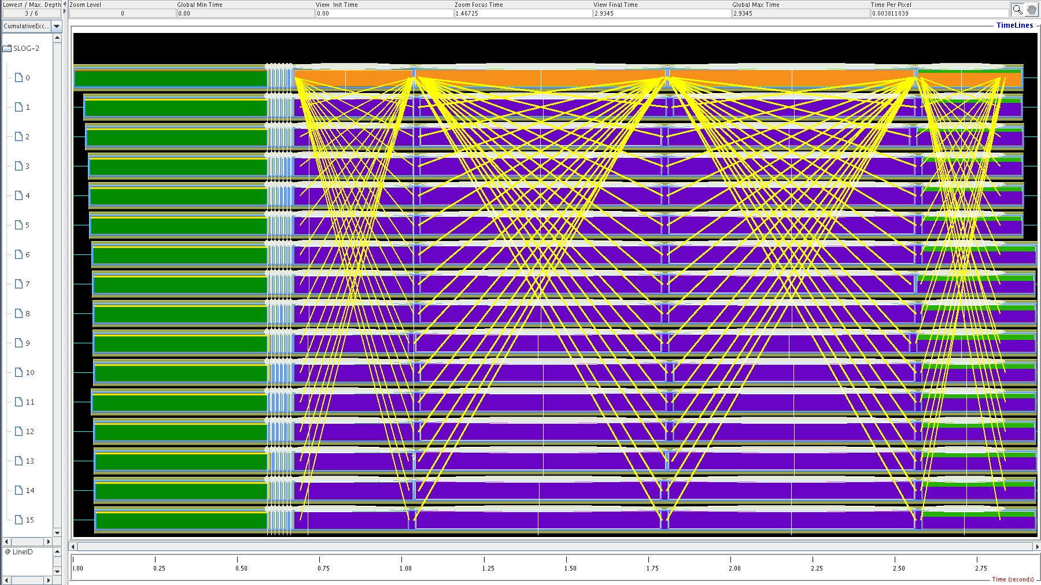
TAU
Profile: statistical summary of all metrics measured
  Example: Show how much total time & resources each call utilized
Trace: timeline of events took place
  Shows when each event happened and where
Source file name and location of the function

Slide 54
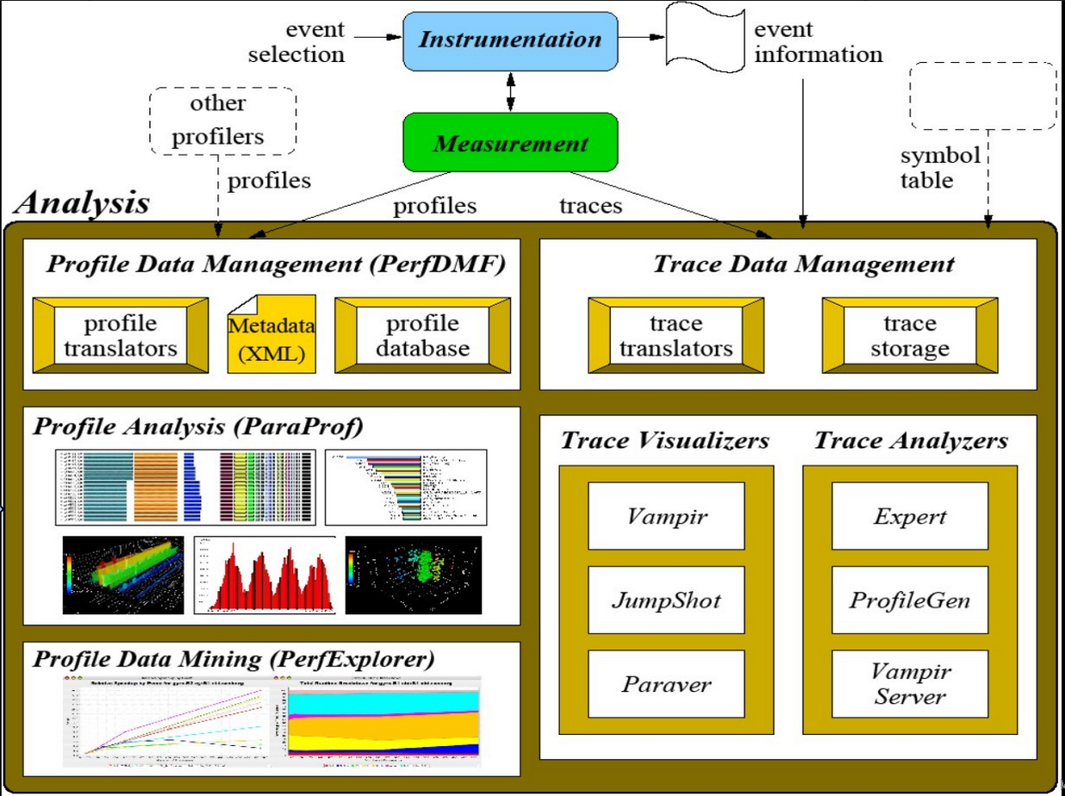

Slide 55
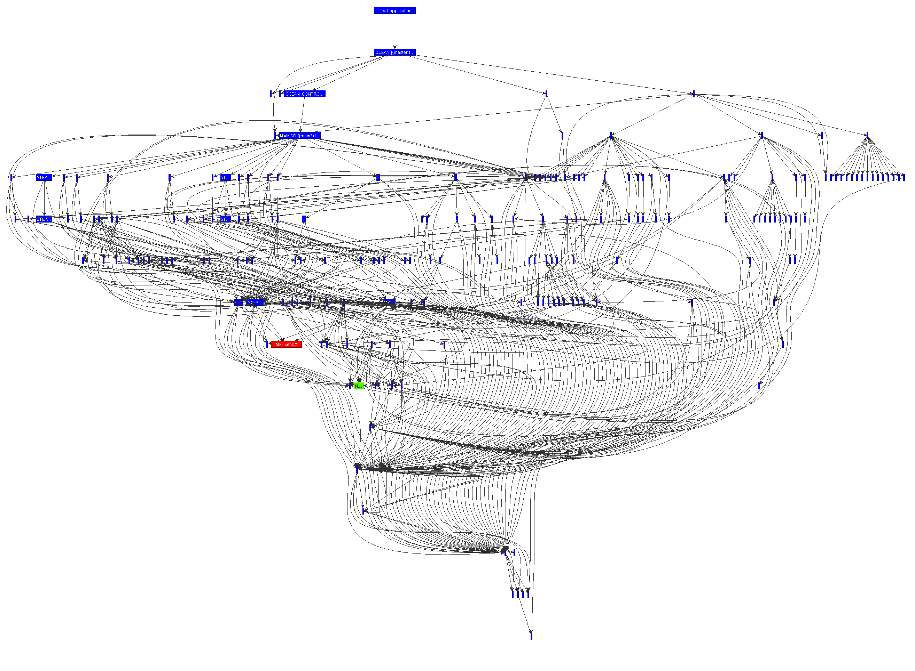
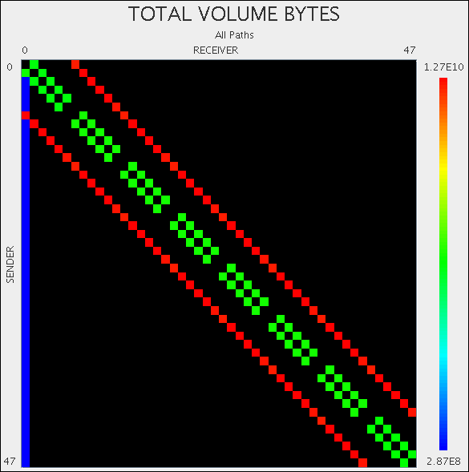
TAU
Communication matrix
Call graph

Slide 56
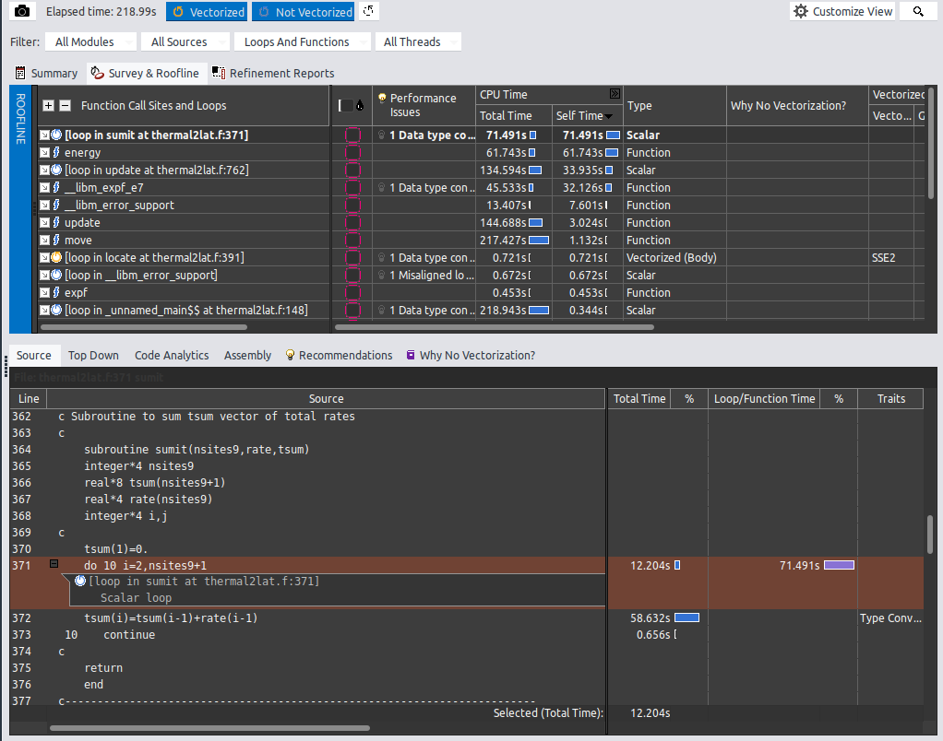
Intel Advisor (FREE)
Vectorization advisor and Threading advisor
  Can time-consuming loops able to benefit from vectorization or already vectorized?
  Compile code with -g
  Collect data
  Visualize data
srun -n 1 -c 1 advixe-cl –-collect=survey
--project-dir=Directory_name --search-dir=Directory_name
--trace-mpi program_name
advisor-gui Directory_name

Slide 57
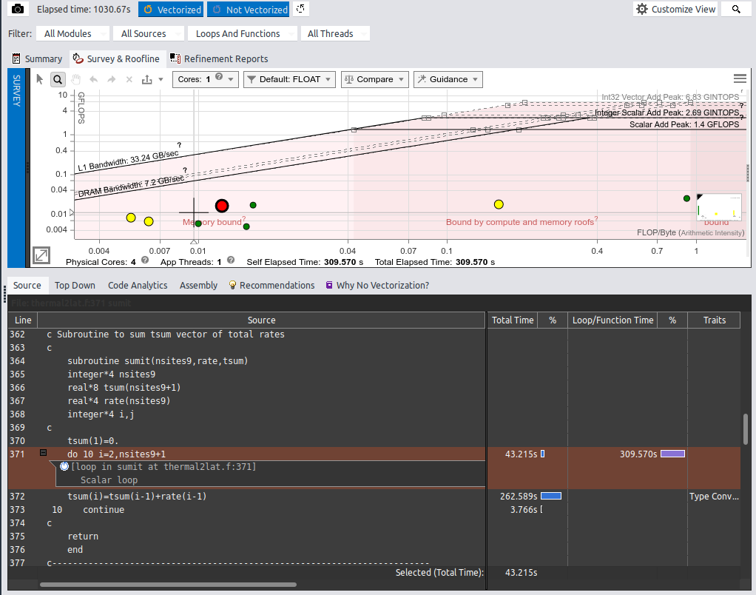
Intel Advisor
Roofline Analysis for CPU/GPU
  What is the maximum achievable performance with the hardware used?
  Does application work optimally on current hardware?
  If not, what are the best candidates for optimization?
  Roofline plot shows theoretical limits of computational performance and communication between processors and memory
Much higher overhead compared to TAU
Different functions
of the code

Slide 58
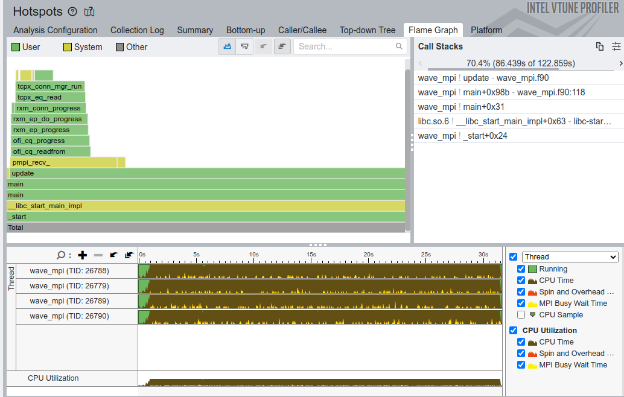
Intel Vtune (FREE)
Tune application performance for CPU / GPU
Profile C, C++, C#, Fortran, OpenCL, Python, Google Go, Java, .NET, Assembly
Coarse-grained system data for an extended period
Detailed results mapped to source code
Multi node (MPI) profiling

Slide 59
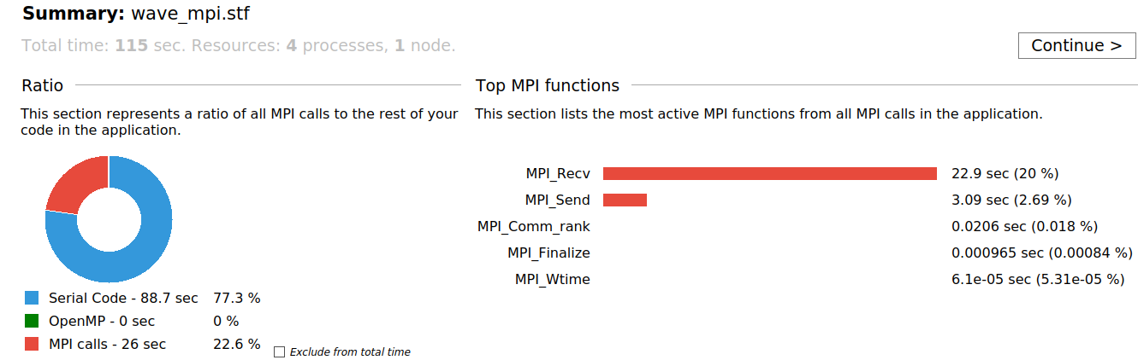
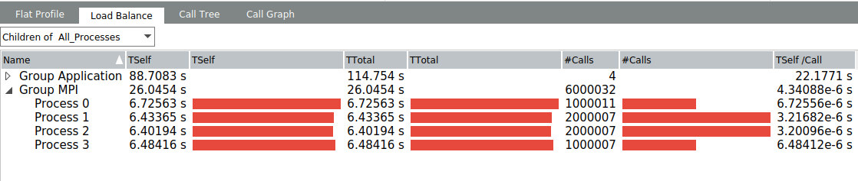
Intel Trace Analyzer (FREE)
MPI profiler
Traces MPI code
Identifies communication
inefficiencies
To use with Intel MPI (only),
traceanalyzer gui visualizes generated results
$ mpirun -trace -np 4 ./wave_mpi
$ traceanalyzer wave_mpi.stf

Slide 60
Profiling Python
Two built in profilers: cProfile and profile
  cProfile is recommended due to low overhead
Whole program profiling
python3 -m cProfile -s tottime numpy_io.py
3820056 function calls (3805275 primitive calls) in 8.231 seconds
Ordered by: internal time
ncalls tottime percall cumtime percall filename:lineno(function)
1 2.315 2.315 2.566 2.566 Gio.py:39(run)
1 0.588 0.588 0.643 0.643 Gtk.py:1(<module>)
32047 0.468 0.000 0.716 0.000 inspect.py:744(cleandoc)
5845 0.288 0.000 0.400 0.000 dates.py:305(_dt64_to_ordinalf)
30 0.214 0.007 0.219 0.007 {built-in method _imp.create_dynamic}
35070 0.155 0.000 0.242 0.000 _parser.py:83(get_token)
35146 0.137 0.000 0.137 0.000 {method 'astype' of 'numpy.ndarray' objects}
282 0.134 0.000 0.134 0.000 {method 'read' of '_io.BufferedReader' objects}
…
import cProfile
pr = cProfile.Profile()
pr.enable()
# ... your code/function to profile ...
pr.disable()
pr.print_stats()
Targeted profiling
  Only profile a selected parts (functions etc) of a code

Slide 61
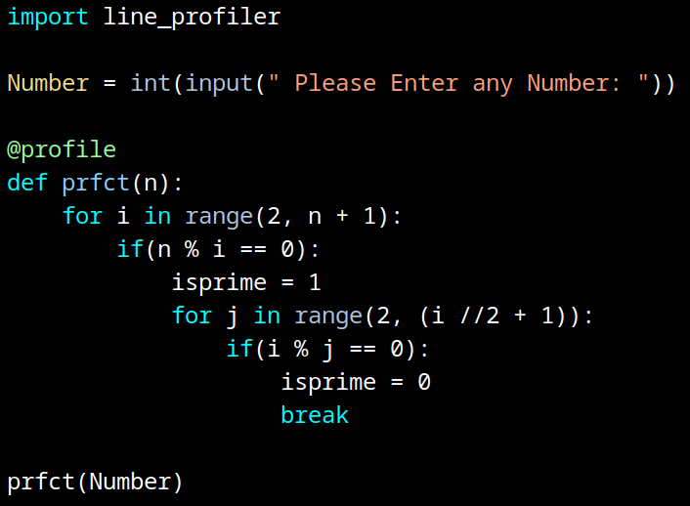
Profiling Python
Line profiling
  Only profile selected lines of a code
$ pip install line_profiler
$ kernprof -l -v prfact.py
Please Enter any Number: 2544
Wrote profile results to prfact.py.lprof
Timer unit: 1e-06 s
Total time: 0.00451784 s
File: prfact.py
Function: prfct at line 5
Line # Hits Time Per Hit % Time Line Contents
==============================================================
5 @profile
6 def prfct(n):
7 2543 2039.2 0.8 45.1 for i in range(2, n + 1):
8 2524 2350.7 0.9 52.0 if(n % i == 0):
9 19 15.5 0.8 0.3 isprime = 1
10 42 57.5 1.4 1.3 for j in range(2, (i //2 + 1)):
11 26 23.4 0.9 0.5 if(i % j == 0):
12 16 11.3 0.7 0.2 isprime = 0
13 16 20.2 1.3 0.4 break
-l : line by line
-v : visualize results

Slide 62
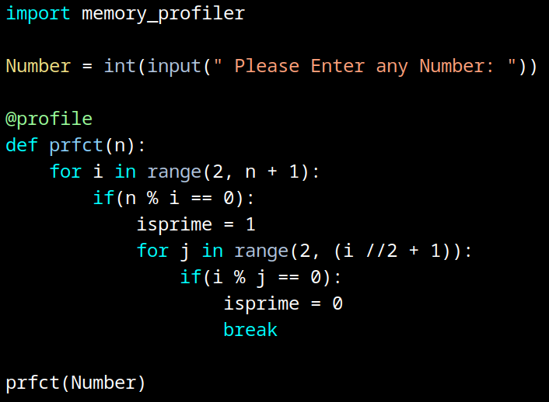
Profiling Python
Memory profiling
  Keep track of memory usage
$ pip install memory_profiler
$ python3 -m memory_profiler prfact.py
Please Enter any Number: 2588
Filename: prfact.py
Line # Mem usage Increment Occurrences Line Contents
=============================================================
5 21.875 MiB 21.875 MiB 1 @profile
6 def prfct(n):
7 21.875 MiB 0.000 MiB 2588 for i in range(2, n + 1):
8 21.875 MiB 0.000 MiB 2587 if(n % i == 0):
9 21.875 MiB 0.000 MiB 5 isprime = 1
10 21.875 MiB 0.000 MiB 327 for j in range(2, (i //2 + 1)):
11 21.875 MiB 0.000 MiB 325 if(i % j == 0):
12 21.875 MiB 0.000 MiB 3 isprime = 0
13 21.875 MiB 0.000 MiB 3 break

Slide 63
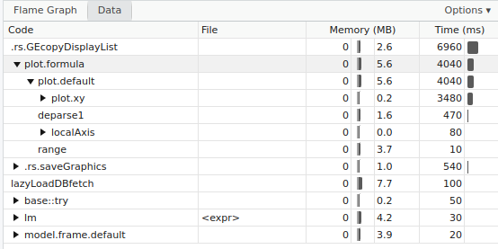
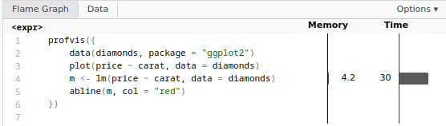
Profiling R
Select Rstudio’s built in Profile > Start Profiling menu and run the R code
Enclose the function or code with profvis function
Enables a user to:
  Measure time and memory
  Find bottlenecks
library(profvis)
profvis({
data(diamonds, package = "ggplot2")
plot(price ~ carat, data = diamonds)
m <- lm(price ~ carat, data = diamonds)
abline(m, coln0 = "red")
})

Slide 64
Debugging
  Debugging using Compiler Flags
  Debugger Basics
  gdb
  Serial Debugging with gdb
  Parallel (MPI) Debugging
    Parallel Debugging with gdb
    Interactive Parallel Debugging with gdb
    Non-interactive Parallel Debugging with gdb
    Totalview and DDT
  CUDA Debugging with gdb
  Intel Inspector
  Language Specific Debuggers
Profiling and Tuning
  Profiling
    GNU Profiler - gprof
    TAU
    Intel Tools
    Profiling Python and R
  Tuning Applications
    Use Compiler Flags
    MAQAO
    Try Different Compilers
    Use Performance Optimized Libraries

Slide 65

Tuning Applications
Code tuning is the process of manually optimizing a program to lower its runtime requirements (runtime, memory, disk space, ...)
  Better algorithms
  Different compiler flags (-O2, -O3 etc)
  Using different compilers
  Using optimized libraries
  Vectorizing loops
  Using non-blocking MPI calls
    Hide latency
https://magazine.foriowa.org/archive/archive-story.php?ed=true&storyid=1568

Slide 66
Use Compiler Flags
-march=cpu-type : Generate instructions for the machine type cpu-type
  Exploits various capabilities in different CPUs, support for different instruction sets, different ways of executing code, etc to generate optimized binary for a target CPU
  cpu-type = native : Use processor type of the compiling machine (local machine installation, compiling for a homogeneous cluster etc)
  cpu-type = sandybridge, haswell, skylake, znver2, etc : Compile for Intel Sandy Bridge, Haswell, Skylate, AMD zen2, etc
  cpu-type = core-avx2 (Intel compiler): Compile for a for processors that supports Advanced Vector Extensions 2

Slide 67
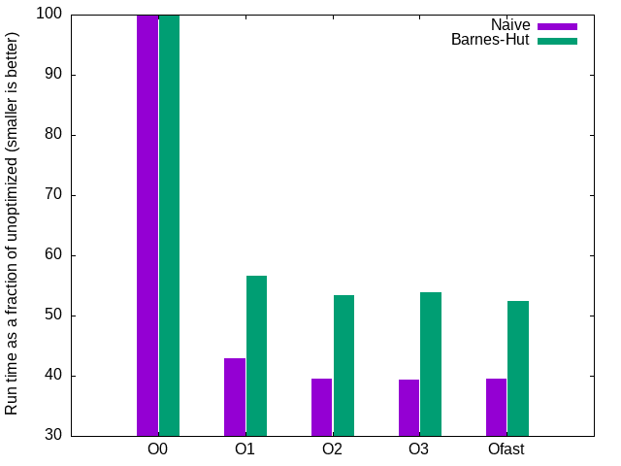
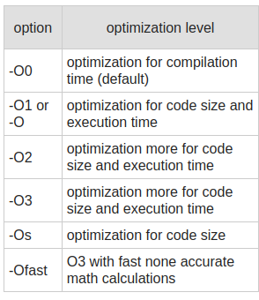
    Use Compiler Flags
-O : Vectorization, scalar optimizations, loop optimizations, inlining, …
  Too aggressive optimizations may affect computtional accuracy
gcc -c barnes_hut.c
Two n body simulations written in C (naive brute force method and Barnes-Hut approximation) compiled with GNU compiler
Source code: https://github.com/KimTorberntsson/Barnes-Hut
gcc -c barnes_hut.c -O1/2/3/fast
https://gcc.gnu.org/onlinedocs/gcc/Optimize-Options.html

Slide 68
Modular Assembly Quality Analyzer and Optimizer (MAQAO)
A profiling tool, binary disassembler, and code quality analyzer
  A user friendly performance analysis and optimization framework
  Provides reports and hints for code optimization
  Analyzes production binary
Binary can be freely downloaded from https://www.maqao.org
Analyzing applications and generating a report
This will run the binary with the given mpi command and generate the results
  Default report format is html and can be configured to text / excel etc
Focuses on memory alignment, loop interchange, loop strides, etc
maqao oneview –create-report=one –binary=../test/wave –mpi_command=”mpirun -np 2”

Slide 69
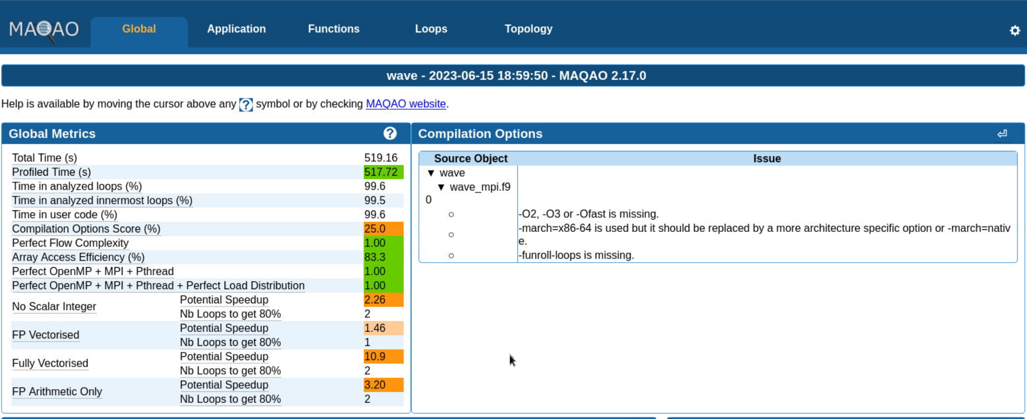
MAQAO
Array Access Efficiency: Percentage of Unit Stride access
FP vectorized: Performance gain if all FP arithmetic operations were vectorized
Fully vectorized: Performance gain if all the FP arithmetic operations +
Load/Store instructions were vectorized

Slide 70
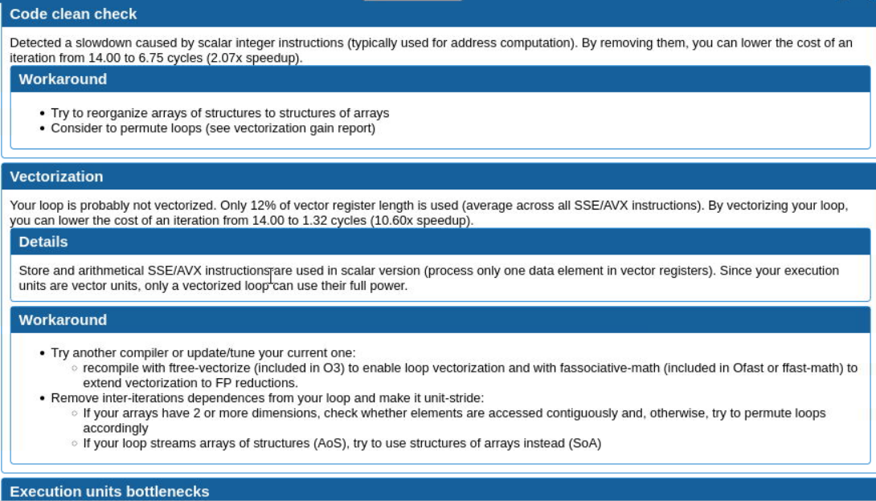

Slide 71
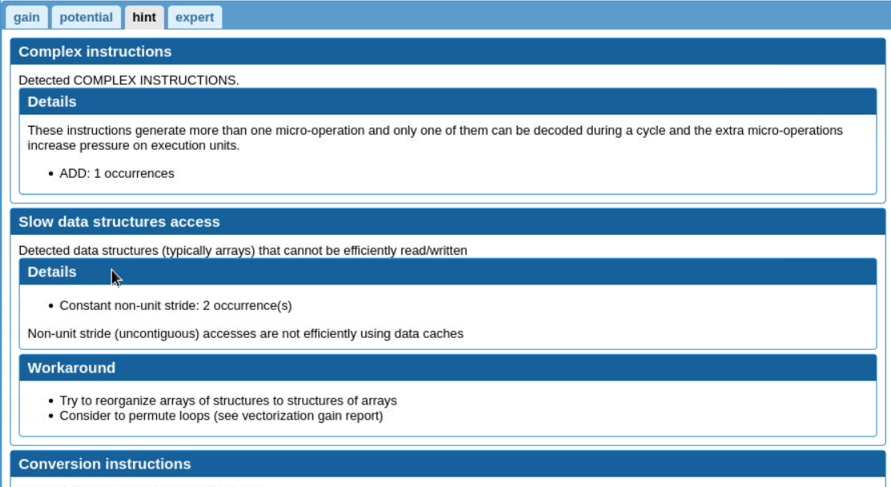

Slide 72
Debugging
  Debugging using Compiler Flags
  Debugger Basics
  gdb
  Serial Debugging with gdb
  Parallel (MPI) Debugging
    Parallel Debugging with gdb
    Interactive Parallel Debugging with gdb
    Non-interactive Parallel Debugging with gdb
    Totalview and DDT
  CUDA Debugging with gdb
  Intel Inspector
  Language Specific Debuggers
Profiling and Tuning
  Profiling
    GNU Profiler - gprof
    TAU
    Intel Tools
    Profiling Python and R
  Tuning Applications
    Use Compiler Flags
    MAQAO
    Try Different Compilers
    Use Performance Optimized Libraries

Slide 73
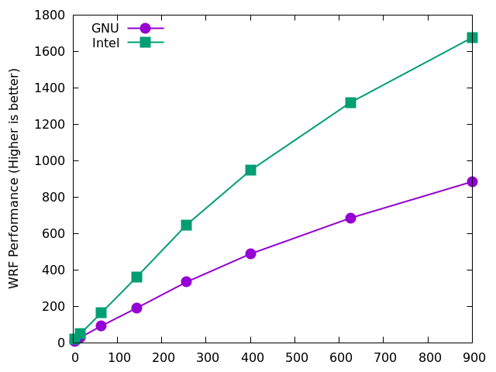
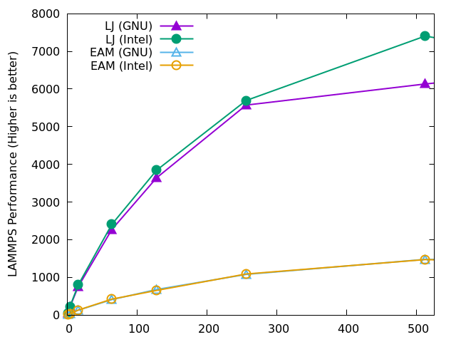
Try Different Compilers
Different compilers (GNU vs Intel vs other) may yield different performance
  OpenMPI vs MVAPICH2 vs Intel MPI
WRF
LAMMPS
a
a
Core Count
Core Count

Slide 74
Use Performance Optimized Libraries
Solving most problems numerically involves performing similar tasks
  Vector operations (dot product, norm, …)
  Matrix operations (solving systems of equations, matrix product, …)
  Fourier Transform, parallel input/output
Numerical libraries are developed to perform these basic tasks optimally
  Highly tuned for performance, different hardware for decade(s)
  Well documented and easy to use
    Most become community standards (eg. FFTw)
  Use these libraries as building blocks to develop applications
    Never write your own solvers!

Slide 75
Numerical Libraries
BLAS
  Basic Linear Algebra Subprograms
    Written in Fortran, provides C bindings
  Provides a standard interface to vector, matrix-vector, matrix-matrix routines that have been optimized for various computer architectures
  Implementations: OpenBLAS, BLIS (BLAS-like Library Instantiation Software), ATLAS (Automatically Tuned Linear Algebra Software), Intel Math Kernel Library (IMKL), Accelerate, cuBLAS (cuda BLAS), GotoBLAS, …
LAPACK
  Linear Algebra PACKage: Built on top of BLAS
  Designed to solve system of linear equations, eigenvalue problems, singular value problems, LU factorization, etc
  ScaLAPACK: Parallel version of LAPACK

Slide 76








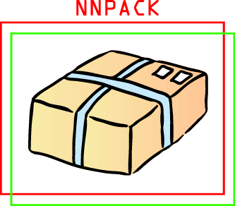






Numerical Libraries
Armadillo
GTS
TA-Lib
SLEPSc
HYPRE
GEOS
PETSc
BLAS
LAPACK
FFTw
SuperLU
ScaLAPACK
Eigen
ELSI
ARPACK
MUMPS
OGDI

Slide 77
Numerical Libraries
Try to use libraries widely used and still active / supported
  Most issues were identified and fixed
  Community support
Test different libraries if available and check performance
  Performance may differ depending on usage, hardware, etc
  Use libraries built / tuned for your hardware architecture

Slide 78
Thank you

