Slide 1

CI User Support
Dylan Perkins
Associate Director of User Services, Research Computing

Slide 2
My Research Computing Story
Community College 2005-2008 (various majors)
BS Geography, University of Wyoming 2008-2012
MA Geography, University of Wyoming 2013-2018
Database Design Analyst – Advanced Research Computing Center, University of Wyoming 2015
End User Support Manager– Advanced Research Computing Center, University of Wyoming 2018
Associate Director of User Services –Research Computing, University of Colorado Boulder 2021

Slide 3

Is CI User Support Important?

Slide 4
What Does is CI User Support Do?
Roles (generally speaking)
  Education
  Consulting
  Outreach
As the most visible/available CI professionals to researchers, user support teams often act as the “Front Door” to CI systems and staff

Slide 5
Is CI User Support Less Important than Other CI Staff?
A study done in 2019 by University of Colorado Boulder determines CI User Support is critical to the operations of any CI Center. (Knuth et al., 2019)
Improvements in the User Support operations (documentation, trainings, automation & request handling) during 2018 resulted in a 31% increase in allocation requests on systems in 2019.

Slide 6
User Support Roles
User Support personnel are responsible for a wide-ranging set of roles. Many of these can also shift on a minute-by-minute basis and over longer periods of time.
  Including, but not limited to:
    Translator
    Teacher
    Troubleshooter
    Outreach Coordinator
    Conflict Resolution Specialist

Slide 7
Agenda
Specific Roles of User Support
  Translator
  Teacher
  Troubleshooting
  Outreach
  Conflict Resolution
*Including frequently encountered problems, various experiences, and important skill sets
Common Expectations
Summary

Slide 8
The Translator
For CI User Support

Slide 9

Translator
Researchers and CI professionals often have different nomenclature that can lead to ambiguity, confusion, and frustration.
This can become even more challenging when background and cultural differences are present.
https://www.pactranz.com/the-translator-skillset/

Slide 10
Translator example
A statement from a real researcher’s website:
  “The purpose of the proposed study is to explore word identification of misarticulated words by children with SSD.”
A CI professional might pick out the acronym ‘SSD’ and assume that the researcher is wanting to use fast storage in a high I/O workflow.
Upon further reading, this researcher is a speech language pathologist, and to them ‘SSD’ means Speech Sound Disorders.
http://www.uwyo.edu/comdis/faculty-staff/krueger.html

Slide 11
Translator example Vise Versa
Scenario:
  An HPC Software Manager might recommend to the User Support personnel that a researcher should use Singularity to accomplish their work.
To some researchers ‘Singularity’ might mean something referring to general relativity or other concept that does not mean a software container
Please choose how the User Support professional should assist the researcher, given this complex concept?

Slide 12
Background and Cultural Differences
CI User Support should also attempt to be mindful of the backgrounds or cultures of the researchers they work with.
  Not all research disciplines are as open as others in sharing ideas
  Personalities differ
  Primary and secondary languages
  Cultural background may also impede communication

Slide 13

CI Translation Skillsets
Attention to detail
Adaptability
Curiosity
Motivation
Writing
Effective communication

Slide 14
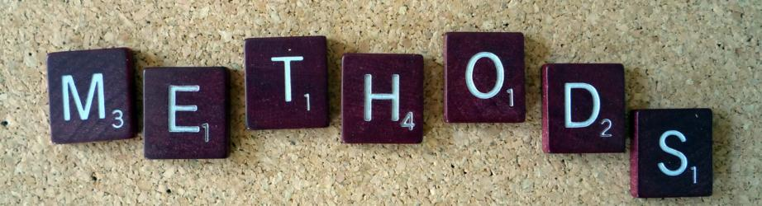
Translation Methods
Reducing jargon/acronyms
Using analogies
Checking for understanding
Active listening
Paraphrasing
Asking Clarifying questions

Slide 15
The Teacher
For CI User Support

Slide 16

Teacher
CI User Support personnel also often act as teachers. The purpose of this role is to provide researchers with the knowledge and tools to enable them.
Workshops/trainings, guest lectures, and one-on-one consultations are frequently used tools that enable User Support to fit in this role.

Slide 17
Teaching Challenges
Motivation
  The ‘Why is it worth it?’ question
    Value
    Commitments
    Consequences
Effectiveness
  The ‘Was the goal achieved?’ question
    Expectations
    Understanding
Format
  The ‘What is the best delivery?’ question
    Documentation
    Large/small workshops
    Multimedia
Improvement
  The ‘What could be better?’ question
    Assessment
    Feedback

Slide 18
Teaching Motivation
Motivation plays a massive role in education. The teacher must be motivated to provide the knowledge. Additionally, the users must be motivated to take advantage of opportunities.
Motivation for CI User Support
  Support time reduction
  Psychological fulfillment
  Build relationships
Motivation for the User
  Removing barriers
  Self-sufficiency

Slide 19
Teaching Formats
Educational formats vary widely with advantages and disadvantages to each. There is no ‘silver bullet’ of a format that works for everyone, but here are a few examples:
  Documentation – persistent, adaptable, accessible, and translatable.
    Pro - online reference materials for everyone and with the use of other technology can serve the majority of audiences
    Con – not everyone can read text and understand the content as intended
  Live workshops/training – online or in-person scheduled events.
    Pro – user engagement is live, questions can be answered quickly, and understanding can be checked
    Con – scheduling, language and accessibility barriers, and reference material
  Multimedia – Hybrid of both, videos, published presentations etc.
    Pro - persistent, accessible, referenceable
    Con – time-consuming, compliance, no live interaction

Slide 20
Effective Teaching
Meeting user expectations and understanding are key contributors to the effectiveness of teaching CI concepts.
  Clear communication of value, prerequisites, and content are vital to setting expectations.
    Why are users interested?
    What do they already know?
  Understanding is more difficult to confirm
    Are users engaged/asking questions?
    How much content was delivered over how much time?
    Did they provide any feedback?
    Did the teacher check for understanding?

Slide 21
Teaching Improvement
No workshop or other educational opportunity is perfect. Nor will it probably ever be, but teachers can always seek to improve themselves, their content, or delivery. Methods for improving are also never perfect, but a few can help:
  Self-assessment – How did the teacher feel a workshop went/is going?
  Feedback – user provided feedback is helpful in finding improvement
  Peer-review – outside perspectives can provide additional feedback from a source familiar with the content

Slide 22

Teaching Skills
Communication
Listening
Collaboration
Adaptability
Engagement
Empathy
Patience

Slide 23
The Troubleshooter
For CI User Support

Slide 24

Troubleshooter
As the most visible members of a CI team, User Support fills the initial troubleshooting role for many researchers.
Support tickets, consultations, and general problem-solving are part of the User Support role.

Slide 25
Troubleshooting - Problem Identification
The first step in troubleshooting is identifying the problem. When assistance is required CI User Support must first determine the type of problem before offering solutions or seeking guidance
Technical Problems
  System malfunctions
  Software issues
  Networking/security
User Problems
  Abilities
  Misuse/abuse
  Workflow design

Slide 26
Troubleshooting – Technical Problems
Occasionally, the first sign that something is wrong with a CI system is user reports about anomalies. Typically, if there is a system problem, there will be multiple reports of something similar, but not always. They can look like user problems at first, but that always may not be the case.
“I can’t login”
“I’m sure I am doing something silly”
“I’m having trouble transferring my data”
“My jobs won’t run”
“I can’t access my files”

Slide 27
Troubleshooting – Technical Problem Resolution
CI User Support can sometimes address these issues, but not always. Attempting to replicate user problems is often the best first step in identifying technical problems.
  If the problem can be replicated, having a good working relationship with the systems-facing staff is very important.
    Report the issue
    Communicate with user
  If the problem can’t be replicated, it could still be a technical issue.
    Ask for more details
    Seek assistance from the CI team or national communities

Slide 28
Troubleshooting – User Problems
Troubleshooting user errors is also a key function of CI User Support. In some situations it can be difficult to determine the error. If a user reports a problem and User Support can’t replicate, additional details should be sought.
“Is there something wrong with the system?!”
“I can’t login”
“I have been waiting in the queue for a week”
“Please install the software I need”

Slide 29
Troubleshooting – User Problems Resolution
User problems can be numerous and unpredictable. Back-and-forth email exchanges can be frustrating for both the user and the CI Staff. Approaching user problems should be handled with nuanced and empathetic approaches.
“I’m sorry you are experiencing trouble. Would you like to schedule a meeting to work through the problem?”
“Thank you for reporting this issue! I’d like to get more information if I can. Do you have time to show me what you are dealing with?”

Slide 30
Troubleshooting Skills
Don’t panic
Make sure there is really a problem
Know the CI you are working with to the best of your ability
Look for clues
Don’t be afraid to ask questions
Be humble about your abilities
Know when to seek assistance

Slide 31
The Outreach Coordinator
For CI User Support

Slide 32

Outreach
Some universities have dedicated people to provide outreach that would otherwise be the CI User Support team’s responsibility to provide.
Even if that is the case, outreach is still an important role for User Support in different scenarios.

Slide 33
Outreach Questions
How are users made aware that your CI team exists?
How would a user know if they could use CI in their research?
Do users know where to look for help?
Is there a way for users to know what workshops/trainings are available and when they are happening?
Can users subscribe to email updates or social media?
How does the CI team know who to reach out to?

Slide 34
Outreach Challenges
While there are many potential answers to these questions, challenges persist in many ways.
  Emails to listservs often go ignored
  The balance of over communicating vs. under
  Awareness of groups
  Viability/necessity

Slide 35
Outreach Strategies
Listservs are a convenient way to manage communications, but present challenges.
  They are still a good strategic method of outreaching to users
Social media is a strange place.
  Good for some folks, but need to stay relevant and require constant work
  Established people may not see the need or have the desire
Targeting potential groups.
  Can be done in many ways
    Research websites
    Funding announcements
    Published research articles
Word-of-mouth
  Researchers will talk with each other. Building goodwill with the folks that are aware of you is important.

Slide 36
Outreach Skills
Organization
Storytelling
Repetition
Community awareness
Marketing
Customer identification

Slide 37
The Conflict Resolution Specialist
For CI User Support

Slide 38
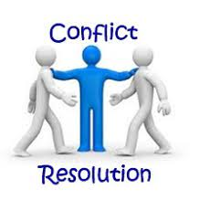
Conflict Resolution
CI User Support can sometimes deal with situations of conflict, whether that is between users, the team, or both.
The ability to recognize conflict and have strategies to mitigate it is a valuable skill for a User Support Professional.

Slide 39
Conflict Scenarios
A user complains that they have not been able to do their work because someone else is ‘hogging’ all the nodes.
User Support is reporting that there may be an issue on the system, but the technical staff says there is nothing to worry about and to tell users that they are being ‘dramatic’.
A user is asking for help from the technical staff because they don’t believe that the User Support folks can help.

Slide 40
Conflict Resolution
While some may take offensive to these scenarios, it’s important to remain professional and to rebuild any relationships that may be impacted.
It’s also important to know what questions CI User Support should ask themselves before reacting to the situation.

Slide 41
Conflict Scenario 1
In Scenario 1) we are given the example of:
  A user complains that they have not been able to do their work because someone else is ‘hogging’ all the nodes.
What would we do in this situation?
Questions to ask before attempting a response:
  Is there a technical issue with the scheduler?
  Is the defendant really misusing the system?
  How can we set expectations for the plaintiff?

Slide 42
Conflict Scenario 2
In Scenario 2) we are given the example of:
  User Support is reporting that there may be an issue on the system, but the systems-facing staff says there is nothing to worry about and to tell users that they are being ‘dramatic’.
What would we do in this situation?
Questions to ask before attempting a response:
  Is there a trust issue between User Support and systems-facing Staff?
  Why does the technical staff think there isn’t a problem?
  How can User Support respond to users that isn’t offensive?

Slide 43
Conflict Scenario 3
In Scenario 2) we are given the example of:
  A user is asking for help from the technical staff because they don’t believe that the User Support folks can help.
What would we do in this situation?
Questions to ask before attempting a response:
  Is there a trust issue between User Support and the User?
  What is the actual problem and can User Support assist?
  How can we rebuild trust?
  How can User Support respond?

Slide 44
Conflict Resolution Skills
Situations arise that can cause tensions within User Support. What skills are valuable in knowing how to resolve them.
  Remain calm
  Listen carefully
  Don’t think it’s personal
  Don’t accuse
  Prioritize resolving the conflict over being right
  Be willing to compromise
  Know when to apologize and forgive
  Remember the importance of the relationship

Slide 45
Common User Expectations
A few examples

Slide 46
For Faculty
Commit to what I want to do, so I can:
  Write it into my proposal
  Do it my way
My discipline needs X, why doesn’t the system support it?
Teach my student’s this stuff, so I don’t have to.
Respond to me, I am important.

Slide 47
For Students
Help write my code for me, it’s too hard to use on your system.
I have homework, can you help me with it?
Why can’t you make it like my laptop?

Slide 48
Other Resources
CI User Support

Slide 49
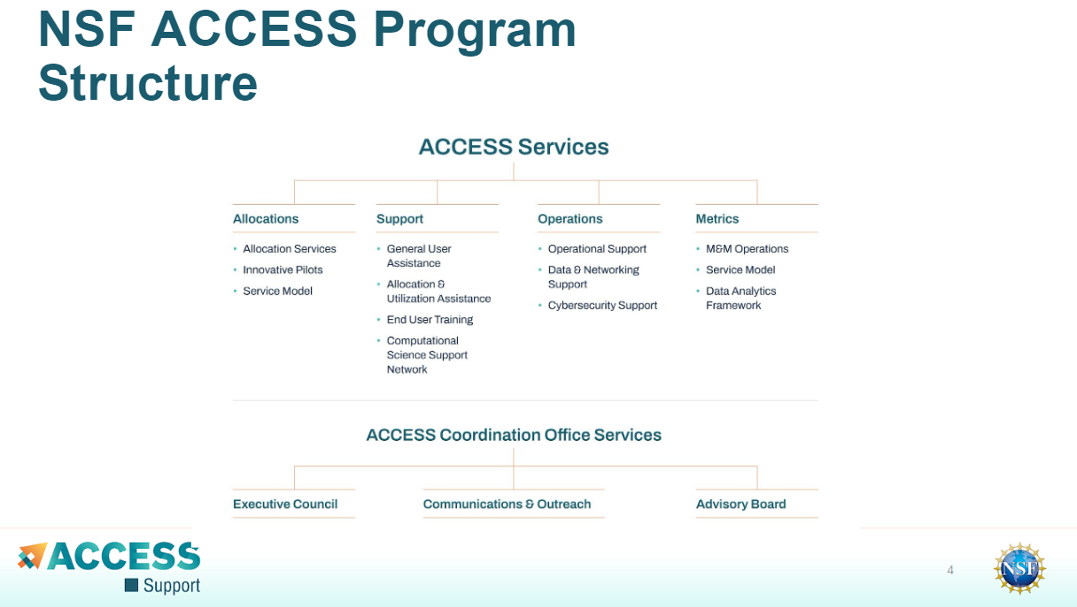
ACCESS

Slide 50
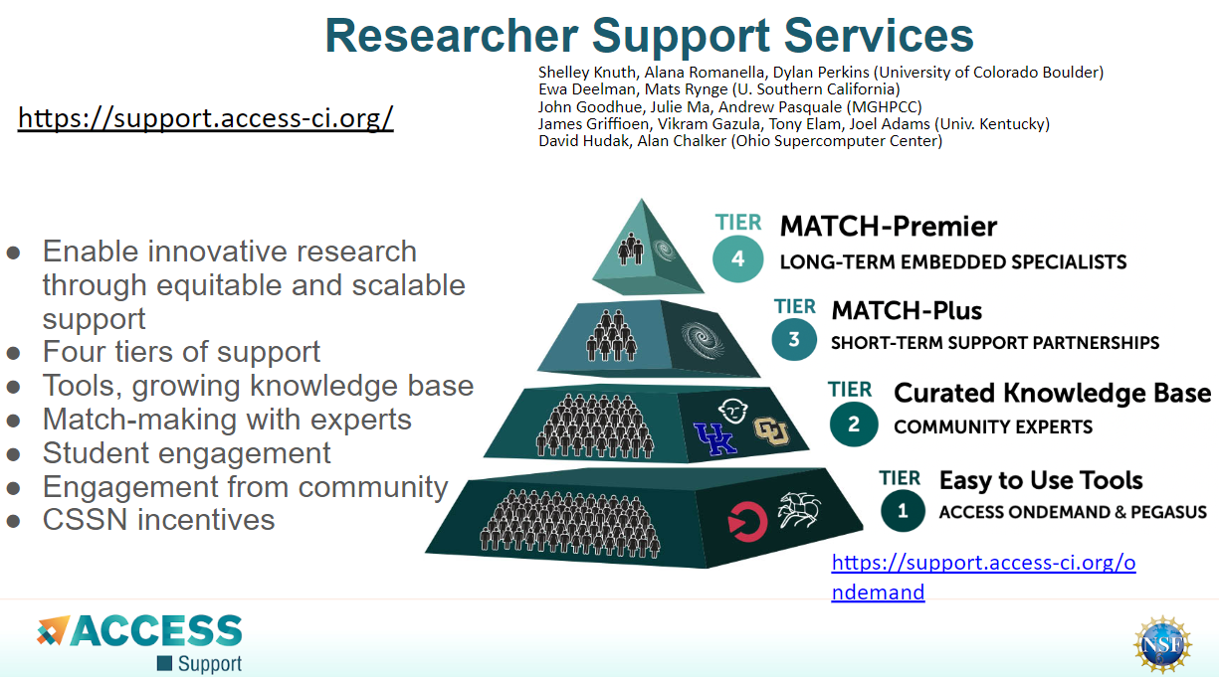
ACCESS

Slide 51
Other Resources
ACCESS
  https://access-ci.org/
Ask CI
  https://ask.cyberinfrastructure.org/
PEARC
  https://pearc.acm.org/pearc23/

Slide 52
Summary
CI User Support

Slide 53
CI User Support Summary
User Support is a challenging and rewarding role in a CI team.
Everything varies each day, but that’s part of the fun.
An effective User Support staff member must have a variety of skills ranging from professionalism to technical ability.
No size-fits-all solution exists for anything, so be prepared to pivot as needed.
Setting user expectations is SO vital.

Slide 54
Thank You!
Any questions?

Slide 55
References
Knuth, S. L., Frahm, J., Monaghan, A. J., Trahan, D., Sampedro, Z., Holt, A., Dunn, T., Hauser, T., & Burns, P. (2019). An Expansion of the User Support Services for the Research Computing Group at the University of Colorado Boulder. Proceedings of the Practice and Experience in Advanced Research Computing on Rise of the Machines (Learning), 1–8. https://doi.org/10.1145/3332186.3332229

