Slide 1
The Cyberinfrastructure Landscape: Systems, Service Providers, Technologies
Gretta Kellogg (gretta.kellogg@psu.edu)
Asst. Director, Center for AI/ML to Industry
Penn State University
Notes:
Gretta Kellogg is the Assistant Director for AIMI. It is a great pleasure and an honor for me to be presenting to this community. Whenever I attend any of these ongoing “open” events as Henry so graciously calls them, I always feel welcome and like I’m in the company of fellow-minded research computing enthusiasts! I will share the materials as described in the title, and first I will share a little of my own journey because of the two goals that Henry outlined for the 2023 Virtual Workshop –
What are we here to accomplish?
Learn how to work with researchers who are using CI
Learn the profession of CI facilitation (and CI Leadership)
NOT a lot of technical content that you can learn from other sources – so those lists can be pulled from the appendix and other materials provided today.

Slide 2
My Research Computing Story….. How I ended up in research computing through Enterprise IT and Computer Mediated Communication.
Graduate Student – IBM SUR Grant for online learning platform development & feedback study
Programmer w/Teaching and Learning in Technology
Course developer for Online Learning for Penn State and textbook publishers
Enterprise IT for Microsoft AD & Linux systems
IT Project Manager
Research Program Mgr (2 Genomic Centers)
ACI-REF
Director Research Facility
Asst. Director of Research Center
The Cyberinfrastructure Landscape: Systems, Service Providers, Technologies
Virtual Residency Introductory Workshop 2023 – Tues June 27, 2023
Notes:
Like many in this community of CI professionals, and as Henry was sharing with us yesterday, my own journey as a research computing professional has been unique. I first learned about this incredible community in 2019 (in the before times) as an ACI-REF at Penn State University. I came up through a uniquely tailored graduate program in computer mediated communication. I submitted my thesis idea as a proposal and was funded by an IBM SUR grant. I then moved into Teaching and Learning with Technology as my masters had been to develop the first online course platform at Penn State for the College of Liberal Arts (for Communications), and then into Enterprise IT supporting Linux and Active Directory services for the 170+K user base that is Penn State. I enjoyed the constant change and need to stay abreast of technologies and transitioned to IT Project Management for Enterprise Computing, and then moved over to the “Dark Side” into research computing where you still had to keep up with all the changes, but also got to learn and support incredible science and discovery.
I enjoyed working as a research program manager and then diving in even further to support research computing as an ACI-REF, a term that I do not believe it used any longer. I worked as an ACI-REF, and program manager for over a decade before heading to Cornell to lead a new Epigenomics Core (EGC) facility. I was then recruited to come back to Penn State to help found this new Center for AI to Industry. And so my talk today, like my professional journey, will be informed by those various experiences I had in both Enterprise and Research computing.
ACI-REF = adv. cyberinfrastructure – research & educational facilitation

Slide 3
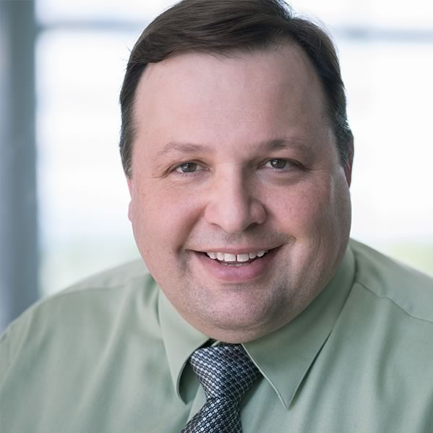
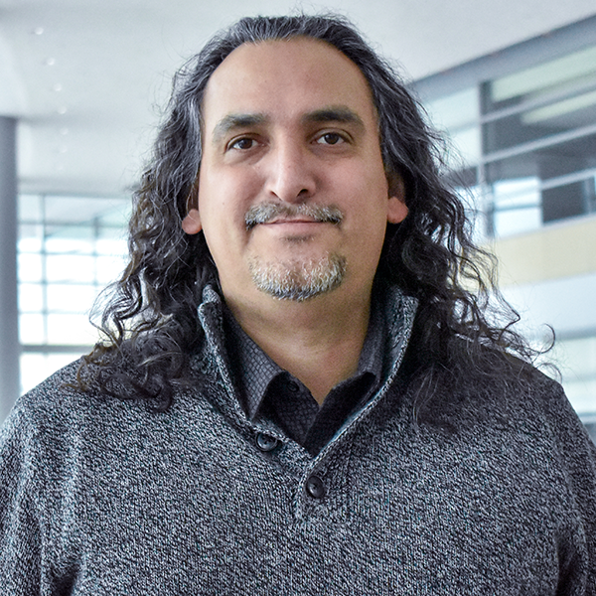
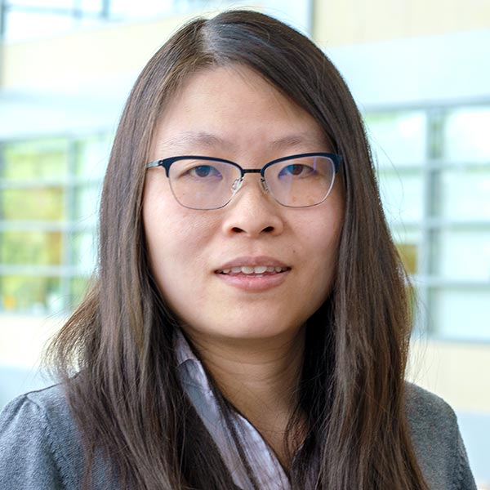
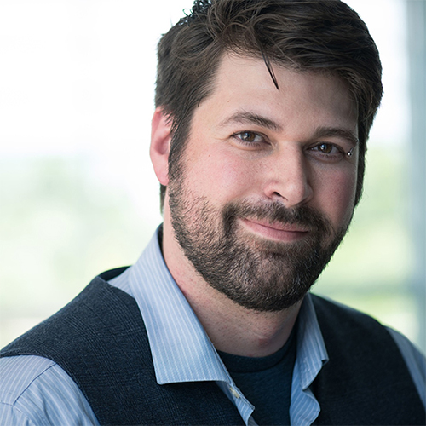
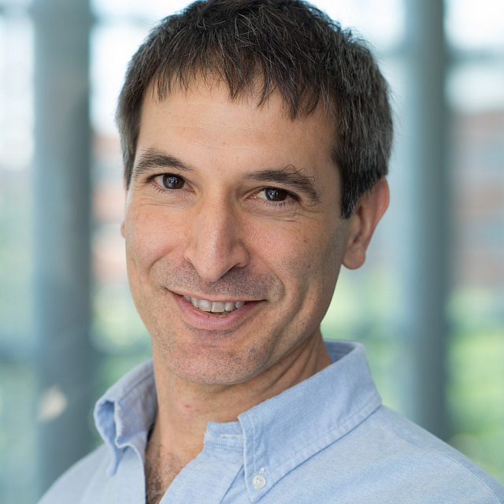
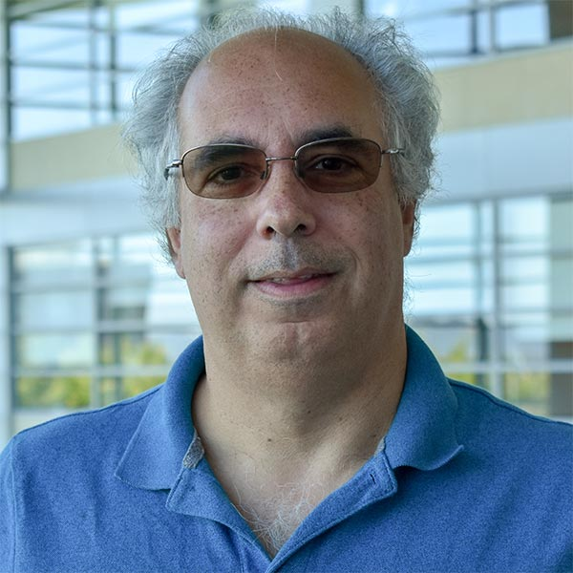
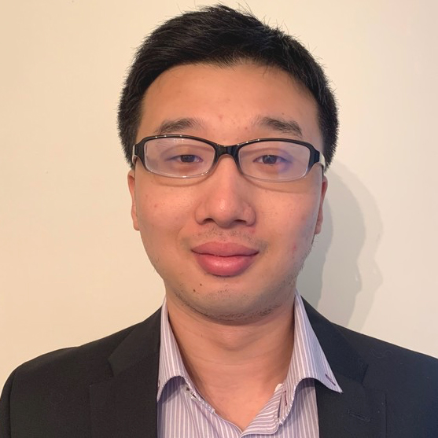
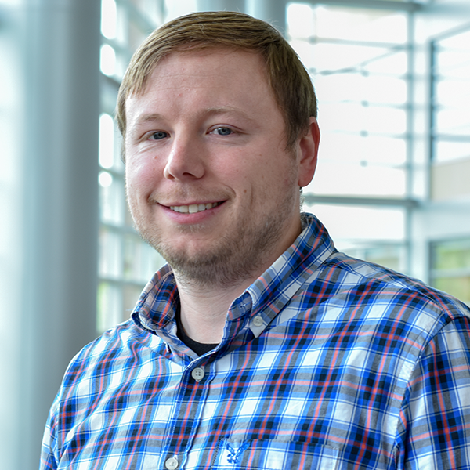
Research Engagement: the PSU RISE Team
RISE is a team of ICDS computational scientists and software engineers that merge advanced computing concepts to a broad spectrum of research projects.
Currently 13 Full Time PhD and Masters level domain specialists
https://www.icds.psu.edu/computing-services/rise/
Dr. Chuck Pavloski
RISE Team Lead
Earth Sciences
Ron Tapia
RISE Engineer
Platform Computing
Clayton Colson
RISE Engineer
Immersive Experiences
Dr. Danying Shao
RISE Engineer
Computational Biology
Dr. Simon Delattre
RISE Engineer
Machine Learning
Dr. Patrick Dudas
Interim CIE Director
Data Visualization
Dave McLaughlin
RISE Engineer
Data Visualization
Diego Menendez
RISE Engineer
Software Engineering
Jeff Nucciarone
RISE Engineer
Parallelization
Dr. Weinan Chen
RISE Engineer
Materials Science
Dr. Justin Petucci
RISE Engineer
Machine Learning
The Cyberinfrastructure Landscape: Systems, Service Providers, Technologies
Virtual Residency Introductory Workshop 2023 – Tues June 27, 2023
Notes:
Quick shout-out to the campus champions and research engineers who are a part of a tremendous team of colleagues in support of our faculty researchers and research computing. Anything I share today that is good is informed by their work with me, and I will accept the fault and correct any mistakes I might make along the way through this talk. And if anyone would like to learn more about the RISE team model at Penn State, feel free to reach out to me directly outside of the talk today. They have also presented at PEARC and we have materials to share if there is interest.
Research Innovations with Scientists and Engineers (RISE)
4 years ago, there were only 4 engineers
New in May 2023: Bart Masters and Alex Fatemi – both CIE engineers (came from Penn State IT)

Slide 4
Sample Intake categories and questions:
Description
Who is the researcher and or college/institute?
What are the funding agencies involved?
Can you describe your current research workflow?
Software
What software do you use for accomplishing your research? What versioning requirements to you have?
Do you typically run your software on your own workstations, local servers or HPC clusters? How long does the analysis run before completion ?
What common software packages do you need for publications/presentations?
Networking
What are your network latency or data transfer expectations?
What is a typical data set size?
What could you do differently if you had unlimited bandwidth?
Systems
What operating systems are you using on workstations? Servers? equipment?
What is a typical CPU time for individual experiments? A subset of analysis? Overall analysis for 1yr? 3years?
The Cyberinfrastructure Landscape: Systems, Service Providers, Technologies
Virtual Residency Introductory Workshop 2023 – Tues June 27, 2023
Notes:
I took a look at the agenda for the day and realized that the next talk is about How to conduct an intake Interview – which is foundational for what we do. So I thought I would share from our intake templates, and use those to organize the types of Systems, Service Providers, and Technologies that you may want to work with depending upon how those researcher interviews unfold. Hopefully this approach will be a help to provide various approaches and resources for your own professional journey.

Slide 5
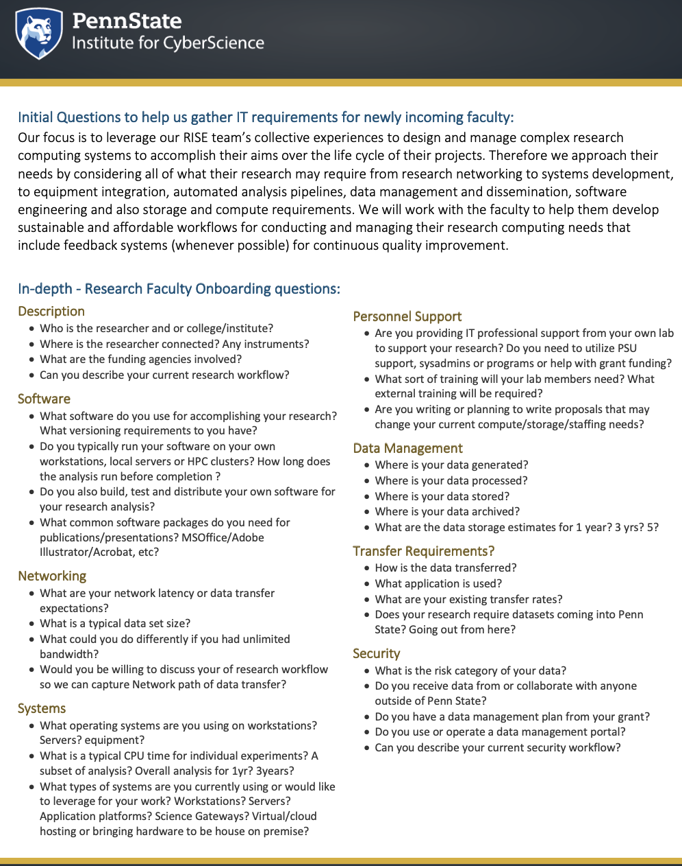
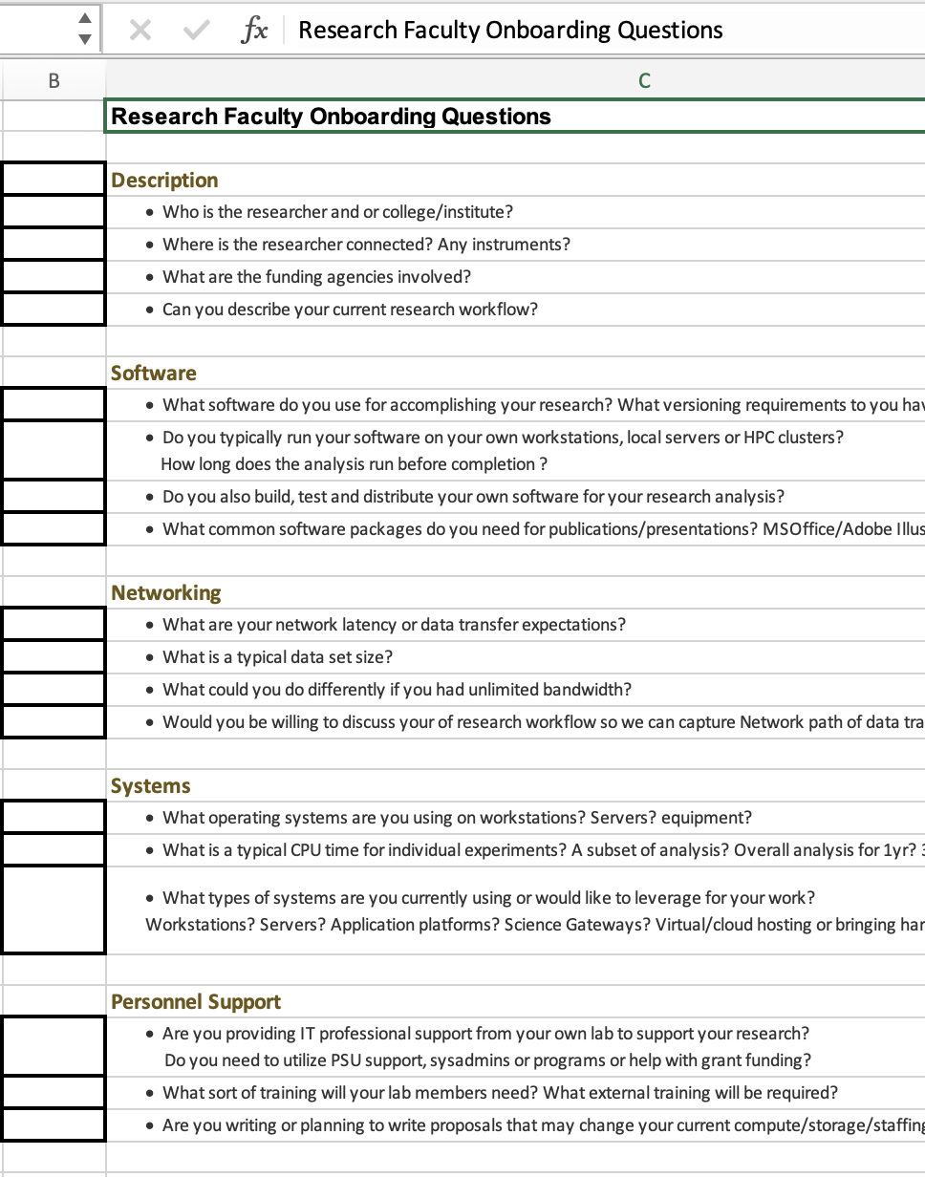
Sample Intake categories and questions – files provided for your own customization and use.
Then you can collect information
Check off services and rates they need
Share this to them first in advance.
Then share again in-person or over zoom
MSWord and Excel templates
The Cyberinfrastructure Landscape: Systems, Service Providers, Technologies
Virtual Residency Introductory Workshop 2023 – Tues June 27, 2023
Notes:
I will share these templates for intake for new faculty to the University as well as faculty that are new to US – or new to cyberinfrastructure and research computing. Many of us this week are naturally focusing our attention to the national resources that are funded and provide services to all researchers at various costs or at no cost to the faculty – because we don’t know what specific resources are available at your own institution. However, I will share based upon experiences at Penn State and Cornell University and trust that you will be encouraged to reach out to other units at your own institution to find out what might be accomplished by working with Enterprise IT, Enterprise Networking, Licensing, Grants Offices, etc. As that also reflects my own meandering journey supporting research computing. I tend to think that a lot of the problems researchers face are not technically impossible, but it might take some people working together to make it available for them.

Slide 6
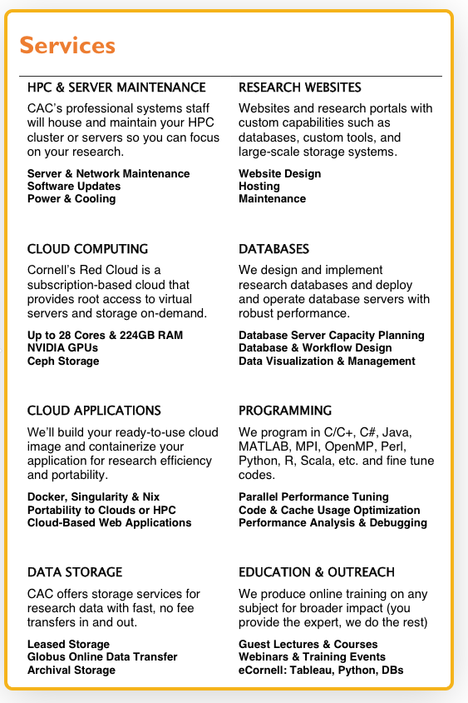
Systems, Service Providers, and Technologies
Let’s talk about how to organize the resources that you want to have available as you work with researchers.
CREDIT: Cornell University Center for Advanced Computing
The Cyberinfrastructure Landscape: Systems, Service Providers, Technologies
Virtual Residency Introductory Workshop 2023 – Tues June 27, 2023
Notes:
It may help to start with organizing the resources according to these categories that most researchers find that they need and will come to you for more information to get started on their own or to have these services provided for them. This is one example from working with the research computing group and campus champions at Cornell – these are the main categories of services that they have organized for faculty for their research. This is not an all-inclusive list of all research computing resources that are of interest to researchers, but sort of the foundational cyberinfrastructure services that you know you will want to cover as you sit down and discuss researcher needs.

Slide 7
Systems, Service Providers, and Technologies
Systems
Service Providers
Technologies
Systems include consortia, platforms, and groups of service providers.
Service Providers are still large-scale national resources.
Technologies include many of the tools they leverage from exoscale to local research computing.
The Cyberinfrastructure Landscape: Systems, Service Providers, Technologies
Virtual Residency Introductory Workshop 2023 – Tues June 27, 2023
Notes:
There are so many examples of each of the categories above, that I put a better list in the Google doc for this talk instead of trying to touch on each of them in this one hour. I also tried to find the difference between these categories, and the truth is that many systems and services are grid or consortia services, and not provided through one institution at a single location.

Slide 8
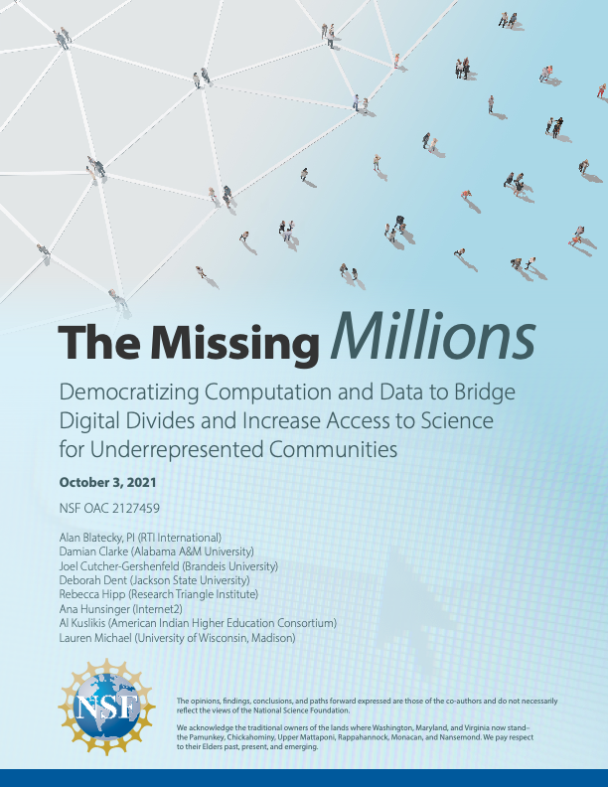
Systems, Service Providers, and Technologies
NSF Cloud Computing
ACCESS
DOE Cloud Computing
ACER
Commercial Cloud Computing
Commodity
MISSING: Other examples like • NIH resources such as BioWulf, Helix and Helixweb
• Cloud resources such as CloudBank, CloudLab, GENI, emulab and Chameleon.
The Cyberinfrastructure Landscape: Systems, Service Providers, Technologies
Virtual Residency Introductory Workshop 2023 – Tues June 27, 2023
Notes:
Biowulf is a supercomputer at the NIH that provides researchers with a high-performance computing (HPC) environment for biomedical science. Biowulf is designed for large numbers of simultaneous jobs, such as those common in the biosciences. It also supports large-scale distributed memory tasks, such as molecular dynamics.
NIH Helix Web is a web-based system that provides scientific tools. It includes a number of web-based applications, such as Partek Flow, which is a web interface for analyzing next generation sequencing applications.
CloudLab provides researchers with control and visibility all the way down to the bare metal. Provisioning an entire cloud inside of CloudLab takes only minutes. Most CloudLab resources provide hard isolation from other users, so it can support hundreds of simultaneous "slices", with each getting an artifact-free environment suitable for scientific experimentation with new cloud architectures. Run standard cloud software stacks such as OpenStack, Hadoop, and Kubernetes. Or, build your own from the ground up.

Slide 9
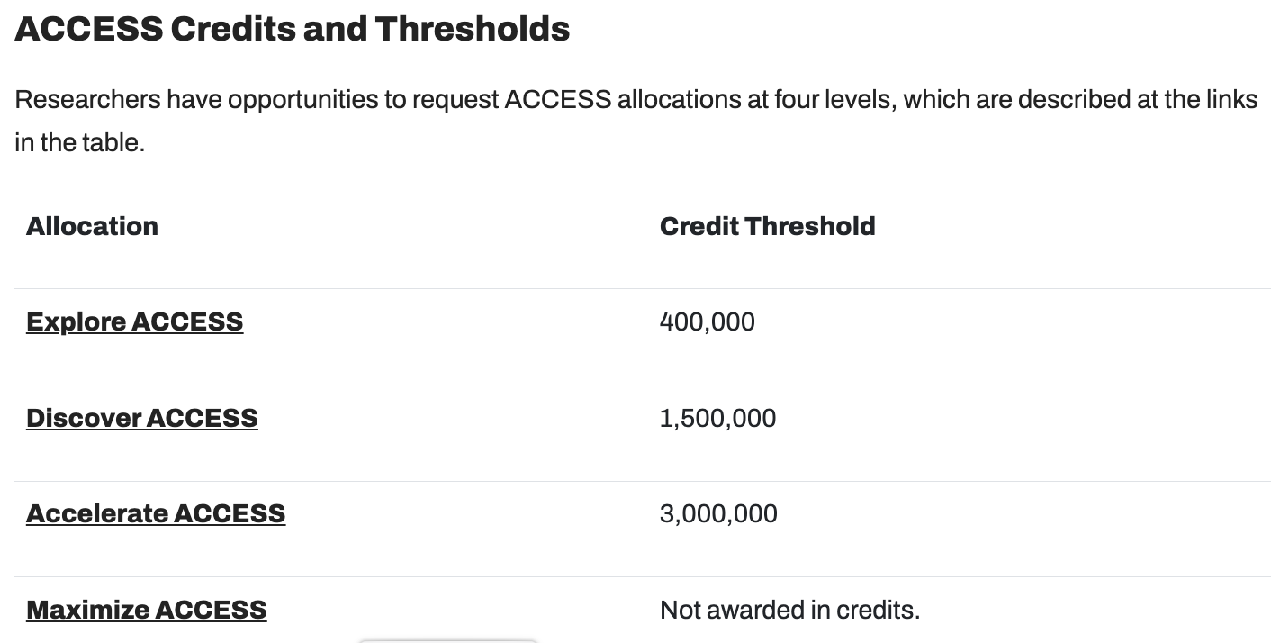
Systems, Service Providers, and Technologies
ACCESS is an advanced computing and data resource supported by the National Science Foundation (NSF). It's a collection of integrated digital resources and services, including supercomputers, visualization, and storage systems.
ACCESS is made possible through these lead institutions and their partners — Carnegie Mellon University; University of Colorado, Boulder; University of Illinois at Urbana-Champaign; and State University of New York at Buffalo.
ACCESS replaced XSEDE.
CREDIT: https://allocations.access-ci.org/
The Cyberinfrastructure Landscape: Systems, Service Providers, Technologies
Virtual Residency Introductory Workshop 2023 – Tues June 27, 2023

Slide 10
Systems, Service Providers, and Technologies
Why are there different “Credit Thresholds”?
CREDIT: https://allocations.access-ci.org/
The Cyberinfrastructure Landscape: Systems, Service Providers, Technologies
Virtual Residency Introductory Workshop 2023 – Tues June 27, 2023
Notes:
Allocations for the first three levels are awarded in ACCESS Credits, which researchers with allocations exchange for resource-specific allocations after your project is created. Credits are issued in two increments, half initially and half following the recipient's submission of a progress report.

Slide 11
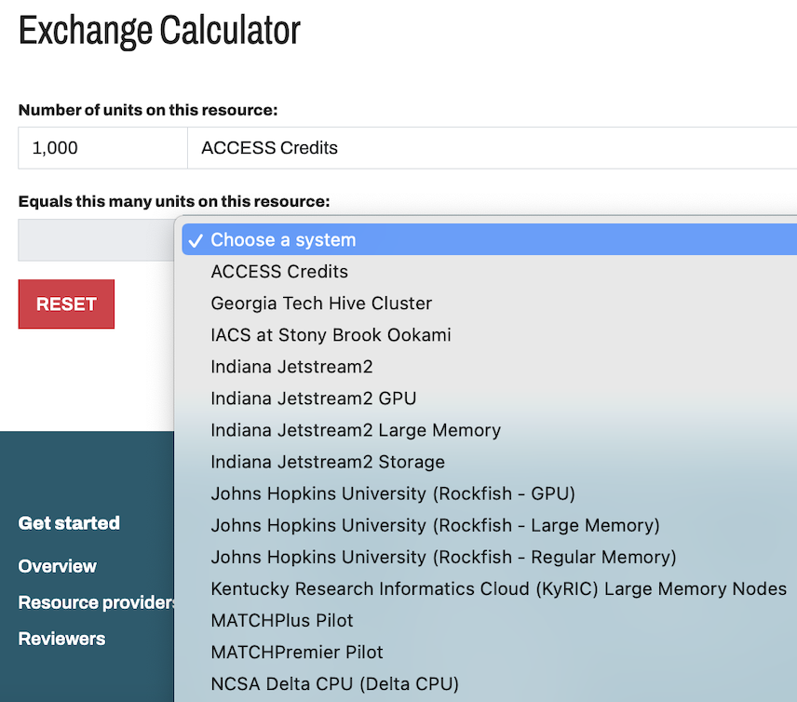
Systems, Service Providers, and Technologies
Credit Threshold Exchange Calculator
CREDIT: https://allocations.access-ci.org/
The Cyberinfrastructure Landscape: Systems, Service Providers, Technologies
Virtual Residency Introductory Workshop 2023 – Tues June 27, 2023
Notes:
I would highly recommend first using the credit threshold exchange calculator and working to estimate how much is needed for a project over time, before and after the required progress report. Remember that these are shared resources and we want to be good stewards.

Slide 12
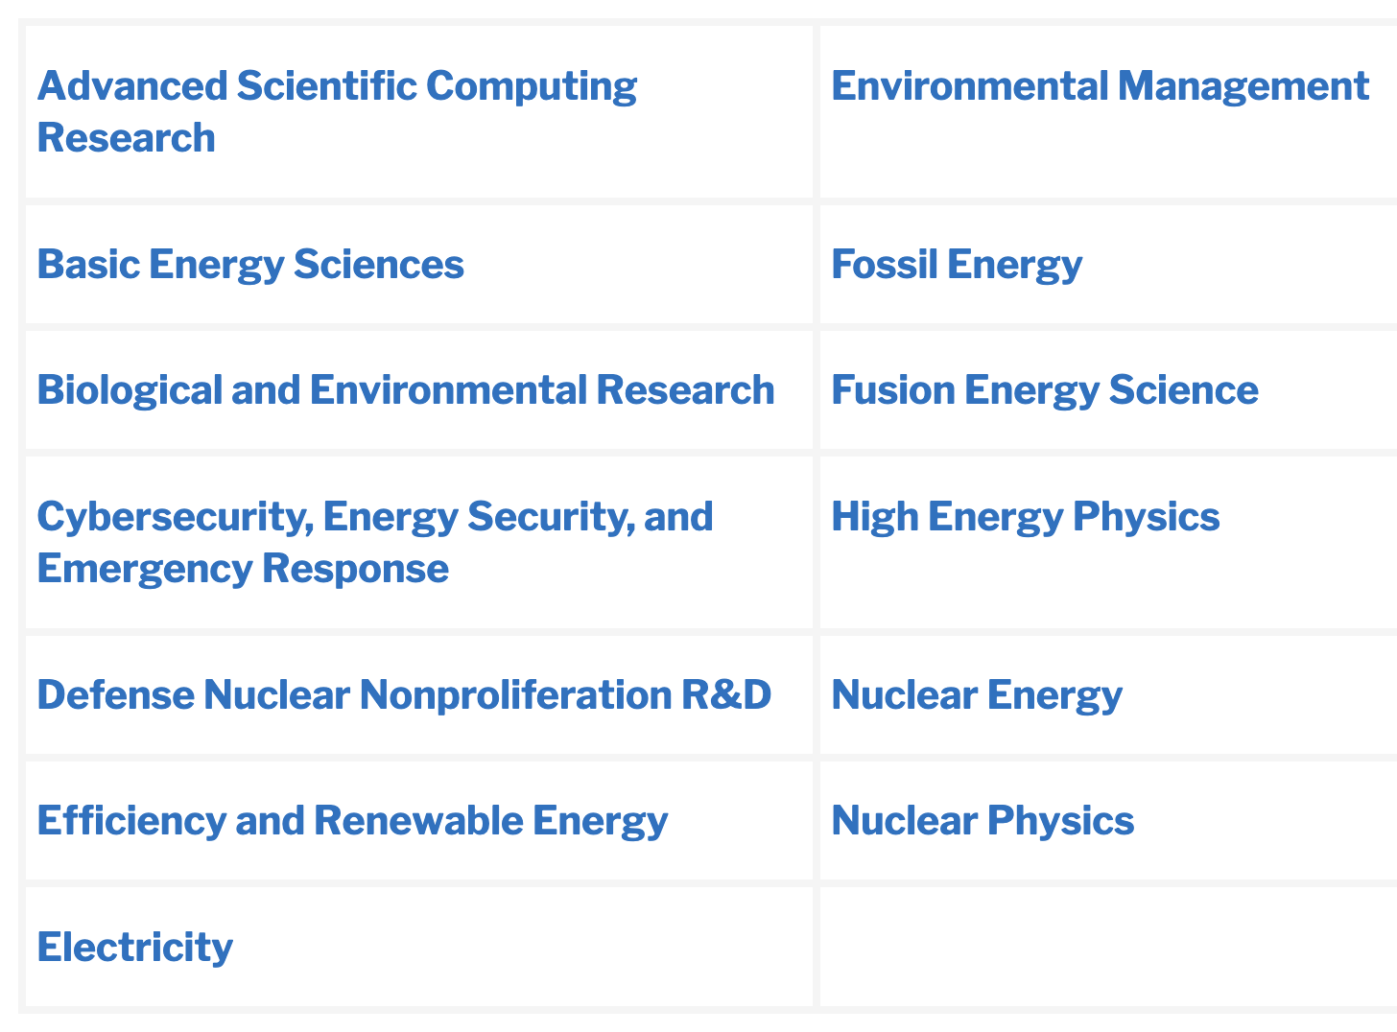
Systems, Service Providers, and Technologies
Advanced Scientific Computing Research (ASCR)
Mission: Discover, develop, and deploy computational and networking capabilities to analyze, model, simulate, and predict complex phenomena important to the Department of Energy (DOE).
CREDIT: https://science.osti.gov/ascr/Facilities/User-Facilities
The Cyberinfrastructure Landscape: Systems, Service Providers, Technologies
Virtual Residency Introductory Workshop 2023 – Tues June 27, 2023

Slide 13
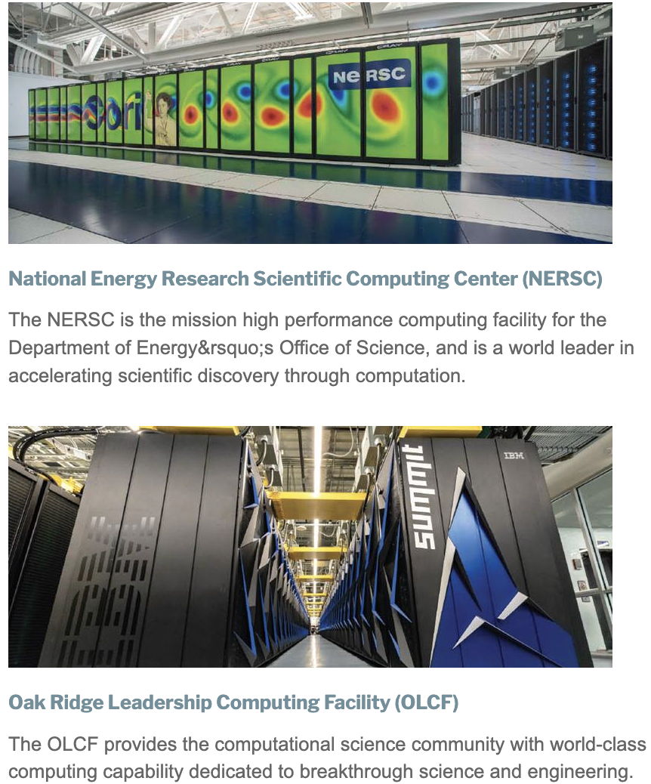
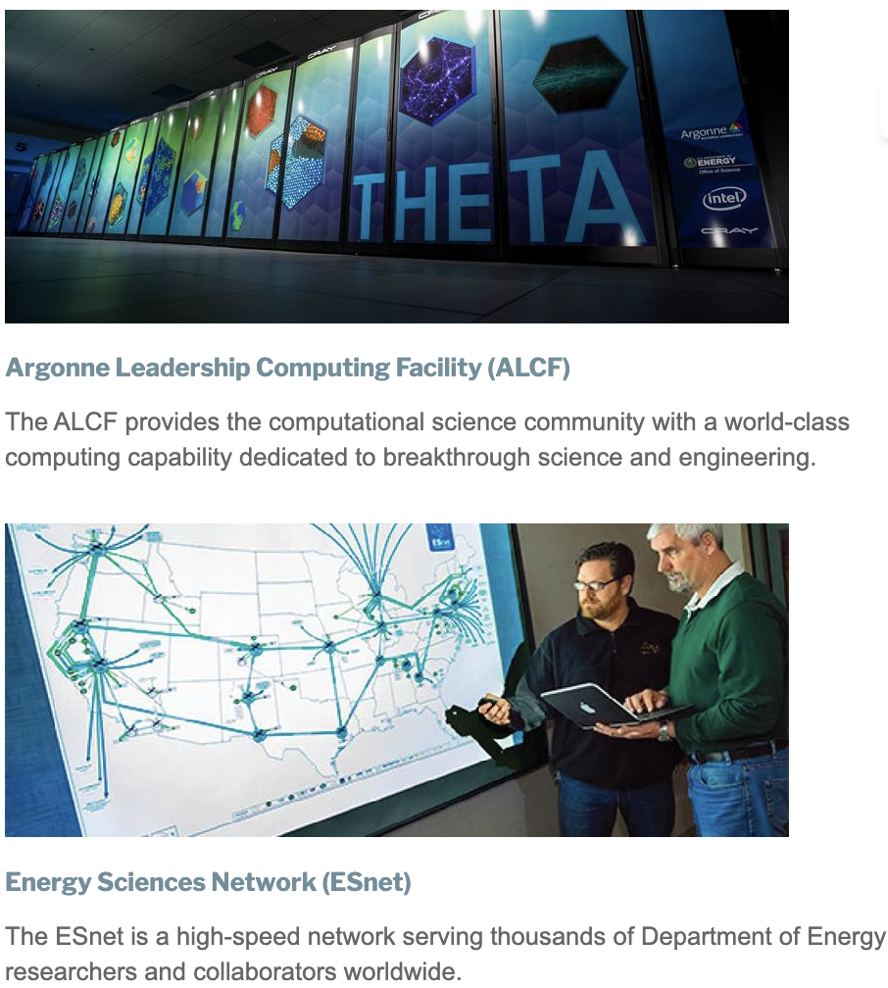
Systems, Service Providers, and Technologies
Advanced Scientific Computing Research (ASCR)
The primary objectives of the ASCR Computational Facilities Allocation Policy are: (i) support DOE Office of Science mission critical projects, and (ii) provide substantial allocations to the open science community through a peer review process for a small number of high-impact scientific research projects.
CREDIT: https://science.osti.gov/ascr/Facilities/User-Facilities
The Cyberinfrastructure Landscape: Systems, Service Providers, Technologies
Virtual Residency Introductory Workshop 2023 – Tues June 27, 2023
Notes:
DOE INCITE
Researchers may apply for an allocation of computing time on DOE HPC platforms through the DOE INCITE Leadership Computing Program. The Innovative and Novel Computational Impact on Theory and Experiment (INCITE) program is an annual competition.
Contact the INCITE Manager
If you would like to get a better understanding of the requirements for the INCITE program, contact the INCITE Manager.

Slide 14
Systems, Service Providers, and Technologies
Advanced Scientific Computing Research (ASCR)
DOE National Lab HPC Centers and Systems
The National Renewable Energy Laboratory (NREL)
https://www.nrel.gov/hpc/
Livermore Computing: HPC at LLNL, https://hpc.llnl.gov/
Los Alamos NL High Performance Computing
https://www.lanl.gov/org/ddste/aldsc/hpc/index.php
Idaho NL HPC, https://hpc.inl.gov/SitePages/Home.aspx
Oak Ridge NL’s Leadership Computing Facility, https://www.olcf.ornl.gov/
Argonne NL’s Leadership Computing Facility, https://www.alcf.anl.gov /
Sandia NL HPC, https://hpc.sandia.gov/access/
CREDIT: https://science.osti.gov/ascr/Facilities/User-Facilities
The Cyberinfrastructure Landscape: Systems, Service Providers, Technologies
Virtual Residency Introductory Workshop 2023 – Tues June 27, 2023
Notes:
DOE INCITE
Researchers may apply for an allocation of computing time on DOE HPC platforms through the DOE INCITE Leadership Computing Program. The Innovative and Novel Computational Impact on Theory and Experiment (INCITE) program is an annual competition.
Contact the INCITE Manager
If you would like to get a better understanding of the requirements for the INCITE program, contact the INCITE Manager.

Slide 15
Systems, Service Providers, and Technologies
Advanced Scientific Computing Research (ASCR)
Accessing ASCR High Throughput Network
Tools and resources deployed, developed, and maintained by the Energy Sciences Network (ESnet) are accessible through multiple mechanisms depending on the specific resource.
ESnet 100G testbed – ESnet 100 G testbed. Access is available to the research community and industry through a peer review process managed by ESnet.
ESnet Engineering Tools – ESnet develops tools and resources for network monitoring, performance and utilization in support of the DOE Office of Science’s large-scale, collaborative science programs.
OSCARS – On-demand Secure Circuits and Advance Reservation System is an advanced software system for reserving time on high speed science networks.
perfSONAR – A tool developed collaboratively with multiple partners for end-to-end monitoring and troubleshooting of multi-domain network performance.
ESnet high speed network – Accessing ESnet’s high-speed network occurs any time users send information to or from an ESnet endpoint, as when data is transported from the Large Hadron Collider at CERN to US collaborators or when citizens visit the webpage of a DOE national laboratory.
CREDIT: https://science.osti.gov/ascr/Facilities/User-Facilities
The Cyberinfrastructure Landscape: Systems, Service Providers, Technologies
Virtual Residency Introductory Workshop 2023 – Tues June 27, 2023
Notes:
Networks or commercial entities interested in peering with ESnet for the purpose of exchanging traffic should send a request to routing@es.net.

Slide 16
Systems, Service Providers, and Technologies
Established in 2005, the OSG Consortium operates a fabric of distributed High Throughput Computing (dHTC) services.
CREDIT: https://osg-htc.org/
The Cyberinfrastructure Landscape: Systems, Service Providers, Technologies
Virtual Residency Introductory Workshop 2023 – Tues June 27, 2023
Notes:
The research collaborations, campuses, national laboratories, and software providers that form the consortium are unified in their commitment to advance open science via these services.
Any US-based academic, government, or non-profit institution may operate a data origin to export their users’ data. Researchers using the OSPool from an OSG-Operated Access Point may also use an OSG operated origin.
Origins in the OSDF are generally managed by the projects or institutions that own the underlying storage. Additionally the PATh project (which funds many core OSG technologies and services) offers options for PATh-hosted origins otherwise owned by and configured specifically for relevant organizations. The caches are largely managed by OSG staff, who remotely operate the services. Some caches are dedicated to a research community or access point; a number of caches are specific to the LIGO experiment.
The annual All-Hands Meeting works to foster relationships between the researchers and campuses using OSG services and service providers in the OSG Consortium. The more than 250 attendees of the 2022 meeting were offered 38 presentations from researchers who reviewed their use of OSG services, executives who discussed the current state and future plans for the OSG services, and administrators who reported on the adoption of HTC by faculty and students on their campuses.

Slide 17
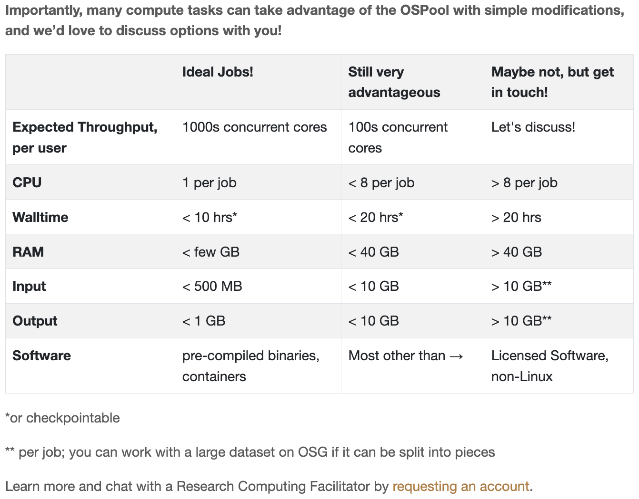
Systems, Service Providers, and Technologies
Submit Locally, Run Globally
Researchers can run jobs on OSG from their home institution or an OSG-Operated Access Point (available for US-based research and scholarship).
The OSG Software Stack
The OSG provides an integrated software stack to enable high throughput computing; visit our technical documents website for information.
CREDIT: https://osg-htc.org/
The Cyberinfrastructure Landscape: Systems, Service Providers, Technologies
Virtual Residency Introductory Workshop 2023 – Tues June 27, 2023
Notes:
The OSG facilitates access to distributed high throughput computing for research in the US. The resources accessible through the OSG are contributed by the community, organized by the OSG, and governed by the OSG consortium. In the last 12 months, they have provided more than 1.2 billion CPU hours to researchers.

Slide 18
Systems, Service Providers, and Technologies
CREDIT: https://osg-htc.org/
The Cyberinfrastructure Landscape: Systems, Service Providers, Technologies
Virtual Residency Introductory Workshop 2023 – Tues June 27, 2023
Notes:
The OSG facilitates access to distributed high throughput computing for research in the US. The resources accessible through the OSG are contributed by the community, organized by the OSG, and governed by the OSG consortium. In the last 12 months, they have provided more than 1.2 billion CPU hours to researchers.

Slide 19
Systems, Service Providers, and Technologies
The National Research Platform (NRP) is a partnership of more than 50 institutions, led by researchers and cyberinfrastructure professionals at UC San Diego. The NRP is supported in part by awards from the National Science Foundation.
The NRP is an all-in-one system that includes computing resources, research, and education. It is designed for distributed growth and expansion.
CREDIT: https://nationalresearchplatform.org/
The Cyberinfrastructure Landscape: Systems, Service Providers, Technologies
Virtual Residency Introductory Workshop 2023 – Tues June 27, 2023
Notes:
Nautilus and Kubernetes have a concept of equipment aging out and how that affects BYOR nodes. When a user’s BYOR node gets hung or drops dead, Kubernetes logically off-lines it and it is rebooted. If it doesn’t come up, it either gets fixed with local hands-on help or recycled. Some of our GPU nodes are 5 years old already and are approaching being not worth fixing.
Nautilus background mode delivers cycles very satisfactorily if the user code is checkpointed. The huge IceCube computations run this way and do not impact real-time users.

Slide 20
Systems, Service Providers, and Technologies
Nautilus is a powerful nationally distributed computer system with CPUs, GPUs, and FPGAs, in two types of subsystems (“high-performance FP64/FPGA” and “FP32-optimized”), specialized for a wide range of data science, simulations, and machine learning or artificial intelligence, allowing data access through a federated national-scale content delivery network.
CREDIT: https://nationalresearchplatform.org/
The Cyberinfrastructure Landscape: Systems, Service Providers, Technologies
Virtual Residency Introductory Workshop 2023 – Tues June 27, 2023
Notes:
NRP is the name of the set of programs, facilities, and policies that are designed for distributed growth and expansion. NRP’s primary computation, storage, and network resource is a ~300 node distributed cluster called Nautilus that will grow significantly by the end of 2022. Nautilus hosts many network testing data transfer nodes including ones used by the Open Science Grid (OSG).

Slide 21
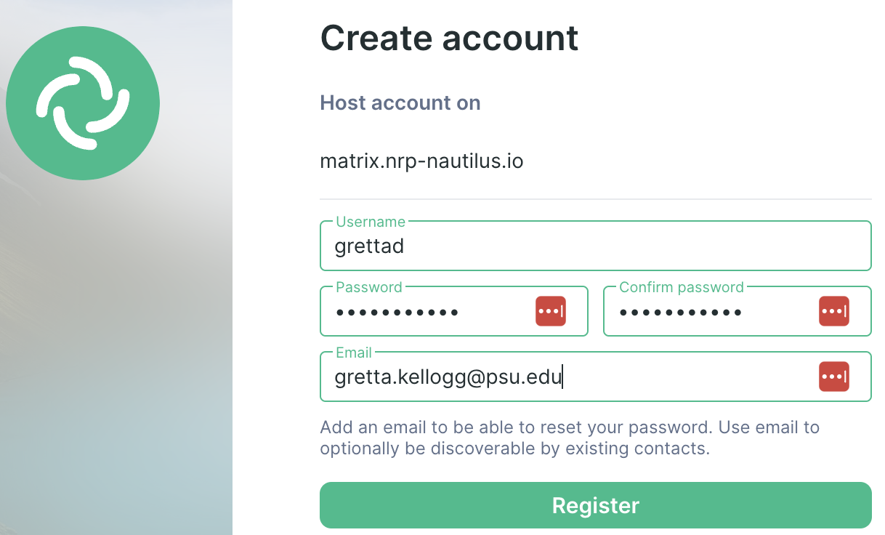
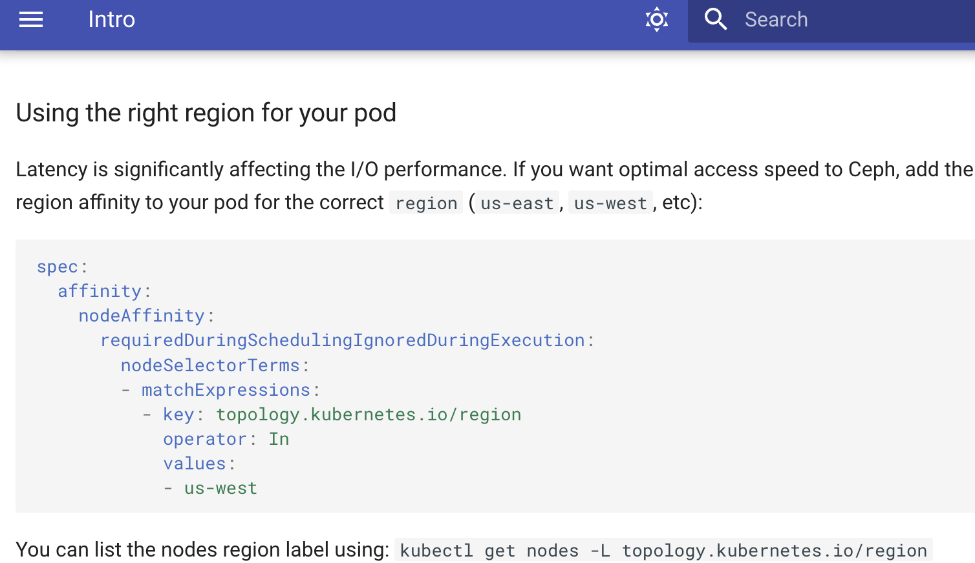
Systems, Service Providers, and Technologies
To get started on NRP/Nautilus, users go to https://nationalresearchplatform.org/ and start at join/contact.
There are JupyterLab notebooks available that address certain classes of need and reduce the pain of getting started a lot, if they do what is needed. They may need to get a cyberinfrastructure professional programmer to assist. Matrix is the online chat room we run; the developers, cyberinfrastructure professionals, and sysadmins prefer to monitor Matrix rather than e-mail.
CREDIT: https://nationalresearchplatform.org/
The Cyberinfrastructure Landscape: Systems, Service Providers, Technologies
Virtual Residency Introductory Workshop 2023 – Tues June 27, 2023
Notes:
Joining via web page
Navigate to our hosted web version of element.io
Choose Create Account, then create an account by entering a desired username, password and (optional) email.
After that you’ll get an account of the form @username:matrix.nrp-nautilus.io, which you can use to join rooms in any federated [matrix] resourse, including the original matrix.org.
Click explore rooms button. Check that you’re exploring the NRP server (matrix.nrp-nautilus.io). Join the Nautilus General channel. Also join the News channel.
(Optional) Join the NRP Community by clicking the +nrp:matrix.nrp-nautilus.io URL in the header of the General channel. Another link to it is: https://matrix-to.nrp-nautilus.io/#/+nrp:matrix.nrp-nautilus.io. It has a list of channels you can join.

Slide 22
Systems, Service Providers, and Technologies
CREDIT: https://www.psc.edu/resources/bridges-2/
The Cyberinfrastructure Landscape: Systems, Service Providers, Technologies
Virtual Residency Introductory Workshop 2023 – Tues June 27, 2023
Notes:
Bridges-2 integrates new technologies for converged, scalable HPC, machine learning and data; prioritizes researcher productivity and ease of use; and provides an extensible architecture for interoperation with complementary data-intensive projects, campus resources, and clouds.
Bridges-2 is available at no cost for research and education, and at cost-recovery rates for other purposes.
I’ll mention this example from ACCESS because I lived in Pittsburgh when I was young, I have used these systems, plus I met Co-Directors Michael Levine (right) and Ralph Roskies long ago - so it has a special place in my heart.

Slide 23
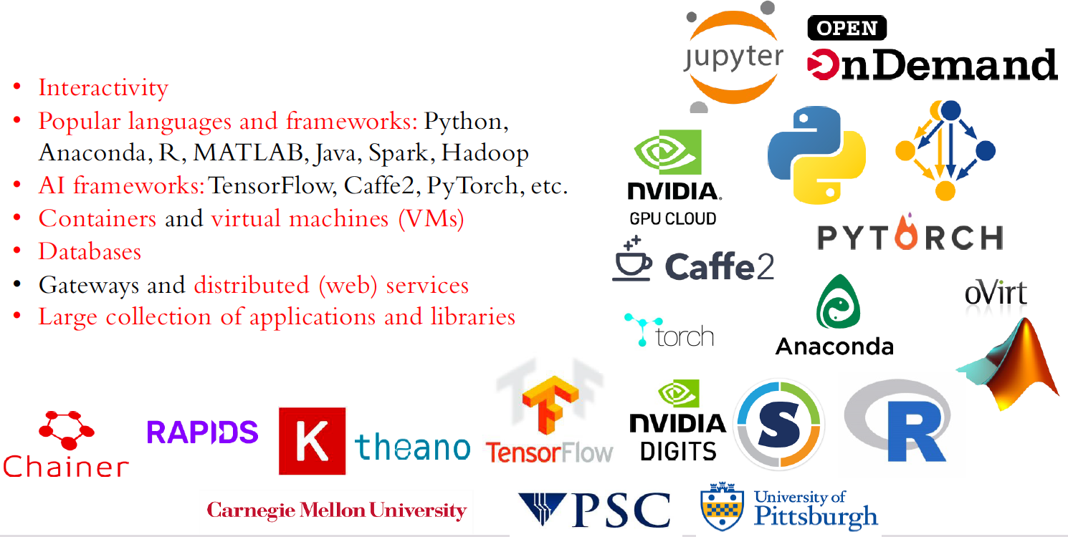
Systems, Service Providers, and Technologies
CREDIT: https://www.psc.edu/resources/bridges-2/
The Cyberinfrastructure Landscape: Systems, Service Providers, Technologies
Virtual Residency Introductory Workshop 2023 – Tues June 27, 2023
Notes:
Bridges-2 integrates new technologies for converged, scalable HPC, machine learning and data; prioritizes researcher productivity and ease of use; and provides an extensible architecture for interoperation with complementary data-intensive projects, campus resources, and clouds.
Bridges-2 is available at no cost for research and education, and at cost-recovery rates for other purposes.

Slide 24
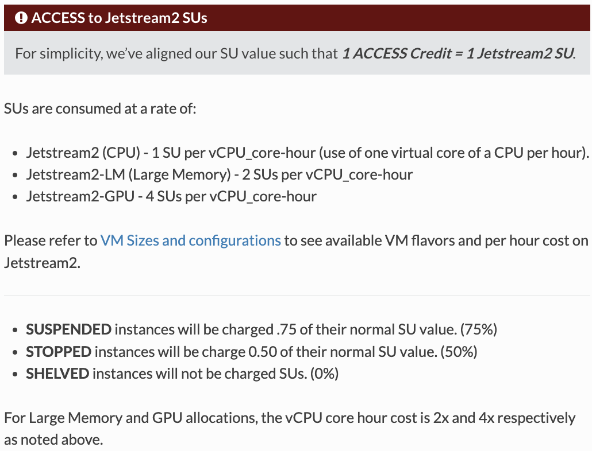
Systems, Service Providers, and Technologies
With a focus on ease of use and broad accessibility, Jetstream2 is designed for those who have not previously used high performance computing and software resources.
The system is particularly geared toward 21st-century workforce development at small colleges and universities—in EPSCoR states.
CREDIT: https://jetstream-cloud.org/about/index.html
The Cyberinfrastructure Landscape: Systems, Service Providers, Technologies
Virtual Residency Introductory Workshop 2023 – Tues June 27, 2023
Notes:
Jetstream2 is meant primarily for interactive research, small scale processing on demand, or as the backend to science gateways to send research jobs to other HPC or HTC resources, or for general infrastructure for research or research-related development.

Slide 25
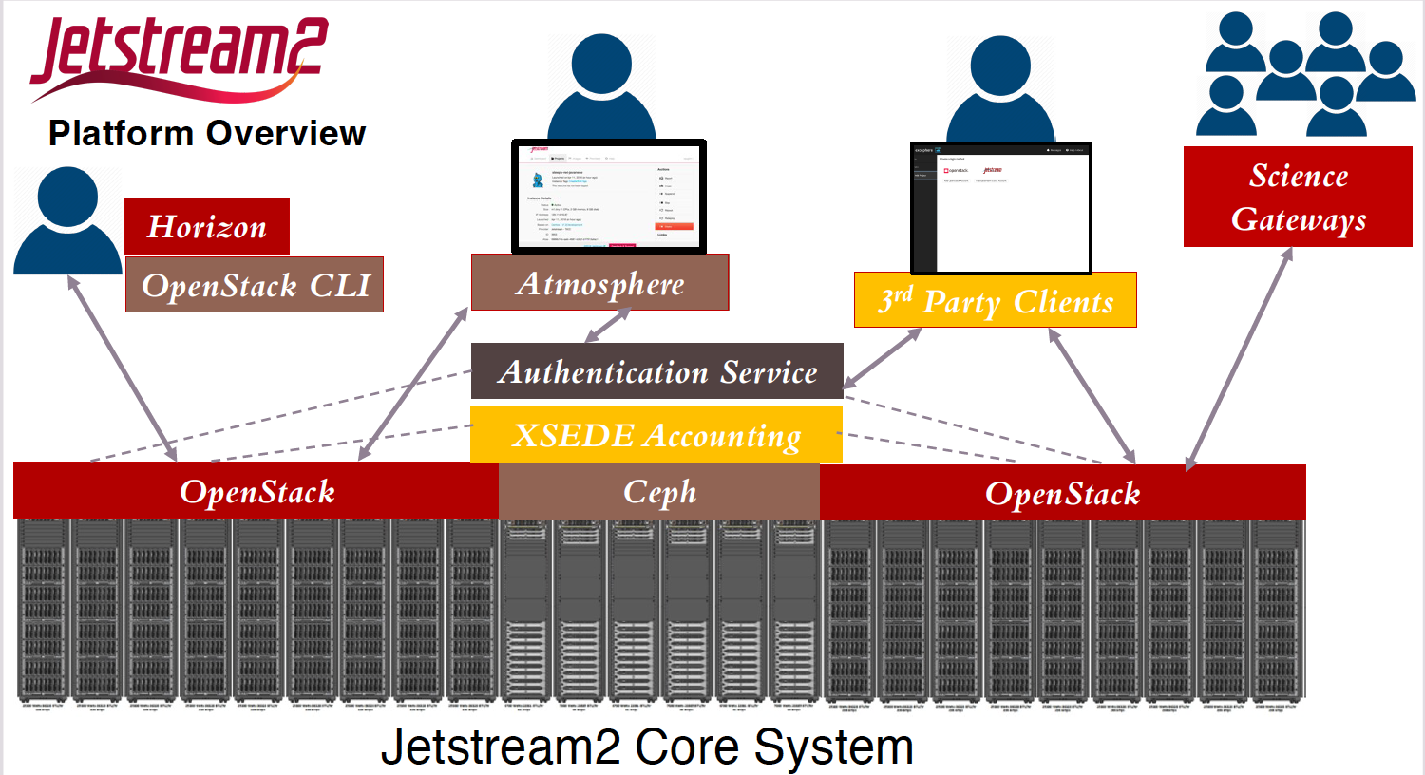
Systems, Service Providers, and Technologies
Core capabilities
Interactive virtual machines (VMs)
Globus Transfer
Virtual Desktops
Digital Object Identifiers (DOIs)
CREDIT: https://jetstream-cloud.org/about/index.html
The Cyberinfrastructure Landscape: Systems, Service Providers, Technologies
Virtual Residency Introductory Workshop 2023 – Tues June 27, 2023
Notes:
Core capabilities
Interactive virtual machines (VMs)—both a public library of preconfigured VMs and a private library with saved, personalized versions
Secure data movement using Globus Transfer
Virtual desktops for access from a tablet or laptop over a cellular network
Reproducible data analysis using digital object identifiers (DOIs) stored and published via IU’s digital archive

Slide 26
Systems, Service Providers, and Technologies
Cyberinfrastructure Center of Excellence called, “SGX3 - A Center of Excellence to Extend Access, Expand the Community, and Exemplify Good Practices for CI Through Science Gateways,” under NSF award #2231406.
Are you building websites that serve your discipline?
Do you wish you could connect with and learn from others, doing the same thing?
This community driven information was used to form the Science Gateways Community Institute (SGCI) in 2016 under NSF award #1547611. To date, the SGCI has served over 200 clients with a variety of services, had over 3,400 attendees to its community building events, supported 1,200 students and faculty, and produced 195 research products.
CREDIT: https://sciencegateways.org/about
The Cyberinfrastructure Landscape: Systems, Service Providers, Technologies
Virtual Residency Introductory Workshop 2023 – Tues June 27, 2023
Notes:
WHAT SGCI DOES
In-Depth Consultation
When your needs go beyond advice on usability, architecture, and sustainability, our consultants can become part of your project team to help your project achieve success. See our storybook (link) for examples of how we can help.
Gateways as a Service
When you want a gateway but don’t want the difficulties associated with creating or operating it, SGCI offers a full-service solution to handle this for you so you can focus on science and community building and have SGCI assist with operations and infrastructure.
• Science Gateways simplify access to computing resources by hiding infrastructure complexities.
• Science Gateways provide higher level user interface for XSEDE resources that are tailored to
specific scientific communities. (https://www.xsede.org/ecosystem/science-gateways/gateways-listing)
• A Science Gateway is a community developed set of tools, applications, and data that are
integrated via a portal or a suite of applications, usually in a graphical user interface, that is further
customized to meet the needs of a specific community

Slide 27
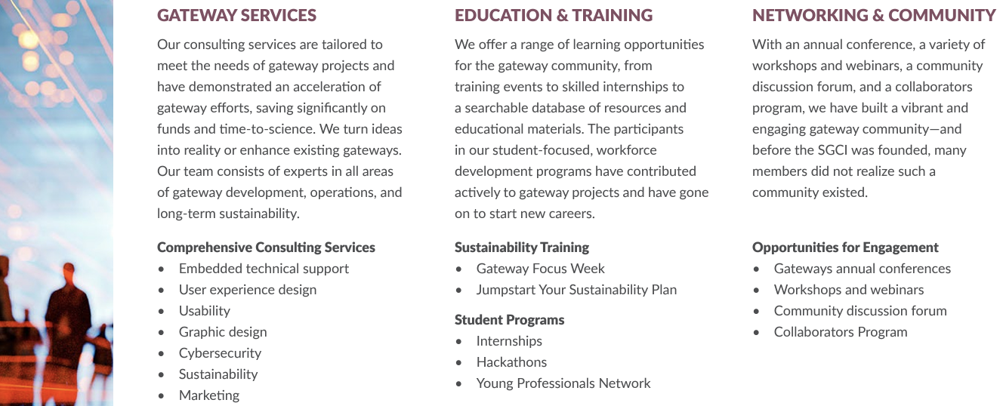
Systems, Service Providers, and Technologies
CREDIT: https://sciencegateways.org/app/site/media/files/SGCI_storybook_interactive_v2022-12-13.pdf
The Cyberinfrastructure Landscape: Systems, Service Providers, Technologies
Virtual Residency Introductory Workshop 2023 – Tues June 27, 2023
Notes:
The SGCI Storybook is an encouraging and enlightening read, very encouraging to pass along to researchers who are all trying to solve the same problems of bringing their efforts online and building their own communities.
This collection of vignettes from SGCI client engagements and programs as much as the SGCI team enjoyed working with these community members to bring their dreams closer to realization.

Slide 28
Systems, Service Providers, and Technologies
CREDIT: https://sciencegateways.org/app/site/media/files/SGCI_storybook_interactive_v2022-12-13.pdf
The Cyberinfrastructure Landscape: Systems, Service Providers, Technologies
Virtual Residency Introductory Workshop 2023 – Tues June 27, 2023
Notes:
The SGCI Storybook is an encouraging and enlightening read, very encouraging to pass along to researchers who are all trying to solve the same problems of bringing their efforts online and building their own communities.
This collection of vignettes from SGCI client engagements and programs as much as the SGCI team enjoyed working with these community members to bring their dreams closer to realization.

Slide 29
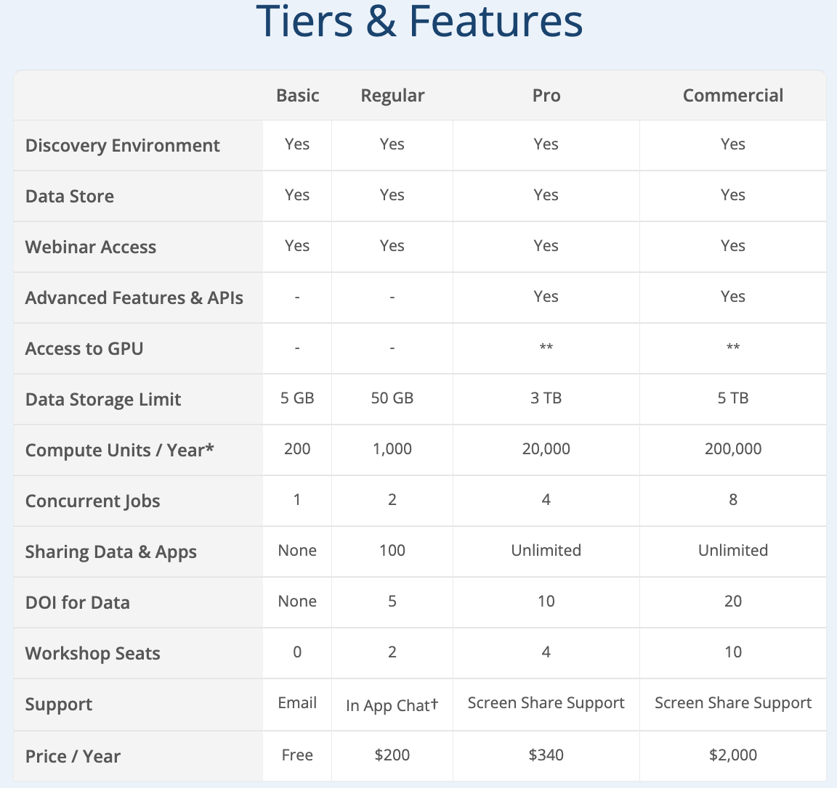
Systems, Service Providers, and Technologies
Vision: Transforming Science through Data-Driven Discovery
Mission: To design, deploy, and expand national Cyberinfrastructure for research, and to train scientists in its use.
About: CyVerse provides scientists with powerful platforms to handle huge datasets and complex analyses, thus enabling data-driven discovery. Our extensible platforms provide data storage, bioinformatics tools, data visualization, interactive analyses, cloud services, APIs, and more.
CREDIT: https://www.cyverse.org/about
The Cyberinfrastructure Landscape: Systems, Service Providers, Technologies
Virtual Residency Introductory Workshop 2023 – Tues June 27, 2023
Notes:
continuing to serve this community as they pursue a sustainable institute.

Slide 30
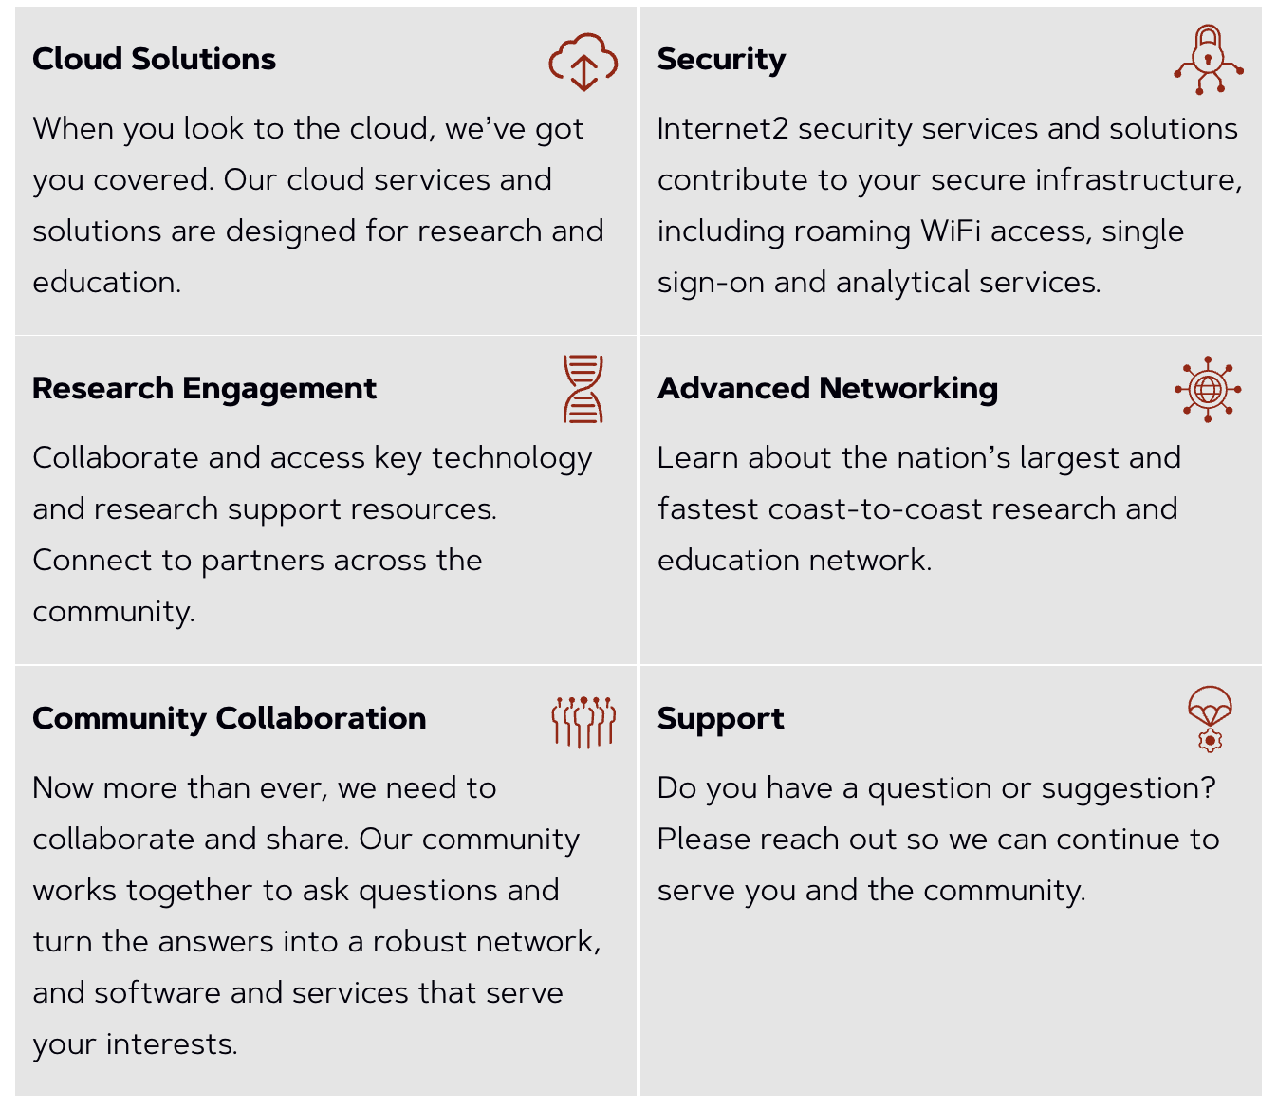
Systems, Service Providers, and Technologies
Internet2 is a community organization: Higher education and Research institutions - Government entities, corporations and cultural organizations
Cyberinfrastructure provider: secure high-speed network, cloud solutions, research support, services tailored for research and education
Through InCommon: Security and privacy, IAM tools for research and education, single sign-on (SSO) for access to cloud and local research computing services and roaming wi-fi w/ eduroam
CREDIT: https://internet2.edu/
The Cyberinfrastructure Landscape: Systems, Service Providers, Technologies
Virtual Residency Introductory Workshop 2023 – Tues June 27, 2023
Notes:
- Internet2 is a community: - Higher education and Research institutions - Government entities, corperations and cultural
organizations - Cyberinfrastructure provider: - secure high-speed network, cloud solutions, - research support, services tailored for research
and education - Through InCommon provides: - Security and privacy, - IAM tools for research and education, - single sign-on (SSO) for access to cloud local
services and roaming wi-fi

Slide 31
Systems, Service Providers, and Technologies
The Minority Serving – Cyberinfrastructure Consortium (MS-CC) and Internet2 have been awarded a nearly $15 million grant from the National Science Foundation (NSF) to support the acceleration of cyberinfrastructure-centric research capacity at HBCU and TCU campuses.
Funding supports accelerating cyberinfrastructure-centric research capacity at historically Black colleges and universities (HBCUs) and tribal colleges and universities (TCUs) through proof-of-concept grants and shared resources
CREDIT: https://internet2.edu/
The Cyberinfrastructure Landscape: Systems, Service Providers, Technologies
Virtual Residency Introductory Workshop 2023 – Tues June 27, 2023
Notes:
The Minority Serving – Cyberinfrastructure Consortium (MS-CC) envisions a transformational partnership to promote advanced cyberinfrastructure capabilities on the campuses of historically Black colleges and universities (HBCUs), Hispanic-serving institutions (HSIs), tribal colleges and universities (TCUs), and other minority serving institutions (MSIs).
The MS-CC focuses on building a trusted community among institutions to advance the following efforts:
Community and Capacity Building
Workforce Development
Research Support and Acceleration
To learn more about the MS-CC’s purpose, vision, community, and how you can get involved and join, please visit www.ms-cc.org

Slide 32
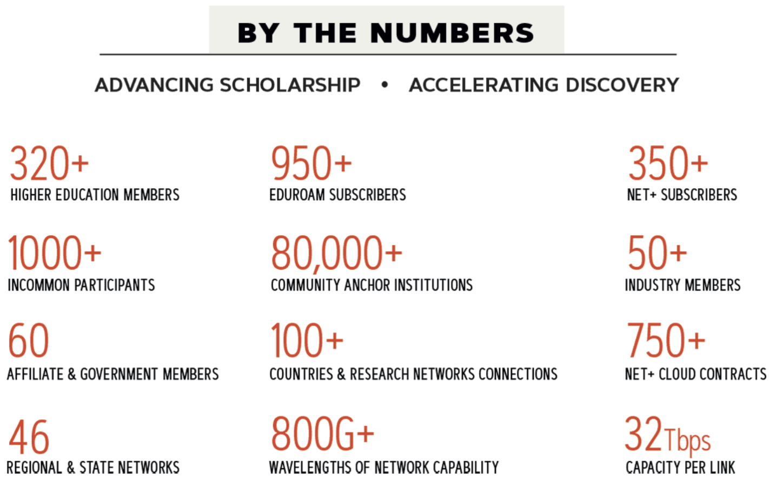
Systems, Service Providers, and Technologies
CREDIT: https://internet2.edu/
The Cyberinfrastructure Landscape: Systems, Service Providers, Technologies
Virtual Residency Introductory Workshop 2023 – Tues June 27, 2023
Notes:
Internet2 is a community providing a secure high-speed network, cloud solutions, research support, and services tailored for research and education. Our community includes higher education, research institutions, government entities, corporations and cultural organizations.
Internet2, formally titled the University Corporation for Advanced Internet Development (UCAID), is a not-for-profit organization governed by a Board of Trustees who represent our diverse membership.
Through InCommon, Internet2 provides security, privacy, and IAM tools built for research and education: single sign-on (SSO), access to cloud and local services, and roaming wi-fi.

Slide 33
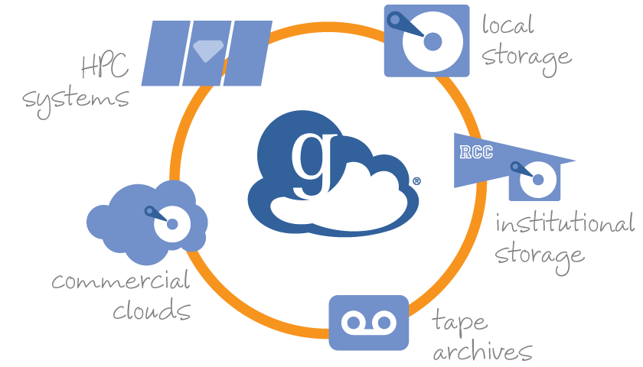
Systems, Service Providers, and Technologies
The Cyberinfrastructure Landscape: Systems, Service Providers, Technologies
Virtual Residency Introductory Workshop 2023 – Tues June 27, 2023
Notes:
What would you describe as a tool? Put into the chat in zoom your favorite tools for research computing. Include the URLs if you have them.

Slide 34
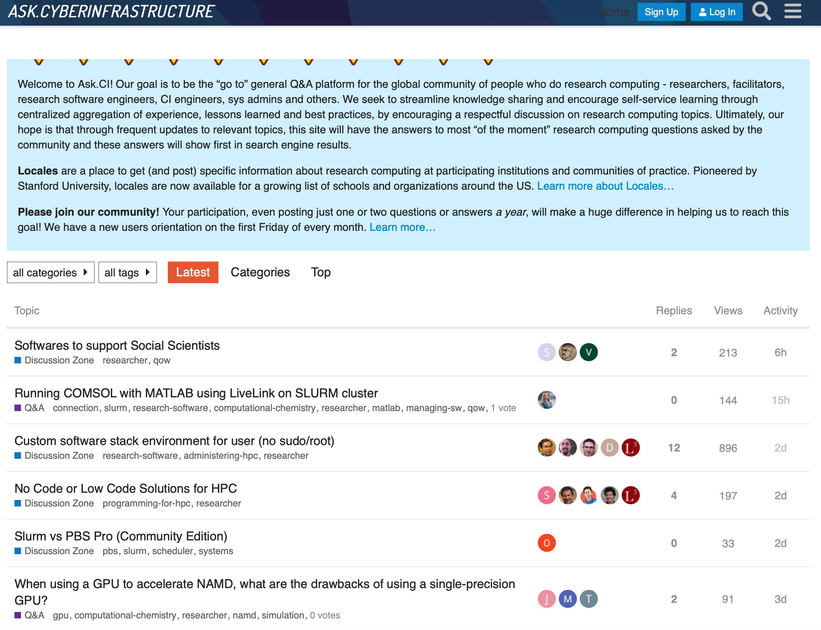
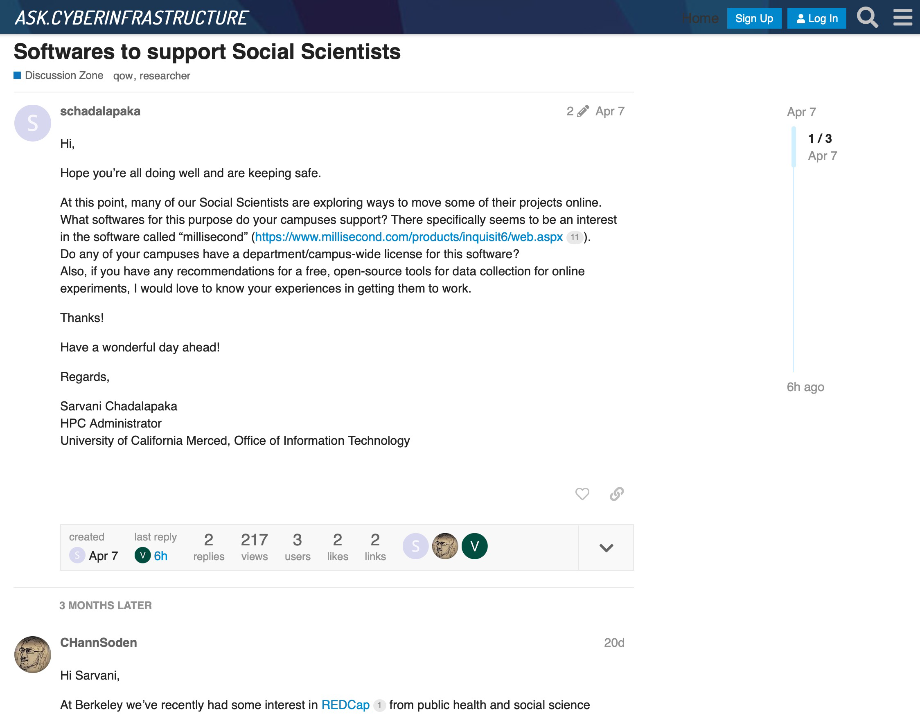
Systems, Service Providers, and Technologies
Online tools like ask.CI foster more than code snippet copy/paste, it involves discussions of best approaches.
CREDIT: https://ask.cyberinfrastructure.org/
The Cyberinfrastructure Landscape: Systems, Service Providers, Technologies
Virtual Residency Introductory Workshop 2023 – Tues June 27, 2023
Notes:
• Sites like Stack Exchange are dominated by the much larger enterprise IT sector.
• Research Computing questions benefit from discussion, not always just one answer.
Welcome to Ask.CI! Our goal is to be the “go to” general Q&A platform for the global research computing community - researchers, facilitators, research software engineers, CI engineers, sys admins and others. We seek to streamline knowledge sharing and encourage self-service learning through centralized aggregation of experience, lessons learned and best practices, by encouraging a respectful discussion on research computing topics.
We welcome the NSF ACCESS Community! ACCESS (Advanced Cyberinfrastructure Coordination Ecosystem: Services & Support) is a new program to improve the accessibility of national cyberinfrastructure centers and increase integration with systems and research communities on campuses across the nation. New forums to support ACCESS Resource Providers are under development in the ACCESS Forums category.

Slide 35
Systems, Service Providers, and Technologies
Search the ACCESS Knowledge Universe. Search is an evolving feature and will improve with time. If you have suggestions to help train this search please use this form.
The Cyberinfrastructure Landscape: Systems, Service Providers, Technologies
Virtual Residency Introductory Workshop 2023 – Tues June 27, 2023
Notes:
Knowing where to find the plethora of resources is better than having endless slides with only a few of your favorites called out.

Slide 36
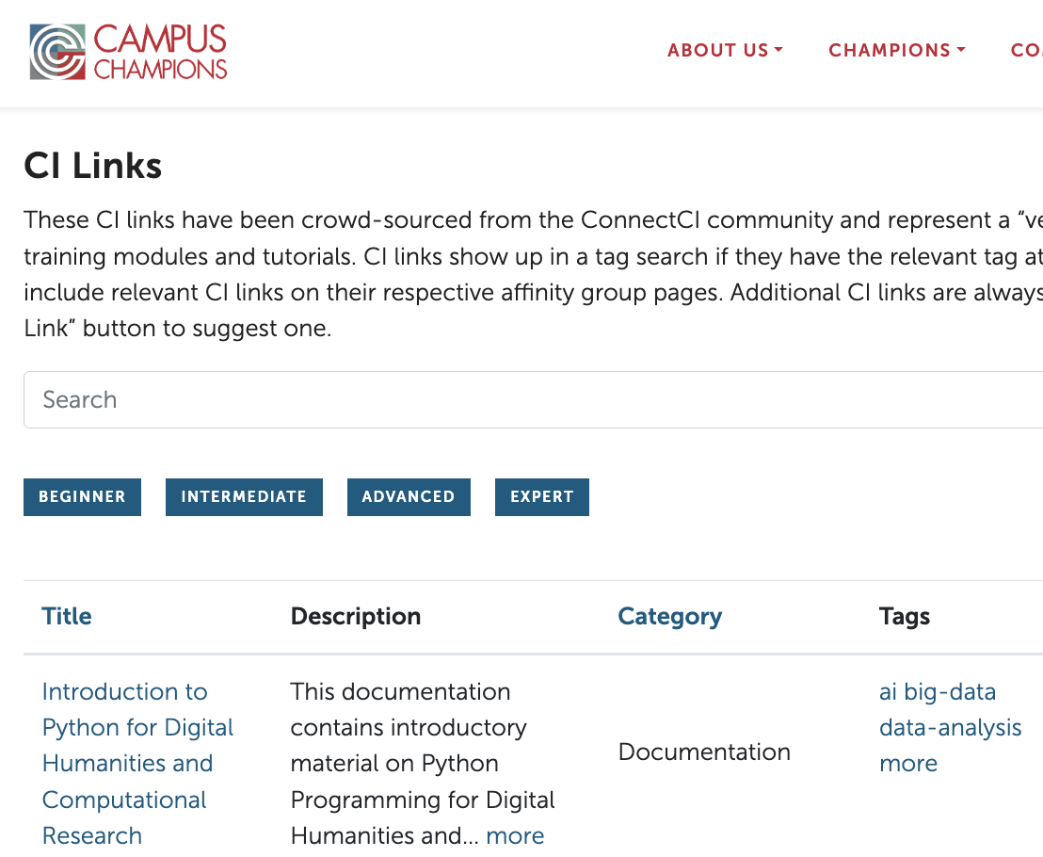
Systems, Service Providers, and Technologies
CI links have been crowd-sourced from the ConnectCI community and represent a “vetted” list of useful websites, training modules and tutorials.
CI links show up in a tag search if they have the relevant tag attached. Affinity groups can include relevant CI links on their respective affinity group pages. Additional CI links are always welcome, click the “Add New CI Link” button to suggest one.
CREDIT: https://campuschampions.cyberinfrastructure.org/ci-links
The Cyberinfrastructure Landscape: Systems, Service Providers, Technologies
Virtual Residency Introductory Workshop 2023 – Tues June 27, 2023
Notes:
• Sites like Stack Exchange are dominated by the much larger enterprise IT sector.
• Research Computing questions benefit from discussion, not always just one answer.
Welcome to Ask.CI! Our goal is to be the “go to” general Q&A platform for the global research computing community - researchers, facilitators, research software engineers, CI engineers, sys admins and others. We seek to streamline knowledge sharing and encourage self-service learning through centralized aggregation of experience, lessons learned and best practices, by encouraging a respectful discussion on research computing topics.
We welcome the NSF ACCESS Community! ACCESS (Advanced Cyberinfrastructure Coordination Ecosystem: Services & Support) is a new program to improve the accessibility of national cyberinfrastructure centers and increase integration with systems and research communities on campuses across the nation. New forums to support ACCESS Resource Providers are under development in the ACCESS Forums category.

Slide 37
Systems, Service Providers, and Technologies
The mission of the Campus Champions is to foster a dynamic environment for a diverse community of research computing and data professionals sharing knowledge and experience in digital research infrastructure.
CREDIT: https://campuschampions.cyberinfrastructure.org/
The Cyberinfrastructure Landscape: Systems, Service Providers, Technologies
Virtual Residency Introductory Workshop 2023 – Tues June 27, 2023
Notes:
Which brings us to the communities engaged with us to use these tools and services. Campus Champions history has already been covered by Henry yesterday. All flavors of campus research computing professionals (directors, sysadmins, user support, trainers, coordinators, etc) Plus new “affiliates” – from organizations that serve the larger community (ACCESS, Internet2, Globus, National Centers, etc.)
Cyberinfrastructure Professionals
A Campus Champion is an employee of, or affiliated with, a college or university (or other institution engaged in research), whose role includes helping their institution's researchers, educators and scholars (faculty, postdocs, graduate students, undergraduates, and professionals) with their computing-intensive and data-intensive research, education, scholarship and/or creative activity, including but not limited to helping them to use advanced digital capabilities to improve, grow and/or accelerate these achievements.

Slide 38
Systems, Service Providers, and Technologies
CREDIT: https://campuschampions.cyberinfrastructure.org/
The Cyberinfrastructure Landscape: Systems, Service Providers, Technologies
Virtual Residency Introductory Workshop 2023 – Tues June 27, 2023
Notes:
Mentors, Peers, and Students
Campus Champions peer-mentor each other, to learn to be more effective. The Campus Champion community has a very active mailing list where Champions exchange ideas and help each other solve problems, regular conference calls where we learn what's going on both within the Champions and at the national level, and a variety of other activities.
In addition to traditional Campus Champions, the Champion Program includes specialized Champions:
Student Champions - offering a unique student perspective on the use of digital resources and services
Champions Fellows - the Fellows Program partners Campus Champions with Extended Collaborative Support Services (ECSS) staff and research teams to work side by side on real-world science and engineering projects.

Slide 39
Systems, Service Providers, and Technologies
People who use or support people who use ACCESS resources and the ACCESS Resource Allocation System.
ACCESS Affinity Groups encourage community members to gather based on common interests, and they provide connections to AG-specific slack channels, Q&A Forums, events, and relevant knowledge base resources. Joining ACCESS Resource Provider Affinity Groups (AGs) will add you to the distribution list for notifications about outages, news, and training events specific to the Resource Provider named.
CREDIT: https://support.access-ci.org/affinity_groups
The Cyberinfrastructure Landscape: Systems, Service Providers, Technologies
Virtual Residency Introductory Workshop 2023 – Tues June 27, 2023
Notes:
Mentors, Peers, and Students
Campus Champions peer-mentor each other, to learn to be more effective. The Campus Champion community has a very active mailing list where Champions exchange ideas and help each other solve problems, regular conference calls where we learn what's going on both within the Champions and at the national level, and a variety of other activities.
In addition to traditional Campus Champions, the Champion Program includes specialized Champions:
Student Champions - offering a unique student perspective on the use of digital resources and services
Champions Fellows - the Fellows Program partners Campus Champions with Extended Collaborative Support Services (ECSS) staff and research teams to work side by side on real-world science and engineering projects.

Slide 40
CONVERSATIONS
Thanks for your attention!
Instead of asking for questions per se, I am asking the group here – in the chat – put your favorite “go-to” resource – anything that was touched on here or not mentioned at all and you just cannot see living without it!
Share a link or a brief call-out.
ACKNOWLEDGEMENTS:
2022 Virtual Residency speaker - "The Cyberinfrastructure Landscape: Systems, Service Providers, Technologies”, Jacob Fosso Tande, The University of North Carolina at Greensboro
2021 Virtual Residency speaker - "The CI Milieu: Systems, Service Providers, Technologies”, Douglas Jennewein, Arizona State U
The Cyberinfrastructure Landscape: Systems, Service Providers, Technologies
Virtual Residency Introductory Workshop 2023 – Tues June 27, 2023
Notes:
Thanks for your attention, contributions to this discussion in the chat and in the Google document! Thank you especially to all those hard-working research computing facilitators, your help is always appreciated!

Slide 41
The Cyberinfrastructure Landscape: Systems, Service Providers, Technologies
Virtual Residency Introductory Workshop 2023 – Tues June 27, 2023

Slide 42
What Is Cyberinfrastructure? What is Cyberinfrastructure (CI)? That depends on who you ask: Network engineers: CI is the network. Supercomputing professionals: CI is supercomputers, plus the network. Cybersecurity professionals: Cyberinfrastructure is everything that needs cybersecurity. Everyone else: CI is my thing, plus supercomputers, plus the network.
What is a CI Facilitator? “Advanced Cyberinfrastructure Research & Education Facilitator” (ACI-REF –term coined by Miron Livny) Work with users –researchers and educators –to help them improve their research and/or education productivity and aspirations via advanced Cyberinfrastructure (CI). Typically, one or a few CI Facilitators have responsibility for an entire institution, or even multiple institutions. At some institutions, CI Facilitation is part time; at others, it’s full time. Some CI Facilitators are or used to be: faculty (current or former); postdocs (current or former); research staff (current or former); IT professionals, including from Enterprise IT (current or former); graduate or undergraduate students (current or former).
The Five Facings
Researcher-facing (e.g., CI Facilitator)
System-facing (e.g., cluster sysadmin, network engineer)
Data-facing (e.g., Research Data Librarian)
Software-facing (e.g., Research Software Engineer) Strategy/policy-facing (e.g., institutional CI leader)
The Cyberinfrastructure Landscape: Systems, Service Providers, Technologies
Virtual Residency Introductory Workshop 2023 – Tues June 27, 2023

