Slide 1

The internet is fine I’m on Facebook right now!
A discussion on how networking in support of data intensive research is not at all the same as networking for general use.
Virtual Residency Introductory Workshop 2022

Slide 2





Slide 3

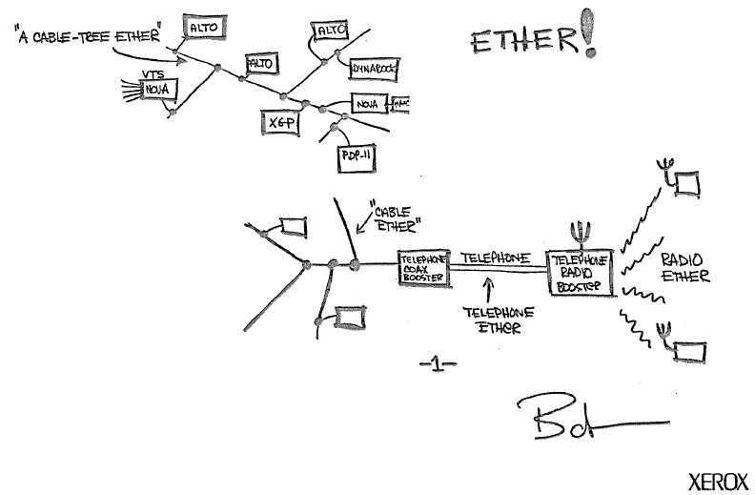







Wallace A. Chase
Head of Department, ITS
wallace.chase@otago.ac.nz
@bmtfr

Slide 4
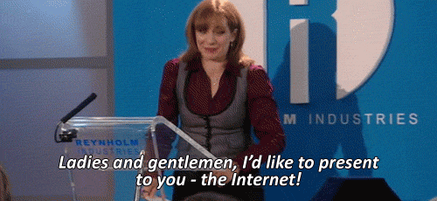
Lets learn some networking!

Slide 5
Will this make me A Network Engineer?

Slide 6
No.

Slide 7
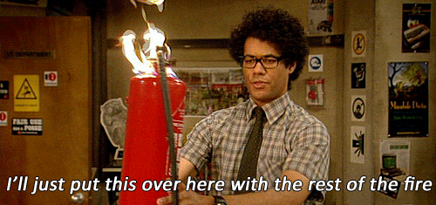
But it will allow you to interpret their world.
End
Start

Slide 8
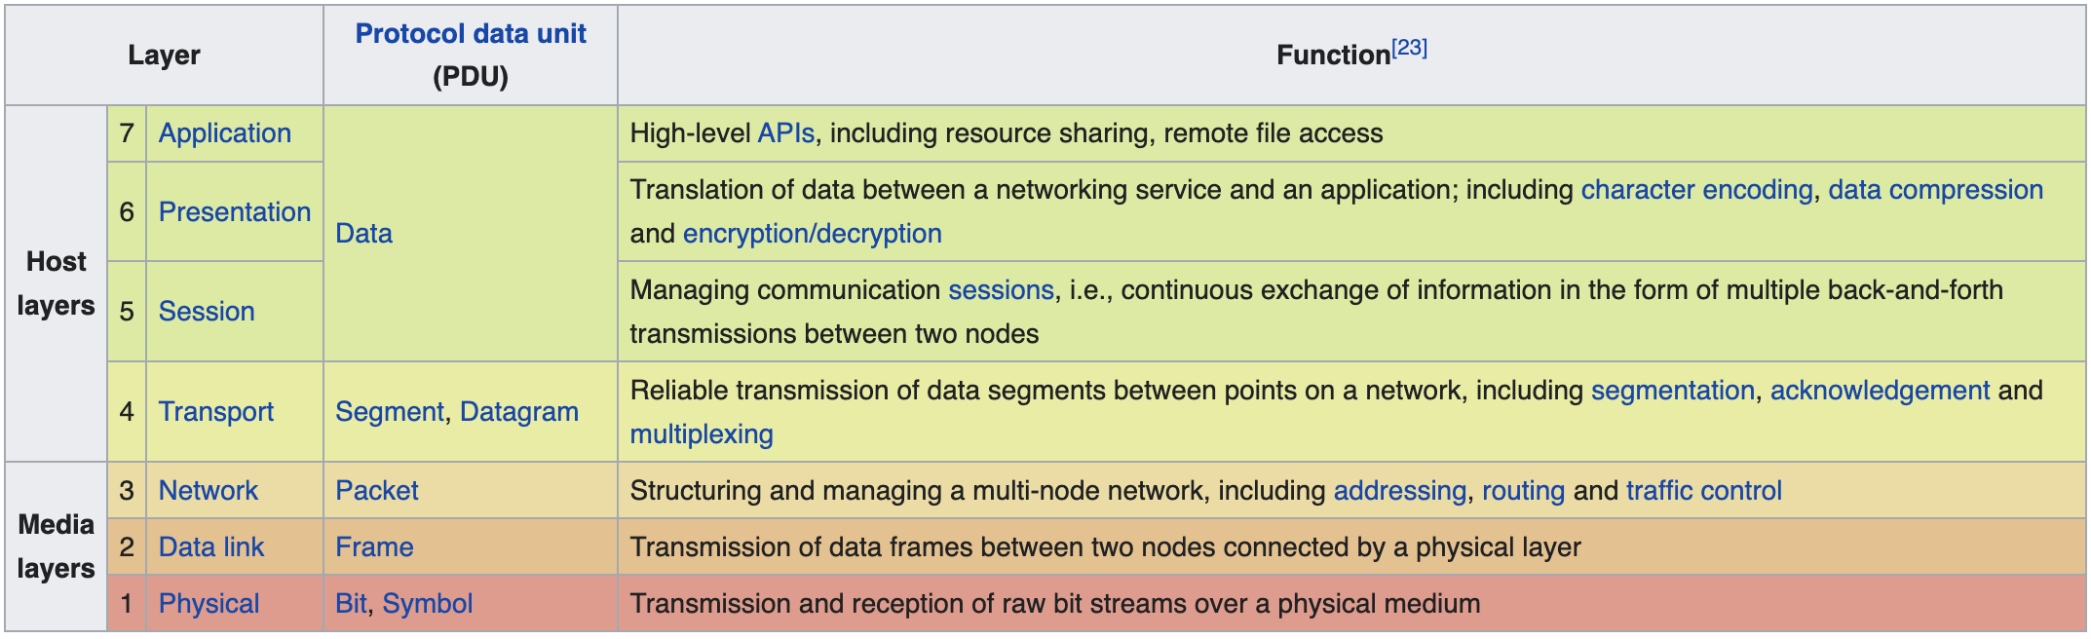
Networking 101
https://en.wikipedia.org/wiki/OSI_model

Slide 9
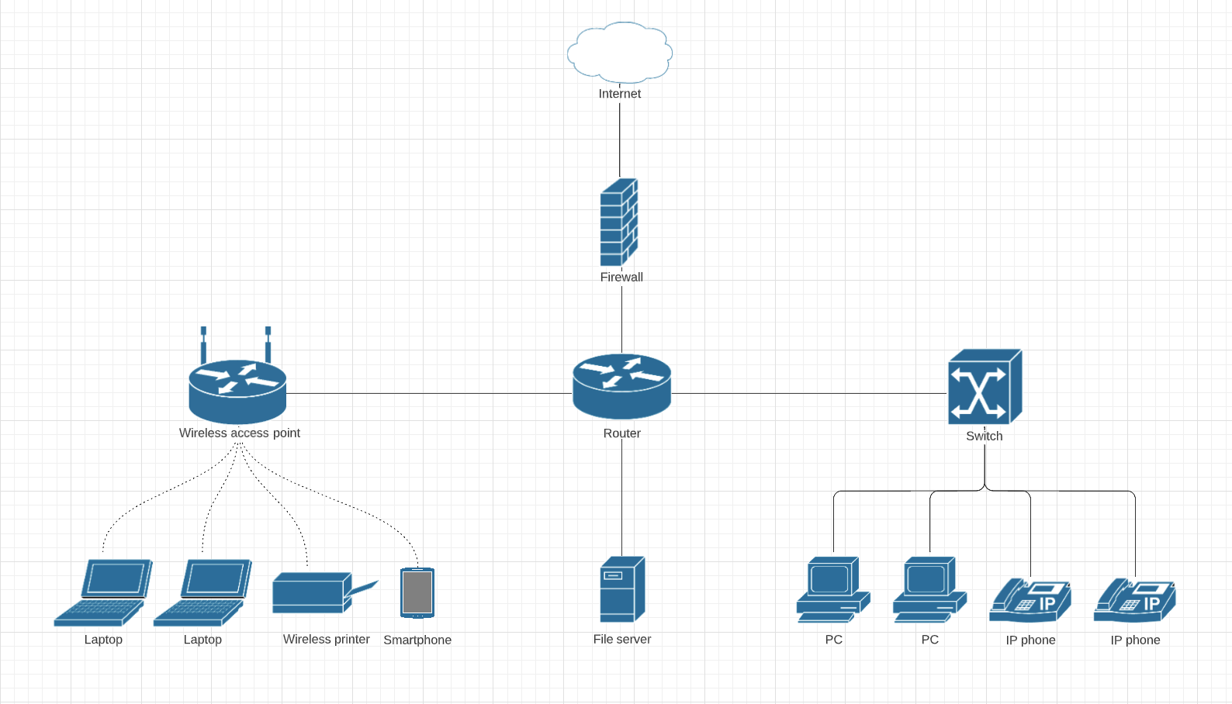
Networking 101

Slide 10
Networking 101
1

Slide 11


Networking 101
2

Slide 12
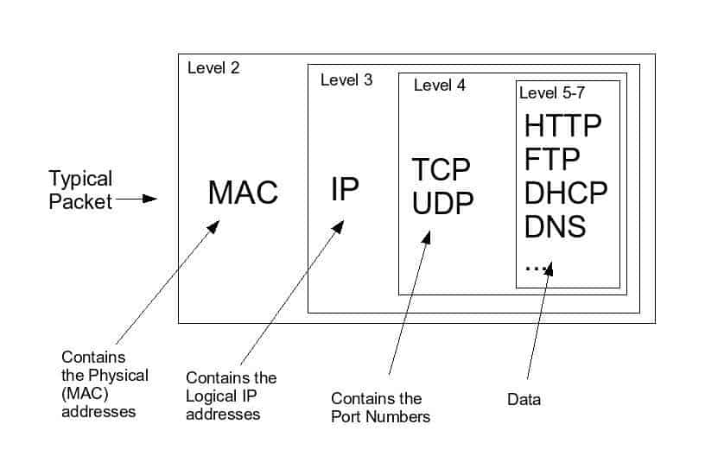

Networking 101

Slide 13
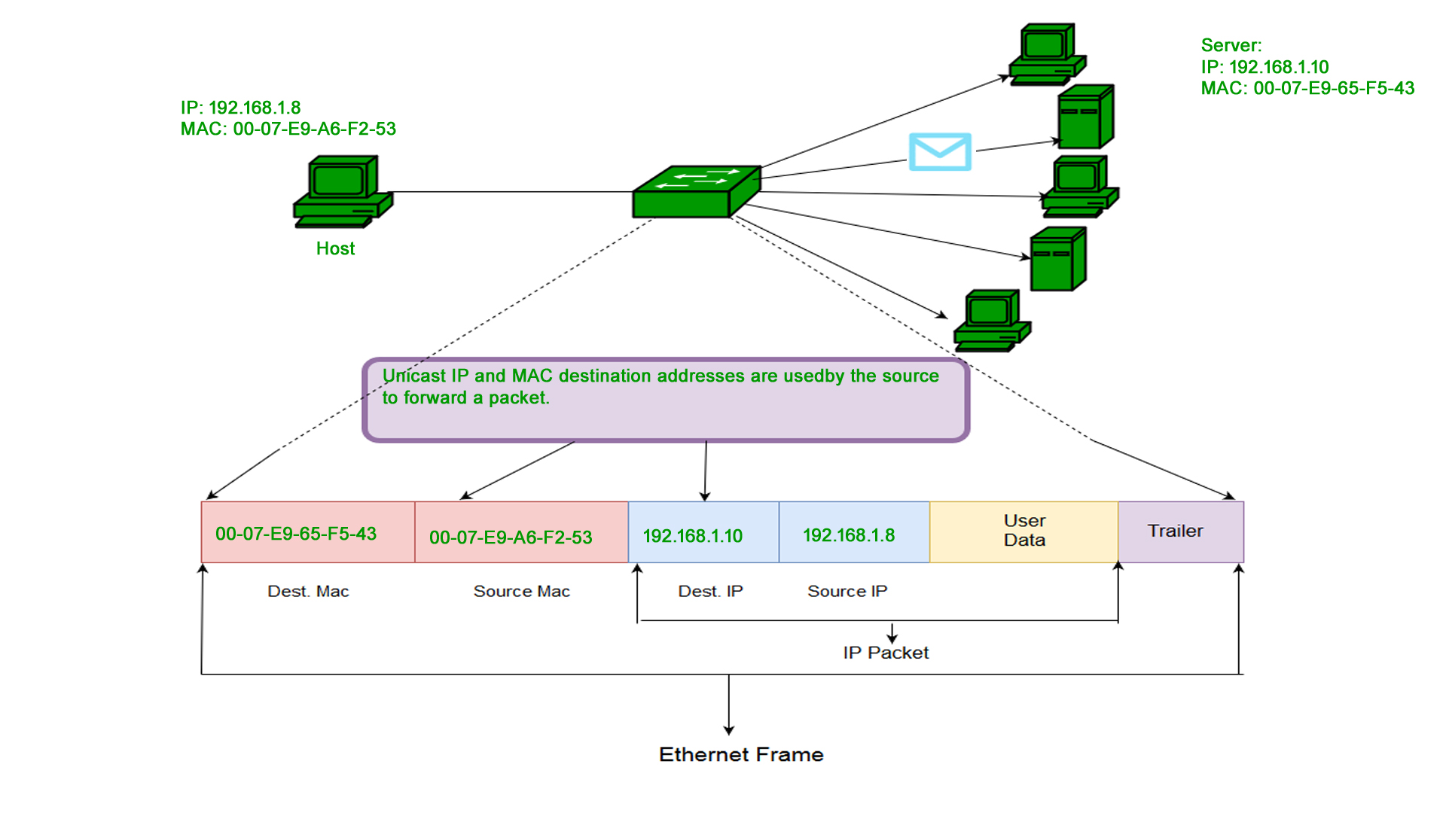

Slide 14

Networking 101
3

Slide 16
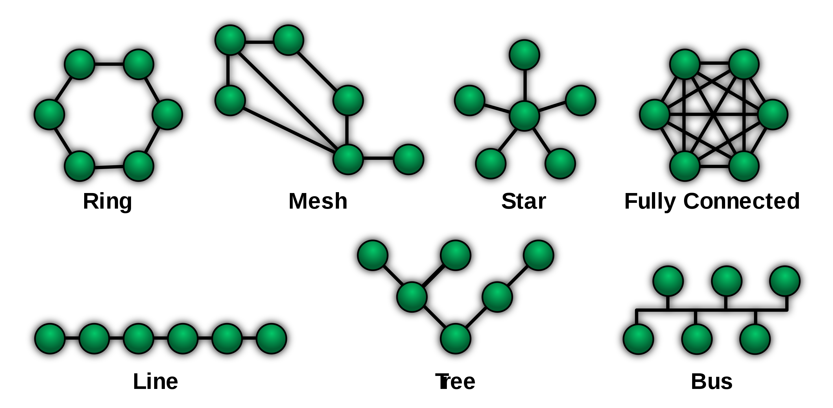
Networking 101

Slide 17
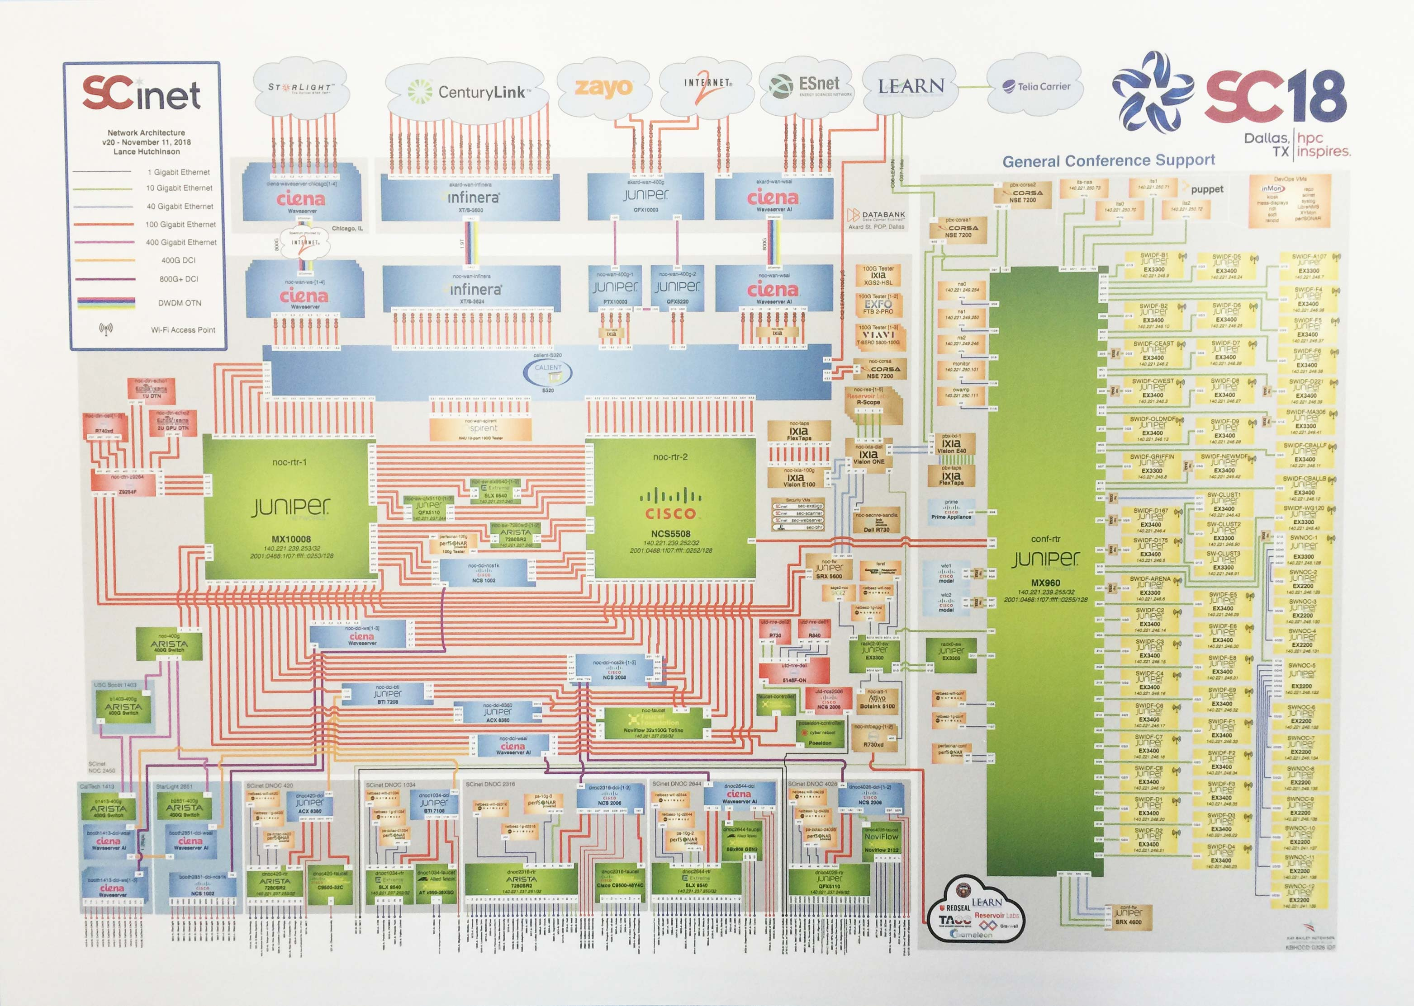
Networking 101

Slide 18
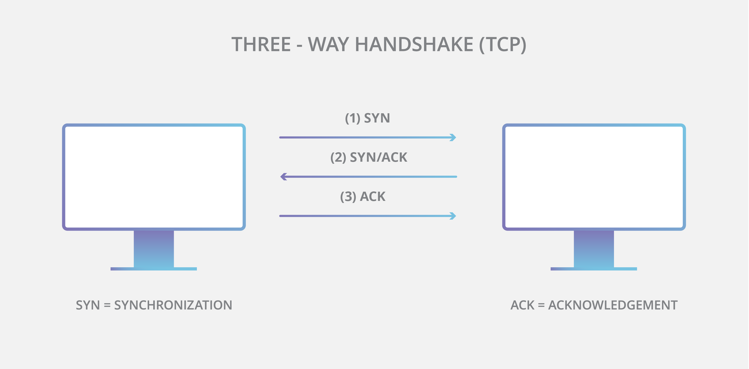
Networking 101

Slide 19
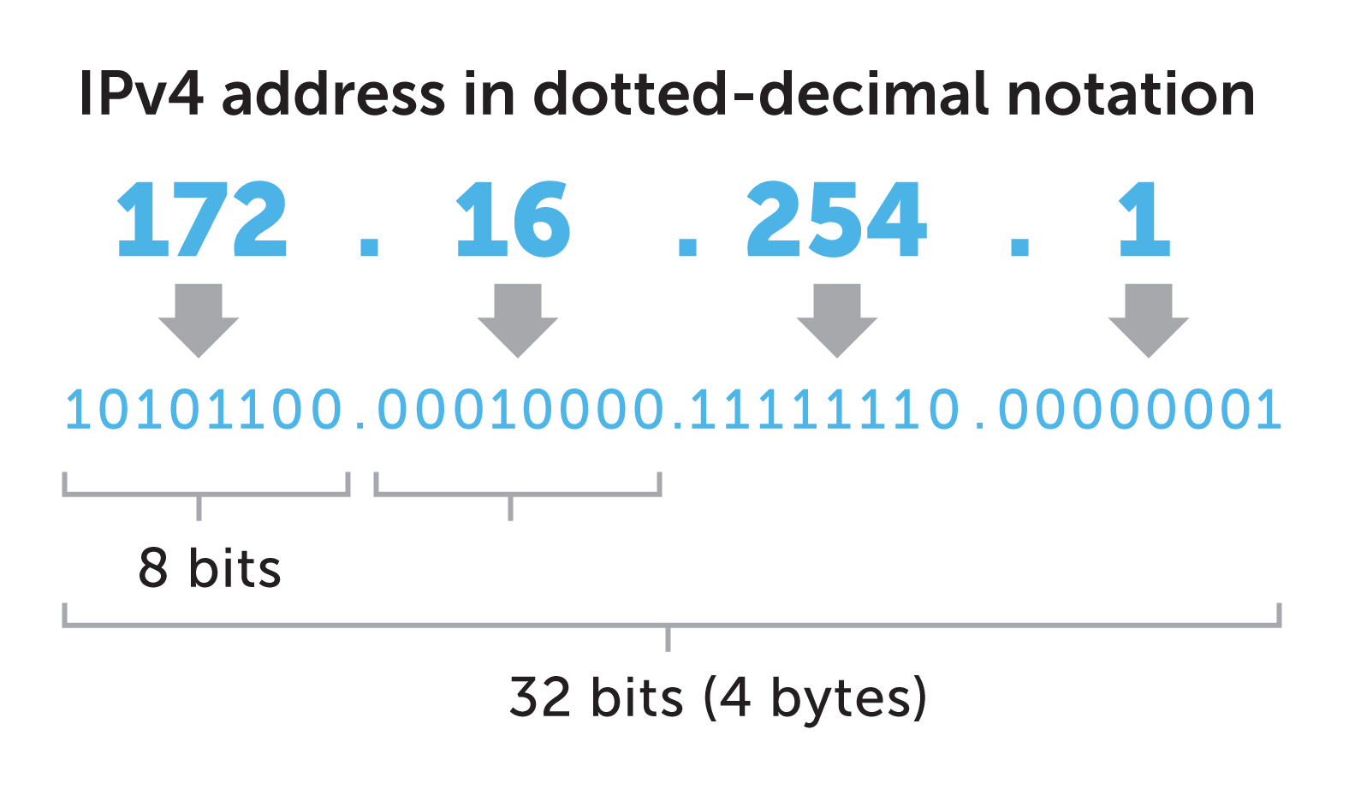
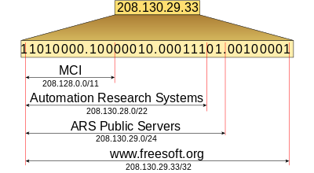
Networking 101
What are IP & TCP?
The Internet Protocol (IP) is the address system of the Internet and has the core function of delivering packets of information from a source device to a target device. IP is the primary way in which network connections are made, and it establishes the basis of the Internet.
IP does not handle packet ordering or error checking. Such functionality requires another protocol, typically TCP.
https://www.cloudflare.com/learning/ddos/glossary/tcp-ip/

Slide 20
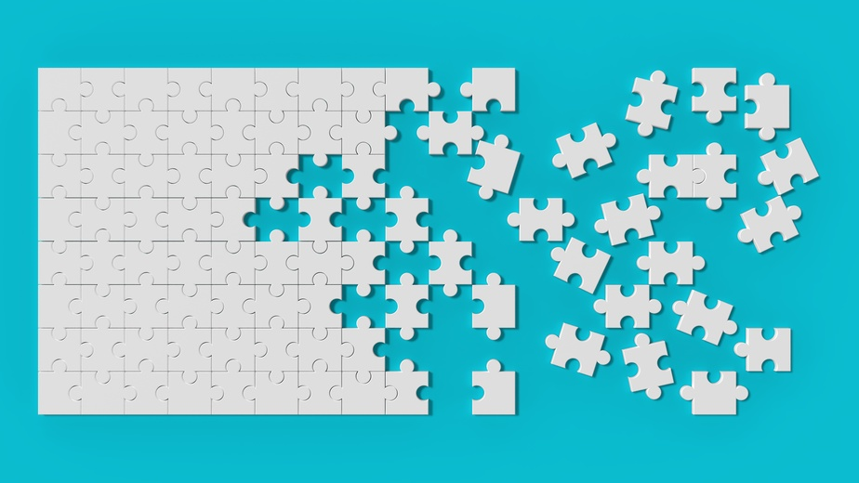

Networking 101
The TCP/IP relationship is similar to sending someone a message written on a puzzle through the mail. The message is written down and the puzzle is broken into pieces. Each piece then can travel through a different postal route, some of which take longer than others. When the puzzle pieces arrive after traversing their different paths, the pieces may be out of order. The Internet Protocol makes sure the pieces arrive at their destination address. The TCP protocol can be thought of as the puzzle assembler on the other side who puts the pieces together in the right order, asks for missing pieces to be resent, and lets the sender know the puzzle has been received. TCP maintains the connection with the sender from before the first puzzle piece is sent to after the final piece is sent.
https://www.cloudflare.com/learning/ddos/glossary/tcp-ip/

Slide 21
A history lesson – how did we get here?

Slide 22
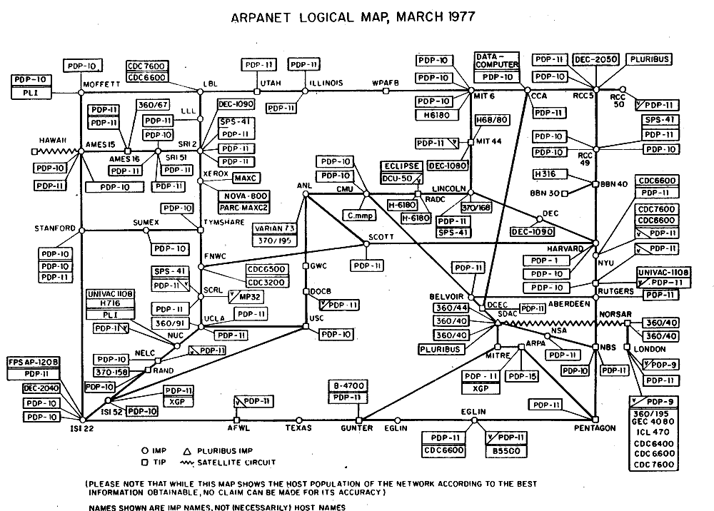
By ARPANET - The Computer History Museum ([1]), en:File:Arpnet-map-march-1977.png, Public Domain, https://commons.wikimedia.org/w/index.php?curid=9990864

Slide 23
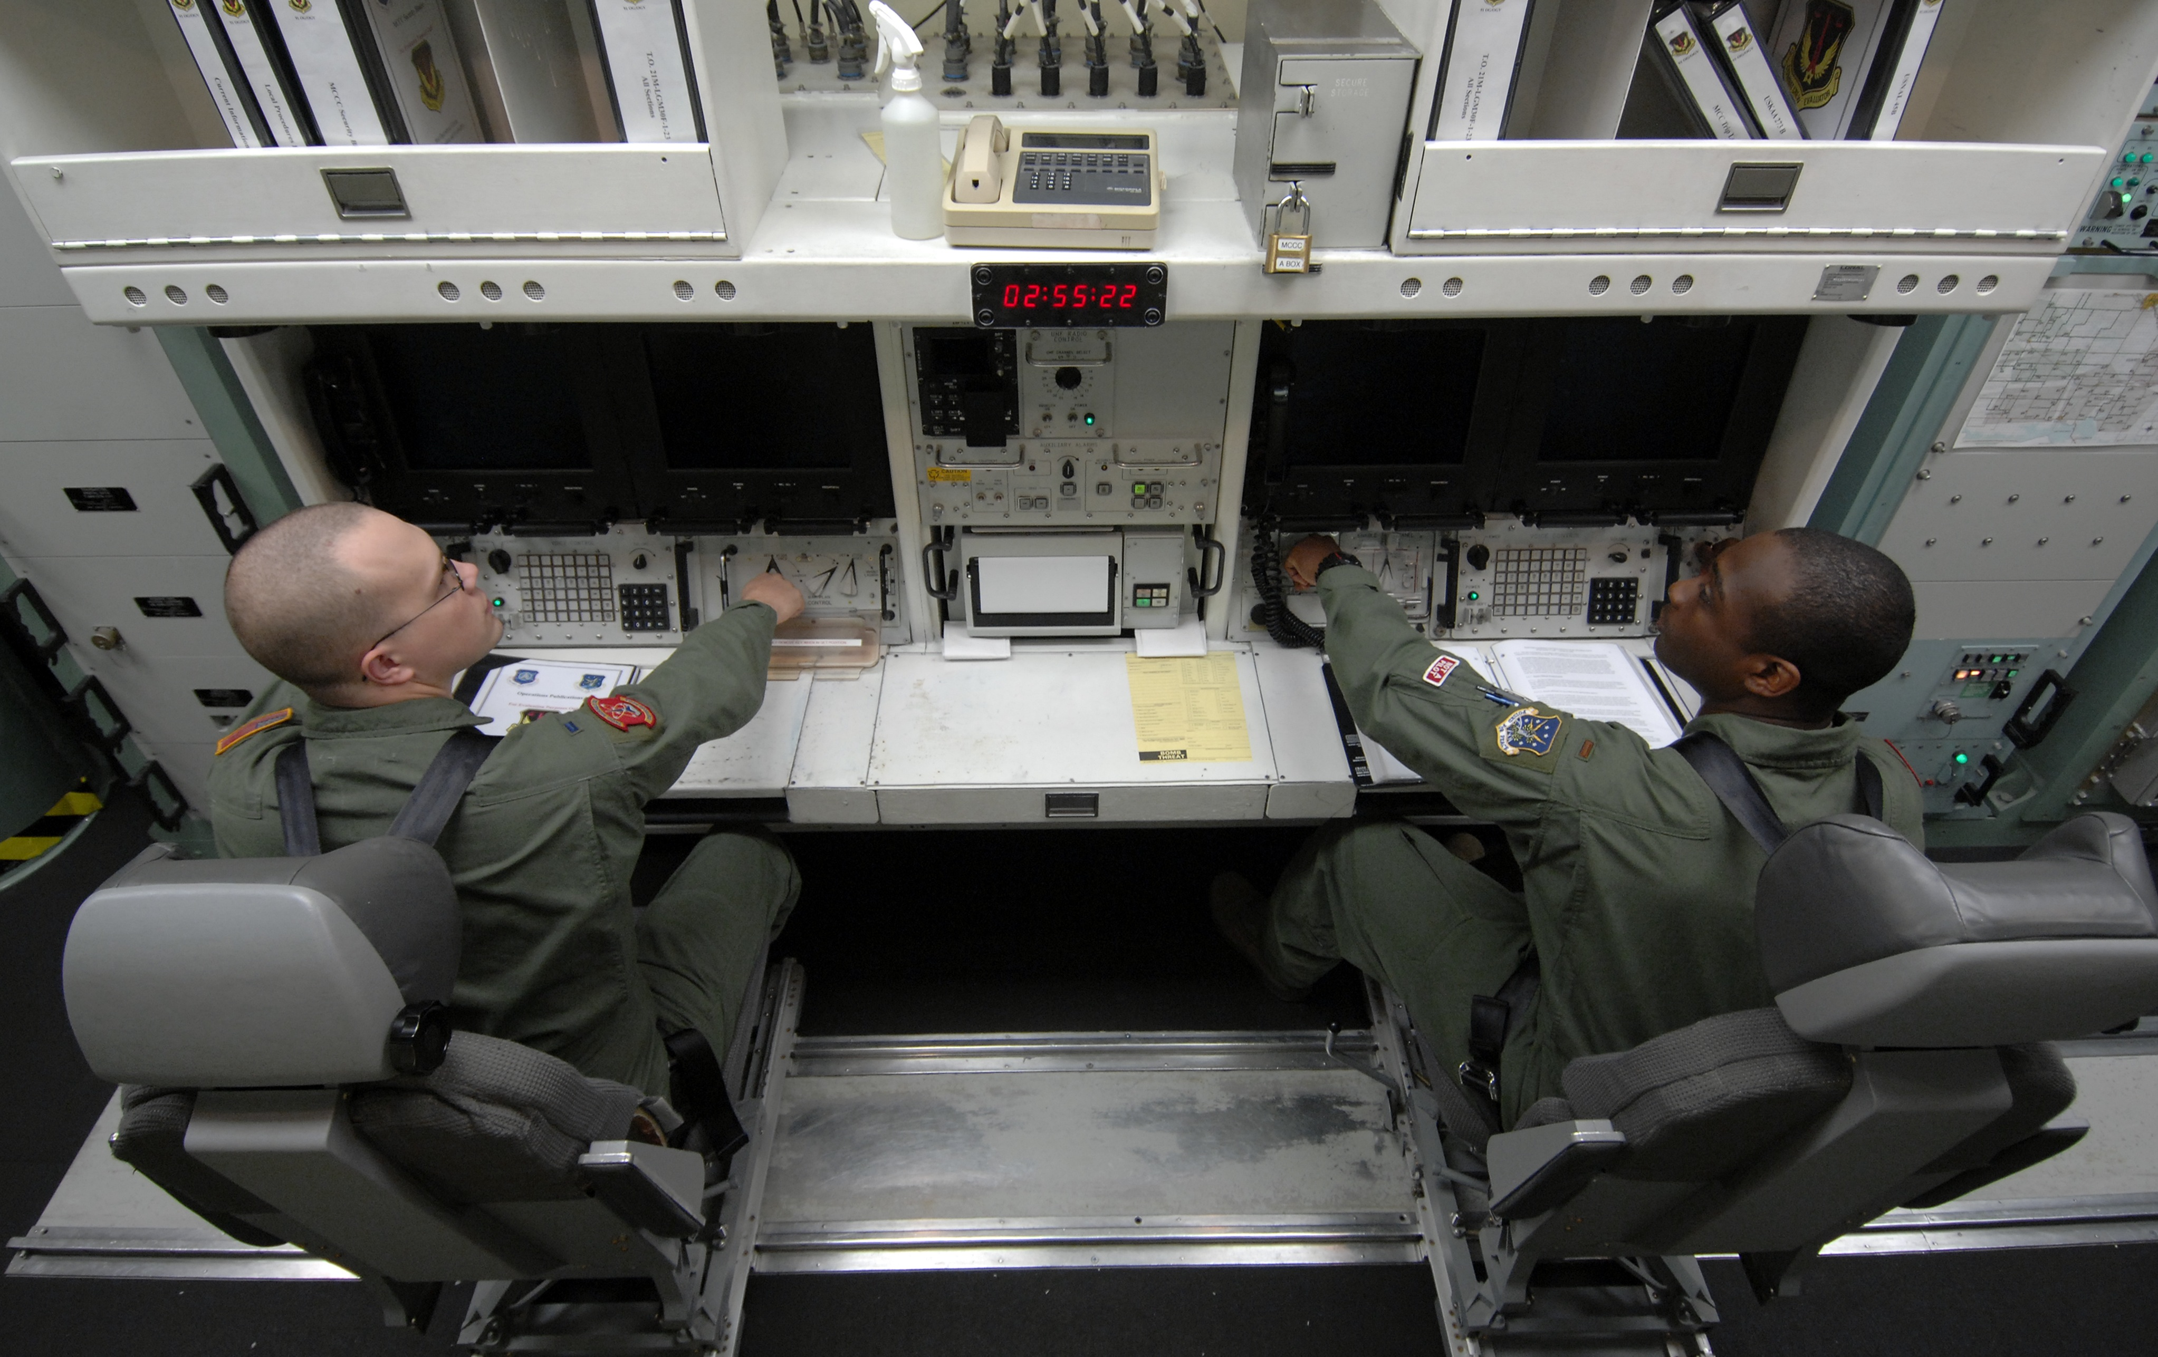
The goal was to exploit new computer technologies to meet the needs of military command and control against nuclear threats, achieve survivable control of US nuclear forces, and improve military tactical and management decision making.
Stephen J. Lukasik
Lukasik, Stephen J. (2011). "Why the Arpanet Was Built". IEEE Annals of the History of Computing. 33 (3): 4–20. doi:10.1109/MAHC.2010.11
Notes:
Because commodity networks are
Massively over subscribed
Very resilient
“best effort”
Ok with retransmissions or just plane old loss

Slide 24
A history lesson – how did we get here?
Survivable
Resilient
Decentralized
Fault tolerant

Slide 25

Why this works well for the “internet”
Think “lots of little”
Decentralized
Fault tolerant
Delay not problem for most
Precision not required
Consume vs publish
CDN (Content Delivery Network)
Profit!

Slide 26
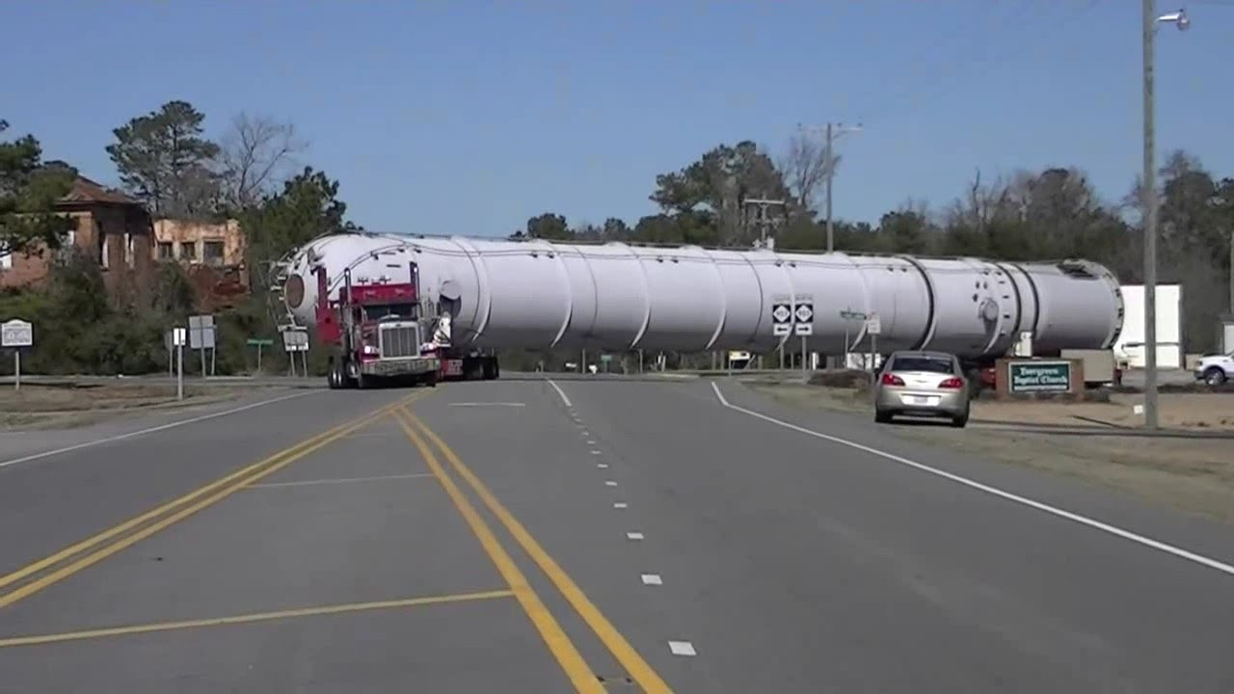
Why this does not work well for research data
Think “fewer large”
Decentralized
Not Fault tolerant
Delay not is problem for most
Precision not is required
Consume vs publish
CDN (Content Delivery Network)
Profit!

Slide 27
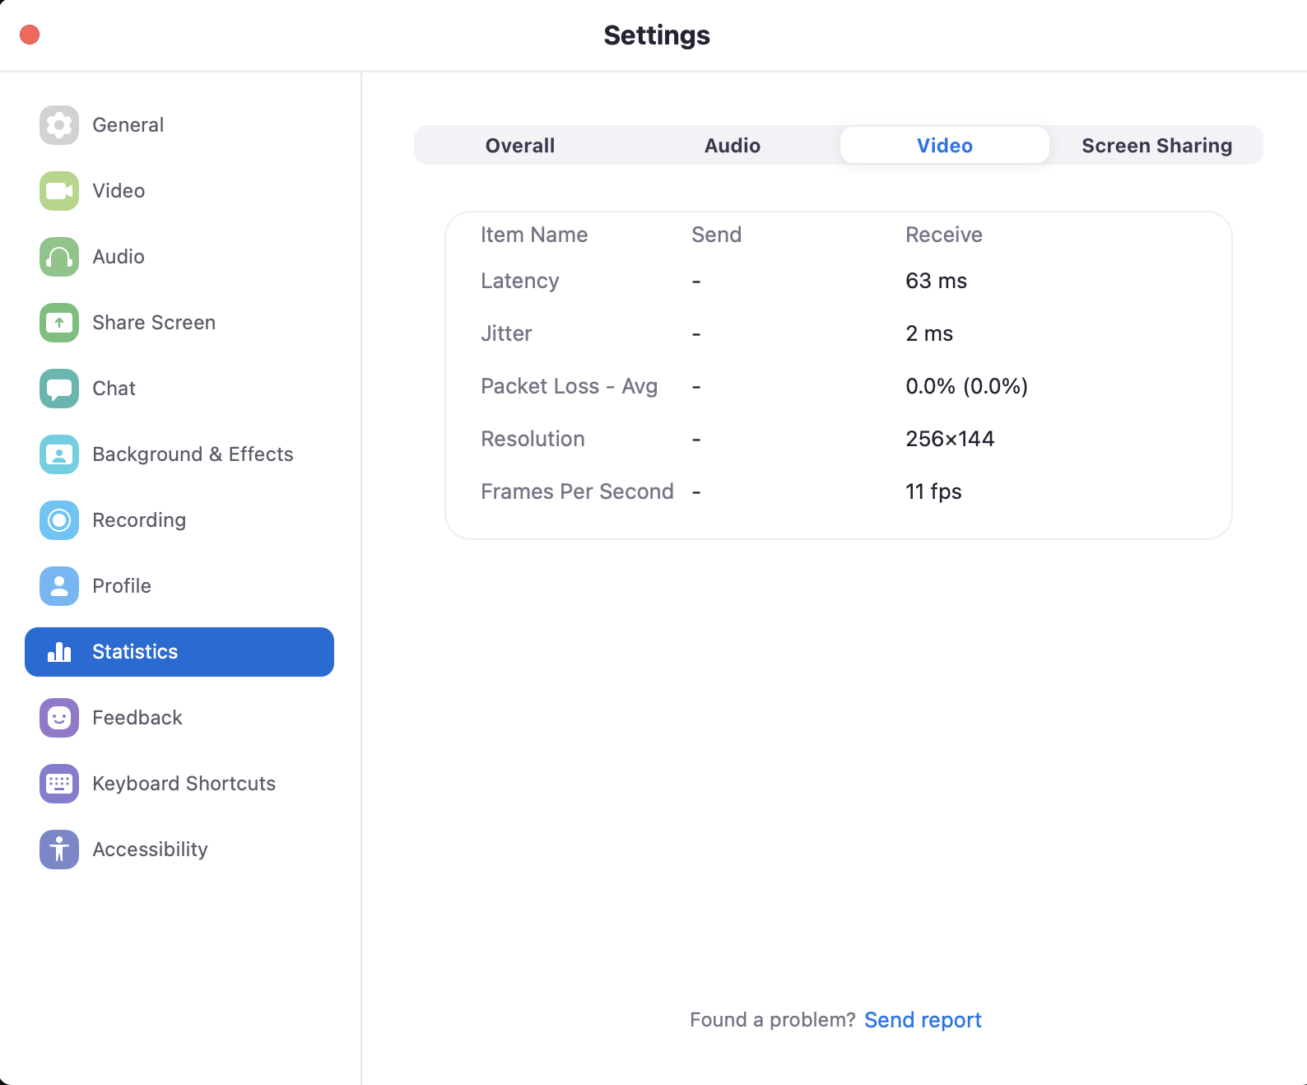
The big three…
Packet loss
Latency (or RTT -Round Trip Time)
Buffer/window size

Slide 28
Networking 101
The TCP/IP relationship is similar to sending someone a message written on a puzzle through the mail. The message is written down and the puzzle is broken into pieces. Each piece then can travel through a different postal route, some of which take longer than others. When the puzzle pieces arrive after traversing their different paths, the pieces may be out of order. The Internet Protocol makes sure the pieces arrive at their destination address. The TCP protocol can be thought of as the puzzle assembler on the other side who puts the pieces together in the right order, asks for missing pieces to be resent, and lets the sender know the puzzle has been received. TCP maintains the connection with the sender from before the first puzzle piece is sent to after the final piece is sent.
https://www.cloudflare.com/learning/ddos/glossary/tcp-ip/

Slide 29
The big three…
Packet loss
When TCP encounters packet loss, it backs off on its sending rate. The mechanism for doing this is to reduce the sender's notion of the window so that it attempts to send less data. TCP then ramps its sending rate back up again, in hopes that the loss was transitory.
When TCP encounters loss, it has to recover - but it starts with a small window and opens it back up again over time. The longer the latency, the longer the control loop is for doing this. So, all other things being equal, the time necessary for a TCP connection to recover from loss goes up as the round-trip time goes up.
This is a case where things are a lot better now than they were for many years....algorithms such as htcp and cubic are much more aggressive about ramping back up again than the old scheme (TCP Reno).

Slide 30
The big three…
Buffer/window size
Buffer and window size determine both the amount of data that the kernel will keep in buffers for the connection, and the "window" that is advertised over the TCP connection (the window information sent via TCP reflects the size of the available buffers). The larger the window, the more data can be in flight between the two hosts. Note that if the window is smaller than the available bandwidth multiplied by the latency ( the Bandwidth Delay Product) then the sender will send a full window of data and then sit and wait for the receiver to acknowledge the data.

Slide 31
The big three…
Buffer/window size
Large windows are required for adequate throughput when latency is large (anything over about 10 milliseconds starts becoming an issue, and 20+ milliseconds is where it gets really tricky). When the window is large, TCP can send a lot of data all at once.
The network card typically doesn't know or care about TCP. The network card just knows that when there are packets to send, it throws packets onto the link until it doesn't have packets to send. This happens at whatever link speed the card is configured for, e.g. 10Gbps.
So, if the TCP window is 4MB, TCP will pass 4MB of data to the network card, and the network card will slam it onto the link at 10Gbps. This means that every device in the path between the sender and the receiver sees a high-speed burst of packets. If there are any buffering or queuing problems anywhere on the path, some of those packets will be dropped, causing TCP to back off.
Thus packet loss…

Slide 32
The big three…
Latency (or RTT -Round Trip Time)
Latency/RTT is the amount of time it takes for a packet to go from the sender to the receiver and back (a "round trip"). This is the minimum amount of time for one host to get information back from the other host about data that was sent.

Slide 33
The big three…
All together now…
Since the TCP windows are much smaller for low-latency connections, these issues often are not noticed at low latencies. If the packet loss is due to random error (e.g. dirty fiber, marginal optics, longer-than-spec cable length) then there will be a bit of loss here and there, and with low latency TCP will recover so quickly that people typically won't notice a performance hit. If there are small switch buffers in the path, they typically don't cause loss for low-latency connections, because TCP is not sending big enough bursts to cause loss. However, if you use the same infrastructure to send data to a host a long way away, you will see dramatic performance degradation. In the case of random error, TCP will always be recovery mode, and so will always have a small window. In the case of small buffers, TCP will ramp up, encounter loss, reduce its window, ramp up again, and so on - so TCP will effectively always have a small window and perform poorly.

Slide 34
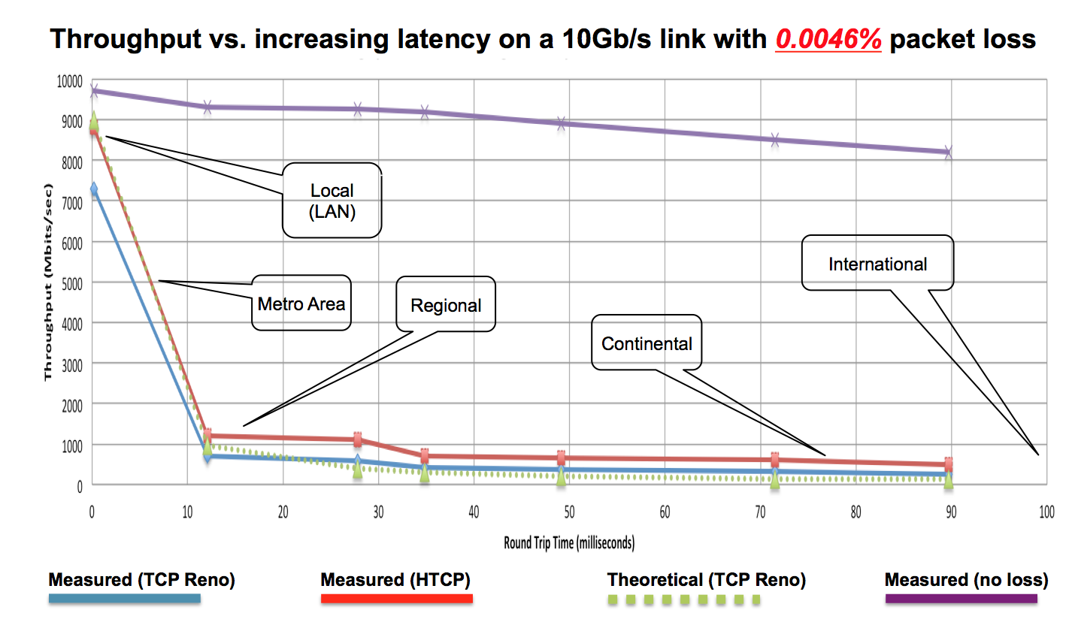
The big three…
https://fasterdata.es.net/network-tuning/tcp-issues-explained/packet-loss/

Slide 35

MTU & Jumbo frames
Jumbo frames are Ethernet frames with more than 1500 bytes of payload, the limit set by the IEEE 802.3 standard.
Jumbo frames can carry up to 9000 bytes of payload

Slide 36
Lets talk about using protection…

Slide 37

Lets talk about using protection…
DDoS
Intrusion Prevention
Firewalls
Access control
Auditing

Slide 38
What works for the 95% does not necessarily work for all…

Slide 41






Commodity networks
The good
Great for “normal” traffic
Resilient by design
Can move lots of “small” things moving around
Great if what you are doing is accessing/and on a CDN (Content Delivery Network)
Available almost everywhere
The not so good
Not at all optimized for large flows
Can be very expensive at scale
Often sub optimal routing and peering for point to point research traffic
Throttling , queuing, traffic shaping destroy throughput (and “they” don’t care)
Commodity networks assume, and are designed for, “lots of small stuff”
High speeds are not always available, or cost effective (10G, 40G, 100G)
If you have issues, good luck getting help
Notes:
Networks were built to be resilient and distributed.

Slide 42
Take the sloth and the giraffe…
Each are extremely efferent at consuming leaves…

Slide 43
But that does not make them interchangeable…

Slide 44
The solution!
Networks designed, built and operated by and for the research community

Slide 45
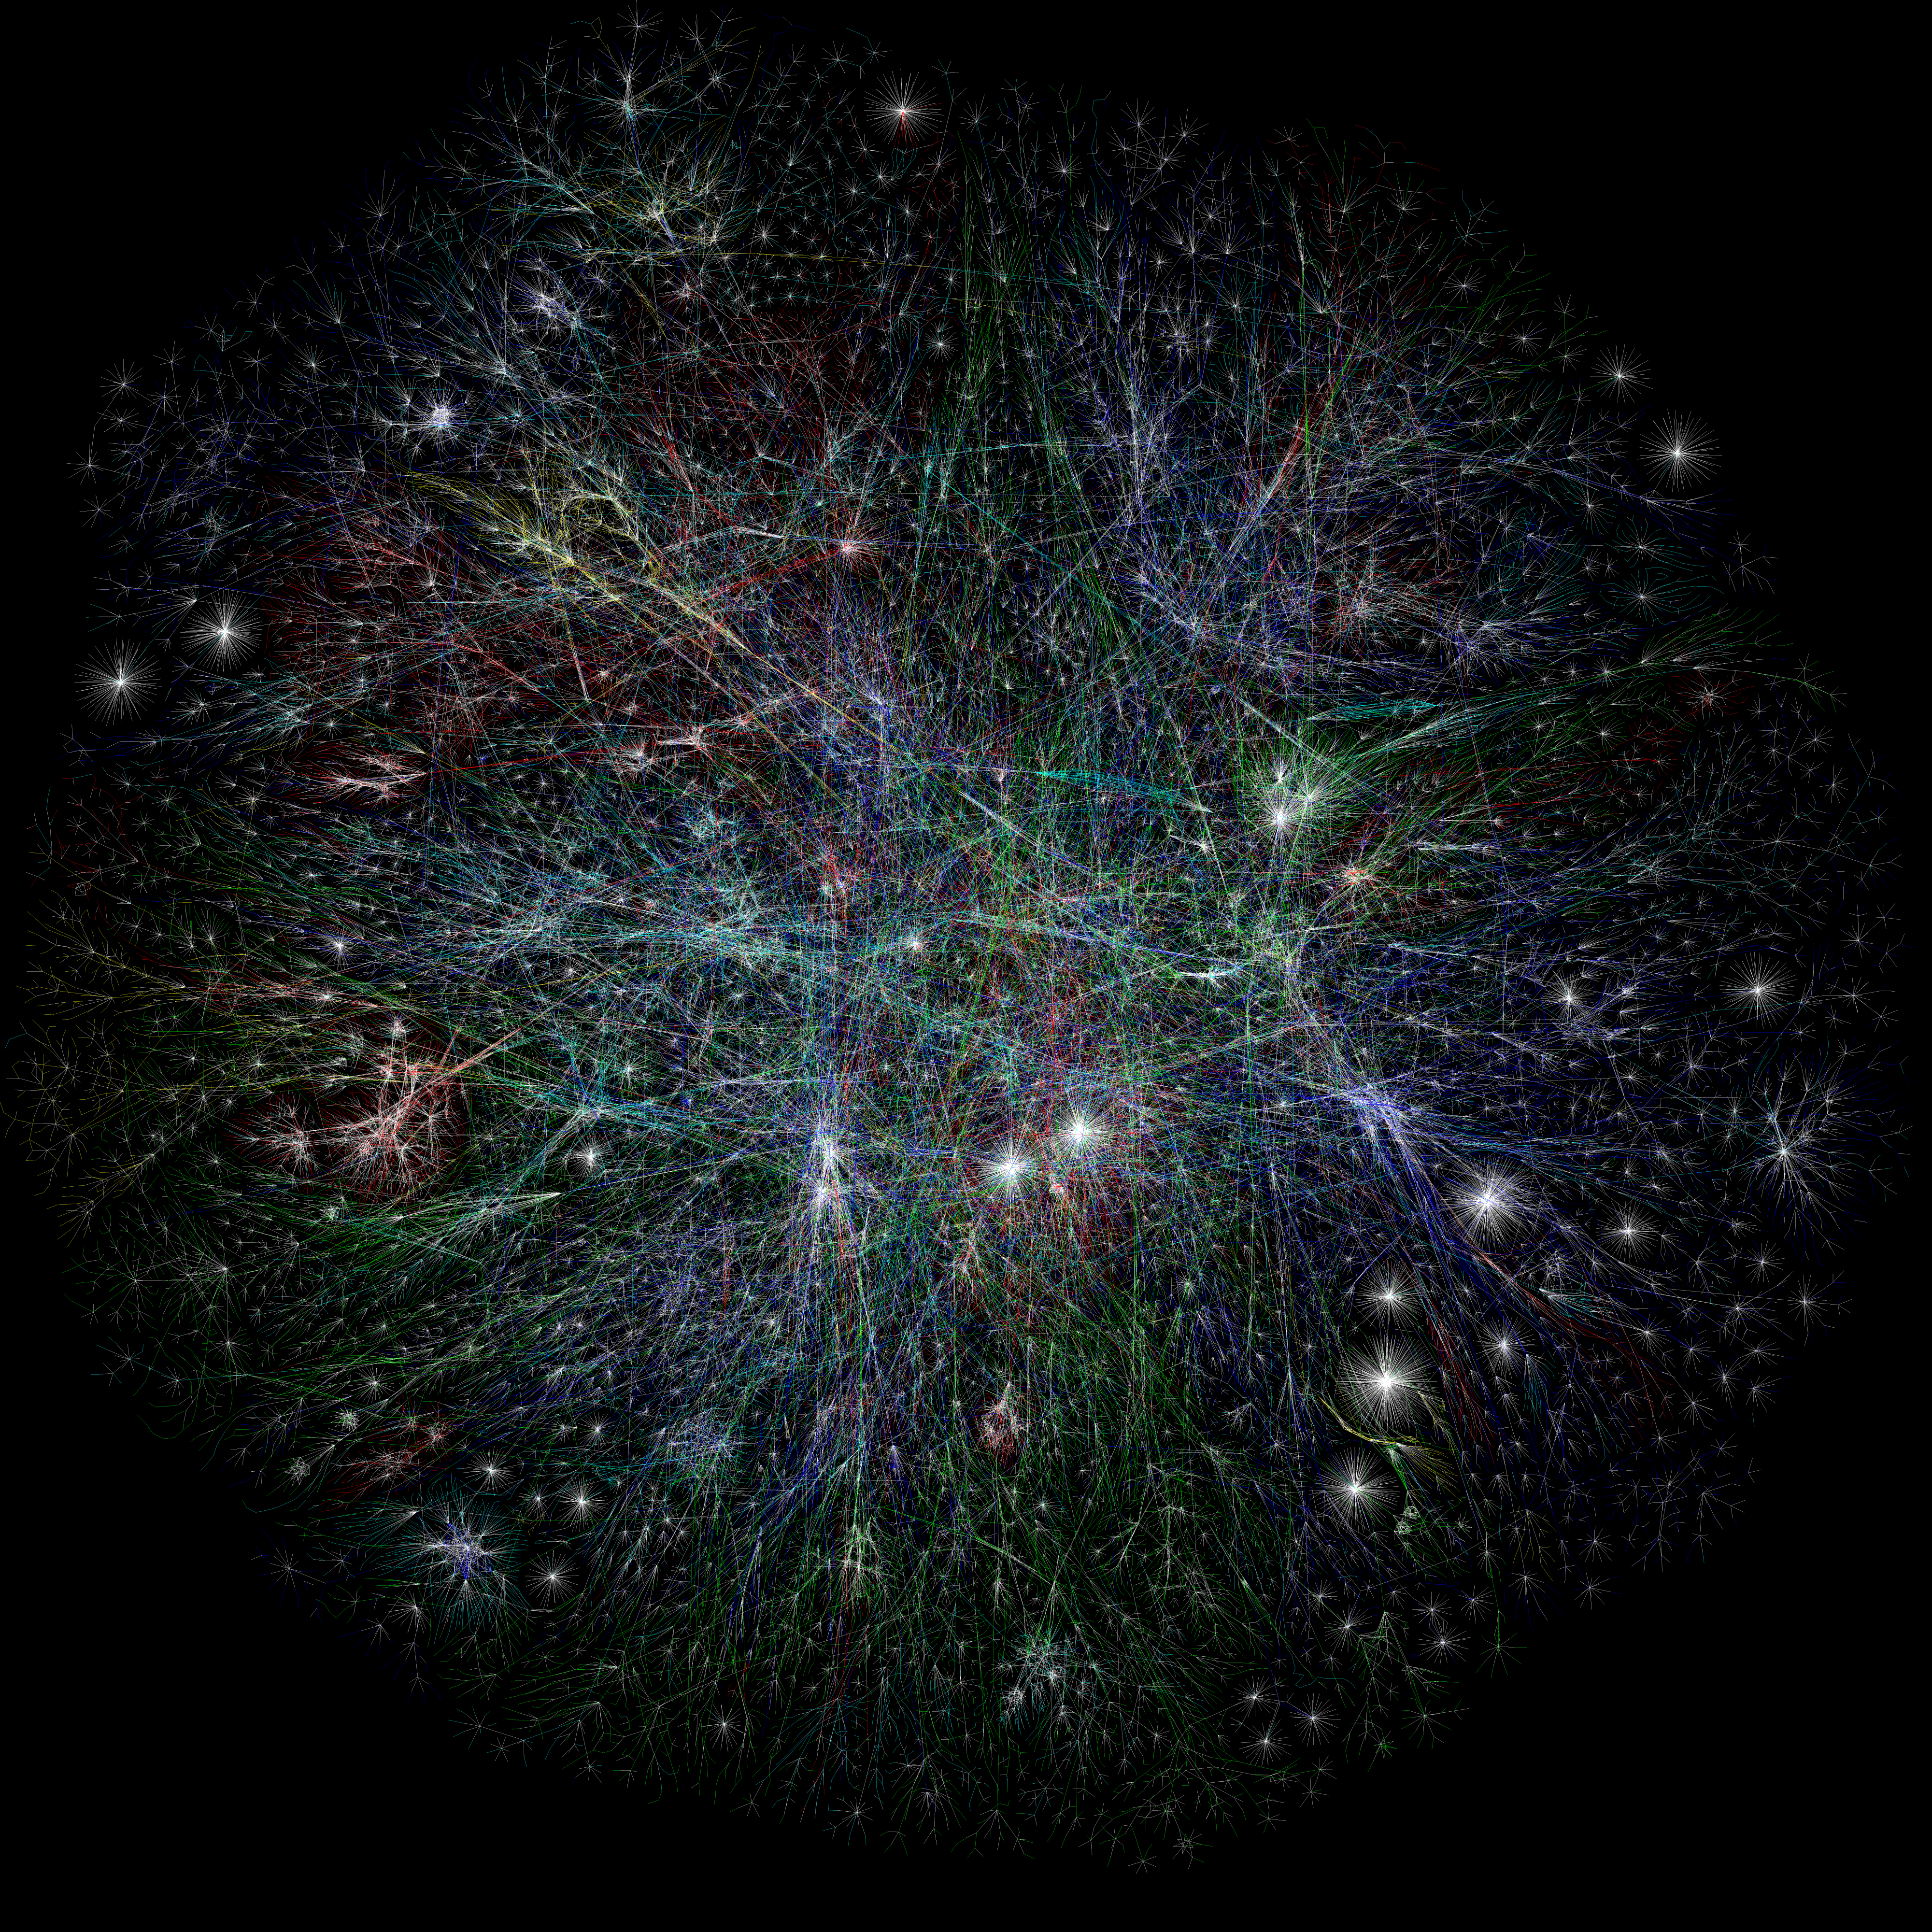
Lets think about networks of networks connecting to networks of networks…
https://www.opte.org/the-internet

Slide 46








International Networks

Slide 47
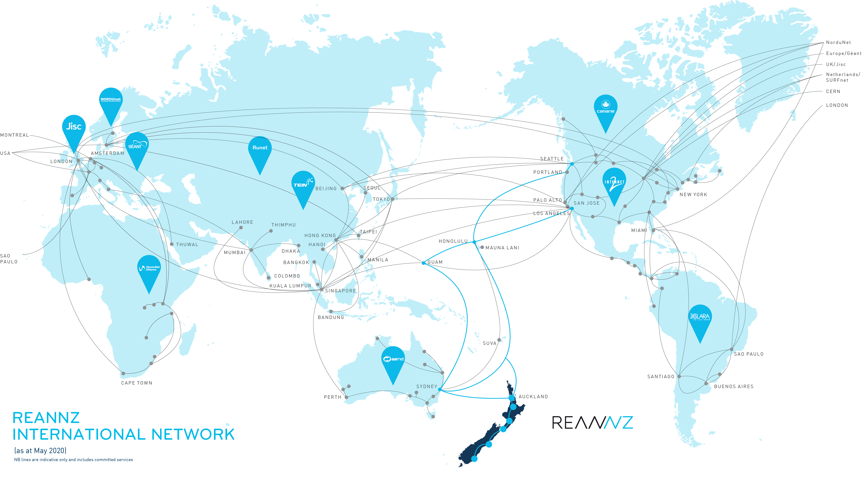

Slide 48
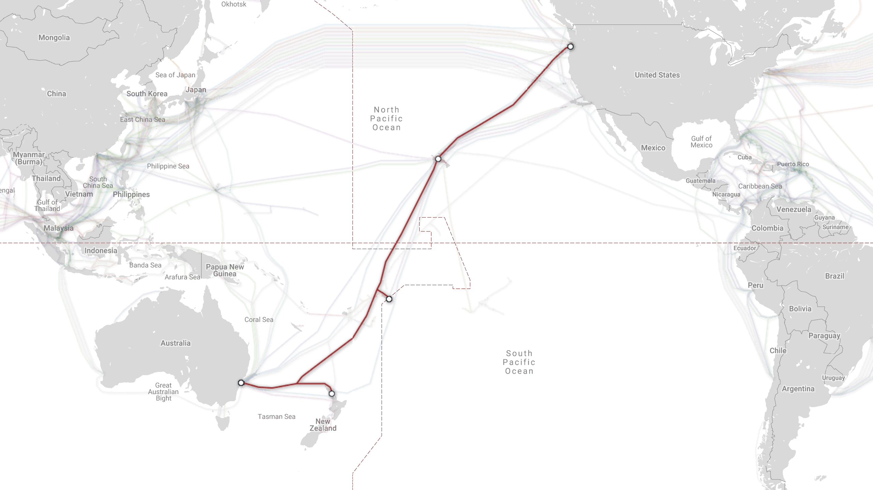
Notes:
Hawaiki is a single cable system, running from NZ and Australia to a branching point north of NZ and then on through to Hawaii and from Hawaii to the US.

Slide 49
REANNZ International Network
Pacific Wave peering in Seattle
Connection in Hawaii with UoH
AARNet peering in Sydney
GOREX peering in Guam
Direct peering with providers and with other NRENs

Slide 50
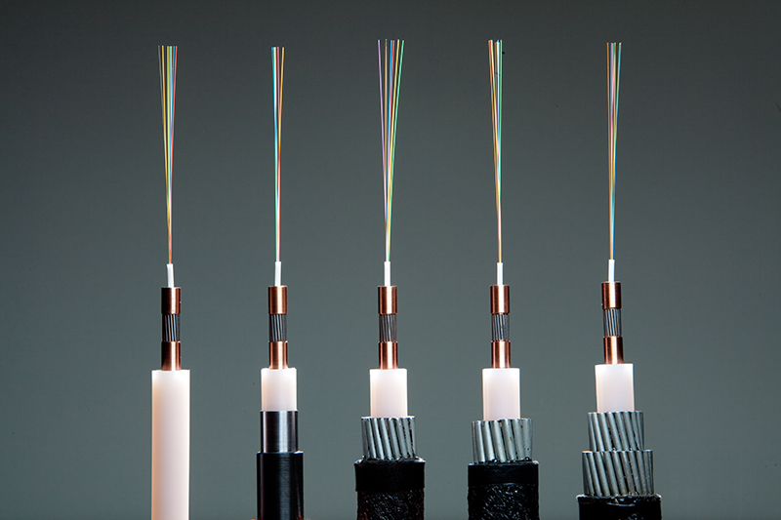
Notes:
These are the different types of fibre that will be used to build Hawaiki – show off the physical one in person
The different types are different level of armour – least armour is for the deepest parts of the ocean – up to 4km deep. Most of Hawaiki is this - the cable is protected by mother nature and 4km of water! As it gets more shallow or as the ocean floor gets more rocky – the cable is armored to protect it.
The 6 fibres are shown at the top – they carry all the data.
The next part is a steel wrap to give the cable it’s strength
Then there is a copper wrap that carries all of the power required along the cable
Then there is insulation coating all of it.
Stress that is *all* that is in the cable, nothing else – most people assume the cable will be huge and covered in lots of protection.

Slide 51
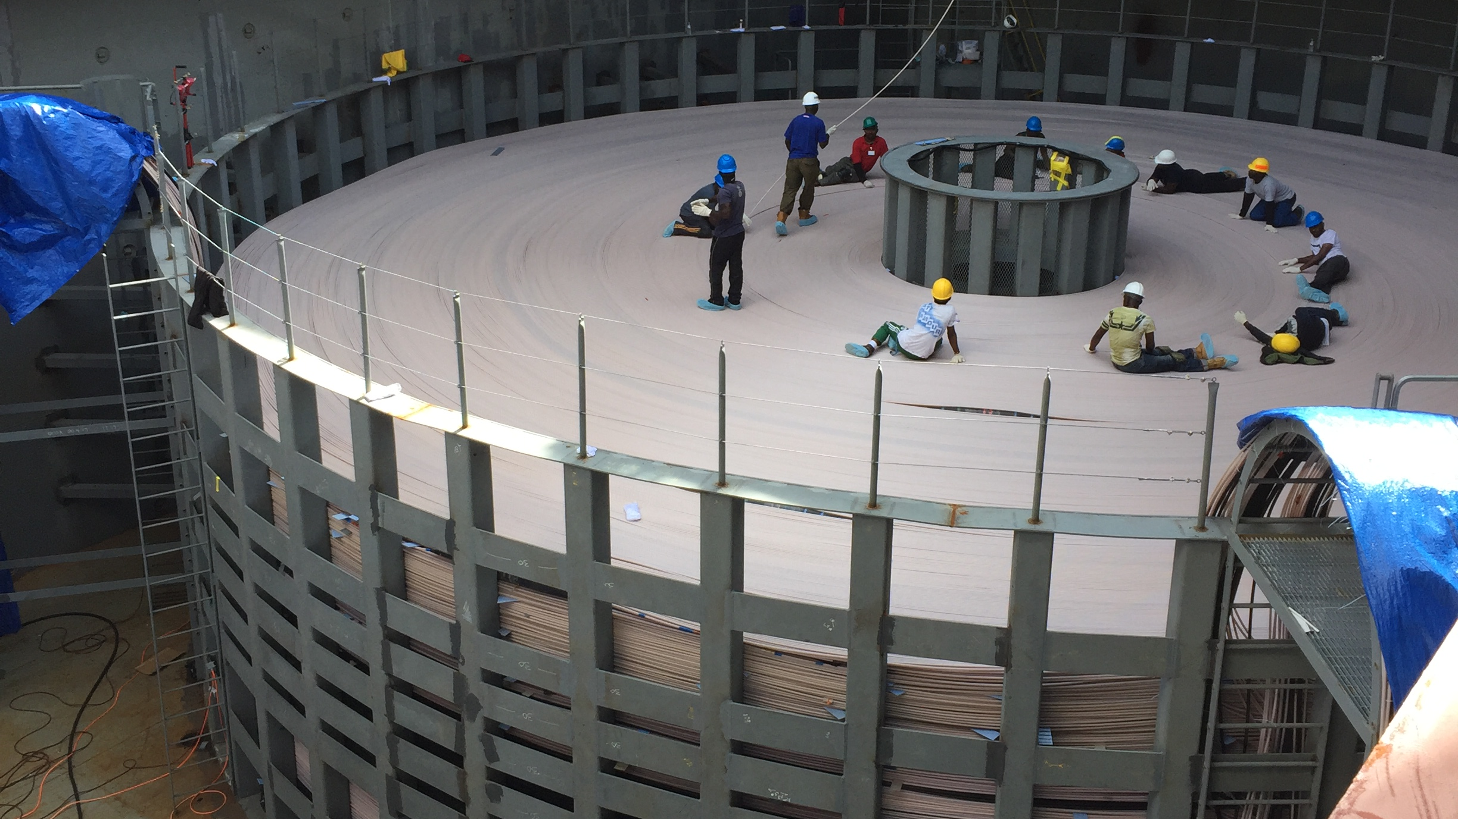
Notes:
This is what a few thousand km of that cable looks like being loaded into a ship.
Loaded fully assembled – all loaded manually – walked in by hand. This means someone has walked *all* 14,600km of the cable as it’s been loaded into the boats!
The other people are packing the cable back onto the previous loop.

Slide 52
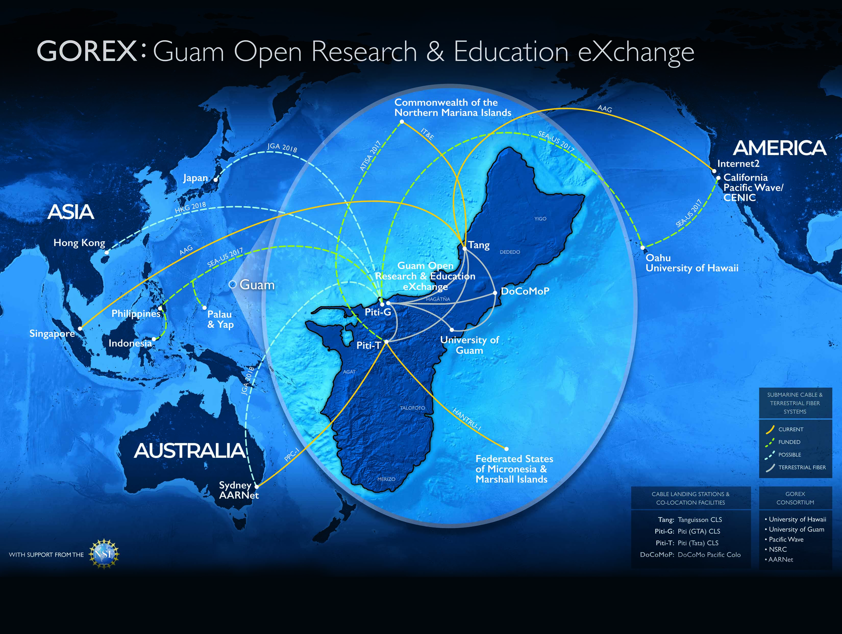

Slide 53



National Networks (US)

Slide 54
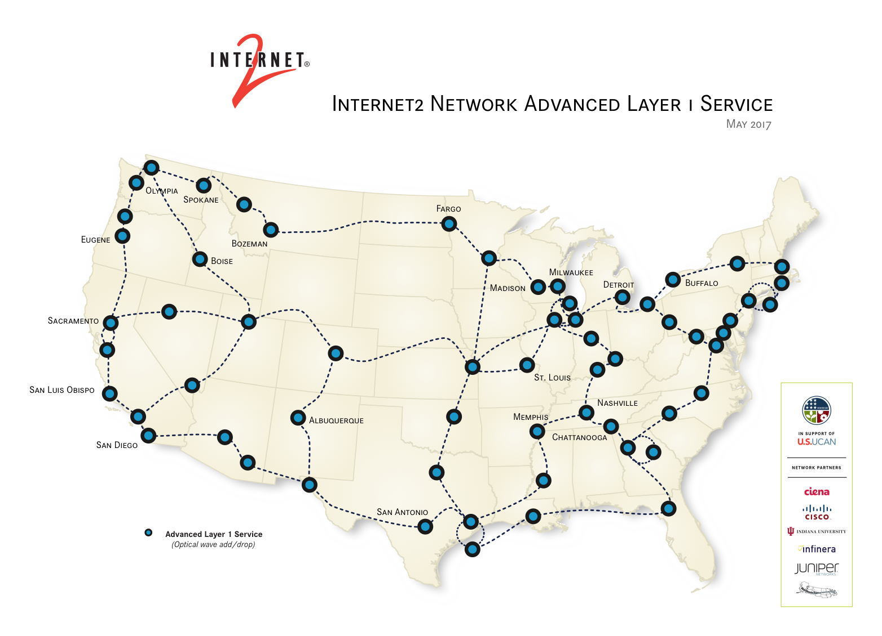

Slide 55
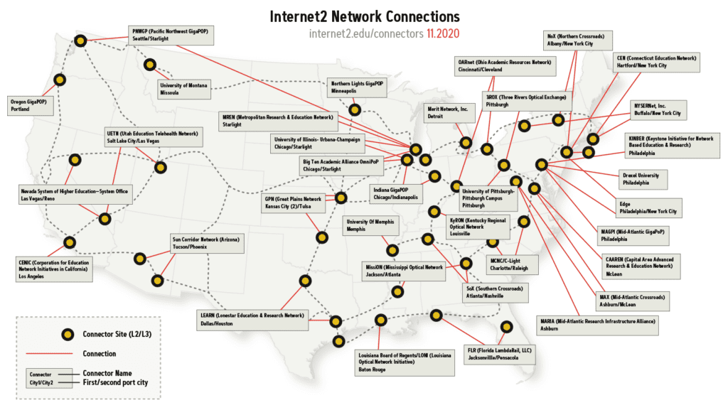

Slide 56
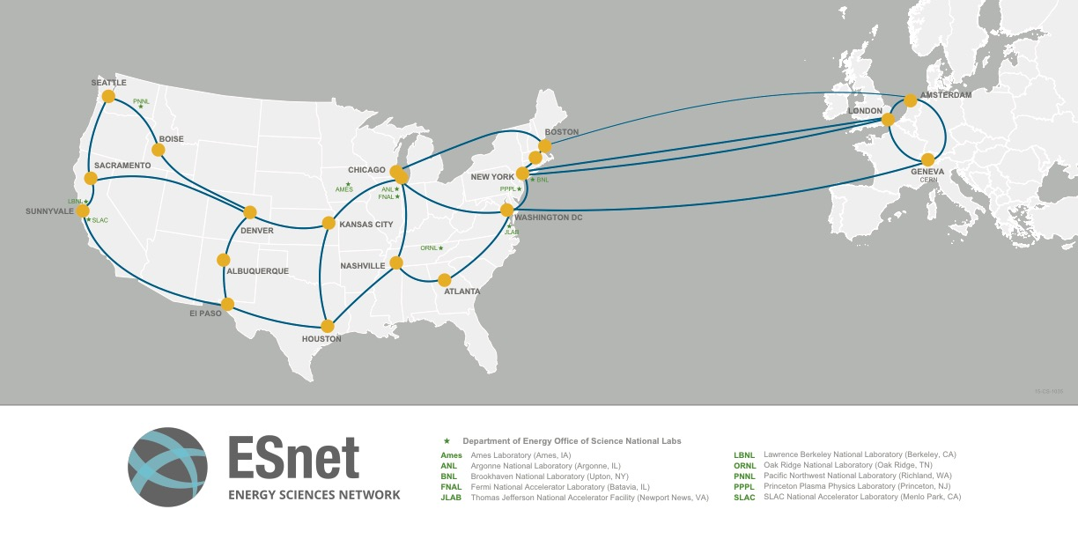

Slide 57
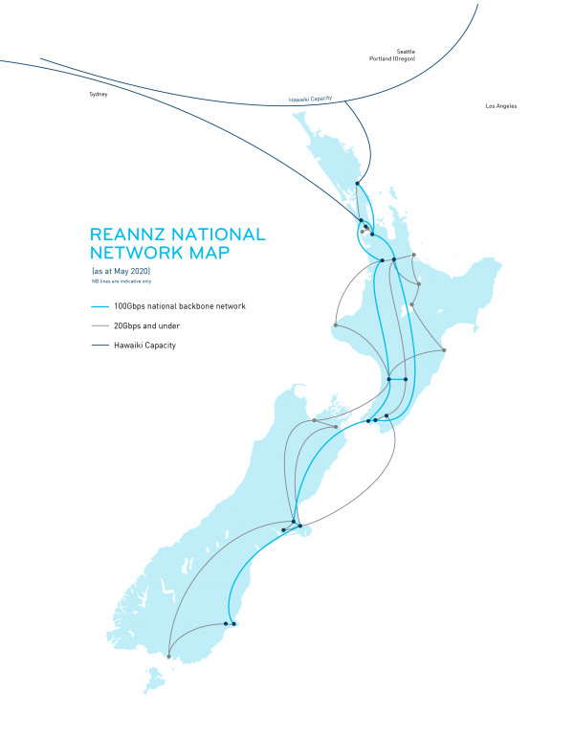

Slide 58
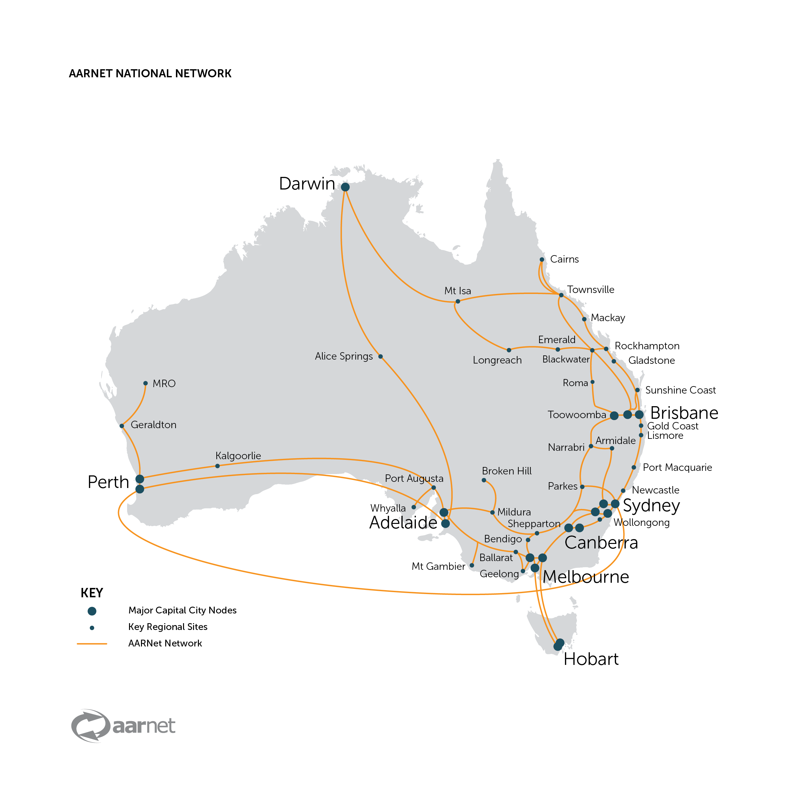
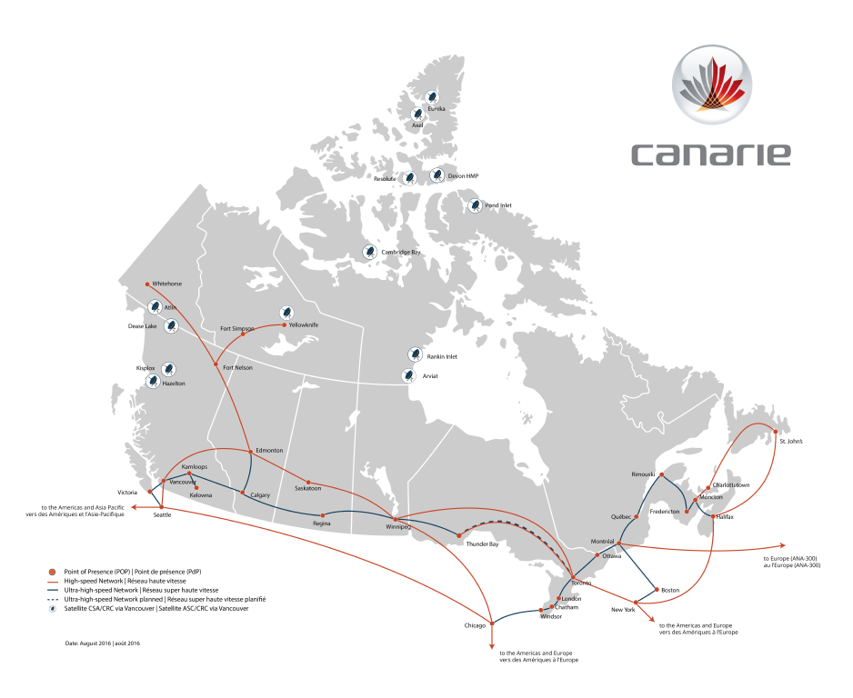

Slide 59










State/regional networks aka “your ISP”
Notes:
State networks
There are a bunch
Some states have more than one
You may connect to more than one
Your university may even run it!
Your path to understanding this is frequently your most senior network engineer (takes a lot more brownies)
These can be powerful sources of knowledge, most very involved in research support

Slide 61






Exchanges and PoPs
Notes:
An Internet exchange point (IX or IXP) is a physical infrastructure through which Internet service providers (ISPs) and Content Delivery Networks (CDNs) exchange Internet traffic between their networks (autonomous systems).
Sometimes these are run by the state networks either directly or indirectly

Slide 62
























Local networks
(Insert your logo here)
Notes:
You need to know how your local network works.
Not a a low level (unless you want to, try it, you may like it…)
But at a high level
Your local friendly (or not so friendly) network engineer is your key. Bring brownies. Be interested, explain why you want to know.

Slide 63
You are here!

Slide 64
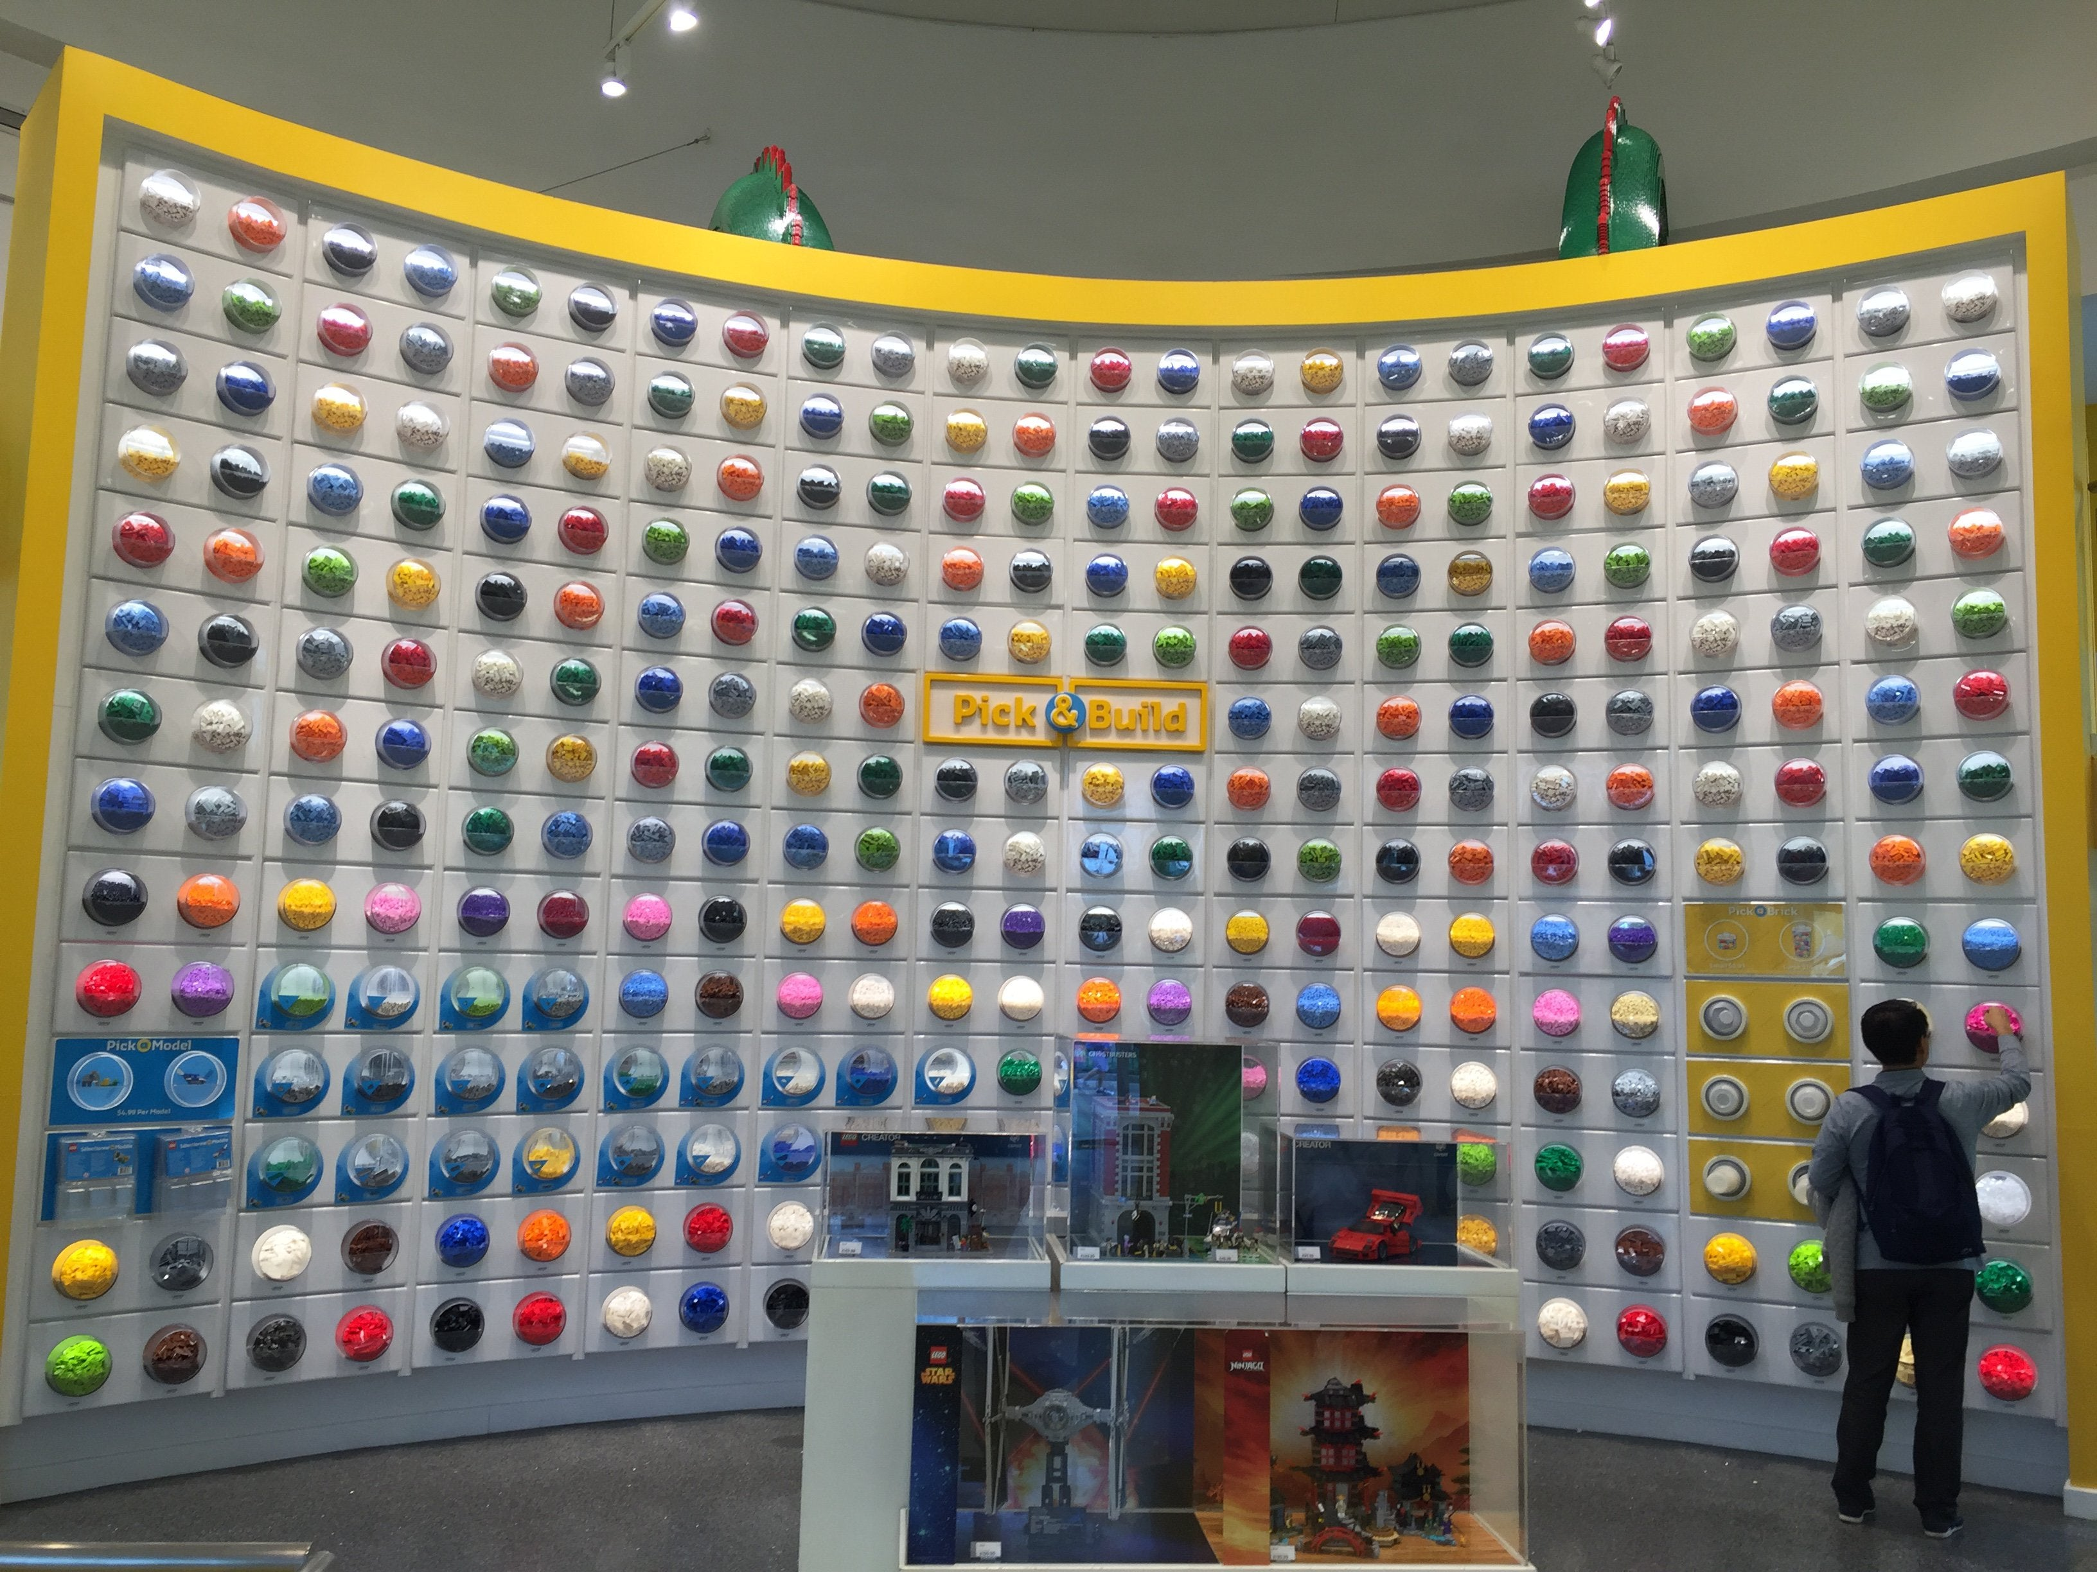
The local area network – spoiled for choice
LAN networks are like Legos – no wrong way to build them (sort of)
Minefield of equipment
Random security systems

Slide 65
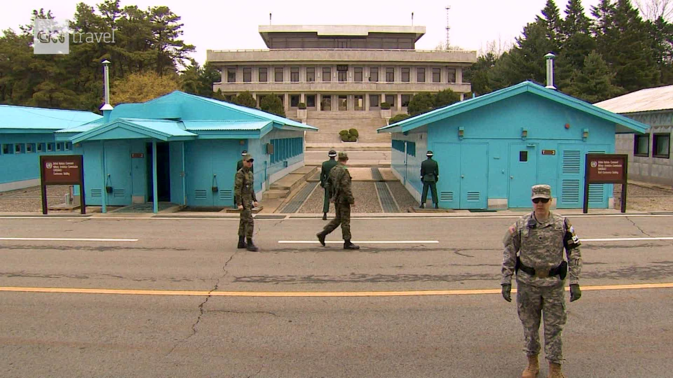
What’s the deal with DMZs?

Slide 66

What makes up an university network?
Students

Slide 67

What makes up an university network?
Students
Business IOT

Slide 68

What makes up an university network?
Students
Business IOT
Research and teaching

Slide 69

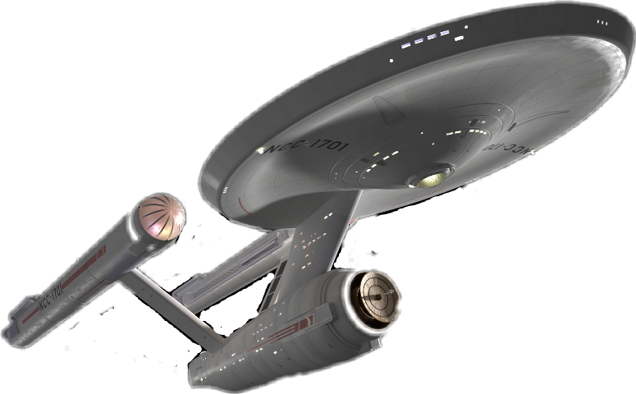
What makes up an university network?
Students
Business IOT
Research and teaching
Enterprise
systems

Slide 70


What makes up an university network?
Students
Business IOT
Research and teaching
Enterprise
systems

Slide 71
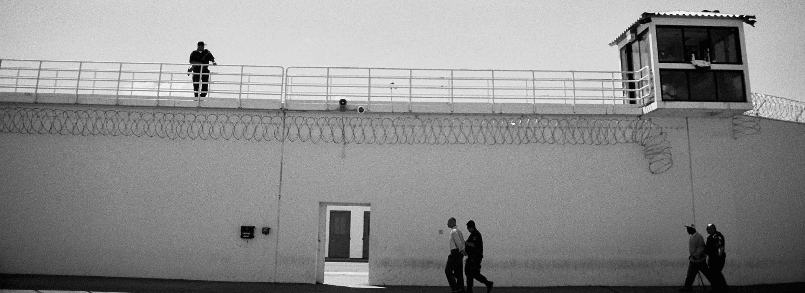
The university enterprise network…

Slide 72
The university enterprise network…
“internet connection”
Notes:
Here we have the “WAN”, basically the external connectivity for the academic network

Slide 73
The university enterprise network…
“Firewall”
“internet connection”
Notes:
Here we have the “WAN”, basically the external connectivity for the academic network

Slide 74
The university enterprise network…
IT security team
“Firewall”
“WAN”
Notes:
Here we have the “WAN”, basically the external connectivity for the academic network

Slide 75
The academic network…
Bureaucracy
(aka “Paperwork”)
IT security team
“Firewall”
“internet connection”
Notes:
Here we have the “WAN”, basically the external connectivity for the academic network

Slide 76
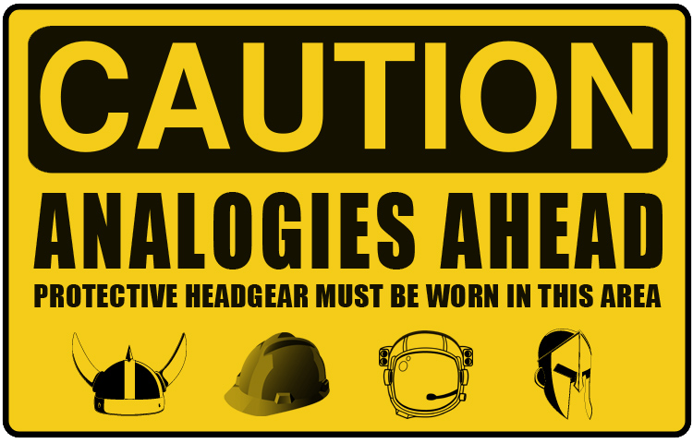

Slide 77
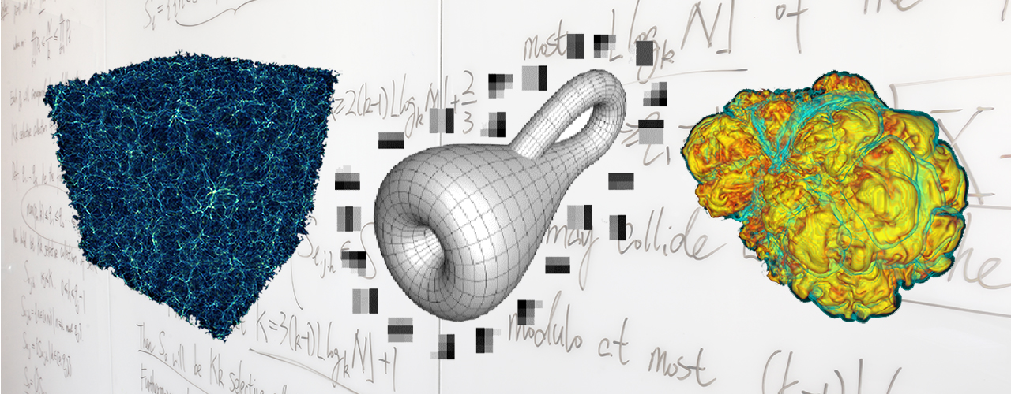
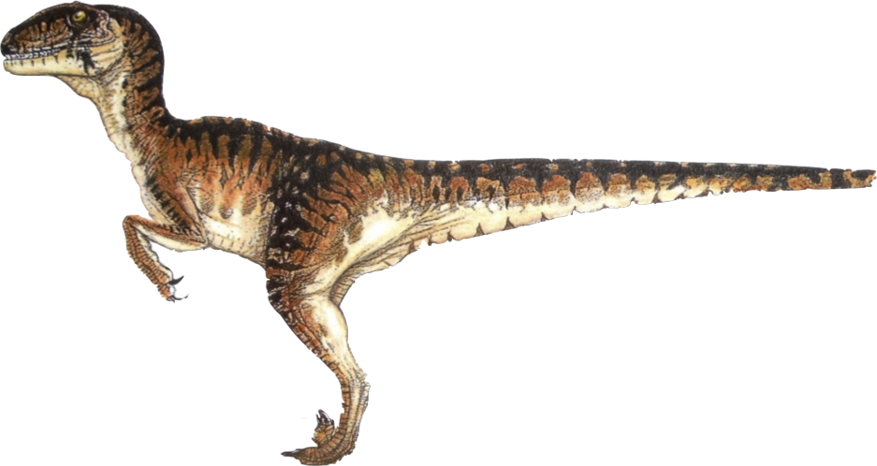
Computational Research, an analogy…
=
Computational Research
Velociraptor

Slide 78
Computational Research, an analogy…
~
=
Computational Research
Velociraptor
Notes:
Well, “approximately”…

Slide 79
Computational Research, an analogy…
Irrefutable proof the analogy is valid…
Notes:
As proof that this analogy holds true…

Slide 80
Computational Research, an analogy…
Notes:
We will use a Venn diagram!

Slide 81
Computational Research, an analogy…
Agile
Notes:
Both computational research and velociraptors are agile. Each of them need to change their behavior to match environmental constraints.

Slide 82
Computational Research, an analogy…
Agile
Moves Rapidly
Notes:
Both tend to move rapidly!

Slide 83
Computational Research, an analogy…
Agile
Moves Rapidly
More Effective
In Groups
Notes:
Both work more effectively as a group.

Slide 84
Computational Research, an analogy…
Agile
Moves Rapidly
More Effective
In Groups
Consumes All
Available Resources
Notes:
And both will consume any (and all) available resources that are presented to them.

Slide 85
Computational Research, an analogy…
Agile
Moves Rapidly
More Effective
In Groups
Consumes All
Available Resources
Cool!
Notes:
And both are really, really cool!

Slide 86
Computational Research, an analogy…
Agile
Moves Rapidly
More Effective
In Groups
Is not reptile
Is reptile
Consumes All
Available Resources
Cool!
Notes:
And both are really, really cool!

Slide 87
When Computational Science Meets Traditional Networks

Slide 88
When Computational Science Meets Traditional Networks
Pardon me good sirs…

Slide 89
When Computational Science Meets Traditional Networks
Yes?

Slide 90
When Computational Science Meets Traditional Networks
I have some important research data…

Slide 91
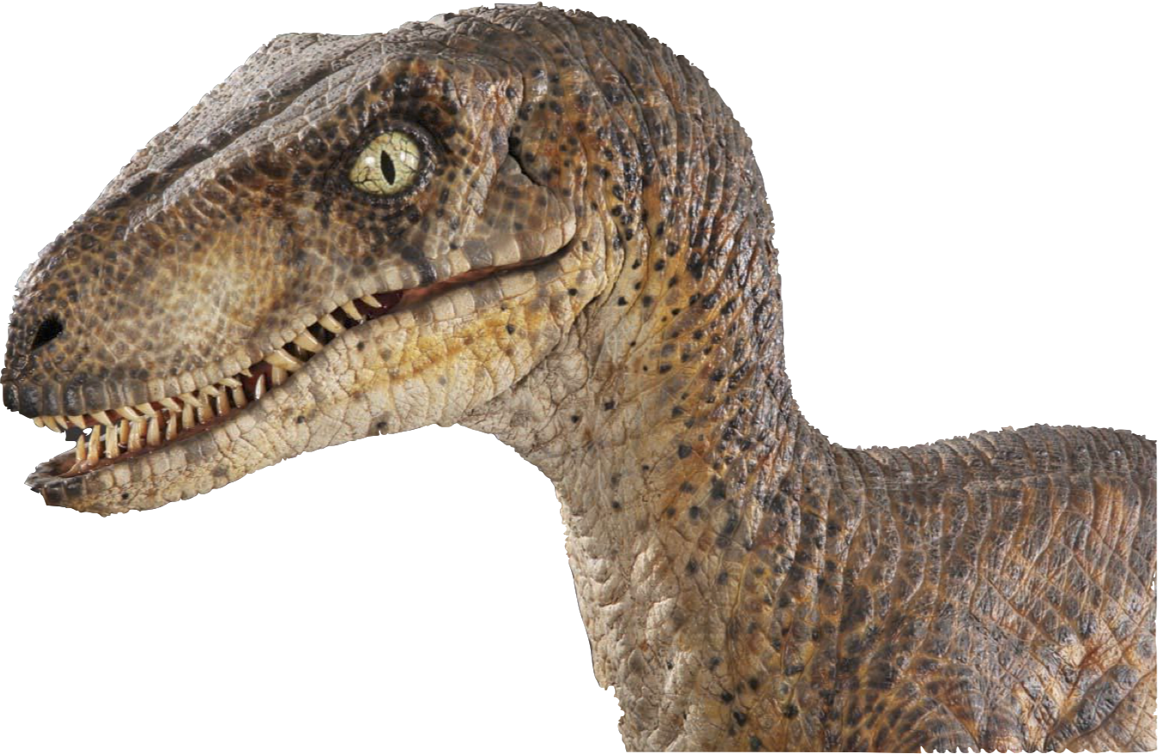
When Computational Science Meets Traditional Networks
…that is highly important to myself, the educational community, and all of mankind as a whole. It is imperative that this data be reasonably secured; yet, available to my research peers. The datasets are rather large, and they may need to be shared across institutions.

Slide 92
When Computational Science Meets Traditional Networks
Would it be possible to place this in a secure, reliable, flexible, accessible, as well as high performing infrastructure?

Slide 93
When Computational Science Meets Traditional Networks
Ummm…

Slide 94
When Computational Science Meets Traditional Networks
Lemme check…

Slide 95
When Computational Science Meets Traditional Networks
Hey, Jim!

Slide 96
When Computational Science Meets Traditional Networks
Yo!

Slide 97
When Computational Science Meets Traditional Networks
Gotta guy here. Says he needs stuff.

Slide 98
When Computational Science Meets Traditional Networks
What kinda stuff?

Slide 99
When Computational Science Meets Traditional Networks
Something about data and connectivity

Slide 100
When Computational Science Meets Traditional Networks
We do that! Send ‘em in.

Slide 101
When Computational Science Meets Traditional Networks

Slide 102
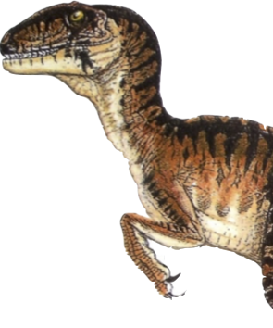
When Computational Science Meets Traditional Networks
ROAR!!!

Slide 103
When Computational Science Meets Traditional Networks
Ye gads!

Slide 104

When Computational Science Meets Traditional Networks
AHHHH!!
Ye gads!

Slide 105

When Computational Science Meets Traditional Networks
AHHHH!!
THE INHUMANITY!!!
Ye gads!

Slide 106
When Computational Science Meets Traditional Networks
AHHHH!!
THE INHUMANITY!!!
Ye gads!
HOM! NOM! NOM!

Slide 107
When Computational Science Meets Traditional Networks
OBSERVATION: The requirements of the computational researcher and the service profile of the traditional campus computer network (or other ”commodity” networks) do not always align!
Ya’ think?!
Notes:
The requirements of the computational researcher simply do not align easily with the traditional capabilities of regular networks.

Slide 108

When Computational Science Meets Commercial Commodity Networks
No.
Help!
Notes:
The requirements of the computational researcher simply do not align easily with the traditional capabilities of regular networks.

Slide 109
When Computational Science Meets Commercial Commodity Networks
On second thought,
how much money yah gots and how may friends do you have I can eat, um, I mean meet?
Eeek… Umm…
Notes:
The requirements of the computational researcher simply do not align easily with the traditional capabilities of regular networks.

Slide 110
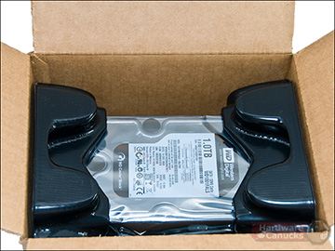
When Computational Science Meets Traditional Networks
This can result in adverse consequences:
  Network performance issues for the researcher
  Network performance issues for everyone else
  Frustration for the researcher
  Frustration for IT staff
  General grumbling and complaining

Slide 111
When Computational Science Meets Traditional Networks
Sigh. I guess cancer cures can wait.

Slide 112
When Computational Science Meets Traditional Networks
But how do we overcome this? I can’t stop my research just because the network can’t keep up! Being able to collaborate is absolutely necessary!

Slide 113
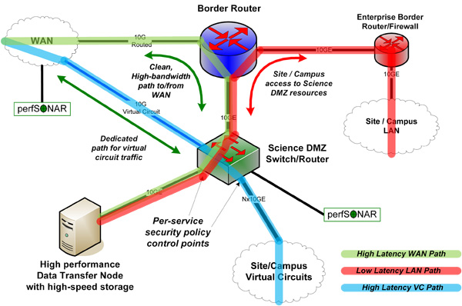
Specialty networks to the rescue!
Both internally to your organization and externally
Science DMZ is an example of a specialty network

Slide 114
Does everyone need one?

Slide 115
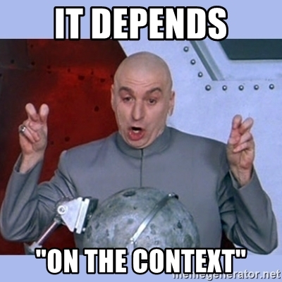
Different SciDMZ architectures
Brute force method
Apply money method
Help me help you method
Get fancy method
Special snowflake method
Come to me method

Slide 116
Brute force method…
Fiber to the end user
Build to demand
Sustainability issues
Bang for buck issues
Looong lead time issues
You expect me to wait for how long?

Slide 117
Apply money…
Full hardware designs
Sometimes just to the buildings
Sometimes all the way to the jacks
Sustainability issues
Bang for buck issues
Loop anyone?
You expect me to fund what? Some kind of tubes?

Slide 118
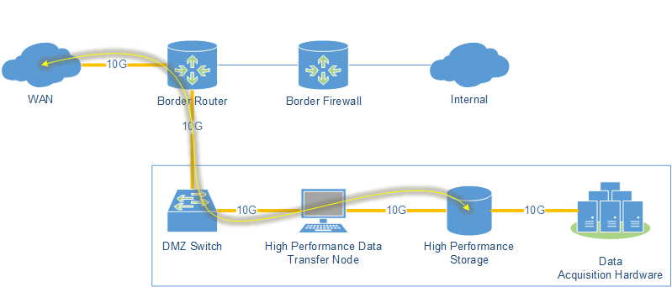
Help me help you…
Replacement of border routers with more powerful boxes
Often a L2 switch in a central location
Good starting point
Is the science driver located where the DMZ is?
What about the labs?
Only a start

Slide 119
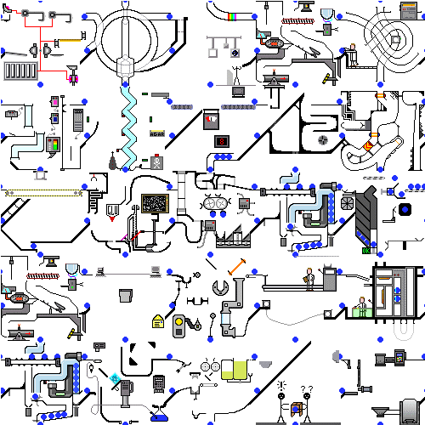
Get fancy…
Virtualize all the things
VRF or other such segmentation of existing network gear
At its most basic – VLANs
Low cost – as sustainable as the network is
Can be is complex
Will IT set this up in a reasonable amount of time?
Congestion still an issue for large flows
More readily sustainable

Slide 120
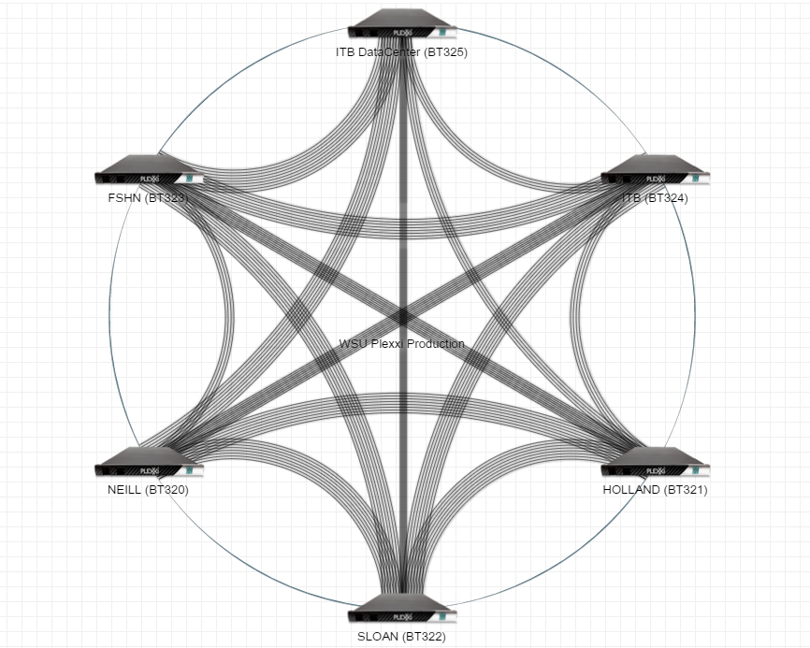
Special snowflake method…
Unique design
Can be overly complex
Will IT set this up in a reasonable amount of time?
Is it sustainable?
Supporting research or doing research?
Ice ages have not gone well for my kind…

Slide 121
Come to me method…
Centralization!
Less hardware and complexity
Must have trust
Will IT set this up in a reasonable amount of time?
Is it sustainable?
Start with one

Slide 122
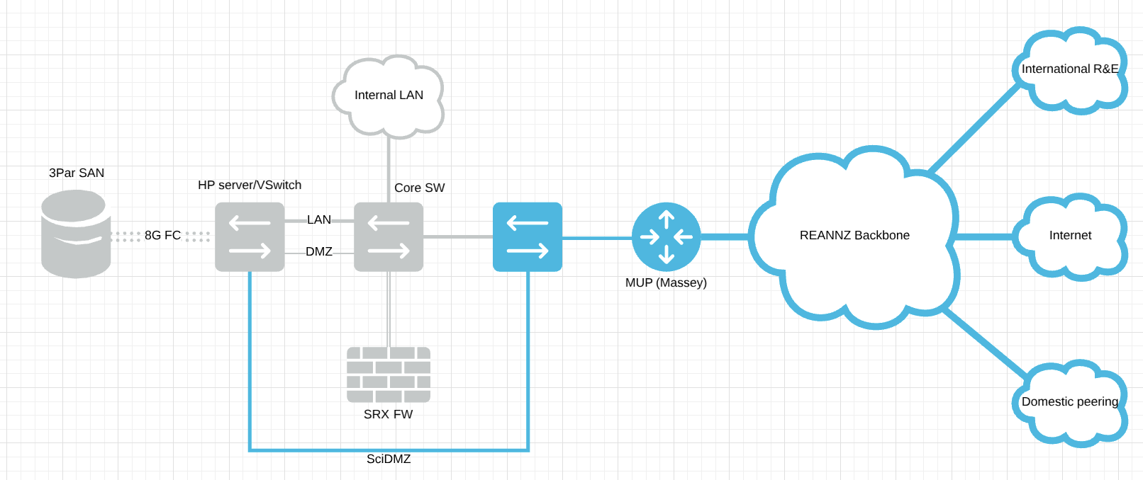

Slide 123

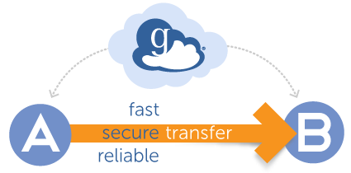

Slide 124
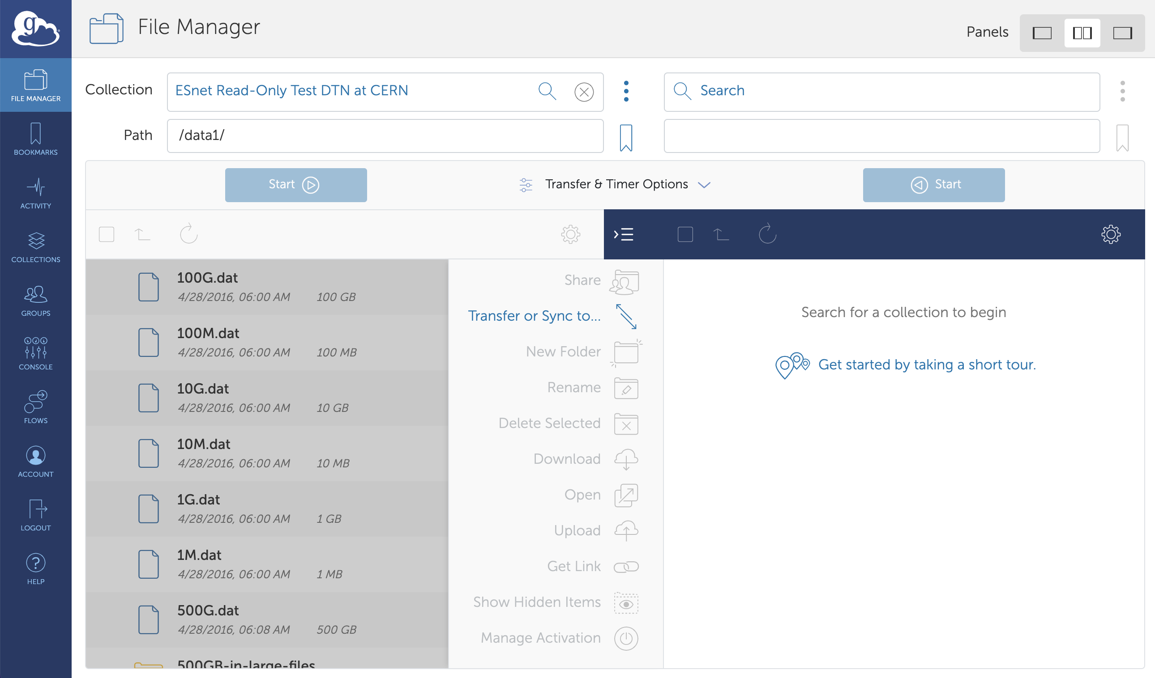

Slide 125
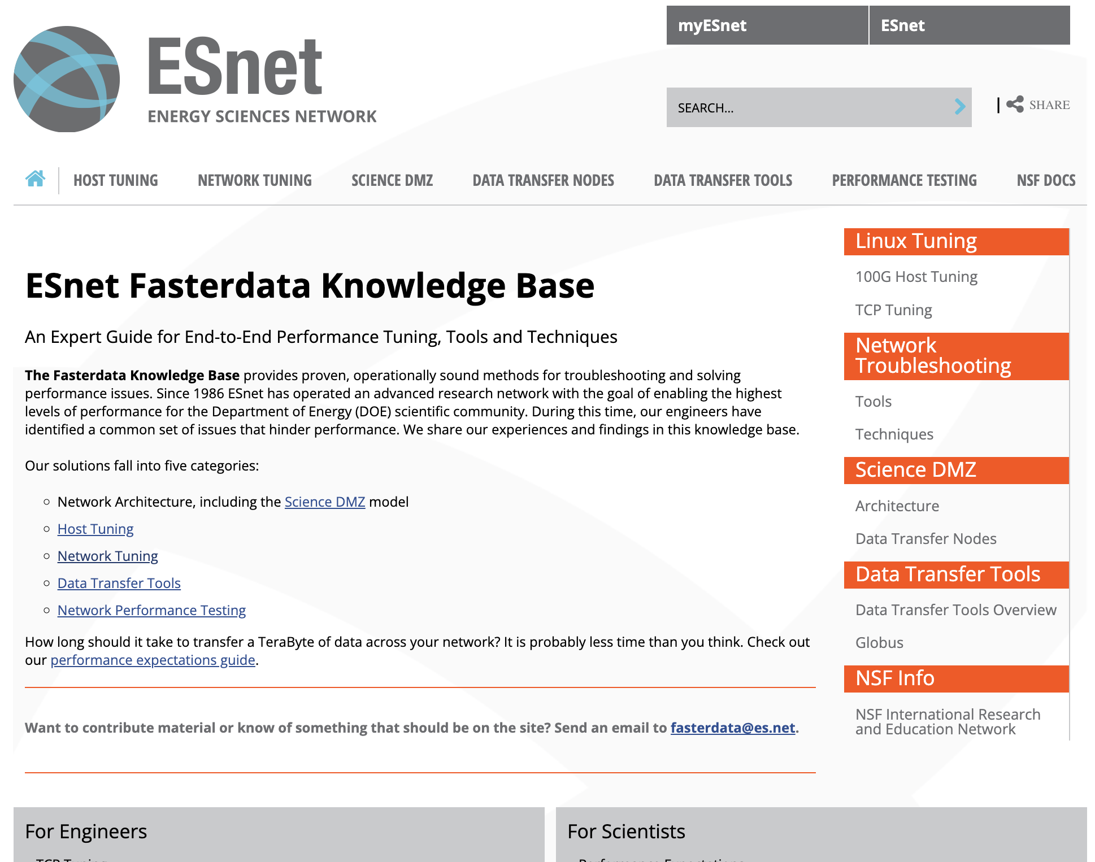
https://fasterdata.es.net/

Slide 126
Weak links break file transfers…
Know your provider and leverage them for help!
Use https://fasterdata.es.net/
Networks come in many shapes and sizes
Networks interconnect to make more networks
Networks get exponentially complex the more connections you have
If your data has to transit it - its “your” network!
You need to know who to go to for help!

Slide 127
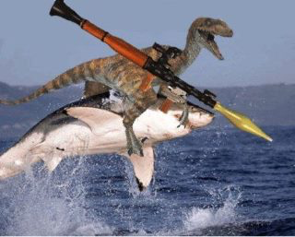
Thank you for your time today!
Wallace A. Chase
Head of Department, ITS
wallace.chase@otago.ac.nz
@bmtfr

