Slide 1
Research Data Management
Jason R. Wells, MDY
jrwells@seas.harvard.edu
ACI-REF VR ‘22

Slide 2
Session Goals
Introduce
Research Data Management (RDM)
The need for RDM
The planned solution
The facets of a research project
Data Lifecycles to introduce RDM resources into a project
Discuss
One data lifecycle in depth
How RDM is changing
Document how you can help
Introduce some RDM communities for further help

Slide 3
Get an ORCiD ID!
Aside from serving as a central record of your academic achievements
Centralized login for:
Dataverse
Dryad
OpenScienceGrid
Etc.

Slide 4
Research Data Management
Research Data Management (RDM) is a broad concept that includes processes undertaken to create organized, documented, accessible, and reusable quality research data. (https://www.ala.org/acrl/publications/keeping_up_with/rdm)

Slide 7
NIH 2023 Changes

Slide 8
What do researchers/faculty need before they need a supercomputer?

Slide 9
Types of Funding Sources
Private
Companies
Foundations
Individuals
Public (including but not limited to)
DOD
DOE
NIH
NOAA
NSF
USGS

Slide 10
Institutional Considerations
If data is coming from a 3rd party:
Data Use Agreements (DUA)
If private money is being used to fund the research:
Outside Activities and Interests Reporting (OAIR)
Gift Terms
If people are being researched:
Institutional Review Board (IRB)
If any harm can happen with a data leak/breach:
Research Data Safety (Data Safety)
Staffing

Slide 11
Other Considerations
Communication
Meeting
Chat
Document Collaboration
Code Collaboration
IT Conventions
Programming
File System
Other
Accessibility

Slide 12
We organize RDM efforts around lifecycles, but which one?

Slide 13
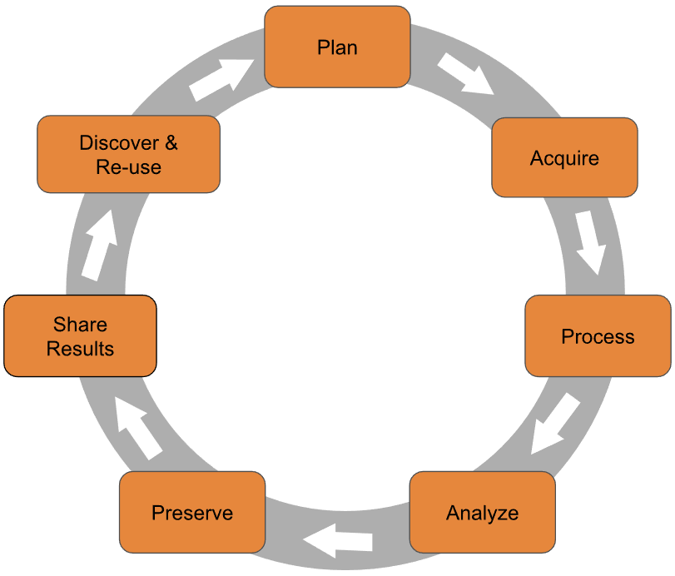
Purdue

Slide 14
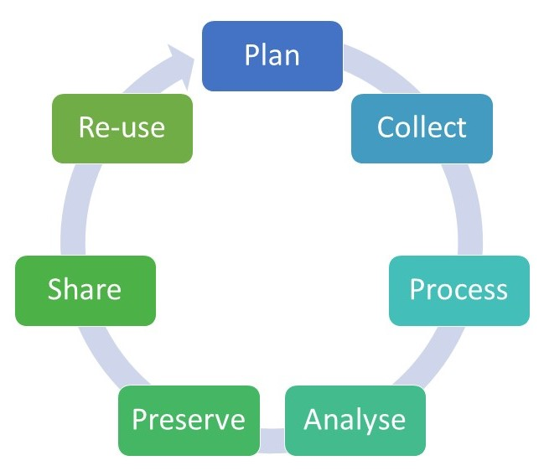
University of Reading

Slide 15
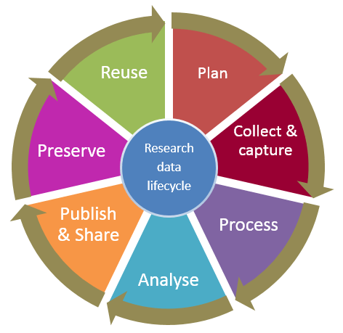
University of Tasmania

Slide 16
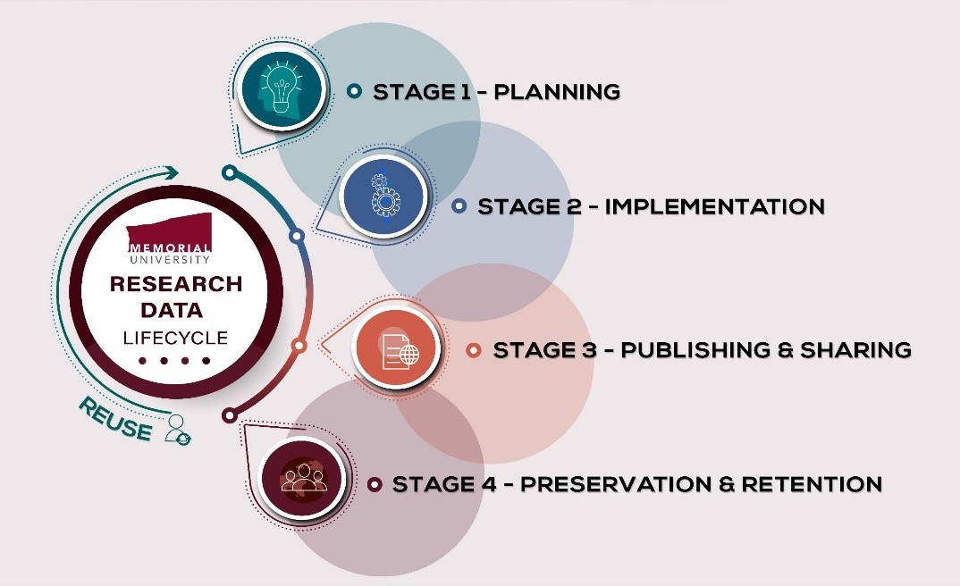
Memorial University

Slide 17
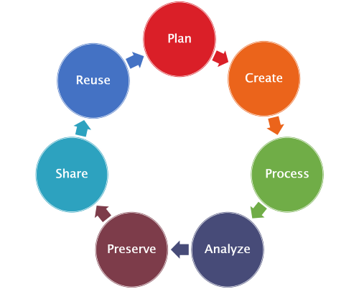
University of Arizona

Slide 18
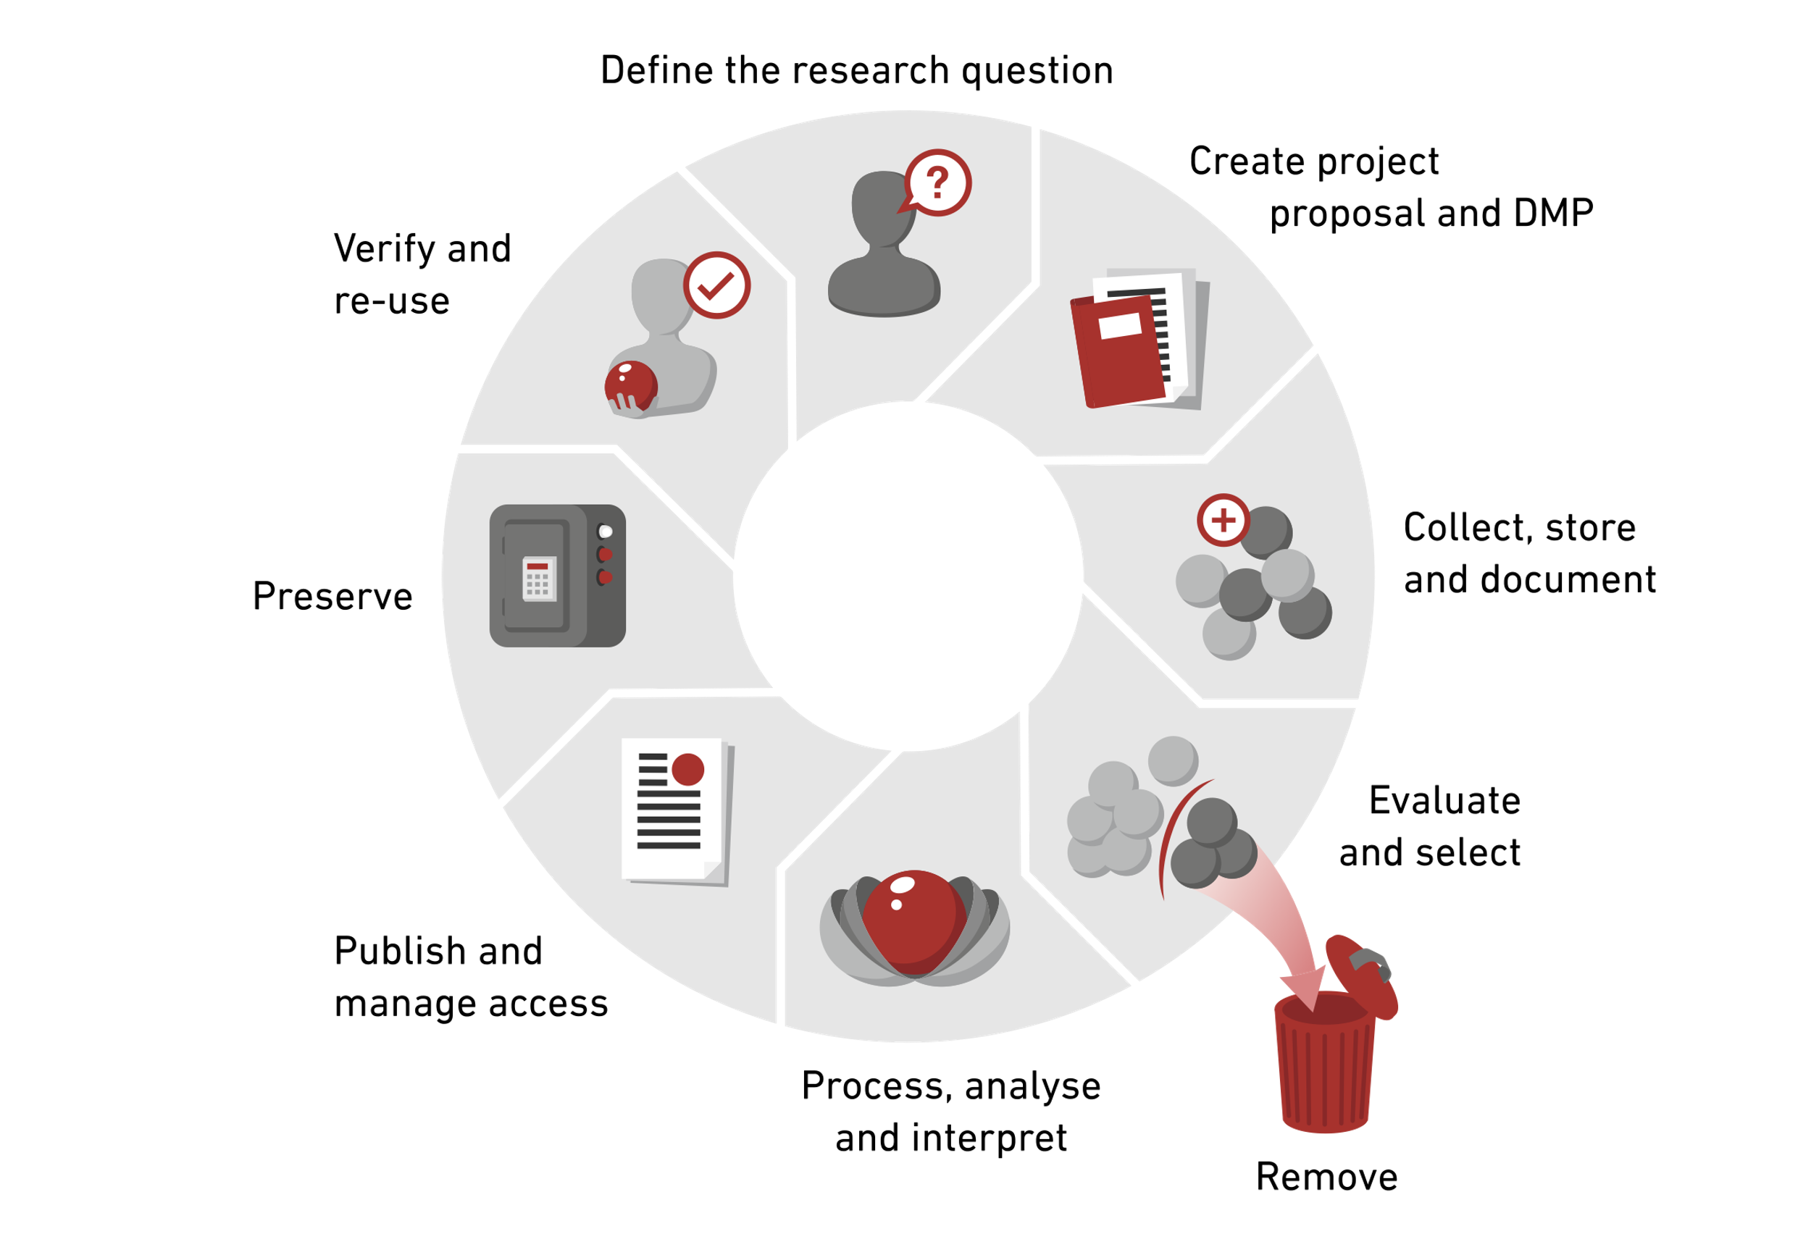
ETH Zurich

Slide 19
Adopt one or develop your own! Harvard Medical School uses…

Slide 20
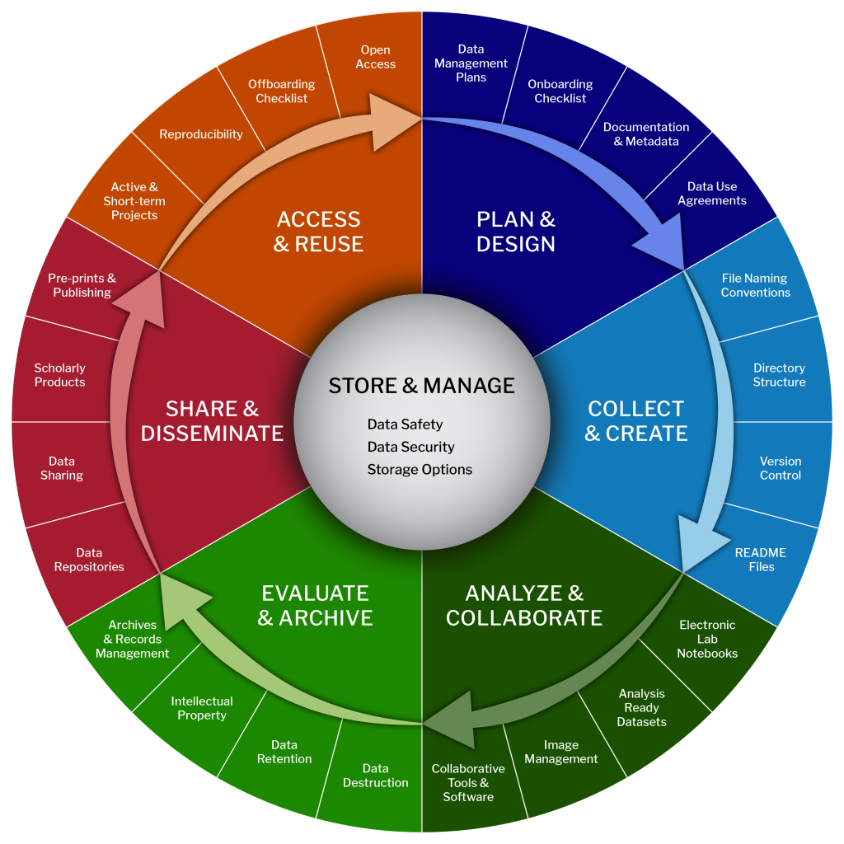
Harvard Biomedical Data Lifecycle

Slide 21
Harvard SEAS Research Data Management Lifecycle
Plan and Design
Collect and Create
Analyze and Collaborate
Evaluate and Archive
Share and Disseminate
Project Close and Extended Missions
At All Times

Slide 22
Plan and Design
Data Management (& Sharing) Plan
NIH: NOT-OD-21-014
Example: https://dmptool.org/plans/74502/export.pdf?export%5Bquestion_headings%5D=true
NSF: https://www.nsf.gov/bfa/dias/policy/dmp.jsp
Example: https://dmptool.org/plans/72003/export.pdf?export%5Bquestion_headings%5D=true
DOD: DoDI 3200.12 (rev 3, 12/17/2018), Enclosure 3c, pg. 14
Example: https://dmptool.org/plans/24333/export.pdf?export%5Bquestion_headings%5D=true
DMPTool’s Public Plans (https://dmptool.org/public_plans)

Slide 23
Example DM Plans

Slide 24
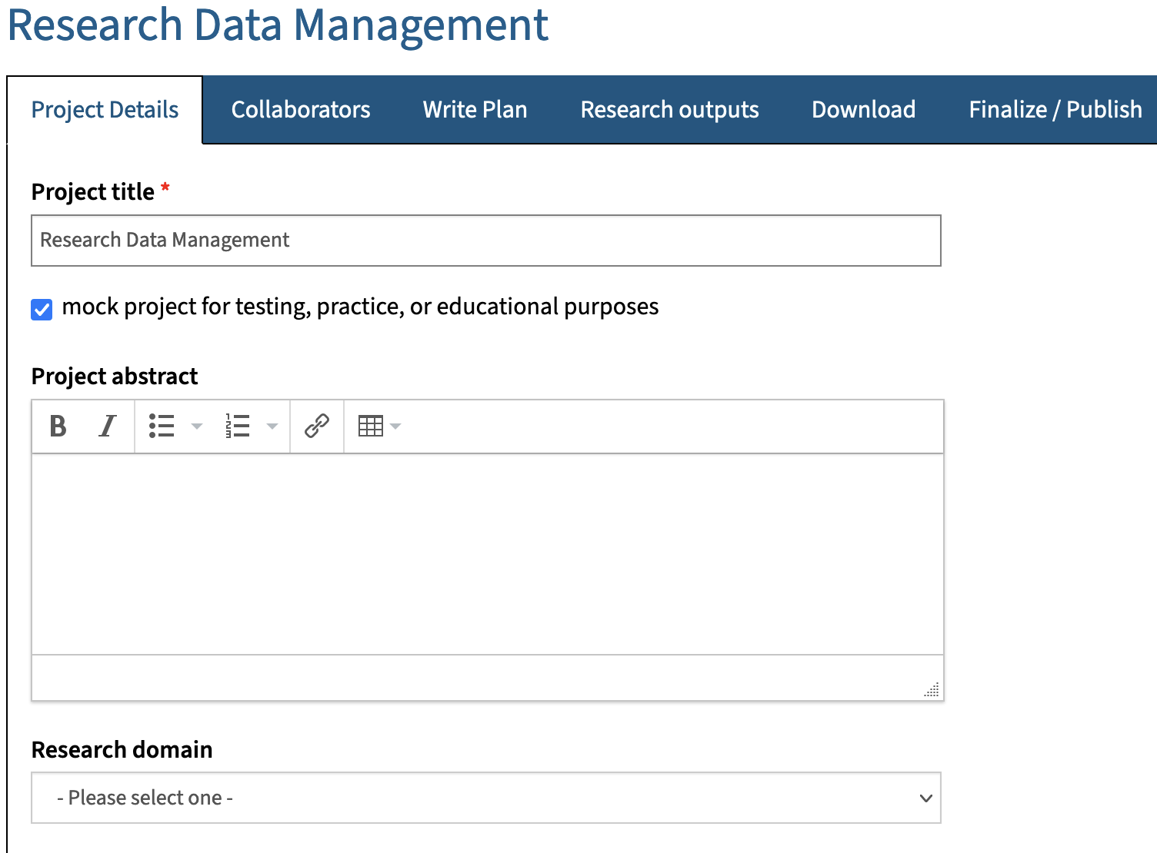
DMPTool Demo

Slide 25
Plan and Design
Documentation
Project Abstract
Research question
Budget
Research Plan
Materials for IRB, DUA, Data Safety, etc.
How research will be conducted
Etc.
Metadata
Date, University, School, Department, PI, Project, Task, Version, Tags, Etc.

Slide 26
Plan and Design
Onboarding and off-boarding checklists
Onboarding: https://osf.io/zwxr7
Off-boarding: https://osf.io/h5d9y

Slide 27
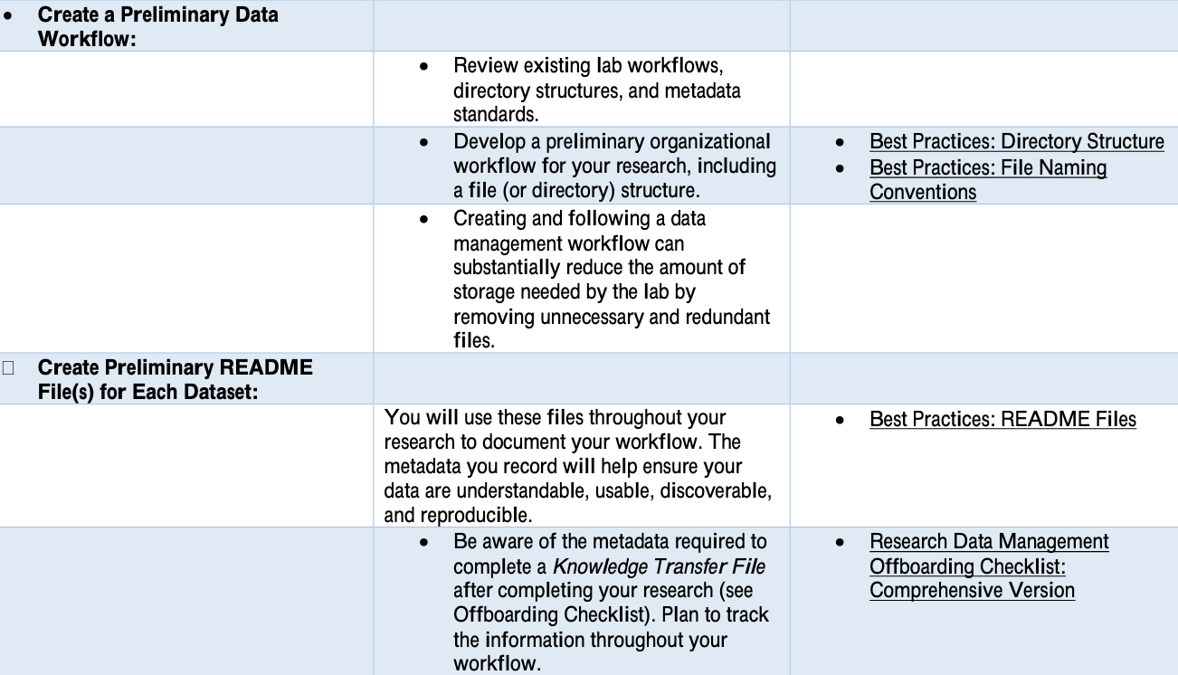
HMS RDM Onboarding Checklist

Slide 28
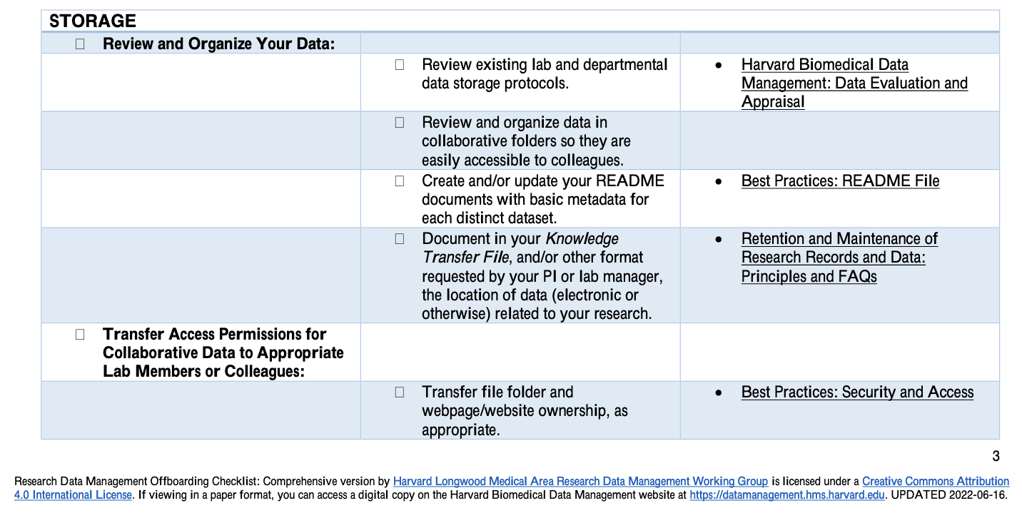
HMS RDM Off-boarding Checklist

Slide 29
Plan and Design
Internal Controls
Data Use Agreements (DUA)
Outside Activities and Interests Reporting (OAIR)
Institutional Review Boards (IRB)
Data Safety

Slide 30
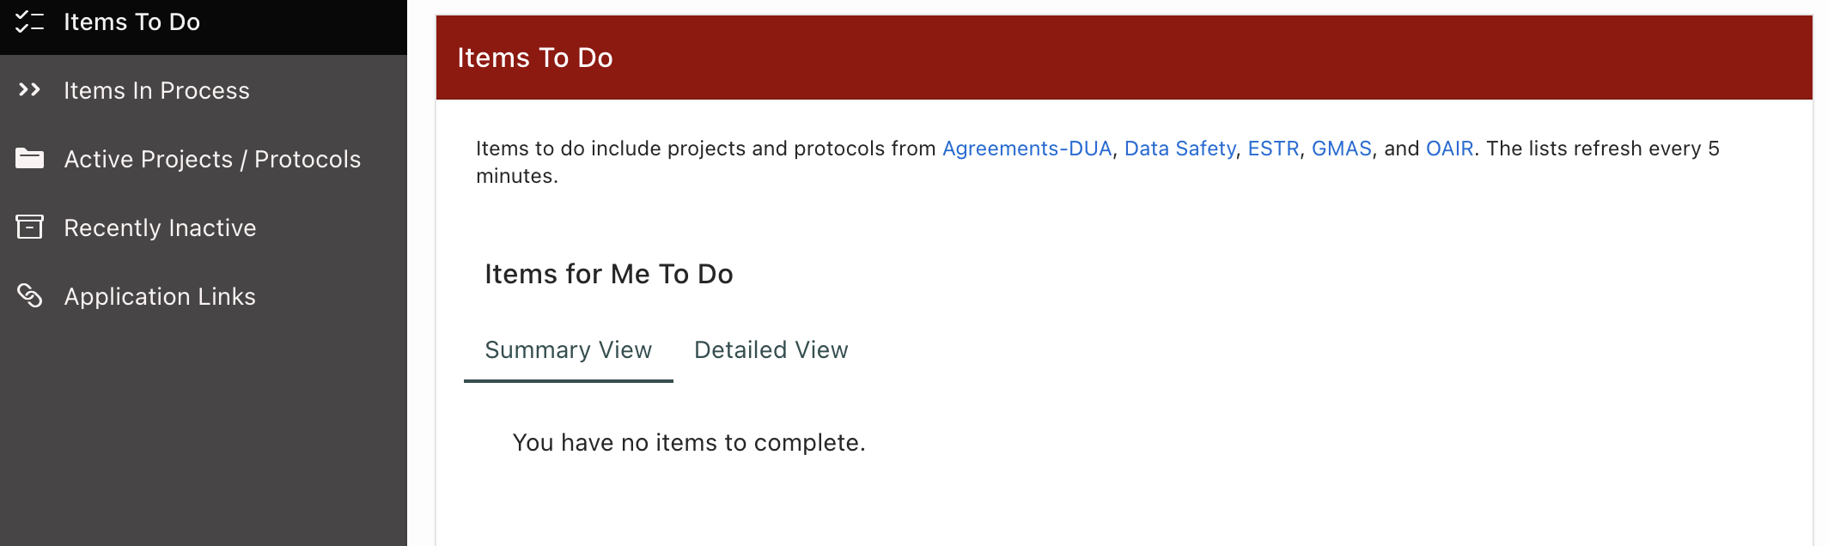
Example Research Portal

Slide 31
DUA

Slide 32
OAIR

Slide 33
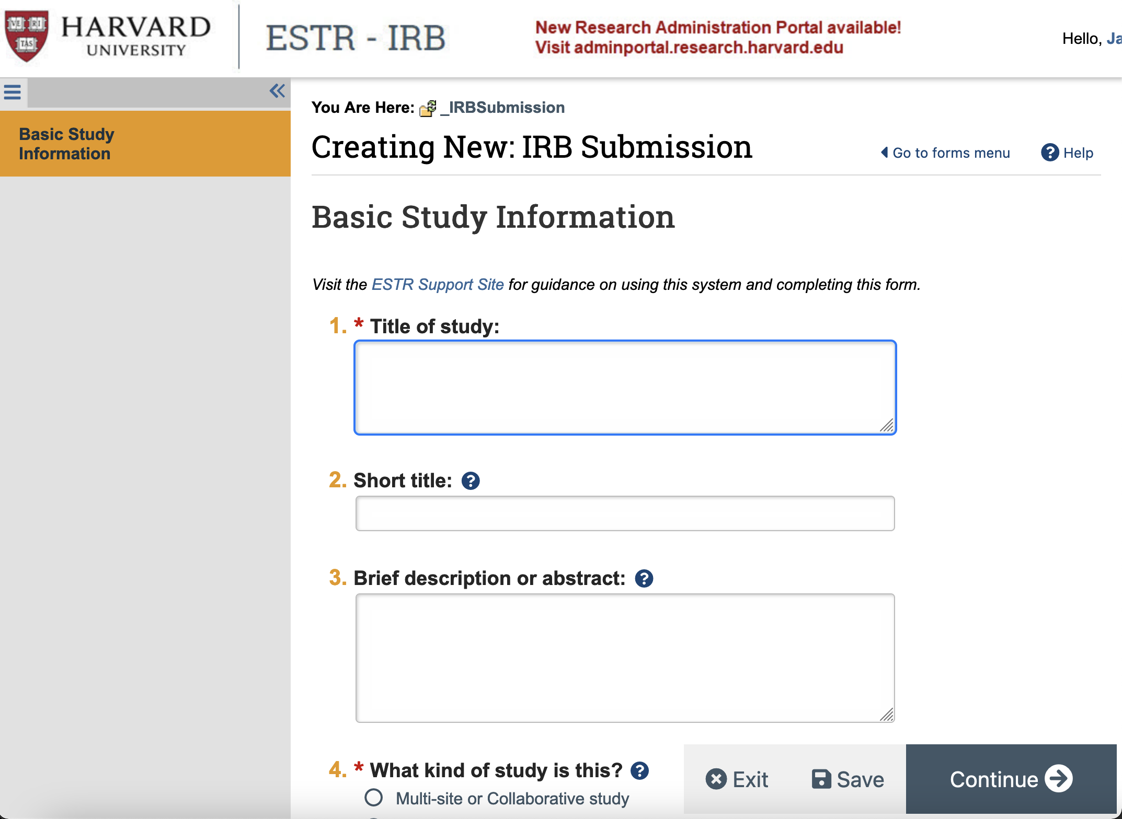
IRB

Slide 34
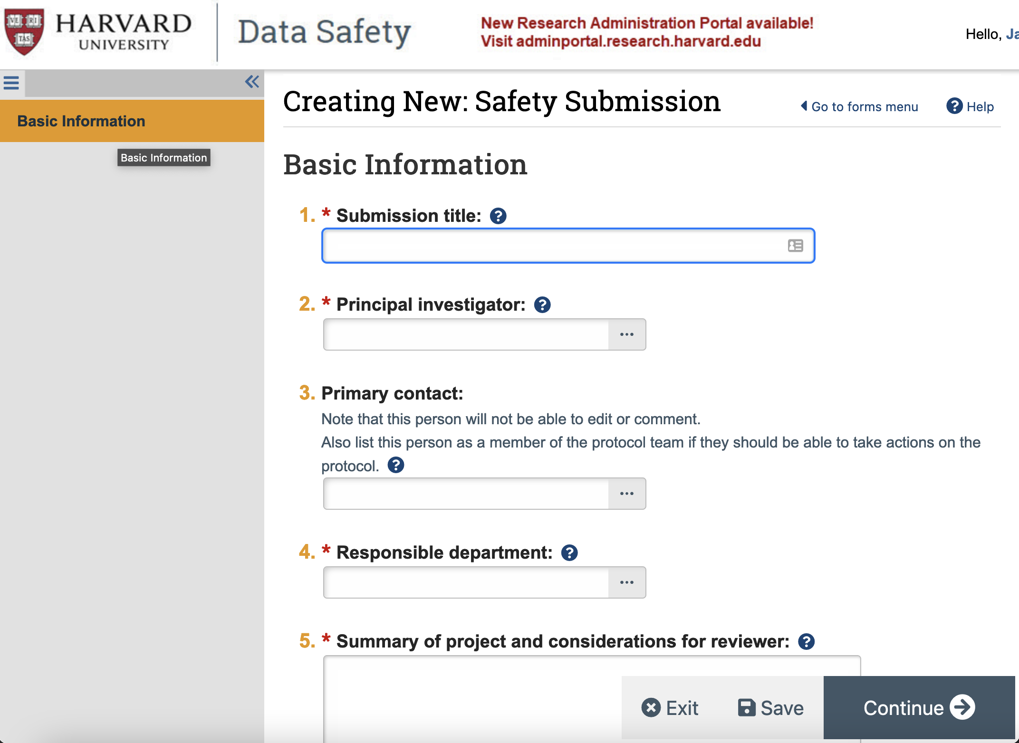
Data Safety

Slide 35
Collect and Create
File Naming Conventions
Wells_RDM_ACIREFVR22_Presentation
Directory Structure
HU_SEAS_Wells_RDM_ACIREF-VR_070122
Version Control
Handled by programs, Google Drive, Github, etc.
Programming Conventions
MyVar, myVar, myvar, MyFunc, myFunc, myfunc, _, -, etc.
README Files
Describe the task, why, version, changes, etc.

Slide 36
Analyze and Collaborate
Electronic Lab Notebooks
OSF, eLabNext, RSpace, eLabJournal, LabArchives

Slide 37
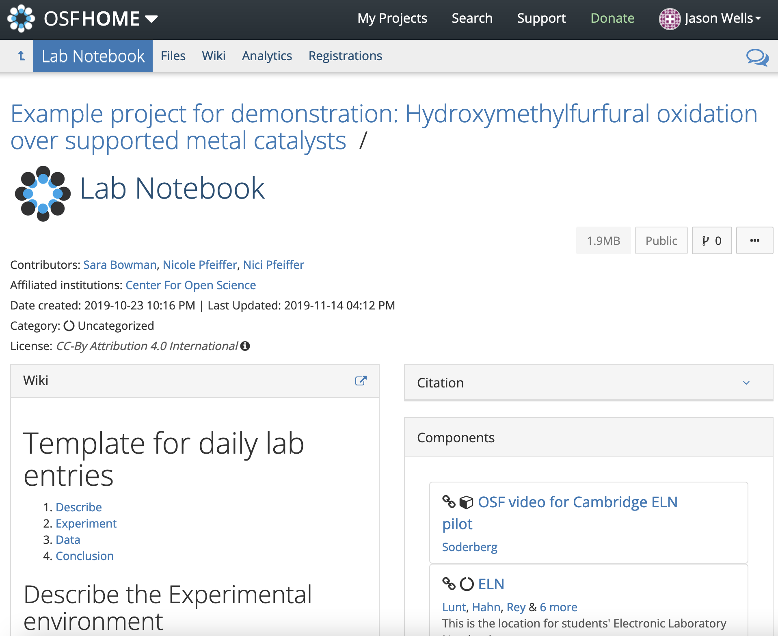
OSF Demo

Slide 38
Analyze and Collaborate
Collaborative Tools & Software
Pandemic 101, but you may need archiving and recording!
Analysis Ready Datasets
Create tips for preparing a dataset for public release.
Image Management
Tropy, ImageJ

Slide 39
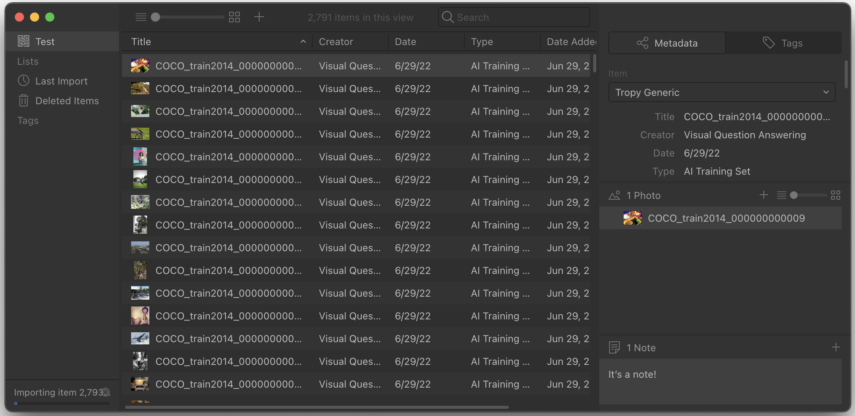
Tropy Demo

Slide 40
Evaluate and Archive
Archives and Record Management
Identify data from long term retention (easy to access, $$-$$$) or archiving (not as easy, $)
Make the arrangements
Refer to the At All Times slide
Intellectual Property
Internal Office or General Counsel

Slide 41
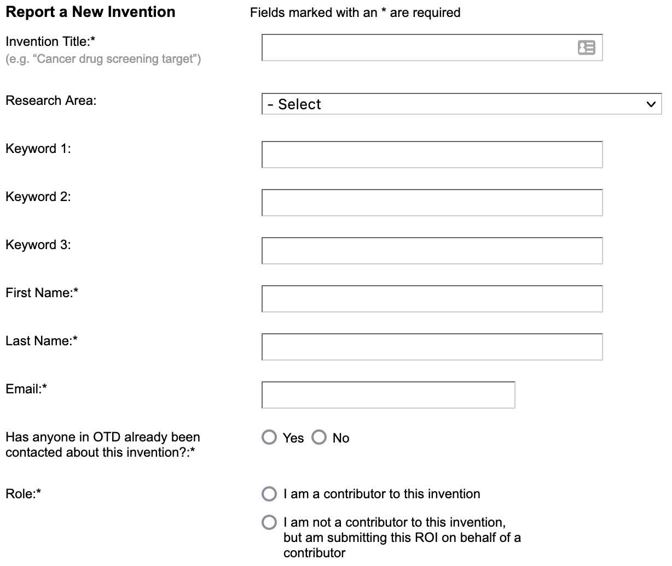
Office of Technology Development

Slide 42
Evaluate and Archive
Data Retention (always double check!)
NIH: 3 years from Final Financial Report
But 6 years after Final Resolution Date if there is a research misconduct report.
NSF: 3 years from submission of all required reports.
Data Destruction
Tomes have been written. Consult your IT Security Group.
There is a big difference between an average hacker, folks with magnetic force microscopy, and folks with capabilities we do not know about.

Slide 43
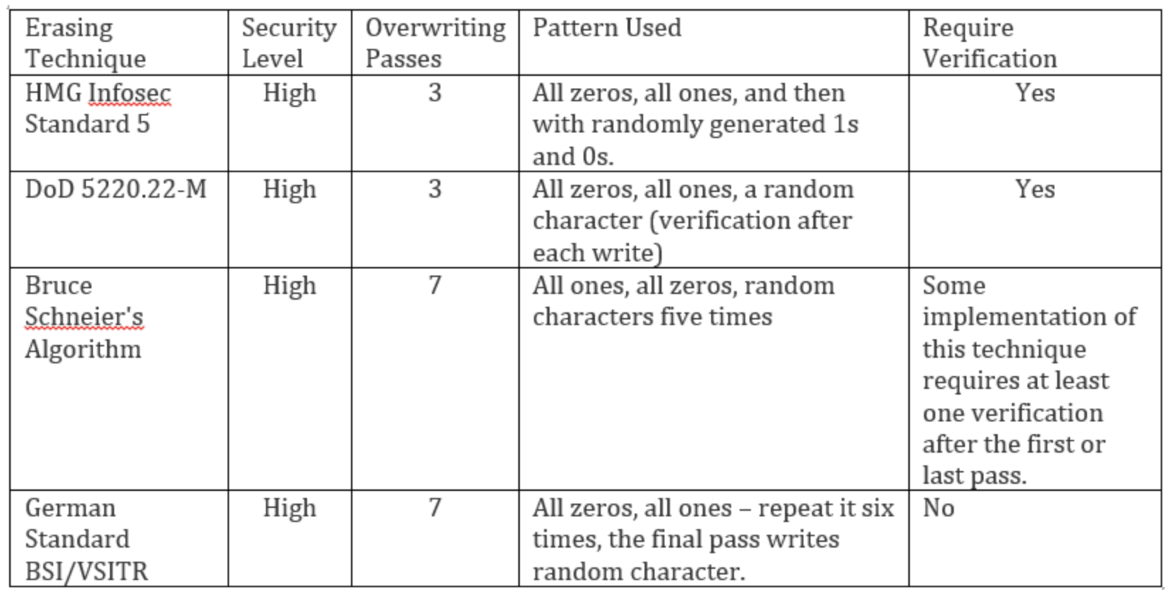
Data Destruction Examples
https://www.secjuice.com/data-destruction-techniques-in-windows-2/

Slide 44
Share and Disseminate
Scholarly Products
Think about what you can share
Data, Metadata, Preprints, Code, Protocols (protocols.io), Reagents, Training Materials, etc.

Slide 45
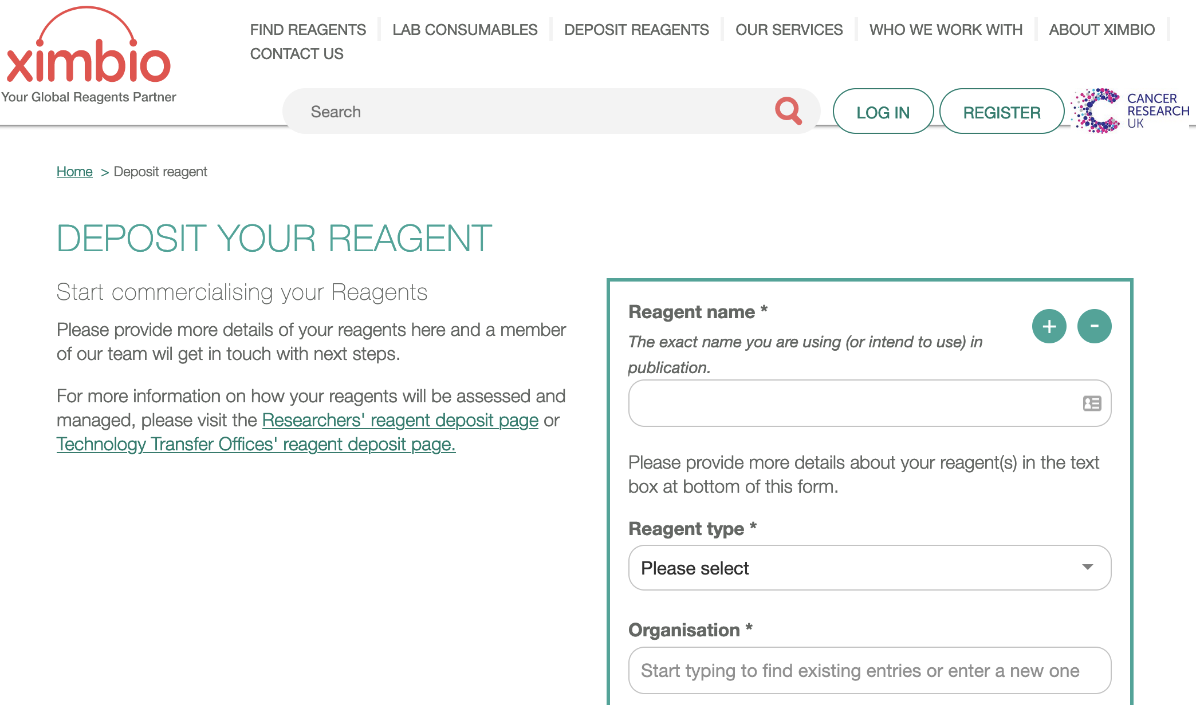
Reagents

Slide 46
Share and Disseminate
Data Repositories
NIH https://www.nlm.nih.gov/NIHbmic/domain_specific_repositories.html
Dryad https://datadryad.org/
Dataverse (free data repository open to all researchers from any discipline) https://dataverse.harvard.edu/)
There are many others.

Slide 47
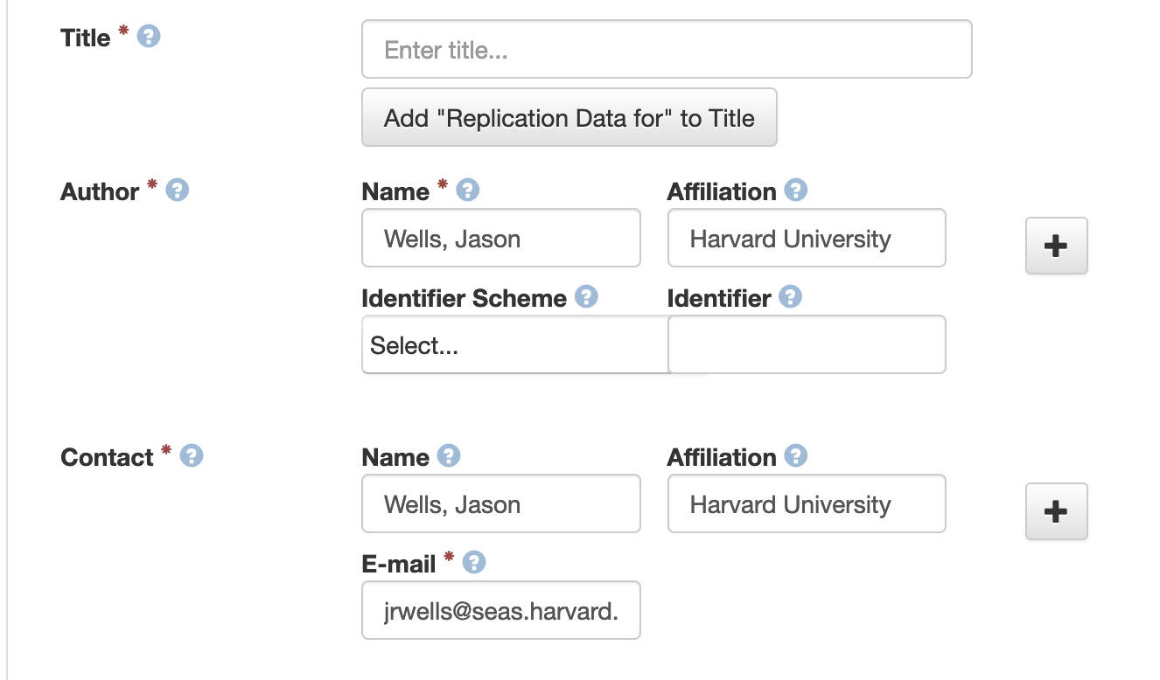
Dataverse Demo

Slide 48
Share and Disseminate
Pre-prints
ArXiv and beyond
Publishing

Slide 49
Preprint Servers
General - OSF - Arxiv - Hal - PeerJ - Preprints Biology and Cognitive Sciences - BioRxiv - Cogprints | Engineering - Engrxiv Mathematics - mp_arc Technology - TechRxiv Psychology & Sociology - SocArXiv - PsyArXiv

Slide 50
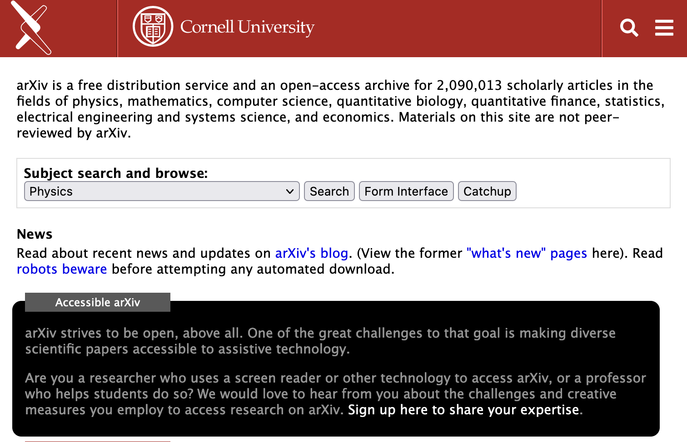
arXiv Demo

Slide 51
Project Close and Extended Missions
Reproducibility
Off-boarding Checklist
Knowledge Transfer File

Slide 52
Knowledge Transfer File
List all the extant projects ever worked on, including but not limited to:
Current Status
Important Contacts
Usernames and Passwords
Code
Documentation
Direction they were being taken and why
Future contact information for questions

Slide 53
At All Times
Security (encryption, access management, patching, etc.)
Safety (security levels, sanctions, ITAR, standards, etc.)

Slide 54
UC Data Safety Levels

Slide 55
At All Times
Storage Options

Slide 56
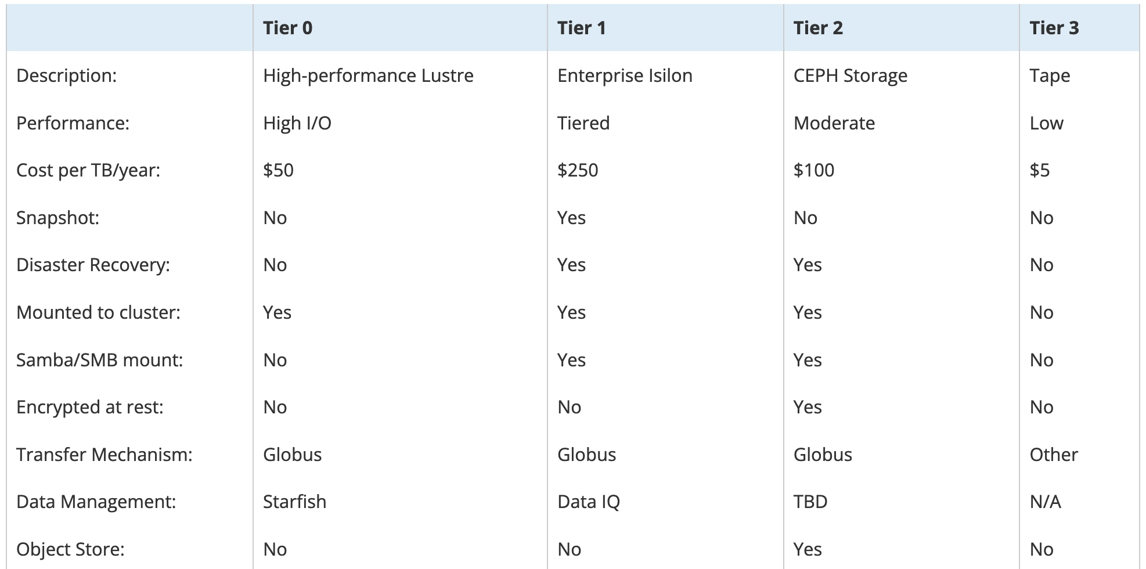
Storage Costs @ Harvard FASRC

Slide 57
After 2023…

Slide 58
Rumor Mill
The NIH changes are going to be common. Look for NSF, DoD, etc. to make the same changes.
Challenges
Public computing
BIOMedical: https://usegalaxy.org/
Sharing large amounts of data

Slide 59
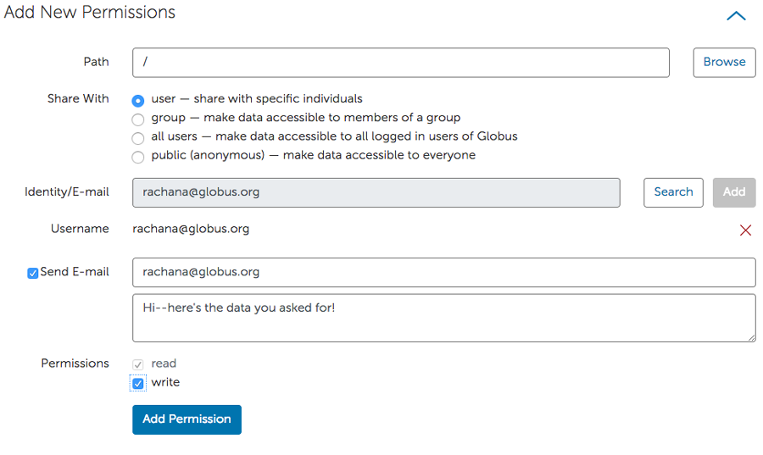
Large Data Ideas
Ask Dryad
Globus Guest Collection with a pointer in Dataverse

Slide 60
As far as ACI-REF VR though…

Slide 61
Familiarize Yourself With
Local Resources & Demands:
DUAs, IRB, Intellectual Property, Data Safety, websites and applications, etc.)
Storage and security options
Talk to your technical librarians & grants people (Sponsored Research, Grant Officer, Directors of Research and Finance, etc.)
Websites: DMPTool, OSF, Protocols.io, etc.
Applications: Tropy, ImageJ, Collab Software
Repositories (Dataverse, Dryad, etc.)
Pre-Print Services (ArXiv, domain-specific, etc.)

Slide 62
Communities
Research Data Access and Preservation Association (RDAP): https://rdapassociation.org/
FORCE11: https://force11.org/
American Librarian Associations’ ACRL Digital Scholarship Section has a Research Data Management Discussion: https://www.ala.org/acrl/dss/acr-dssdgrdm
Research Data Alliance: https://www.rd-alliance.org/
Australia Research Data Commons Research Data Management Community: https://sites.google.com/ardc.edu.au/rdmcommunity/home
Campus Research Computing Consortium Researcher Facing Track: https://carcc.org/people-network/researcher-facing-track/
United States Research Software Engineer Association: https://us-rse.org/

Slide 63
A typical RDM job
On a day-to-day basis:
Learning about RDM and it can be implemented
Helping faculty with Data Management (& Sharing) Plans & other RDM needs
Educating faculty about RDM resources
Facilitating lifecycle requests
Tracking storage usage and encouraging cheaper solutions
Serving on university committees about RDM
Meeting with the administration over RDM concerns
Discussing RDM with anyone who will listen (“Hi!”)

Slide 64
Please feel free to contact me: jrwells@seas.harvard.edu

