Slide 1

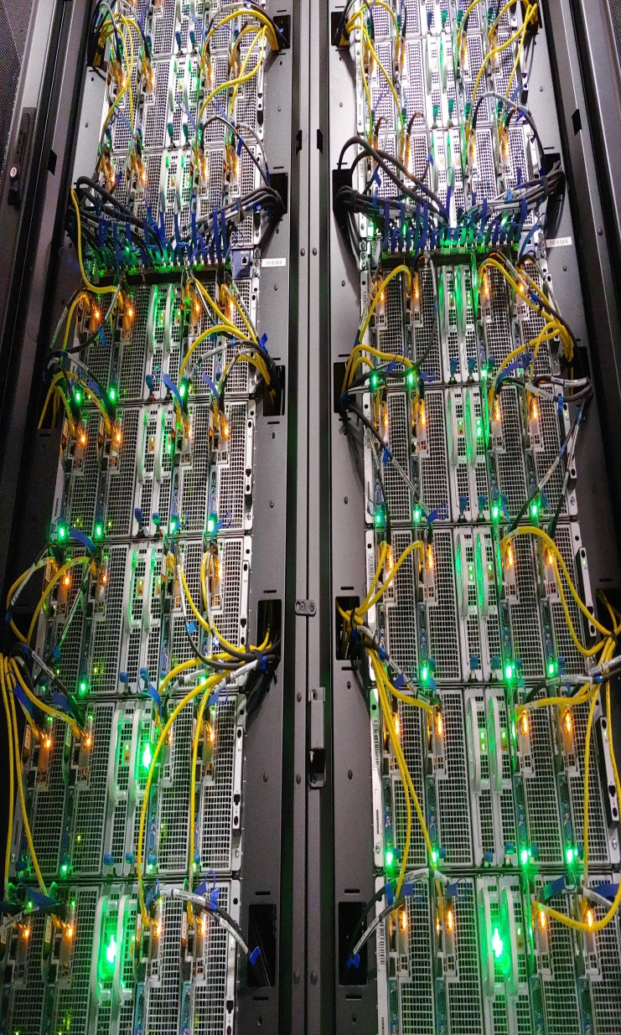

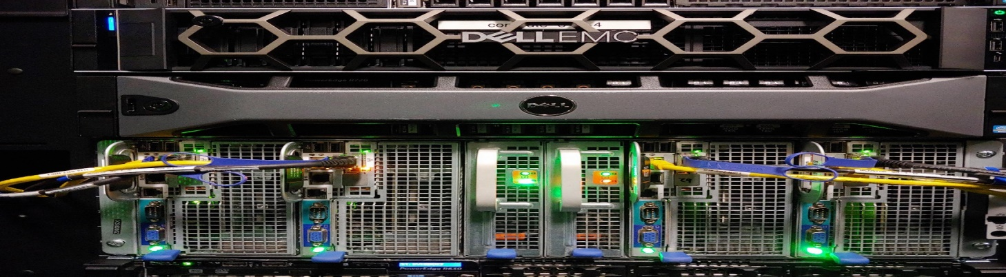
The Structure of a Cluster Supercomputer
Dr. Jerry Perez
Virtual Residency
06/28/2022

Slide 2
Introduction
What is a Supercomputer?
An Example
Why?

Slide 3
HPC Challenges
Simulation
Parallelism
Cluster Components

Slide 4
Design, a brief discussion
Deployment
Performance
New Technologies: do you Quantum compute?
XSEDE
ACCESS

Slide 5
Cyber Infrastructure Research Computing (CIRC) at the University of Texas at Dallas:
Established in 2015
Serves campus with the following clusters:
Ganymede – University and PI Funded general use compute cluster.
Europa – NSF Funded research cluster
Titan – GPU cluster

Slide 6
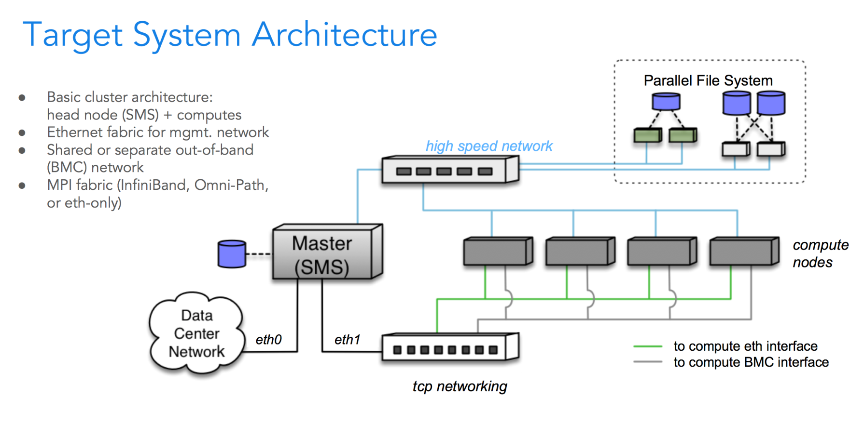
Deploying an openHPC cluster with Ansible

Slide 7
Ansible Roles
These are playbooks designed for specific tasks.
Example: Cluster frontend deployment
Example: Virtual Machine for Electronic Notebook
Example: File storage server
Example: Add users
Example: Make changes to deployments: adding/removing services

Slide 8
Cyber Infrastructure Research Computing (CIRC) at the University of Texas at Dallas:
Research examples running on CIRC clusters:
Geophysics
Molecular Dynamics
Spatial Simulations
Big Data Analysis

Slide 9
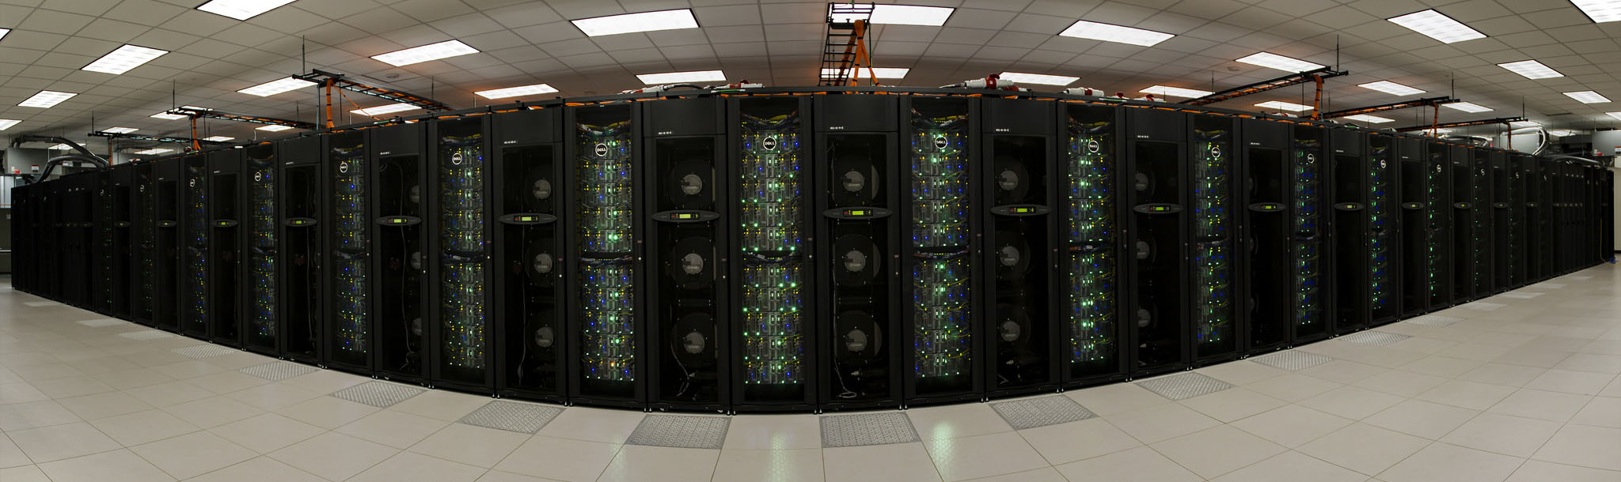
What is a supercomputer?
A computer with very high-level computational capacities compared to general purpose computers such as a personal desktop, laptop, or cell phone.

Slide 10
Example: Ganymede
Ganymede, named after Jupiter’s largest satellite, is a Cyberinfrastructure Research Computing (CIRC) cluster built on the condo model.
While Ganymede does have free-to-use queues available to all UT Dallas researchers, a majority of the computational power is provided by nodes purchased for exclusive group access.

Slide 11
Example: Ganymede General Queue
Queue Name | Number of nodes | Cores (CPU Architecture) | Memory | Time Limit ([d-]hh:mm:ss)
Debug | 2 | 16 (Intel Sandy Bridge) | 32 GB | 2:00:00
Normal | 110 | 16 (Intel Sandy Bridge) | 32 GB | 4-00:00:00
Smallmem | 26 | 8 (Intel Nehalem) | 24 GB | 4-00:00:00
96n | 8 | 8 (Intel Nehalem) | 96 GB | 4-00:00:00
128s | 8 | 16 (Intel Sandy Bridge) | 128 GB | 4-00:00:00
256h | 1 | 16 ( Intel Haswell) | 256 GB | 4-00:00:00
The above resources only account for a fraction of the compute capacity of Ganymede. All nodes cluster-wide considered, Ganymede has nearly 7300 CPU cores and 36 TB of RAM.

Slide 12
But Why?
To resolve tomorrow’s problems, which can’t be studied using today’s infrastructure, by using computer simulations.
Cluster HPC helps bypassing the limitations of Moore’s law.
Increase the research outcomes by an order of magnitude by manipulating excessive data points and machine learning.
Solve expensive and dangerous problems in simulations.

Slide 13
HPC Challenges
Staffing: need broad experience in IT and Research
Costs: creating a supercomputer is expensive!
Equipment, power, space, and cooling

Slide 14
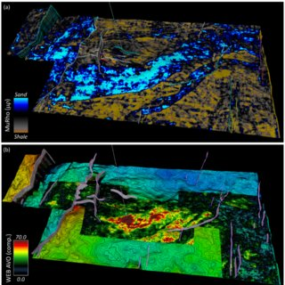
Computer Simulation
A computer simulation is a program that attempts to reproduce an abstract model of a particular system in the virtual space before building it in reality. (Seismic simulation, Prof. David Lumley, 2022).

Slide 15
Parallelism
Performing computations in parallel by carrying out many calculations simultaneously. Utilizing thousands of general-purpose computers all working together to solve the same problem at the same time. This, in fact, is an excellent case for how modern supercomputers work.

Slide 16
Parallelism
Multithreading vs. Multiprocessing
Shared Memory Parallelism is concerned with threads.
Distributed Parallelism is concerned with processes.

Slide 17
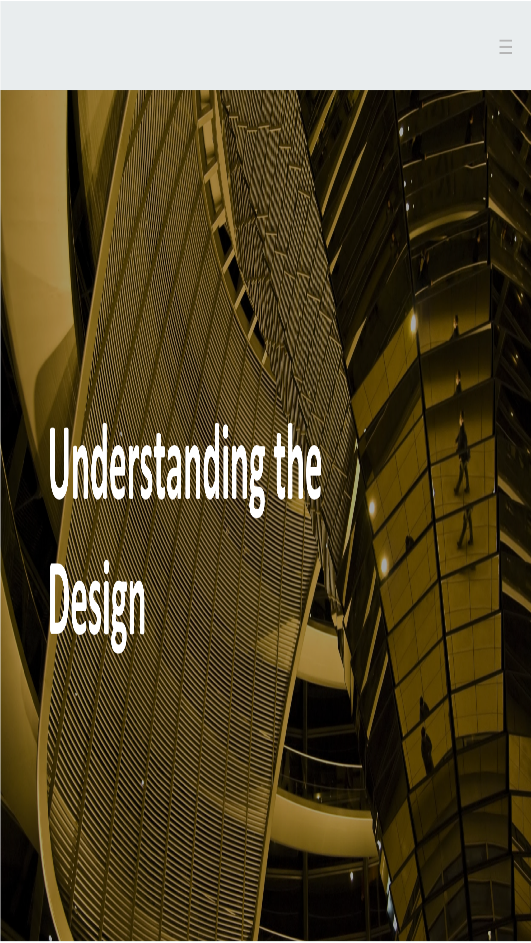

Slide 18

Cluster Components

Slide 19
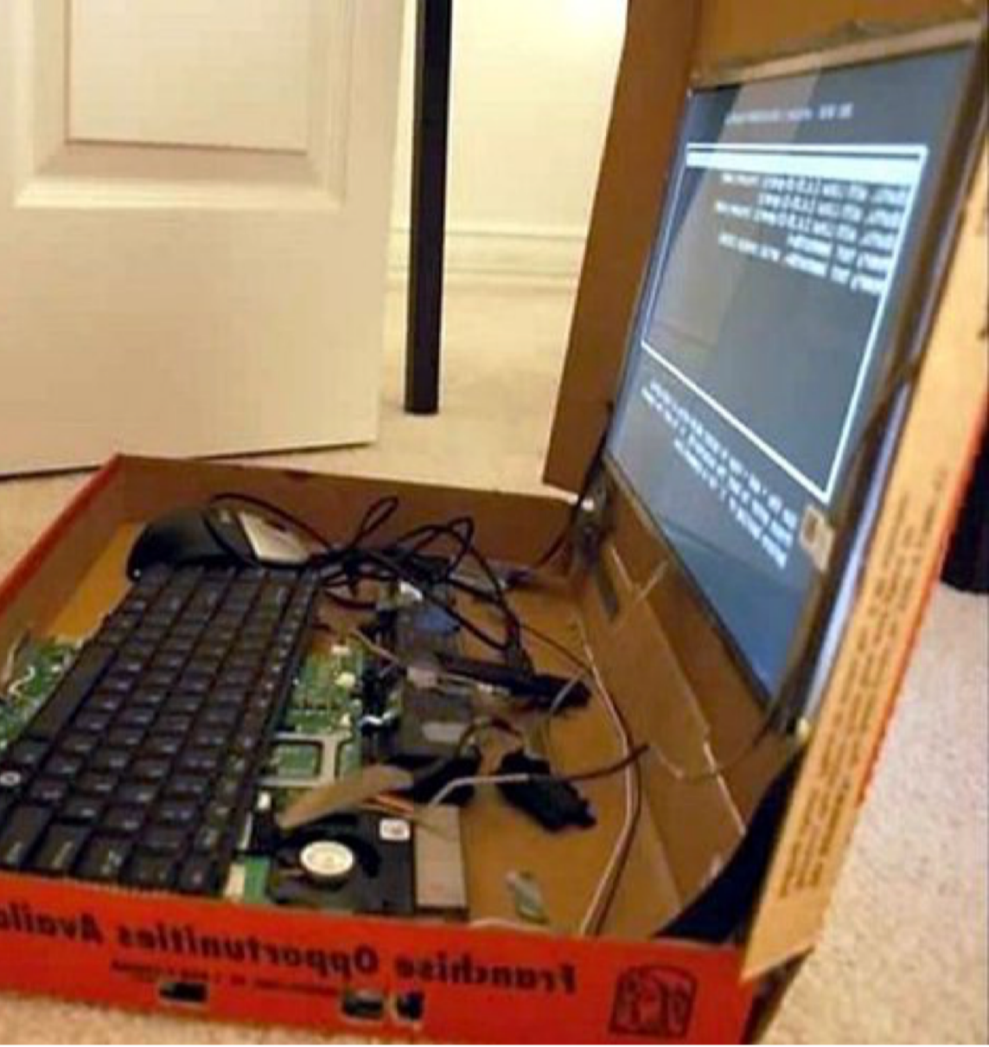
Compute
CPU
GPU
Memory
Interconnects
Diskful (stateful)
Diskless (stateless)

Slide 20
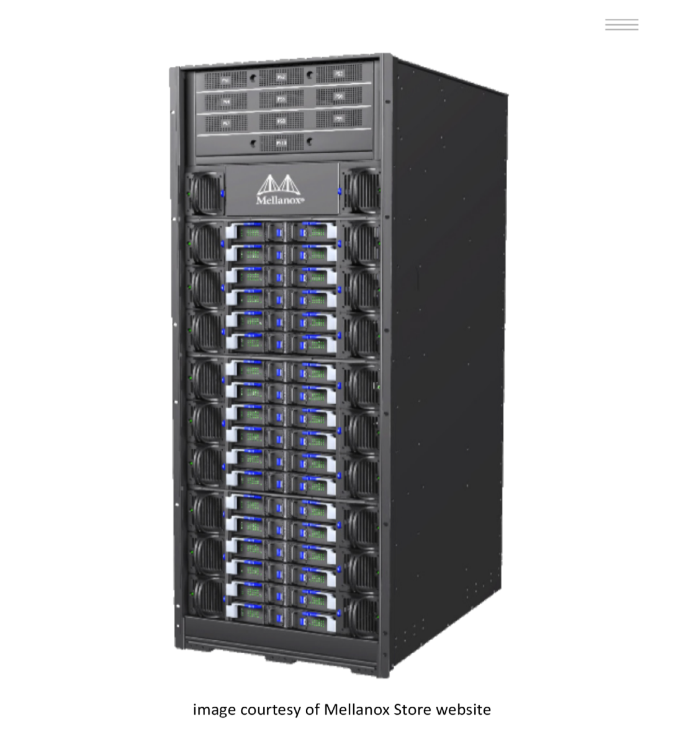
Network Interconnects
Main factors:
  Latency
  Bandwidth
Types
Infiniband
  Low Latency (~1.5 µsec through ~<.6 µsec )
  Cluster interconnect (400G, 100G, 56G, 40G)
Ethernet
  Low Latency (~12 through ~ 1.5 µsec)
  Data management (1G, 10G, 100G)
  Communication (10G, 400G)

Slide 21
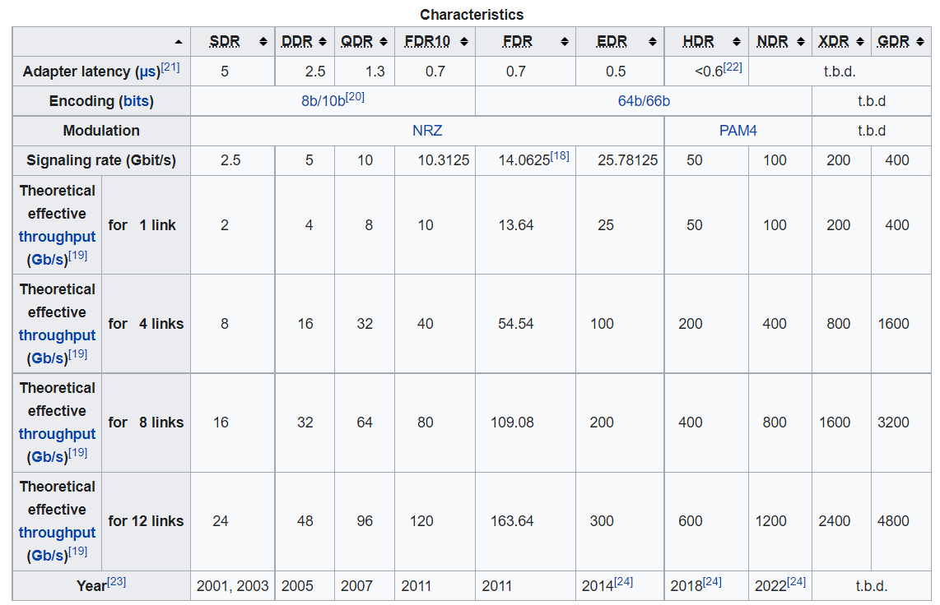
Infiniband Network Improves
Current defined InfiniBand Data Rates include the following: The evolution of InfiniBand can be easily tracked by its data rates as demonstrated in the table above. A typical server or storage interconnect uses 4x links or 4 lanes per port. However, clusters and supercomputers can leverage 12x link bandwidth interconnects for even greater performance.

Slide 22
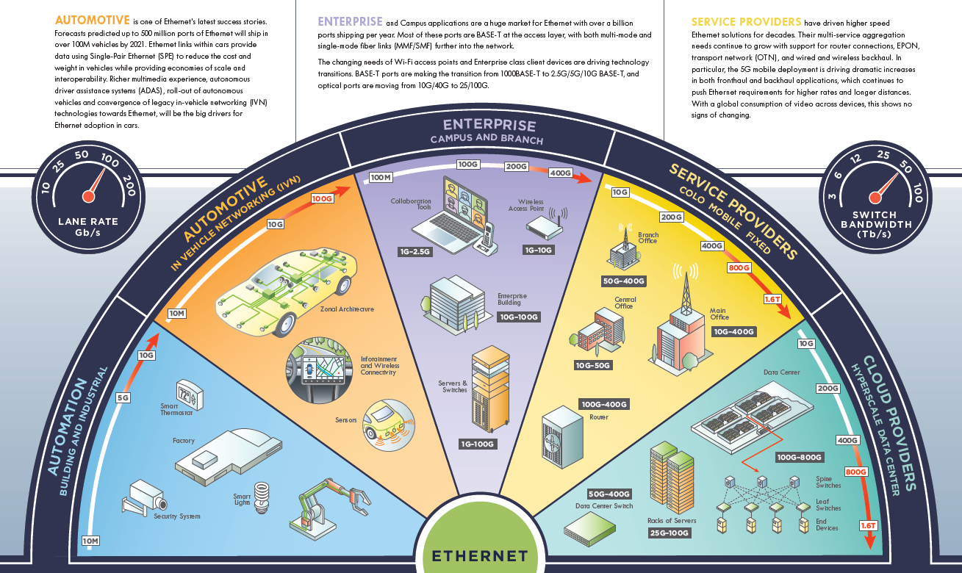
Ethernet Network improves

Slide 23

Storage
Storage Usage
  Home directories
  Scratch space
  Project space
Storage Types:
  Traditional file systems (Spinning disk)
  Parallel file systems (Hybrid Flash/Spin)
  Flash Parallel file systems (Pure Flash)

Slide 24
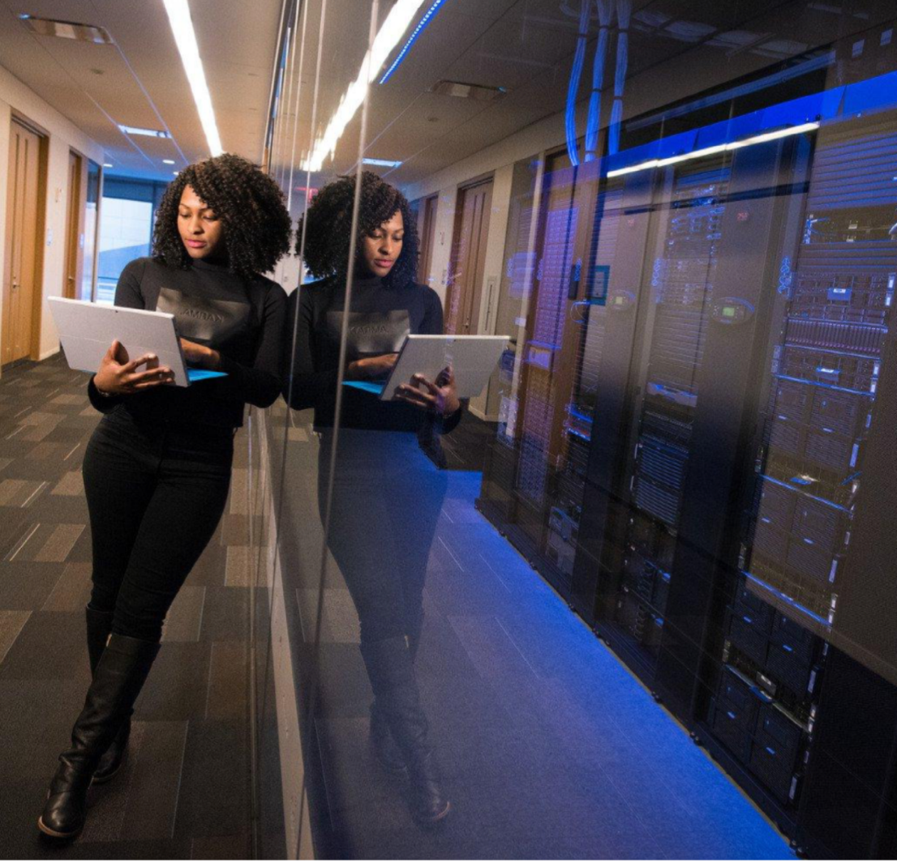
Resource Manager/Scheduler
Resource Manager oversees the
available resources of the cluster.
Scheduler determines what runs
where.
Examples:
Slurm, Torque, Moab, PBS, LSF

Slide 25
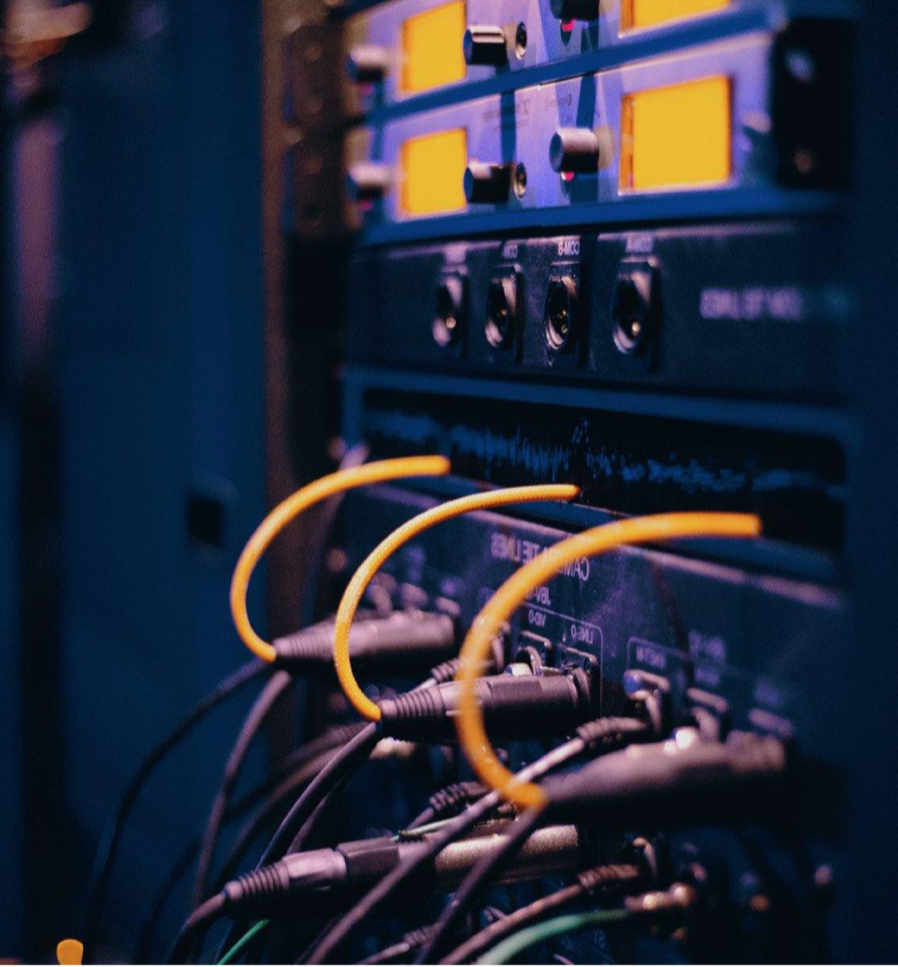
HPC Software
General usage
Field dependant

Slide 26
Other HPC Components
Benchmarks: LINPACK Benchmarks, are we running at peak efficiency?
Security and logs: helping users and sys admins understand CI behavior.
Monitoring utilities: tenable, Linux Defender
Backup systems: is our data safe?
Cooling systems: balance between amount of CI and ability to keep it cool.
Backup power
Licensing

Slide 27
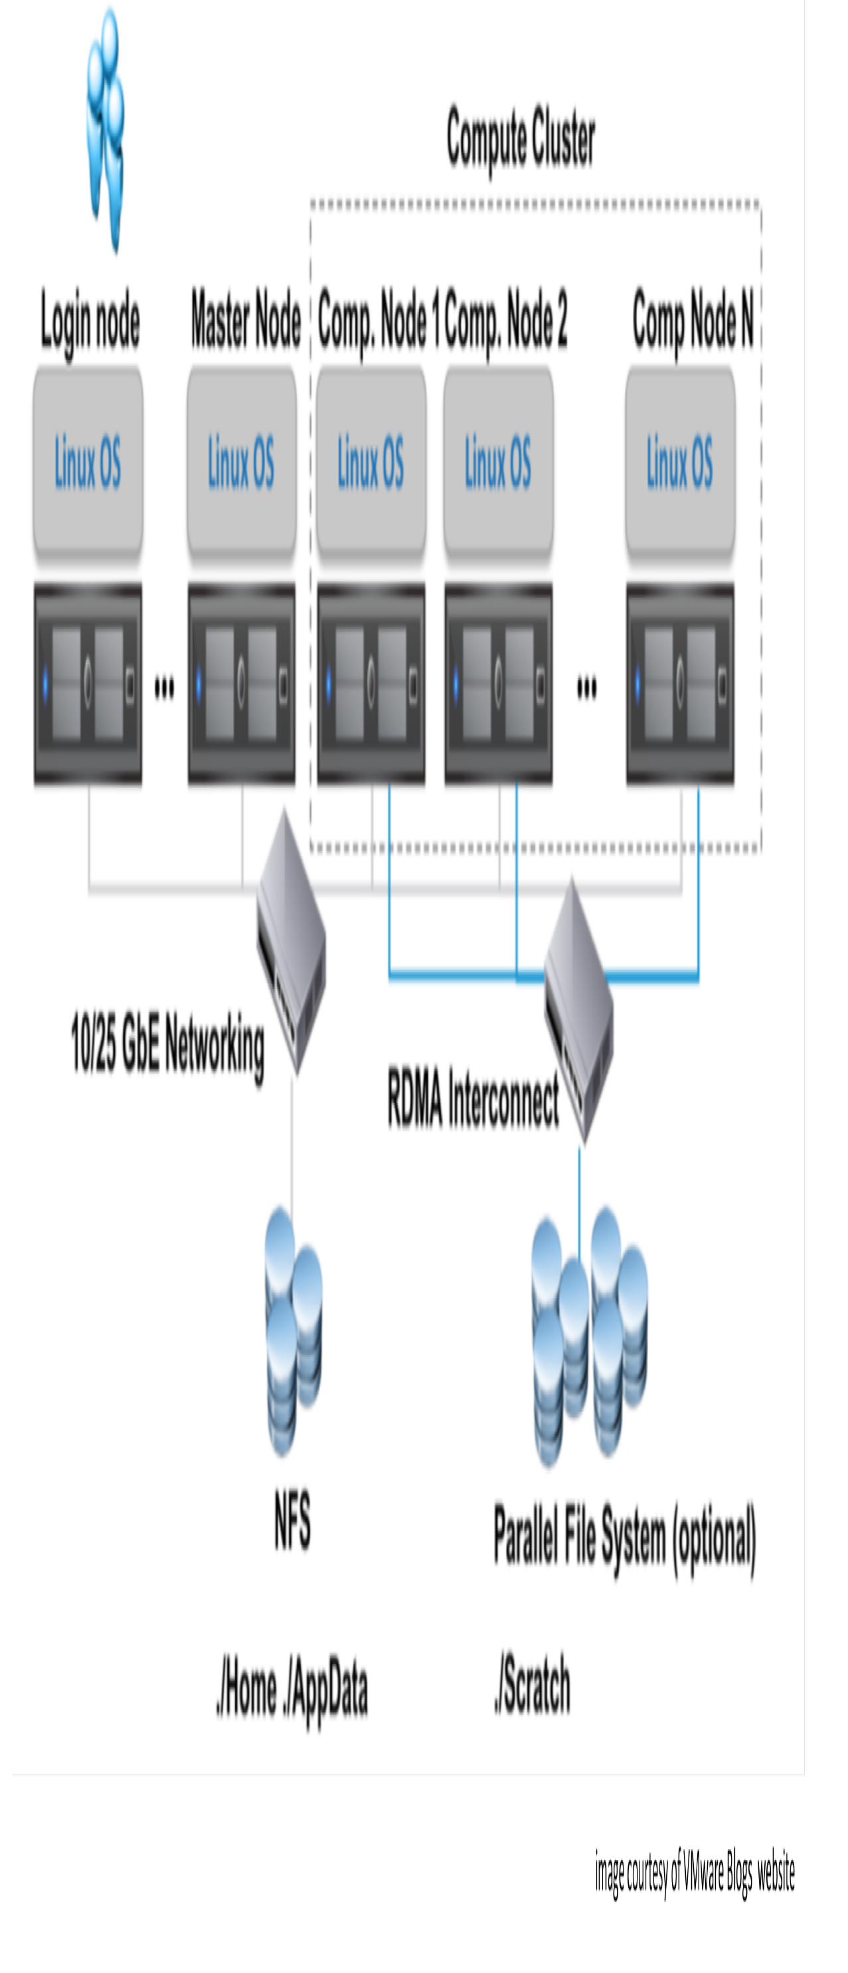
Traditional HPC Cluster – OpenHPC – Open source

Slide 28
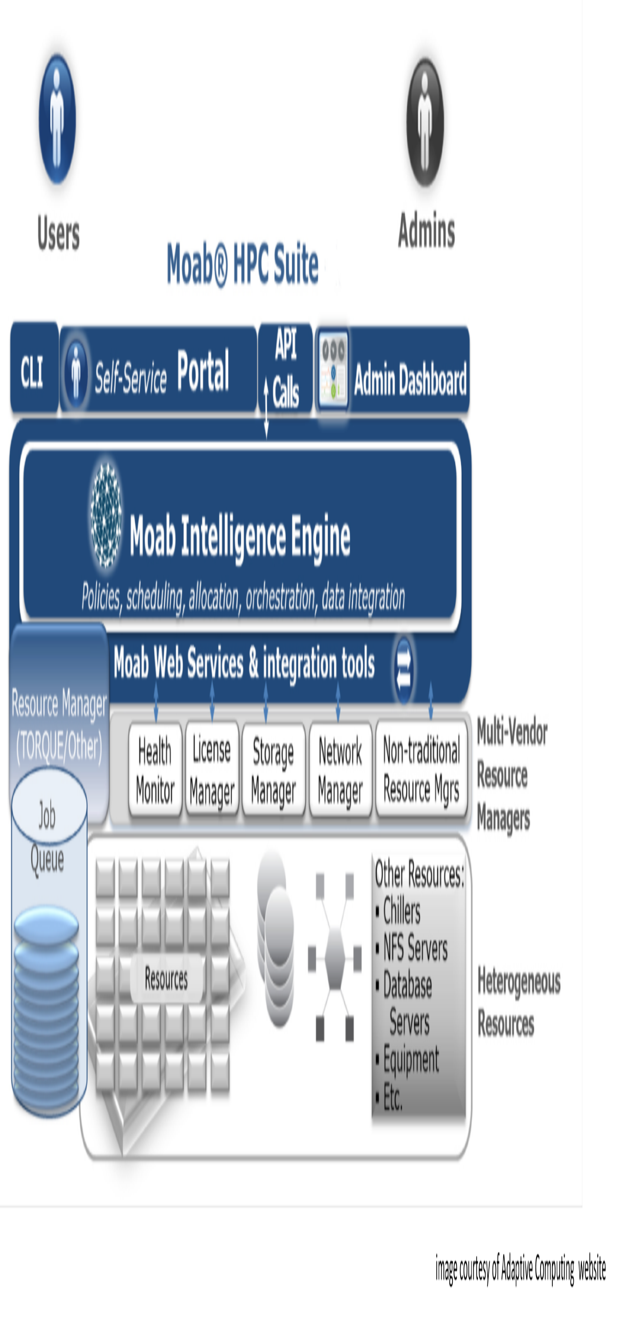
Moab HPC Cluster – Commercial (Make vs. Buy)

Slide 29
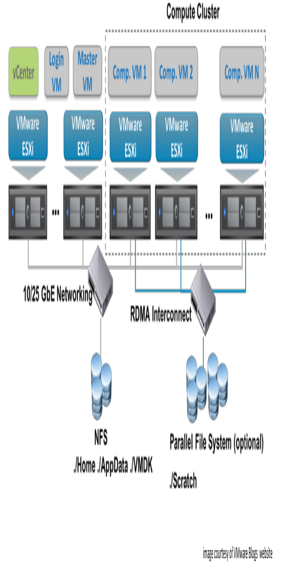
Virtualized HPC Cluster – Open and Commercial Cloud

Slide 30
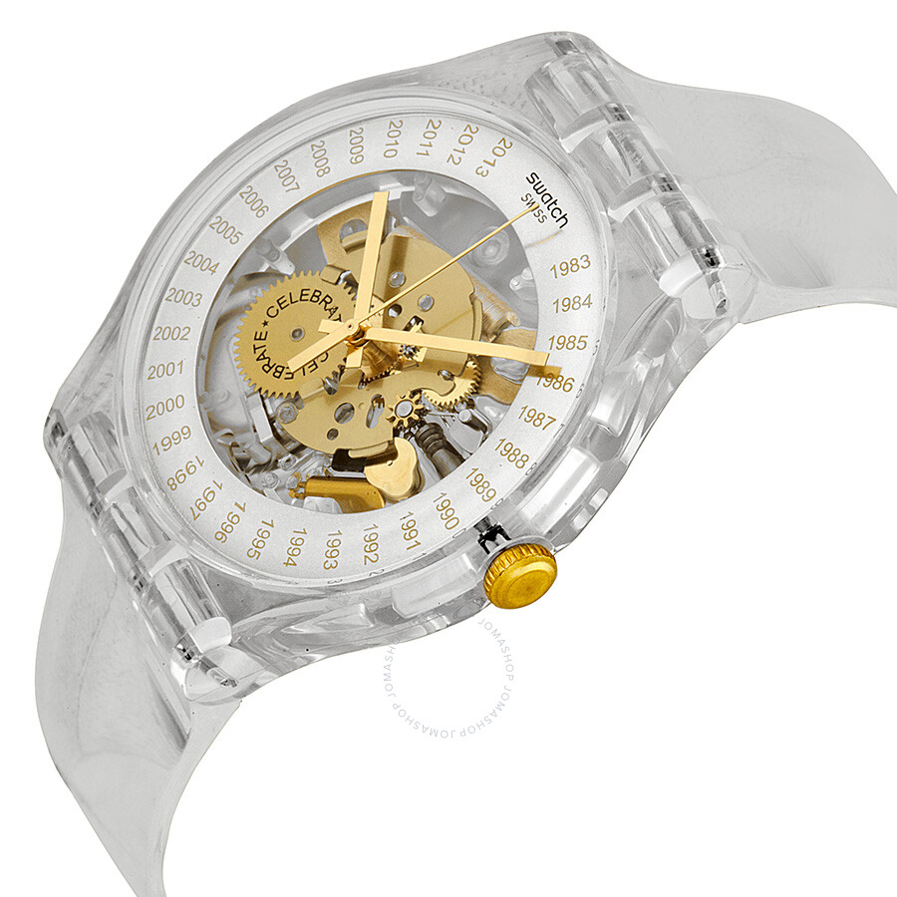
How long is a trillion seconds?
1,000 seconds ago was equal to
almost 17 minutes.
It would take almost 12 days for a
million seconds to elapse and
31.7 years for a billion seconds.
Therefore, a trillion seconds
would amount to no less
than 31,709.8 years.
HPC provides this amount of compute
time and more with each technology breakthrough.

Slide 31
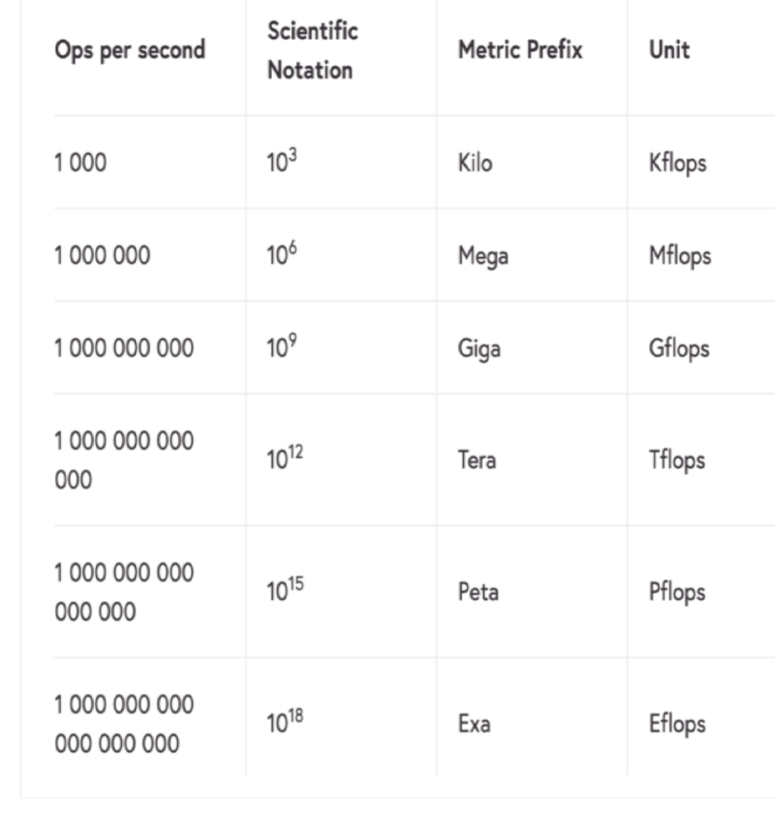
Computers store numbers in floating-point format,
so they are called floating-point numbers.
A single instruction like addition or multiplication
is called an operation.
HPC speed is measured in terms of floating-point operations
per second or Flops/s (Flops).
Rmax – Maximal LINPACK performance achieved.
Rpeak – Theoretical peak performance.

Slide 32

Performance
CPU clock frequency in GHz
Clock speed in cycles per second (Hertz)
# of floating-point operations per cycle
Example:
2.6 GHz processor
2.6 billion cycles per second
16 floating-point operations per cycle
16x 2.6 billion = 41.6 billion Flops
41.6 GFlops

Slide 33

Top 500 History Peak Speed (Rmax)

Slide 34
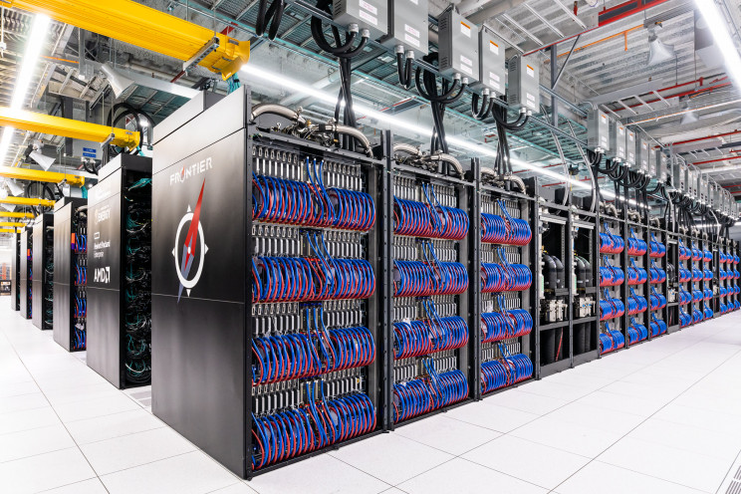
Exaflop supercomputer in the USA
Frontier
Oakridge National Lab
Focus on materials and energy
Identify new materials, new power sources
New power storage devices
Health area, including a lot of research in drug discovery and treatment
efficacy.
Protein docking and other things that are important for drug discovery
on the system, but it's really a broad array of application areas.
24 different scientific applications ready to use the system on day one,
and those span a really wide array of different science domains.

Slide 35
HPC in the Cloud
Pros
Cost – Xsede Jetstream
Easy to build
Cloud bursting
Huge business Investments
Cons
Cost – Commercial solutions
Compliance
Vendor Specific
Harder to track on the institutional level

Slide 36
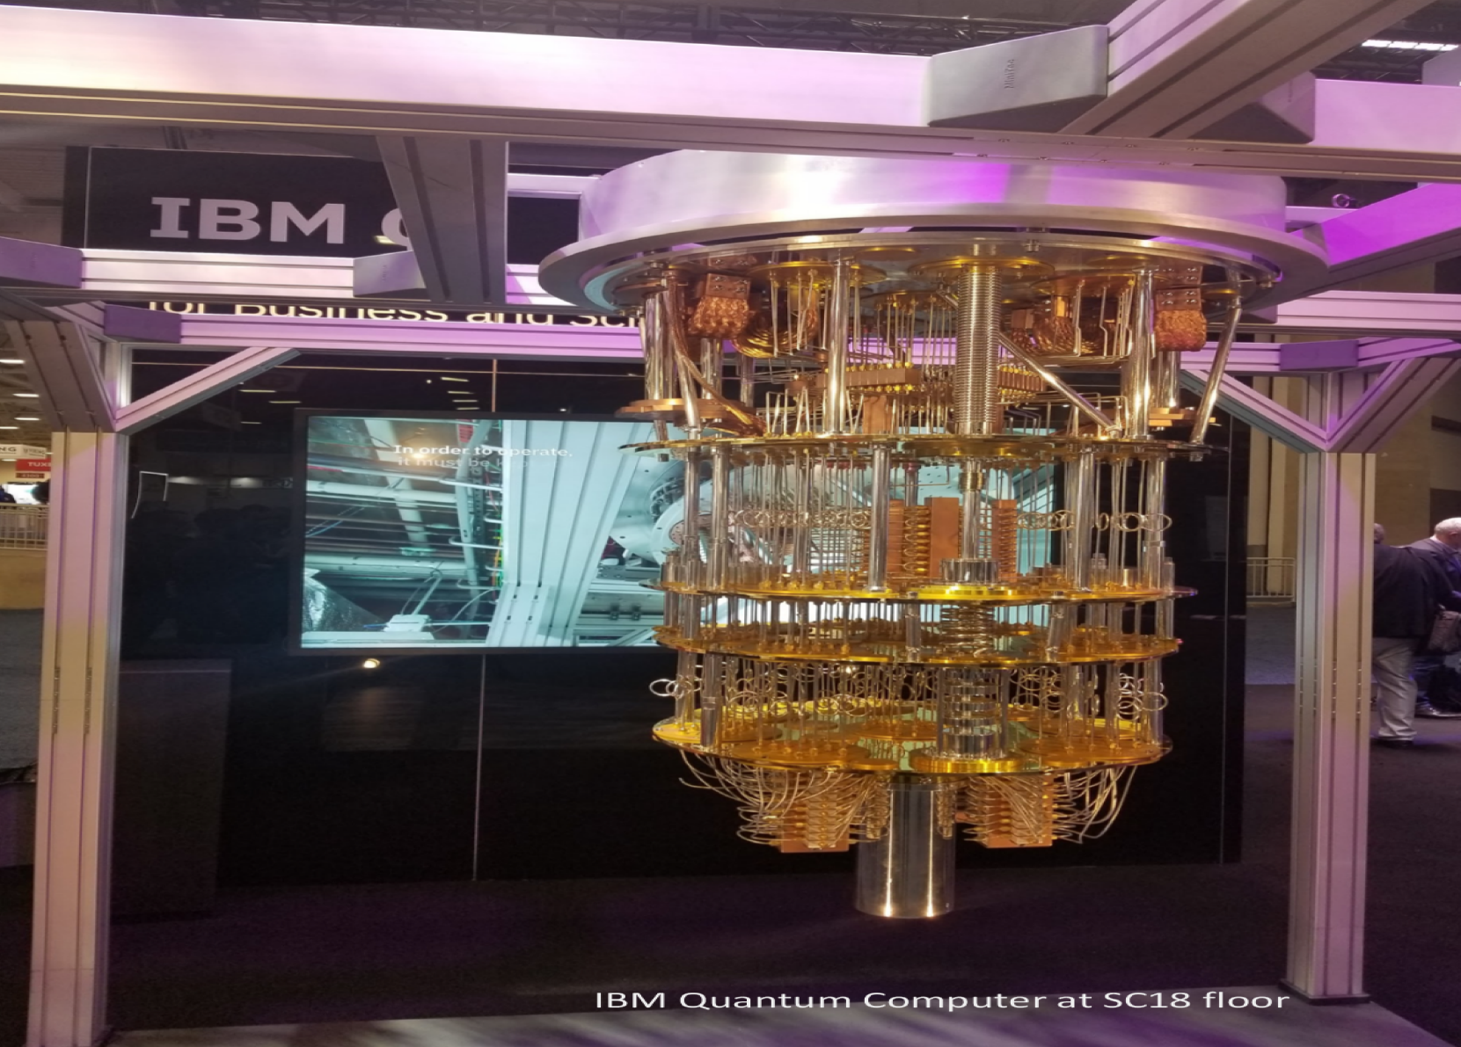
Quantum Computers
Transistors are already at the atom
Size, what is next?
The use of quantum-mechanical
phenomena such as superposition and
entanglement to perform computations.
Qubits vs Bianary bits
1 or 0 quantum state
1 and 0 super position states
Using quantum algorithm to solve specific complex
Problems beyond the capabilities of a classical HPC

Slide 37
Quantum Computing and HPC
Introduction to Qiskit use on HPC CI.
When using Qiskit a user workflow nominally consists of following four high-level steps:
Build: Design a quantum circuit(s) that represents the problem you are considering using a UI such as the CLI or Jupyter notebook. Run on a VDI node such as X2Go or VMware.
Compile: Compile circuits for a specific quantum service, e.g. a quantum system or classical simulator.
Run: Run the compiled circuits on the specified quantum service(s). These services can be cloud-based or local cluster.
Analyze: Compute summary statistics and visualize the results of the experiments.
If all is good, then submit to a real quantum computer to run pure quantum production!
Interested? Install it now! https://qiskit.org/ It is free!

Slide 38
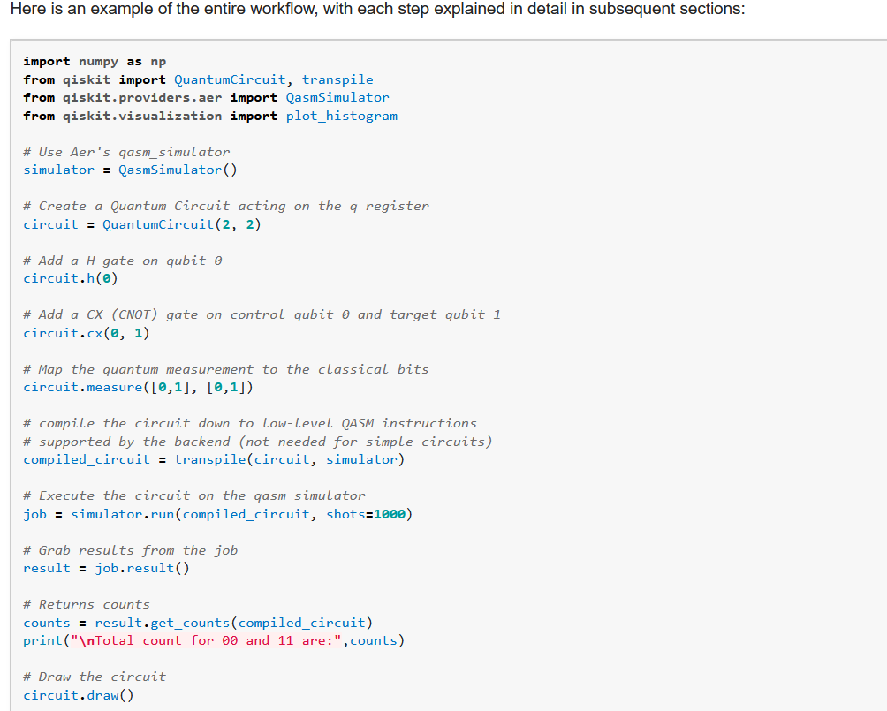
Quantum Computing and HPC

Slide 39
XSEDE HPC Systems
01 Stampede 2 – TACC
02 Comet – SDSC
03 Bridges – PSC
04 Jetstream – Indiana U
05 Open Science Grid – OSG
06 Ranch – UT Austin

Slide 40
Follow-on to XSEDE program to be instituted September 1, 2022.
The National Science Foundation has awarded $52 million over five years to five lead institutions and their sub-awardees to facilitate its Advanced Cyberinfrastructure Coordination Ecosystem Services and Support, or ACCESS program. The award period is from May 1, 2022, through April 30, 2027; however, XSEDE will still be active through this August.

Slide 41
The ACCESS program 2022
The ACCESS program decentralizes its various services, democratizing and further broadening access to NSF's cyberinfrastructure ecosystem. Its service tracks and awardees are:
Track 1 – The RAMPS Allocations team led by Shawn Brown, Pittsburgh Supercomputing Center. The Allocation Services track comprises three defined activities: Allocation Services; Innovative Pilots; and a Service Model.
Track 2 – The MATCH User Services team, led by Shelley Knuth, University of Colorado Boulder. The End User Support Services track comprises four defined activities: General User Assistance; Allocation and Utilization Assistance; End User Training; and a Computational Science Support Network.
Track 3 – The CONECT Operations and Integration Services team, led by Amy Schuele, National Center for Supercomputing Applications. The Operations and Integration Services track comprises three defined activities: Operational Support; Data and Networking Support; and Cybersecurity Support.
Track 4 – The MMS Monitor & Measurement Services team, led by Tom Furlani, State University of New York at Buffalo. The Monitoring & Measurement Services track comprises three elements: Monitoring & Measurement Operations; Service Model; and Data Analytics Framework.
ACCESS Coordination Office – The OpenCI team, led by John Towns, NCSA. The ACO will provide coordination and support services and staffing for top-level coordination and communications among the ACCESS awardees and with the public, including support for top-level inter-awardee governance, coordination of an external advisory board to the ACCESS awardees, maintenance of the top-level landing page of the ACCESS website, and coordinated community-building activities. The ACO itself will not engage in overall governance or management responsibilities for ACCESS but awardees will enable other ACCESS awardees to accomplish those activities through provision of staffing and services.

Slide 42
Thank you!
Q & A:
How do you compute?
Are you planning any new deployments?
Are you exploring new technologies?
What are your users asking for the most?

Slide 43
References
(2021) David Lumley. Central-difference time-lapse 4D seismic full-waveform inversion. GEOPHYSICS(2021),86(2):R161.
(2022) UTD CIRC Documentation. https://docs.circ.utdallas.edu/user-guide/index.html
(2019) Hussein Al-Azzawi. Structure of a Supercomputer. UNM Center for Advanced Computing.
(2022) Frontier Supercomputer. https://spectrum.ieee.org/frontier-exascale-supercomputer
(2022) Qiskit Quantum Computing. https://qiskit.org/
(2022) XSEDE https://www.xsede.org/
(2022) ACCESS https://www.xsede.org/advancetoaccess

