Slide 1
Cyberinfrastructure Landscape: Organizations
Timothy Middelkoop and Dana Brunson
Internet2
2022 OU Virtual Residency Workshop

Slide 2
We are interactive!
https://www.menti.com/v3vxtrpnwn
We ask you questions.
You ask us questions!
https://www.menti.com/v3vxtrpnwn

Slide 3
Warm up interactive:
What’s your favorite breakfast food?
Notes:
Click QR Code for Menti Results

Slide 4
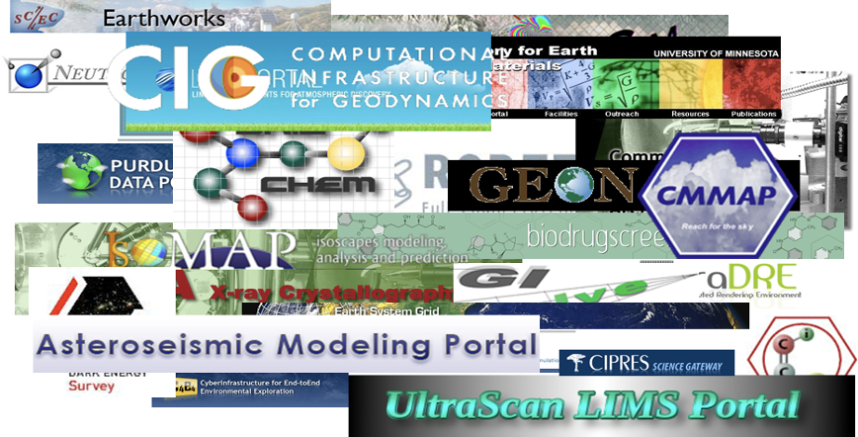
CI Landscape - Complicated, Diverse, and Rapidly Changing
Notes:
Just like Breakfast, there are many options when it comes to CI orgs.
More than anyone can keep up with individually and still tackle your day-to-day duties.
But TOGETHER - through communities - we can have people we can ask and assist (recall Jacob covered systems and service providers on Tuesday)

Slide 5
Poll: Communities you interact/participate in the most?

Slide 6
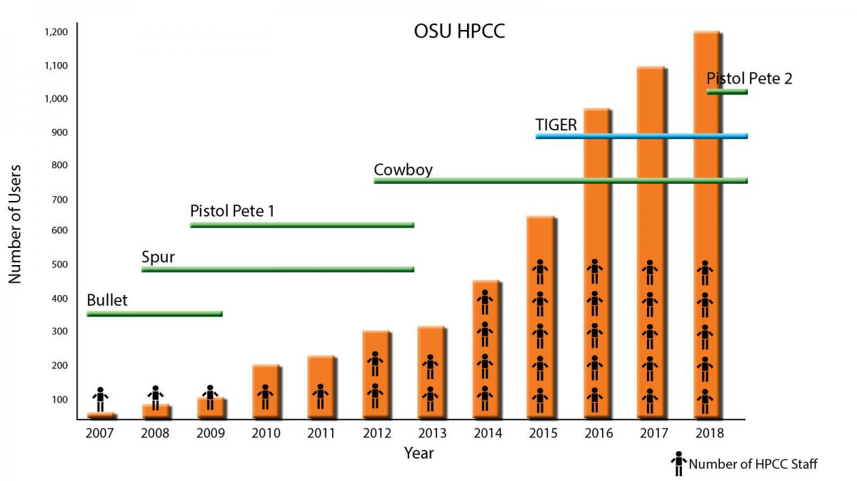
Case Study: How Dana learned to love communities
Notes:
One person shop, new!, zero hits.
GPN - met librarians..

Slide 7
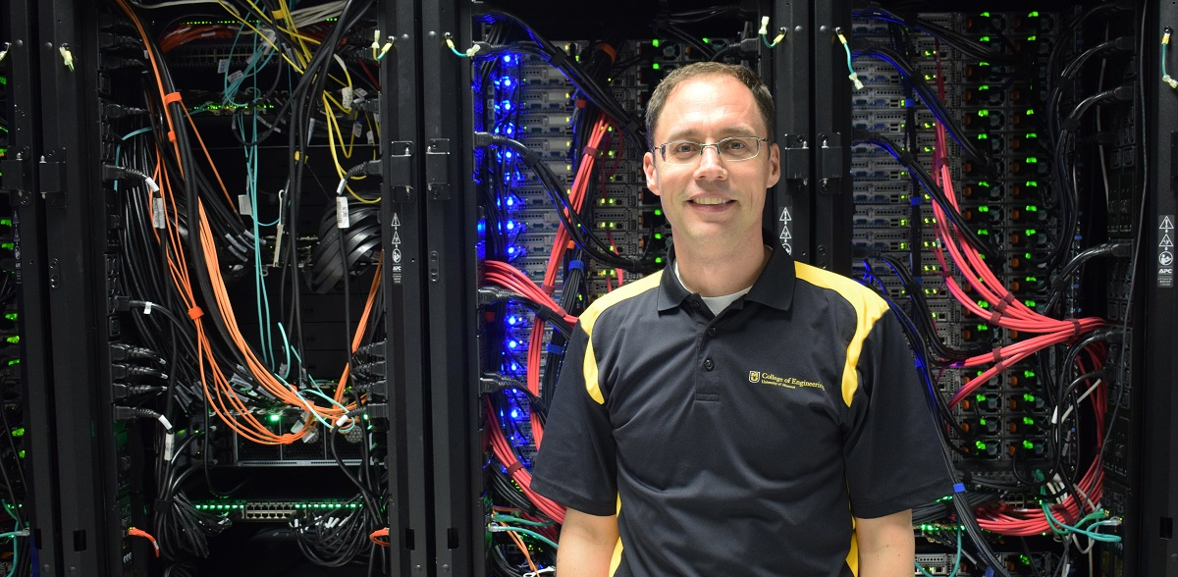
Case Study: Tim
https://munewsarchives.missouri.edu/news-releases/2019/0912-national-science-foundation-1-4-million-grant-will-help-develop-cyberinfrastructure-across-midwest/attachment/middelkoop-timothy-2/index.html
Notes:
Dual hire, Director at MU opening - Hey I could do this - first “Real” job.
Panic did not set in … Ignorance is bliss
Are you going to the GPN conference? w/ Library
Lots of communities (IE, Engineering) Why am I here
By the end of the conference, I found my peeps - I can do this! A network of people!
Still excited at every conference!
Wanted to give back - lead me to Internet2

Slide 8
Poll: Where are you in your CI Journey

Slide 9
Poll: How many CI/RCD people in your organization?
Notes:
Remove this if too many polls!

Slide 10
Starter Pack of Organizations
XSEDE Campus Champions
Campus Research Computing Consortium (CaRCC) People Network
PEARC

Slide 11
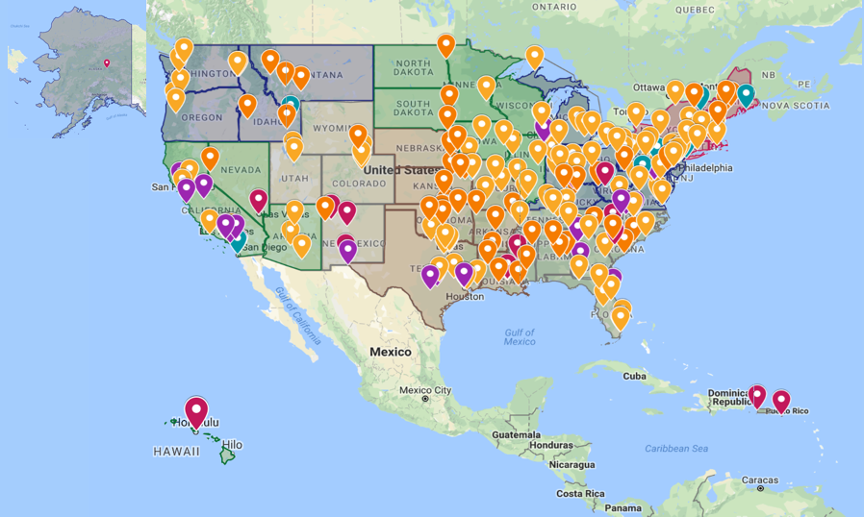
Since 2008, a national community of practice, facilitating computing/data-
intensive research and education
Every US state
Every EPSCoR jurisdiction
We help researchers do their research using cyberinfrastructure

Slide 12
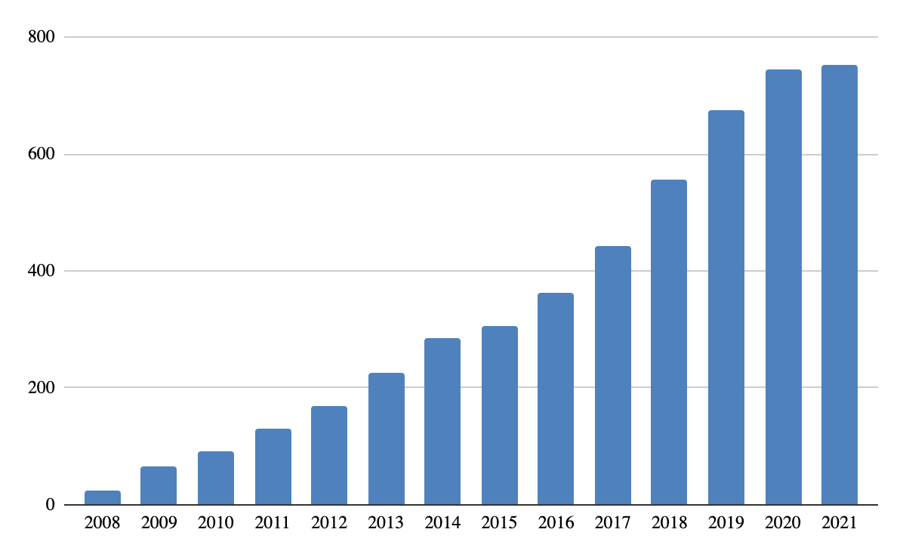
Growth of Champions

Slide 13
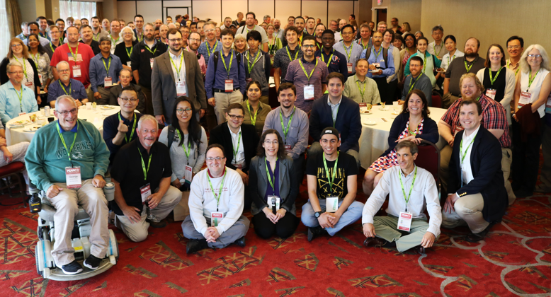
The Campus Champions Program fosters a dynamic, welcoming environment for a diverse community of research computing and data professionals sharing knowledge and experience in digital research infrastructure
There are over 750 Campus Champions
Including CI organization leaders, faculty, researchers, students, as well as research-enabling and systems professionals
At over 350 academic, non-academic, and not-for-profit research-focused institutions

Slide 14
2018 Champion Climate study key findings highlights
Champions reported high Overall Experience in the program. Newer members expressed exceptionally high satisfaction and accounted for more than half of the respondents.
The Champion community’s impact extends beyond individual knowledge and skills improvement to institutionalization of the Champion role, changes in institutional research computing policy, and inclusion of Champions in strategic talent recruitment for their organizations.
Some Champions are considering sustainability following XSEDE. They would also like to see the program continue to expand beyond advocating for NSF systems to other agencies.
Respondents from non-research-intensive organizations and members of marginalized groups including women and underrepresented racial/ethnic groups in HPC, report positive experiences in the organization.

Slide 15
Main Components of the Campus Champions Program
All Campus Champions Call (3rd Tuesday of the month 3:00 ET) generally sessions from national programs for presentations, questions, and discussion.
Campus Champions Chat (2nd Tuesday of the month 3:00pm ET) general discussion about current issues and new Campus Champions introductions.
CC-ALL: A trusted and safe mailing list for open discussion about all things research computing and data; job postings.
Campus Champions Slack: A way to connect with peers during and after events.

Slide 16
How to Become a Champion
Write to info@campuschampions.org and ask to get involved
We'll send you a template letter of collaboration
Ask questions, add signatures, send it back, and join the community
More info: https://www.xsede.org/community-engagement/campus-champions
Stay tuned for evolution of Campus Champions Program with end of XSEDE this fall.

Slide 17
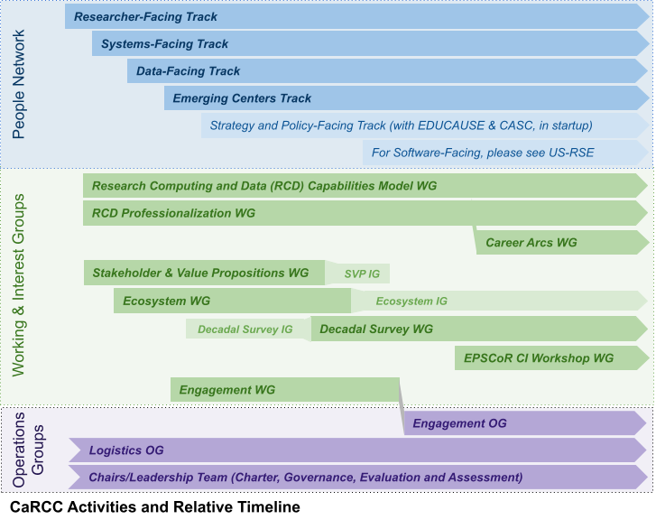
CaRCC: Campus Research Computing Consortium
We advance the frontiers of research by improving:
the effectiveness of professionals in RCD positions
their career development & visibility, and
their ability to deliver services & resources for researchers. Please join us!
People Network - Year-round remote conference, with call recordings posted on our CaRCC YouTube Channel
Data-Facing: Data management, publishing/sharing, data science, data viz, workflows, transfer and networks, & other topics.
Emerging Centers: Community for organizations developing or growing RC&D programs or centers
Researcher-Facing: Consulting/facilitation, outreach, education/training, increasing communications & collaborations, RC tech, etc
Systems-Facing: Systems planning, engineering, security, optimization, middleware, virtualization, and cloud, among other topics.
Working and Interest Groups - Activities that connect RCD professionals & organizations to increase knowledge sharing & enable research innovation
Professionalization and Career Arcs: Workforce Survey, RCD Job Elements & Career Frameworks
Capabilities Model for Research Computing and Data: Capabilities Model Introduction, Guide, and Assessment Tool; 2020 Community Dataset; and Regular Office Hours
Engagement: Increase visibility & participation in CaRCC, esp. with underserved & underrepresented persons and organizations
RCD Nexus: Resource & Career Center to provide products, tools, services, & community to build/sustain successful RCD operations
EPSCoR CI Workshop: Plan to host a workshop to reduce the CI capabilities knowledge gap across EPSCoR jurisdictions, and address a recent “Call to Action” to increase CI access across EPSCoR
Decadal Survey: Develop a decadal survey for RCD to distribute to the broader community to potentially guide joint efforts
Notes:
Form to join https://goo.gl/forms/OSjvPZVVCTJgmlkh1

Slide 18
RCD/CI Professional Roles: The facings
Researcher-facing: Outreach, education, training, consulting, facilitation, advanced user support, etc. (e.g., CI Facilitator)
Systems-facing: Systems planning, engineering, security, optimization, middleware, virtualization, and cloud, among other topics. (e.g., sysadmin, network engineer)
Data-facing: Data creation; data discovery and collection; data analysis and visualization; research data curation, storage, backup, preservation, and transfer; and research data policy compliance. (e.g., Research Data Librarian)
Software-facing: Software package management, research software development, research software optimization or troubleshooting, workflow engineering, securing access to software, etc. (e.g., Research Software Engineer)
Strategy and Policy facing: Institutional alignment, culture for research support, funding, and partnerships and engagement with external communities. (e.g., HPC Center Director)
Notes:
The Five Facings -
These are the facings
The model recognizes different roles that staff and faculty fill in supporting Research Computing and Data, with names that reflect who or what each role is facing (i.e., focused on).
is important to note that these are roles and not persons, and many CI professionals act in more than one of these roles. In a small organization, one or two individuals may cover these different roles, and while a large center may have a team associated with each facing, the work of some team members may still span more than one facing.
The five facings are:
Researcher-facing – Research IT suer support, research computing facilitator, CI engineer
Systems-facing – hpc systems engineer, storage engineer, network engineer
Data-facing - Research Data Management specialist, Data Librarian, Data Scientist.
Software-facing – RSE – who are making great strides!
Strategy- and policy facing – Resarch IT leadership
We admit that this is a start – and has room for improvement... For example – how do we make cleat that security cuts across all of the facinegs? But increasingly we see a need for specific specific role to focus on security for research.
Fun fact – in the 2018 Champion survey about 75% of the Campus Champions reported that they researcher-facing role. .{next slide). So what is this researcher-facing role/CI facilitator? First is that they need to need to work well with researchers and second...
Next slide.
This model was taken up in a December 2018 “Maturity Model” development workshop, where the names evolved and expanded somewhat. In the course of discussions in the community, what had been a combined software and data facing was split into two separate concepts, yielding the current model that is being adopted by a number of working groups (e.g., RCD Professionalization, and the Research Computing and Data Capabilities Model) and other activities (e.g., the People Network).
Nicholas Berente, James Howison, Joel Cutcher-Gershenfeld, John L. King, Stephen R. Barley, John Towns, 2017. Professionalization in Cyberinfrastructure (February 15, 2017). Available at SSRN: https://ssrn.com/abstract=3138592 or http://dx.doi.org/10.2139/ssrn.3138592
^{[2]} “CI Engineers” have different roles at different institutions, and some might (also) be in the Systems Facing roles.

Slide 19
= Inclusive Community
CaRCC's People Network
An ongoing "remote conference" to share/leverage expertise in various facings (Tracks)
Data-Facing:
Analysis, curation, preservation, compliance, movement
Emerging-Centers:
Newer or emerging RCD service leaders & programs
Researcher-Facing:
Consulting, bridging, facilitation,
outreach, training
Systems-Facing:
Hardware, networks,
security, compliance, data centers
Software-Facing:
Develop or contribute to research software, scripts, workflows
Strategy/Policy-Facing:
Institutional alignment, culture, funding, policy, community
Co-Coordinators: Lauren Michael, UW-Madison
Bob Freeman, Harvard Business School
Notes:
Not Dana -> Bob or Lauren (total 4 minutes for People Network)
The People Network aims to foster, build and grow an inclusive community (termed the “People Network”) for campus CI professionals who support research computing and data resources and the researchers who use them. The Network includes synchronous and asynchronous opportunities to leverage collective and individual expertise, with focused discussion “tracks” reflective of professional activities.

Slide 20
The People Network - Track Details
Each track has its own focus area and coordination
Multiple communication channels: email list, Slack, monthly calls
Monthly call topics decided by/for each track community; some multi-track & all-track topics
Significant progress on shared infrastructure, continuity and leadership opportunities
Data-Facing
Coordinators:
Amy Koshoffer
Deb McCaffrey
Steering Committee:
Recruiting now!
Emerging-Centers
Coordinators:
Rich Knepper
Jane Combs
Steering Committee:
Kirk Anne
Patrick Clemens
Alex Feltus
Preston Smith
Jason Wells
Researcher-Facing
Coordinators:
Justin Booth
Tobin Magle
Steering Committee:
Gladys Karina Andino Bautista
Katia Bulekova
Martin Cuma
Christina Koch
Janna Ore Nugent
Annelie Rugg
Systems-Facing
Coordinators:
Brian Haymore
Betsy Hillery
Steering Committee:
Sai Pinnepalli
Jim Leous
Jason Wells
John Blaas
Position open now!
Software-Facing
Represented by US-RSE
Strategy & Policy-Facing
coming soon with EDUCAUSE & CASC
Notes:
Bob or Lauren

Slide 21
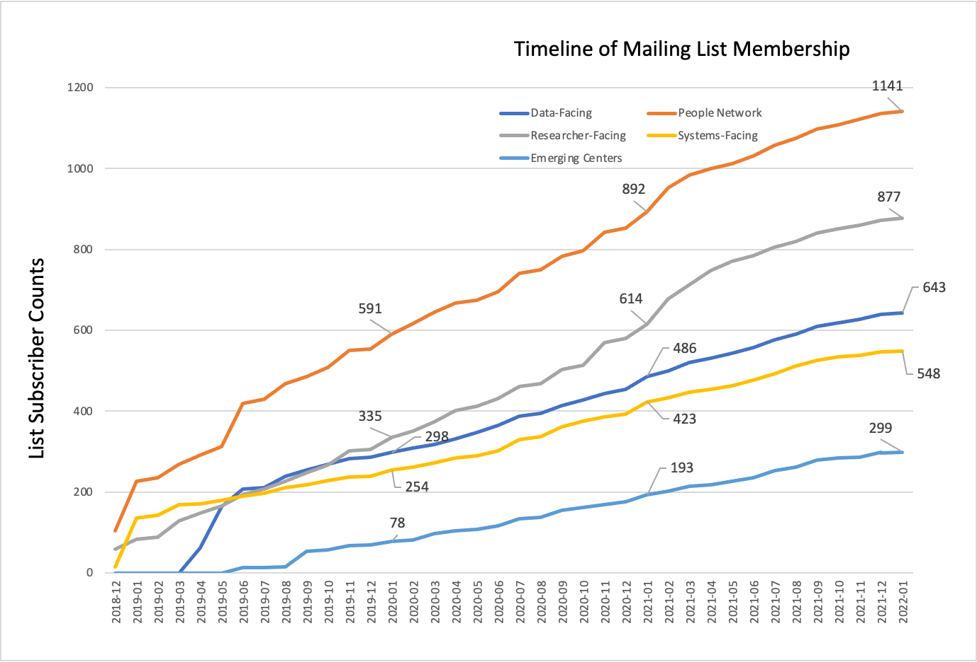
The People Network - Growth and Engagement
Membership growth continues 2-3x
Call attendance > 1500/year
All Tracks now have (or soon will) a Steering Committee!
Notes:
Bob
details to join on website -
gratuitous growth chart.
back to Tom…

Slide 22
The People Network - Highlights
Overall
~25 different people involved with leadership for calls
Joint US-RSE / CaRCC calls (5/12 and 5/26) on RSEs in the workforce
1500+ call attendees in the last year
Increased reach via YouTube:
391 hrs of YouTube videos viewed (2020: 262 hrs; 1.5x increase)
3900 video views & 73 new subscribers
Strategy-Facing: Coming soon!
To join, fill in the google form linked from https://carcc.org/people-network/
Notes:
Bob

Slide 23
Poll: What facing do you spend a lot of time on?

Slide 24
PEARC
PEARC is the de facto annual meeting for the RCD profession.
PEARC is about the people and the profession (all the facings)
PEARC is the publishing venue for RCD – think promotion!
Full papers, short papers, posters, panels, Bird’s of a Feather (BoF’s) ++
A lot of great content, not just a “hallway” conference.
Take advantage of the workshops
Build your professional network (it takes work)
Notes:
Hand off to Tim, stop sharing screen. Send folks to menti
Poll: For those who are getting started: What do you need the most?

Slide 25
Matching People with Organizations
Poll: For those who are getting started: What do you need the most?
Poll: For those who are familiar with the communities: What do these organizations provide (for you)?

Slide 26
Some facing specific groups (add-on packs!):
Software-Facing: US-RSE
Systems-Facing: HPC Syspros
Researcher-Facing: Virtual Residency Program (You are here!)
Data-Facing: RDAP
Strategy and Policy Facing: CASC

Slide 27
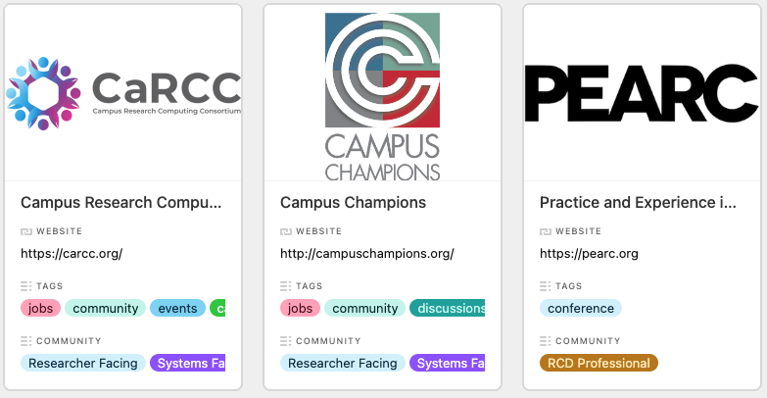
RCD Community Landscape (Demo)
RCD Start Here: https://airtable.com/shra4PuWtzEsfwW1H
RCD Next: https://airtable.com/shreFF2mTAlpiPXpr
RCD Onboard: https://airtable.com/shrkyYqDdEvNOl5OE
Data Table: https://airtable.com/shr369iMAdVrCdjUI

Slide 28
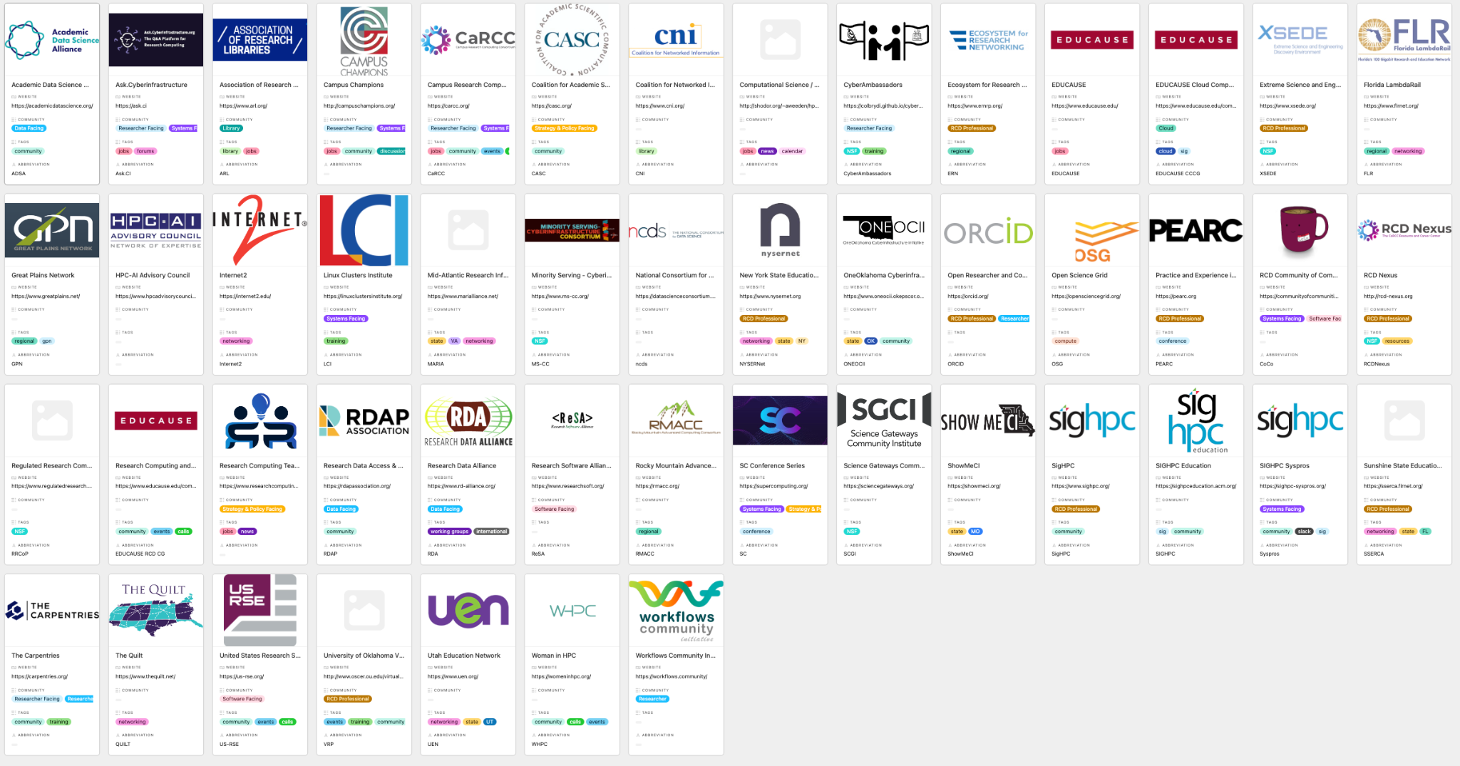
Poll: Wait there is more! What organizations did we miss?
Contribute! https://airtable.com/shrkyYqDdEvNOl5OE

Slide 29
Poll: Where would you start?

Slide 30
Things to consider
Attend PEARC (http://pearc.org) at least once - this is the people conference.
Attend SC (http://supercomputing.org/) at least once - this is the technology conference.
Read about the RCD Facings (https://carcc.org/rcd-professionalization/facings/)
Attend some training. (OU-VRP, CyberAmbassadors)
Join the community by joining various organizations based on your work and interests (facings) (CaRCC People Network, US-RSE)
Find your state and regional network and explore what they have to offer.
Never stop learning.

Slide 31
Optional Topics
What organization would you like to learn more about?
What do you have questions about?
What do you fear the most?
What are you excited about?
Yes, we can talk forever!
Let’s hear your questions first!

Slide 32
Thanks!
Dana Brunson <dbrunson@internet2.edu>
Timothy Middelkoop <tmiddelkoop@internet2.edu>

Slide 34
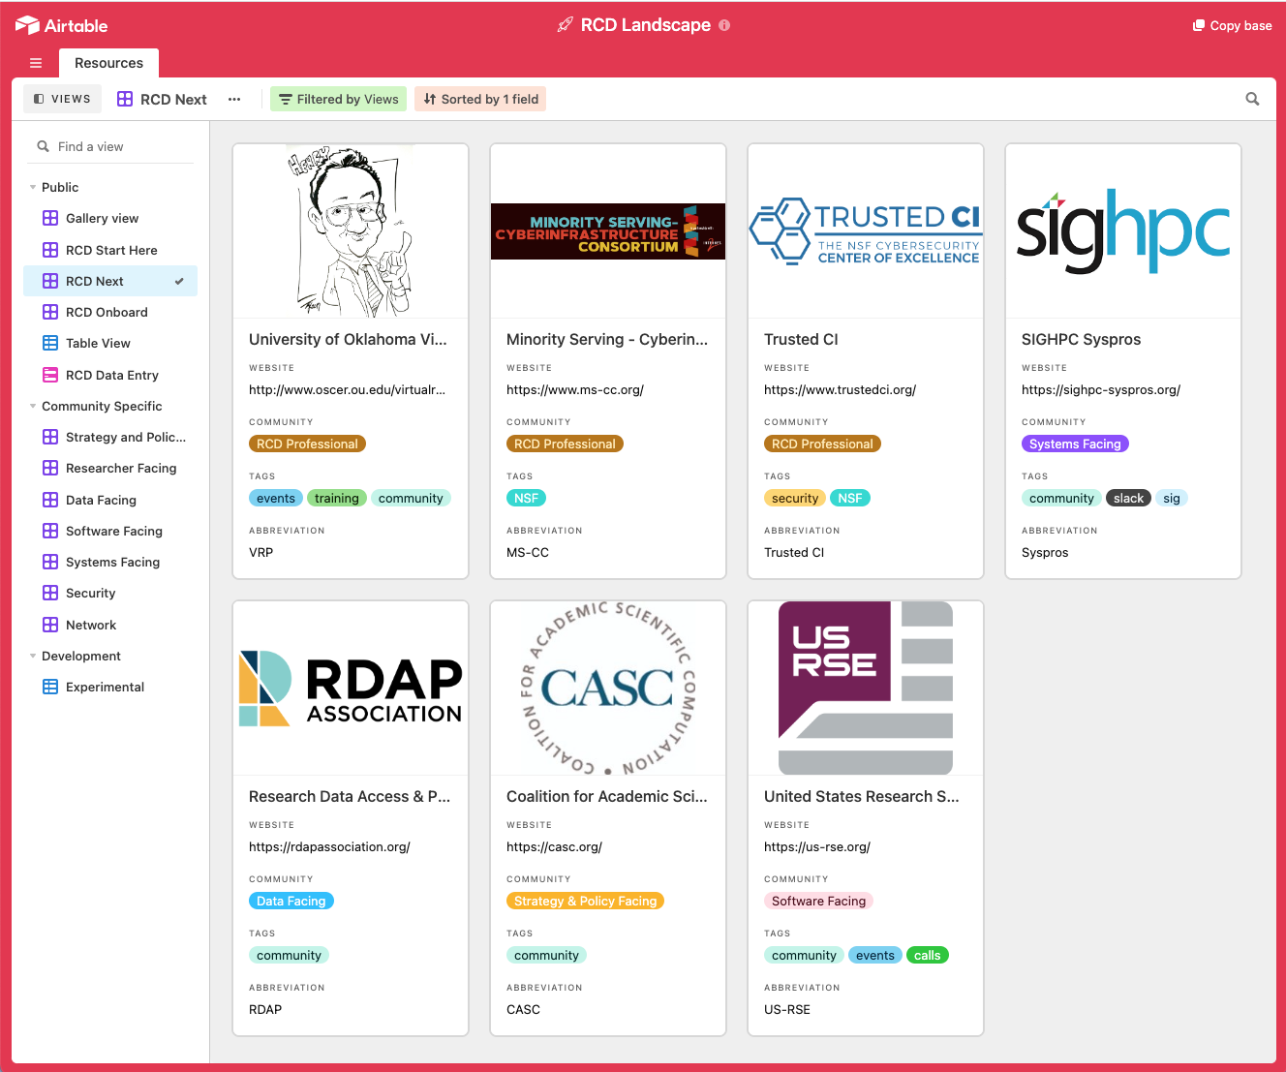

Slide 35
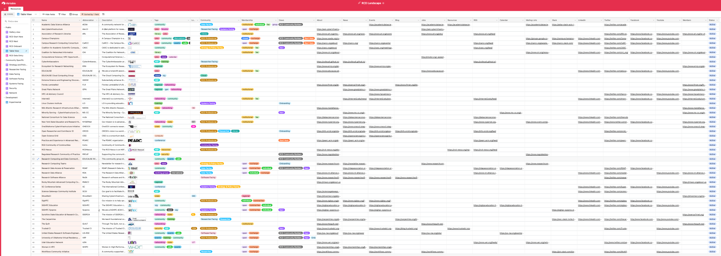

Slide 36
RCD Nexus -
The Research Computing and Data Resource and Career Center
An NSF-supported CI Center of Excellence Pilot
Dana Brunson, PI - Internet2 - Executive Director for Research Engagement
Scott Yockel, co-PI - Harvard - University Research Computing Officer
Claire Mizumoto, co-PI - UC San Diego - Director, Research IT Services Tom Cheathamm co-PI - University of Utah - Professor of Pharmacy & Director of RC/CHPC
Patrick Schmitz, co-PI - Semper Cogito
https://carcc.org/rcd-nexus/
Notes:
NSF award page: https://nsf.gov/awardsearch/showAward?AWD_ID=2100003
We’re delighted to announce NSF funding for a pilot CoE to build upon the work of several CaRCC working groups and advance support for RCD Professionals.
The new Research Computing and Data Resource and Career Center will create tools, practices, and professional development resources to support individuals and institutions. The main areas of emphasis include:
A more robust and sustainable implementation RCD Capabilities Model and a new Community Dataset portal.
Conducting an RCD Professional Staffing survey and sharing the results
Advancing the adoption of the HR Job Family Framework
Curating leading practices for staff professional development, and for involving students in RCD/workforce development
The RCD Resource and Career Center portal will gather these and related tools and resources together to support the community. We will place strong emphasis on helping to bridge the gap for smaller institutions that are struggling to get RCD programs started to support their researchers.
We are also excited to continue the work together with the various organizations that currently support RCD professionals and coordinate our respective work to provide a clear voice advocating for the profession.
Read the full announcement on the Internet2 website.
Read this post on the CaRCC website.

Slide 37
Why an Research Computing and Data RCC?
Researchers struggling to take advantage of ever-evolving RCD technology
No time to become technology experts
Rely heavily on RCD Professionals for tech services, support and facilitation.
Institutions need support and guidance
To boot-strap, grow, and sustain their programs
To make the case to leadership that RCD is critical to research
To recruit, retain, and develop RCD professional staff
RCD Professionals are clamoring for a shared voice
To advocating for the profession
For broader understanding of their roles
For training, mentoring, and professional development resources.

Slide 38
What will the RCD Nexus provide?
RCD Nexus will advance and enable the nation's capacity for computational and data-intensive research
Create tools, practices, and professional development resources:
Enhanced RCD Capabilities Model and Community Dataset Portal
Conduct RCD Workforce Staffing survey
Advance the adoption of HR Job Family Framework
Curate leading practices for Staff Professional Development
Curate leading practices for Involving Students in RCD/Workforce Development
Gather these into an RCD Resource and Career Center
Help bridge the gap for smaller institutions struggling to get RCD programs started to support their researchers.
Notes:
See CaRCC working group pages for more information:
https://carcc.org/rcd-professionalization/
https://carcc.org/rcdcm/

Slide 39
RCD Pulse Survey
Joel Cutcher-Gershenfeld
Research Computing and Data Professionalization Pulse Survey
(supported by XSEDE Campus Champions)
Notes:
https://docs.google.com/presentation/d/16uurCIXXlQYGEUKNlksKdPtIBYfk5Zi1/edit#slide=id.p9

Slide 40
Executive Summary – 11 Indicator Issues (n=204)
Points of Alignment on What to Do
Awareness of career opportunities associated with research data and computing support.
Documenting and supporting aspirational career paths for RCD professionals within higher education.
Points of Alignment on What Not to Do
NOT: Each cyberinfrastructure professional organization or consortia “staying in its lane” and not “stepping on the toes” of others.
NOT: Controlling entry into the profession in ways similar to what medical and legal professional societies do.
Pain Points (Important and Difficult)
Advancing diversity, equity, and inclusion among RCD professionals.
Protecting RCD professionals from burnout on the job.
Communication and coordination among RCD professional organizations and consortia.
Points of Incomplete Alignment
Documenting and supporting aspirational career paths for RCD professionals in the commercial sector.
Advocacy on behalf of the RCD professional community.
Groups of cyberinfrastructure professional organizations or consortia hiring joint staff as shared resources (e.g. subject matter experts, communication professionals, and other shared services).
Low Hanging Fruit (Important and Easy)
Access to a professional network of RCD professionals.

Slide 41
Executive Summary – Priorities and Additional Observations
Top Five Priorities
Educational and professional development opportunities
Access to a network of other RCD professionals for assistance
Advancing diversity, equity and inclusion in the profession
Forming working groups to address priority issues for the profession
Coordination with other professional societies and consortia relevant to research computing and data
”Must Have” Comments
Networking/Communication/Collaboration – 37%
Professionals/Career Development – 27%
Awareness/Advocacy/Recognition of RCD – 14%
Resource Access – 8%
Leadership/Mentorship/Sustainable Funding/Staffing – 8%
Do we need another organization – 2%
Barriers to the “Must Have” Comments
Organization/Culture/Careers – 29%
Time – 20%
People/CI Professionals/IT Community – 17%
Funding/Tech/Resources – 10%
Communications/Common Language – 9%
Travel/Location – 6%
N/A – 10%
Anything Else?
RCD respondents made extensive, heart-felt comments at the end of the survey, with most pointing to a professional association that is inclusive, developmental, and interdisciplinary.

Slide 42
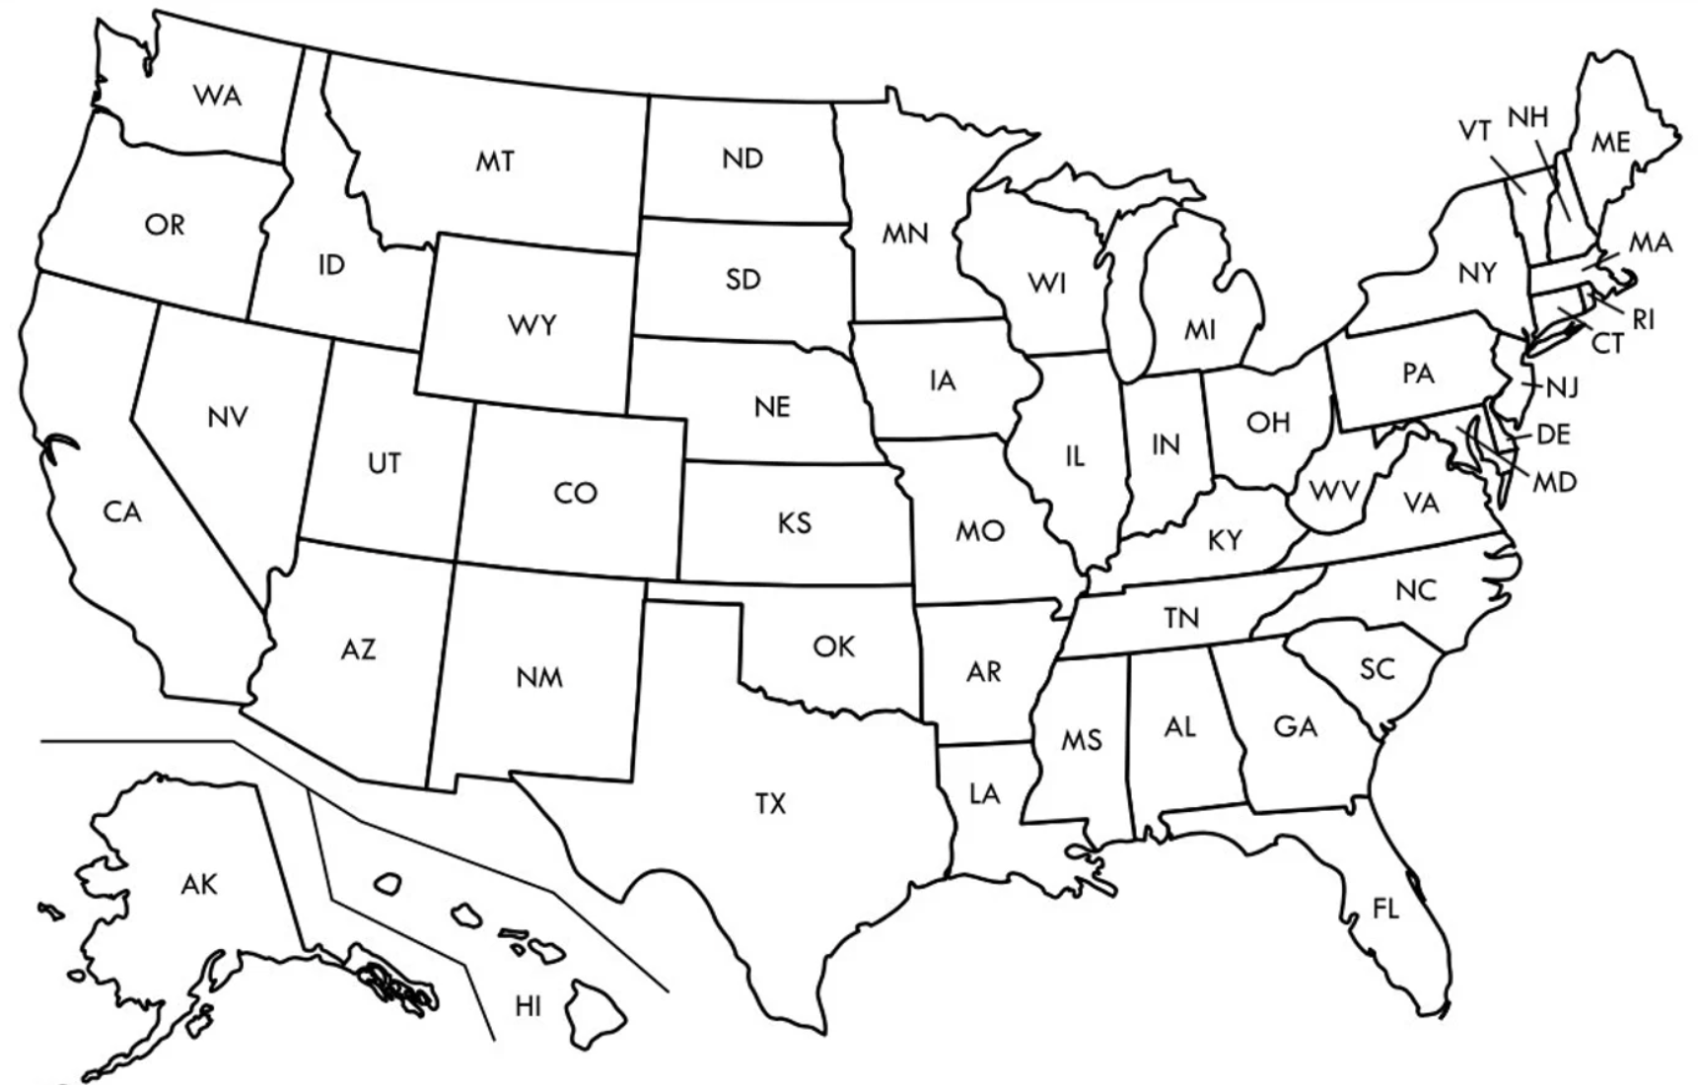
Distribution of Respondents
2
BC
1
Alberta
2
1
Ontario
2
1
-
2
1
1
2
-
5
-
6
15
1
8
1
12
2
5
3
5
2
6
6
1
3
4
9
2
10
4
20
-
11
1
7
3
2
1
1
-
2
-
3
3
13
-
-
3
1

Slide 44
Challenges for the RCD Profession
Individuals do not understand RCD as a career
No formal career path structure
Little awareness of career potential
RCD groups struggle to recruit and retain staff
Where to find people?
How to train and develop them?
How to ensure RCD profession matches broader workforce diversity?
How to compensate and promote them?
Occupational distinction from
IT (i.e. Administrative/Enterprise IT)
Researchers in other disciplines
Notes:
Patrick

Slide 45
HR Job Family Matrix
Notes:
Patrick
Back in 2016-2017 a group of about 30 RC directors and Organizational Sociologists wrestled with the state of the “practice”. Interest around “professionalization” as spurred considerable number of activities. This working group continues to be really active year over year. 2018 workshop Job Elements doc: which after feedback from the last Virtual Residency Program at OU, I realize we might need to revisit some of this content and refresh it and actually publish it. Some of our ideas have matured a bit in 3 years.
2019 Job Family Matrix: Job Family Matrix has been downloaded 137 times. 31% looking to implement, the remaining 69% general interest in reviewing it.
2020 Workforce Survey:
2021 launched the Career Arcs activity,

Slide 46
RCD
Workforce Survey
Survey from June - September 2021
Educational background, individual characteristics, and RCD facing
Level of satisfaction with current position
How included they feel in RCD field
Job responsibilities and compensation
563 valid responses
Early observations:
Differences in feeling of belonging between historically dominant identities and respondents from historically excluded groups.
Large portion of respondents feel their work is valued by those they work with, but relatively few felt their work was valued by their institution.
Overall, survey results support prior qualitative assessments of the challenges to recruit and retain talent, develop career pathways, and grow the profession.
Analysis still in progress on job responsibilities and compensation.
For more, see the paper to appear at PEARC’22: Christina Maimone, Scott Yockel, Timothy Middelkoop, Ashley Stauffer, and Chris Reidy. 2022. Characterizing the US Research Computing and Data (RCD) Workforce.
https://carcc.org/rcd-professionalization/

Slide 47
Elements of a Career Arcs Resource
Narratives of how (and why) existing RCD staff got into these roles
Allow potential staff to see themselves in a story
Help groups/managers understand the diversity of career paths into RCD
Emergent patterns will identify gaps/opportunities, inform strategic planning, etc.
Examples of effective recruitment programs
Targeted at staff: previous roles, training needed for RCD roles
Targeted at students: identifying candidates, making the pitch, effective training
Next steps for existing RCD staff
Paths for advancement: Technical expertise, domain expertise, leadership, etc., etc.
Training requirements, sources/providers
Career paths to and from industry and other non-academic areas
Staff transitions to and from industry
Notes:
Patrick
3 min
stories are unique. without making any assumptions, potential answers include: outreach channels, mentors, special project, etc. In other words, any hint about successful awareness. Was any special degree or training important
How did managers recruit successful RCD staff
d
It is also not all about how to retain staff within academic RCD. It will be helpful to understand the career path to RCD or potentials outside RCD relying on RCD skills

Slide 48
RCD
Career Arcs
Survey from November 2021 - January 2022
General characteristics of RCD professionals and their entry into RCD field
Factors for RCD Career Entry, Advancement, and Satisfaction
Factors for Changing Jobs, and/or leaving RCD for other domains
225 reponses (159 complete)
Early observations:
Top ranking answers to “What advancement Means”: recognition, salary, and influence on organizational strategy.
Top factors motivating job changes: more meaningful contribution, professional development, and joining a more innovative organization.
Women ranked recognition and impact far more important than salary, while men ranked them more equally.
Working group next steps: Additional analysis and interviews
For more, see the paper to appear at PEARC’22: Shafaq Chaudhry, Arman Pazouki, Patrick Schmitz, Elizabett Hillery, and Kerk Kee. 2022. Understanding Factors that Influence Research Computing and Data Careers.
https://carcc.org/career-arcs/

