Slide 1
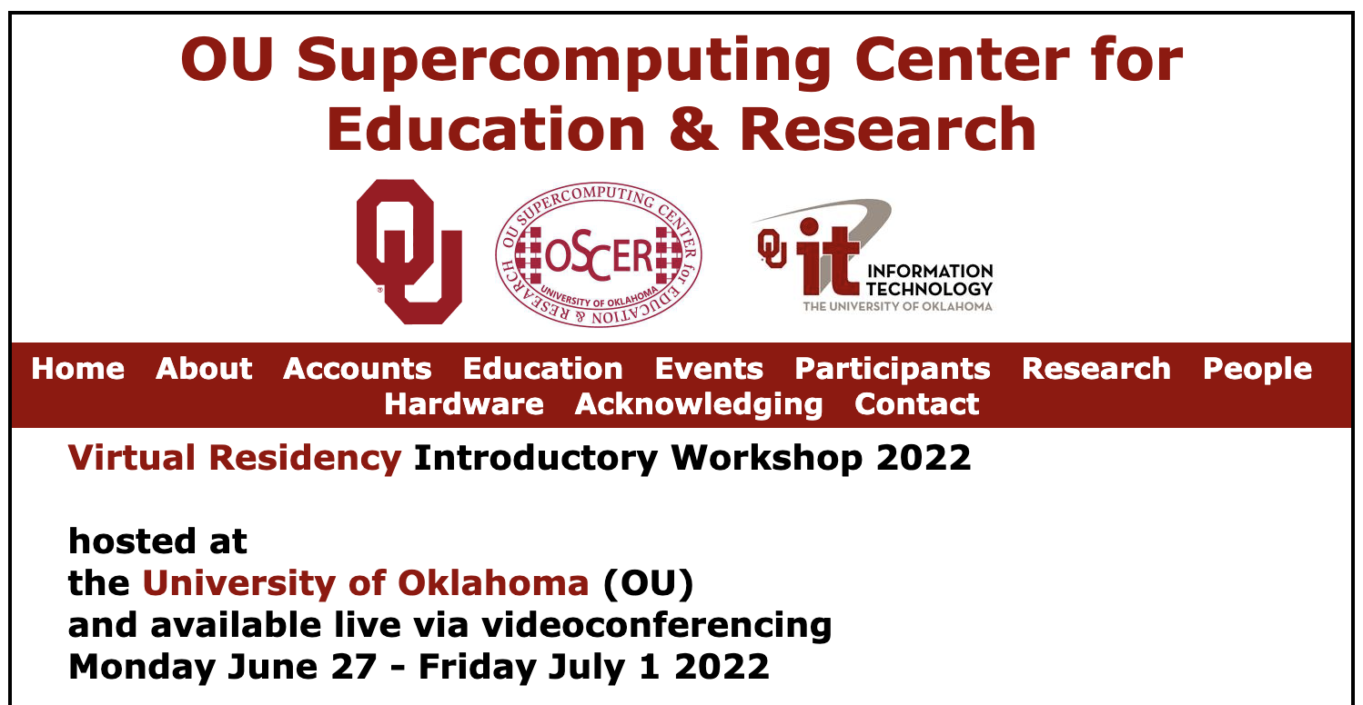
Cyberinfrastructure Organization Leader Perspectives: What Do CI Organizations Need from Their CI Facilitators?
Sandra Gesing
sandra.gesing@nd.edu
http://sandra-gesing.com/
June 30, 2022

Slide 2
Panelists
Our VP of IT and other university leadership continue to prioritize the need for CI facilitators, recognizing they are integral to the success of fulfilling the research cyberinfrastructure needs of institutional research and education.
Kevin Brandt, South Dakota State U
Sarvani Chadalapaka, U California Merced
Curt Hillegas, Princeton U
Himanshu Sharma, U Illinois Chicago
Jason Simms, Lafayette College
Lisa Snyder, U California Los Angeles
We roll research facilitation into a number of other roles – help sessions, programming and workflow support, system administration, research software engineers. We find that the required approach varies broadly from division to division.
The leadership at the University of Illinois at Chicago recognized the importance of CI facilitators and funded multiple new positions to expand capabilities and capacity in this area. As compliance requirements and HPC/AI/Cloud technology continue to evolve, CI facilitators will play a critical role at UIC.
I would say that one mark of success we've had as a result of using a more explicit CI facilitation approach is that we have been able to attract and retain faculty who have research programs that we historically were unable to support effectively.
At UCLA, we have a handful of research facilitators housed in different units across campus. We also have a nascent Research Concierge Program within the Office of Research and Creative Activities designed to onboard new researchers, and within the Office of Advanced Research Computing, we have teams of research consultants

Slide 3
How does your center apportion resources among the diverse needs of your various research constituencies?
What resources should an institution's central research computing facility provide to the institution's researchers?
What should be the balance between research computing facilities on-campus versus remote, for example at national research computing centers? What circumstances govern the need for one or the other?
Does your institution have research data management policies and/or practices? Who is responsible for implementing your institution's policies and/or practices? How have these policies/practices positively impacted researcher needs around research data?
We ask researchers what they may need, but often researchers don't have a clear idea of what HPC is, even if they're actively using it — for example, researchers who run MPI codes but don't really understand how MPI jobs are distributed or the challenges of achieving parallel speedup. What mechanisms does your organization use to create an HPC baseline, beyond the very specific needs associated with successfully launching such jobs?
At your institution, what kinds of researcher-facing roles do you have, and what do these folks do?
What qualities and skills do you look for in a research computing facilitator? Do you prioritize generalized/broad CI skills, or discipline-specific skills? How do you balance the need for technical skills versus the need for professional/interpersonal skills?
What sort of professional development opportunities do your research computing facilitators need, and how do you provide those? What do you prioritize for their professional development?
What is your institution's view of a funding model that addresses the needs of the full spectrum of computing-intensive/data-intensive researchers, not just the biggest consumers, and how well is that spectrum of needs addressed?

Slide 4
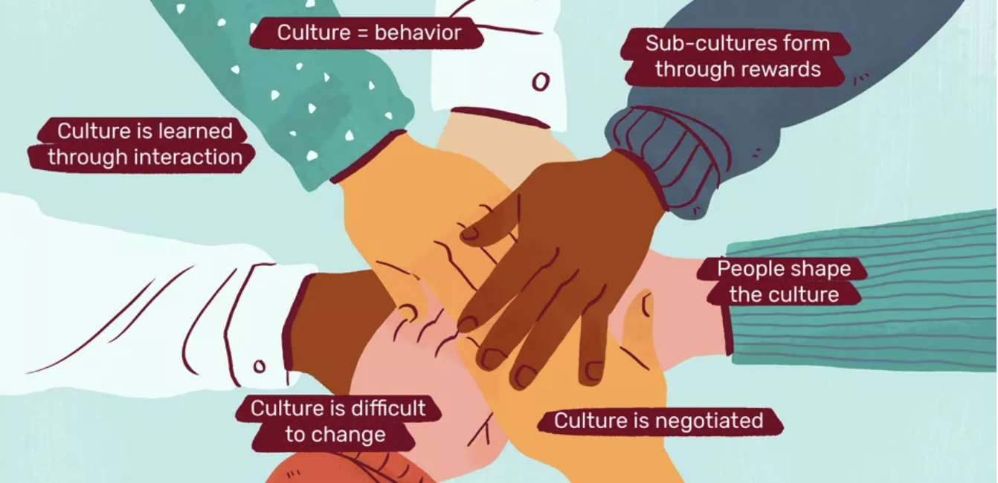
Sandra Gesing
Thanks!
sandra.gesing@nd.edu
http://sandra-gesing.com/

