Slide 1
Teams of CI Professionals: Recruitment & Retention, Management,
Team-building, and Motivation
Sandra Gesing,Ian Cosden,
Scott Hampton, Christina Maimone,
Amy Neeser, Dane Skow
sandra.gesing@nd.edu
https://iwsgateways.github.io/iwsg2021
June 11, 2021

Slide 2
Non-Traditional Academic
Career Paths
Teams of CI Professionals
HPC Facilitators
RSEs
Science Gateway Creators
Research Computing Professionals
Research Data Professionals

Slide 3
Cyberinfrastructure, research software and science gateways are widely used in
academia,
national labs and
industry
Lack of
incentives
recognition
formal training
in academia for CI professionals
Teams of CI Professionals
HPC Facilitators
RSEs
Science Gateway Creators
Research Computing Professionals
Research Data Professionals

Slide 4
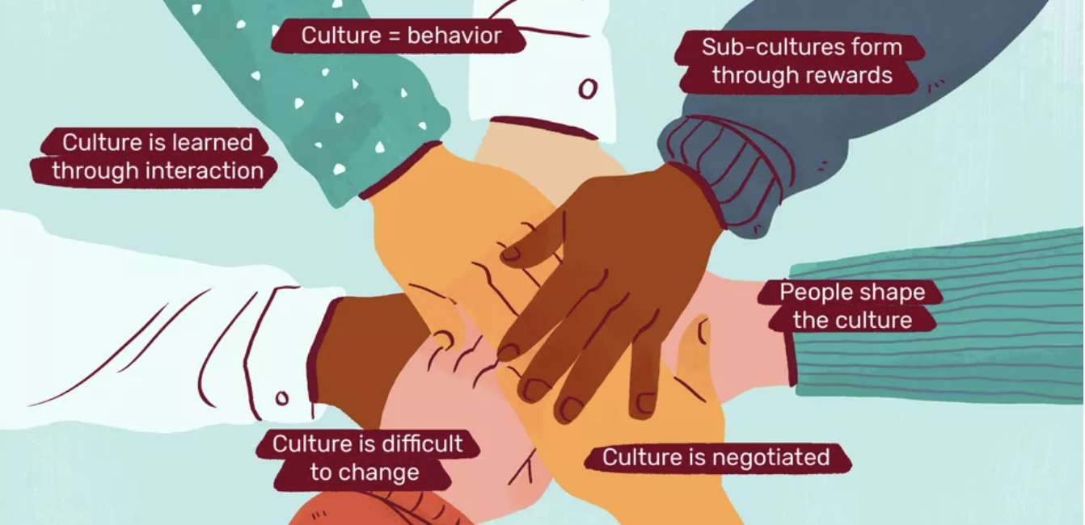
Changing Academic Culture
Teams of CI Professionals
HPC Facilitators
RSEs
Science Gateway Creators
Research Computing Professionals
Research Data Professionals
I'm passionate about changing academic culture to improve career paths for the "hidden figures" in research. It's still a long road but it started!

Slide 5
Panelists
Ian Cosden, Director, Research Software Engineering for Computational & Data Science, Princeton University. During his Ph.D. Ian discovered he liked writing code, helping others, and the technology around research more than the research itself. Ian believes Research Computing is an increasing essential service that provides a competitive advantage to researchers. He is also passionate about bringing awareness and recognition to the role of “Research Software Engineer” within the academic research community.
Amy Neeser (she/they) is the Consulting + Outreach Lead in Research IT at the University of California, Berkeley. They coordinate the consulting efforts across the Data Management and Research Computing programs to offer a holistic approach to data and computation and also facilitate Research IT's community, partnership, and outreach programs. Amy’s background is as a science and data librarian giving them experience with data in all aspects of the research lifecycle. Their professional and research interests include interdisciplinary and open digital scholarship, innovative uses of technologies in academic environments, equity in STEM, and critical digital literacy.
Christina Maimone, Research Data Services Lead, Northwestern University. Christina is happy to have found her way to research computing and wants to ensure research computing and research support roles are viable, respected career paths for others as well.
Dane Skow, Executive Director of North Dakota State University’s Center for Computationally Assisted Science and Technology (NDSU/CCAST). Dane was thrilled to be dubbed “both a geek AND a nerd” by his then 12-year-old daughter, and has spent his career trying to earn those accolades. He is passionate about improving opportunities for residents of rural communities to work on world class teams on leading edge technologies and creating bridges between communities.
Scott Hampton, Assistant Director,
High Performance Computing, University of Notre Dame

Slide 6
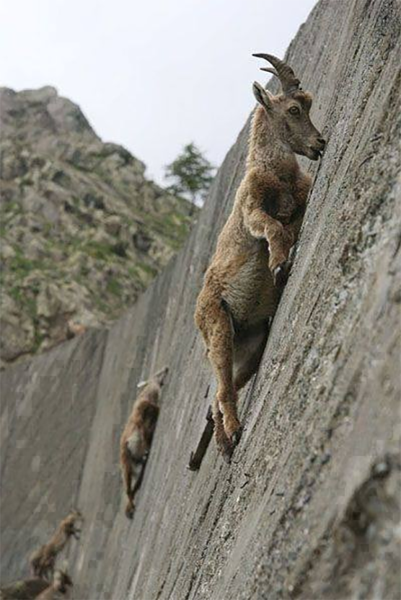
What worked and what did not work so well?
Recruitment & Retention
Management
Team-building
Motivation

Slide 7
What are you looking for when you look at applications of CI professionals?
What are incentives you can offer at your institution in regard to career development?
What can/should be done to provide adequate professional development opportunities ?
What are the biggest challenges in managing a team of CI professionals?
What are normally topics that motivate people to stay in this line of work?
Are you seeing improvement in professional diversity ? What works ? What doesn’t?
“Home-grown vrs. Hire-in” pros and cons
How can academia and industry collaborate on improving career paths?
How can we best combine actions to develop a critical mass that can change academic culture?
How can we reach decision makers beyond the research software and research computing communities?
Questions

Slide 8
Thanks!
sandra.gesing@nd.edu
https://iwsgateways.github.io/iwsg2021

