Slide 1
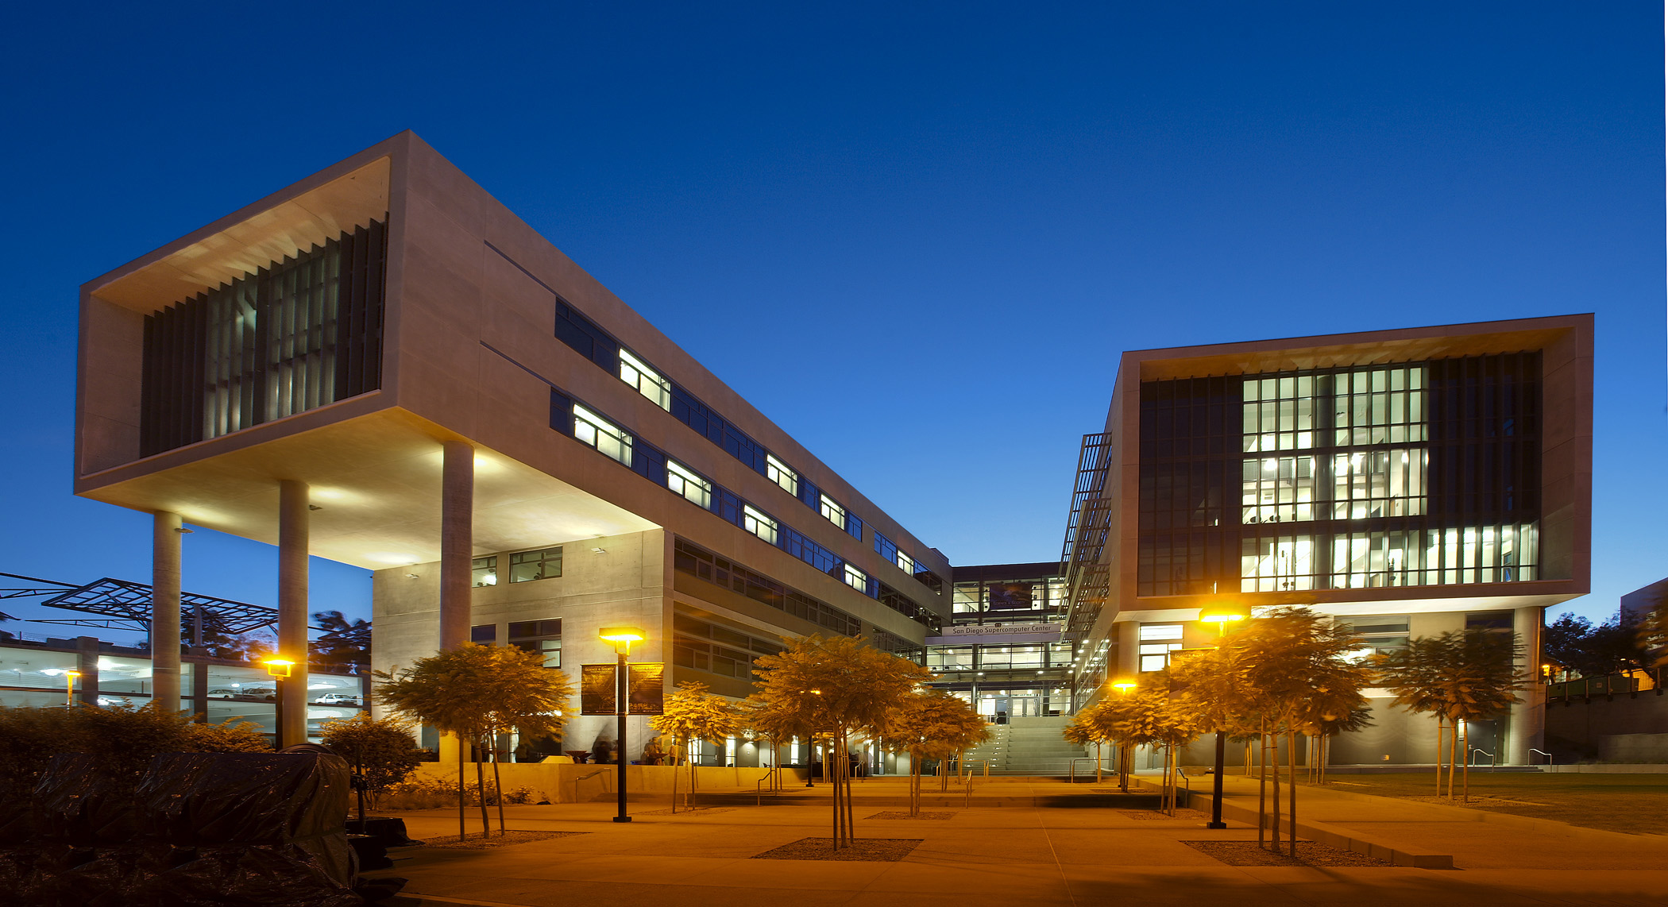
Low-Cost Solutions for Research Computing Hardware and Maximizing Value from Acquisitions
CI Facilitator Virtual Residency Panel
Shawn Strande
June 10, 2021

Slide 2
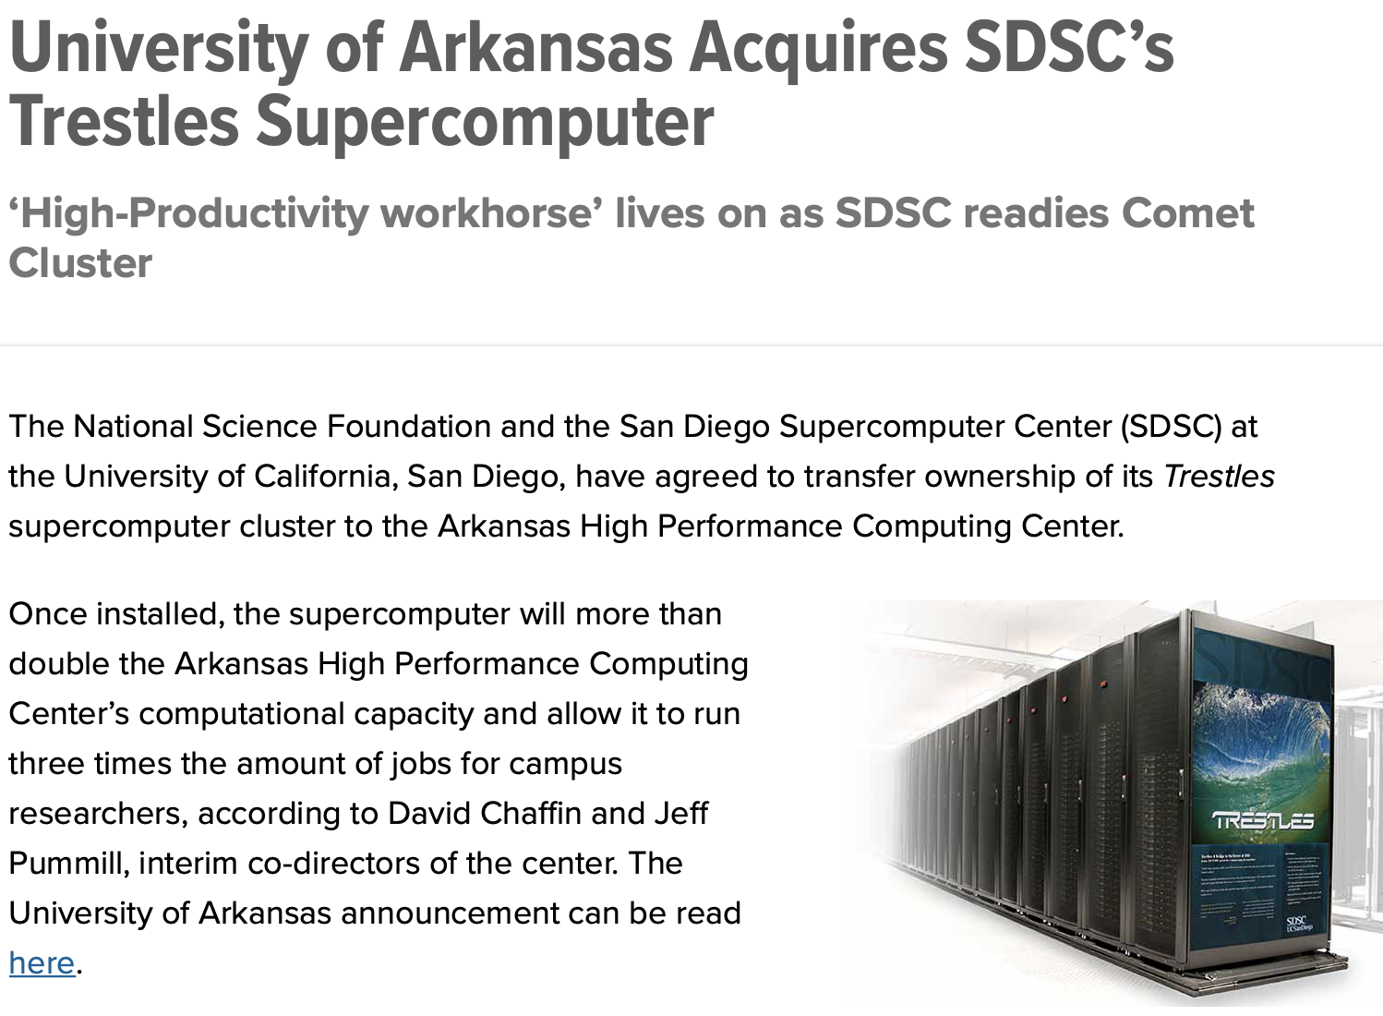
Trestles* redeployed to University of Arkansas as resource to the campus research community (where it has grown!)
324 node, 8c/4s AMD Magny-Cours nodes
2011
2015
2021
?
* NSF Award: Supplement to 0503944

Slide 3
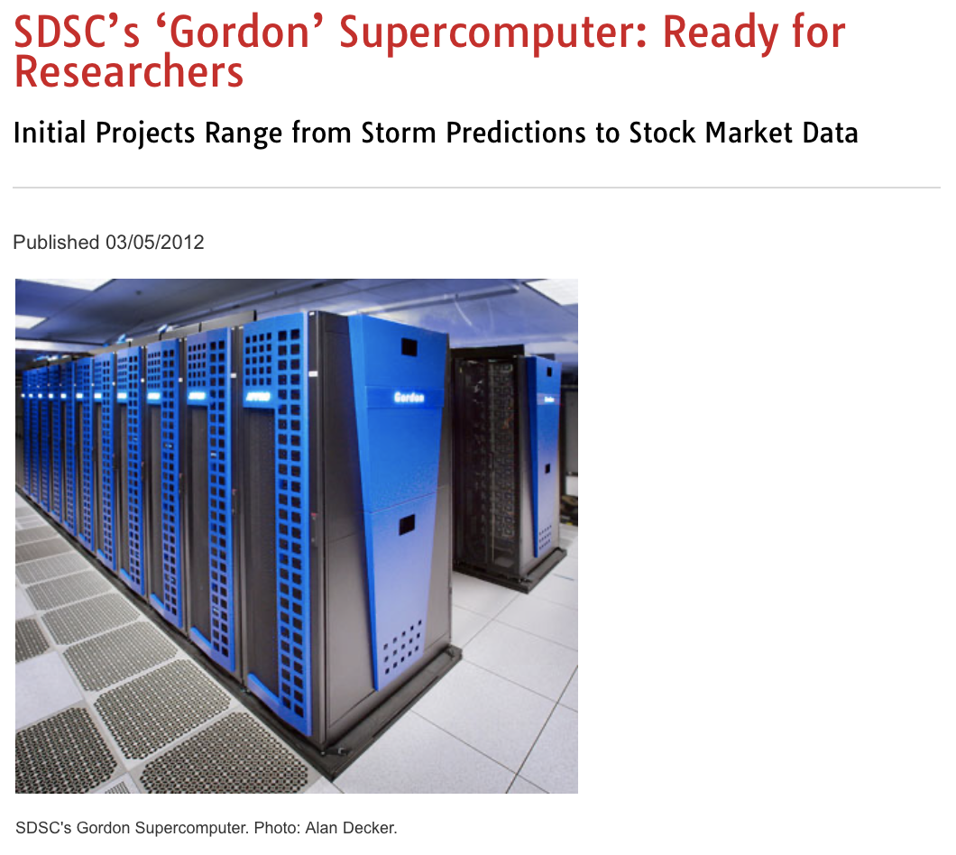
Gordon* second life with the Flatiron Institute, a non-profit research institution; this has led to new systems we operate for them
1,064 node, 8c/2s Intel Sandy Bridge
2012
2017
2020/decommissioned
(a few racks still in use by staff)
* NSF Award: 0910847

Slide 4
Comet* second life as a resource for the Center for Western Weather and Water Extremes @ Scripps Institute of Oceanography
1,944 node, 12c/2s Intel Haswell + K80 & P100 GPUs
2015
2021
?
* NSF Award: 1341698

Slide 5
Lessons learned (and still learning!)
We do this for the sake of collaboration and helping the research community
Based on preexisting collaborations and services in support of research
It expands our knowledge by working with the groups
It makes the most out of investments by NSF and the benefits institutions involved
There is value in older hardware
Various second life models have been successful
Hardware can last longer that your initial plan -> think about second life from the start
Many applications perform just as well on older hardware than new (e.g., don’t need AVX512, or aren’t network bottlenecked)
To the extent these deals generate flexible revenue (Gordon, Comet) they may allow you to do synergistic work
You need multiple strategies for hardware replacements
Buy spares far in advance of what you’ll need; press the vendors; graceful degradation of capacity (aka self cannibalize)
When continuing to provide services, document expectations with your collaborators, i.e., put them in a well-structured service agreement or contract
For Gordon and Comet, collaborators brought additional hardware to the deal, i.e., storage systems, to replace those which are prone to failure earlier than other subsystems

