Slide 1
Talon Research Cluster
GEORGIA SOUTHERN UNIVERSITY
INFORMATION TECHNOLOGY SERVICES

Slide 2
Introduction
Georgia Southern University’s Talon HPC cluster is a Rocks7-managed, SLURM scheduled cluster with a ScalaFS filesystem.
Previous Talon Cluster
71 compute nodes
1600 computing cores
Approx. 6TB of Memory
130 TB of storage space
New Talon Cluster
Close to 300 compute nodes
Over 4500 computing cores
Over 10TB of Memory
220TB of storage space.
Current hardware consists mostly of surplussed academic/enterprise servers.

Slide 3
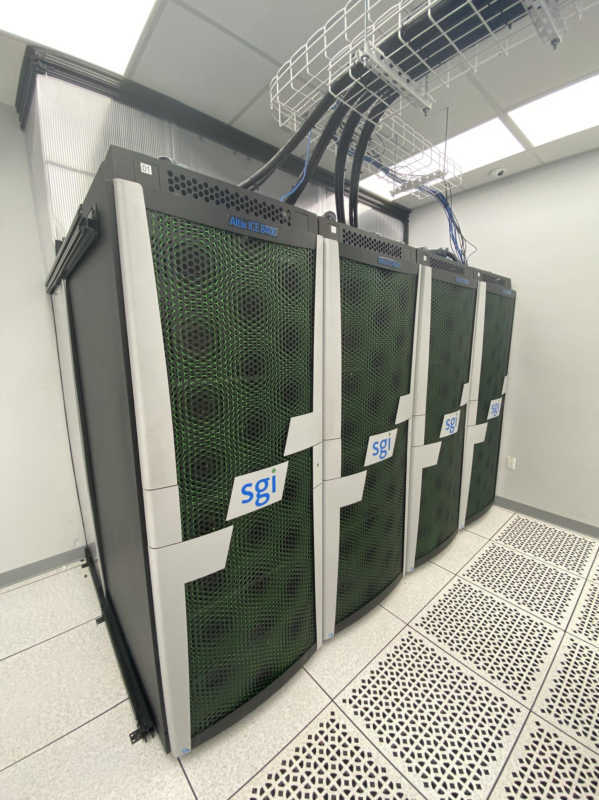
We acquired 4 SGI (Silicon Graphics Inc) ICE 8400 server racks[1].
220 stateless (diskless) compute nodes
12 CPU cores each
24-48GB of RAM
40Gb InfiniBand interconnect
1 rack leader per rack
3 service nodes
Have been repurposed as storage nodes using Scala software
These have been incorporated with our existing infrastructure.
The legacy operating system has been upgraded from CentOS 6.5 to CentOS 7.9.
The existing cluster management software was upgraded from Rocks version 6 to version 7
INFORMATION TECHNOLOGY SERVICES

Slide 4
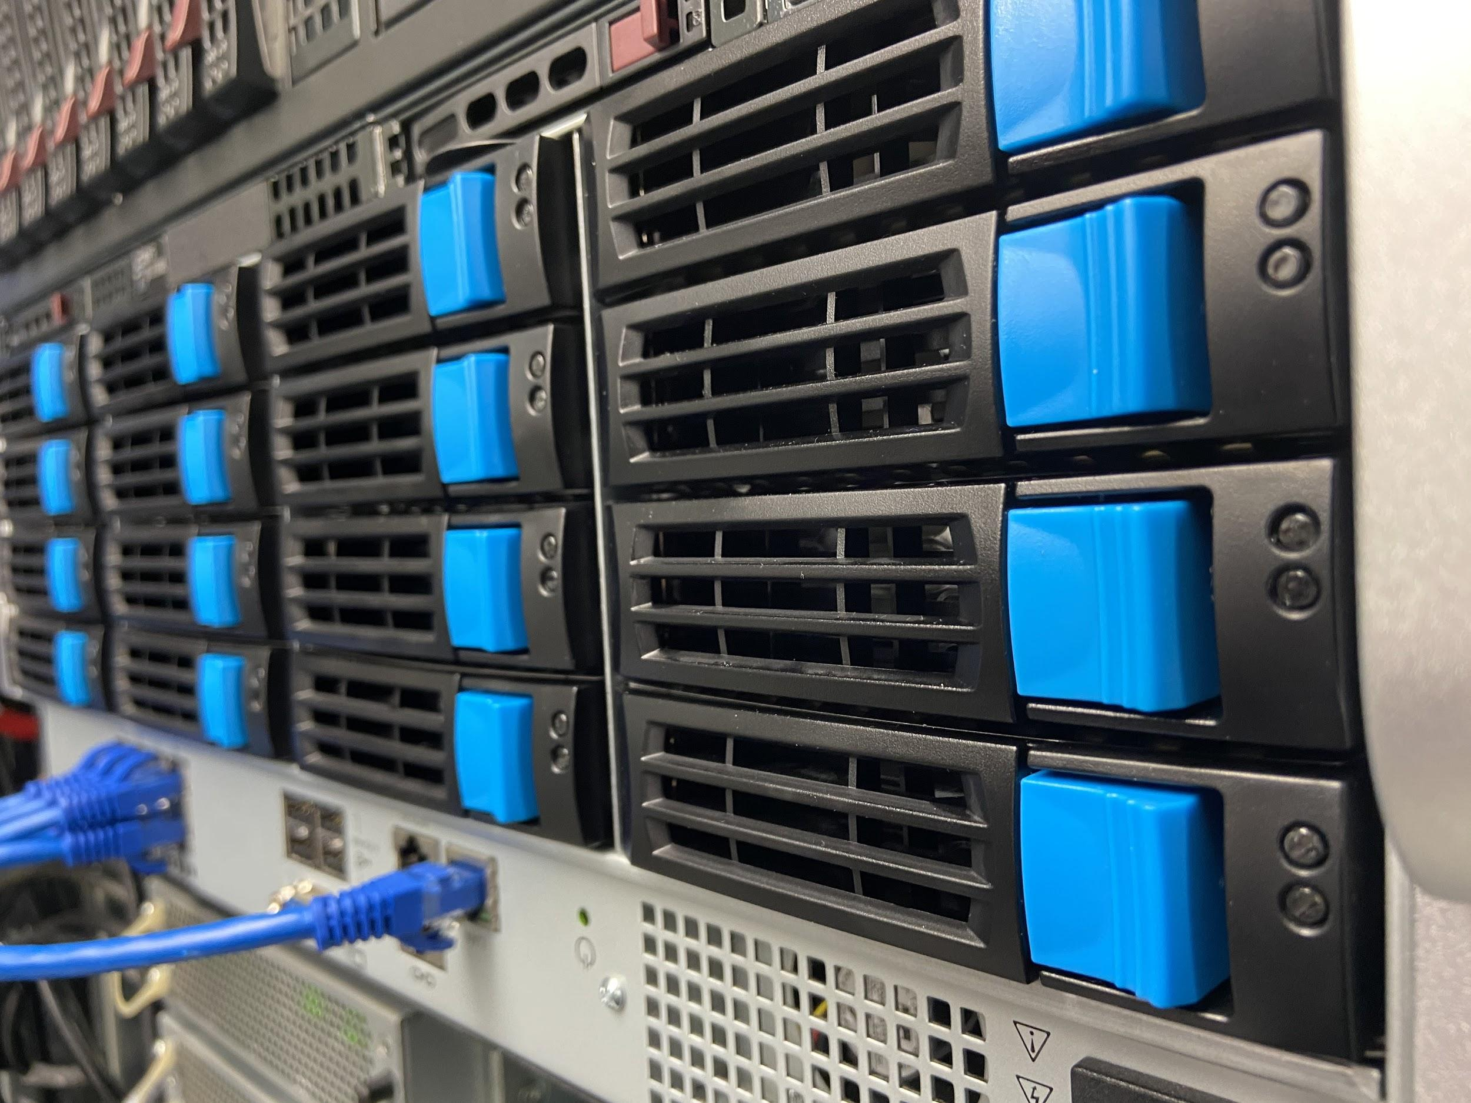
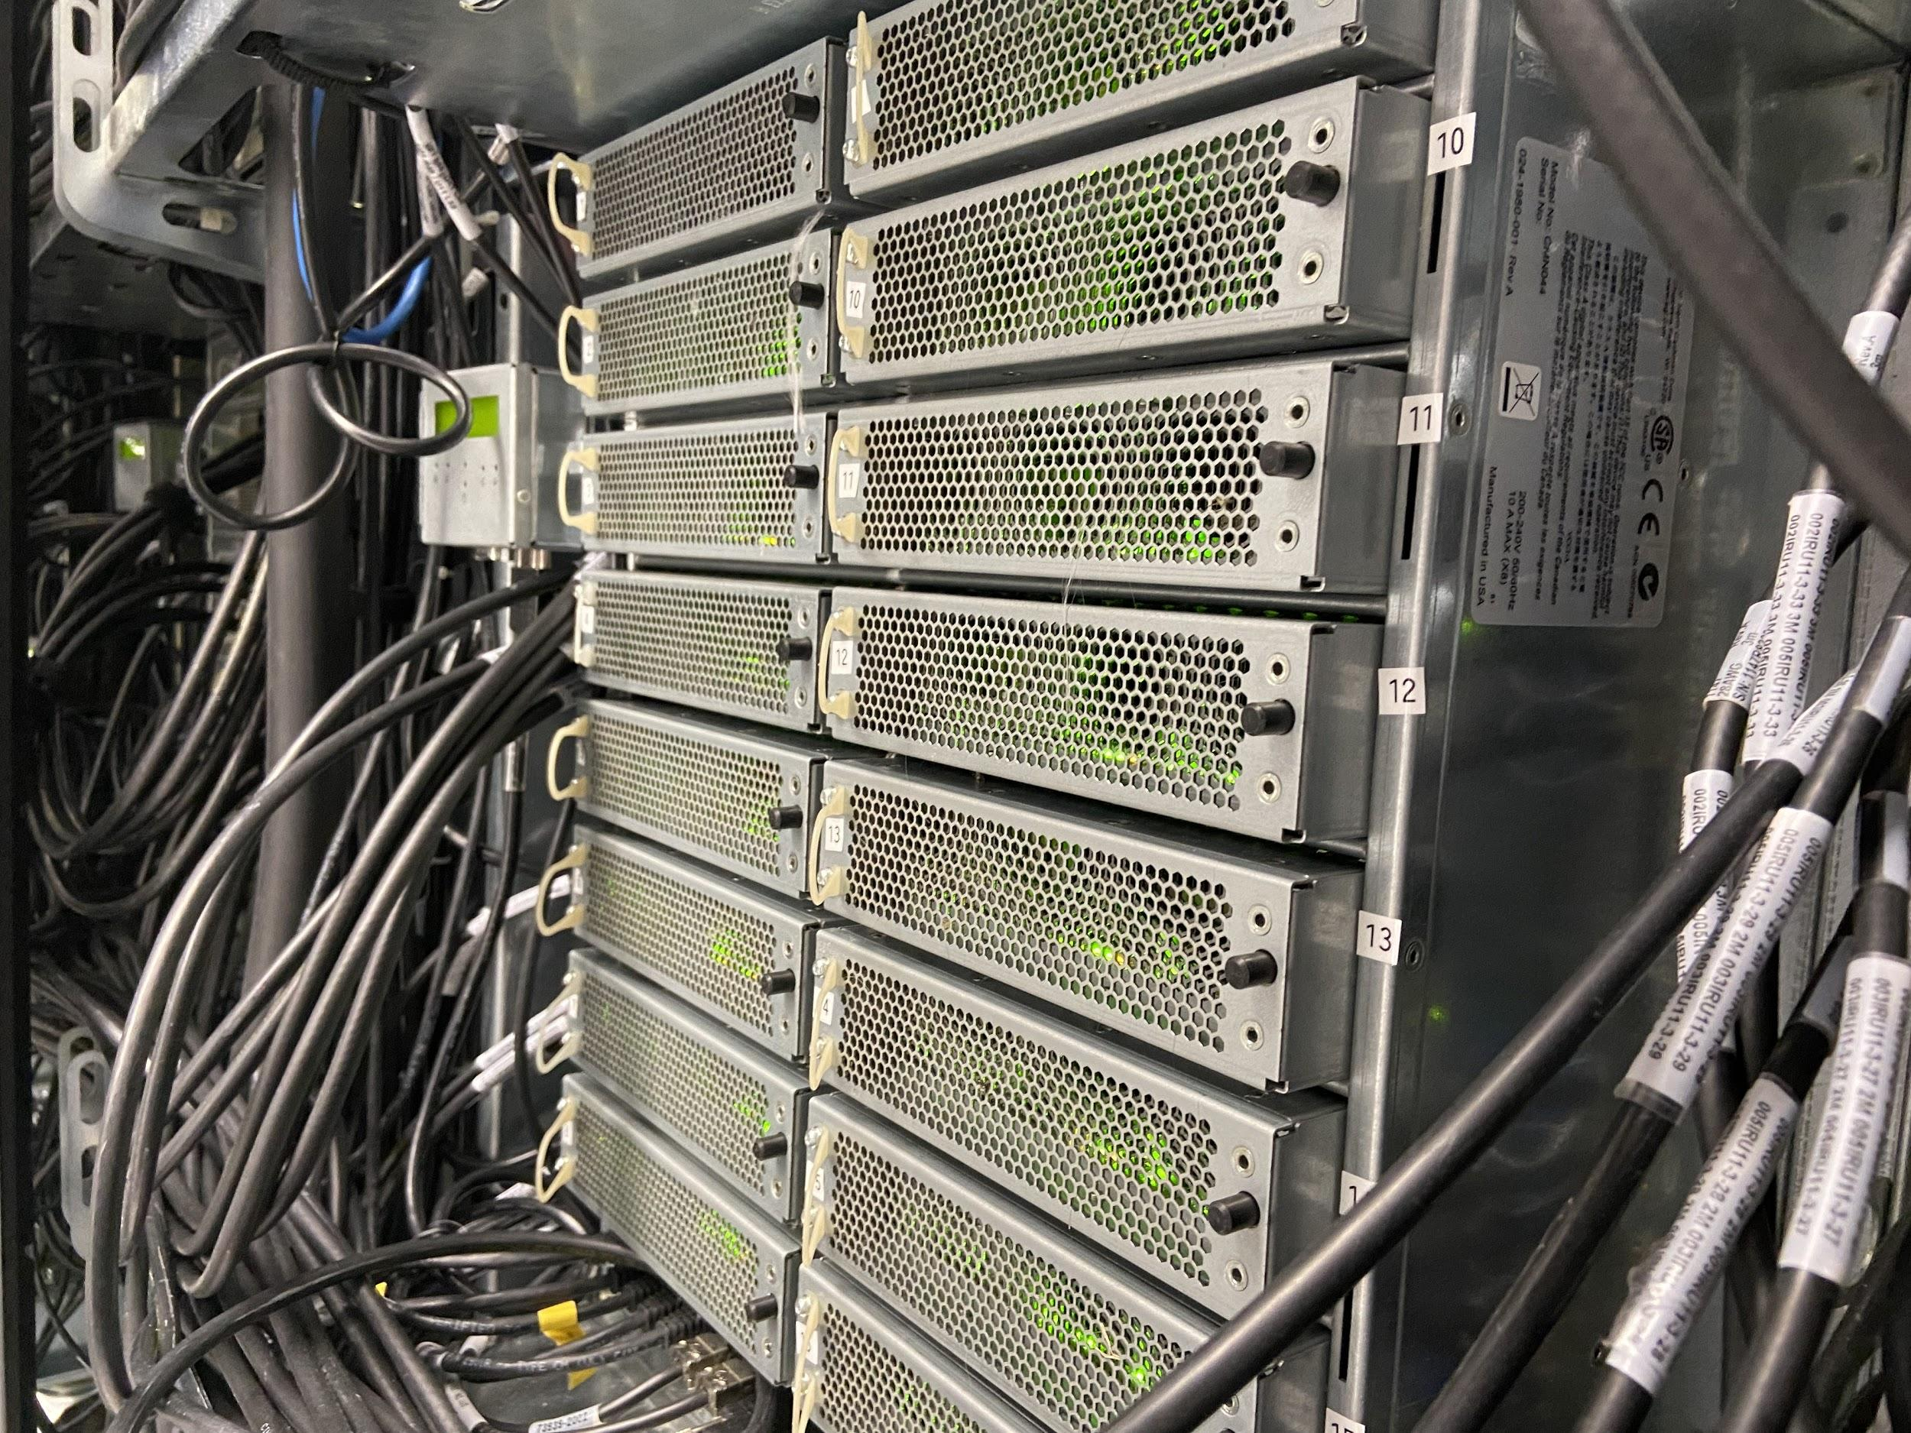
Scala Scale-out Storage Solution
240TB of raw storage space
/home
/work
Standard workspace for Talon users
/scratch
Temporary, fast storage space
/usr/local
Software installation and configuration file locations
INFORMATION TECHNOLOGY SERVICES

Slide 5
Hardware Standards
As part of the cluster build going forward, we have established a three tier set of standards for our general-use compute nodes.
As well as a tiered GPU node standard
This allows for an ease of management and maintenance.
INFORMATION TECHNOLOGY SERVICES

Slide 6
Questions, Comments &
Ideas

