Slide 1
Trustworthy AI (for Conservation):
AI and Humans
Combatting Extinction Together
Tanya Berger-Wolf
Director, Translational Data Analytics Institute Professor, Computer Science and Engineering,
Electrical and Computer Engineering,
Evolution, Ecology and Organismal Biology
The Ohio State University
Director and Co-Founder, Wildbook at WildMe.org
Much of the work has been done while at University of Illinois at Chicago

Slide 2
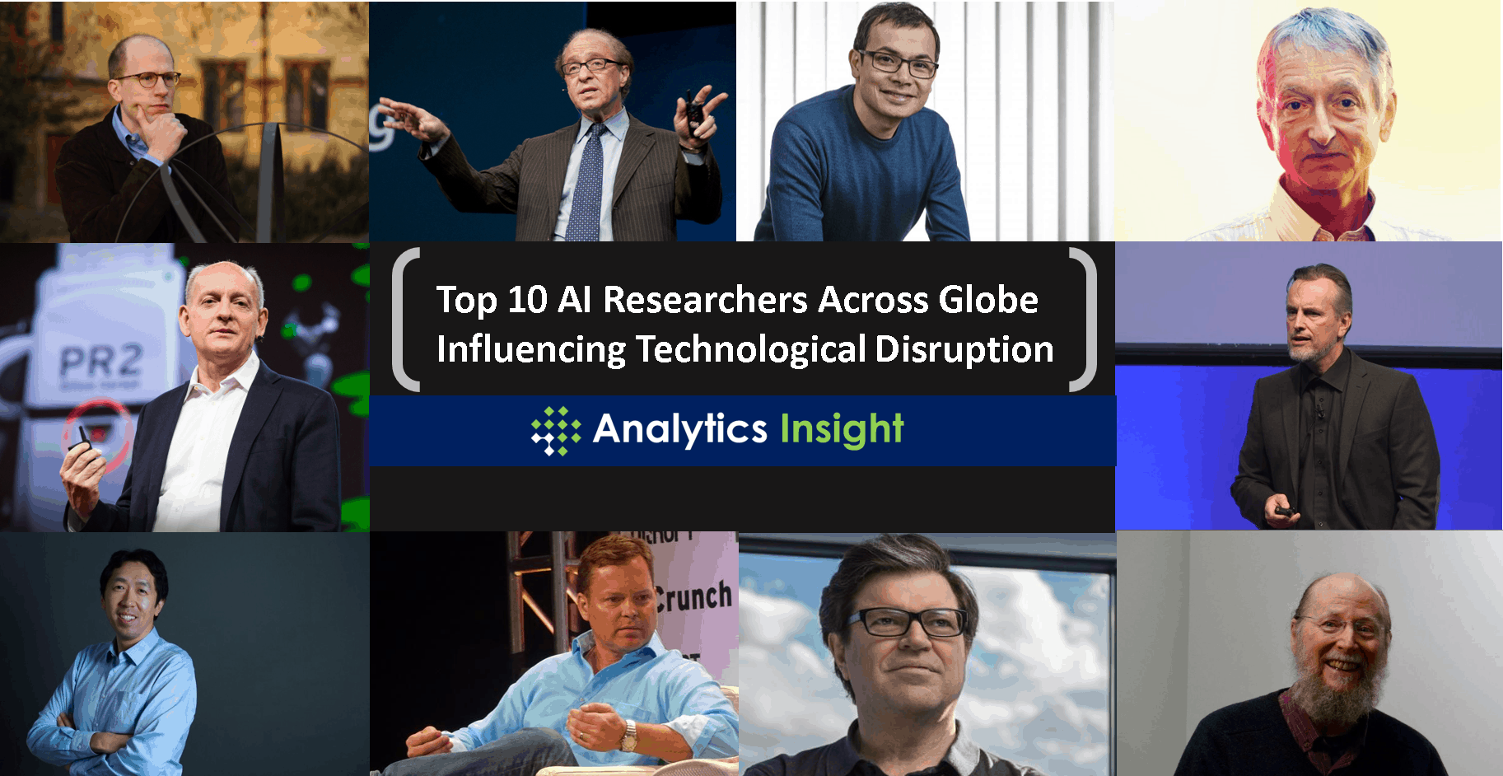
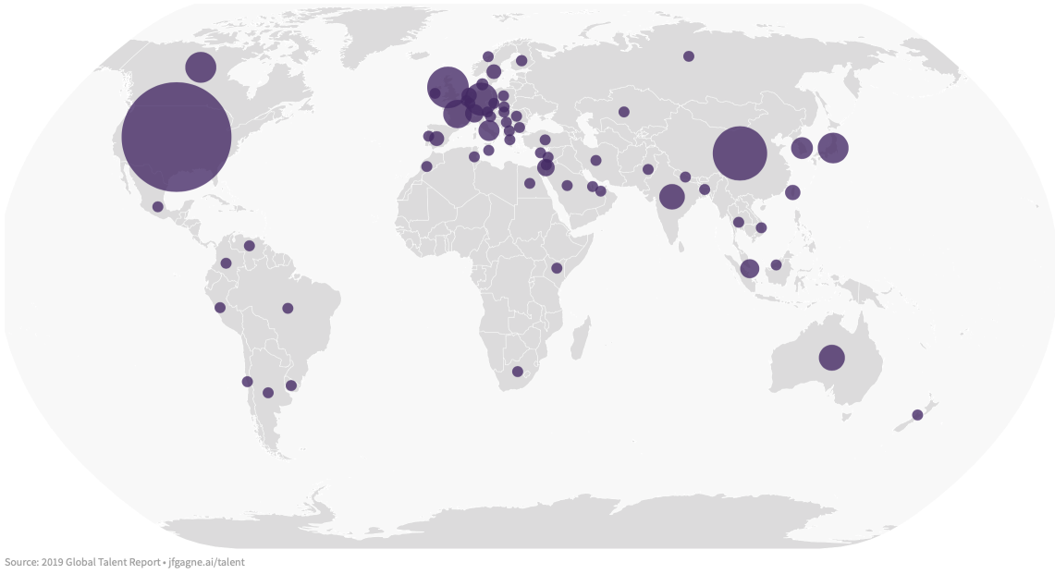
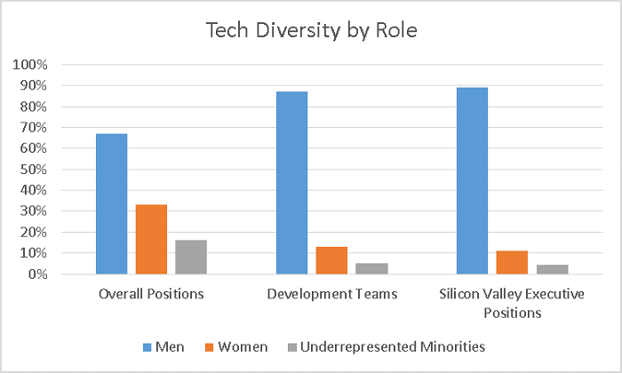
K.Stathoulopoulos, J. Mateos-Garcia, H. Owen, NESTA Gender Diversity in AI Research, 2019
Colleen M. Farrelly, Quantopo, LLC., 2018

Slide 3
How do we engender trust in AI?
Inclusive, collaborative partnership
Change how the solutions are created: with whom they benefit, not for them
Change who creates the solutions: diversity of data science
Build global data science capacity
Transparency, accountability
Open source, open process, explainability
Clear assumptions, uncertainty, limits
Responsibility for the outcomes
Safety
Do no harm: improvement on existing, including the cost (environmental too)
Data governance (protection, security, privacy)
Fairness and bias

