Slide 1
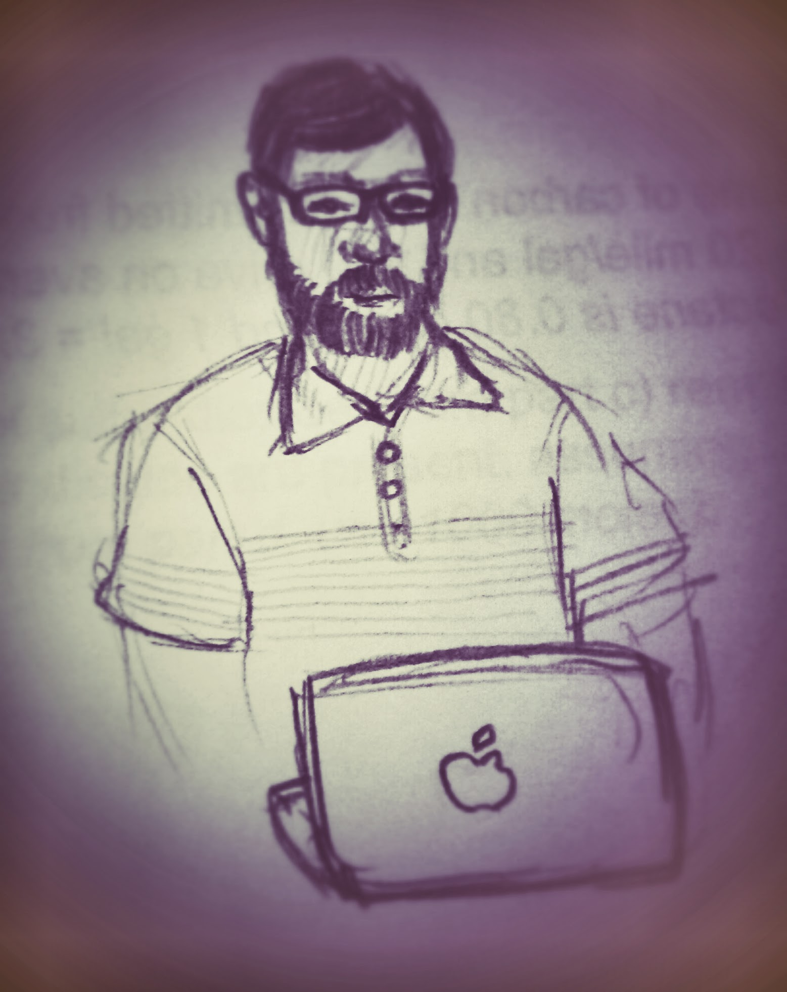
Scott Yockel University Research Computing Officer
Towards a Data Commons MVP
Mercé Crosas
University Research Data Management Officer

Slide 2
The RDM Challenge
Review of Research Data Services in U.S. Universities
A recent increase of research data and computing services:
Along with increase in data-centric and data science research
To support funders and journals requirements
Uncoordinated growth resulting in services distributed across units and schools often disconnected
Ithaka S+R report (Radecki & Springer, 2020, https://doi.org/10.18665/sr.314397)
Reviewed research data services from 120 U.S. Universities and Colleges
A growing number of research data services distributed across various university units:
Within Libraries and IT (main providers)
• Consulting (~65%)
• Training events (~35%)
• Backend (data engineering), metadata design)
• Frontend (web dev, data vis)
Outside Libraries and IT
• Statistics • Bioinformatics
• Geospatial • Social Science
• Visualizations • Clinical data
• Business

Slide 3
A Harvard Data Commons MVP will ...
improve the researcher experience by automating the flow of research data from research computing environments to management, publication, and preservation environments. As a result, data integrity, provenance, and reproducibility of research data will be improved in order to meet sponsor requirements.
Objectives
1. Integrate RC environments and repositories to facilitate publishing data and/or metadata throughout the research project lifecycle
2. Support advanced research workflows and provide packaging options that can be deposited in a repository to enable reproducibility and reuse
3. Integrate Harvard repositories:
Dataverse with the DRS for long-term preservation
Dataverse with DASH to connect datasets with open access publications
Guiding Principles
1. Facilitate the workflow from managing active research data to data sharing and archiving, following best practices
2. Use existing (open source) systems when possible and build on top in an iterative fashion
3. Engage researchers to drive the use case and be user testers of the MVP tools built from this project
4. Collaborate with peer institutions and build tools and guidelines that can be reused and updated by others
Key Performance Indicators
The connector tools with well documented code in GitHub
Standards for packaging multiple common workflow artifacts with rich metadata
Publish active datasets, large (TB sized) datasets, and only metadata about data
Preserve selected datasets from Dataverse through DRS
Link automatically datasets deposited in Dataverse to publications in DASH

Slide 4
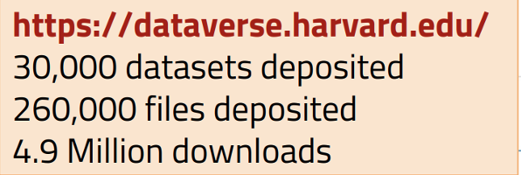
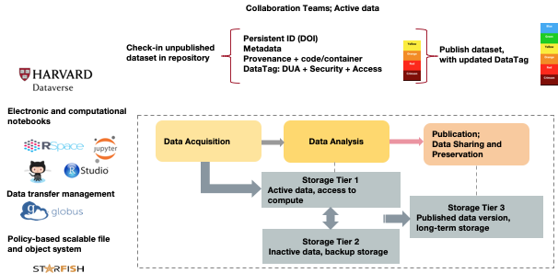
Towards a Data Commons MVP

