Slide 1
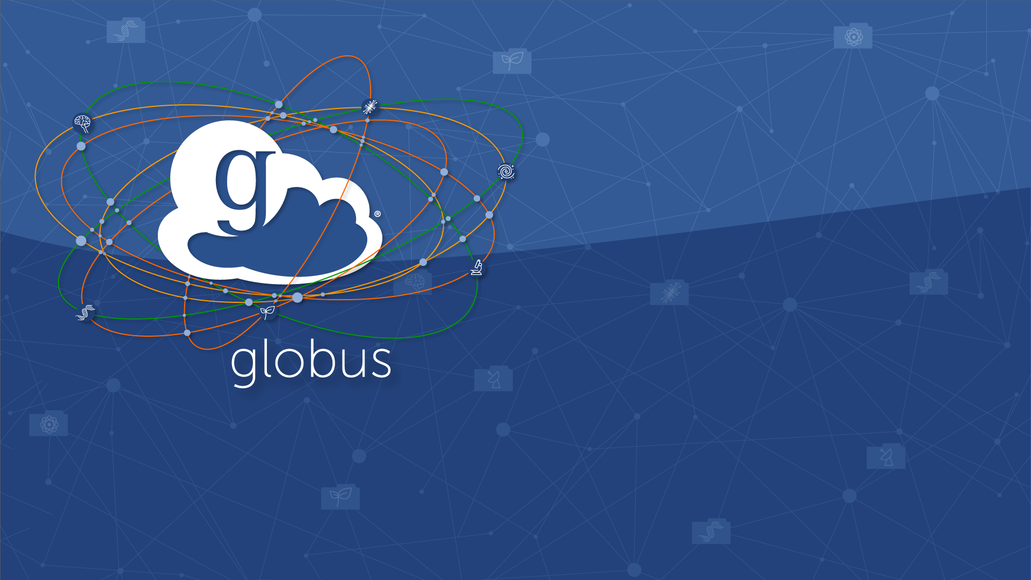
Automating Data Management Flows with iRODS and Globus
Vas Vasiliadis
Virtual Residency Workshop - June 8, 2021

Slide 2
Globus is …
a non-profit data management service developed and operated by

Slide 3
Our mission is to…
increase the efficiency and effectiveness of researchers engaged in data-driven science and scholarship through sustainable software

Slide 4
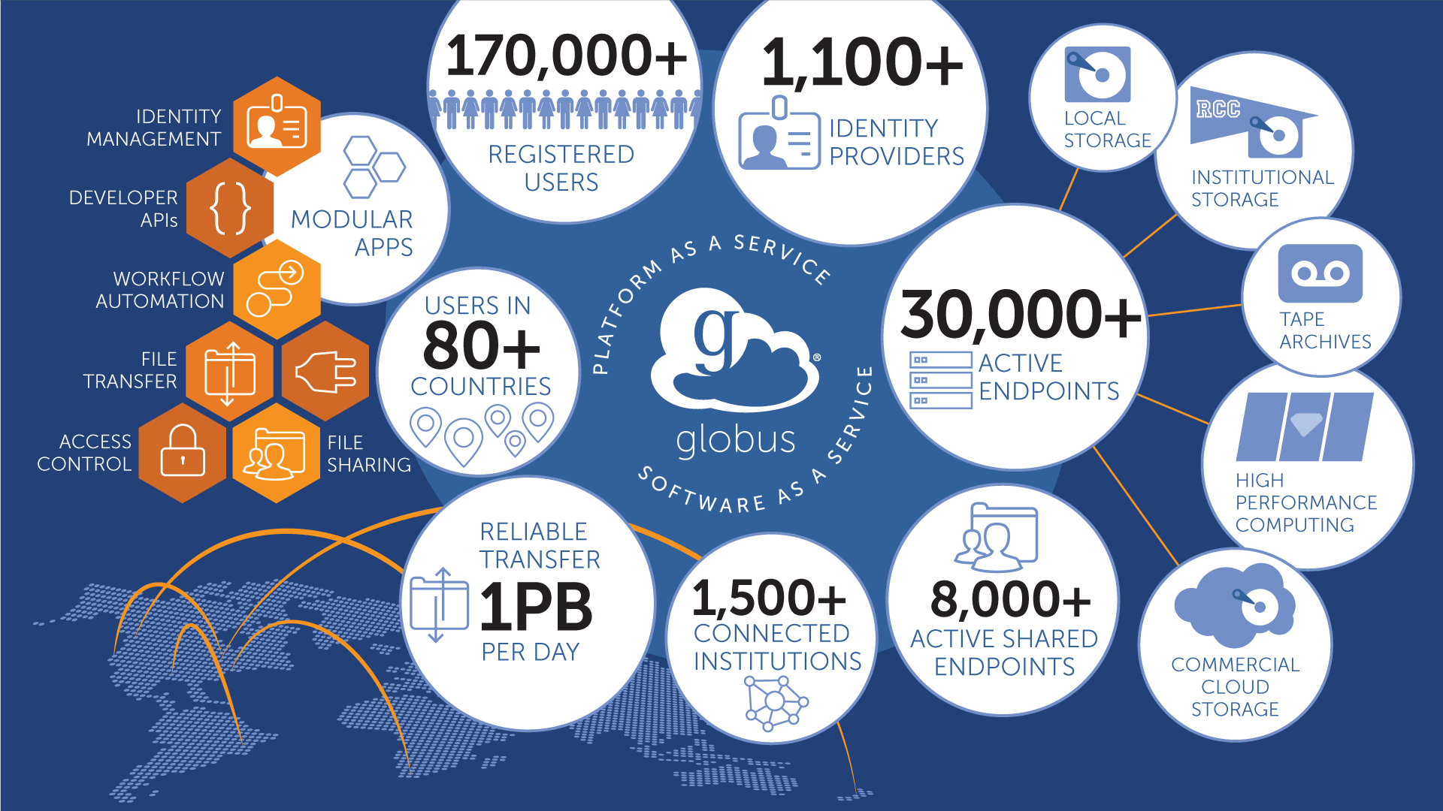

Slide 5
In over 10 years of working with research computing and data management teams, we’ve seen a thing or two…

Slide 6
Thing 1: A Clear and Present Danger!
Notes:
Sequencing Center
Move data off to shared folder
Monitor when pick up
Delete or move to archive
User facility
fast transfer speed, data can be written near real time
Sequencing centers: University cores, NIH, NCI, NYGS
Many sequencing centers rely on Globus to move data off the sequencers and then they create a shared folder that the user can access to pick up their data. The sequencing center can use Globus to monitor when the user has picked up the data and then again using Globus, delete the data or move it to archival storage.
Cryo-EM: Purdue, National Cryo-EM Facility at NCI
Beamlines: APS at ANL, ALS at Lawrence Berkeley National lab, and SLAC at Stanford.
Another type of facility, one where the user actually operates the system, such as synchortron beam line or a Cryo- electron microscope. In that case, the fast transfer speed of globus have an extra advantage in that data can be written near real time as it comes off the instrument to the user home institutions or another remtoe location so that multipe people can be collaborating and analyzing data and make insturment or experiemtn adjustments as the experiemtn is running. In one case, we had a user at her home institutinog use visualization software avaiale ony at her home institutions to view and analsze data as it comeing off the camera and then remote make camer adjustment based on the results she was seeing.

Slide 7
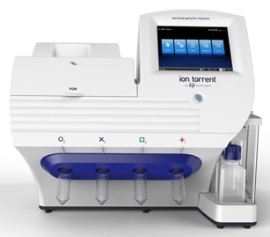
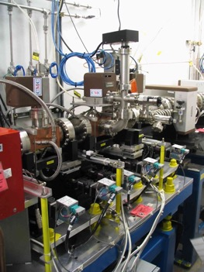
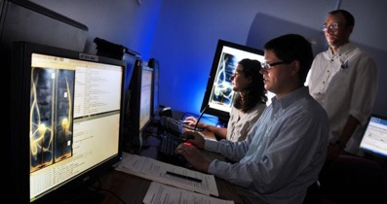
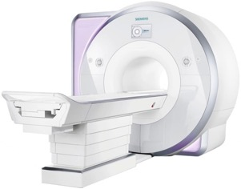
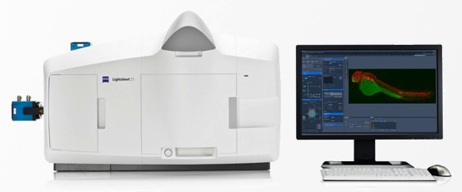
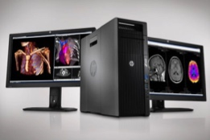
How do/will we deal with TBs per day?
Analysis store
Data Archival/ Distribution
Next-Gen Sequencer
Cryo-EM
Advanced Light Source
Remote visualization
MRI
Light Sheet Microscope
Distributed Labs

Slide 8
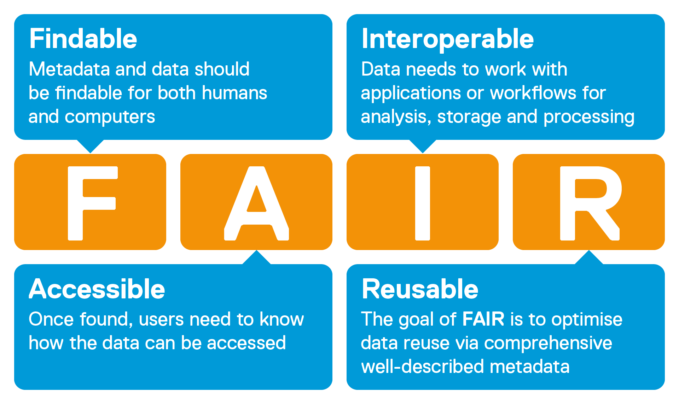
Thing 2: Your USB drive is not FAIR
Image courtesy of SciBite
Notes:
Your researchers will need to apply FAIRness to ALL their data …and not too far in the future.

Slide 9
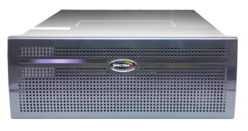
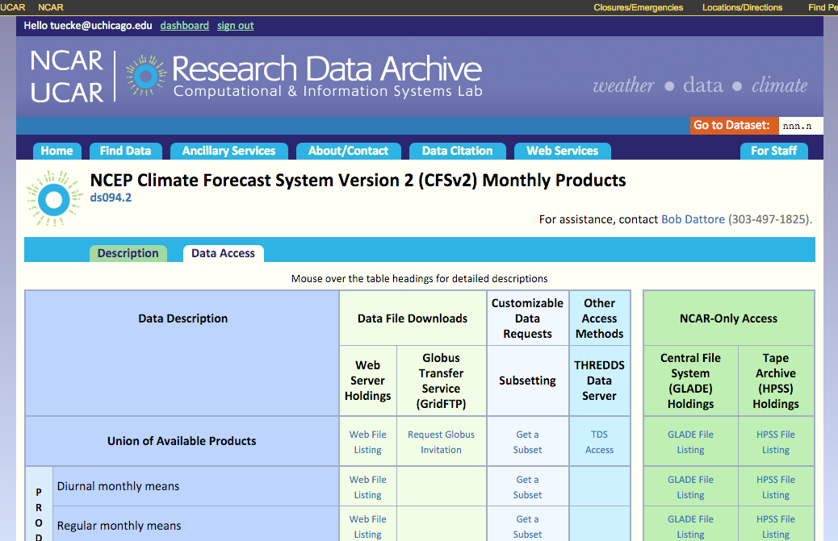
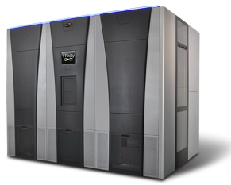
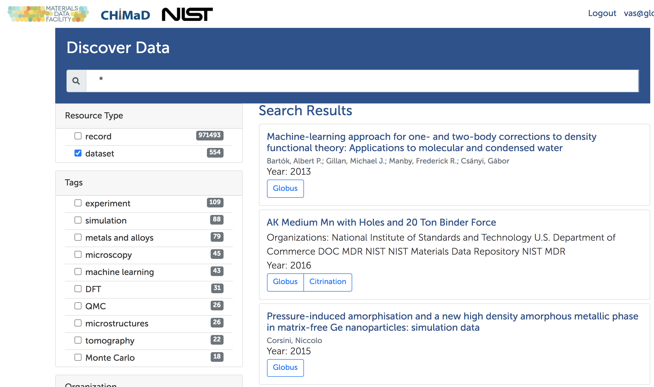
How do we build shared, accessible repositories?
Campus
stores
Project
repositories
National / public repositories
Public / private cloud stores
Notes:
For large well funded projects this is much easier
What about for small

Slide 10
Thing 3: NOT all your base are belong to us!
Security controls → NIST 800-53 → 800-171
Restricted data handling → PHI, PII, CUI → Compliant data sharing
Legal Protections → Business Associate Agreements → Privacy regulations (e.g. GDPR DPA)

Slide 11
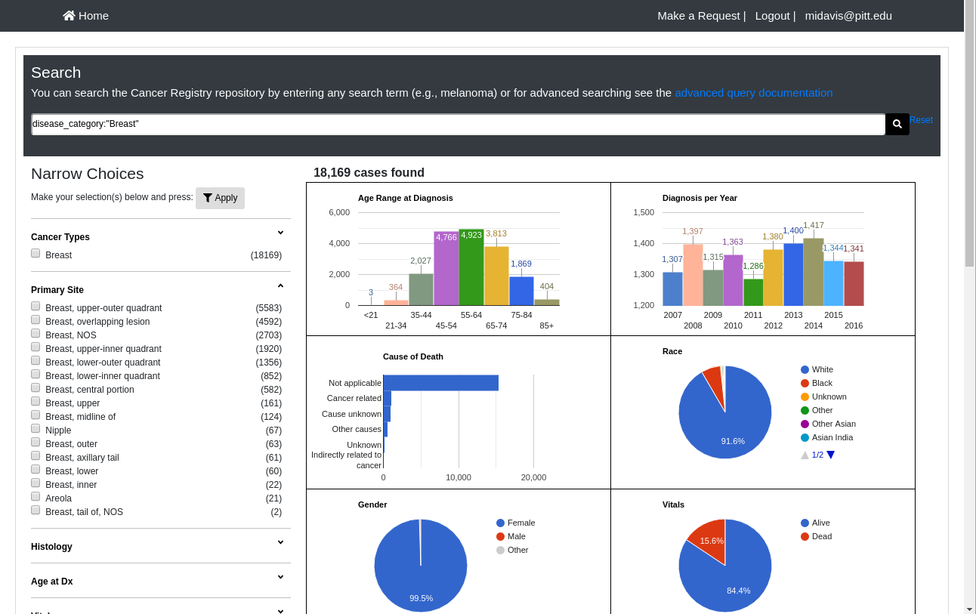
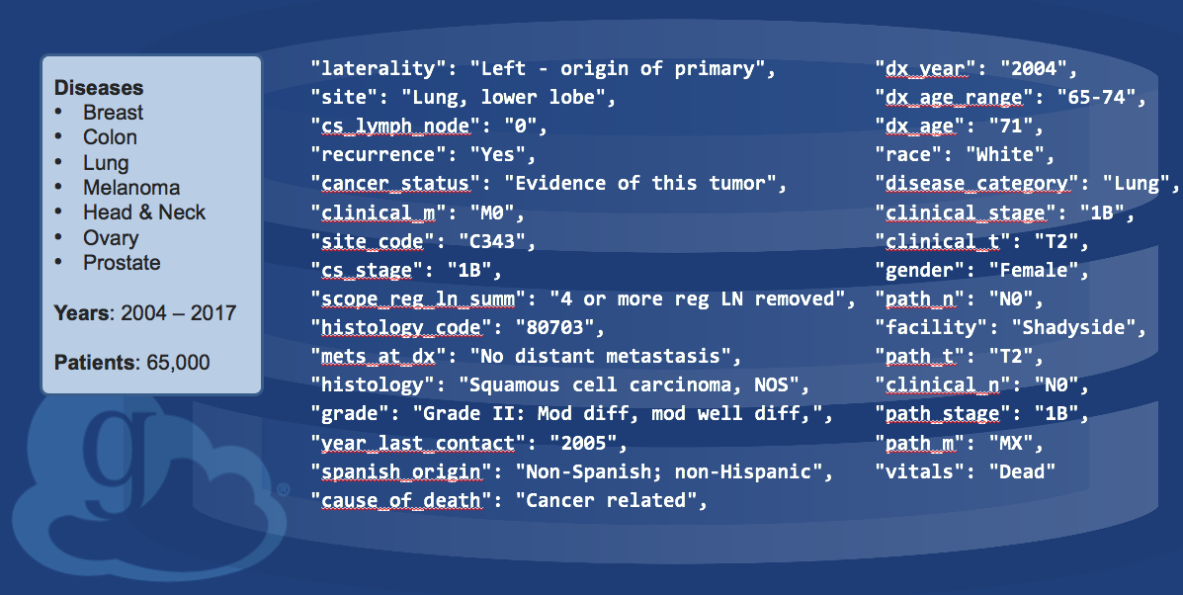
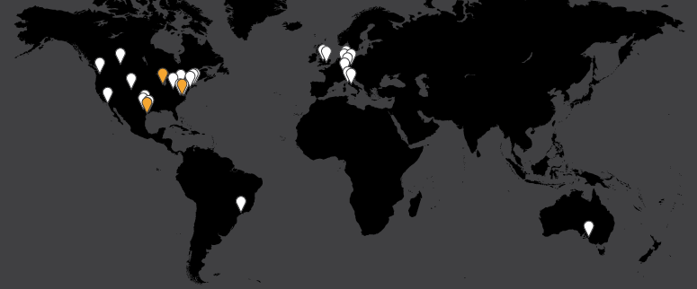
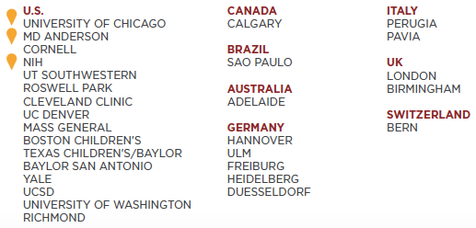
How do we reduce compliance “friction” in research?
Granular access control to both data and metadata
The RUNX1 International Sequencing Consortium (RISC)

