Slide 1
Marketing, Communication, Demonstrating Impact/Value
Sandra Gesing
sandra.gesing@nd.edu
Virtual Residency
Intermediate/Advanced Workshop 2020
University of Oklahoma
June 5, 2020

Slide 2
ND CRC in 2006-2008
Effort with 7 FTEs centrally funded
HTC and HPC Computing and basic user support
One centrally funded cluster plus multiple faculty funded clusters in various cabinets on campus
Around 300 active users
80% centrally funded hardware
No other kinds of research computing services
Underserved social sciences and humanities for their need on science gateways
~1000 faculty, ~12000 students

Slide 3
Implementation by CRC Director
Take the risk and hire people first
train people
generate / bring projects
assign people to projects and focus on getting more projects and more people -> etc...
if not successful then exit, i.e. quit ☺
Fortunately, we had many projects, mostly science gateway projects of various kinds and difficulty.

Slide 4
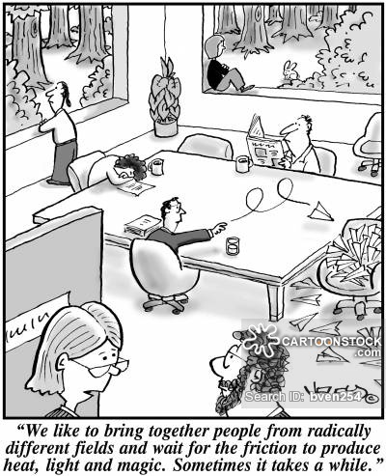
Marketing and Communcation
Direct outreach to departments
Yearly user event
User awards
Training
Extension of services
Software development and profiling
Cyberinfrastructure/ science gateway development
Computational Scientist support
Collaborative research/grant development
System administration/prototype architectures
National resources (e.g., XSEDE, OSG)

Slide 5
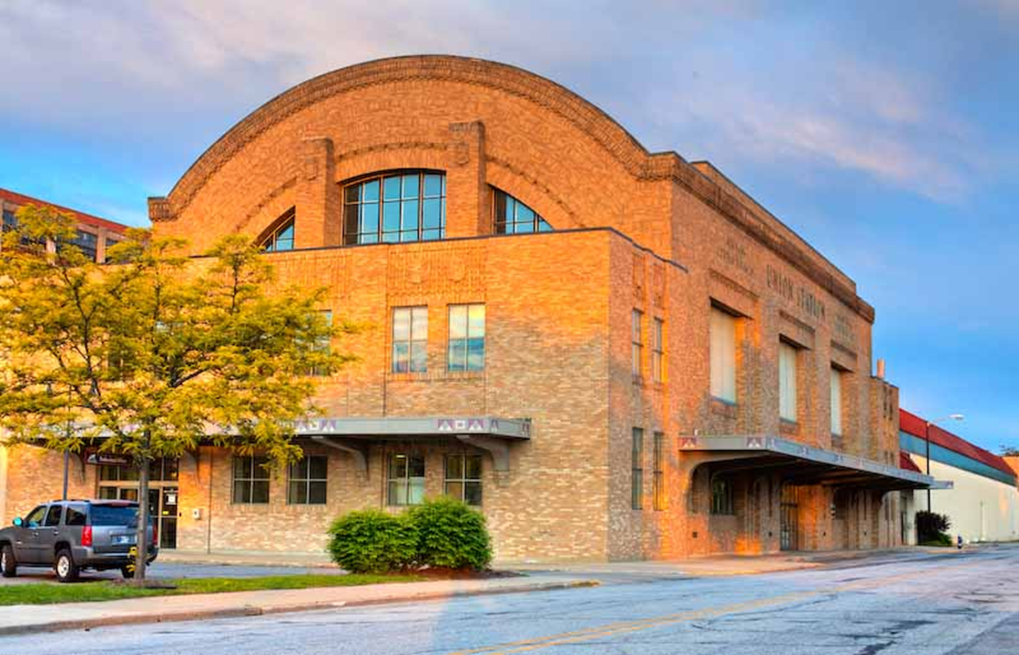
Impact/Metrics – ND CRC in 2020
50 FTEs with 70% of the staff salaries supported through grants and services
HTC and HPC Computing and user support
30,000 cores
2,200 active users
12 HPC engineers and user support staff
25% of compute nodes are centrally funded
Cyberinfrastructure development
~15-20 CI projects each year with ~35 faculty from various departments including social sciences and humanities
supported by ~25 research programmers, ~8 computational scientists, some FTE fractions of HPC engineers, and a few (7) grad students and undergraduate interns (4-6)
~1000 faculty, ~12000 students
CRC HPC Center (old Union Station)
http://crc.nd.edu

Slide 6
Thanks
Thanks!
sandra.gesing@nd.edu

