Slide 1

Virtual Residency Workshop 2020
“Marketing, Communication, Demonstrating Impact/Value”

Slide 2
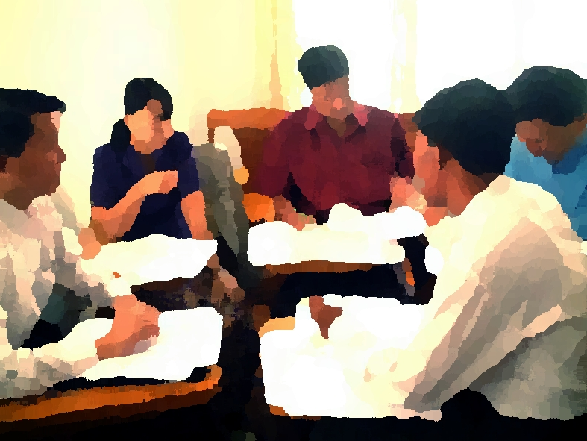
PANELISTS
Kevin Brandt
South Dakota State University
Kevin.Brandt@sdstate.edu
Moderator: Anchalee Phataralaoha
University of Florida
Sandra Gesing
University of Notre Dame
sandra.gesing@nd.edu
Chris Reidy
University of Arizona
chrisreidy@arizona.edu
Dena Strong
University of Illinois at Urbana-Champaign
dlstrong@illinois.edu

