Slide 1
Virtual Residency Workshop 2020
“Strategic Thinking & Visioning”
Wed June 3
Google Doc: https://bit.ly/vr2020-strategic
Moderator: Henry Neeman, U Oklahoma, Director, OU Supercomputing Center for Education & Research (OSCER)
Shafaq Chaudhry, U Central Florida, Assistant Director, Research IT
Shawn Doughty, Tufts U, Manager, Research Computing
Frank Feagans, U Texas Dallas, VP and CIO
Claire Mizumoto, U California San Diego, Director, Research IT Services
Annamaria Szakonyi, St. Louis U, Research Computing Architect
Scott Valcourt, U New Hampshire, Director of Strategic Technology

Slide 2
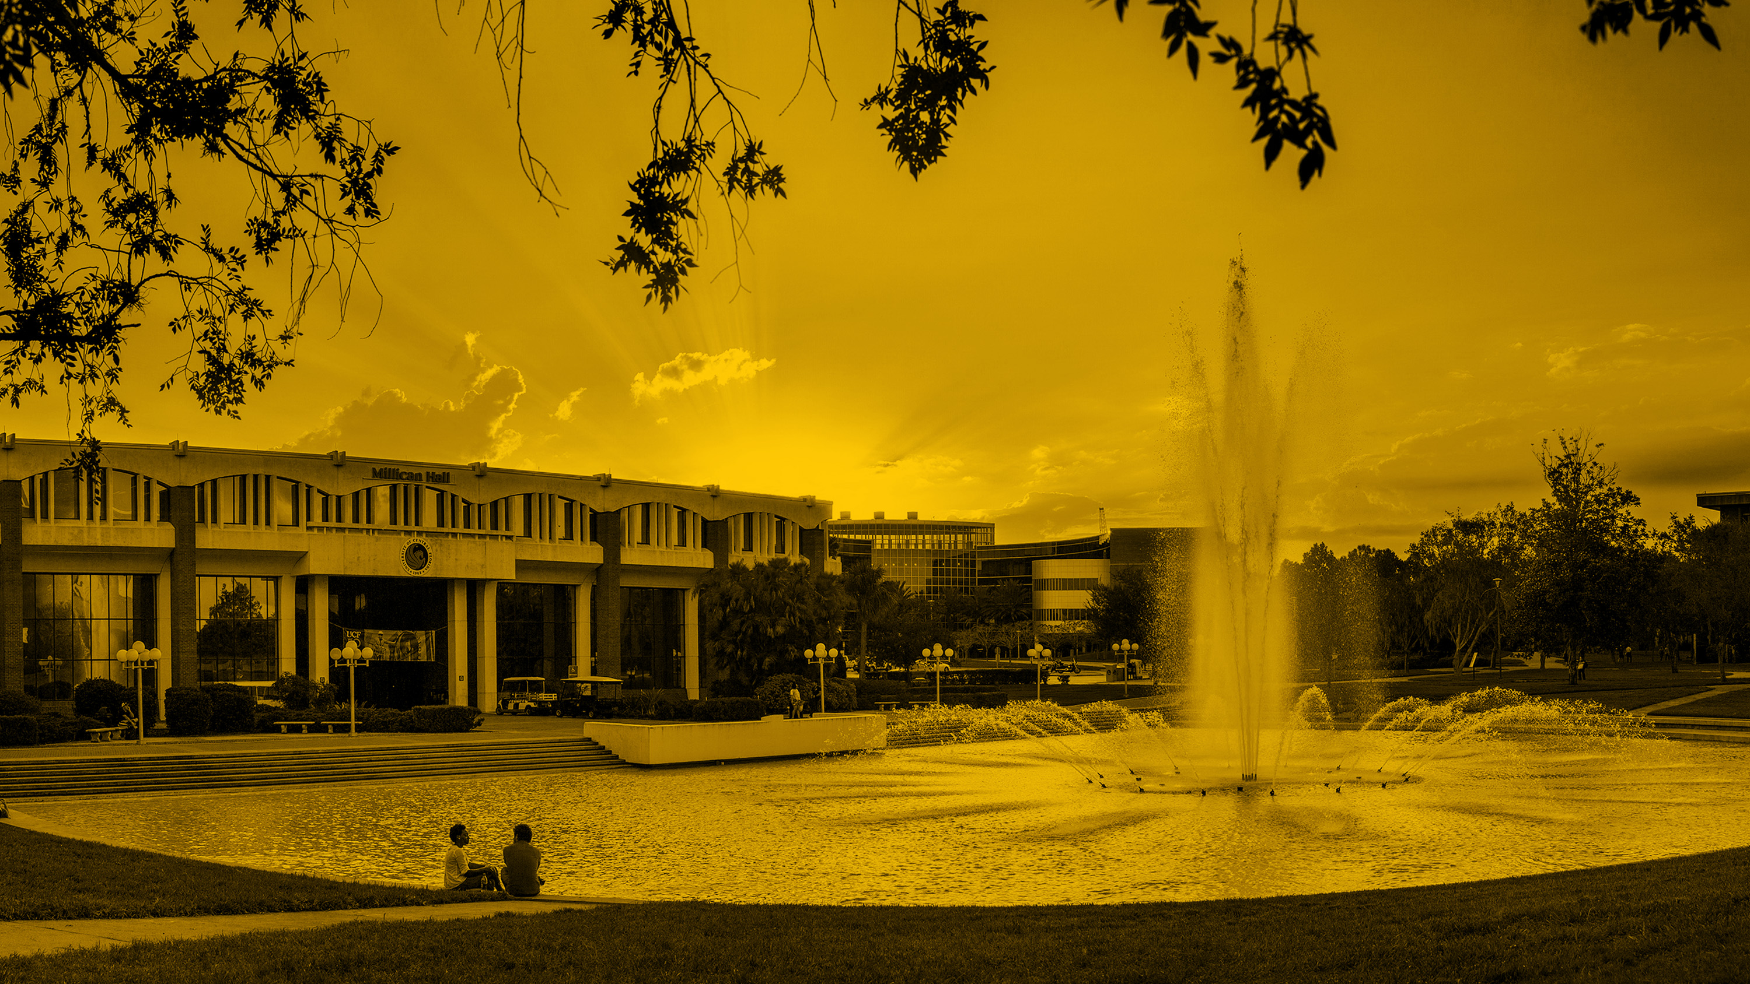

Shafaq Chaudhry
Assistant Director, Graduate & Research IT, Office of Research, UCF
NSF Trusted CI Cybersecurity Fellow, 2019
Email: Shafaq.Chaudhry@ucf.edu

Slide 3
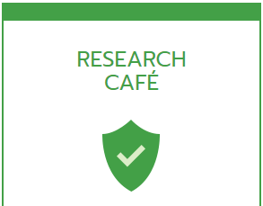
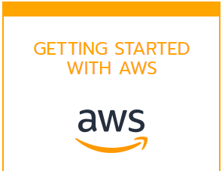
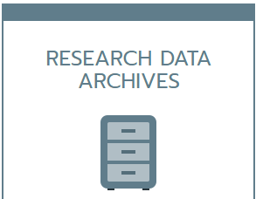
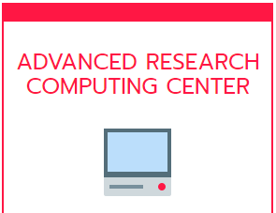




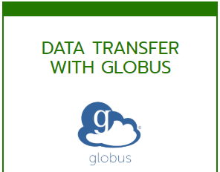


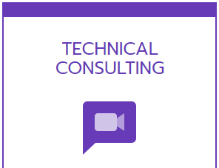
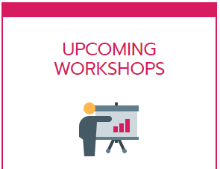




Service Provider
Research Facilitator
Researcher Advocate
one who supports or promotes the interests of a cause or group
make (an action or process) easy or easier
offer a service designed to address the needs of a consumer group
Examples:
SPSS facilitation
GIS facilitation
Agreements with vendors
Cloud computing
Technical consulting
CUI/FISMA environment
Examples
Data collection and analysis tools
Liaise with HPC, library, other IT depts, InfoSec Office, Research Compliance, C&G office
Examples:
Researcher Needs Assessments
External capabilities assessments
Presenting to senior leadership (VPR, Provost, Faculty Senate)
Virtual Residency Workshop 2020 Shafaq Chaudhry (shafaq@ucf.edu)

Slide 4
Shawn G. Doughty
Tufts University
Tufts Technology Services (TTS)
Manager Research Computing
shawn.doughty@tufts.edu

Slide 5
Roles
Sponsor/Stakeholder
Systems Facing
Researcher Facing
Software Data Facing

Slide 6
Frank Feagans
Vice President and Chief Information Officer
University of Texas at Dallas
OIT Business Strategies
Higher Ed (2011-present)
UTD HPC
U of AZ HPC
Private Sector (1981-2011)
McD HPC
MS, Computer Sci. – U of IL
BS, Computer Eng. – U of IL
Focus on delivery of IT services that improve agility, quality & availability, while continuing to reduce operational costs.
Leverage digital transformation to enhance learning, strengthen collaboration, reduce administrative burden & boost decision making capabilities.
Provide cyber-infrastructure services that help advance research & attract T/TT faculty.
Establish a partnering, “can do” customer-care culture with our customers, stakeholders, colleagues & each other.

Slide 7

UTD “Science-Optimized” Cyber-Infrastructure Services
6 FTEs
Gi Vania, Sr. Dir.
PhD
PhD
HPN Services
Research Facilitation
HPC Architectures
HPC Operations
Grants
TACC
Ganymede (condo)
Europa (shared)
Io (storage/AI/ML)
Private PI HPC
Fed Reserve HPC
Data Management
GENI
OSG
AWS

Slide 8
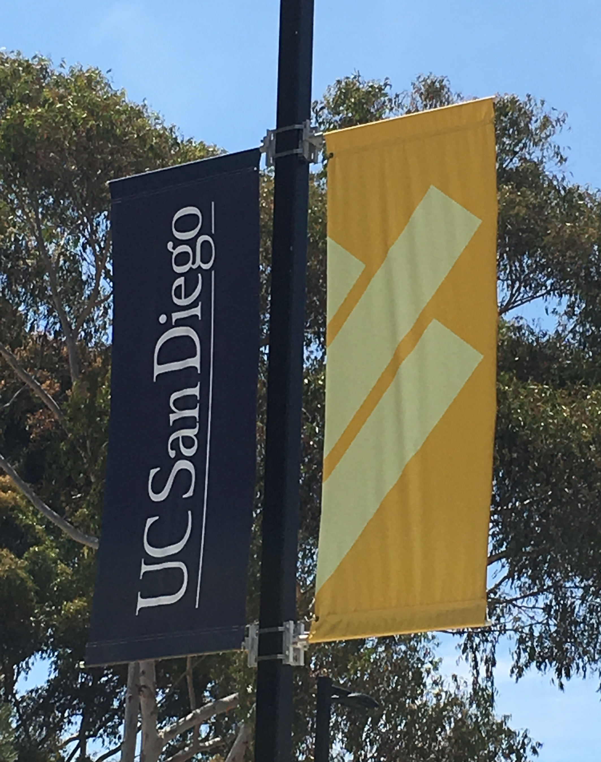
Claire Mizumoto
Director, Research IT Services
About the University of California San Diego:
RI Research Institution
$1.35B in annual research funding
One of the 10 campuses in the University of CA System
~3,000 Faculty and ~1300 Postdocs and ~40k students
A division of the central IT Services, under CIO
As a formal group, Research IT is just 5 years old
We have both Executive IT Governance and Research IT Governance
ACI-REF Virtual Residency 2020 Workshop
June 3, 2020

Slide 9

What We do
Newsflash: We didn’t start in an HPC/HTC Center
Researcher-Facing
not necessarily systems- , services-focused
Consultation Services
Proofs of Concept & Pilot Programs
Sell off small percentages of effort, co-located Researcher-Facing professionals,
Contract and Grant Support
Training, Software Support
Built on the long-tail of research, partnerships with service-providers, fill the gaps in support
Acutely aware of the RCD Ecosystem

Slide 10
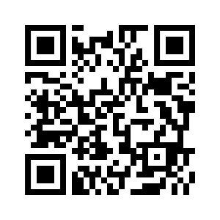
Annamaria Szakonyi
Research Computing Architect
annamaria.szakonyi@health.slu.edu
linkedin.com/in/annamarias
@AMSzakonyi

Slide 11
Research Computing Expert:
IT & Research liaison
Internal consultant and advisor to the research community
Designer of research technologies
“IT Ninja”
Previously: app support & projects
Products and Services:
Research Computing Consulting
HPC
Cloud computing
Strategy advisor
Project implementations
Process improvements
Security & compliance reviews
External partnerships
Report to CISO
PhD Student & Researcher:
Effects of technology (AI, ML) and technology policies on social justice and equity
Application of technology to fight human trafficking and the exploitation of women and children
STEM Education & Advocacy:
CyberAmbassadors Program (MSU, NSF)
Leadership in Women in Tech groups (women & underrepresented groups in STEM)

Slide 12

Scott Valcourt, PhD
Director of Strategic Technology
603-380-2860 (mobile)
sav@unh.edu
Strategic Technology
Notes:
Where the person is in Org
Part of IT consolidation and reorganization – so, this is what was, not what is to come
Report directly to CIO
Focused on future disruptive opportunities (Henry’s intro about RCF)
No operational duties
Partner with researchers across UNH, NH, New England, Northeast, Nationally

Slide 13


Research Computing Professional
XSEDE Campus Champion – Started as a TeraGrid Campus Champion just before the change in 2011
RC Evangelist – “Fake it till you make it” doesn’t work
Project Management isn’t just for Central IT anymore
Strategic Thinking – where do you want to be, when, and what are the steps to get there

Slide 14
Q&A
Strategic Thinking & Visioning
Can you give us some examples of projects that you initiated and how you came up with the vision(s) for those projects?
Google Doc: https://bit.ly/vr2020-strategic
Virtual Residency Workshop 2020

Slide 15
Q&A
Strategic Thinking & Visioning
How do you align your vision for your organization with the vision and direction provided by the VP/VC-Research, CIO, etc.?
Google Doc: https://bit.ly/vr2020-strategic
Virtual Residency Workshop 2020

Slide 16
Q&A
Strategic Thinking & Visioning
Does your strategic planning include input from a Research Governance and/or Advisory Group? If so, how does that affect your plans?
Google Doc: https://bit.ly/vr2020-strategic
Virtual Residency Workshop 2020

Slide 17
Q&A
Strategic Thinking & Visioning
How do you support others (researchers, departments, partners) as an RCF in thinking strategically themselves?
Google Doc: https://bit.ly/vr2020-strategic
Virtual Residency Workshop 2020

Slide 18
Q&A
Strategic Thinking & Visioning
How does your autonomy (or lack thereof) affect your vision and strategic planning?
Google Doc: https://bit.ly/vr2020-strategic
Virtual Residency Workshop 2020

Slide 19
Q&A
Strategic Thinking & Visioning
To what extent does funding/financial backing affect your development of a strategic plan?
Google Doc: https://bit.ly/vr2020-strategic
Virtual Residency Workshop 2020

Slide 20
Q&A
Strategic Thinking & Visioning
What's your vision for your own organization? How did you come up with it?
Google Doc: https://bit.ly/vr2020-strategic
Virtual Residency Workshop 2020

Slide 21
Q&A
Strategic Thinking & Visioning
Can you give us some examples of how you used strategic thinking to resolve an issue or need for your organization and/or your researchers?
Google Doc: https://bit.ly/vr2020-strategic
Virtual Residency Workshop 2020

Slide 22
Q&A
Strategic Thinking & Visioning
How did you learn how to do strategic thinking and visioning?
Google Doc: https://bit.ly/vr2020-strategic
Virtual Residency Workshop 2020

