Slide 1
CI Leadership Panel
Dan Stanzione
Executive Director, Texas Advanced Computing Center
Associate Vice President for Research,
The University of Texas at Austin
June 2020

Slide 2
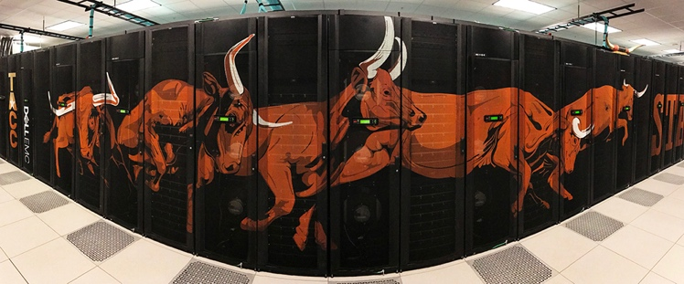
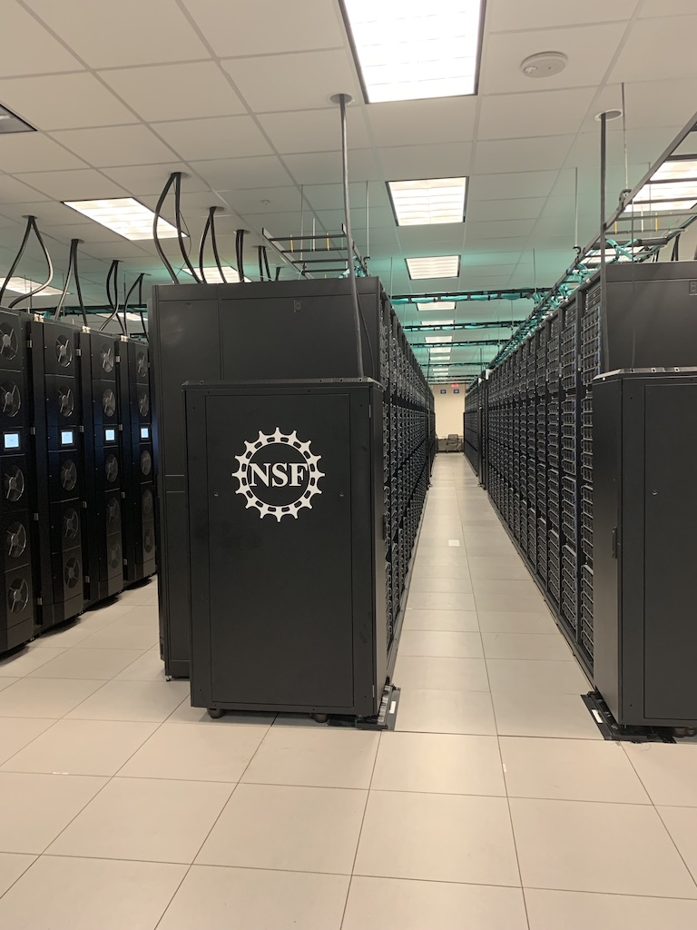
Who am I?
Head of Texas Advanced Computing Center at UT-Austin (~180 full time CI people).
Principle Investigator for LCCF, Frontera, Stampede-2

Slide 3
A bit about my journey here Like a lot of people, becoming a CI Leader was mostly an accident
Undergrad (91), MS(93), EE, Clemson University
Master’s project – designing hardware for cool embedded multi-processor satellite telemetry systems for NASA. I happened to also end up as the one with root on all our Sun workstations.
Got hooked up with original Beowulf project in 1993, at NASA Goddard.
PhD project (CompE) – Problem Solving Environments for Supercomputers, with a particular focus on Electromagnetics.
Somewhere in there, started teaching a bunch of courses in a short-handed ECE department (like 3 per semester).
Won an MRI project for a big set of clusters near the end of my PhD, at Clemson, stayed a few more years as the Pre-CI-CI person for the films and fibers center, genomics institute, and electromagnetics group (at this point I was still the primary sysadmin, though I started hiring).
In what deceptively seemed like a diversion, became an AAAS Science Policy Fellow in 2003 stationed at NSF.
HPC Center head at Arizona State, 2004-2009.
Joined TACC as Deputy Director 2009, became Exec Director 2014.

Slide 4
A couple of notes along the way
The skills for managing and leadership are the skills for managing and leadership, and totally independent of anything you may know about CI.
Good communication is the Most. Important. Skill.
Good communication is not about fancy slides – it’s about understanding what your audience needs to know, and tailoring your response to that (not so much public, as VPR, Faculty, President, Program Officer, etc.).
It helps to know something about CI.
It helps more to actually understand the research context, including not just the science but the process, funding, etc. – what are your user’s constraints?
Understand the role of research computing to a campus/organization as a scientific instrument – you can’t just be another competing cost.
Understand the policy context – lab, university, state, national.
People first. Fixing computers is easy.

