Slide 1
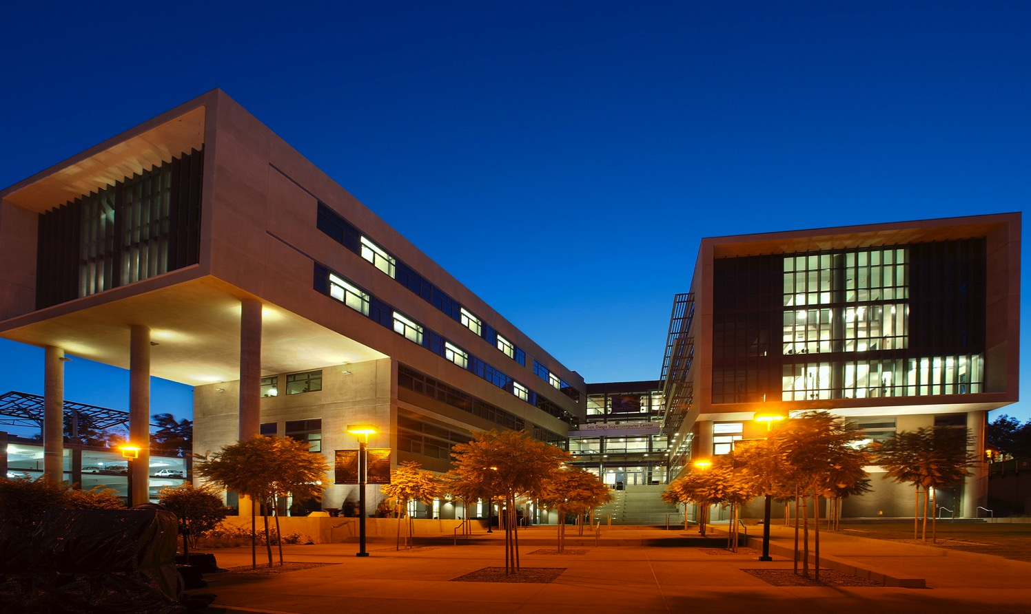
Things I Wish I'd Known Before I Became a CI Leader
Christine Kirkpatrick
June 2020
Notes:
Introduction
UC for 21 years…
Last 5 as division director of IT at SDSC

Slide 2
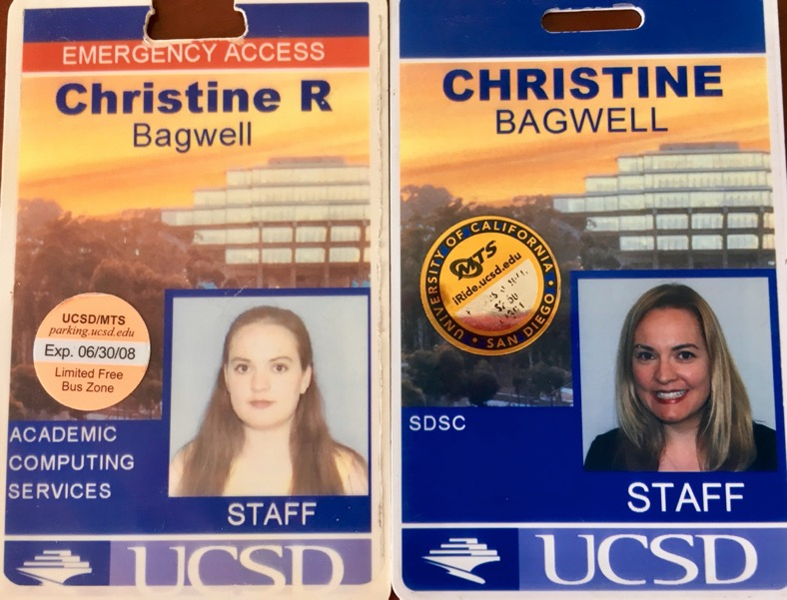
My Background
28 years in computing
University of California
Industry (ChipSoft, Intuit, IVAC, Inform, Dataworks…)
Education
Masters in Architecture-based Enterprise Systems Engineering Leadership
PhD Computer Science (in progress)

Slide 3
How did I get here?

Slide 4
Things I Wish I’d Known…
Still mostly people issues (not technical)
Growth opportunities may be disguised as extra work
Being known helps (fight the wallflower instinct)
Latch on to visionaries, but…
Find your own vision Gaps, pain points, increasing impact ‘Why doesn’t this exist?’
Try to get paid to do work you would (want to) do anyway! (see above)

Slide 5
Do what you can, where you are, with what you have. - Teddy Roosevelt christine@sdsc.edu @SuperChristineK
Christine Kirkpatrick
Division Director, Research Data Services, SDSC

