Slide 1
Virtual Residency Intermediate/Advanced Workshop 2020
Building Community
Amy Latessa, PhD
Research Associate
IT@UC Research Computing Services
University of Cincinnati

Slide 2
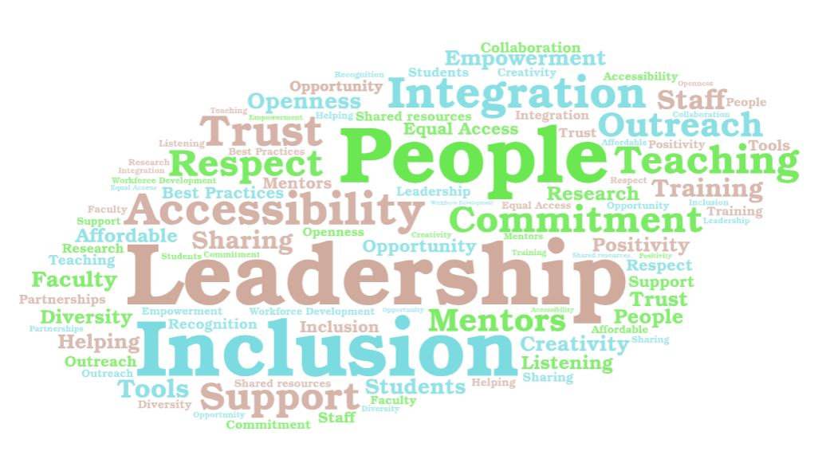
Community Building as a Philosophy

Slide 3
Data and Computational Science Series
DCS2 brings to the University of Cincinnati research and education community innovative workshops and distinguished speakers on advanced research data topics such as HPC, cloud computing, data visualization and analytics, research story-mapping, spatial analysis, artificial intelligence and machine learning.
Lisa Federer, PhD, Data Science and Open Science Librarian at the National Library of Medicine.
If You Share It, Will They Come? Quantifying and Characterizing Reuse of Biomedical Research Data
Creating Customized Data Visualization With Ggplot2 In R
Emad Khazraee, PhD, Data Scientist at Indeed, Fellow at Berkman-Klein Center for Internet and Society, Harvard University Persian Twitter: Evolution of a Social Media Landscape
Research Computing: A View from the Trenches, George Turner, Indiana University Chief Systems Architect, University Information Technology Services (UITS) Research Technologies
GIS Day
Sandra Gesing Introduction to Science Gateways & hands-on workshop
Introduction to Shiny Applications & Workshop
Jetstream Overview - A National Research and Education Cloud; Jetstream Atmosphere; Jetstream Gateway API
Introduction to Screen Scraping using R
Inter-university Consortium for Political and Social Research (ICPSR) Summer Institute Webinar
XSEDE monthly HPC workshops
Data Management BINGO
Ohio Supercomputer Center (OSC) Workshops
  OSC Hands-on Workshop
  Using Parallel R at OSC
  OnDemand workshop
UC Data Day
Eleanor Dickson Koehl, Text Mining Hathi Trust Resources Using Python
Rob Sisneros, National Center for Supercomputing Applications (NCSA) Scientific Visualization Using Visit
Mine Cetinkaya-Rundel, R Studio
Engagement and Performance Operations Center (EPOC) UC Research Case Study Deep Dive
DCS2 Social at Kingsgate Bearcat Lounge

Slide 4
Community Groups and Forums
Faculty Advisory Board
UC Faculty Enrichment Center
Data & Computational Science Series
Workshops
Lunch & Learn
Socials
Consultation Hours
Research Technical Advisory Group (R-TAG)
ARC Listserv
UC Intranet
UC Libraries
UC Digital Scholarship Center
Institute for Interdisciplinary Sciences
XSEDE resources
Ohio Supercomputer Center
IT Research & Development Governance Committee
UC Office of Research
NSF
SciNet
Internet2
Educause
CaRCC
Pearc
SC
OSG
Indiana University Pervasive Technology Institute

Slide 5

Thank You

