Slide 1
PresQT
Community Building
Sandra Gesing
sandra.gesing@nd.edu
Virtual Residency
Intermediate/Advanced Workshop 2020
University of Oklahoma
June 3, 2020

Slide 2
Four Examples – Overlap in Communities
NSF Institutes
PresQT
IMLS Project
Open-Source Development
Community-Driven Association

Slide 3
Four Examples – Overlap in Communities
NSF Institutes
It almost looks like the Olympic Rings...
PresQT
IMLS Project
Open-Source Development
Community-Driven Association

Slide 4
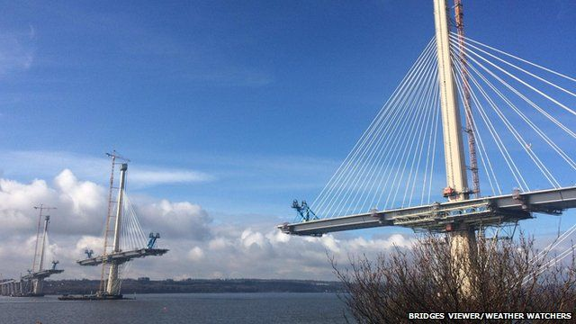
Four Examples – Overlap in Communities

Slide 5
Why is community building important?
Exchanging knowledge and experience
Connecting research computing, software, science and people
Scalability of support
Avoiding re-inventing the wheel
Avoiding silos
personnel
products

Slide 6
Connect with SGCI
Website https://sciencegateways.org
Focus Week
Consulting
Yearly Conference
Partner program
Software/Gateway Catalog
Workforce development
Gateway Ambassadors
Science Ambassadors
Webinars
Blogs
Newsletter
Twitter
LinkedIn
YouTube
Scalability

Slide 7
How to Connect with URSSI
Website http://urssi.us/
Materials
Blog posts
Mailing list
Discuss
Twitter
Workshops
Newsletter
Slack
Defining areas of interests for filling gaps

Slide 8
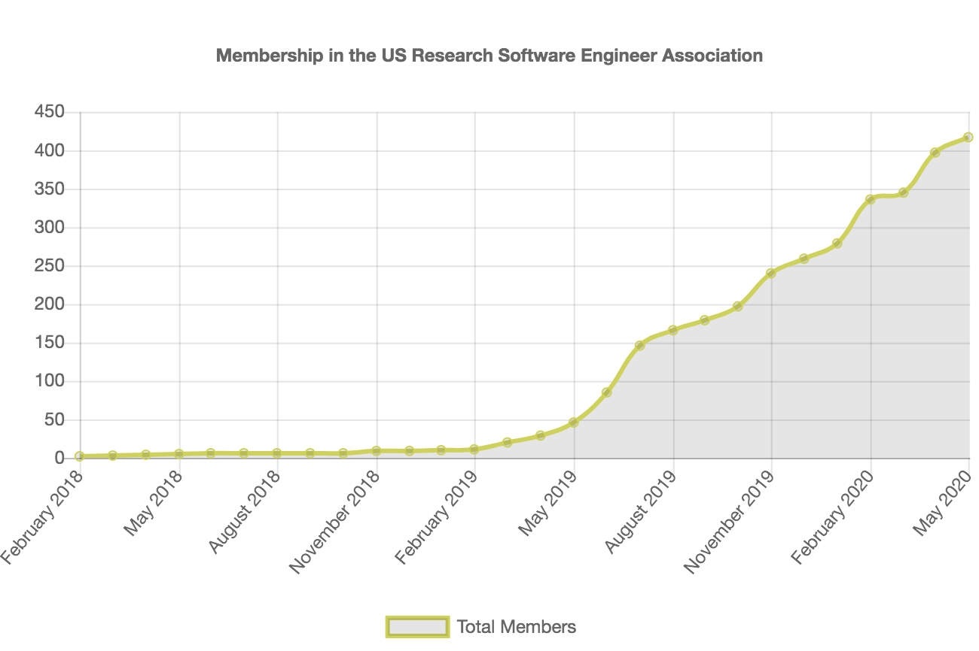
How to Connect with US-RSE
Website http://us-rse.org/
Slack
Twitter
Newsletters
Community calls
Workshops
Community-driven community building

Slide 9
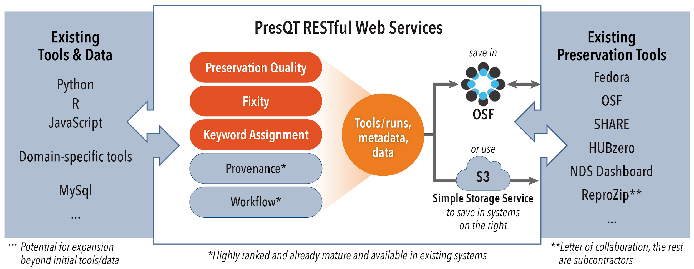
How to Connect with PresQT
Website https://presqt.crc.nd.edu/
Slack
Community calls
Workshops/ hack-a-thons
Open-source development
Progress in integrations

Slide 10
Thanks
Questions?
sandra.gesing@nd.edu

