Slide 1
The 5 step plan for building a community
Sarvani Chadalapaka HPC Manager University of California Merced
schadalapaka@ucmerced.edu

Slide 2
THANK YOU ALL FOR BEING HERE!!

Slide 3
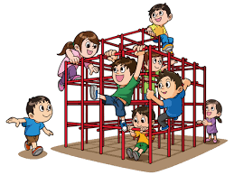
Why build a community?
Career is a jungle gym

Slide 4
Research Computing Communities
Notes:
These communities are in place to solve a problem/an umbrella of problems for a diverse group of people that have similar research computing interests.

Slide 5
How to build a community?
Identify barrier(s)
Leverage existing work in the space
Have a plan
Execute
Receive feedback
(Repeat)

Slide 6
Women in HPC Mentoring Program: womeninhpc.org/mentoring

