Slide 1
Explaining Complex Technical Topics to Researchers
Jacob Fosso Tande, Ph.D
Research Computing Administrator
University of North Carolina at Greensboro
Virtual Residency Workshop 2020

Slide 2
What it Takes
Complex Topic and Researcher is an interesting mixture.
Subtlety is required.
Humility is a force
Knowing your interlocutor is an impetus
Preparedness is your key.
Your choice of words makes the difference

Slide 3
Explaining should not be ...
Image courtesy https://www.jarkkorantanen.com/four-steps-to-get-forward-when-youre-stuck-in-a-conversation/

Slide 4
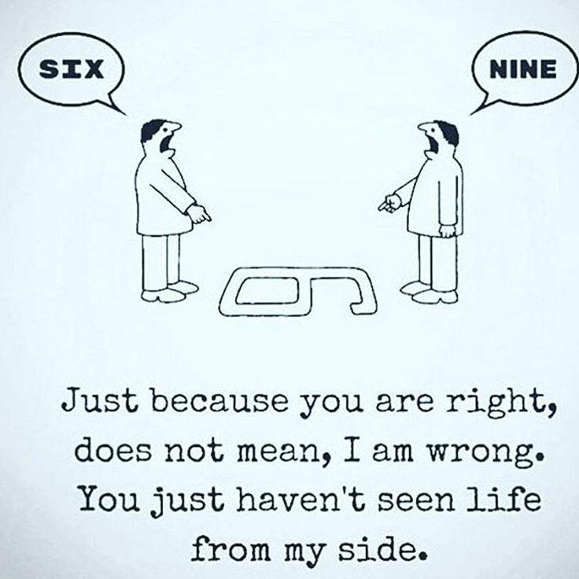
Explaining should not be ...
Image courtesy https://www.jarkkorantanen.com/four-steps-to-get-forward-when-youre-stuck-in-a-conversation/

Slide 5
Painting the Picture
Accurate picture as much as possible relying on Commonality.
Operators: Theory Versus Experiment
Basis Sets: Chemist Versus Physicist
Secure Computing Environment:
Concept Versus Reality
Shield vs vault

Slide 6
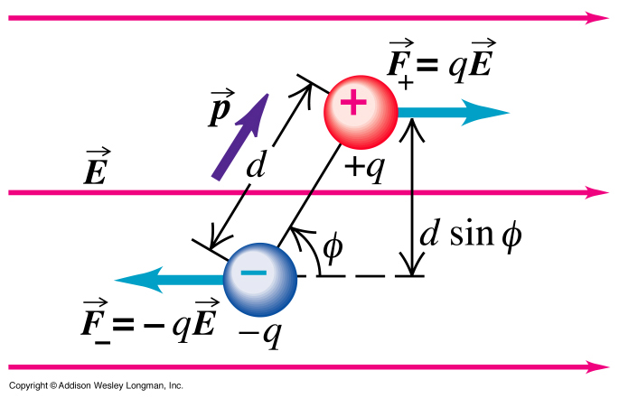
Hard-Coded Misconceptions

Slide 7
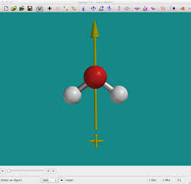
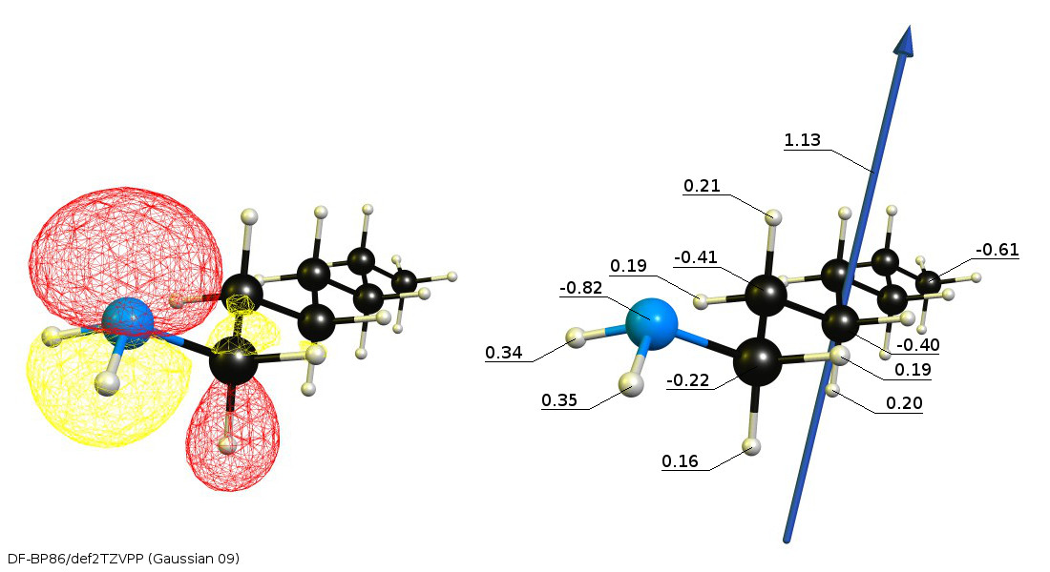
Hard-Coded Misconceptions
GaussView
Spartan

Slide 8
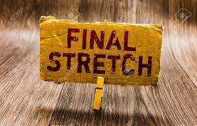
Ending the Encounter
Express appreciation for the discussion.
Be forthcoming about your shortcomings.
Note Questions you couldn’t answer.
Follow up with clarifications or with additional information

