Slide 1
Academic Life:
Tenure, Promotion, & More
or
Congratulations, you’ve just won the Lottery!

Slide 2
Know your Audience

Slide 3
Academic Vocabulary Test
Assistant Prof
Associate Prof
Professor
Chair
Dean
Director
Endowed Prof
Endowed Chair
Emeritus Prof
Grad Assistant
Instructor
President
Chancellor
Provost
Renewable Term Prof
Adjunct Prof
Research Prof
Vice President

Slide 4
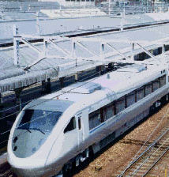
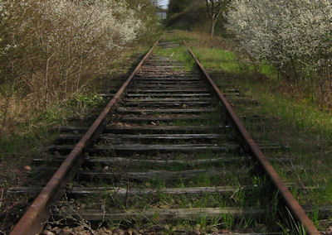
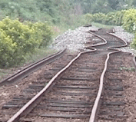
The “Tenure Track”

Slide 5
Tenure & Academic Freedom
Tenure … is a means to assure unfettered, unbiased, unencumbered search, verification, and communication of truth by professional scholars and teachers. Tenure is designed to provide faculty members with freedom from political, doctrinaire, and other pressures, restraints, and reprisals which would otherwise inhibit the independent thought and actions in their professional responsibility of search, verification, and communication of truth.
OU Faculty Handbook

Slide 6
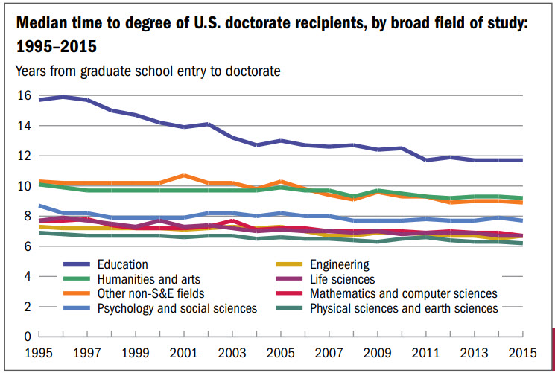
Academic Time-Line
Prof
– Year ?
Associate Prof
– Year 17
Assistant Prof
– Year 10
Finish PhD
– Year 6
Graduate School – Year 0
NSF, Survey of Earned Doctorates, 2017

Slide 7
The Tenure Decision
New Assistant Professor
(External) Reviews
Six Years of
Academic Productivity
Write Life Story
Departmental Vote
Campus Tenure Committee
Dean/College
Provost
President/Regents

Slide 8
Academic Productivity
Papers
Money
Books
Papers
Money
Collaborations
Talks
Papers
Money

Slide 9
Tenure Evaluation
Official
Reality
Research
Teaching
Service
50%
33%
17%

Slide 10
Research Focus
Measurement of the t-tbar production cross section and top quark mass extraction using dilepton events in ppbar collisions
To Swear Like a Sailor: Language, Culture, and Meaning in the American Maritime World, 1750 – 1850
Elimination of threading dislocations in as-grown PbSe film on patterned Si(111) substrate using molecular beam epitaxy

Slide 11
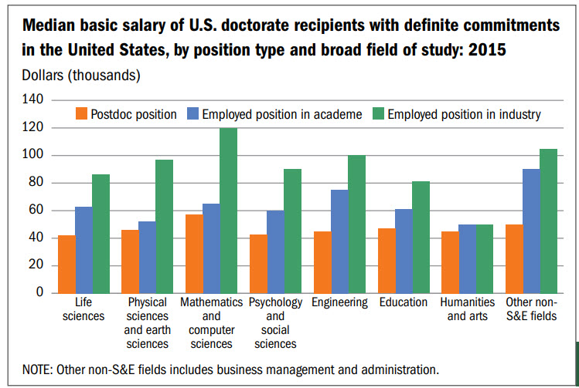
No Tenure, You Leave
Why???
NSF, Survey of Earned Doctorates, 2017

Slide 12
After Tenure 1: Promotion
Assistant Professor
Proven, Established, International Recognition
Associate Professor
Full Professor
Almost always with the Tenure Decision

Slide 13
Post-Tenure Academic Productivity
Papers
Money
Books
International Talks
Conference Committees
Collaborations
Disciplinary Service
Public/Professional Service
Leadership
Instruction & Outreach

Slide 14
After Tenure 2: “PTR”
5 Year Self Evaluation
Annual Evaluations
Departmental Evaluation
Prof. Dev. Plan
Dean & Provost
Okay for Next 5 Years

Slide 15
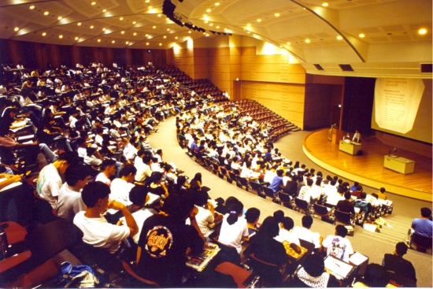
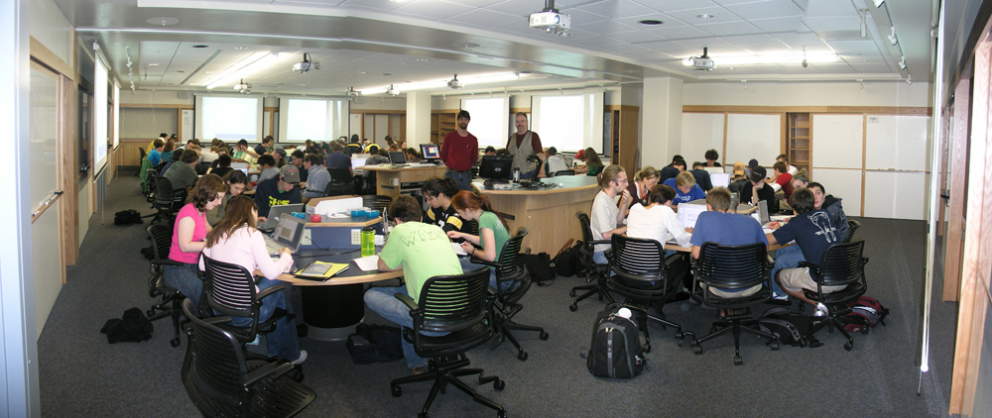
Teaching?

Slide 16
Abrogation of Tenure
Incompetence or Dishonesty
Substantial Failure to Fulfill Duties
Personal Behavior
Failure to Adhere to University Policies
Violations of the Law
Elimination of Academic Unit
Financial Emergency
About 2% of Tenured Faculty dismissed each year nationally. (NEA)

Slide 17
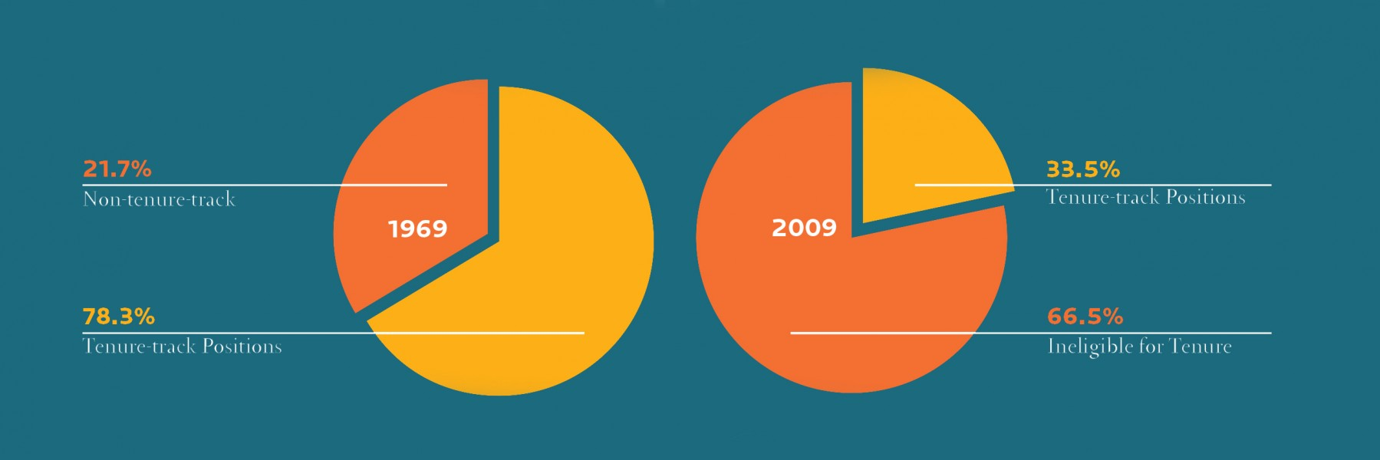
Direction of Tenure
“Trusteeship Magazine”,
May/June 2013

Slide 18
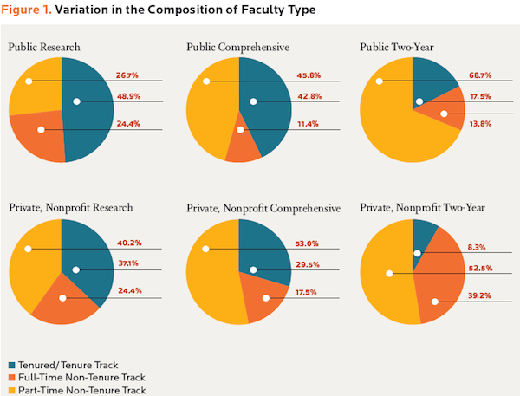
Tenure Details (2009)
“Trusteeship Magazine”,
May/June 2013

Slide 19
Academics – Who is Important?
Assistant Prof
Associate Prof
Professor
Chair
Dean
Director
Endowed Prof
Endowed Chair
Emeritus Prof
Grad Assistant
Instructor
President
Chancellor
Provost
Renewable Term Prof
Adjunct Prof
Research Prof
Vice President

