Slide 1
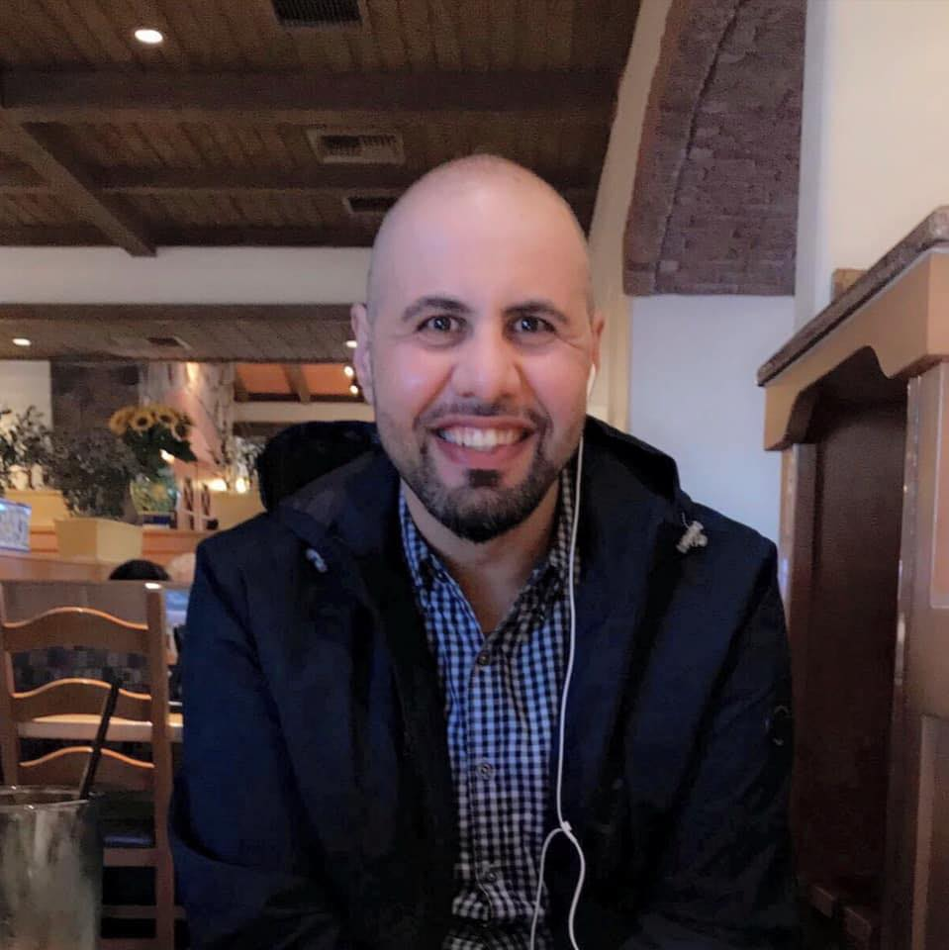
HELLO!
My name is Mohammed Tanash
I am here because I am going to present at the ACI-REF.
You can contact me at tanash@ksu.edu

Slide 2
Cyberinfrastructure (CI) User
Support
Mohammed Tanash
Ph.D Student
Kansas State University

Slide 3
“I do not fear computers. I fear lack of them.”
— Isaac Asimov

Slide 4




Who am I
BSC in Computer Science (2005), MSC in Information Technology (2008), MSC in Computer Science (2014).
Ph.D. Student at Kansas State University
Research Area: High Performance Computing (Improving the Performance of the Slurm Workload Manager)
Instructor (2008 – 2012), TA & RA
A Cyberinfrastructure team member at New Mexico State University (Jan 2017 – Jan 2019)
Role: Cyberinfrastructure User Support
XSEDE Student Campus Champion (2017 – Current) & XSEDE Fellow (2018 – 2019)

Slide 5
Agenda Layout
CI user expectations, categorization and commonalities
Policies, Politics, Conflicts and Personality Management
Outreach and Education
some Results
Lessons learned
These slides are based on material from Mehmet (Memo) Belgin (GA Tech), modified by Henry Neeman (OU), Andrew Sherman (Yale), Dirk Colbry (MSU), and are used with permission. Numerous edits have been made.

Slide 6
Agenda Layout
CI user expectations, Categorization and Commonalities
Policies, Scheduled Maintenance, and Personality Management
Outreach and Education
Some Results
Lessons Learned

Slide 7
What is CI
Computing systems
Technology
Linked
Data storage systems
Advanced instruments data repositories
Software & High Performance Networks
Visualization environments
Linked
People
Managed
Managed
People
Purpose
Goal
Improve research & scholarly productivity
Effect
Enable knowledge breakthroughs and discoveries not otherwise possible
Enabling derivation of novel scientific theories.
Stewart, C.A. 2010. What is Cyberinfrastructure? Presentation. ACM SIGUCCS 2010 Annual Meeting, 24-27 October, Norfolk, VA. http://hdl.handle.net/2022/13987
Notes:
Cyberinfrastructure consists of computing systems, data storage systems, advanced instruments and data repositories, visualization environments, and people, all linked together by software and high performance networks to improve research productivity and enable breakthroughs not otherwise possible.
Three discrete elements
Technology
People
Effect

Slide 8
What is CI User Support
Key Element
Computing systems
Technology
Linked
Data storage systems
Advanced instruments data repositories
Software & High Performance Networks
Visualization environments
Linked
People
Managed
Managed
People
Purpose
Goal
Improve research & scholarly productivity
Effect
Enable knowledge breakthroughs and discoveries not otherwise possible
Enabling derivation of novel scientific theories and knowledge.
Stewart, C.A. 2010. What is Cyberinfrastructure? Presentation. ACM SIGUCCS 2010 Annual Meeting, 24-27 October, Norfolk, VA. http://hdl.handle.net/2022/13987
Notes:
Cyberinfrastructure consists of computing systems, data storage systems, advanced instruments and data repositories, visualization environments, and people, all linked together by software and high performance networks to improve research productivity and enable breakthroughs not otherwise possible.
Three discrete elements
Technology
People
Effect

Slide 9



What is CI User Support

Slide 10


Successful User Support
CI User Support Equation:
Help & Support Users
Solve Problems
Successful User Support
Build Relationships

Slide 11
Differences between CI and conventional IT
Primary target is Application performance
Usually relies on conventional IT services (by a separate team)
More focus on supporting end-users than services
Uses common IT technologies in uncommon ways
Uses common IT technologies in uncommon ways
May mix shared and dedicated resources in one entity
Requires specific middleware and software layers
Requires code compilations using complicated mechanisms
May require specific knowledge about the application/science
Has irregular usage patterns, which may become obvious and troubling to users

Slide 12



CI Hardware Resources
Local/Internal Resources
Your Own or Departmental Resources (Usually low capabilities)
Your Institutional Resources ( Low to high Capabilities (depends))
External Resources
NSF (XSEDE Resources, Blue Waters) ( High Capabilities)
DOE ( High Capabilities)
…… Others
Commercial Resources (cloud computing)
Amazon
Azure
Liquid Web
……Many Others

Slide 13
Why CI Resources?
Computations takes too long to run (Days, months, maybe more)
Needs more CPU's
Computation runs out of memory
Needs more RAM's
Need licensed software
Need advanced interface (visualization/database)
Need more storage

Slide 14
Who are CI users?
Institutional Administrators
Faculty (Principal Investigators) Faculty (a.k.a PI) (owner of research and maybe of resources, but not active users):
Users (Students, Post-Docs, Collaborators, computationally active PIs)

Slide 15
Institution Administration Roles
Funder and Supporter
Does not use the HPC
Doesn't know how to use the HPC

Slide 16
Institution Administration Expectation
Enables more science (i.e., more journal papers)
Brings in funding (i.e., more grants) to the institution
Low cost to Institution (i.e. wants total cost recovery)
Brings prestige to university (i.e. dog and pony show)

Slide 17
Faculty Rules
Researcher, entrepreneur, teacher
Manager and funder of CI users
Often knowledgeable about CI
Often does not use CI directly (that pleasure is reserved for students & postdocs!)
May own or pay for resources and services (but shared resources may be free at some institutions)

Slide 18
Faculty Expectations
CI resources are reliably up and running on 7x24 basis
Students and collaborators have fair (?) access to CI resources needed to meet deadlines and get the work done (on time).
Assistance available as and when needed
Maximum availability of resources
Minimum communication with CI support staff
Regular usage and expense reports (especially for storage)

Slide 19
Actual CI User Roles
Some “hands on” faculty
Usually students, postdocs, or others who are not permanent
Permanent research staff or research faculty
External collaborators

Slide 20
Actual CI User Expectations
24x7 access to CI resources (and short job wait times, of course)
“Insider” relationship to CI staff for advanced users
Ultra-fast learning curve
Simple and instant solutions to complex problems
Applications, computation, and simulation run much faster than on desktops (not always possible!)
Help diagnosing/fixing problems that may be externally controlled
Answers that match their level of knowledge

Slide 21



CI Users Categories
Novice
Intermediate
Advanced
Difficult to identify a user's category without prior interaction
The language used in requests is a good indicator
Replies to follow-up questions also decide their level of proficiency
In case of uncertainty, assume “novice”

Slide 22
Novice Users
Common Points
Characteristics
Little experience with Linux or command-line environments
May use Matlab, Mathematica, and sometimes R (or even Excel)
May have limited knowledge of a scripting language like Python
Rarely any inkling about parallelism

Slide 23
Novice Users
Common Points
Generate the most of support requests. Common examples:
  Desktop setup (especially for Linux)
  Login procedures (ssh keys, two-factor authentication, etc.)
  Finding software on the cluster(s)
  Finding help and documentation
Most requests are straightforward, but some “simple-sounding” ones may take a lot of work (or be impossible)

Slide 24
Novice Users
Common Points Cont.
  Get’s better and better over time
No/little Linux skills
No/little experience with running the domain specific packages
  No/little understanding of the scientific fundamentals behind the packages
  Mostly identical or similar requests with straightforward solutions
  Usually not aware of the standard help channels
  May feel insecure or apologetic when seeking for help

Slide 25
Novice Users
Common Needs
  Get’s better and better over the time
  Cluster orientation and structure
Linux basic commands (Introduction to Linux)
  E-mail list
  Text editors (nano, vi, vim, emacs, etc.)
  Load/unload modules
  Request software installation
  Help with tools to move data in/out
  Help with the job submission script (specify # of nodes, CPUs, time, etc.)

Slide 26
Novice Users
Common approaches for effective support
  BE PATIENT and
  PATIENT!
  BE FRIENDLY!
  MORE TRAINING and
  WORKSHOPS!
  Do everything to build mutual trust
Provide regular orientations and help opportunities.
  Maintain up-to-date web documentation
  Smile ☺
  Provide links to existing help locations
  Suggest proper web search terms (How to google)
  Make them feel better about their simple (or sometimes stupid) questions
  Explain all the steps for resolution in simple, replicable terms
  Prefer exact list of commands to general/conceptual answers

Slide 27
Intermediate Users
Intermediate
Characteristics
  Have prior Linux cluster experience; can create job scripts, but may not understand system-wide impact of their actions
  Varying degrees of proficiency in Python, C, Fortran, R, etc.
  Use workflows involving multiple domain-specific packages
  Often notice and report HW or system problems
  May use web search to try to overcome difficulties

Slide 28
Intermediate Users
Common Points
Generate less than half of support requests.
Largest portion of the compute activity on the cluster
Experience with Linux, and clusters in the same or other institutions
First to notice and report system problems
Hybrid mix of straightforward and complex questions
Aware of the standard help channels
Suggest solutions to their own problems and may not like what you did
Act as the local technical expert and often train novice users in their group

Slide 29
Intermediate Users
Common Needs
SOMETIMES NOT POSSIBLE OR MAYBE THERE IS SOME CONSTRAINTS!
Advanced (and group-specific) information sessions
Well-explained effective solutions
More performance/efficiency from already running codes
Specific modules/patches/versions for existing software
Higher level of control on their jobs (e.g. higher queue priority)
Access to specialized computational resources
Configurations that may conflict with system defaults
Code development/debugging/profiling support

Slide 30
Intermediate Users
Common approaches for effective support
  BE PATIENT and
  PATIENT!
  BE FRIENDLY!
Do everything to build mutual trust
Hold advanced classes to “teach how to fish.”
  Smile ☺
Schedule one-on-one meetings
Add exceptional/advanced cases to existing help pages
Present solid data/evidence instead of speculation
Show complete transparency: they can separate excuses from facts
Get help from vendor support and user forums, keeping users CC'ed

Slide 31

Advanced Users
Advanced
Characteristics
  May be hands-on faculty, research staff, or advanced students
  Experience with and access to multiple clusters (including XSEDE, etc.)
  Technically proficient in scripting or programming languages
  Develop and/or use parallel applications
  Develop complex workflows and job scripts
  Always trying new things; willing to experiment with new software

Slide 32

Advanced Users
Common Points
Generate a small fraction of support requests
  Installation of complex software & tools
  Open to experimentation with new systems and software
  Too busy or advanced to act as the local expert for their group
  Help with special hardware (e.g., GPUs, FPGAs)
  Bugs found in hardware, 3rd party applications, or libraries
Try to fix problems themselves, and see CI support as a last resort
Inclination for bypassing the ticket system

Slide 33
Advanced Users
Common Needs
VIP treatment
  Direct and open communication channels
  Acknowledgement of their level of knowledge and intelligence
  High-level and direct vendor/developer support
  Lots of exceptions, even though they require violation of existing policies
  Almost everything else listed under “common intermediate users needs”
Root password (the answer is still NO!)

Slide 34
Advanced Users
Common approaches for effective support
  BE PATIENT and
  PATIENT!
  BE FRIENDLY!
Do everything to build mutual trust
  Schedule one-on-one meetings
  Try to learn more about their research, deadlines and aspirations
  Smile ☺
  Be very careful saying that something is impossible
  Make small exceptions as long as it does not impact other users
  Avoid speculation as much as possible (as with all users)
Be completely transparent: they can easily separate excuses from facts
Encourage them to contact vendor support or user forums

Slide 35
Agenda Layout
CI user expectations, Categorization and Commonalities
Policies, Scheduled Maintenance, and Personality Management
Outreach and Education
Some Results
Lessons Learned

Slide 36
Policies
Clear policies help keep user demands under control
Publish policies in places easy to find (online)
  Be prepared to explain the reasoning behind each policy item
  Make policies as strict as possible, be open to exceptions when necessary
  Encourage users to openly discuss and criticize the policies
  Don’t hesitate updating policies frequently to stay relevant
  Build trust and effective communication with decision makers
  Seek delegation privileges to speed things up
Don’t make policies for resources you don’t own, but influence them

Slide 37
Scheduled Maintenance
Set regular schedule, with multiple advance announcements
Provide a report after maintenance
  Prepare for potential problems during/after maintenance days
  Show best effort for minimal impact
  Configure the scheduler to have no running jobs
  Disable user access to resources during the maintenance activities
  Assist users in moving work to alternative clusters when possible
  Test, Test, and do more Testing before turn back the resources

Slide 38
Personality Management
Some users are difficult than others; why they behave that way is irrelevant
Do not take anything personally; report any harassment you may receive and do not retaliate
  In most cases users do not mean bad, but they are extremely frustrated
  If you make a mistake, take responsibility and offer an apology
  Acknowledge that:
  You understand the problem
  You are aware of its particular impact on the user
Be aware of, and show tolerance for cultural differences and language difficulties
Humor is powerful only when used appropriately, avoid being awkward or insulting
Communicate frequently while working on any issue

Slide 39
CI Users Support
  HELPING
  VS
  DOING THEIR WORK

Slide 40
Agenda Layout
CI user expectations, Categorization and Commonalities
Policies, Scheduled Maintenance, and Personality Management
Outreach and Education
Some Results
Lessons Learned

Slide 41




Outreach
Spread email frequently (e.g. monthly bases)
Advertisement brochures
  Digital signage
  Events announcements
  Orientations announcements

Slide 42
Education
Training and Tutorials
Online Courses
  Workshops
Introduction to Super Computing
Onboarding Training
Introduction to Linux
Intermediate Linux
Customized Classes
How to Write Scripts
  Parallel Programming
Introduction to Python
  System architecture
webinars
Online videos

Slide 43
Deal With Users Issues
Emails
Ticket systems
Office hours
Onsite visit
Personalized Meeting
  One-to-one Meetings
  Group meetings

Slide 44
Skills Needed
Technical Skills
  Advanced Linux
  Advance HPC knowledge
  Parallel programming
  Script programming
  Interested in new technologies (FPGA, GPUs, etc.)
  ??
Personal Skills
  Responsible
  Communication skills
  Sense of humor
  ??

Slide 45





CI User Support Process
Oh God, I have a deadline soon and my experiments need long time to get done!
I would like to learn how to use HPC!
I have problems with my parallel code and scripts!
advertisement brochures
digital signage
events announcements
Workshops
Onboarding-training
Personalized meetings

Slide 46
Agenda Layout
CI user expectations, Categorization and Commonalities
Policies, Scheduled Maintenance, and Personality Management
Outreach and Education
Some Results
Lessons Learned

Slide 47
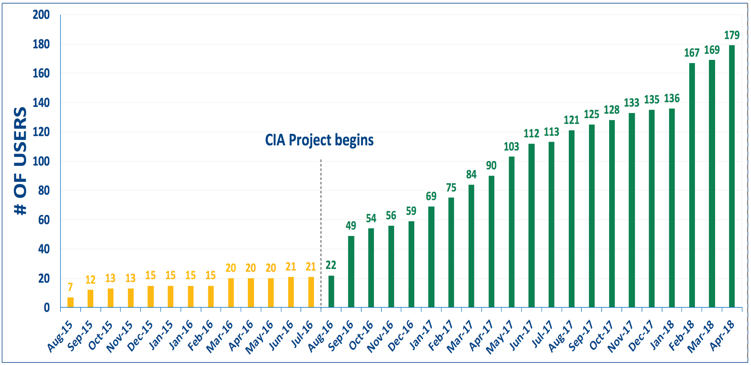
Some Results (NMSU)

Slide 48
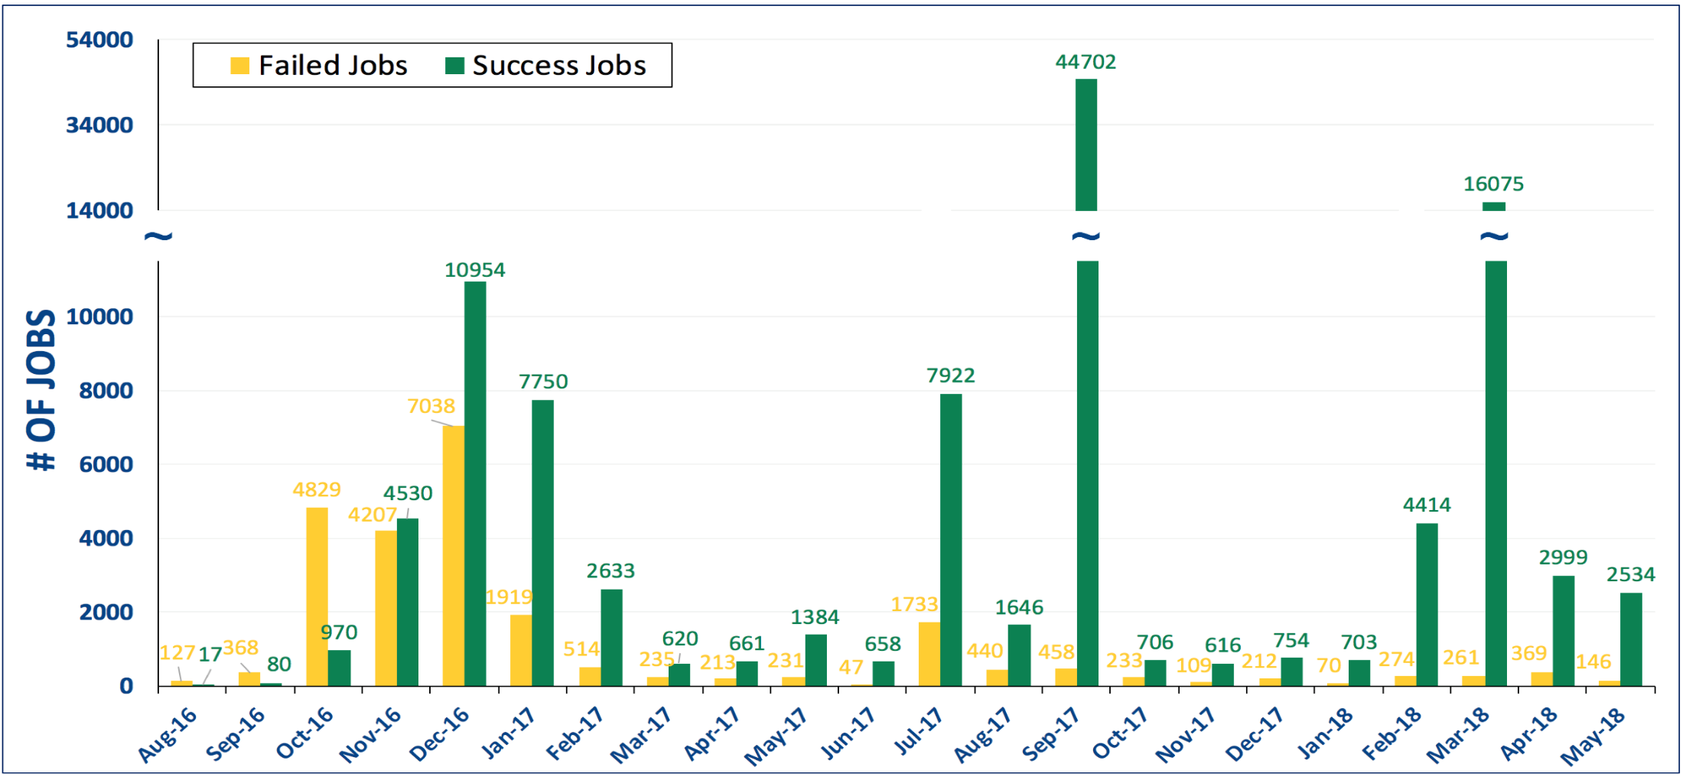
Some Results (NMSU)

Slide 49
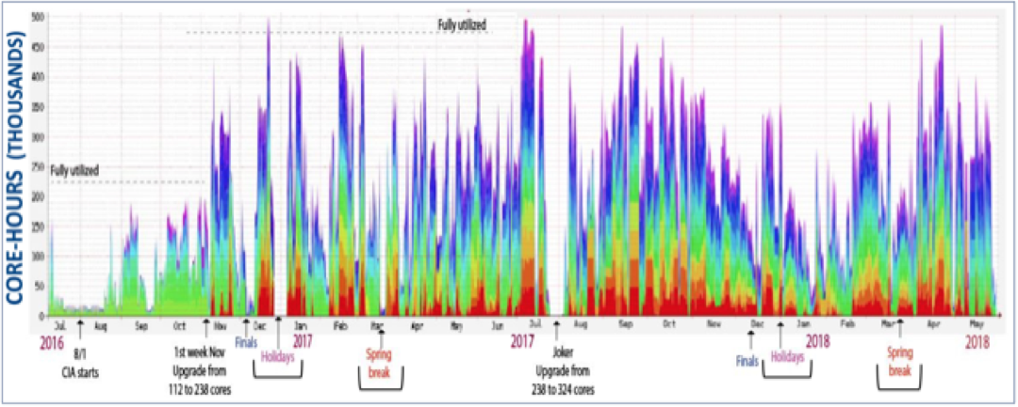
Some Results (NMSU)

Slide 50
Agenda Layout
CI user expectations, Categorization and Commonalities
Policies, Scheduled Maintenance, and Personality Management
Outreach and Education
Some Results
Lessons Learned

Slide 51
“Imagination is more important than knowledge. For knowledge is limited, whereas imagination embraces the entire world, stimulating progress, giving birth to evolution.”
— Albert Einstein

Slide 52
Thank you!

