Slide 1








The CI Milieu: Organizations
SGCI, URSSI, WSSSPE, UK RSE, US RSE
Sandra Gesing
sandra.gesing@nd.edu
Virtual Residency Summer Workshop on
Intermediate Research Computing Facilitation
University of Oklahoma
June 6, 2019

Slide 2
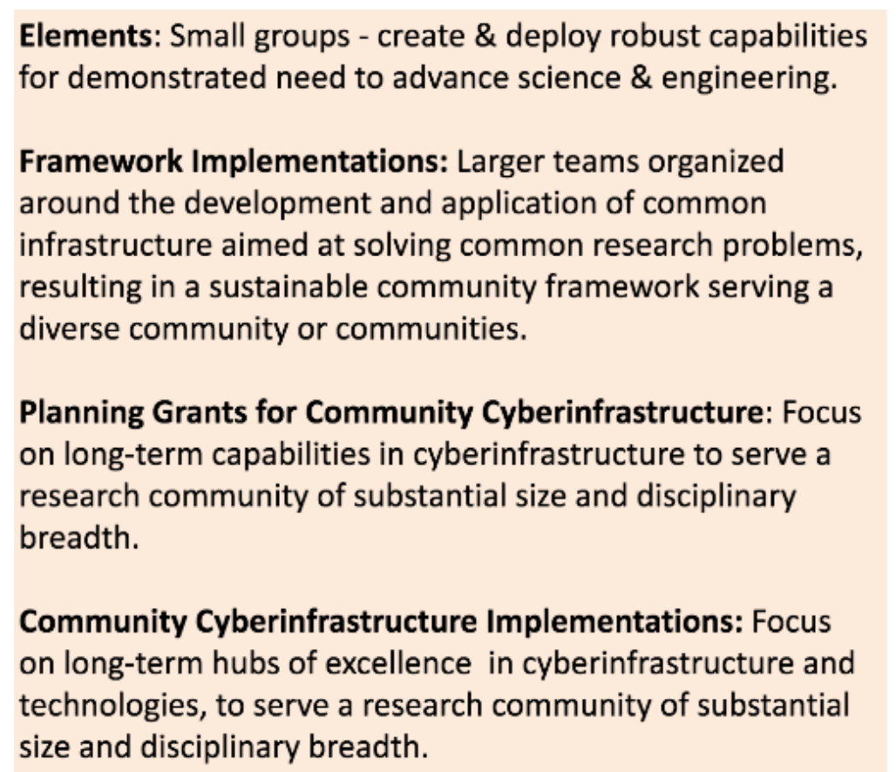
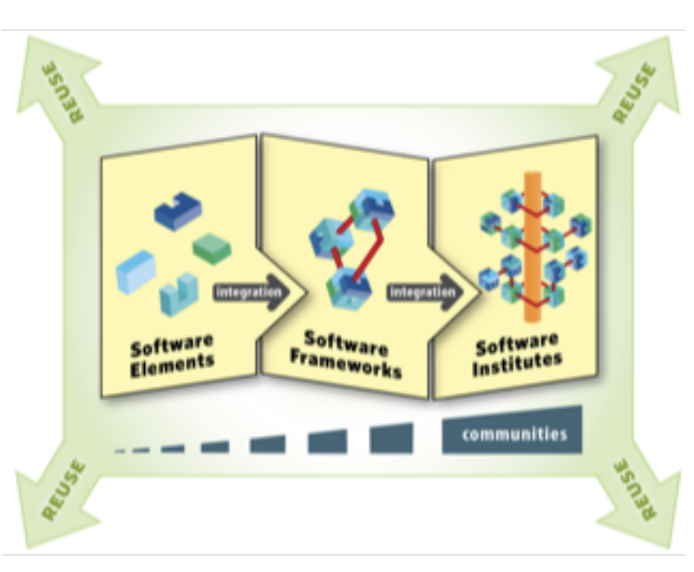
Sustainability for Cyberinfrastructure - NSF
SI2
Software Infrastructure for
Sustained innovation
CSSI
Cyberinfrastructure for Sustained
Scientific Innovation

Slide 3

Sustainability for Cyberinfrastructure - NSF
Sustainability Institutes and Excellence Hubs are funded to support the CI and research community
Support via implemented institutes is free for you!
Your chance to influence conceptualizations!
Implementations
Science Gateways Community Institute (SGCI)
The Molecular Sciences Software Institute (MolSSI)
Institute for Research and Innovation in Software for High Energy Physics (IRIS-HEP)
Conceptualizations
US Research Software Sustainability Institute (URSSI)
Geospatial
…

Slide 4

State of the Art in Research
Increased complexity of
research questions
hardware
software
instruments
data volume
data formats
The need for end-to-end solutions for accessing data, software, computing services, and equipment specific to the needs of a science or engineering discipline

Slide 5

Science Gateways
Increased complexity of
research questions
hardware
software
instruments
data volume
data formats
The need for end-to-end solutions (not only GUIs!!!) for accessing data, software, computing services, and equipment specific to the needs of a science or engineering discipline
Science Gateways!

Slide 6
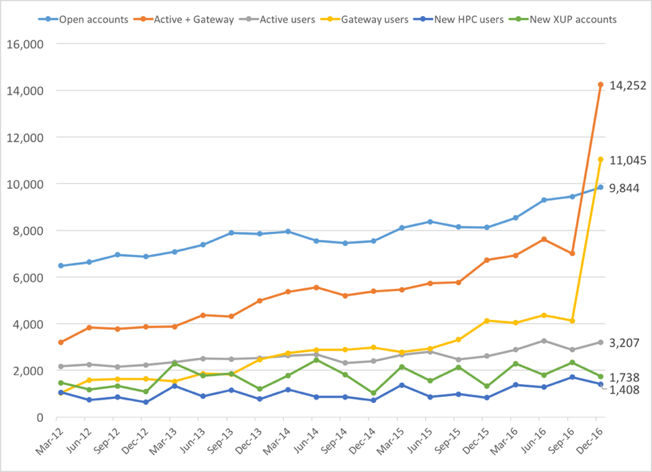
Science Gateways
Gateway users are 77% of active XSEDE users in Q4 2016
All users
Gateways
Login
XSEDE users
This is largely due to the CIPRES and I-TASSER gateways, but others are gaining

Slide 7
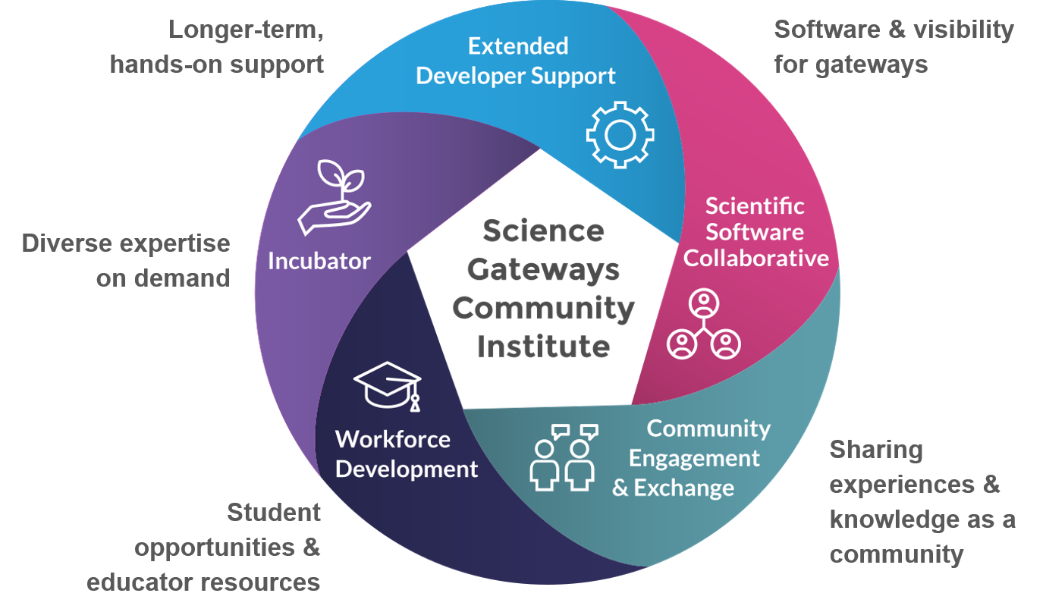
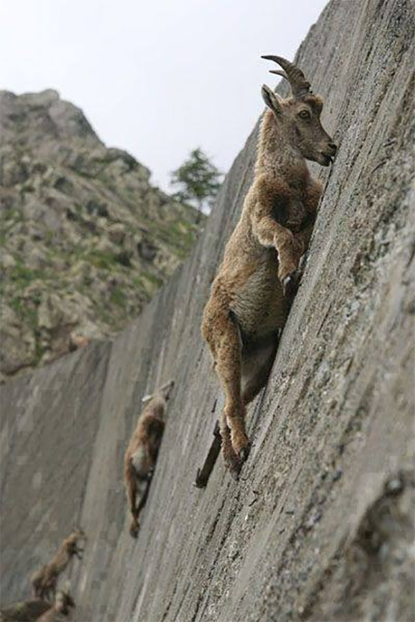
Science Gateways Community Institute
Incubator
  Get advice (sustainability, usability, cybersecurity, other) on your existing gateway
Extended Developer Support
  Work with SGCI to build a gateway for you – up to 1 year developer time
Scientific Software Collaborative
  Find a working gateway or gateway development software in our catalog
Community Engagement and Exchage
  webinar series, gateways in the news, google scholar feed, case studies, annual conference, blog posts
Workforce Development
  Enroll a student in an internship program to learn gateway development
Launch of a new SGCI program at PEARC19!
Gateway Ambassadors
  Community building
  Building of gateway groups at institutions and in consortia
Collaborations Make Challenges
Less
Steep
http://sciencegateways.org

Slide 8
Connect with SGCI
Incubator Sustainability Bootcamp
  https://sciencegateways.org/engage/bootcamp
Work with us
  https://sciencegateways.org/consulting/work-with-us
Yearly Conference
  https://sciencegateways.org/engage/annual-conference
Become involved as a partner or affiliate
  https://sciencegateways.org/about/partners
Software/Gateway Catalog
  https://catalog.sciencegateways.org/
Train students in internships
  https://sciencegateways.org/engage/student-focused
Gateway Ambassadors
  https://sciencegateways.org/engage/gateway-ambassadors
Webinars, blogs, newsletter, Twitter, LinkedIn etc.
https://sciencegateways.org

Slide 9
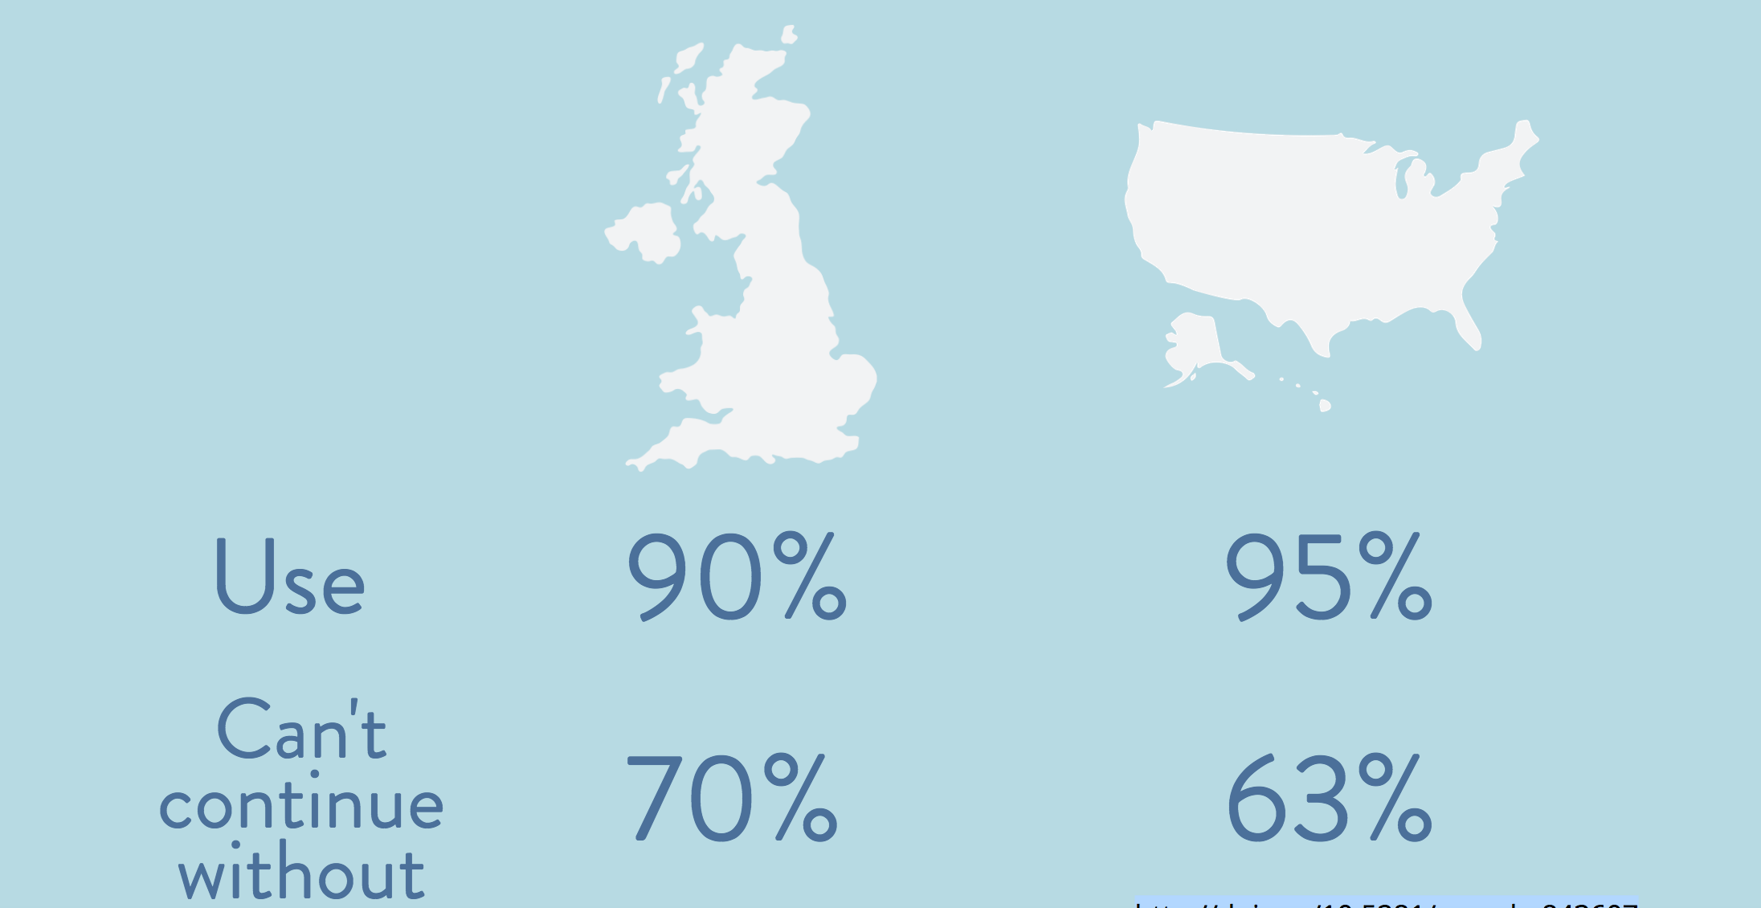
Research Software
http://doi.org/10.5281/zenodo.843607

Slide 10
Research Software
> 50% neither formal nor informal training
in software engineering
http://doi.org/10.5281/zenodo.843607

Slide 11
Research Software
Lack of career paths
http://doi.org/10.5281/zenodo.843607

Slide 12
Research Software
How to cite software?
http://doi.org/10.5281/zenodo.843607

Slide 13
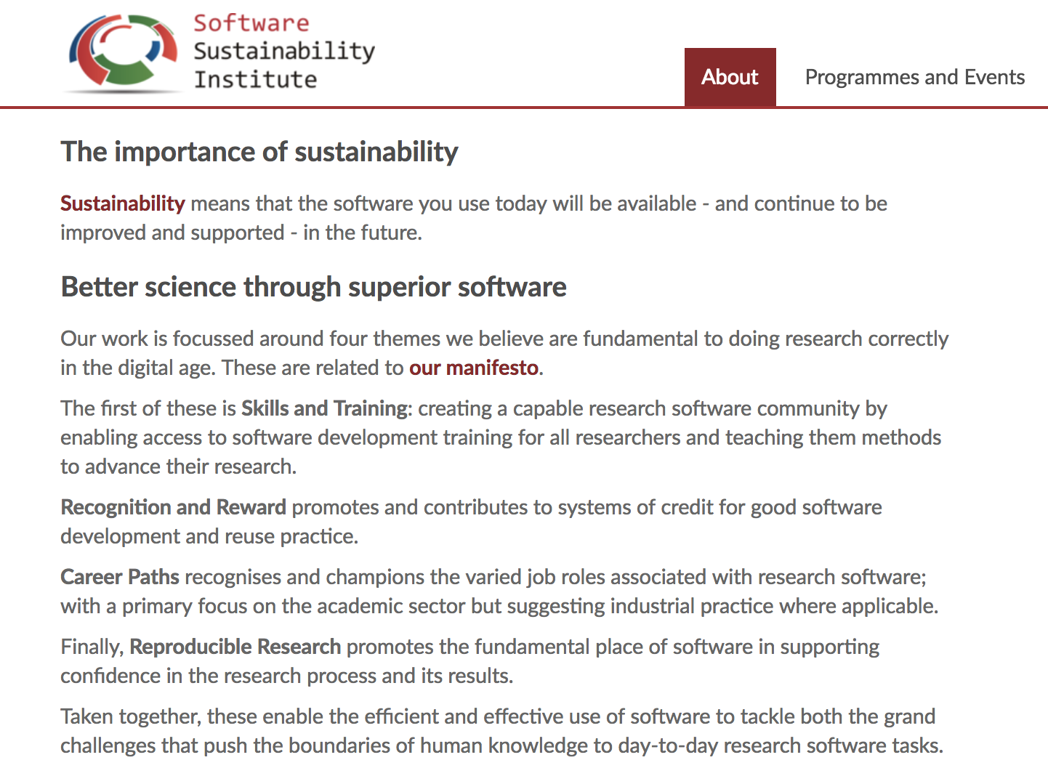

Software Sustainability
https://www.software.ac.uk/about

Slide 14
Conceptualization
Workshops
  Requirements gathering workshops
  Software credit workshop
  Incubator workshop
  Winter school in December!
Survey
Ethnographic studies
Mission and vision working group

Slide 15
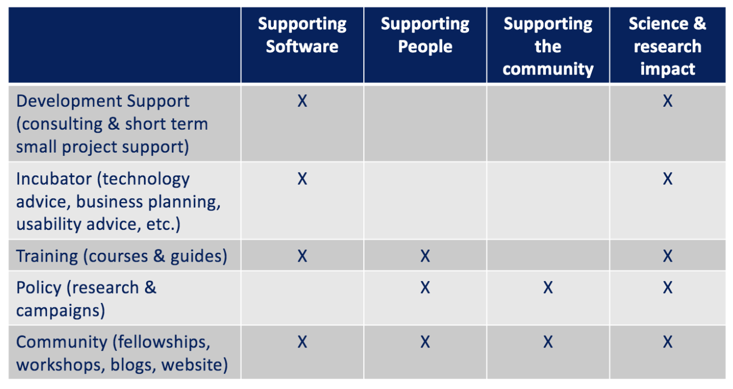
URSSI Strawhorse

Slide 16
How to Connect
Website http://urssi.us/
Materials https://github.com/si2-urssi
Blog posts http://urssi.us/blog/
Mailing list http://urssi.us/
Discuss https://discuss.urssi.us/
Twitter https://twitter.com/si2urssi
Workshops http://urssi.us/workshops/

Slide 17
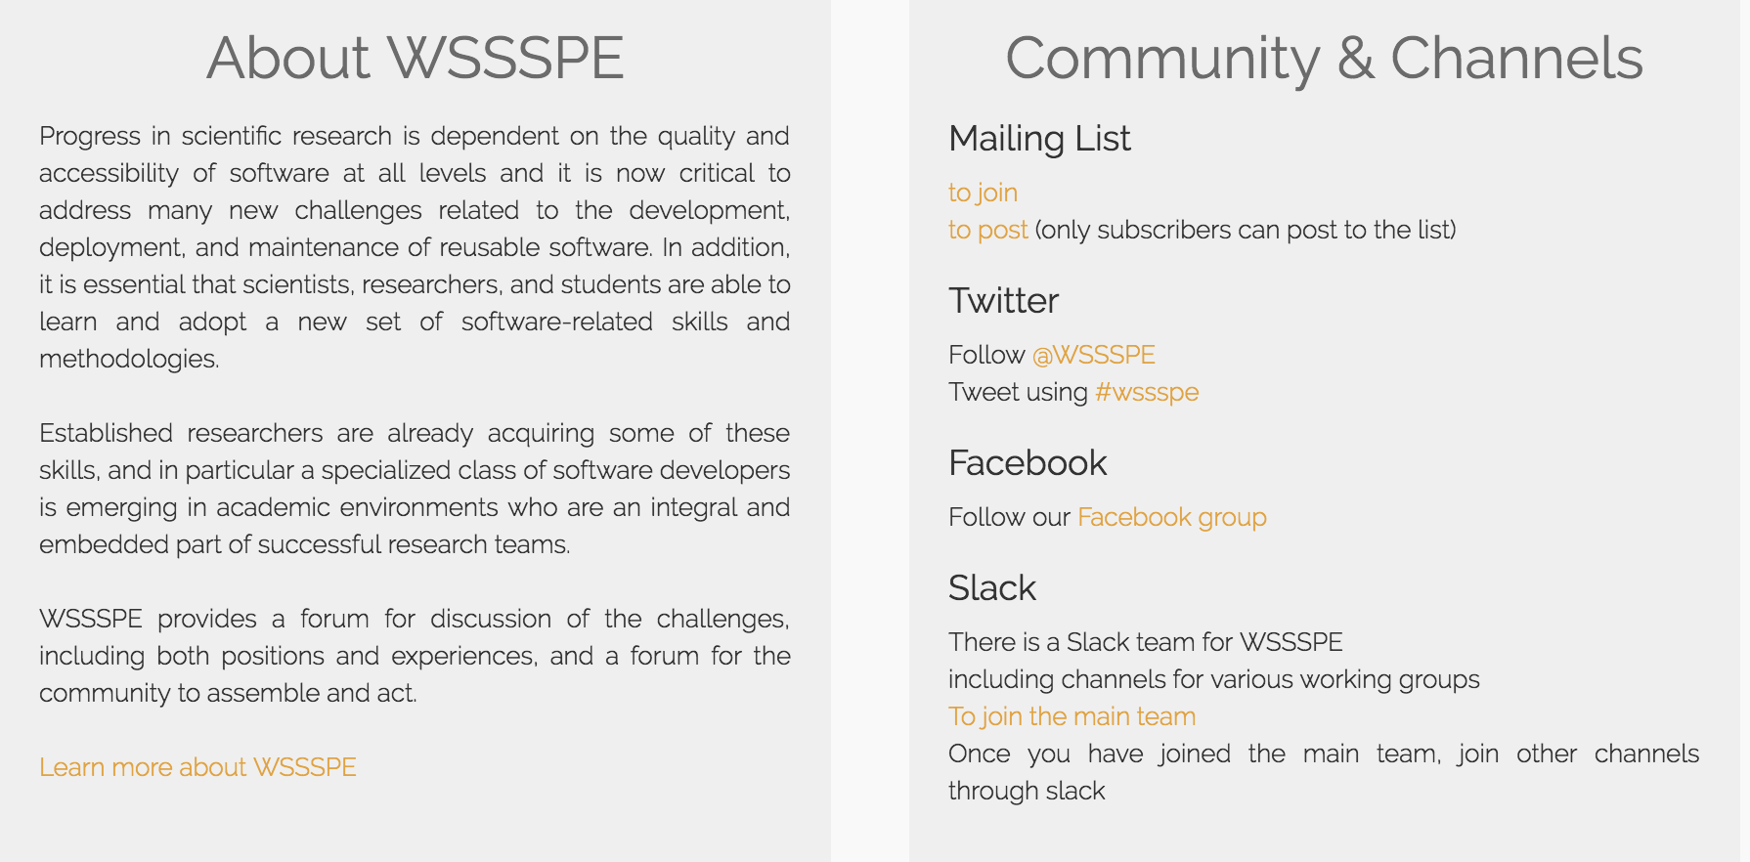
WSSSPE (Working Towards Sustainable Software for Science: Practice and Experience)
Workshops since 2013
Working groups
http://wssspe.researchcomputing.org.uk/

Slide 18
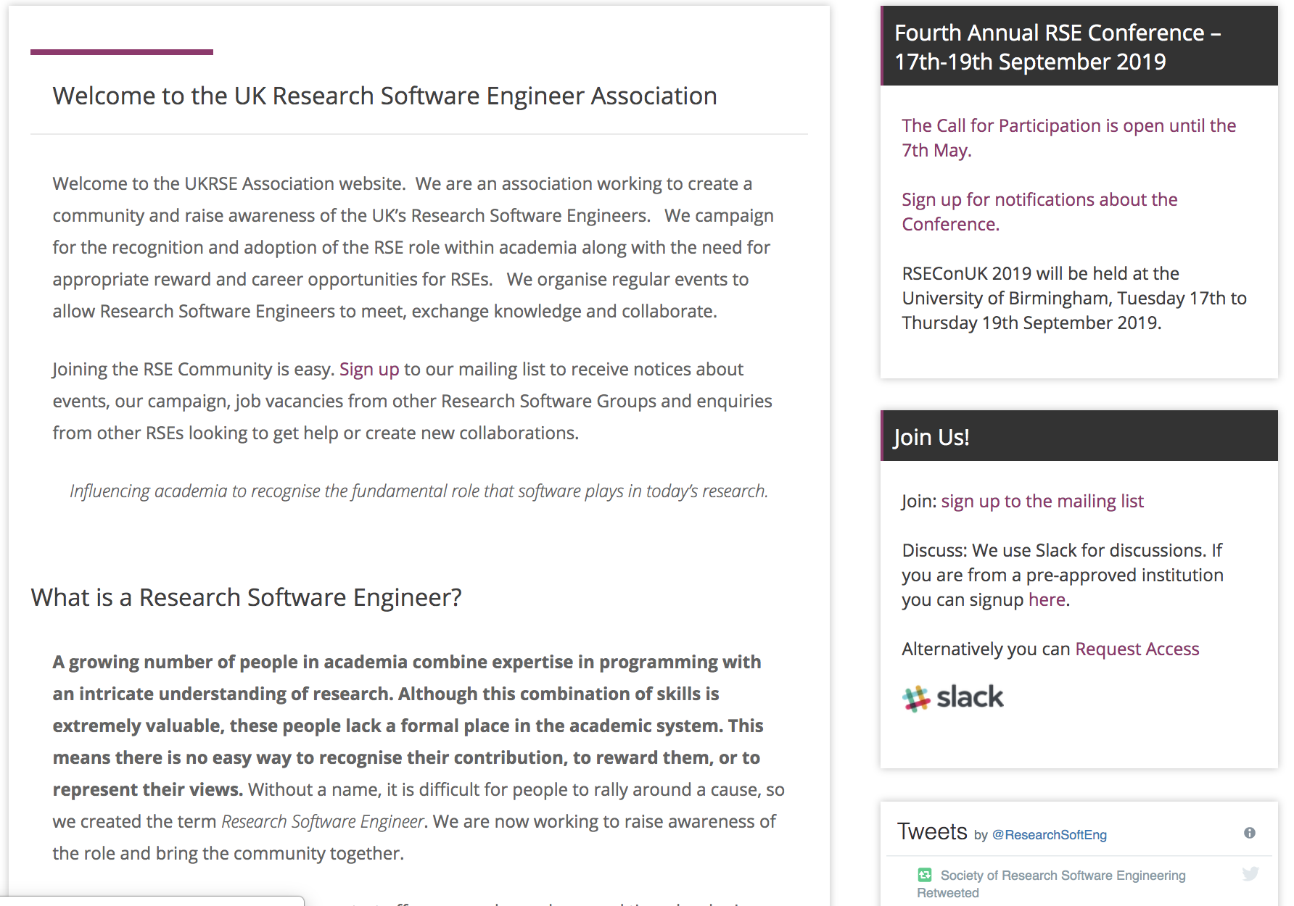
UK RSE Association
https://rse.ac.uk/

Slide 19
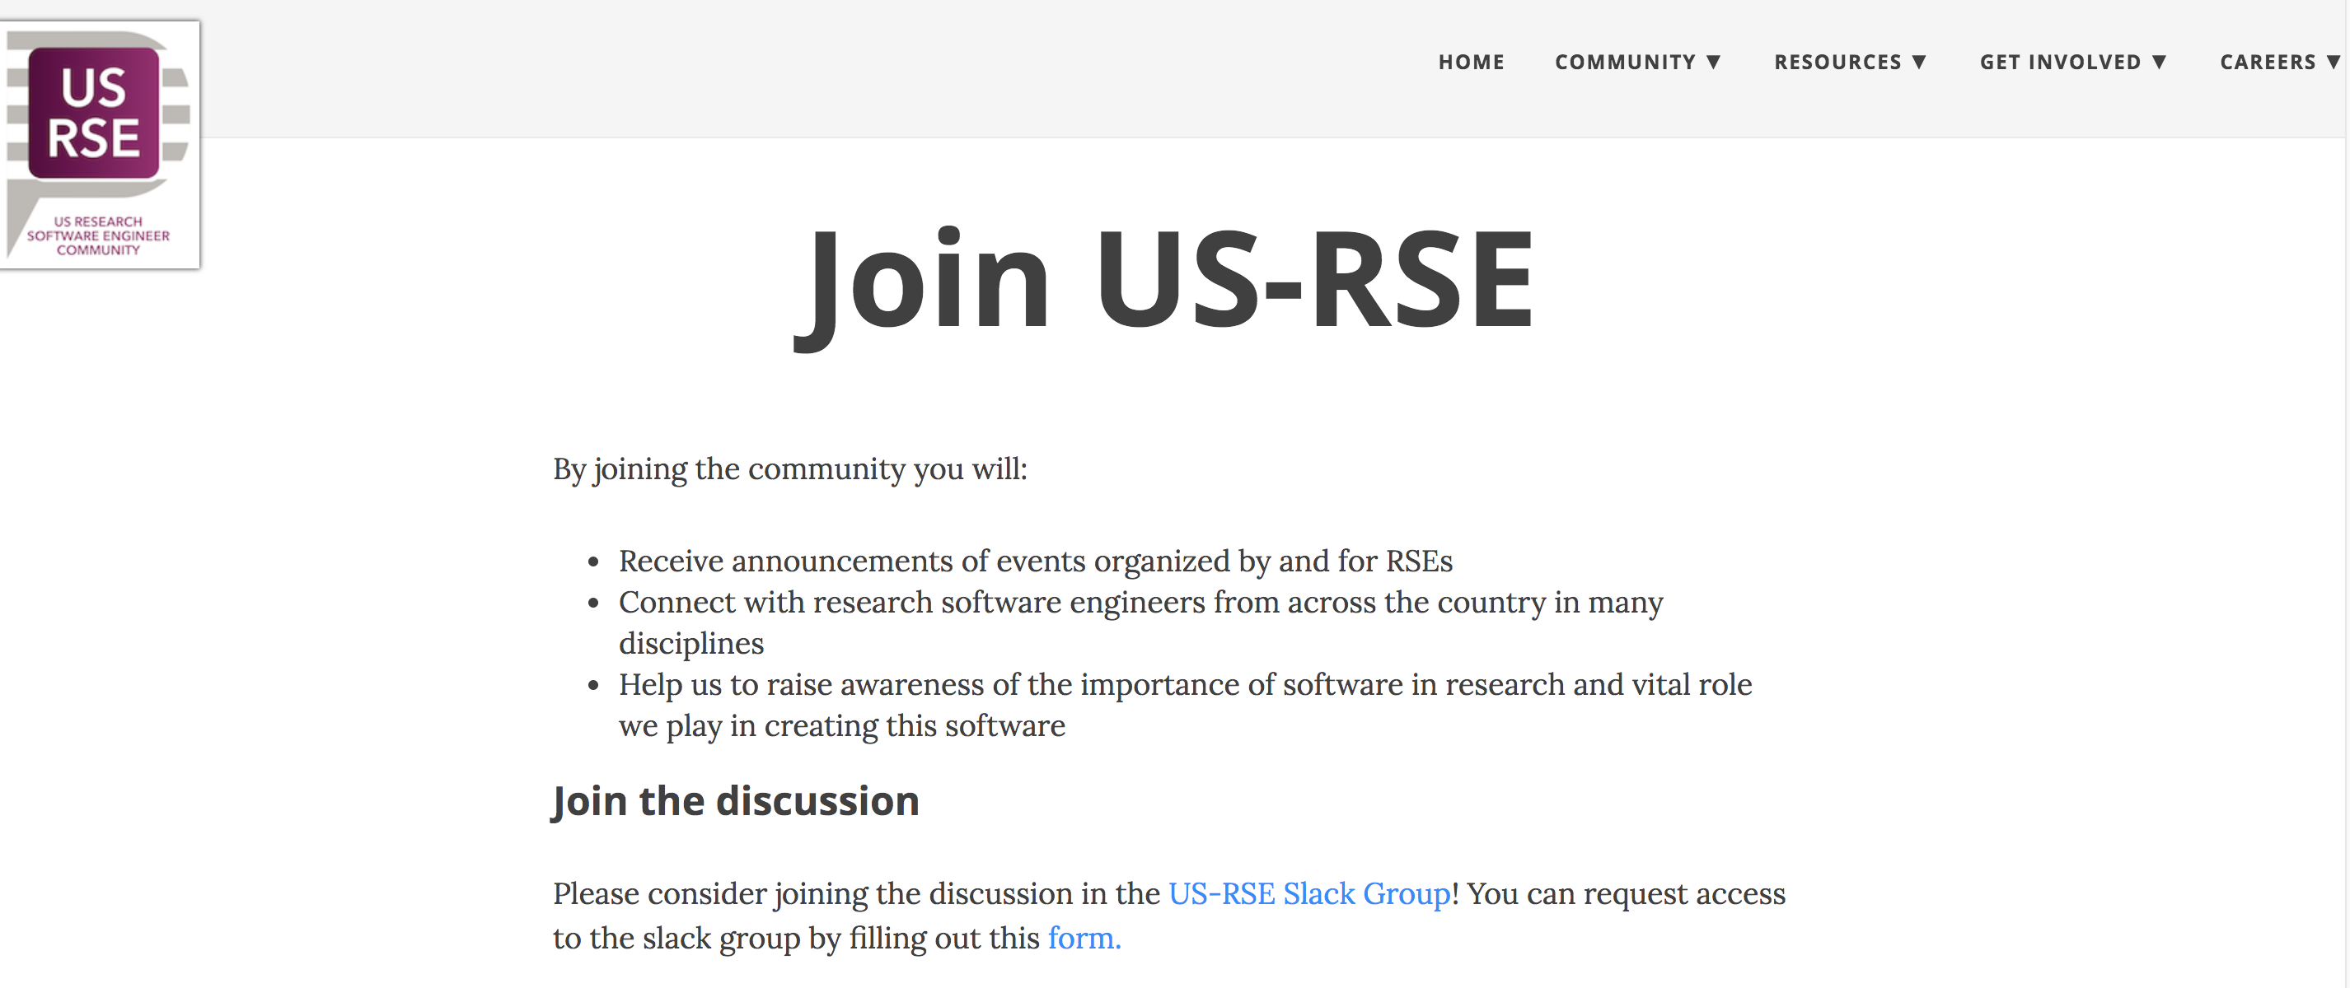
US RSE Community
Slack channel and upcoming email list
Has grown to over 50 people in the last three months
Steering committee will suggest rules to govern community (biweekly calls)
Soon: Monthly community calls
BoFs: PEARC19 and SC19
https://us-rse.org/

Slide 20
Thanks
Questions?
sandra.gesing@nd.edu

