Slide 1




ACI-Ref Virtual Residency
2019
XSEDE Demonstration
Kevin Brandt
June 4, 2019

Slide 2


Kevin Brandt, South Dakota State University
Manager, University Networking and Research Computing
Division of Technology and Security
XSEDE Campus Champion - Region 3

Slide 3
Agenda
New Account Creation
Use of the Single Sign-on Portal (Duo)
Sample Job Run (Bridges / Comet)
    Slurm Batch

Slide 4
XSEDE
Extreme Scale Engineering and Discovery Environment (XSEDE): NSF-funded resource that provides high-performance computing resources to support research across the United States.
Provided through resources from eleven partner sites to create a single virtual computational resource to advance scientific discovery.

Slide 5



XSEDE User Account Provisioning
  XSEDE Resource Eligibility?
  Nearly all US – based university and non-profit researchers can get allocations on XSEDE systems.
User Account Connections

Slide 6
XSEDE Single Sign-on
Some XSEDE systems require separate login credentials.
An alternative to the multiple logins - XSEDE now has a Single Sign-on portal to log into all resources with the use of multiple-factor authorization.
To use this function,
Setup user account to use Multi-Factor Authorization (MFA) using Duo - via our user profile).
Duo Application: Android or iOS-based device to host the Duo application.

Slide 7

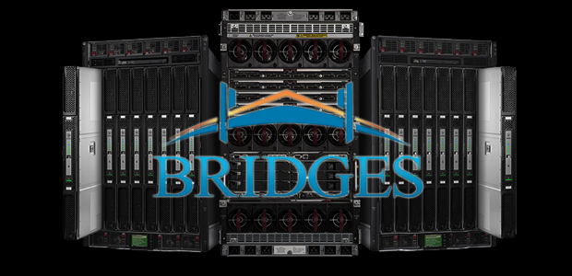
XSEDE JOB SUBMISSION
Sample Job Run (Bridges/Comet)
Bridges (OnDemand)
Slurm Batch: MPI

Slide 8
Thanks!
Questions?

