Slide 1

HITRUST compliance for Legally Regulated Computing and Data on HPC systems
2024 Oklahoma Supercomputing Symposium
Sep 25, 2024
University of Oklahoma
Erik Deumens

Slide 2

Overview
Preparation
  HPC system description
  Compliance and audits
  RRCoP community
Compliance frameworks
  Assuring compliance
Assessment process
  Scoping workshop
  Readiness assessment & Remediation
  Validated assessment
  Full timeline
Benefit for research

Slide 3
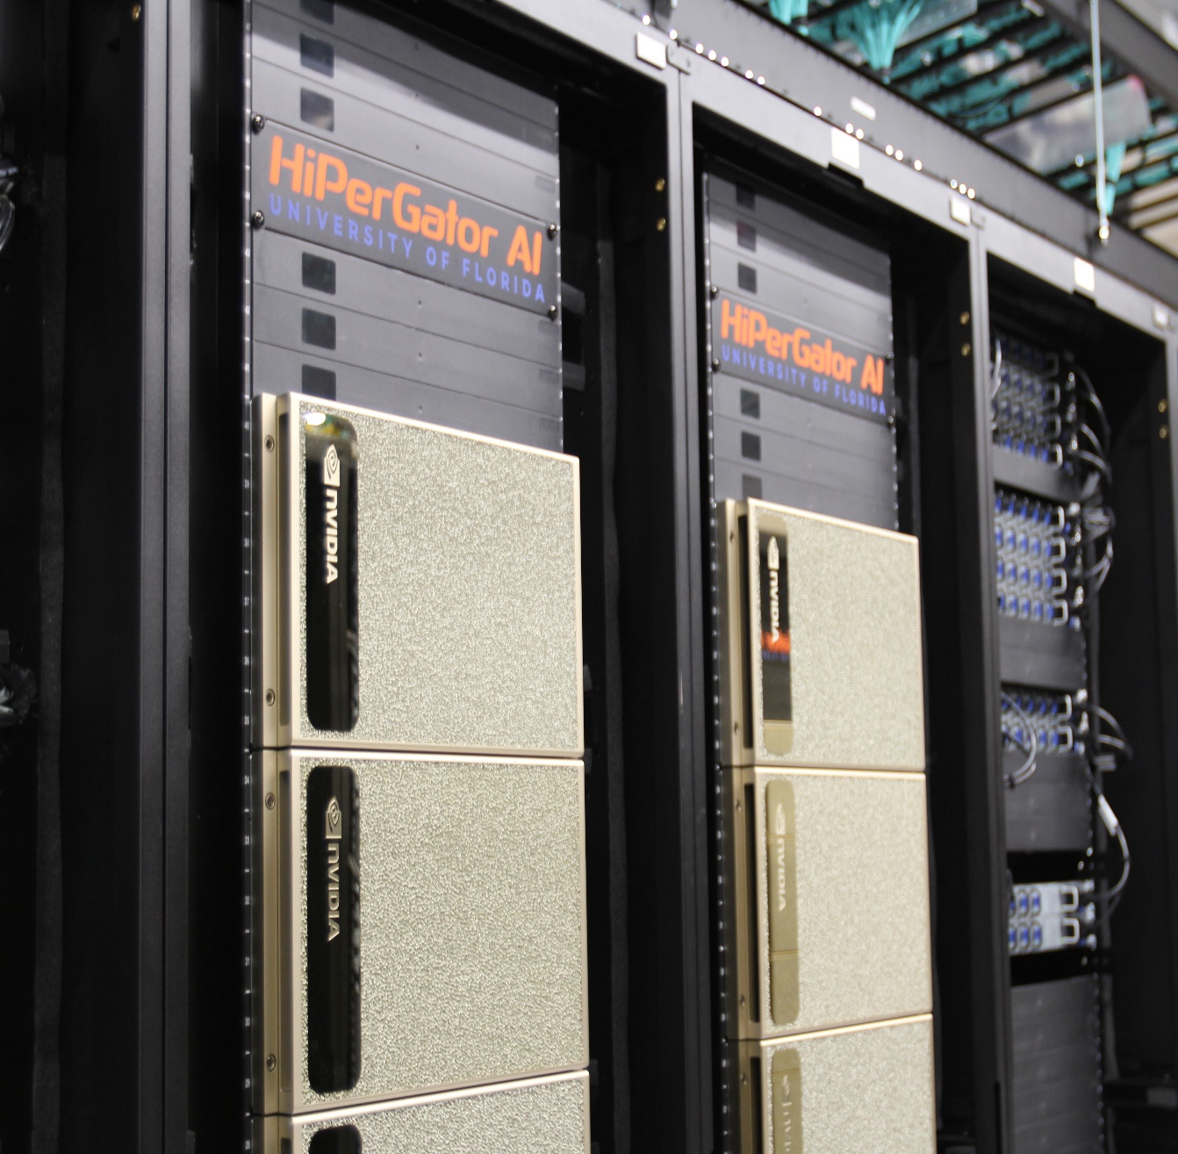
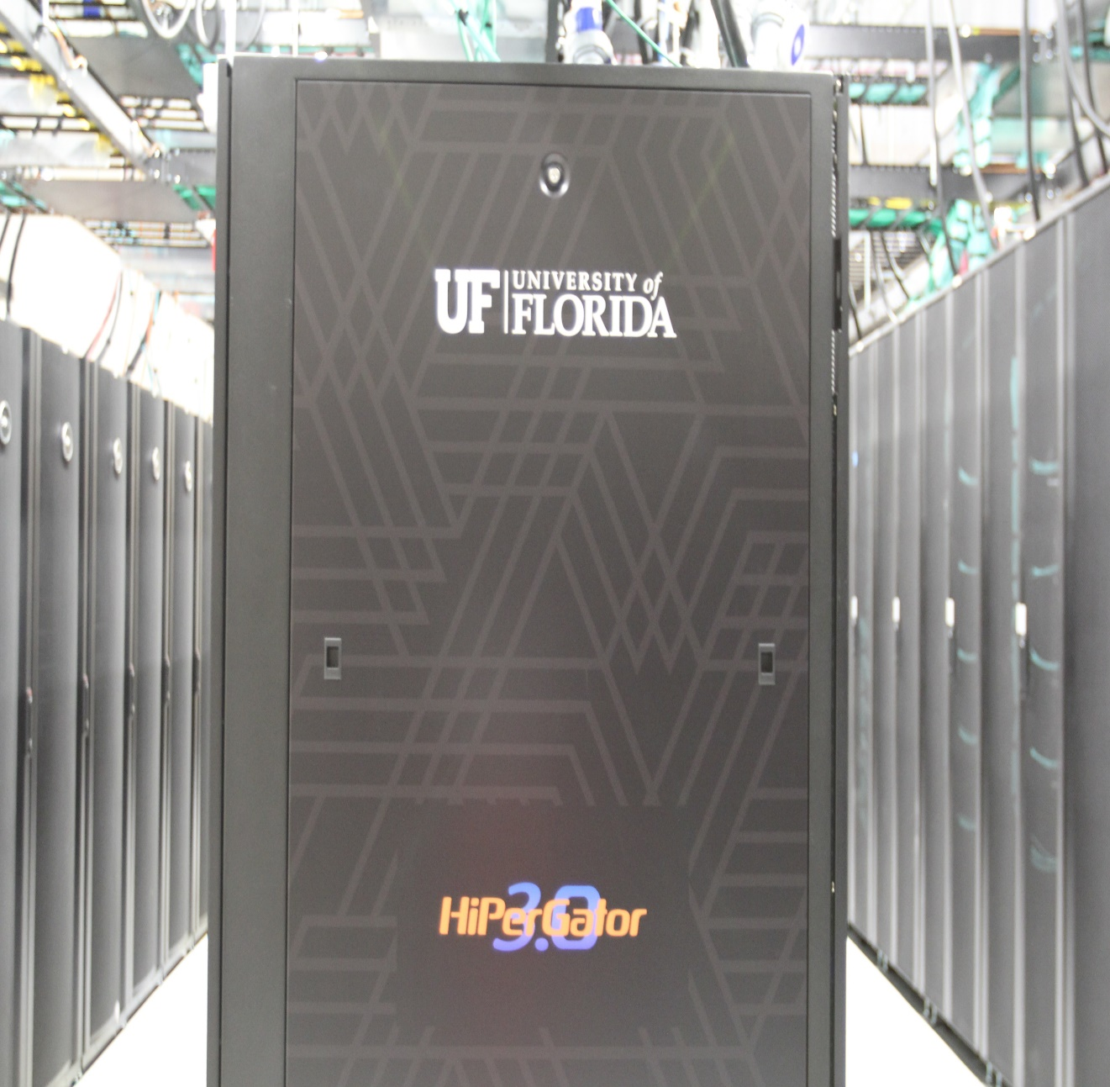
Preparation: HiPerGator
Specs:
70,320 CPU cores
1,800 NVIDIA GPUs
30 petabytes of
fast storage
51st fastest supercomputer in
the world (Nov 2023 top500)

Slide 4

Preparation: HPC system description
High-performance computing (HPC) system
Designed to handle large-scale, data-intensive computing workloads that require substantial processing power, memory and storage
Used by researchers and students for development and production
Clustered environment consisting of hundreds of interconnected compute nodes, switches, and PetaByte storage systems
Software used: newly developed, open source, and commercially licensed

Slide 5
Preparation: HPC system description
2013
  Data center constructed in 2012 – 1.6 MW
  HiPerGator 1.0 was built – 16,000 cores
2015
  HiPerGator 2.0 – added 30,000 cores
2021
  HiPerGator 1.0 – decommissioned
  HiPerGator 3.0 – add 40,000 cores, now total 70,000 cores
  Data center – power & cooling upgrade to 3.2 MW
  HiPerGator AI in 2021 – added 1,120 A100 GPUs by donation from Chris Malachowsky and NVIDIA

Slide 6
Preparation: Compliance
2015 – need for NIST 800-53 moderate compliant system for one big contract
We built an enclave on premise – it was too expensive to scale to small grants and projects
But we learned about compliance
  It is not just IT and technical controls
  Policies, procedures, documentation
  Communication with other offices: Research, Privacy, IT Security, Internal Audit
2017 – DFARS calls for NIST 800-171 for CUI
We build a second enclave – cheaper to operate
  Compliant with both 800-53 moderate and 800-171
  with a lot more self service and automation to meet demands of complex research scenarios

Slide 7
Preparation: Audits
Annual audits of 800-53-moderate enclave
  Done by Internal Audit
External 3rd party assessment of 800-171 enclave
  We did two (2017 and 2018)
  We are about to do another soon for CMMC (2024? or 2025)
Participated in community development
  Regulated Research Community of Practice (RRCoP)
  https://regulatedresearch.org
  Sharing experience and expertise
  Get advice from peers and mentors

Slide 8
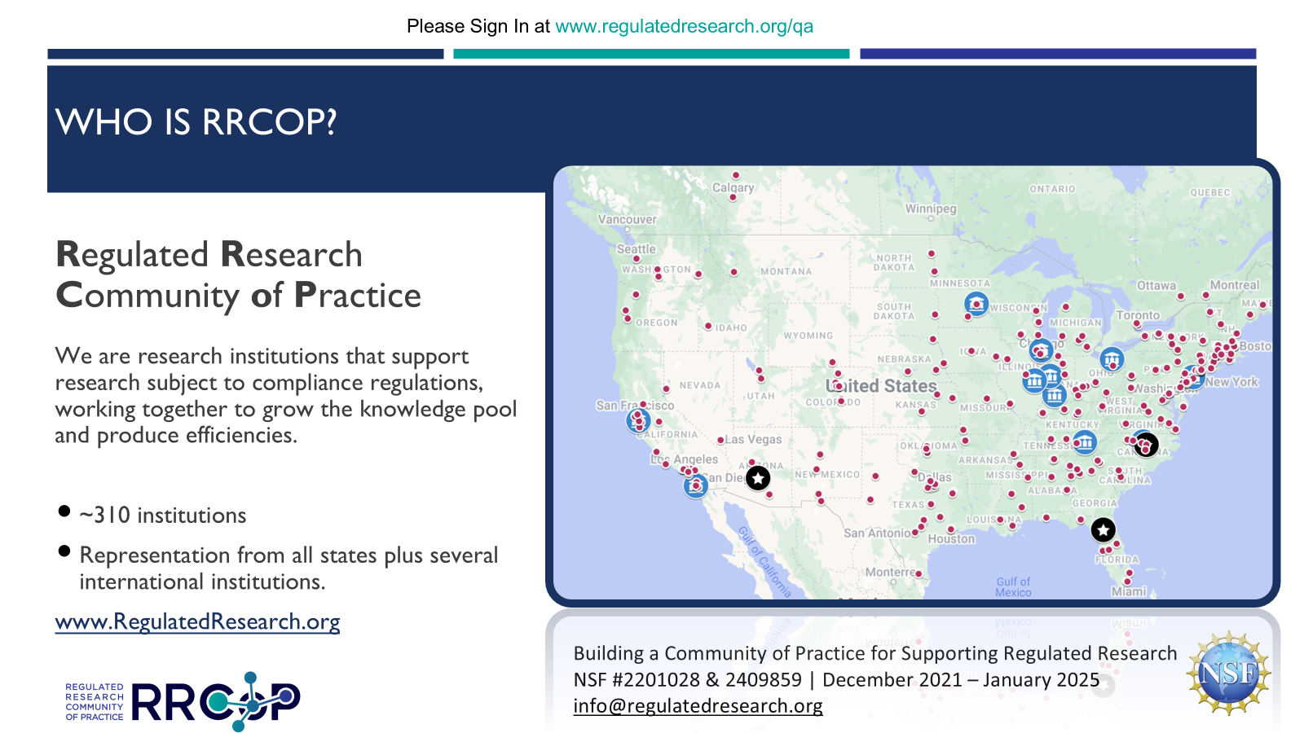

Slide 9
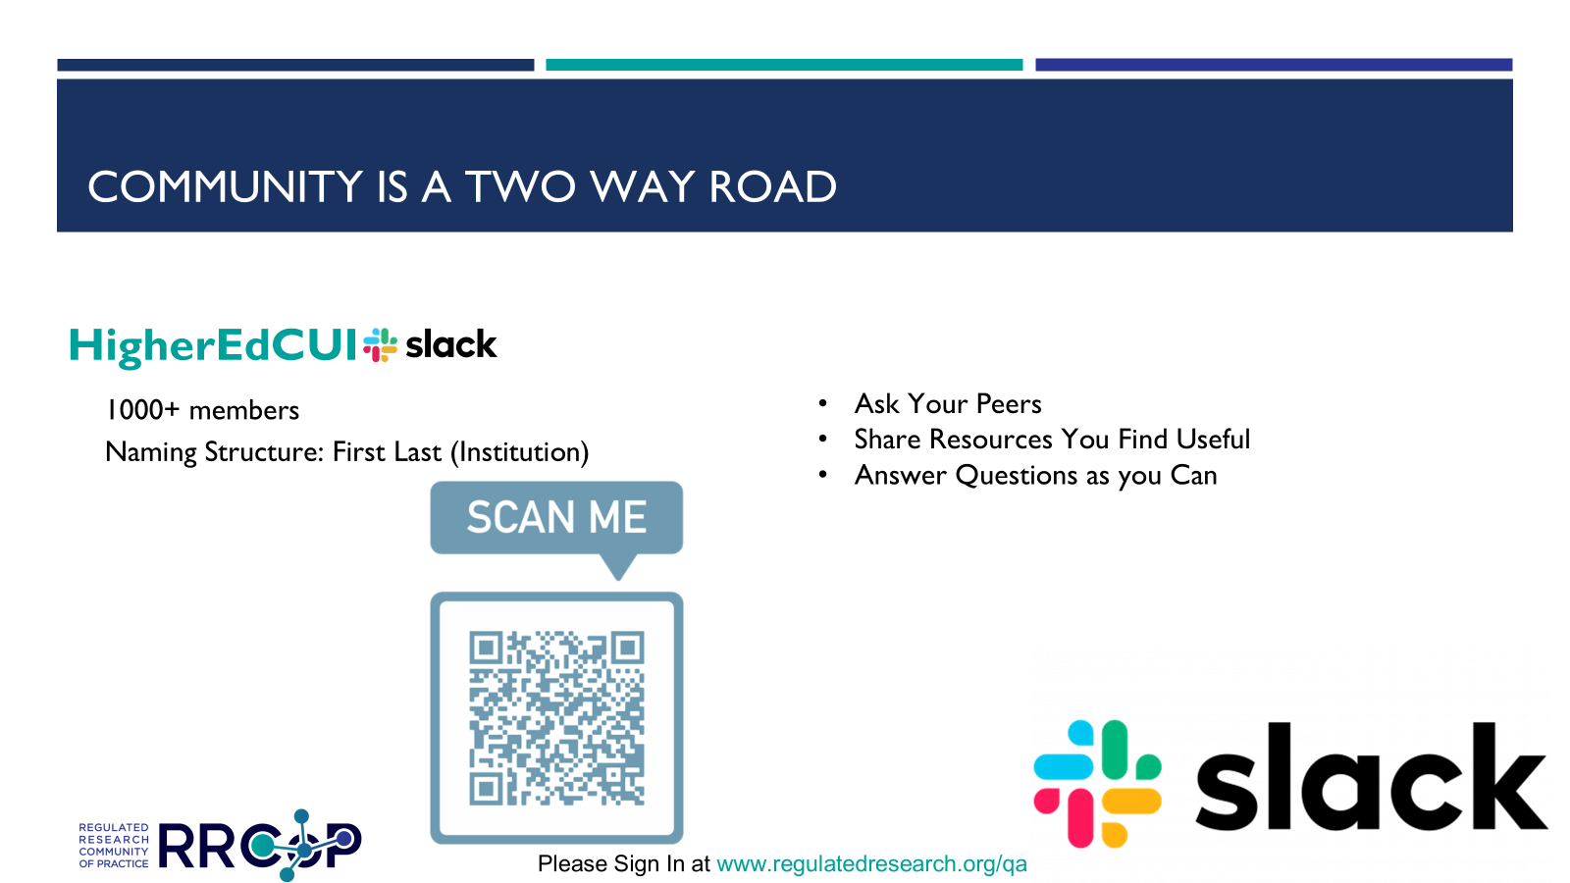

Slide 10
Compliance Frameworks
NIST – National Institute for Science and Technology
  Risk Management Framework (RMF)
    Special Publication 800-53 is the catalog of all controls
    Many other NIST documents describe how to use the catalog
    SP 800-171 was created for non-federal organization to safeguard Controlled Unclassified Information (CUI) – DFARS requires compliance with 800-171 for DoD contacts with CUI
  Cybersecurity Framework (CSF)
    Similar but easier to follow and implement, especially for large organizations
ISO – International Standards Organization
  Maps to NIST frameworks
HITRUST CSF – Originated to meet HIPAA (Next slide)

Slide 11
Compliance Frameworks: HITRUST
Founded in 2007, HITRUST is a nonprofit responsible for frameworks, standards and methodologies. HITRUST champions programs that safeguard sensitive information and manage information risk for organizations across all industries.
A certifiable controls framework built upon other frameworks and authoritative sources
Originally built on ISO 27001 and ISO 27002
Managed and maintained by HITRUST
Designed by security professionals to address:
Risk management requirements
Security requirements
Compliance needs
HITRUST CSF® is a comprehensive, prescriptive and certifiable framework that’s built upon other standards and authoritative sources. It’s one of the most widely adopted frameworks that covers over 40 authoritative sources.

Slide 12
Compliance Frameworks: Proof = assessment or certification
Researchers wanted to use the full HPC system
  With Protected Health Information (PHI) using AI tools
  Going beyond the enclave
To avoid any doubts about compliance, the administration decided to go with HITRUST Alliance certification
  It is considered the gold standard in healthcare (hospitals, health insurance, pharma)
  HITRUST has “certified assessors” (like CMMC)
UF did a purchase process called “invitation to negotiate (ITN)”
  Vendors submit a proposal
  A committee reviews, interviews, negotiates, and selects the vendor

Slide 13
Assessment process with certified assessor
2. READINESS ASSESSMENT
The likelihood of HITRUST Certification is directly dependent of how well an organization prepares
4. HITRUST VALIDATION
Assessment that tests the design and effectiveness of implemented controls; often results in CSF Certification
1
2
3
4
5
1. WORKSHOP
Proper planning, scoping, training and organizational alignment is a critical success factor
3. REMEDIATION
Implementation of remediated controls is necessary to boost scores to a “certifiable” level
5. INTERIM
Year two HITRUST assessment requirement that ensures CAP fulfillment and no erosion of control maturity

Slide 14
Assessment process: Workshop
Purpose
Prepare control owners
Solidify scoping parameters
Evaluate existing policies and procedures
Introduce HITRUST key stakeholders
Understand control responsibilities between UF Research Computing
and UFIT
Identify inheritance opportunities
Understand the nuances of the HiPerGator environment
Perform MyCSF scoping
Establish timeline, investment estimate and success factors
Process
Two-day virtual exercise
Representation from UF Research Computing, HITRUST and FD
Review of:
Network design
In-scope systems
Implemented controls
Policies and procedures
HITRUST scoping factors
Post-workshop meeting
with HITRUST
Evaluate one requirement from
each domain
Payoff
Three-way agreement on scope
Confirmation from HITRUST that HiPerGator was “certifiable”
Control owners were prepared for the process ahead; executive buy-in
Solidified scope; 266 requirements,
8 N/A’s
Communication of expected remediation
Treatment plans defined for areas of non-conformance

Slide 15
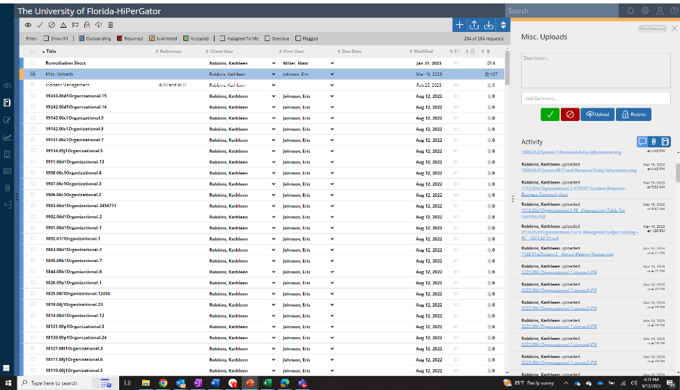
Assessment process: Readiness assessment
Performed “facilitated walkthroughs” onsite at UF
FD provided policy and procedure templates and guidance
UF established a central point of contact for evidence collection
Remediation was performed collaboratively between UF and FD
Visibility was given to HITRUST QA as needed throughout

Slide 16
Assessment process: Remediation considerations
Policies and procedures did not conform to the prescriptive nature of HITRUST
Removal of laptops/desktops from scope
AV scanning negated the high-performance design of HiPerGator
“Copy/paste/print” functionality could not be restricted
Hundreds of end-user deployed software applications
Management of privileged access
Encryption of data within the HiPerGator environment

Slide 17
Assessment process: Remediation
Because of our experience with compliance and audits
  We were able to address the 87 findings in 6 weeks (Oct 1st through Nov 15th)
Because of the close relation of the assessor with HITRUST
  We could discuss the troublesome controls with the HITRUS quality assessment (QA) team during remediation
  We could ensure that compensating controls were satisfactory
  Thus we would not run into unexpected obstacles after validated assessment in Feb-Mar 2023

Slide 18
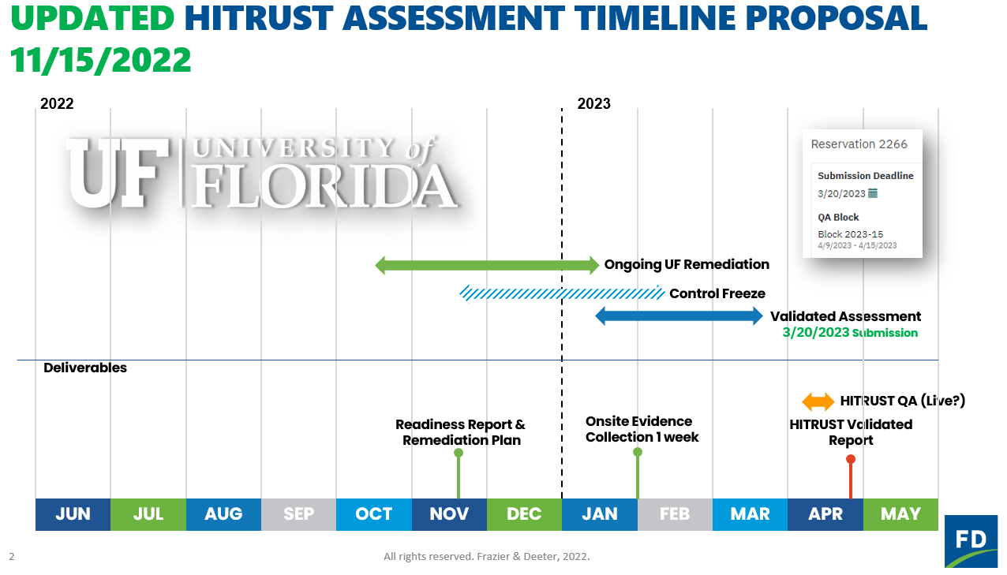
Assessment process: Full timeline

Slide 19
Benefit for research
Our faculty are very grateful
They can write proposals that process PHI data with the most advanced computing system available to them
Many projects are running now
Many more are being reviewed for award this year and next.
Questions?

