Slide 1
OITMP
Tulsa Community College
September 11-12, 2012
Geoff Wilson University of Oklahoma

Slide 2
A little about OITMP
The Oklahoma Information Technology Mentorship Program (OITMP) is an outreach initiative that connects networking professionals from Oklahoma institutions with students who are studying networks at Oklahoma academic institutions.
The OITMP is part of a National Science Foundation grant whose purpose is to boost Oklahoma’s education and research capability through network improvements.

Slide 3
Goals
Official Goal: Expose Oklahoma students to the practical day-to-day life of networking and security professionals.
Not So Secret Goal: Identify, develop and recruit talent!

Slide 4
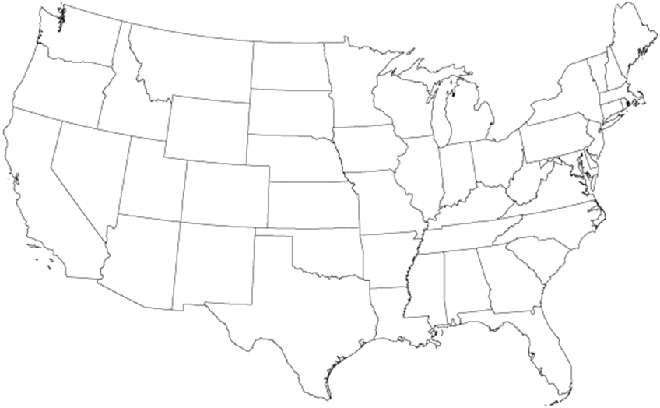
My Journey
’99-’03
BS in CS
Summa cum laude
GPS project
Cryptography

Slide 5
My Journey
’99-’03
‘03
Web application developer
Project voting system
Security Incident submission and tracking system
‘02

Slide 6
My Journey
‘03-’05
’99-’03
‘03
MS Information Security Technology & Management
CyberCorps
NATBLASTER
‘02

Slide 7
My Journey
‘03-’05
’99-’03
‘03
Policy gap assessment
NIST 800-53
Internal policies
‘04
‘02

Slide 8
My Journey
‘03-’05
’99-’03
‘03
FW Audit
FISCAM Audit
Designed, deployed pen testing lab
‘05-’06
‘04
‘02

Slide 9
My Journey
‘03-’05
‘06-’08
’99-’03
‘03
Tool development
Malware research
Vuln assessments
System administration
Security guidance
‘05-’06
‘04
‘02

Slide 10
My Journey
‘03-’05
‘06-’08
’99-’03
‘03
‘09-Pres
Risk assessment
Incident response
Training & Awareness
Forensics
Software development
‘05-’06
‘04
‘02

Slide 11
Roadmap
Why do we need information security?
How do we secure organizations?
What have I done?
Career and job hunting advice

Slide 12
Why do we need security?
To be able to provide for the confidentiality, integrity, and availability of data and services
We’re often required to implement a certain baseline security through regulations
Customers expect service providers to be good stewards of the data that is being provided
Loss of intellectual property, trust, revenue
Regulations have made data breaches costly

Slide 13
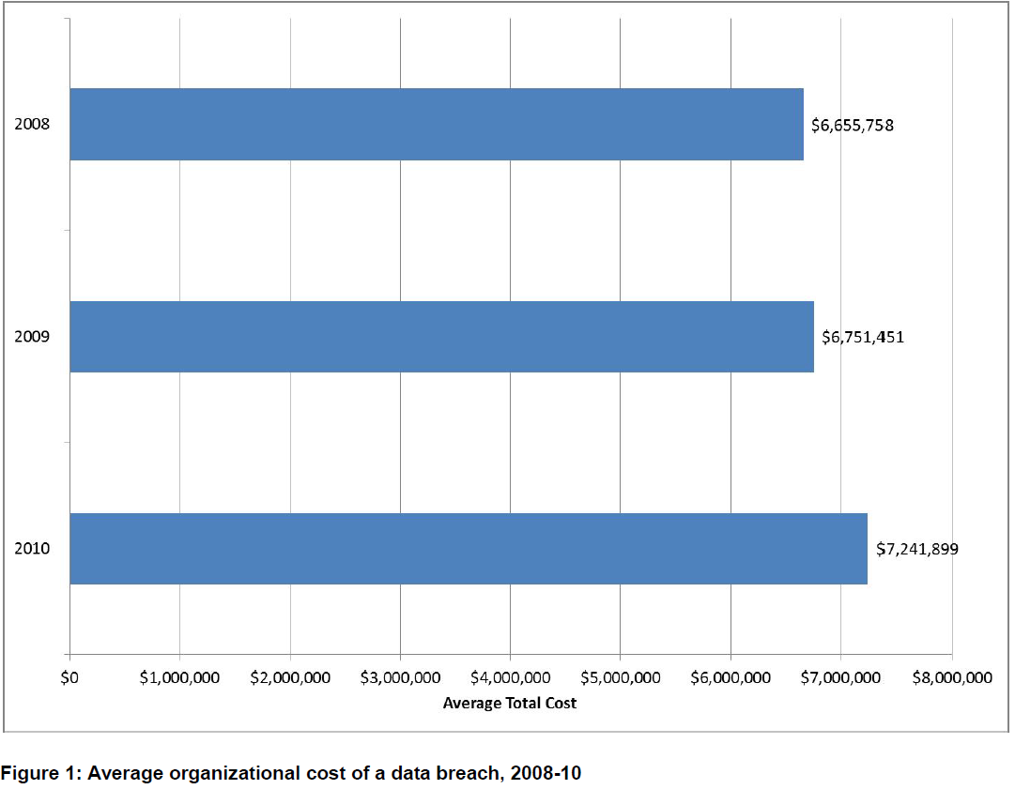
Data Breach Cost
Average data breach cost is high and increasing
Source: Ponemon Institute, 2010 Annual Study:
U.S. Cost of a Data Breach

Slide 14
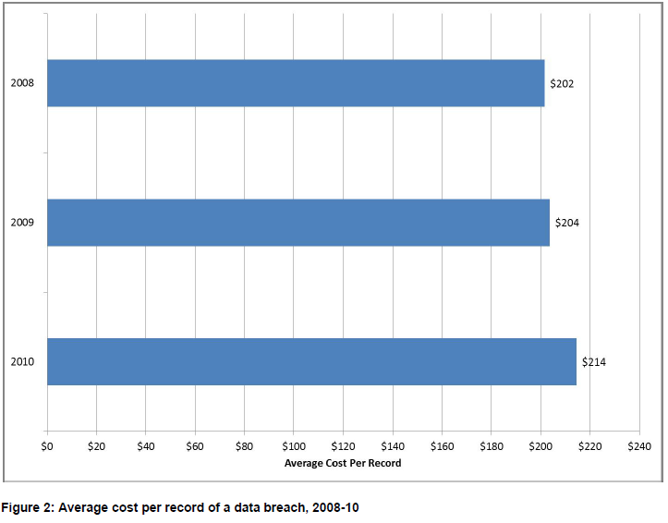
Data Breach Cost
Average cost per record
Source: Ponemon Institute, 2010 Annual Study:
U.S. Cost of a Data Breach

Slide 15
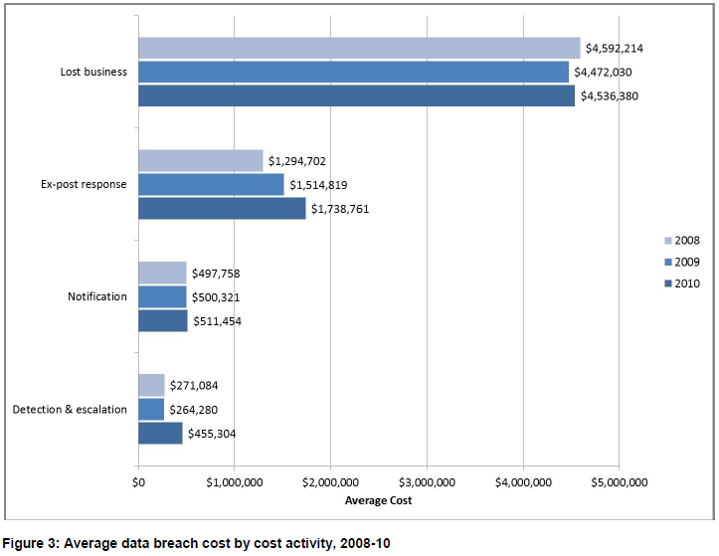
Data Breach Cost
Source: Ponemon Institute, 2010 Annual Study:
U.S. Cost of a Data Breach

Slide 16
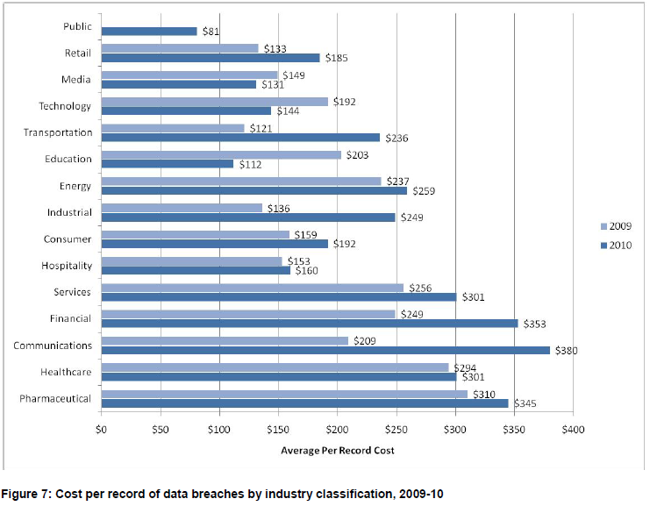
Data Breach Cost
Source: Ponemon Institute, 2010 Annual Study:
U.S. Cost of a Data Breach

Slide 17
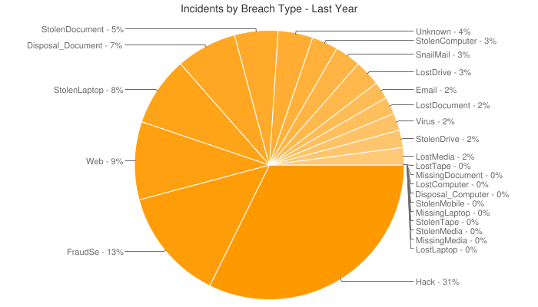
2011 Data Breaches by Type
Source: http://datalossdb.org

Slide 18
Significant Oklahoma Data Breaches
Date | Agency | Records | Approx. Cost | Cause
2011 | Oklahoma Health Department | 133,000 | $28.5 M | Laptop and paper files stolen from employee’s car
2009 | Oklahoma Housing Finance Agency | 225,000 | $48 M | Laptop stolen from employee’s home
2009 | Oklahoma Dept. of Human Services | 1,000,000+ | $214 M | Stolen laptop
2009 | Western Oklahoma State College | 1,500 | $321 K | Infected server
2008 | Oklahoma State University | 70,000 | $15 M | Compromised server

Slide 19
Largest US Data Breaches
Heartland Payment Systems breach (Jan. 2009)
SQL vulnerability in web form code written 8 years prior allowed internal access to Heartland corporate network (separate from payment processing network)
Intruders spent 6 months attempting to access payment processing network
Intruders carefully hid their activities
Built exploit packages to avoid detection by Heartland’s antivirus product

Slide 20
Largest US Data Breaches
Eventually gained access to payment processing network and installed a network sniffer
Compromised data in motion including credit card numbers, expiration dates, cardholder names
130,000,000 records breached
Heartland was certified by a PCI QSA as being PCI compliant at the time of the breach

Slide 21
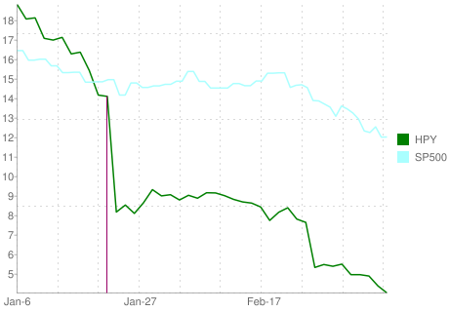
Largest US Data Breaches
Total known costs = $68,198,380.00
Ponemon Institute Direct Costs Estimate = $7.8 Billion

Slide 22
Largest US Data Breaches
TJX Companies, Inc. breach (Jan. 2007)
Attackers targeted a wireless network at Marshalls discount clothing store near St. Paul Minnesota
Wireless network used Wireless Equivalent Privacy protocol (WEP) was used to “encrypt” wireless communication
WEP is a weak encryption protocol and can be cracked in under 10 seconds with freely available tools

Slide 23
Largest US Data Breaches
Other reasons cited for breach include lack of software patching and lack of firewalls
Attackers eavesdropped on employees authenticating to TJX’s data center servers
Attackers were able to gain access and create their own accounts for sustained remote access
Compromise was sustained for over 18 months
45,600,000 credit & debit card numbers compromised

Slide 24
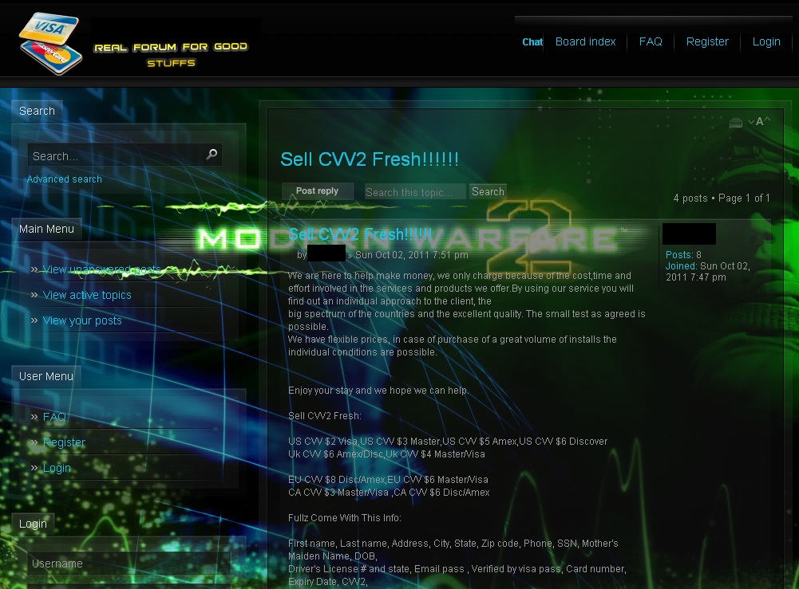
What do the bad guys want with our data?

Slide 25
What do the bad guys want with our data?
They want any information that can assist in identity theft
Black market value of your data*
Products | Price
Credit card details (basic info) | US $2, EU $5
Credit card details (full info) | US $25, EU $50
Exclusive (e.g. gold, platinum) credit card details (full info) | US $40, EU $90
Physical credit cards | $190 + cost of details
Bank credentials | $80-$700
Card cloners | $200-$1000
Fake ATMs | Up to $35,000
*Source: Panda Security Report 2010, The Cyber-Crime Black Market: Uncovered

Slide 26
Advanced Persistent Threat
A sophisticated, typically well-funded, determined, organized cyber attackers. Typically target governments and contractors (e.g. DIB), financial, manufacturing, and research industry
RSA APT breach led to compromise of SecureID one-time tokens
Nation-state threat attempting to access defense company networks – Lockheed Martin, L3, Northrop Grumman
Excel spreadsheet sent to EMC employees rigged with an Adobe Flash vulnerability
Exfiltrated data was compressed and encrypted, making it more difficult to detect

Slide 27
Advanced Persistent Threat
F-35 Joint Strike Fighter data compromised by organized group originating in China
Several terabytes of data were stolen from unclassified systems
Systems infiltrated for up to two years
Access was gained through compromise of defense contractor networks
Exfiltrated data was encrypted, so it is not clear what data was stolen

Slide 28
How To Secure Organizations?
ISO 27002 information security standard
Organization of information security
Security policy
Compliance
Risk assessment
Asset management
Human resources security
Physical and environmental security
Communications and operations management
Access control
Information systems acquisition, development, and maintenance
Information security incident management
Business continuity management

Slide 29
What Have I Done?
Software development – ConocoPhillips, NSA, OU
Governance & Compliance – IHS, OU
Audit – HUD OIG
Risk assessment & Vulnerability assessment - OU
Vulnerability assessment – NSA, OU
Penetration testing - OU
Incident response - OU
Forensics & malware analysis – NSA, OU
Education & training - All
System administration – NSA, OU

Slide 30
What Have I Done?
Software development – ConocoPhillips, NSA, OU
Governance & Compliance – IHS, OU
Audit – HUD OIG
Risk & Vulnerability assessment – OU, NSA
Penetration testing - OU
Incident response - OU
Forensics & malware analysis – NSA, OU
Education & training - All
System administration – NSA, OU

Slide 31
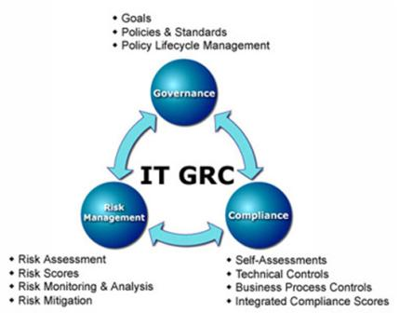
GRC
Design and deploy
Governance
policy and procedure
Risk Management
vulnerability assessment
penetration testing
secure architecture
Compliance
PCI
HIPAA
FERPA
FTC Red Flags

Slide 32
IT Audit
Audit and assess
Governance
policy and procedure
Risk Management
vulnerability assessment
penetration testing
secure architecture
Compliance
PCI
HIPAA
FERPA
FTC Red Flags

Slide 33
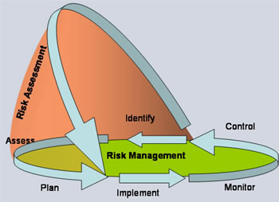
Risk Assessment
Identify risks through asset identification, threat analysis, vulnerability identification, business process analysis, control analysis
Estimate risk (qualitative or quantitative)

Slide 34
Vulnerability Assessment
Identify and quantify all vulnerabilities in a system
Report includes findings and recommended remediation
Use risk assessment methodology to prioritize vulnerabilities

Slide 35
Vulnerability Assessment Types
Perspective
Black Box – No insider knowledge, no source code
White Box (a.k.a. crystal box) – Insider knowledge, source code
Gray Box – Somewhere in between
Platform
Black box web application
White box web application
Network vulnerability assessment
Non-credentialed (black box)
Credentialed (white box)

Slide 36
Vulnerability Assessment Types
Automated
Can find many vulnerabilities, but will only find those vuln’s that it is programmed to find
Automated, so requires less time typically
Still have to interpret and validate results to remove false positives
Manual
Can find business logic flaws
Less false positives
More tedious, requires time

Slide 37
Penetration Testing
Simulate the activity of a malicious attacker
Often without cooperation or knowledge of broad IT staff
Can involve active exploitation of security vulnerabilities
Often includes social engineering
Findings and mitigation recommendations are delivered in a report

Slide 38
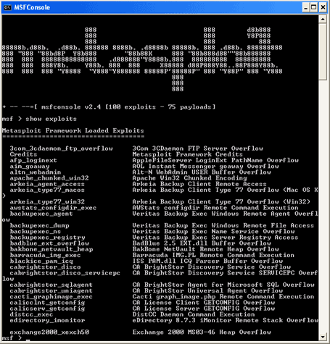
Vuln & Pen Testing Tools

Slide 39
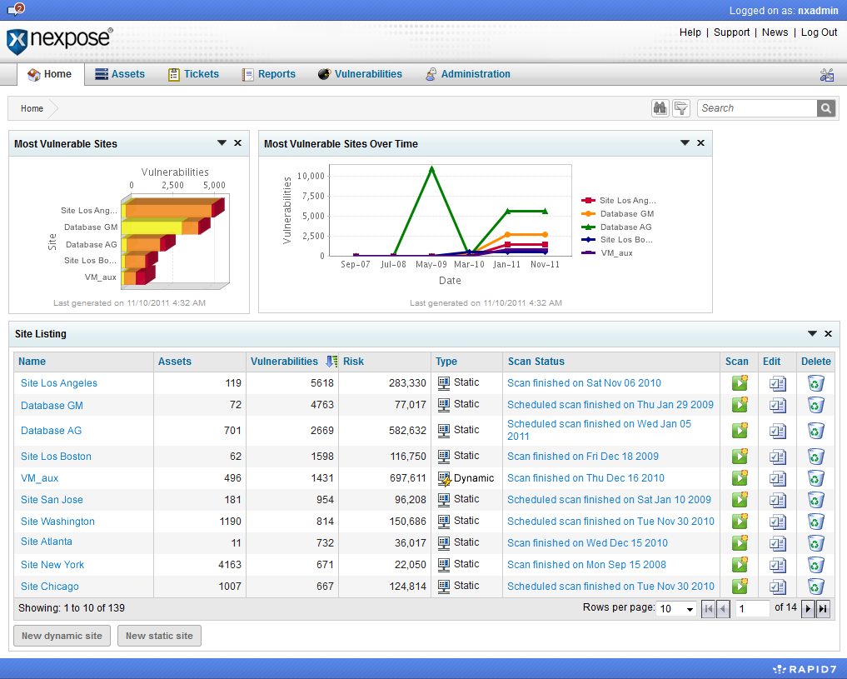
Vuln & Pen Testing Tools

Slide 40
Incident Response
Proactive
Reactive
Detection
Triage
Analysis or other Response
Fix /
Resolution
Lessons Learned Feed
Proactive Processes & Strategy
Feeds
Communication & Outreach Strategy
Notes:
What is often left out is that lessons learned should be derived
What’s the right balance?

Slide 41
Security Incidents at OU
Malware infection
Copyright infringement complaint
System misuse
Policy violation (HR, student code)
Account compromise
E-discovery
Stolen devices
Law enforcement investigations

Slide 42
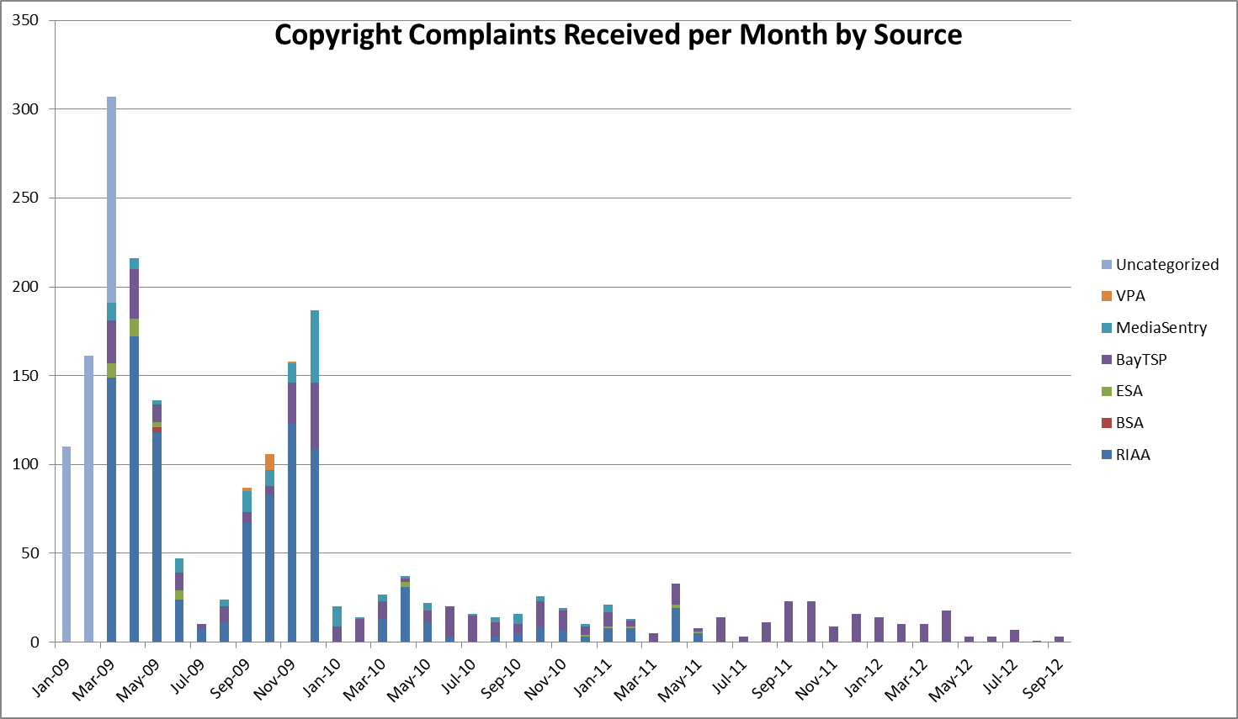
Copyright Statistics

Slide 43
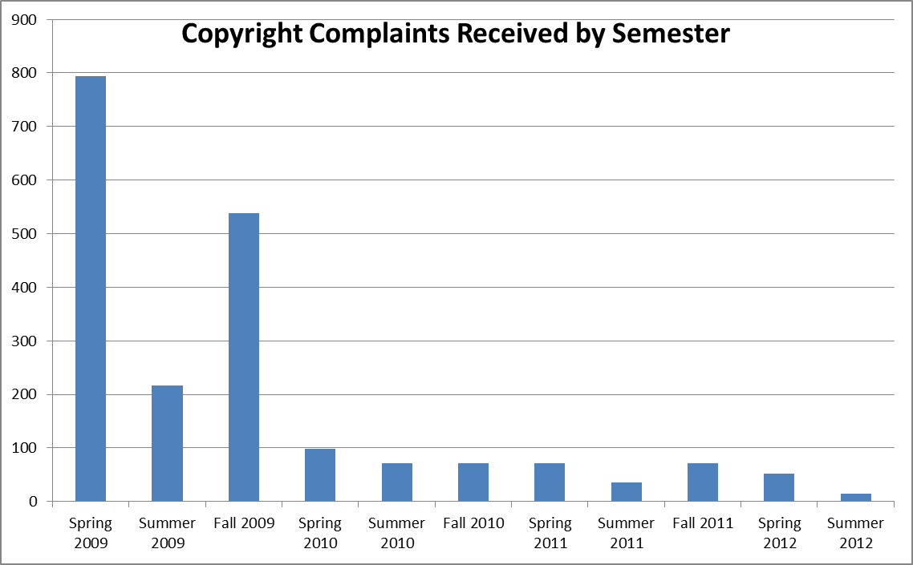
Copyright Statistics

Slide 44
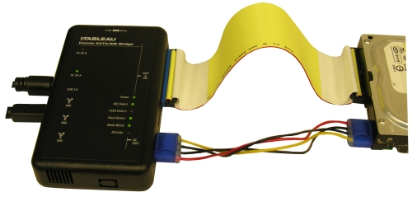
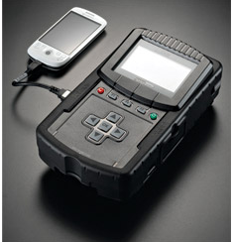
Forensics
Hard Drives
Memory Analysis
Mobile Devices
Email
Logs
Packet Traces

Slide 45
Training & Awareness
Date Given | Presentation | Audience
10/21/2011 | There’s a Party in Security and Everyone is Invited | Educause Annual
10/11/2011 | Introduction to Security Awareness Campaign | Campus IT Leaders
8/5/2011 | Lessons Learned from Incident Response | Incident Response Team
3/9/2011 | Information Security Awareness Training | Various
3/2/2011 | Information Security Update | Legal Counsel
1/11/2011 | Sandboxing and 3rd Party Patching Utilities | Campus IT Leaders
12/8/2010 | Malware Guest Lecture | CS Students
10/12/2010 | Removable Media Viruses | Campus IT Leaders
9/27/2010 | Security Incident Response | IT Field Services & Reps
9/14/2010 | Securing the University: Challenges and Opportunities, Incident Triage Procedures | Campus IT Leaders
8/14/2010 | Securing the University: Challenges and Opportunities | Deans & VPs
8/4/2010 | Security Awareness for Developers | IT Developers
7/13/2010 | Security Awareness for Developers | IT Developers
5/19/2010 | Emerging Threat Briefing | Various IT (workshop)

Slide 46
Finding the Right Job
Figure out what you want to do
Security?
Risk assessments?
Incident response?
Vulnerability research?
Profile individuals who have achieved what you want. What did they do? Reach out to them on LinkedIn
Be willing to take an entry level position with the right company & growth potential

Slide 47
Finding Your IT Job (cont’d)
Differentiate Yourself
College diploma in a relevant field
Worth up to 5 years of experience
Internships
Certifications (start small, and work your way up)
Extracurricular activities
Home lab
Local IT user organizations
Excel outside of your career
Success breeds success

Slide 48
Application Materials
I’ve reviewed ~500 resumes of recent graduates.
What successful candidates did:
Cover letter explaining why they are interested in the position and highlighting key resume items
Prompt thank you letters/emails after interviews
No spelling/grammatical mistakes
Customize application materials for the job
Limit non-relevant items (displays ability to edit)

Slide 49
Application Materials
What successful candidates did:
Manage whitespace
Have someone on the inside pass along your resume
Ask this person what the resume reviewer looks for
A few days after submitting resume, follow up with a phone call or email demonstrating interest in the job
Don’t try to use humor or sarcasm

Slide 50
Interviewing
Be prepared to answer difficult questions
What are your 5/10 year career goals and how would this job help you achieve those goals?
Tell me about yourself.
Here’s a difficult situation. How would you handle it?
It’s okay to take a minute to prepare a response to a tough question
Know your technical stuff
Come prepared with a printed list of questions for the interviewer

Slide 51
Interviewing
Ask for a business card
Do your homework. Know about the company
“I was reading on your website that your company does X…tell me more about this.”
Turn off you phone
Be relaxed
Be your professional self
Don’t be underdressed

Slide 52
Career Sustaining Recommendations
Always be learning
Build a strong foundation
Understand how business works
Understand how technology works
Learn how to be a good public speaker
Learn how to be articulate in communication
Network with fellow IT professionals
Be willing to learn new technologies

Slide 53
Career Sustaining Recommendations
Find a mentor (formal or informal) to help you
Understand the organization
Develop your perspective
Provide a sounding board for your ideas
Locate more job opportunities
Derive higher job satisfaction
Don’t always stay in your comfort zone
Practice public speaking skills
Develop time and project management skills

Slide 54
Career Sustaining Recommendations
Know the business
Have to know how technology is used
Learn how to get things accomplished within the business
Understand your customers
Be a team player
Build relationships
Become a trusted advisor

Slide 55
Thank you!
Geoff Wilson
ggwilson@ou.edu

