Slide 1
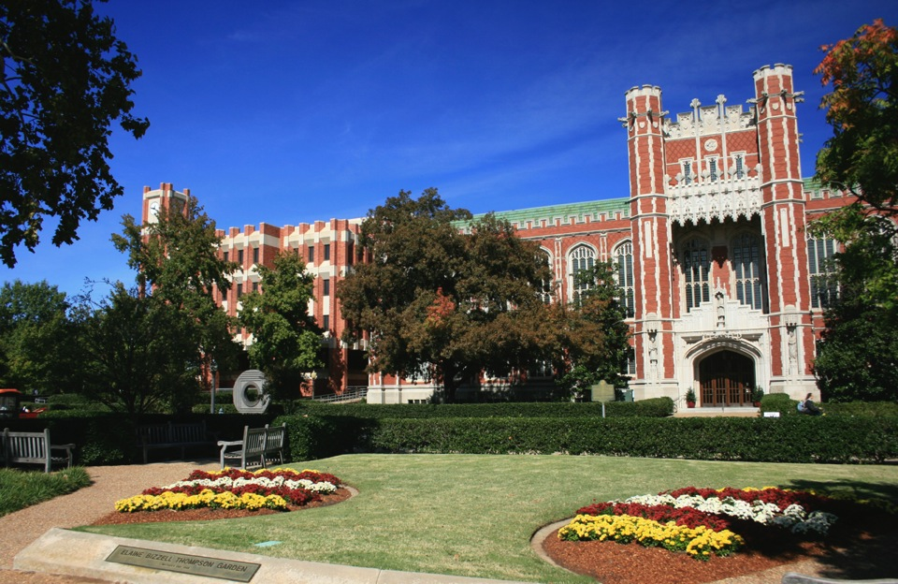
Research Data management university of Oklahoma university Libraries
Mark Laufersweiler
Research Data Specialist
University of Oklahoma University Libraries

Slide 2
Why we are here: data sharing
Office of Science and Technology 2013
Increasing Access to the Results of Federally Funded Scientific Research
Agencies with over $100 million research and development expenditures

Slide 3
Institutional Repository
ShareOK
Primarily documents
Dissertation
Thesis
Publications
Faculty, staff, and student
Limited research data
Citizen Science specimen sample photos

Slide 4
Education/training Workshops
Software Carpentry/Data Carpentry Foundation member
Software Carpentry 3 per semester
REU (Research Experience for Undergraduates)
Workshops in support of BioSurvey NRT grant
Research Data Management classes/hands-on
Tips, tricks, and tools
Workflow best practices
DMPTool
ResBaz (Research Bazzar)
Focuses on creating opportunities for researchers to share their digital skills
Two day event

Slide 5
RDM consult
OU Faculty, staff, and students can schedule appointments with UL staff for DMP consultation
Liaison Librarians
Research Data Specialist
Digital Scholarship Specialists
Informatics Specialist
CLIR Fellowship postdoc (starting September)
open office hours @ Digital Scholarship Lab
Innovation HUB
Innovation @ EDGE
Virtual Reality
3D printing
Circuits

Slide 6
Scholarly Communications
Digital Identity
ORCID iD
Adoption increasing with publishers and large repositories
Integrations with
SCOPUS, CrossRef, ResearcherID
Dryad, PLOS
AGU, APS
UL and OU is an ORCID member
Integration with
ShareOK
Digital Object Identifiers

Slide 7
Scholarly IP
Digital Object Identifiers
DOI def: unique alphanumeric string assigned by a registration agency (International DOI Foundation) to identify content and provide a persistent link to its location on the Internet.
UL assists researchers with registering
South Central Climate Science Center (5)
OK Mesonet (3)
The Anthropocene Biosphere (21) symposium serries
Promotes sharing of research output
Citable reference
Dataset authors/producers, data release date: Dataset title, version. Data archive/distributor, access date in standard AMS format, data locator/identifier (doi or URL).

Slide 8
Data Repository Need
Systems better suited for data formats
CSV, NetCDF, GRIBB, HD5, Excel, SQL
Systems to consider
CKAN/DKAN
IRODS
Build what community needs
Research Computing and Data Advisory Group
Survey
Data interviews
Use case based
Best practices

Slide 9
How is UL doing?
Curatorial role for data stewardship
Establish a robust digital repository
Advocacy for open access and appropriate IP policies
Consulting services to the community regarding data management plans
New unit – not a traditional library but rather an information hub for research
Educational opportunities
Open access/copyright

