Slide 1








Introduction to Parallel Programming & Cluster Computing
Multicore Madness
Joshua Alexander, U Oklahoma
Ivan Babic, Earlham College
Michial Green, Contra Costa College
Mobeen Ludin, Earlham College
Tom Murphy, Contra Costa College
Kristin Muterspaw, Earlham College
Henry Neeman, U Oklahoma
Charlie Peck, Earlham College

Slide 2
Outline
The March of Progress
Multicore/Many-core Basics
Software Strategies for Multicore/Many-core
A Concrete Example: Weather Forecasting

Slide 3
The March of Progress

Slide 4
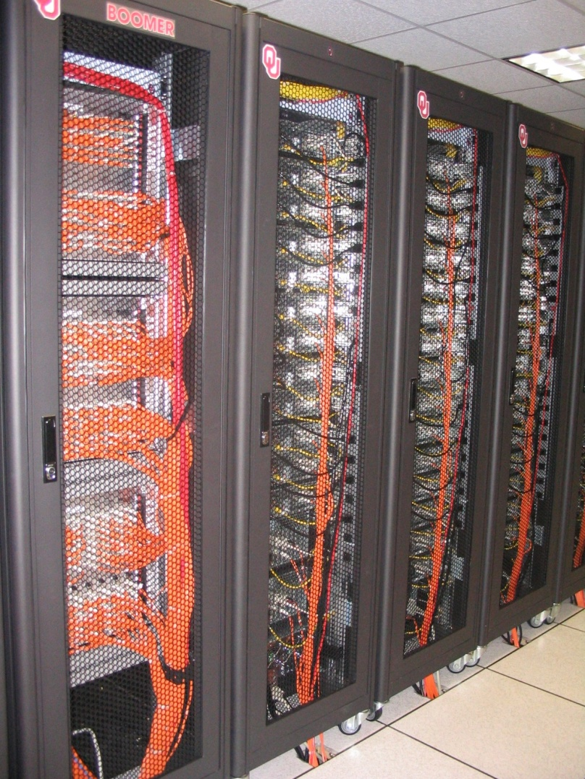

OU’s TeraFLOP Cluster, 2002
10 racks @ 1000 lbs per rack
270 Pentium4 Xeon CPUs, 2.0 GHz, 512 KB L2 cache
270 GB RAM, 400 MHz FSB
8 TB disk
Myrinet2000 Interconnect
100 Mbps Ethernet Interconnect
OS: Red Hat Linux
Peak speed: 1.08 TFLOPs
(1.08 trillion calculations per second)
One of the first Pentium4 clusters!
boomer.oscer.ou.edu

Slide 5
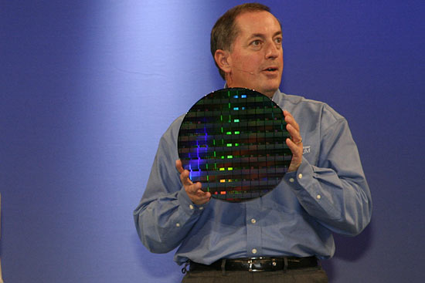
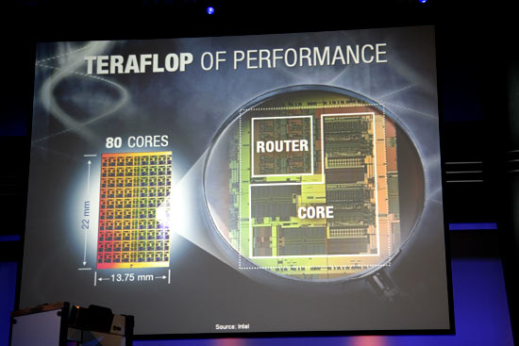
TeraFLOP, Prototype 2006
4 years from room to research chip!
http://news.com.com/2300-1006_3-6119652.html

Slide 6
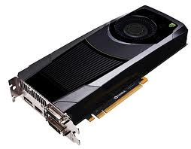
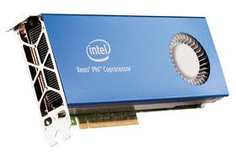
1 TFLOPs Accelerator Cards
NVIDIA Kepler
Intel MIC (a.k.a. Xeon Phi)
https://encrypted-tbn1.google.com/images?q=tbn:ANd9GcR54ueFclKjDsoHQ7rcM9c1Y8lMEBT0cgrbQenvyhFobr_WY5v-
https://encrypted-tbn0.google.com/images?q=tbn:ANd9GcQIsf2A8XlkilhxIMYl4XWnd5g6VKYjXkKIKngkg36G_jmaTPuiAg
10 years from room to card!

Slide 7
Moore’s Law
In 1965, Gordon Moore was an engineer at Fairchild Semiconductor.
He noticed that the number of transistors that could be squeezed onto a chip was doubling about every 18 months.
It turns out that computer speed is roughly proportional to the number of transistors per unit area.
Moore wrote a paper about this concept, which became known as “Moore’s Law.”

Slide 8
Moore’s Law in Practice
CPU
log(Speed)
Year

Slide 9
Moore’s Law in Practice
Network Bandwidth
CPU
log(Speed)
Year

Slide 10
Moore’s Law in Practice
Network Bandwidth
CPU
log(Speed)
RAM
Year

Slide 11
Moore’s Law in Practice
Network Bandwidth
log(Speed)
CPU
RAM
1/Network Latency
Year

Slide 12
Moore’s Law in Practice
Network Bandwidth
CPU
log(Speed)
RAM
1/Network Latency
Software
Year

Slide 13
Fastest Supercomputer vs. Moore
Speed in GFLOPs
GFLOPs:
billions of calculations per second
1993: 1024 CPU cores
Year

Slide 14
The Tyranny of the Storage Hierarchy

Slide 15
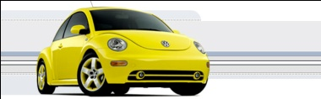
The Storage Hierarchy
Fast, expensive, few
Registers
Cache memory
Main memory (RAM)
Hard disk
Removable media (CD, DVD etc)
Internet
Slow, cheap, a lot
[5]

Slide 16

RAM is Slow
CPU
307 GB/sec^{[6]}
The speed of data transfer
between Main Memory and the
CPU is much slower than the
speed of calculating, so the CPU
spends most of its time waiting
for data to come in or go out.
Bottleneck
4.4 GB/sec^{[7]} (1.4%)

Slide 17
Why Have Cache?
CPU
Cache is much closer to the speed
of the CPU, so the CPU doesn’t
have to wait nearly as long for
stuff that’s already in cache:
it can do more
operations per second!
27 GB/sec (9%)^{[7]}
4.4 GB/sec^{[7]} (1%)

Slide 18
A Laptop
Dell Latitude Z600^{[4]}
Intel Core2 Duo SU9600 1.6 GHz w/3 MB L2 Cache
4 GB 1066 MHz DDR3 SDRAM
256 GB SSD Hard Drive
DVD+RW/CD-RW Drive (8x)
1 Gbps Ethernet Adapter

Slide 19
Storage Speed, Size, Cost
Laptop | Registers (Intel Core2 Duo 1.6 GHz) | Cache Memory (L2) | Main Memory (1066MHz DDR3 SDRAM) | Hard Drive (SSD) | Ethernet (1000 Mbps) | DVD+R (16x) | Phone Modem (56 Kbps)
Speed (MB/sec) [peak] | 314,573^{[6]} (12,800 MFLOP/s*) | 27,276 ^{[7]} | 4500 ^{[7]} | 250 ^{[9]} | 125 | 22 ^{[10]} | 0.007
Size (MB) | 464 bytes** ^{[11]} | 3 | 4096 | 256,000 | unlimited | unlimited | unlimited
Cost ($/MB) | – | $285 ^{[13]} | $0.03 ^{[12]} | $0.002 ^{[12]} | charged per month (typically) | $0.00005 ^{[12]} | charged per month (typically)
* MFLOP/s: millions of floating point operations per second
** 16 64-bit general purpose registers, 8 80-bit floating point registers,
16 128-bit floating point vector registers

Slide 20
Storage Use Strategies
Register reuse: Do a lot of work on the same data before working on new data.
Cache reuse: The program is much more efficient if all of the data and instructions fit in cache; if not, try to use what’s in cache a lot before using anything that isn’t in cache.
Data locality: Try to access data that are near each other in memory before data that are far.
I/O efficiency: Do a bunch of I/O all at once rather than a little bit at a time; don’t mix calculations and I/O.

Slide 21
A Concrete Example
Consider a cluster with Harpertown CPUs: quad core, 2.0 GHz, 1333 MHz Front Side Bus.
The theoretical peak CPU speed is 32 GFLOPs (double precision) per CPU chip, and in practice the benchmark per core as 87% of that (93% for a single core). For a dual chip node, the peak is 64 GFLOPs.
Each double precision calculation is 2 8-byte operands and one 8-byte result, so 24 bytes get moved between RAM and CPU.
So, in theory each node could transfer up to 1536 GB/sec.
The theoretical peak RAM bandwidth is 21 GB/sec (but in practice benchmarks have shown 3.4 GB/sec).
So, even at theoretical peak, any code that does less than 73 calculations per byte transferred between RAM and cache has speed limited by RAM bandwidth.

Slide 22
Good Cache Reuse Example

Slide 23
A Sample Application
Matrix-Matrix Multiply
Let A, B and C be matrices of sizes
nr × nc, nr × nk and nk × nc, respectively:
The definition of A = B • C is
for r ∈ {1, nr}, c ∈ {1, nc}.

Slide 24
Matrix Multiply: Naïve Version
SUBROUTINE matrix_matrix_mult_naive (dst, src1, src2, &
& nr, nc, nq)
IMPLICIT NONE
INTEGER,INTENT(IN) :: nr, nc, nq
REAL,DIMENSION(nr,nc),INTENT(OUT) :: dst
REAL,DIMENSION(nr,nq),INTENT(IN) :: src1
REAL,DIMENSION(nq,nc),INTENT(IN) :: src2
INTEGER :: r, c, q
DO c = 1, nc
DO r = 1, nr
dst(r,c) = 0.0
DO q = 1, nq
dst(r,c) = dst(r,c) + src1(r,q) * src2(q,c)
END DO
END DO
END DO
END SUBROUTINE matrix_matrix_mult_naive

Slide 25
Performance of Matrix Multiply
Better

Slide 26
Tiling

Slide 27
Tiling
Tile: A small rectangular subdomain of a problem domain. Sometimes called a block or a chunk.
Tiling: Breaking the domain into tiles.
Tiling strategy: Operate on each tile to completion, then move to the next tile.
Tile size can be set at runtime, according to what’s best for the machine that you’re running on.

Slide 28
Tiling Code
SUBROUTINE matrix_matrix_mult_by_tiling (dst, src1, src2, nr, nc, nq, &
& rtilesize, ctilesize, qtilesize)
IMPLICIT NONE
INTEGER,INTENT(IN) :: nr, nc, nq
REAL,DIMENSION(nr,nc),INTENT(OUT) :: dst
REAL,DIMENSION(nr,nq),INTENT(IN) :: src1
REAL,DIMENSION(nq,nc),INTENT(IN) :: src2
INTEGER,INTENT(IN) :: rtilesize, ctilesize, qtilesize
INTEGER :: rstart, rend, cstart, cend, qstart, qend
DO cstart = 1, nc, ctilesize
cend = cstart + ctilesize - 1
IF (cend > nc) cend = nc
DO rstart = 1, nr, rtilesize
rend = rstart + rtilesize - 1
IF (rend > nr) rend = nr
DO qstart = 1, nq, qtilesize
qend = qstart + qtilesize - 1
IF (qend > nq) qend = nq
CALL matrix_matrix_mult_tile(dst, src1, src2, nr, nc, nq, &
& rstart, rend, cstart, cend, qstart, qend)
END DO
END DO
END DO
END SUBROUTINE matrix_matrix_mult_by_tiling

Slide 29
Multiplying Within a Tile
SUBROUTINE matrix_matrix_mult_tile (dst, src1, src2, nr, nc, nq, &
& rstart, rend, cstart, cend, qstart, qend)
IMPLICIT NONE
INTEGER,INTENT(IN) :: nr, nc, nq
REAL,DIMENSION(nr,nc),INTENT(OUT) :: dst
REAL,DIMENSION(nr,nq),INTENT(IN) :: src1
REAL,DIMENSION(nq,nc),INTENT(IN) :: src2
INTEGER,INTENT(IN) :: rstart, rend, cstart, cend, qstart, qend
INTEGER :: r, c, q
DO c = cstart, cend
DO r = rstart, rend
IF (qstart == 1) dst(r,c) = 0.0
DO q = qstart, qend
dst(r,c) = dst(r,c) + src1(r,q) * src2(q,c)
END DO
END DO
END DO
END SUBROUTINE matrix_matrix_mult_tile

Slide 30
Reminder: Naïve Version, Again
SUBROUTINE matrix_matrix_mult_naive (dst, src1, src2, &
& nr, nc, nq)
IMPLICIT NONE
INTEGER,INTENT(IN) :: nr, nc, nq
REAL,DIMENSION(nr,nc),INTENT(OUT) :: dst
REAL,DIMENSION(nr,nq),INTENT(IN) :: src1
REAL,DIMENSION(nq,nc),INTENT(IN) :: src2
INTEGER :: r, c, q
DO c = 1, nc
DO r = 1, nr
dst(r,c) = 0.0
DO q = 1, nq
dst(r,c) = dst(r,c) + src1(r,q) * src2(q,c)
END DO
END DO
END DO
END SUBROUTINE matrix_matrix_mult_naive

Slide 31
Performance with Tiling
Better

Slide 32
The Advantages of Tiling
It allows your code to exploit data locality better, to get much more cache reuse: your code runs faster!
It’s a relatively modest amount of extra coding (typically a few wrapper functions and some changes to loop bounds).
If you don’t need tiling – because of the hardware, the compiler or the problem size – then you can turn it off by simply setting the tile size equal to the problem size.

Slide 33
Why Does Tiling Work Here?
Cache optimization works best when the number of calculations per byte is large.
For example, with matrix-matrix multiply on an n × n matrix, there are O(n³) calculations (on the order of n³), but only O(n²) bytes of data.
So, for large n, there are a huge number of calculations per byte transferred between RAM and cache.

Slide 34
Will Tiling Always Work?
Tiling WON’T always work. Why?
Well, tiling works well when:
the order in which calculations occur doesn’t matter much, AND
there are lots and lots of calculations to do for each memory movement.
If either condition is absent, then tiling won’t help.

Slide 35
Multicore/Many-core Basics

Slide 36
What is Multicore?
In the olden days (that is, the first half of 2005), each CPU chip had one “brain” in it.
Starting the second half of 2005, each CPU chip can have up to 2 cores (brains); starting in late 2006, 4 cores; starting in late 2008, 6 cores; in early 2010, 8 cores; in mid 2010, 12 cores; in 2011, 16 cores (AMD).
Jargon: Each CPU chip plugs into a socket, so these days, to avoid confusion, people refer to sockets and cores, rather than CPUs or processors.
Each core is just like a full blown CPU, except that it shares its socket (and maybe some of its cache) with one or more other cores – and therefore shares its bandwidth to RAM with them.

Slide 37
Dual Core
Core Core

Slide 38
Quad Core
Core Core
Core Core

Slide 39
Oct Core
Core Core Core Core
Core Core Core Core

Slide 40
The Challenge of Multicore: RAM
Each socket has access to a certain amount of RAM, at a fixed RAM bandwidth per SOCKET – or even per node.
As the number of cores per socket increases, the contention for RAM bandwidth increases too.
At 2 or even 4 cores in a socket, this problem isn’t too bad. But at 16 or 32 or 80 cores, it’s a huge problem.
So, applications that are cache optimized will get big speedups.
But, applications whose performance is limited by RAM bandwidth are going to speed up only as fast as RAM bandwidth speeds up.
RAM bandwidth speeds up much slower than CPU speeds up.

Slide 41
The Challenge of Multicore: Network
Each node has access to a certain number of network ports, at a fixed number of network ports per NODE.
As the number of cores per node increases, the contention for network ports increases too.
At 2 or 4 cores in a socket, this problem isn’t too bad. But at 16 or 32 or 80 cores, it’s a huge problem.
So, applications that do minimal communication will get big speedups.
But, applications whose performance is limited by the number of MPI messages are going to speed up very very little – and may even crash the node.

Slide 42
A Concrete Example:
Weather Forecasting

Slide 43
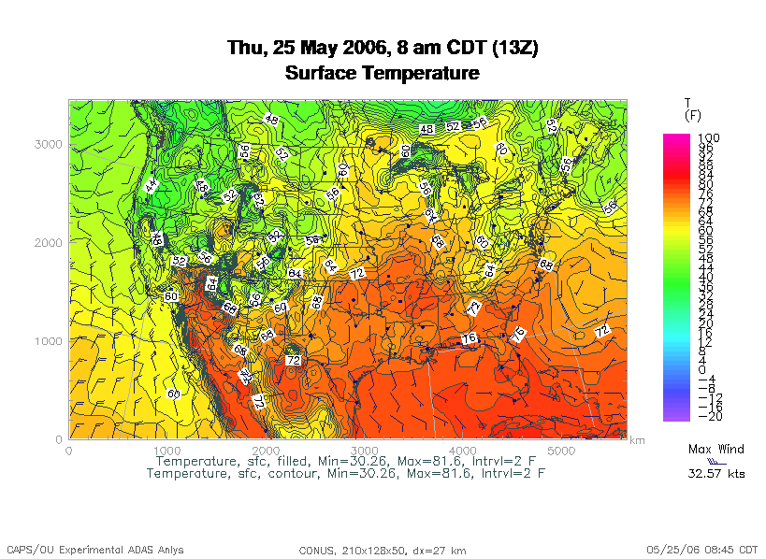
Weather Forecasting
http://www.caps.ou.edu/wx/p/r/conus/fcst/

Slide 44
Weather Forecasting
Weather forecasting is a transport problem.
The goal is to predict future weather conditions by simulating the movement of fluids in Earth’s atmosphere.
The physics is the Navier-Stokes Equations.
The numerical method is Finite Difference.

Slide 45
Cartesian Mesh

Slide 46
Finite Difference
unew(i,j,k) = F(uold, i, j, k, Δt) =
F(uold(i,j,k),
uold(i-1,j,k), uold(i+1,j,k),
uold(i,j-1,k), uold(i,j+1,k),
uold(i,j,k-1), uold(i,j,k+1), Δt)

Slide 47
Ghost Boundary Zones

Slide 48
Virtual Memory

Slide 49
Virtual Memory
Typically, the amount of main memory (RAM) that a CPU can address is larger than the amount of data physically present in the computer.
For example, consider a laptop that can address 16 GB of main memory (roughly 16 billion bytes), but only contains 2 GB (roughly 2 billion bytes).
NCSI Parallel & Cluster: Multicore Madness
U Oklahoma, July 29 - Aug 4 2012

Slide 50
Virtual Memory (cont’d)
Locality: Most programs don’t jump all over the memory that they use; instead, they work in a particular area of memory for a while, then move to another area.
So, you can offload onto hard disk much of the memory image of a program that’s running.
NCSI Parallel & Cluster: Multicore Madness
U Oklahoma, July 29 - Aug 4 2012

Slide 51
Virtual Memory (cont’d)
Memory is chopped up into many pages of modest size (e.g., 1 KB – 32 KB; typically 4 KB).
Only pages that have been recently used actually reside in memory; the rest are stored on hard disk.
Hard disk is typically 0.1% as fast as main memory, so you get better performance if you rarely get a page fault, which forces a read from (and maybe a write to) hard disk: exploit data locality!
NCSI Parallel & Cluster: Multicore Madness
U Oklahoma, July 29 - Aug 4 2012

Slide 52
Cache vs. Virtual Memory
Lines (cache) vs. pages (VM)
Cache faster than RAM (cache) vs. RAM faster than disk (VM)
NCSI Parallel & Cluster: Multicore Madness
U Oklahoma, July 29 - Aug 4 2012

Slide 53
Virtual Memory
Every CPU family today uses virtual memory, in which disk pretends to be a bigger RAM.
Virtual memory capability can’t be turned off.
RAM is split up into pages, typically 4 KB each.
Each page is either in RAM or out on disk.
To keep track of the pages, a page table notes whether each table is in RAM, where it is in RAM (that is, physical address and virtual address are different), and some other information.
So, a 4 GB physical RAM would need over a million page table entries.

Slide 54
Why Virtual Memory is Slow
When you want to access a byte of memory, you have to find out whether it’s in physical memory (RAM) or virtual disk (disk) – and the page table is in RAM!
A page table of a million entries can’t fit in a 2 MB cache.
So, each memory access (load or store) is actually 2 memory accesses: the first for the page table entry, and the second for the data itself.
This is slow!
And notice, this is assuming that you don’t need more memory than your physical RAM.

Slide 55
The Notorious T.L.B.
To speed up memory accesses, CPUs today have a special cache just for page table entries, known as the Translation Lookaside Buffer (TLB).
The size of TLBs varies from 64 entries to 1024 entries, depending on chip families.
At 4 KB pages, this means that the size of cache covered by the TLB varies from 256 KB to 4 MB.
Some TLBs allow large pages (1 MB to a few GB) – but the operating systems often provide poor or no support.

Slide 56
The T.L.B. on a Recent Chip
On Intel Core Duo (“Yonah”):
Cache size is 2 MB per core.
Page size is 4 KB.
A core’s data TLB size is 128 page table entries.
Therefore, D-TLB only covers 512 KB of cache.

Slide 57
The T.L.B. on a Recent Chip
On Intel Core Duo (“Yonah”):
Cache size is 2 MB per core.
Page size is 4 KB.
A core’s data TLB size is 128 page table entries.
Therefore, D-TLB only covers 512 KB of cache.
Mesh: At 100 vertical levels of 150 single precision variables, 512 KB is a 3 x 3 vertical domain – nothing but ghost zones!
The cost of a TLB miss is 49 cycles, equivalent to as many as 196 calculations! (4 FLOPs per cycle)
http://www.digit-life.com/articles2/cpu/rmma-via-c7.html

Slide 58
Software Strategies for Weather Forecasting on Multicore/Many-core

Slide 59
Tiling NOT Good for Weather Codes
Weather codes typically have on the order of 150 3D arrays used in each timestep (some transferred multiple times in the same timestep, but let’s ignore that for simplicity).
These arrays typically are single precision (4 bytes per floating point value).
So, a typical weather code uses about 600 bytes per mesh zone per timestep.
Weather codes typically do 5,000 to 10,000 calculations per mesh zone per timestep.
So, the ratio of calculations to data is less than 20 to 1 – much less than the 73 to 1 needed (on mid-2008 hardware).

Slide 60
Weather Forecasting and Cache
On current weather codes, data decomposition is per process. That is, each process gets one subdomain.
As CPUs speed up and RAM sizes grow, the size of each processor’s subdomain grows too.
However, given RAM bandwidth limitations, this means that performance can only grow with RAM speed – which increases slower than CPU speed.
If the codes were optimized for cache, would they speed up more?
First: How to optimize for cache?

Slide 61
How to Get Good Cache Reuse?
Multiple independent subdomains per processor.
Each subdomain fits entirely in L2 cache.
Each subdomain’s page table entries fit entirely in the TLB.
Expanded ghost zone stencil allows multiple timesteps before communicating with neighboring subdomains.
Parallelize along the Z-axis as well as X and Y.
Use higher order numerical schemes.
Reduce the memory footprint as much as possible.
Coincidentally, this also reduces communication cost.

Slide 62
Cache Optimization Strategy: Tiling?
Would tiling work as a cache optimization strategy for weather forecasting codes?

Slide 63
Multiple Subdomains Per Core
Core 0
Core 2
Core 3
Core 1

Slide 64
Why Multiple Subdomains?
If each subdomain fits in cache, then the CPU can bring all the data of a subdomain into cache, chew on it for a while, then move on to the next subdomain: lots of cache reuse!
Oh, wait, what about the TLB? Better make the subdomains smaller! (So more of them.)
But, doesn’t tiling have the same effect?

Slide 65
Why Independent Subdomains?
Originally, the point of this strategy was to hide the cost of communication.
When you finish chewing up a subdomain, send its data to its neighbors non-blocking (MPI_Isend).
While the subdomain’s data is flying through the interconnect, work on other subdomains, which hides the communication cost.
When it’s time to work on this subdomain again, collect its data (MPI_Waitall).
If you’ve done enough work, then the communication cost is zero.

Slide 66
Expand the Array Stencil
If you expand the array stencil of each subdomain beyond the numerical stencil, then you don’t have to communicate as often.
When you communicate, instead of sending a slice along each face, send a slab, with extra stencil levels.
In the first timestep after communicating, do extra calculations out to just inside the numerical stencil.
In subsequent timesteps, calculate fewer and fewer stencil levels, until it’s time to communicate again – less total communication, and more calculations to hide the communication cost underneath!

Slide 67
An Extra Win!
If you do all this, there’s an amazing side effect: you get better cache reuse, because you stick with the same subdomain for a longer period of time.
So, instead of doing, say, 5000 calculations per zone per timestep, you can do 15000 or 20000.
So, you can better amortize the cost of transferring the data between RAM and cache.

Slide 68
New Algorithm (F90)
DO timestep = 1, number_of_timesteps, extra_stencil_levels
DO subdomain = 1, number_of_local_subdomains
CALL receive_messages_nonblocking(subdomain,
timestep)
DO extra_stencil_level=0, extra_stencil_levels - 1
CALL calculate_entire_timestep(subdomain,
timestep + extra_stencil_level)
END DO
CALL send_messages_nonblocking(subdomain,
timestep + extra_stencil_levels)
END DO
END DO

Slide 69
New Algorithm (C)
for (timestep = 0;
timestep < number_of_timesteps;
timestep += extra_stencil_levels) {
for (subdomain = 0;
subdomain < number_of_local_subdomains;
subdomain++) {
receive_messages_nonblocking(subdomain, timestep);
for (extra_stencil_level = 0;
extra_stencil_level < extra_stencil_levels;
extra_stencil_level++) {
calculate_entire_timestep(subdomain,
timestep + extra_stencil_level);
} /* for extra_stencil_level */
send_messages_nonblocking(subdomain,
timestep + extra_stencil_levels);
} /* for subdomain */
} /* for timestep */

Slide 70
Higher Order Numerical Schemes
Higher order numerical schemes are great, because they require more calculations per mesh zone per timestep, which you need to amortize the cost of transferring data between RAM and cache. Might as well!
Plus, they allow you to use a larger time interval per timestep (dt), so you can do fewer total timesteps for the same accuracy – or you can get higher accuracy for the same number of timesteps.

Slide 71
Parallelize in Z
Most weather forecast codes parallelize in X and Y, but not in Z, because gravity makes the calculations along Z more complicated than X and Y.
But, that means that each subdomain has a high number of zones in Z, compared to X and Y.
For example, a 1 km CONUS run will probably have 100 zones in Z (25 km at 0.25 km resolution).

Slide 72
Multicore/Many-core Problem
Most multicore chip families have relatively small cache per core (for example, 1 - 4 MB per core at the highest/slowest cache level) – and this problem seems likely to remain.
Small TLBs make the problem worse: 512 KB per core rather than 1 - 4 MB.
So, to get good cache reuse, you need subdomains of no more than 512 KB.
If you have 150 3D variables at single precision, and 100 zones in Z, then your horizontal size will be 3 x 3 zones – just enough for your stencil!

Slide 73
What Do We Need?
We need much bigger caches!
  16 MB cache ➔ 16 x 16 horizontal including stencil
  32 MB cache ➔ 23 x 23 horizontal including stencil
TLB must be big enough to cover the entire cache.
It’d be nice to have RAM speed increase as fast as core counts increase, but let’s not kid ourselves.
Keep this in mind when we get to GPGPU!

Slide 74


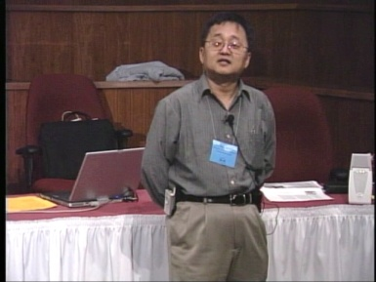
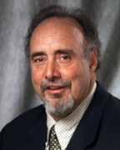

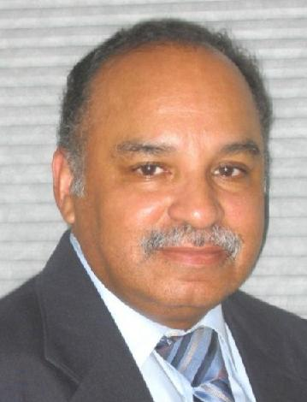
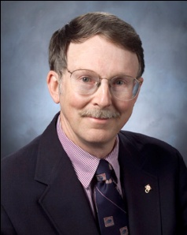
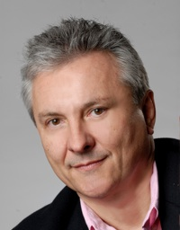
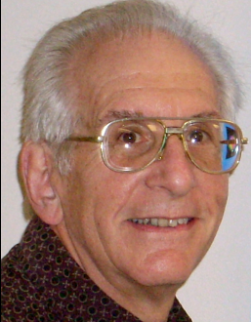
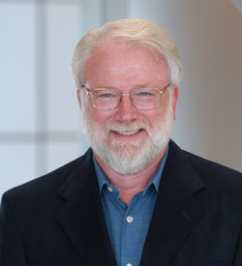
OK Supercomputing Symposium 2012
2003 Keynote:
Peter Freeman
NSF
Computer & Information
Science & Engineering
Assistant Director
2004 Keynote:
Sangtae Kim
NSF Shared
Cyberinfrastructure
Division Director
2005 Keynote:
Walt Brooks
NASA Advanced
Supercomputing
Division Director
2006 Keynote:
Dan Atkins
Head of NSF’s
Office of
Cyberinfrastructure
2007 Keynote:
Jay Boisseau
Director
Texas Advanced
Computing Center
U. Texas Austin
2008 Keynote: José Munoz Deputy Office Director/ Senior Scientific Advisor NSF Office of Cyberinfrastructure
Thom Dunning, Director
National Center for Supercomputing
Applications
2009 Keynote: Douglass Post Chief Scientist US Dept of Defense HPC Modernization Program
2010 Keynote: Horst Simon Deputy Director Lawrence Berkeley National Laboratory
FREE! Wed Oct 3 2012 @ OU
Over 235 registra2ons already!
Over 150 in the first day, over 200 in the first week, over 225 in the first month.
2011 Keynote: Barry Schneider Program Manager National Science Foundation
http://symposium2012.oscer.ou.edu/
Reception/Poster Session
FREE! Tue Oct 2 2012 @ OU
FREE! Symposium Wed Oct 3 2012 @ OU

Slide 75
Thanks for your attention!
Questions? www.oscer.ou.edu

Slide 76
References
[1] Image by Greg Bryan, Columbia U.
[2] “Update on the Collaborative Radar Acquisition Field Test (CRAFT): Planning for the Next Steps.”
Presented to NWS Headquarters August 30 2001.
[3] See http://hneeman.oscer.ou.edu/hamr.html for details.
[4] http://www.dell.com/
[5] http://www.vw.com/newbeetle/
[6] Richard Gerber, The Software Optimization Cookbook: High-performance Recipes for the Intel Architecture. Intel Press, 2002, pp. 161-168.
[7] RightMark Memory Analyzer. http://cpu.rightmark.org/
[8] ftp://download.intel.com/design/Pentium4/papers/24943801.pdf
[9] http://www.seagate.com/cda/products/discsales/personal/family/0,1085,621,00.html
[10] http://www.samsung.com/Products/OpticalDiscDrive/SlimDrive/OpticalDiscDrive_SlimDrive_SN_S082D.asp?page=Specifications
[11] ftp://download.intel.com/design/Pentium4/manuals/24896606.pdf
[12] http://www.pricewatch.com/

