Slide 1








Introduction to Parallel Programming & Cluster Computing
MPI Collective Communications
Joshua Alexander, U Oklahoma
Ivan Babic, Earlham College
Michial Green, Contra Costa College
Mobeen Ludin, Earlham College
Tom Murphy, Contra Costa College
Kristin Muterspaw, Earlham College
Henry Neeman, U Oklahoma
Charlie Peck, Earlham College

Slide 2
Point to Point Always Works
MPI_Send and MPI_Recv are known as Point to Point communications: they communicate from one MPI process to another MPI process.
But, what if you want to communicate like one of these?
  one to many
  many to one
  many to many
These are known as collective communications.
MPI_Send and MPI_Recv can accomplish any and all of these – but should you use them that way?

Slide 3
Point to Point Isn’t Always Good
We’re interested in collective communications:
  one to many
  many to one
  many to many
In principle, MPI_Send and MPI_Recv can accomplish any and all of these.
But that may be:
  inefficient;
  inconvenient and cumbersome to code.
So, the designers of MPI came up with routines that perform these collective communications for you.

Slide 4
Collective Communications
MPI_Bcast
MPI_Reduce, MPI_Allreduce
MPI_Gather, MPI_Gatherv, MPI_Allgather, MPI_Allgatherv
MPI_Scatter, MPI_Scatterv
MPI_Alltoall, MPI_Alltoallv

Slide 5
MPI_Bcast
What happens if one process has data that everyone else needs to know?
For example, what if the server process needs to send a value that it input from standard input to the other processes?
MPI_Bcast(&length, 1, MPI_INTEGER,
source, MPI_COMM_WORLD);
Notice:
MPI_Bcast doesn’t use a tag.
The call is the same for both the sender and all of the receivers (COUNTERINTUITIVE!).
All processes have to call MPI_Bcast at the same time; everyone waits until everyone is done.

Slide 6
Broadcast Example Part 1
#include <stdio.h>
#include <stdlib.h>
#include <math.h>
#include <mpi.h>
int main (int argc, char** argv)
{ /* main */
const int server = 0;
const int source = server;
float* array = (float*)NULL;
int length, index;
int number_of_processes, my_rank, mpi_error_code;
mpi_error_code = MPI_Init(&argc, &argv);
mpi_error_code = MPI_Comm_rank(MPI_COMM_WORLD, &my_rank);
mpi_error_code = MPI_Comm_size(MPI_COMM_WORLD,
&number_of_processes);

Slide 7
Broadcast Example Part 2
if (my_rank == source) {
scanf("%d", &length);
} /* if (my_rank == source) */
fprintf(stderr, "%d: before MPI_Bcast, length = %d\n",
my_rank, length);
mpi_error_code =
MPI_Bcast(&length, 1, MPI_INTEGER, source, MPI_COMM_WORLD);
fprintf(stderr, "%d: after MPI_Bcast, length = %d\n",
my_rank, length);
array = (float*)malloc(sizeof(float) * length);
if (my_rank == source) {
for (index = 0; index < length; index++) {
array[index] = sqrt(index * 1.0); /* Or whatever you want */
} /* for index */
} /* if (my_rank == source) */
mpi_error_code =
MPI_Bcast(array, length, MPI_FLOAT, source, MPI_COMM_WORLD);
mpi_error_code = MPI_Finalize();
} /* main */

Slide 8
Broadcast Compile & Run
% mpicc -o mpibroadcast mpibroadcast.c -lm
% mpirun -np 8 mpibroadcast
4: before MPI_Bcast, length = 0
7: before MPI_Bcast, length = 0
3: before MPI_Bcast, length = 0
5: before MPI_Bcast, length = 0
6: before MPI_Bcast, length = 0
2: before MPI_Bcast, length = 0
0: before MPI_Bcast, length = 1000000
0: after MPI_Bcast, length = 1000000
2: after MPI_Bcast, length = 1000000
4: after MPI_Bcast, length = 1000000
5: after MPI_Bcast, length = 1000000
7: after MPI_Bcast, length = 1000000
6: after MPI_Bcast, length = 1000000
3: after MPI_Bcast, length = 1000000
1: before MPI_Bcast, length = 0
1: after MPI_Bcast, length = 1000000

Slide 9
Reductions
A reduction converts an array to a scalar: for example, sum, product, minimum value, maximum value, Boolean AND, Boolean OR, etc.
Reductions are so common, and so important, that MPI has two routines to handle them:
MPI_Reduce: sends result to a single specified process
MPI_Allreduce: sends result to all processes (and therefore may take longer)

Slide 10
Reduction Example Part 1
#include <stdio.h>
#include <stdlib.h>
#include <mpi.h>
int main (int argc, char** argv)
{ /* main */
const int server = 0;
const int destination = server;
int value, value_sum;
int number_of_processes, my_rank, mpi_error_code;
mpi_error_code = MPI_Init(&argc, &argv);
mpi_error_code = MPI_Comm_rank(MPI_COMM_WORLD, &my_rank);
mpi_error_code = MPI_Comm_size(MPI_COMM_WORLD,
&number_of_processes);

Slide 11
Reduction Example Part 1
value = my_rank * number_of_processes;
fprintf(stderr, "%d: reduce value = %d\n",
my_rank, value);
mpi_error_code =
MPI_Reduce (&value, &value_sum, 1, MPI_INT, MPI_SUM,
destination, MPI_COMM_WORLD);
fprintf(stderr, "%d: reduce value_sum = %d\n",
my_rank, value_sum);
mpi_error_code =
MPI_Allreduce(&value, &value_sum, 1, MPI_INT, MPI_SUM,
MPI_COMM_WORLD);
fprintf(stderr, "%d: allreduce value_sum = %d\n",
my_rank, value_sum);
mpi_error_code = MPI_Finalize();
} /* main */

Slide 12
Reduce: Compiling and Running
% mpicc -o mpireduce mpireduce.c
% mpirun -np 8 mpireduce
0: reduce value = 0
4: reduce value = 32
6: reduce value = 48
7: reduce value = 56
3: reduce value = 24
2: reduce value = 16
5: reduce value = 40
1: reduce value = 8
7: reduce value_sum = -9120
3: reduce value_sum = -9120
2: reduce value_sum = -9120
5: reduce value_sum = -9120
1: reduce value_sum = -9120
6: reduce value_sum = -9120
4: reduce value_sum = -9120
0: reduce value_sum = 224
2: allreduce value_sum = 224
7: allreduce value_sum = 224
4: allreduce value_sum = 224
3: allreduce value_sum = 224
1: allreduce value_sum = 224
5: allreduce value_sum = 224
0: allreduce value_sum = 224
6: allreduce value_sum = 224

Slide 13
Why Two Reduction Routines?
MPI has two reduction routines because of the high cost of each communication.
If only one process needs the result, then it doesn’t make sense to pay the cost of sending the result to all processes.
But if all processes need the result, then it may be cheaper to reduce to all processes than to reduce to a single process and then broadcast to all.
You can think of MPI_Allreduce as MPI_Reduce followed by MPI_Bcast (though it doesn’t have to be implemented that way).

Slide 14
Reduction on Arrays #1
MPI_Reduce and MPI_Allreduce are actually designed to work on arrays, where the corresponding elements of each source array are reduced into the corresponding element of the destination array (all of the same length):
MPI_Allreduce(source_array, destination_array,
number_of_array_elements,
MPI_DATATYPE, MPI_OPERATION, MPI_COMMUNICATOR);
For example:
MPI_Allreduce(local_force_on_particle, global_force_on_particle,
number_of_particles,
MPI_FLOAT, MPI_SUM, MPI_COMM_WORLD);

Slide 15
Reduction on Arrays #2
MPI_Allreduce(local_force_on_particle, global_force_on_particle,
number_of_particles,
MPI_FLOAT, MPI_SUM, MPI_COMM_WORLD);
global_force_on_particle[p] =
local_force_on_particle[p] on Rank 0 +
local_force_on_particle[p] on Rank 1 +
local_force_on_particle[p] on Rank 2 +
...
local_force_on_particle[p] on Rank np–1;

Slide 16
Scatter and Gather
To scatter is to send data from one place to many places.
To gather is to receive data from many places into one place.
MPI has a variety of scatter and gather routines:
  MPI_Scatter, MPI_Scatterv
  MPI_Gather, MPI_Gatherv, MPI_Allgather, MPI_Allgatherv
The scatter routines split up a single larger array into smaller subarrays, one per MPI process, and send each subarray to an MPI process.
The gather routines receive many smaller subarrays, one per MPI process, and assemble them into a single larger array.

Slide 17
MPI_Scatter
MPI_Scatter takes an array whose length is divisible by the number of MPI processes, and splits it up into subarrays of equal length, then sends one subarray to each MPI process.
MPI_Scatter(large_array, small_array_length,
MPI_DATATYPE,
small_subarray, small_subarray_length,
MPI_DATATYPE, source, MPI_COMMUNICATOR);
So, for a large array of length 100 on 5 MPI processes:
each smaller subarray has length 20;
large_array[ 0] .. large_array[19] go to small_array on Rank 0;
large_array[20]..large_array[39] go to small_array on Rank 1;
etc

Slide 18
MPI_Scatterv
MPI_Scatterv is just like MPI_Scatter, except that the subarray lengths don’t have to be the same (and therefore the length of the large array doesn’t have to be divisible by the number of MPI processes).
MPI_Scatterv(large_array, small_subarray_lengths,
displacements,
MPI_DATATYPE,
small_subarray, small_subarray_lengths,
MPI_DATATYPE, source, MPI_COMMUNICATOR);
The displacements array says where each small subarray begins within the large array.

Slide 19
MPI_Gather
MPI_Gather receives a small array on each of the MPI processes, all subarrays of equal length, and joins them into a single large array on the destination MPI process.
MPI_Gather(small_subarray, small_subarray_length,
MPI_DATATYPE,
large_array, large_array_length,
MPI_DATATYPE, destination, MPI_COMMUNICATOR);
So, for a small subarray of length 20 on each of 5 MPI processes:
the large array on the destination process has length 100;
large_array[ 0] .. large_array[19] come from small_array on Rank 0;
large_array[20]..large_array[39] come from small_array on Rank 1;
etc

Slide 20
MPI_Gatherv
MPI_Gatherv is just like MPI_Gather, except that the subarray lengths don’t have to be the same (and therefore the length of the large array doesn’t have to be divisible by the number of MPI processes).
MPI_Gatherv(small_subarray, small_subarray_length,
MPI_DATATYPE,
large_array, small_subarray_lengths,
displacements,
MPI_DATATYPE, destination, MPI_COMMUNICATOR);
The displacements array says where each small subarray begins within the large array.

Slide 21
MPI_Allgather & MPI_Allgatherv
MPI_Allgather and MPI_Allgatherv are the same as MPI_Gather and MPI_Gatherv, except that the large array gets filled on every MPI process, so no destination process argument is needed.

Slide 22
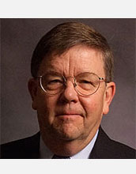

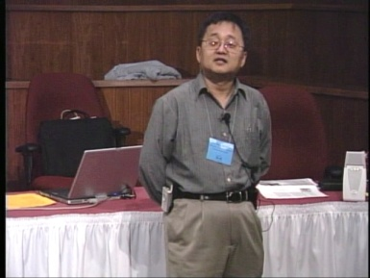
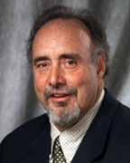

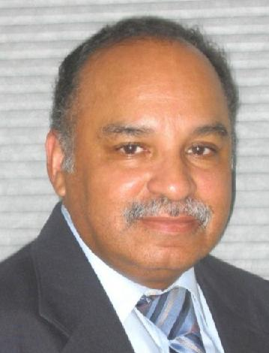
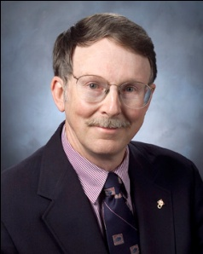
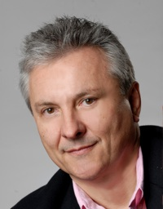
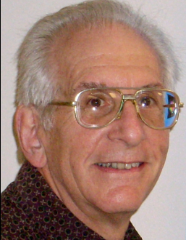
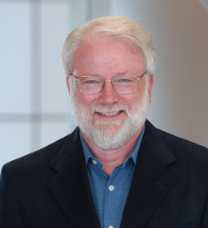
OK Supercomputing Symposium 2012
2003 Keynote:
Peter Freeman
NSF
Computer & Information
Science & Engineering
Assistant Director
2004 Keynote:
Sangtae Kim
NSF Shared
Cyberinfrastructure
Division Director
2005 Keynote:
Walt Brooks
NASA Advanced
Supercomputing
Division Director
2006 Keynote:
Dan Atkins
Head of NSF’s
Office of
Cyberinfrastructure
2007 Keynote:
Jay Boisseau
Director
Texas Advanced
Computing Center
U. Texas Austin
2008 Keynote: José Munoz Deputy Office Director/ Senior Scientific Advisor NSF Office of Cyberinfrastructure
Thom Dunning, Director
National Center for Supercomputing
Applications
2009 Keynote: Douglass Post Chief Scientist US Dept of Defense HPC Modernization Program
2010 Keynote: Horst Simon Deputy Director Lawrence Berkeley National Laboratory
FREE! Wed Oct 3 2012 @ OU
Over 235 registra2ons already!
Over 150 in the first day, over 200 in the first week, over 225 in the first month.
2011 Keynote: Barry Schneider Program Manager National Science Foundation
http://symposium2012.oscer.ou.edu/
Reception/Poster Session
FREE! Tue Oct 2 2012 @ OU
FREE! Symposium Wed Oct 3 2012 @ OU

Slide 23
Thanks for your attention!
Questions? www.oscer.ou.edu

