Slide 1










High Performance Computing
Modernization Program (HPCMP)
Summer 2011 Puerto Rico Workshop on
Intermediate Parallel Programming & Cluster Computing in conjunction with the National Computational Science Institute (NCSI)/ SC11 Conference
Jointly hosted at
Polytechnic U of Puerto Rico
and U Oklahoma
and available live via videoconferencing
(streaming video recordings coming soon

Slide 2
Intermediate Parallel Programming & Cluster Computing
Scientific Libraries
Joshua Alexander, University of Oklahoma
Ivan Babic, Earlham College
Andrew Fitz Gibbon, Shodor Education Foundation Inc.
Henry Neeman, University of Oklahoma
Charlie Peck, Earlham College
Skylar Thompson, University of Washington
Aaron Weeden, Earlham College
Sunday July 31 – Saturday August 6 2011

Slide 3
This is an experiment!
It’s the nature of these kinds of videoconferences that FAILURES ARE GUARANTEED TO HAPPEN! NO PROMISES!
So, please bear with us. Hopefully everything will work out well enough.
If you lose your connection, you can retry the same kind of connection, or try connecting another way.
Remember, if all else fails, you always have the toll free phone bridge to fall back on.

Slide 4
H.323 (Polycom etc)
If you want to use H.323 videoconferencing – for example, Polycom – then:
If you ARE already registered with the OneNet gatekeeper, dial 2500409.
If you AREN’T registered with the OneNet gatekeeper (which is probably the case), then:
  Dial 164.58.250.47
  When asked for the conference ID, enter:
  #0409#
Many thanks to Roger Holder and OneNet for providing this.

Slide 5
H.323 from Internet Explorer
From a Windows PC running Internet Explorer:
You MUST have the ability to install software on the PC (or have someone install it for you).
Download and install the latest Java Runtime Environment (JRE) from here
(click on the Java Download icon, because that install package includes both the JRE and other components).
Download and install this video decoder.
Start Internet Explorer.
Copy-and-paste this URL into your IE window:
http://164.58.250.47/
When that webpage loads, in the upper left, click on "Streaming".
In the textbox labeled Sign-in Name, type your name.
In the textbox labeled Conference ID, type this:
0409
Click on "Stream this conference".
When that webpage loads, you may see, at the very top, a bar offering you options.
If so, click on it and choose "Install this add-on."

Slide 6
EVO
There’s a quick description of how to use EVO on the workshop logistics webpage.

Slide 7
Phone Bridge
If all else fails, you can call into our toll free phone bridge:
1-800-832-0736
* 623 2874 #
Please mute yourself and use the phone to listen.
Don’t worry, we’ll call out slide numbers as we go.
Please use the phone bridge ONLY if you cannot connect any other way: the phone bridge is charged per connection per minute, so our preference is to minimize the number of connections.
Many thanks to OU Information Technology for providing the toll free phone bridge.

Slide 8
Please Mute Yourself
No matter how you connect, please mute yourself, so that we cannot hear you.
At ISU and UW, we will turn off the sound on all conferencing technologies.
That way, we won’t have problems with echo cancellation.
Of course, that means we cannot hear questions.
So for questions, you’ll need to send some kind of text.

Slide 9
Thanks for helping!
OSCER operations staff (Brandon George, Dave Akin, Brett Zimmerman, Josh Alexander, Patrick Calhoun)
Kevin Blake, OU IT (videographer)
James Deaton and Roger Holder, OneNet
Keith Weber, Abel Clark and Qifeng Wu, Idaho State U Pocatello
Nancy Glenn, Idaho State U Boise
Jeff Gardner and Marya Dominik, U Washington
Ken Gamradt, South Dakota State U
Jeff Rufinus, Widener U
Scott Lathrop, SC11 General Chair
Donna Cappo, ACM
Bob Panoff, Jack Parkin and Joyce South, Shodor Education Foundation Inc
ID, NM, NV EPSCoR (co-sponsors)
SC11 conference (co-sponsors)

Slide 10
Questions via Text: Piazza
Ask questions via:
http://www.piazza.com/
All questions will be read out loud and then answered out loud.
NOTE: Because of image-and-likeness rules, people attending remotely offsite via videoconferencing CANNOT ask questions via voice.

Slide 11
This is an experiment!
It’s the nature of these kinds of videoconferences that FAILURES ARE GUARANTEED TO HAPPEN! NO PROMISES!
So, please bear with us. Hopefully everything will work out well enough.
If you lose your connection, you can retry the same kind of connection, or try connecting another way.
Remember, if all else fails, you always have the toll free phone bridge to fall back on.

Slide 12
Outline
Scientific Computing Pipeline
Scientific Libraries

Slide 13
Scientific Computing Pipeline
Real World
Physics
Mathematical Representation (continuous)
Numerical Representation (discrete)
Algorithm
Implementation (program)
Port (to a specific platform)
Result (run)
Analysis
Verification
Thanks to Julia Mullen of MIT Lincoln Lab for this concept.

Slide 14
Five Rules of Scientific Computing
Know the physics.
Control the software.
Understand the numerics.
Achieve expected behavior.
Question unexpected behavior.
Thanks to Robert E. Peterkin for these.

Slide 15
Scientific Libraries

Slide 16
Preinvented Wheels
Many simulations perform fairly common tasks; for example, solving systems of equations:
Ax = b
where A is the matrix of coefficients, x is the vector of unknowns and b is the vector of knowns.

Slide 17
Scientific Libraries
Because some tasks are quite common across many science and engineering applications, groups of researchers have put a lot of effort into writing scientific libraries: collections of routines for performing these commonly-used tasks (for example, linear algebra solvers).
The people who write these libraries know a lot more about these things than we do.
So, a good strategy is to use their libraries, rather than trying to write our own.

Slide 18
Solver Libraries
Probably the most common scientific computing task is solving a system of equations
Ax = b
where A is a matrix of coefficients, x is a vector of unknowns, and b is a vector of knowns.
The goal is to solve for x.

Slide 19
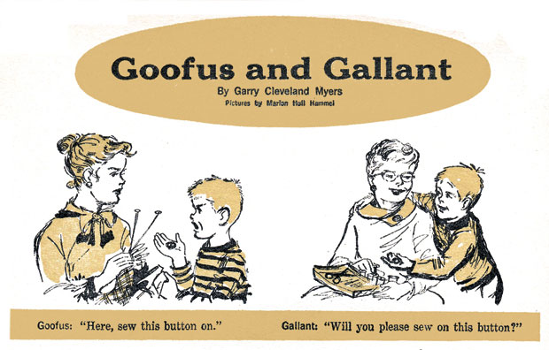
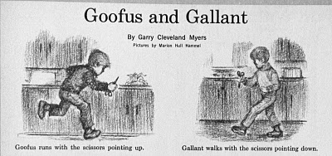
Solving Systems of Equations
Don’ts:
Don’t invert the matrix (x = A⁻¹b). That’s much more costly than solving directly, and much more prone to numerical error.
Don’t write your own solver code. There are people who devote their whole careers to writing solvers. They know a lot more about writing solvers than we do.

Slide 20
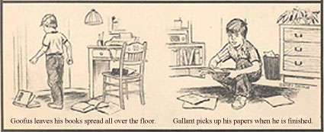
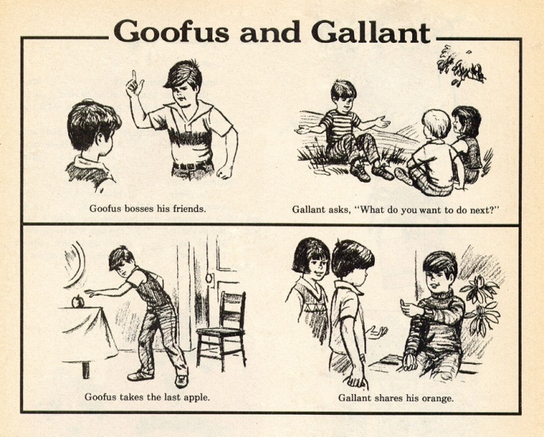
Solving Do’s
Do’s:
Do use standard, portable solver libraries.
Do use a version that’s tuned for the platform you’re running on, if available.
Do use the information that you have about your system of equations to pick the most efficient solver.

Slide 21
All About Your Matrix
If you know things about your matrix, you maybe can use a more efficient solver.
Symmetric: a_{i,j} = a_{j,i}
Positive definite: x^{T}Ax > 0 for all x ≠ 0 (for example, if all eigenvalues are positive)
Banded:
zero
except
on the
bands
Tridiagonal:
0
and …
0

Slide 22
Sparse Matrices
A sparse matrix is a matrix that has mostly zeros in it. “Mostly” is vaguely defined, but a good rule of thumb is that a matrix is sparse if more than, say, 90-95% of its entries are zero. (A non-sparse matrix is dense.)

Slide 23
Linear Algebra Libraries
BLAS ^{[1],[2]}
ATLAS^{[3]}
LAPACK^{[4]}
ScaLAPACK^{[5]}
PETSc^{[6],[7],[8]}

Slide 24
BLAS
The Basic Linear Algebra Subprograms (BLAS) are a set of low level linear algebra routines:
Level 1: Vector-vector (for example, dot product)
Level 2: Matrix-vector (for example, matrix-vector multiply)
Level 3: Matrix-matrix (for example, matrix-matrix multiply)
Many linear algebra packages, including LAPACK, ScaLAPACK and PETSc, are built on top of BLAS.
Most supercomputer vendors have versions of BLAS that are highly tuned for their platforms.

Slide 25
ATLAS
The Automatically Tuned Linear Algebra Software package (ATLAS) is a self-tuned version of BLAS (it also includes a few LAPACK routines).
When it’s installed, it tests and times a variety of approaches to each routine, and selects the version that runs the fastest.
ATLAS is substantially faster than the generic version of BLAS.
And, it’s FREE!

Slide 26
Goto BLAS
In the past several years, a new version of BLAS has been released, developed by Kazushige Goto (currently at UT Austin).
This version is unusual, because instead of optimizing for cache, it optimizes for the Translation Lookaside Buffer (TLB), which is a special little cache that often is ignored by software developers.
Goto realized that optimizing for the TLB would be more efficient than optimizing for cache.

Slide 27
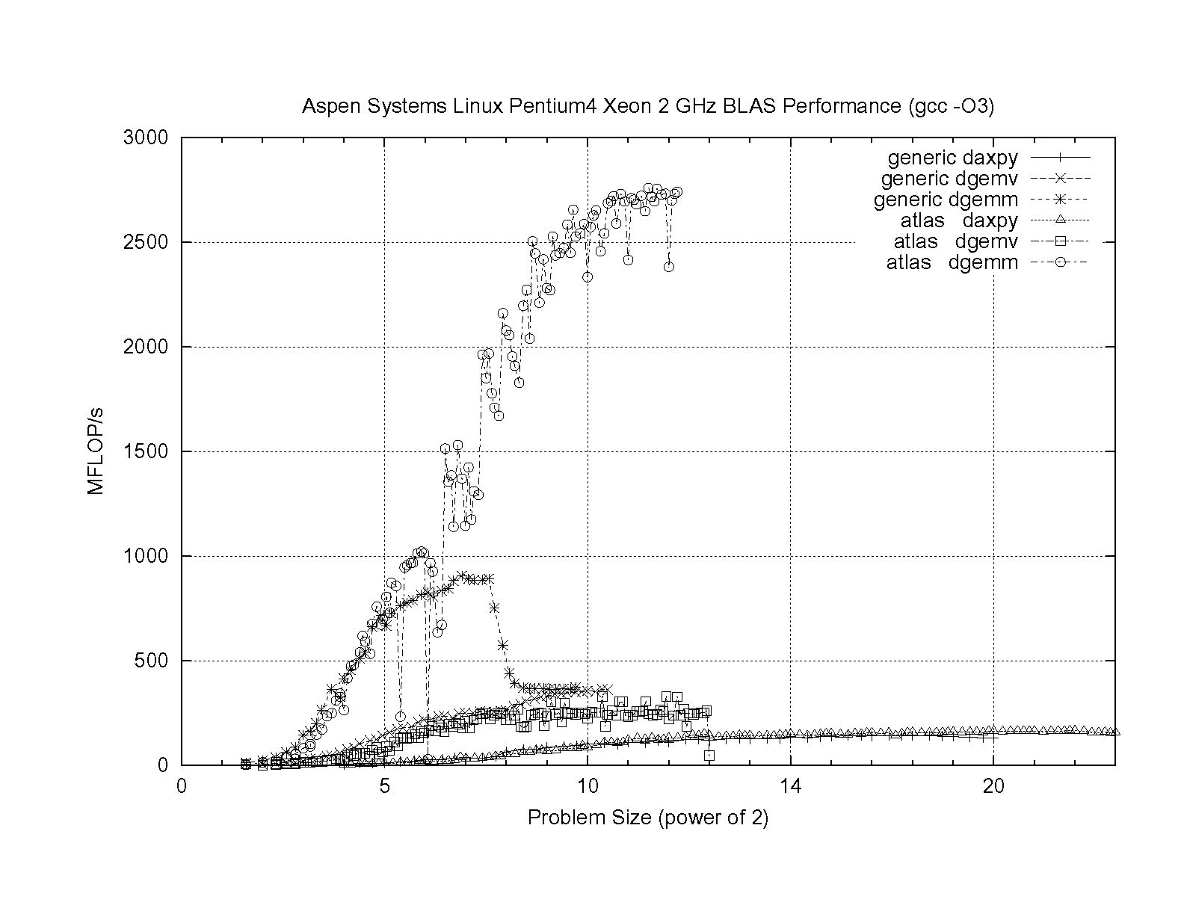
ATLAS vs. Generic BLAS
BETTER
ATLAS DGEMM: 2.76 GFLOP/s = 69% of peak
Generic DGEMM: 0.91 GFLOP/s = 23% of peak
DGEMM: Double precision GEneral Matrix-Matrix multiply
DGEMV: Double precision GEneral Matrix-Vector multiply

Slide 28
LAPACK
LAPACK (Linear Algebra PACKage) solves dense or special-case sparse systems of equations depending on matrix properties such as:
Precision: single, double
Data type: real, complex
Shape: diagonal, bidiagonal, tridiagonal, banded, triangular, trapezoidal, Hesenberg, general dense
Properties: orthogonal, positive definite, Hermetian (complex), symmetric, general
LAPACK is built on top of BLAS, which means it can benefit from ATLAS.

Slide 29
LAPACK Example
REAL,DIMENSION(numrows,numcols) :: A
REAL,DIMENSION(numrows) :: B
REAL,DIMENSION(numcols) :: X
INTEGER,DIMENSION(numrows) :: pivot
INTEGER :: row, col, info, numrhs = 1
DO row = 1, numrows
B(row) = …
END DO
DO col = 1, numcols
DO row = 1, numrows
A(row,col) = …
END DO
END DO
CALL sgesv(numrows, numrhs, A, numrows, pivot, &
& B, numrows, info)
DO col = 1, numcols
X(col) = B(col)
END DO

Slide 30
LAPACK: A Library and an API
LAPACK is a library that you can download for free from the Web:
www.netlib.org
But, it’s also an Application Programming Interface (API): a definition of a set of routines, their arguments, and their behaviors.
So, anyone can write an implementation of LAPACK.

Slide 31
It’s Good to Be Popular
LAPACK is a good choice for non-parallelized solving, because its popularity has convinced many supercomputer vendors to write their own, highly tuned versions.
The API for the LAPACK routines is the same as the portable version from NetLib, but the performance can be much better, via either ATLAS or proprietary vendor-tuned versions.
Also, some vendors have shared memory parallel versions of LAPACK.

Slide 32
LAPACK Performance
Because LAPACK uses BLAS, it’s about as fast as BLAS.
For example, DGESV (Double precision General SolVer) on a 2 GHz Pentium4 using ATLAS gets 65% of peak, compared to 69% of peak for Matrix-Matrix multiply.
In fact, an older version of LAPACK, called LINPACK, is used to determine the top 500 supercomputers in the world.

Slide 33
ScaLAPACK
ScaLAPACK is the distributed parallel (MPI) version of LAPACK. It actually contains only a subset of the LAPACK routines, and has a somewhat awkward Application Programming Interface (API).
Like LAPACK, ScaLAPACK is also available from
www.netlib.org.

Slide 34
PETSc
PETSc (Portable, Extensible Toolkit for Scientific Computation) is a solver library for sparse matrices that uses distributed parallelism (MPI).
PETSc is designed for general sparse matrices with no special properties, but it also works well for sparse matrices with simple properties like banding and symmetry.
It has a simpler, more intuitive Application Programming Interface than ScaLAPACK.

Slide 35
Pick Your Solver Package
Dense Matrix
  Serial: LAPACK
  Shared Memory Parallel: threaded LAPACK
  Distributed Parallel: ScaLAPACK
Sparse Matrix: PETSc

Slide 36
Thanks for your attention!
Questions?

