Slide 1







Introduction to
Parallel Programming
& Cluster Computing
Overview:
What the Heck is Supercomputing?
Josh Alexander, University of Oklahoma
Ivan Babic, Earlham College
Andrew Fitz Gibbon, Shodor Education Foundation Inc.
Henry Neeman, University of Oklahoma
Charlie Peck, Earlham College
Skylar Thompson, University of Washington
Aaron Weeden, Earlham College
Sunday June 26 – Friday July 1 2011
Co-sponsored by SC11

Slide 2
This is an experiment!
It’s the nature of these kinds of videoconferences that FAILURES ARE GUARANTEED TO HAPPEN! NO PROMISES!
So, please bear with us. Hopefully everything will work out well enough.
If you lose your connection, you can retry the same kind of connection, or try connecting another way.
Remember, if all else fails, you always have the toll free phone bridge to fall back on.

Slide 3
H.323 (Polycom etc)
If you want to use H.323 videoconferencing – for example, Polycom – then:
If you ARE already registered with the OneNet gatekeeper, dial 2500409.
If you AREN’T registered with the OneNet gatekeeper (which is probably the case), then:
  Dial 164.58.250.47
  When asked for the conference ID, enter:
  #0409#
Many thanks to Roger Holder and OneNet for providing this.

Slide 4
H.323 from Internet Explorer
From a Windows PC running Internet Explorer:
You MUST have the ability to install software on the PC (or have someone install it for you).
Download and install the latest Java Runtime Environment (JRE) from here
(click on the Java Download icon, because that install package includes both the JRE and other components).
Download and install this video decoder.
Start Internet Explorer.
Copy-and-paste this URL into your IE window:
http://164.58.250.47/
When that webpage loads, in the upper left, click on "Streaming".
In the textbox labeled Sign-in Name, type your name.
In the textbox labeled Conference ID, type this:
0409
Click on "Stream this conference".
When that webpage loads, you may see, at the very top, a bar offering you options.
If so, click on it and choose "Install this add-on."

Slide 5
EVO
There’s a quick description of how to use EVO on the workshop logistics webpage.

Slide 6
Phone Bridge
If all else fails, you can call into our toll free phone bridge:
1-800-832-0736
* 623 2874 #
Please mute yourself and use the phone to listen.
Don’t worry, we’ll call out slide numbers as we go.
Please use the phone bridge ONLY if you cannot connect any other way: the phone bridge is charged per connection per minute, so our preference is to minimize the number of connections.
Many thanks to OU Information Technology for providing the toll free phone bridge.

Slide 7
Please Mute Yourself
No matter how you connect, please mute yourself, so that we cannot hear you.
At ISU and UW, we will turn off the sound on all conferencing technologies.
That way, we won’t have problems with echo cancellation.
Of course, that means we cannot hear questions.
So for questions, you’ll need to send some kind of text.

Slide 8
Questions via Text: Piazzza
Ask questions via:
http://www.piazzza.com/
All questions will be read out loud and then answered out loud.
NOTE: Because of image-and-likeness rules, people attending remotely offsite via videoconferencing CANNOT ask questions via voice.

Slide 9
Thanks for helping!
OSCER operations staff (Brandon George, Dave Akin, Brett Zimmerman, Josh Alexander, Patrick Calhoun)
Kevin Blake, OU IT (videographer)
James Deaton and Roger Holder, OneNet
Keith Weber, Abel Clark and Qifeng Wu, Idaho State U Pocatello
Nancy Glenn, Idaho State U Boise
Jeff Gardner and Marya Dominik, U Washington
Ken Gamradt, South Dakota State U
Jeff Rufinus, Widener U
Scott Lathrop, SC11 General Chair
Donna Cappo, ACM
Bob Panoff, Jack Parkin and Joyce South, Shodor Education Foundation Inc

Slide 10
This is an experiment!
It’s the nature of these kinds of videoconferences that FAILURES ARE GUARANTEED TO HAPPEN! NO PROMISES!
So, please bear with us. Hopefully everything will work out well enough.
If you lose your connection, you can retry the same kind of connection, or try connecting another way.
Remember, if all else fails, you always have the toll free phone bridge to fall back on.

Slide 11
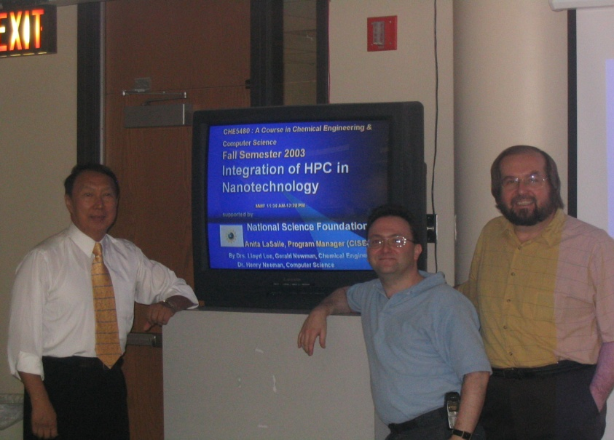
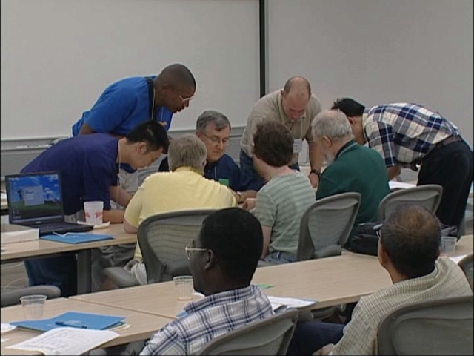
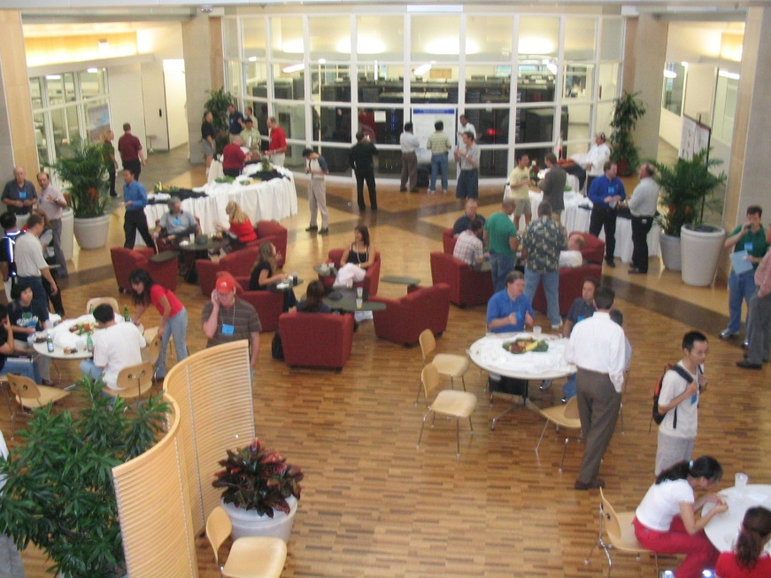
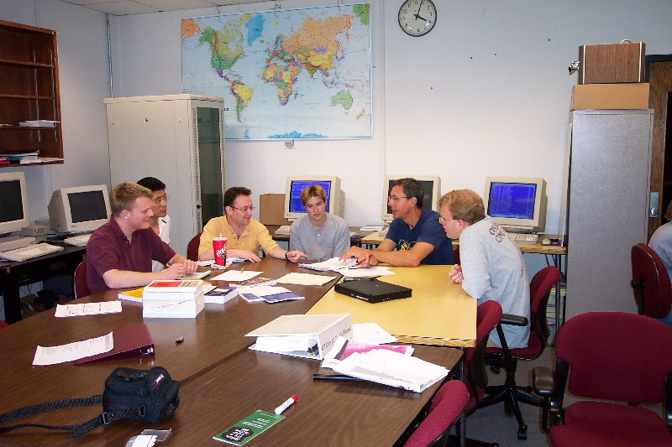
People

Slide 12
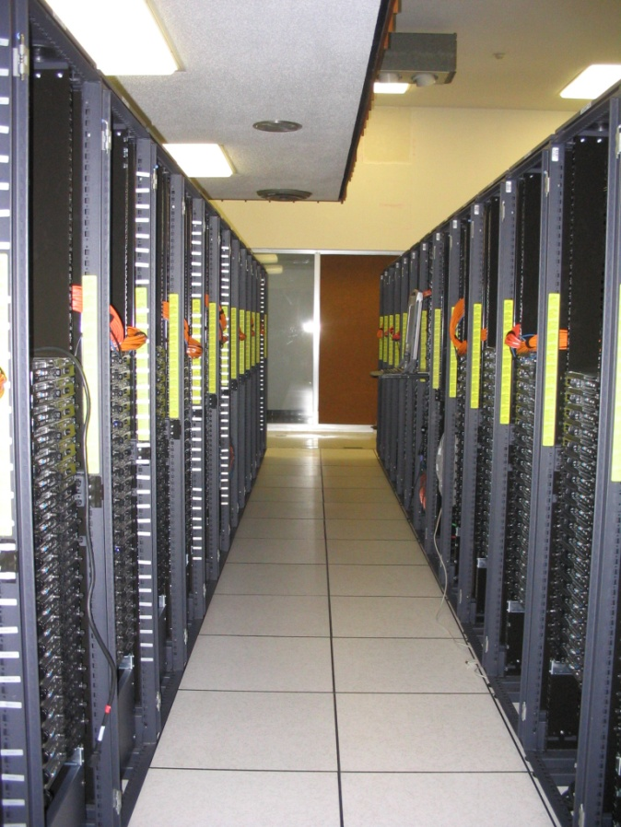
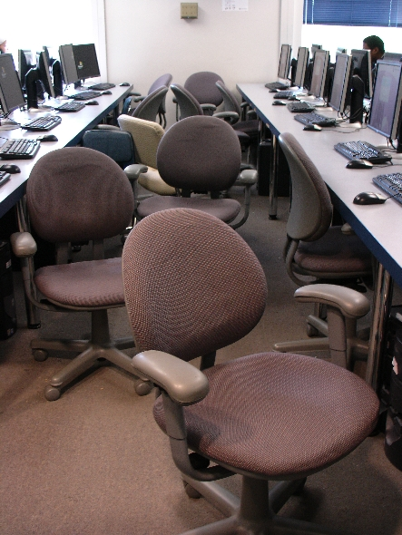
Things

Slide 13
Thanks for your attention!
Questions? www.oscer.ou.edu

Slide 14
What is Supercomputing?
Supercomputing is the biggest, fastest computing right this minute.
Likewise, a supercomputer is one of the biggest, fastest computers right this minute.
So, the definition of supercomputing is constantly changing.
Rule of Thumb: A supercomputer is typically at least 100 times as powerful as a PC.
Jargon: Supercomputing is also known as High Performance Computing (HPC) or High End Computing (HEC) or Cyberinfrastructure (CI).

Slide 15
Fastest Supercomputer vs. Moore
GFLOPs:
billions of calculations per second

Slide 16
What is Supercomputing About?
Size
Speed
Laptop

Slide 17
What is Supercomputing About?
Size: Many problems that are interesting to scientists and engineers can’t fit on a PC – usually because they need more than a few GB of RAM, or more than a few 100 GB of disk.
Speed: Many problems that are interesting to scientists and engineers would take a very very long time to run on a PC: months or even years. But a problem that would take a month on a PC might take only a few hours on a supercomputer.

Slide 18
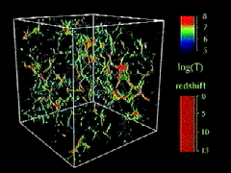
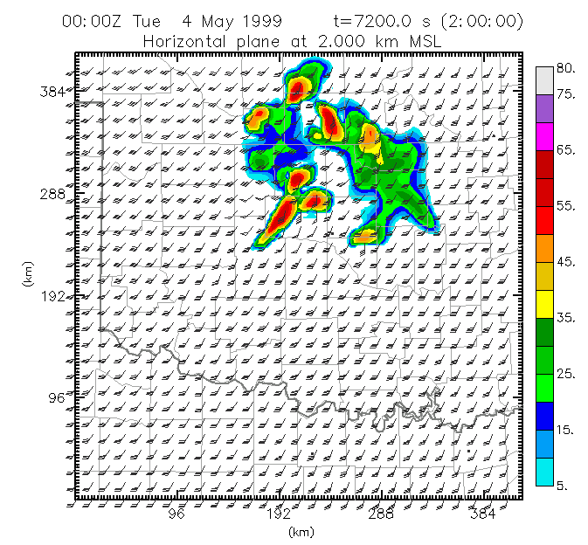
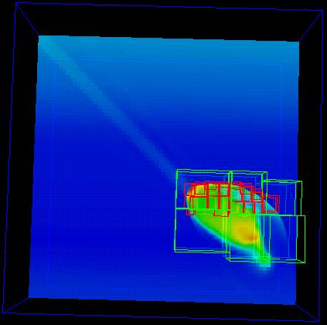
What Is HPC Used For?
Simulation of physical phenomena, such as
  Weather forecasting
  Galaxy formation
  Oil reservoir management
Data mining: finding needles of information in a haystack of data,
such as
  Gene sequencing
  Signal processing
  Detecting storms that might produce tornados
Visualization: turning a vast sea of data into pictures that a scientist can understand
^{[1]}
Moore, OK
Tornadic
Storm
May 3 1999^{[2]}
^{[3]}

Slide 19
Supercomputing Issues
The tyranny of the storage hierarchy
Parallelism: doing multiple things at the same time

Slide 20
What is a Cluster?

Slide 21
OK Cyberinfrastructure Initiative
All academic institutions in Oklahoma are eligible to sign up for free use of OU’s and OSU’s centrally-owned CI resources.
Other kinds of institutions (government, NGO, commercial) are eligible to use, though not necessarily for free.
Everyone can participate in our CI education initiative.
The Oklahoma Supercomputing Symposium, our annual conference, continues to be offered to all.

Slide 22
Dell Intel Xeon Linux Cluster
1,076 Intel Xeon CPU chips/4288 cores
528 dual socket/quad core Harpertown 2.0 GHz, 16 GB each
3 dual socket/quad core Harpertown 2.66 GHz, 16 GB each
3 dual socket/quad core Clovertown 2.33 GHz, 16 GB each
2 x quad socket/quad core Tigerton, 2.4 GHz, 128 GB each
8,800 GB RAM
~130 TB globally accessible disk
QLogic Infiniband
Force10 Networks Gigabit Ethernet
Red Hat Enterprise Linux 5
Peak speed: 34.5 TFLOPs*
*TFLOPs: trillion calculations per second
sooner.oscer.ou.edu

Slide 23
Dell Intel Xeon Linux Cluster
DEBUTED NOVEMBER 2008 AT:
#90 worldwide
#47 in the US
#14 among US academic
#10 among US academic excluding TeraGrid
#2 in the Big 12
#1 in the Big 12 excluding TeraGrid
sooner.oscer.ou.edu

Slide 24
Dell Intel Xeon Linux Cluster
Purchased mid-July 2008
First friendly user Aug 15 2008
Full production Oct 3 2008
Christmas Day 2008: >~75% of nodes and ~66% of cores were in use.
sooner.oscer.ou.edu

Slide 25

What is a Cluster?
“… [W]hat a ship is … It's not just a keel and hull and a deck and sails. That's what a ship needs. But what a ship is ... is freedom.”
– Captain Jack Sparrow
“Pirates of the Caribbean”

Slide 26
What a Cluster is ….
A cluster needs of a collection of small computers, called nodes, hooked together by an interconnection network (or interconnect for short).
It also needs software that allows the nodes to communicate over the interconnect.
But what a cluster is … is all of these components working together as if they’re one big computer ... a super computer.

Slide 27
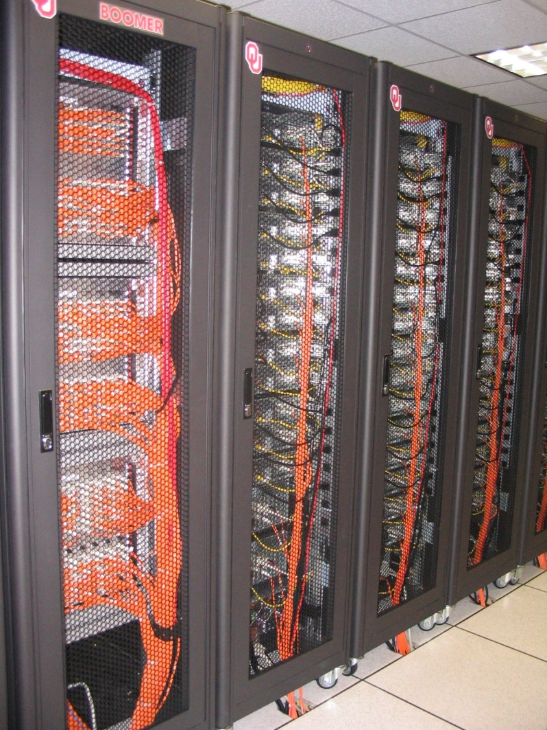
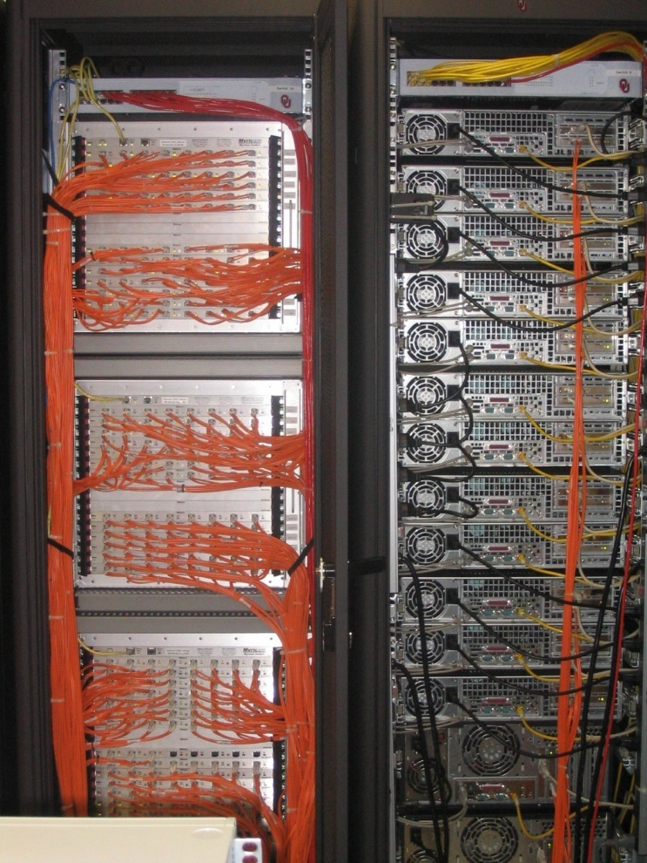
An Actual Cluster
Interconnect
Nodes

Slide 28
A Quick Primer on Hardware

Slide 29

Henry’s Laptop
Dell Latitude Z600^{[4]}
Intel Core2 Duo SU9600 1.6 GHz w/3 MB L2 Cache
4 GB 1066 MHz DDR3 SDRAM
256 GB SSD Hard Drive
DVD+RW/CD-RW Drive (8x)
1 Gbps Ethernet Adapter

Slide 30
Typical Computer Hardware
Central Processing Unit
Primary storage
Secondary storage
Input devices
Output devices

Slide 31
Central Processing Unit
Also called CPU or processor: the “brain”
Components
Control Unit: figures out what to do next – for example, whether to load data from memory, or to add two values together, or to store data into memory, or to decide which of two possible actions to perform (branching)
Arithmetic/Logic Unit: performs calculations – for example, adding, multiplying, checking whether two values are equal
Registers: where data reside that are being used right now

Slide 32
Primary Storage
Main Memory
  Also called RAM (“Random Access Memory”)
  Where data reside when they’re being used by a program that’s currently running
Cache
  Small area of much faster memory
  Where data reside when they’re about to be used and/or have been used recently
Primary storage is volatile: values in primary storage disappear when the power is turned off.

Slide 33
Secondary Storage
Where data and programs reside that are going to be used in the future
Secondary storage is non-volatile: values don’t disappear when power is turned off.
Examples: hard disk, CD, DVD, Blu-ray, magnetic tape, floppy disk
Many are portable: can pop out the CD/DVD/tape/floppy and take it with you

Slide 34
Input/Output
Input devices – for example, keyboard, mouse, touchpad, joystick, scanner
Output devices – for example, monitor, printer, speakers

Slide 35
The Tyranny of the Storage Hierarchy

Slide 36
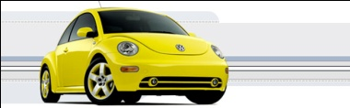
The Storage Hierarchy
Fast, expensive, few
Registers
Cache memory
Main memory (RAM)
Hard disk
Removable media (CD, DVD etc)
Internet
Slow, cheap, a lot
[5]

Slide 37
RAM is Slow
CPU
307 GB/sec^{[6]}
The speed of data transfer
between Main Memory and the
CPU is much slower than the
speed of calculating, so the CPU
spends most of its time waiting
for data to come in or go out.
Bottleneck
4.4 GB/sec^{[7]} (1.4%)

Slide 38
Why Have Cache?
CPU
Cache is much closer to the speed
of the CPU, so the CPU doesn’t
have to wait nearly as long for
stuff that’s already in cache:
it can do more
operations per second!
27 GB/sec (9%)^{[7]}
4.4 GB/sec^{[7]} (1%)

Slide 39
Henry’s Laptop
Dell Latitude Z600^{[4]}
Intel Core2 Duo SU9600 1.6 GHz w/3 MB L2 Cache
4 GB 1066 MHz DDR3 SDRAM
256 GB SSD Hard Drive
DVD+RW/CD-RW Drive (8x)
1 Gbps Ethernet Adapter

Slide 40
Storage Speed, Size, Cost
Henry’s Laptop | Registers (Intel Core2 Duo 1.6 GHz) | Cache Memory (L2) | Main Memory (1066MHz DDR3 SDRAM) | Hard Drive (SSD) | Ethernet (1000 Mbps) | DVD+R (16x) | Phone Modem (56 Kbps)
Speed (MB/sec) [peak] | 314,573^{[6]} (12,800 MFLOP/s*) | 27,276 ^{[7]} | 4500 ^{[7]} | 250 ^{[9]} | 125 | 22 ^{[10]} | 0.007
Size (MB) | 464 bytes** ^{[11]} | 3 | 4096 | 256,000 | unlimited | unlimited | unlimited
Cost ($/MB) | – | $285 ^{[12]} | $0.03 ^{[12]} | $0.002 ^{[12]} | charged per month (typically) | $0.00005 ^{[12]} | charged per month (typically)
* MFLOP/s: millions of floating point operations per second
** 16 64-bit general purpose registers, 8 80-bit floating point registers,
16 128-bit floating point vector registers

Slide 41
Parallelism

Slide 42
Parallelism
Parallelism means doing multiple things at the same time: you can get more work done in the same time.
Less fish …
More fish!

Slide 43
The Jigsaw Puzzle Analogy

Slide 44
Serial Computing
Suppose you want to do a jigsaw puzzle
that has, say, a thousand pieces.
We can imagine that it’ll take you a
certain amount of time. Let’s say
that you can put the puzzle together in
an hour.

Slide 45
Shared Memory Parallelism
If Scott sits across the table from you, then he can work on his half of the puzzle and you can work on yours. Once in a while, you’ll both reach into the pile of pieces at the same time (you’ll contend for the same resource), which will cause a little bit of slowdown. And from time to time you’ll have to work together (communicate) at the interface between his half and yours. The speedup will be nearly 2-to-1: y’all might take 35 minutes instead of 30.

Slide 46
The More the Merrier?
Now let’s put Paul and Charlie on the other two sides of the table. Each of you can work on a part of the puzzle, but there’ll be a lot more contention for the shared resource (the pile of puzzle pieces) and a lot more communication at the interfaces. So y’all will get noticeably less than a 4-to-1 speedup, but you’ll still have an improvement, maybe something like 3-to-1: the four of you can get it done in 20 minutes instead of an hour.

Slide 47
Diminishing Returns
If we now put Dave and Tom and Horst and Brandon on the corners of the table, there’s going to be a whole lot of contention for the shared resource, and a lot of communication at the many interfaces. So the speedup y’all get will be much less than we’d like; you’ll be lucky to get 5-to-1.
So we can see that adding more and more workers onto a shared resource is eventually going to have a diminishing return.

Slide 48
Distributed Parallelism
Now let’s try something a little different. Let’s set up two tables, and let’s put you at one of them and Scott at the other. Let’s put half of the puzzle pieces on your table and the other half of the pieces on Scott’s. Now y’all can work completely independently, without any contention for a shared resource. BUT, the cost per communication is MUCH higher (you have to scootch your tables together), and you need the ability to split up (decompose) the puzzle pieces reasonably evenly, which may be tricky to do for some puzzles.

Slide 49
More Distributed Processors
It’s a lot easier to add more processors in distributed parallelism. But, you always have to be aware of the need to decompose the problem and to communicate among the processors. Also, as you add more processors, it may be harder to load balance the amount of work that each processor gets.

Slide 50
Load Balancing
Load balancing means ensuring that everyone completes their workload at roughly the same time.
For example, if the jigsaw puzzle is half grass and half sky, then you can do the grass and Scott can do the sky, and then y’all only have to communicate at the horizon – and the amount of work that each of you does on your own is roughly equal. So you’ll get pretty good speedup.

Slide 51
Load Balancing
Load balancing can be easy, if the problem splits up into chunks of roughly equal size, with one chunk per processor. Or load balancing can be very hard.

Slide 52
Load Balancing
EASY
Load balancing can be easy, if the problem splits up into chunks of roughly equal size, with one chunk per processor. Or load balancing can be very hard.

Slide 53
Load Balancing
EASY
HARD
Load balancing can be easy, if the problem splits up into chunks of roughly equal size, with one chunk per processor. Or load balancing can be very hard.

Slide 54
Moore’s Law

Slide 55
Moore’s Law
In 1965, Gordon Moore was an engineer at Fairchild Semiconductor.
He noticed that the number of transistors that could be squeezed onto a chip was doubling about every 18 months.
It turns out that computer speed is roughly proportional to the number of transistors per unit area.
Moore wrote a paper about this concept, which became known as “Moore’s Law.”

Slide 56
Fastest Supercomputer vs. Moore
GFLOPs:
billions of calculations per second

Slide 57
Moore’s Law in Practice
CPU
log(Speed)
Year

Slide 58
Moore’s Law in Practice
Network Bandwidth
CPU
log(Speed)
Year

Slide 59
Moore’s Law in Practice
Network Bandwidth
CPU
log(Speed)
RAM
Year

Slide 60
Moore’s Law in Practice
Network Bandwidth
log(Speed)
CPU
RAM
1/Network Latency
Year

Slide 61
Moore’s Law in Practice
Network Bandwidth
CPU
log(Speed)
RAM
1/Network Latency
Software
Year

Slide 62
Why Bother?

Slide 63
Why Bother with HPC at All?
It’s clear that making effective use of HPC takes quite a bit of effort, both learning how and developing software.
That seems like a lot of trouble to go to just to get your code to run faster.
It’s nice to have a code that used to take a day, now run in an hour. But if you can afford to wait a day, what’s the point of HPC?
Why go to all that trouble just to get your code to run faster?

Slide 64
Why HPC is Worth the Bother
What HPC gives you that you won’t get elsewhere is the ability to do bigger, better, more exciting science. If your code can run faster, that means that you can tackle much bigger problems in the same amount of time that you used to need for smaller problems.
HPC is important not only for its own sake, but also because what happens in HPC today will be on your desktop in about 10 to 15 years: it puts you ahead of the curve.

Slide 65
The Future is Now
Historically, this has always been true:
Whatever happens in supercomputing today will be on your desktop in 10 – 15 years.
So, if you have experience with supercomputing, you’ll be ahead of the curve when things get to the desktop.

Slide 66
Thanks for your attention!
Questions? www.oscer.ou.edu

Slide 67
References
[1] Image by Greg Bryan, Columbia U.
[2] “Update on the Collaborative Radar Acquisition Field Test (CRAFT): Planning for the Next Steps.”
Presented to NWS Headquarters August 30 2001.
[3] See http://hneeman.oscer.ou.edu/hamr.html for details.
[4] http://www.dell.com/
[5] http://www.vw.com/newbeetle/
[6] Richard Gerber, The Software Optimization Cookbook: High-performance Recipes for the Intel Architecture. Intel Press, 2002, pp. 161-168.
[7] RightMark Memory Analyzer. http://cpu.rightmark.org/
[8] ftp://download.intel.com/design/Pentium4/papers/24943801.pdf
[9] http://www.samsungssd.com/meetssd/techspecs
[10] http://www.samsung.com/Products/OpticalDiscDrive/SlimDrive/OpticalDiscDrive_SlimDrive_SN_S082D.asp?page=Specifications
[11] ftp://download.intel.com/design/Pentium4/manuals/24896606.pdf
[12] http://www.pricewatch.com/

