Slide 1

Using The CUDA Programming Model
Leveraging GPUs for Application Acceleration
Dan Ernst, Brandon Holt
University of Wisconsin – Eau Claire

Slide 2

What is (Historical) GPGPU ?
General Purpose computation using GPU and graphics API in applications other than 3D graphics
  GPU accelerates critical path of application
Data parallel algorithms leverage GPU attributes
  Large data arrays, streaming throughput
  Fine-grain SIMD parallelism
  Low-latency floating point (FP) computation
Applications – see GPGPU.org
  Game effects (FX) physics, image processing
  Physical modeling, computational engineering, matrix algebra, convolution, correlation, sorting
Notes:
Mark Harris, of Nvidia, runs the gpgpu.org website

Slide 3
Why GPGPU Processing?
A quiet revolution
  Calculation: TFLOPS vs. 100 GFLOPS
  Memory Bandwidth: ~10x
  GPU in every PC– massive volume and potential impact

Slide 4
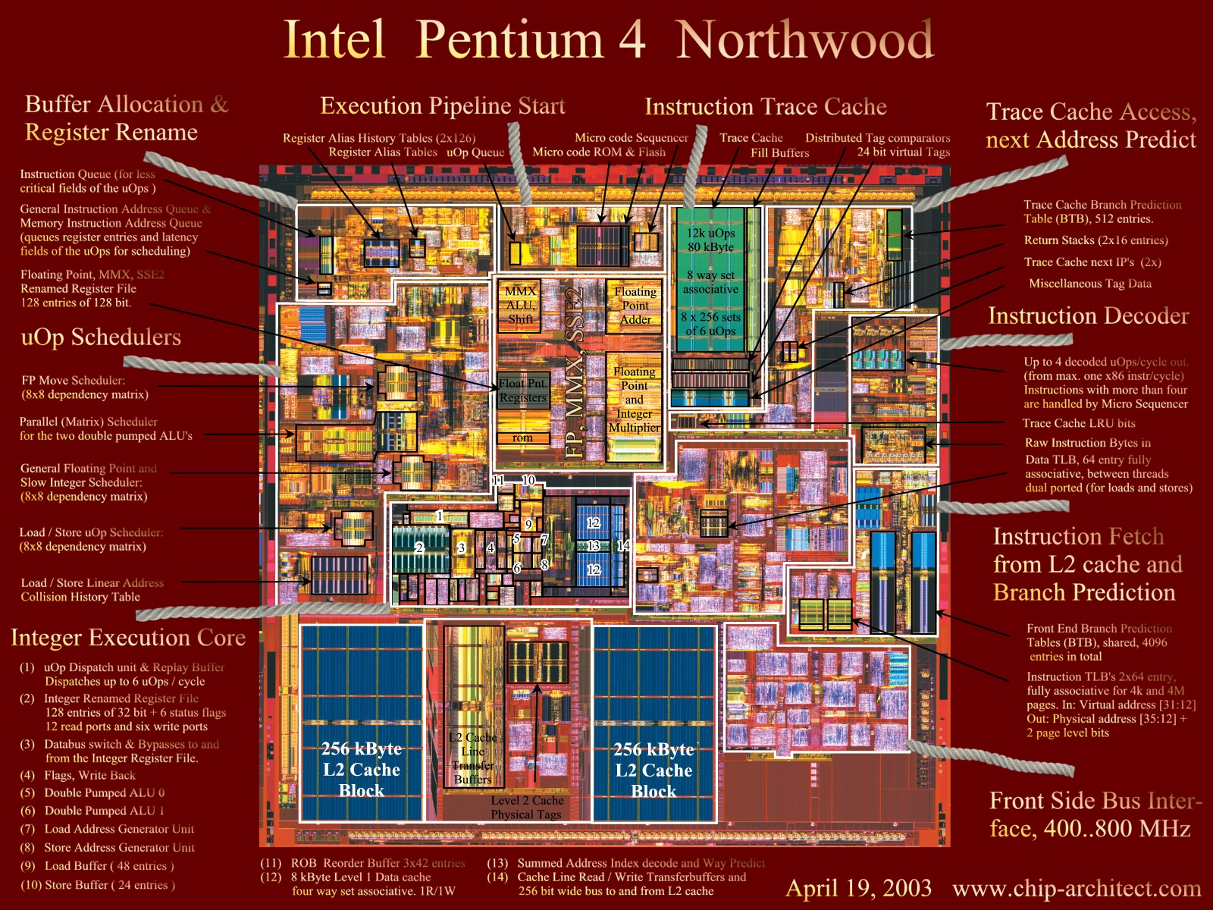
Intel P4 Northwood

Slide 5
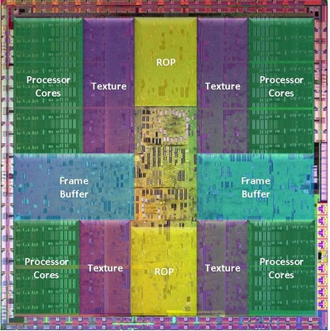
NVIDIA GT200

Slide 6
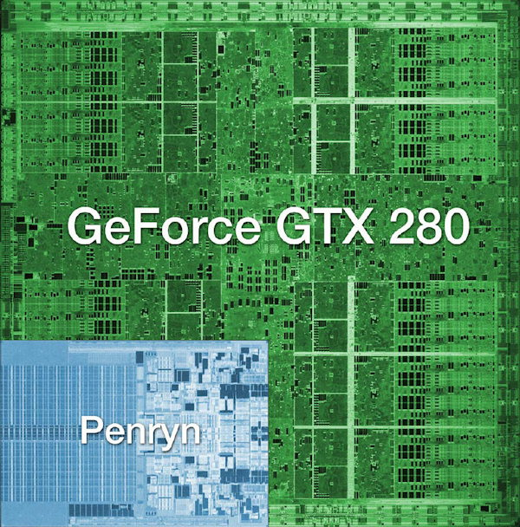
NVIDIA GT200

Slide 7
GeForce 8800 (2007)
Host
Input Assembler
Thread Execution Manager
Parallel Data
Cache
Parallel Data
Cache
Parallel Data
Cache
Parallel Data
Cache
Parallel Data
Cache
Parallel Data
Cache
Parallel Data
Cache
Parallel Data
Cache
Texture
Texture
Texture
Texture
Texture
Texture
Texture
Texture
Texture
Load/store
Load/store
Load/store
Load/store
Load/store
Load/store
Global Memory

Slide 8
G80 Characteristics
367 GFLOPS peak performance (25-50 times of current high-end microprocessors)
265 GFLOPS sustained for apps such as VMD
Massively parallel, 128 cores, 90W
Massively threaded, sustains 1000s of threads per app
30-100 times speedup over high-end microprocessors on scientific and media applications: medical imaging, molecular dynamics
“I think they're right on the money, but the huge performance differential (currently 3 GPUs ~= 300 SGI Altix Itanium2s) will invite close scrutiny so I have to be careful what I say publically until I triple check those numbers.”
  John Stone, VMD group, Physics, UIUC

Slide 9
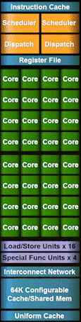
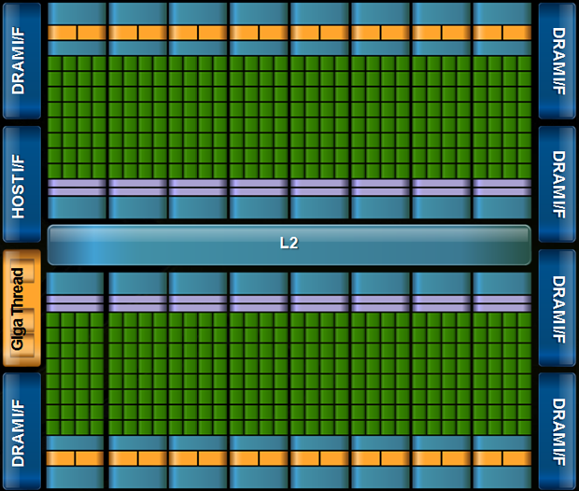

Fermi (Earlier this year)
~1.5TFLOPS (SP)/~800GFLOPS (DP)
140+ GB/s DRAM Bandwidth
ASCI Red – Sandia National Labs – 1997

Slide 10
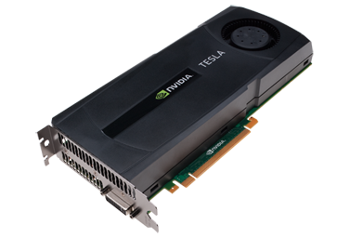
NVIDIA Tesla C2050 Card Specs
448 GPU cores
1.15 GHz
Single precision floating point performance: 1030.4 GFLOPs
(2 single precision flops per clock per core)
Double precision floating point performance: 515.2 GFLOPs
(1 double precision flop per clock per core)
Internal RAM: 3 GB DDR5
Internal RAM speed: 144 GB/sec (compared 21-25 GB/sec for regular RAM)
Has to be plugged into a PCIe slot (at most 8 GB/sec)

Slide 11
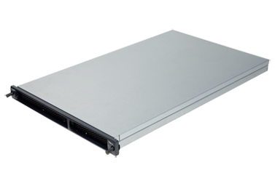
NVIDIA Tesla S2050 Server Specs
4 C2050 cards inside a 1U server
(looks like a Sooner node)
1.15 GHz
Single Precision (SP) floating point performance: 4121.6 GFLOPs
Double Precision (DP) floating point performance: 2060.8 GFLOPs
Internal RAM: 12 GB total (3 GB per GPU card)
Internal RAM speed: 576 GB/sec aggregate
Has to be plugged into two PCIe slots
(at most 16 GB/sec)

Slide 12
Compare x86 vs S2050
Let’s compare the best dual socket x86 server today vs S2050.
 | Dual socket, AMD 2.3 GHz 12-core | NVIDIA Tesla S2050
Peak DP FLOPs | 220.8 GFLOPs DP | 2060.8 GFLOPs DP (9.3x)
Peak SP FLOPS | 441.6 GFLOPs SP | 4121.6 GFLOPs SP (9.3x)
Peak RAM BW | 25 GB/sec | 576 GB/sec (23x)
Peak PCIe BW | N/A | 16 GB/sec
Needs x86 server to attach to? | No | Yes
Power/Heat | ~450 W | ~900 W + ~400 W (~2.9x)
Code portable? | Yes | No (CUDA) Yes (PGI, OpenCL)

Slide 13
Compare x86 vs S2050
Here are some interesting measures:
 | Dual socket, AMD 2.3 GHz 12-core | NVIDIA Tesla S2050
DP GFLOPs/Watt | ~0.5 GFLOPs/Watt | ~1.6 GFLOPs/Watt (~3x)
SP GFLOPS/Watt | ~1 GFLOPs/Watt | ~3.2 GFLOPs/Watt (~3x)
DP GFLOPs/sq ft | ~590 GFLOPs/sq ft | ~2750 GFLOPs/sq ft (4.7x)
SP GFLOPs/sq ft | ~1180 GFLOPs/sq ft | ~5500 GFLOPs/sq ft (4.7x)
Racks per PFLOP DP | 142 racks/PFLOP DP | 32 racks/PFLOP DP (23%)
Racks per PFLOP SP | 71 racks/PFLOP SP | 16 racks/PFLOP SP (23%)
OU’s Sooner is 34.5 TFLOPs DP, which is just over 1 rack of S2050.

Slide 14
Previous GPGPU Constraints
Dealing with graphics API
  Working with the corner cases of the graphics API
  Essentially – re-write entire program as a collection of shaders and polygons
per thread
per Shader
per Context
Input Registers
Fragment Program
Texture
Constants
Temp Registers
Output Registers
FB Memory

Slide 15

CUDA
“Compute Unified Device Architecture”
General purpose programming model
  User kicks off batches of threads on the GPU
  GPU = dedicated super-threaded, massively data parallel co-processor
Targeted software stack
  Compute oriented drivers, language, and tools
Driver for loading computation programs onto GPU

Slide 16
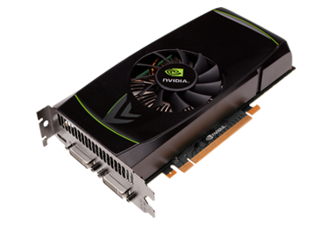
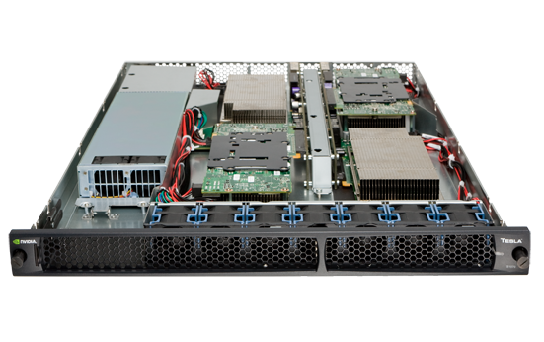
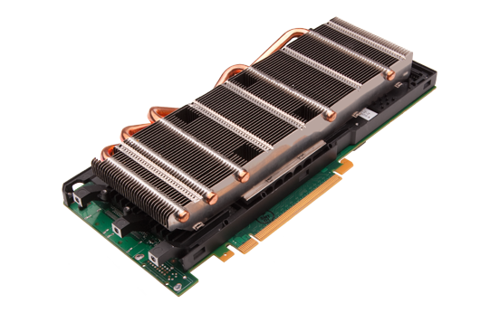
Parallel Computing on a GPU
400-series GPUs deliver 450 to 1,400+ GFLOPS on compiled parallel C applications
  Available in laptops, desktops, and clusters
GPU parallelism is doubling every year
Programming model scales transparently
Programmable in C with CUDA tools
Multithreaded SPMD model uses application data parallelism and thread parallelism
GeForce GTX 460
Tesla S1070
Tesla M2050

Slide 17
Overview
CUDA programming model
  Basic concepts and data types
CUDA application programming interface (API) basics
A couple of simple examples
Performance features will be covered this afternoon

Slide 18
CUDA Devices and Threads
A CUDA compute device
  Is a coprocessor to the CPU or host
  Has its own DRAM (device memory)‏
  Runs many threads in parallel
  Is typically a GPU but can also be another type of parallel processing device
Data-parallel portions of an application are expressed as device kernels which run on many threads
Differences between GPU and CPU threads
  GPU threads are extremely lightweight
    Very little creation overhead
  GPU needs 1000s of threads for full efficiency
    Multi-core CPU needs only a few (and is hurt by having too many)

Slide 19
CUDA – C with a Co-processor
One program, two devices
  Serial or modestly parallel parts in host C code
  Highly parallel parts in device kernel C code
Serial Code (host)‏
Parallel Kernel (device)‏
KernelA<<< nBlk, nTid >>>(args);
. . .
Serial Code (host)‏
Parallel Kernel (device)‏
KernelB<<< nBlk, nTid >>>(args);
. . .

Slide 20
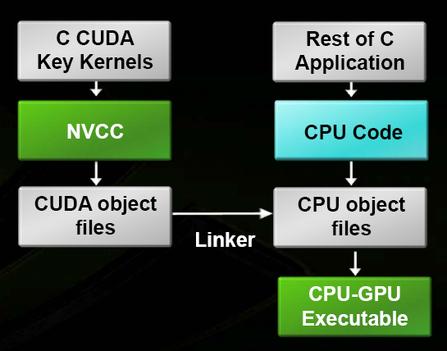
Extended C

Slide 21
Buzzword: Kernel
In CUDA, a kernel is code (typically a function) that can be run inside the GPU.
The kernel code runs on the many stream processors in the GPU in parallel.
  Each processor runs the code over different data (SPMD)

Slide 22
Buzzword: Thread
In CUDA, a thread is an execution of a kernel with a given index.
  Each thread uses its index to access a specific subset of the data, such that the collection of all threads cooperatively processes the entire data set.
  Think: MPI Process ID
These are very much like threads in OpenMP
  they even have shared and private variables.
So what’s the difference with CUDA?
  Threads are free
threadID
0
1
2
3
4
5
6
7
…
float x = input[threadID];
float y = func(x);
output[threadID] = y;
…

Slide 23
Buzzword: Block
In CUDA, a block is a group of threads.
Blocks are used to organize threads into manageable chunks.
  Can organize threads in 1D, 2D, or 3D arrangements
  What best matches your data?
  Some restrictions, based on hardware
Threads within a block can do a bit of synchronization, if necessary.

Slide 24
Buzzword: Grid
In CUDA, a grid is a group of blocks
  no synchronization at all between the blocks.
Grids are used to organize blocks into manageable chunks.
  Can organize blocks in 1D or 2D arrangements
  What best matches your data?
A Grid is the set of threads created by a call to a CUDA kernel

Slide 25
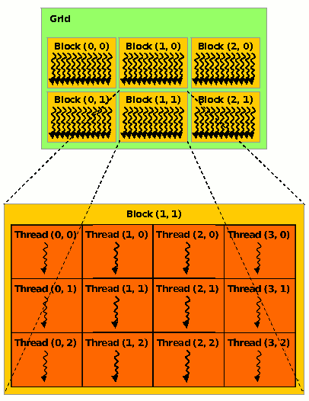
Mapping Buzzwords to GPU Hardware
Grids map to GPUs
Blocks map to the MultiProcessors (MP)‏
  Blocks are never split across MPs, but an MP can have multiple blocks
Threads map to Stream Processors (SP)‏
Warps are groups of (32) threads that execute simultaneously
  Completely forget about these until later
Image Source:
NVIDIA CUDA Programming Guide

Slide 26
Transparent Scalability
Hardware is free to assign blocks to any SM (processor)
  A kernel scales across any number of parallel processors
Device
Kernel grid
Block 0
Block 1
Device
Block 2
Block 3
Block 0
Block 1
Block 4
Block 5
Block 6
Block 7
time
Block 0
Block 1
Block 2
Block 3
Block 2
Block 3
Block 4
Block 5
Block 6
Block 7
Block 4
Block 5
Each block can execute in any order relative to other blocks.
Block 6
Block 7

Slide 27
Block IDs and Thread IDs
Each thread uses IDs to decide what data to work on
  BlockIdx: 1D or 2D
  ThreadIdx: 1D, 2D, or 3D
Simplifies memory
addressing when processing
multidimensional data
  Image processing
  Solving PDEs on volumes
  …

Slide 28
CUDA Memory Model Overview
Global memory
  Main means of communicating R/W Data between host and device
  Contents visible to all threads
  Long latency access
We will focus on global memory for now
  Other memories will come later
Note: This is not hardware!
Grid
Block (0, 0)‏
Block (1, 0)‏
Shared Memory
Shared Memory
Registers
Registers
Registers
Registers
Thread (0, 0)‏
Thread (1, 0)‏
Thread (0, 0)‏
Thread (1, 0)‏
Host
Global Memory

Slide 29
CUDA Device Memory Allocation
cudaMalloc()
  Allocates object in the device Global Memory
  Requires two parameters
    Address of a pointer to the allocated object
    Size of of allocated object
cudaFree()
  Frees object from device Global Memory
    Pointer to freed object

Slide 30
CUDA Device Memory Allocation (cont.)‏
Code example:
  Allocate a 64 * 64 single precision float array
  Attach the allocated storage to pointer named Md
  “d” is often used in naming to indicate a device data structure
TILE_WIDTH = 64;
float* Md;
int size = TILE_WIDTH * TILE_WIDTH * sizeof(float);
cudaMalloc((void**)&Md, size);
cudaFree(Md);

Slide 31
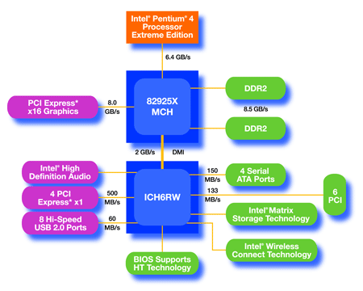
The Physical Reality Behind CUDA
CPU
(host)
GPU w/
local DRAM
(device)

Slide 32
CUDA Host-Device Data Transfer
cudaMemcpy()
  memory data transfer
  Requires four parameters
    Pointer to destination
    Pointer to source
    Number of bytes copied
    Type of transfer
      Host to Host
      Host to Device
      Device to Host
      Device to Device
Asynchronous transfer
Grid
Block (0, 0)‏
Block (1, 0)‏
Shared Memory
Shared Memory
Registers
Registers
Registers
Registers
Thread (0, 0)‏
Thread (1, 0)‏
Thread (0, 0)‏
Thread (1, 0)‏
Host
Global
Memory

Slide 33
CUDA Host-Device Data Transfer (cont.)
Code example:
  Transfer a 64 * 64 single precision float array
  M is in host memory and Md is in device memory
  cudaMemcpyHostToDevice and cudaMemcpyDeviceToHost are symbolic constants
cudaMemcpy(Md, M, size, cudaMemcpyHostToDevice);
cudaMemcpy(M, Md, size, cudaMemcpyDeviceToHost);

Slide 34
CUDA Kernel Template
In C:
void foo(int a, float b)
{
// slow code goes here
}
In CUDA:
__global__ void foo(int a, float b)
{
// fast code goes here!
}

Slide 35
Calling a Kernel Function
A kernel function must be called with an execution configuration:
__global__ void KernelFunc(...);
dim3 DimGrid(100, 50); // 5000 thread blocks
dim3 DimBlock(4, 8, 8); // 256 threads per block
KernelFunc(...); // invoke a function

Slide 36
Calling a Kernel Function
A kernel function must be called with an execution configuration:
__global__ void KernelFunc(...);
dim3 DimGrid(100, 50); // 5000 thread blocks
dim3 DimBlock(4, 8, 8); // 256 threads per block
KernelFunc(...); // invoke a function
Declare the dimensions for grid/blocks

Slide 37
Calling a Kernel Function
A kernel function must be called with an execution configuration:
__global__ void KernelFunc(...);
dim3 DimGrid(100, 50); // 5000 thread blocks
dim3 DimBlock(4, 8, 8); // 256 threads per block
KernelFunc<<<DimGrid, DimBlock>>>(...);
//invoke a kernel
Any call to a kernel function is asynchronous from CUDA 1.0 on, explicit synch needed for blocking
Declare the dimensions for grid/blocks

Slide 38
C SAXPY
void
saxpy_serial(int n, float a, float *x, float *y)
{
int i;
for(i=0; i < n; i++) {
y[i] = a*x[i] + y[i];
}
}
…
//invoke the kernel
saxpy_serial(n, 2.0, x, y);

Slide 39
SAXPY on a GPU
Doing anything across an entire vector is perfect for massively parallel computing.
Instead of one function looping over the data set,
we’ll use many threads, each doing one calculation
threadID
0
1
2
3
4
5
6
7
…
y[tid] = a*x[tid] + y[tid];
…

Slide 40
CUDA SAXPY
__global__ void
saxpy_cuda(int n, float a, float *x, float *y)
{
int i = (blockIdx.x * blockDim.x) + threadIdx.x;
if(i < n)
y[i] = a*x[i] + y[i];
}
…
int nblocks = (n + 255) / 256;
//invoke the kernel with 256 threads per block
saxpy_cuda<<<nblocks, 256>>>(n, 2.0, x, y);

Slide 41
Matrix Multiplication in CUDA
A case study

Slide 42
Matrix Multiplication: A Case Study
Matrix multiplication illustrates many of the basic features of memory and thread management in CUDA
  Usage of thread/block IDs
  Memory data transfer between host and device
  Motivates some performance issues:
    shared memory usage
    register usage
  Assumptions:
    Basic unoptimized sgemm
    Matrices are square (for simplicity)

Slide 43
Programming Model:
Square Matrix Multiplication Example
P = M * N
  Each is of size WIDTH x WIDTH
Basic Idea:
  One thread calculates one element of P
    M and N are loaded WIDTH times from global memory
N
WIDTH
M
P
WIDTH
WIDTH
WIDTH

Slide 44
Step 1: Matrix Multiplication
A Simple Host Version in C
// Matrix multiplication on the (CPU) host in double precision
void MatrixMulOnHost(float* M, float* N, float* P, int WIDTH)‏
{
int i, j, k;
double a, b, sum;
for (i = 0; i < WIDTH; ++i)‏
for (j = 0; j < WIDTH; ++j) {
sum = 0;
for (k = 0; k < WIDTH; ++k) {
a = M[i * WIDTH + k];
b = N[k * WIDTH + j];
sum += a * b;
}
P[i * WIDTH + j] = sum;
}
}
N
k
j
WIDTH
M
P
i
WIDTH
k
WIDTH
WIDTH

Slide 45
Step 2: Input Matrix Data Transfer
(Host-side Code)‏
void MatrixMulOnDevice(float* M, float* N, float* P, int WIDTH)‏
{
int size = WIDTH * WIDTH * sizeof(float);
float* Md, Nd, Pd;
…
// 1. Allocate and Load M, N to device memory
cudaMalloc(&Md, size);
cudaMemcpy(Md, M, size, cudaMemcpyHostToDevice);
cudaMalloc(&Nd, size);
cudaMemcpy(Nd, N, size, cudaMemcpyHostToDevice);
// Allocate P on the device
cudaMalloc(&Pd, size);

Slide 46
Step 3: Output Matrix Data Transfer
(Host-side Code)‏
// 2. Kernel invocation code – to be shown later
…
// 3. Read P from the device
cudaMemcpy(P, Pd, size, cudaMemcpyDeviceToHost);
// Free device matrices
cudaFree(Md); cudaFree(Nd); cudaFree (Pd);
}

Slide 47
Step 4: Kernel Function
__global__ void MatrixMulKernel(float* Md, float* Nd, float* Pd, int WIDTH)‏
{
float Pvalue = 0;
for (int k = 0; k < WIDTH; ++k)‏ {
float Melement = Md[threadIdx.y*WIDTH+k];
float Nelement = Nd[k*WIDTH+threadIdx.x];
Pvalue += Melement * Nelement;
}
Pd[threadIdx.y*WIDTH+threadIdx.x] = Pvalue;
}
Nd
k
tx
WIDTH
Md
Pd
ty
ty
WIDTH
k
tx
WIDTH
WIDTH

Slide 48
Step 5:
Kernel Invocation (Host-side Code)
// Setup the execution configuration
dim3 dimGrid(1, 1);
dim3 dimBlock(WIDTH, WIDTH);
// Launch the device computation threads!
MatrixMulKernel<<<dimGrid, dimBlock>>>(Md, Nd, Pd, WIDTH);

Slide 49
Only One Thread Block Used
Nd
One Block of threads compute the matrix Pd
  Each thread computes one element of the matrix Pd
Each thread
  Loads a row of matrix Md
  Loads a column of matrix Nd
  Perform one multiply and addition for each pair of Md and Nd elements
Compute to off-chip memory access ratio close to 1:1 (not very good)‏
Size of matrix limited by the number of threads allowed in a thread block (512)
Grid 1
Block 1
Thread
(2, 2)‏
48
WIDTH
Pd
Md

Slide 50
Block IDs and Thread IDs
Each thread uses IDs to decide what data to work on
  Block ID: 1D or 2D
  Thread ID: 1D, 2D, or 3D
Simplifies memory
addressing when processing
multidimensional data
  Image processing
  Solving PDEs on volumes
  …

Slide 51
Matrix Multiplication Using Multiple Blocks
bx
0
1
2
tx
0
TILE_WIDTH-1
1
2
Break-up Pd into tiles
Each block calculates one tile
  Each thread calculates one element
  Block size equal tile size
Nd
WIDTH
Md
Pd
0
0
Pd_{sub}
1
by
ty
2
WIDTH
1
TILE_WIDTHE
TILE_WIDTH-1
TILE_WIDTH
2
WIDTH
WIDTH

Slide 52
Revised mmult Kernel using Multiple Blocks
__global__ void MatrixMulKernel(float* Md, float* Nd, float* Pd, int Width)
{
// Calculate the row index of the Pd element and M
int Row = blockIdx.y*TILE_WIDTH + threadIdx.y;
// Calculate the column idenx of Pd and N
int Col = blockIdx.x*TILE_WIDTH + threadIdx.x;
float Pvalue = 0;
// each thread computes one element of the block sub-matrix
for (int k = 0; k < Width; ++k)
Pvalue += Md[Row*Width+k] * Nd[k*Width+Col];
Pd[Row*Width+Col] = Pvalue;
}

Slide 53
G80 Block Granularity Considerations
Q: For Matrix Multiplication using multiple blocks, should I use 8x8, 16x16 or 32x32 blocks?
  For 8x8, we have 64 threads per Block. Since each SM can take up to 768 threads, there are 12 Blocks. However, each SM can only take up to 8 Blocks, only 512 threads will go into each SM!
  For 16x16, we have 256 threads per Block. Since each SM can take up to 768 threads, it can take up to 3 Blocks and achieve full capacity unless other resource considerations overrule.
  For 32x32, we have 1024 threads per Block. Not even one can fit into an SM!

Slide 54
Exercise: Area Under the Curve
cp -r ~ernstdj/NCSI2010 .
go to “cuda_trap” directory.
less README.txt

