Slide 1
Supercomputing in Plain English Scientific Libraries and I/O Libraries
National Computational Science Institute
Intermediate Parallel Programming & Cluster Computing
University of Oklahoma
Aug 8-14 2010

Slide 2
Scientific Libraries

Slide 3
Preinvented Wheels
Many simulations perform fairly common tasks; for example, solving systems of equations:
Ax = b
where A is the matrix of coefficients, x is the vector of unknowns and b is the vector of knowns.

Slide 4
Scientific Libraries
Because some tasks are quite common across many science and engineering applications, groups of researchers have put a lot of effort into writing scientific libraries: collections of routines for performing these commonly-used tasks (for example, linear algebra solvers).
The people who write these libraries know a lot more about these things than we do.
So, a good strategy is to use their libraries, rather than trying to write our own.

Slide 5
Solver Libraries
Probably the most common scientific computing task is solving a system of equations
Ax = b
where A is a matrix of coefficients, x is a vector of unknowns, and b is a vector of knowns.
The goal is to solve for x.

Slide 6
Solving Systems of Equations
Don’ts:
Don’t invert the matrix (x = A⁻¹b). That’s much more costly than solving directly, and much more prone to numerical error.
Don’t write your own solver code. There are people who devote their whole careers to writing solvers. They know a lot more about writing solvers than we do.

Slide 7
Solving Do’s
Do’s:
Do use standard, portable solver libraries.
Do use a version that’s tuned for the platform you’re running on, if available.
Do use the information that you have about your system of equations to pick the most efficient solver.

Slide 8
All About Your Matrix
If you know things about your matrix, you maybe can use a more efficient solver.
Symmetric: a_{i,j} = a_{j,i}
Positive definite: x^{T}Ax > 0 for all x ≠ 0 (for example, if all eigenvalues are positive)
Banded:
zero
except
on the
bands
Tridiagonal:
0
and …
0

Slide 9
Sparse Matrices
A sparse matrix is a matrix that has mostly zeros in it. “Mostly” is vaguely defined, but a good rule of thumb is that a matrix is sparse if more than, say, 90-95% of its entries are zero. (A non-sparse matrix is dense.)

Slide 10
Linear Algebra Libraries
BLAS ^{[1],[2]}
ATLAS^{[3]}
LAPACK^{[4]}
ScaLAPACK^{[5]}
PETSc^{[6],[7],[8]}

Slide 11
BLAS
The Basic Linear Algebra Subprograms (BLAS) are a set of low level linear algebra routines:
Level 1: Vector-vector (for example, dot product)
Level 2: Matrix-vector (for example, matrix-vector multiply)
Level 3: Matrix-matrix (for example, matrix-matrix multiply)
Many linear algebra packages, including LAPACK, ScaLAPACK and PETSc, are built on top of BLAS.
Most supercomputer vendors have versions of BLAS that are highly tuned for their platforms.

Slide 12
ATLAS
The Automatically Tuned Linear Algebra Software package (ATLAS) is a self-tuned version of BLAS (it also includes a few LAPACK routines).
When it’s installed, it tests and times a variety of approaches to each routine, and selects the version that runs the fastest.
ATLAS is substantially faster than the generic version of BLAS.
And, it’s FREE!

Slide 13
Goto BLAS
In the past few years, a new version of BLAS has been released, developed by Kazushige Goto (currently at UT Austin).
This version is unusual, because instead of optimizing for cache, it optimizes for the Translation Lookaside Buffer (TLB), which is a special little cache that often is ignored by software developers.
Goto realized that optimizing for the TLB would be more efficient than optimizing for cache.

Slide 14
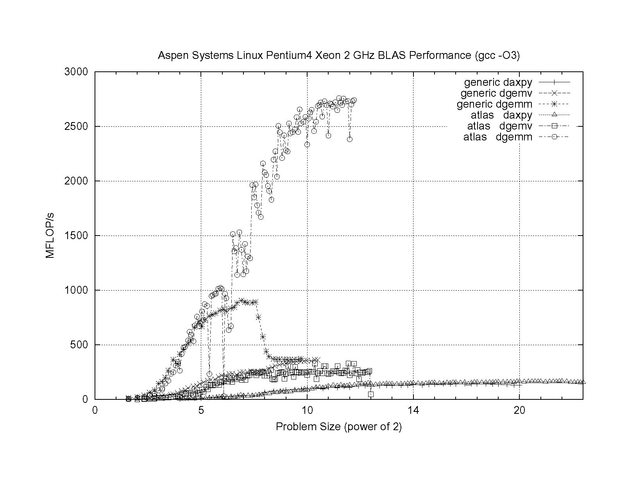
ATLAS vs. Generic BLAS
BETTER
ATLAS DGEMM: 2.76 GFLOP/s = 69% of peak
Generic DGEMM: 0.91 GFLOP/s = 23% of peak
DGEMM: Double precision GEneral Matrix-Matrix multiply
DGEMV: Double precision GEneral Matrix-Vector multiply

Slide 15
LAPACK
LAPACK (Linear Algebra PACKage) solves dense or special-case sparse systems of equations depending on matrix properties such as:
Precision: single, double
Data type: real, complex
Shape: diagonal, bidiagonal, tridiagonal, banded, triangular, trapezoidal, Hesenberg, general dense
Properties: orthogonal, positive definite, Hermetian (complex), symmetric, general
LAPACK is built on top of BLAS, which means it can benefit from ATLAS.

Slide 16
LAPACK Example
REAL,DIMENSION(numrows,numcols) :: A
REAL,DIMENSION(numrows) :: B
REAL,DIMENSION(numcols) :: X
INTEGER,DIMENSION(numrows) :: pivot
INTEGER :: row, col, info, numrhs = 1
DO row = 1, numrows
B(row) = …
END DO
DO col = 1, numcols
DO row = 1, numrows
A(row,col) = …
END DO
END DO
CALL sgesv(numrows, numrhs, A, numrows, pivot, &
& B, numrows, info)
DO col = 1, numcols
X(col) = B(col)
END DO

Slide 17
LAPACK: A Library and an API
LAPACK is a library that you can download for free from the Web:
www.netlib.org
But, it’s also an Application Programming Interface (API): a definition of a set of routines, their arguments, and their behaviors.
So, anyone can write an implementation of LAPACK.

Slide 18
It’s Good to Be Popular
LAPACK is a good choice for non-parallelized solving, because its popularity has convinced many supercomputer vendors to write their own, highly tuned versions.
The API for the LAPACK routines is the same as the portable version from NetLib, but the performance can be much better, via either ATLAS or proprietary vendor-tuned versions.
Also, some vendors have shared memory parallel versions of LAPACK.

Slide 19
LAPACK Performance
Because LAPACK uses BLAS, it’s about as fast as BLAS.
For example, DGESV (Double precision General SolVer) on a 2 GHz Pentium4 using ATLAS gets 65% of peak, compared to 69% of peak for Matrix-Matrix multiply.
In fact, an older version of LAPACK, called LINPACK, is used to determine the top 500 supercomputers in the world.

Slide 20
ScaLAPACK
ScaLAPACK is the distributed parallel (MPI) version of LAPACK. It actually contains only a subset of the LAPACK routines, and has a somewhat awkward Application Programming Interface (API).
Like LAPACK, ScaLAPACK is also available from
www.netlib.org.

Slide 21
PETSc
PETSc (Portable, Extensible Toolkit for Scientific Computation) is a solver library for sparse matrices that uses distributed parallelism (MPI).
PETSc is designed for general sparse matrices with no special properties, but it also works well for sparse matrices with simple properties like banding and symmetry.
It has a simpler, more intuitive Application Programming Interface than ScaLAPACK.

Slide 22
Pick Your Solver Package
Dense Matrix
Serial: LAPACK
Shared Memory Parallel: threaded LAPACK
Distributed Parallel: ScaLAPACK
Sparse Matrix: PETSc

Slide 23
I/O Libraries

Slide 24
I/O Challenges
I/O presents two important challenges to scientific computing:
Performance
Portability
The performance issue arises because I/O is much more time-consuming than computation, as we saw in the “Storage Hierarchy” session.
The portability issue arises because different kinds of computers can have different ways of representing real (floating point) numbers.

Slide 25
Storage Formats
When you use a PRINT statement in Fortran or a printf in C or output to cout in C++, you are asking the program to output data in human-readable form:
x = 5
PRINT *, x
But what if the value that you want to output is a real number with lots of significant digits?
1.3456789E+23

Slide 26
Data Output as Text
1.3456789E+23
When you output data as text, each character takes 1 byte.
So if you output a number with lots of digits, then you’re outputting lots of bytes.
For example, the above number takes 13 bytes to output as text.
Jargon: Text is sometimes called ASCII (American Standard Code for Information Interchange).

Slide 27
Output Data in Binary
Inside the computer, a single precision real number (Fortran REAL, C/C++ float) typically requires 4 bytes, and a double precision number (DOUBLE PRECISION or double) typically requires 8.
That’s less than 13.
Since I/O is very expensive, it’s better to output 4 or 8 bytes than 13 or more.
Happily, Fortran, C and C++ allow you to output data as binary (internal representation) rather than as text.

Slide 28
Binary Output Problems
When you output data as binary rather than as text, you output substantially fewer bytes, so you save time (since I/O is very expensive) and you save disk space.
But, you pay two prices:
Readability: Humans can’t read binary.
Portability: Different kinds of computers have different ways of internally representing numbers.

Slide 29
Binary Readability: No Problem
Readability of binary data isn’t a problem in scientific computing, because:
You can always write a little program to read in the binary data and display its text equivalent.
If you have lots and lots of data (that is, MBs or GBs), you wouldn’t want to look at all of it anyway.

Slide 30
Binary Portability: Big Problem
Binary data portability is a very big problem in scientific computing, because data that’s output on one kind of computer may not be readable on another, and so:
You can’t output the data on one kind of computer and then use them (for example, visualize, analyze) on another kind.
Some day the kind of computer that output the data will be obsolete, so there may be no computer in the world that can input it, and thus the data are lost.

Slide 31
Portable Binary Data
The HPC community noticed this problem some years ago, and so a number of portable binary data formats were developed.
The two most popular are:
HDF (Hierarchical Data Format) from the National Center for Supercomputing Applications:
http://www.hdfgroup.org/
NetCDF (Network Common Data Form) from Unidata:
http://www.unidata.ucar.edu/software/netcdf

Slide 32
Advantages of Portable I/O
Portable binary I/O packages:
give you portable binary I/O;
have simple, clear APIs;
are available for free;
run on most platforms;
allow you to annotate your data (for example, put into the file the variable names, units, experiment name, grid description, etc).
Also, both HDF and netCDF support distributed parallel I/O.

Slide 33
Thanks for your attention! Questions?

Slide 34
References
[1] C. L. Lawson, R. J. Hanson, D. Kincaid, and F. T. Krogh, Basic Linear Algebra Subprograms for FORTRAN Usage, ACM Trans. Math. Soft., 5 (1979), pp. 308--323.
[2] http://www.netlib.org/blas/
[3] http://math-atlas.sourceforge.net/
[4] E. Anderson, Z. Bai, C. Bischof, S. Blackford, J. Demmel, J. Dongarra, J. Du Croz, A. Greenbaum, S. Hammarling, A. McKenney, D. Sorensen, LAPACK Users' Guide, 3rd ed, 1999. http://www.netlib.org/lapack/
[5] L. S. Blackford, J. Choi, A. Cleary, E. D'Azevedo, J. Demmel, I. Dhillon, J. Dongarra, S. Hammarling, G. Henry, A. Petitet, K. Stanley, D. Walker, R. C. Whaley, ScaLAPACK Users' Guide, 1997. http://www.netlib.org/scalapack/
[6] S. Balay, K. Buschelman, W. D. Gropp, D. Kaushik, L. Curfman McInnes and B. F. Smith, PETSc home page, 2001. http://www.mcs.anl.gov/petsc
[7] S. Balay, W. D. Gropp. L. Curfman McInnes and B. Smith, PETSc Users Manual, ANL-95/11 - Revision 2.1.0, Argonne National Laboratory, 2001.
[8] S. Balay, W. D. Gropp, L. Curfman McInnes and B. F. Smith, "Efficient Management of Parallelism in Object Oriented Numerical Software Libraries", in Modern Software Tools in Scientific Computing, E. Arge, A. M. Bruaset and H. P. Langtangen, editors, Birkhauser Press, 1997, 163-202.

