Slide 1





Sustainability in Research Computing
Sandra Gesing
sandra.gesing@nd.edu
Virtual Residency Summer Workshop on
Intermediate Research Computing Facilitation
University of Oklahoma
August 6, 2018

Slide 2
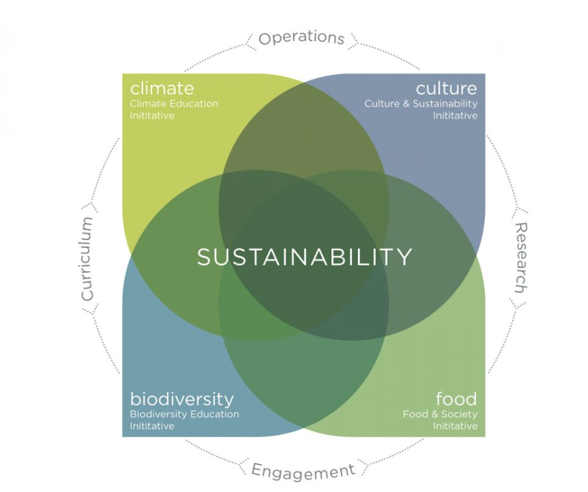

Sustainability
University of New Hampshire:
“We define sustainability as what sustains us as diverse people and communities—from clean air and water to healthcare, education and art—and making decisions in our individual and collective lives with this big picture in mind.
Sustainability is both local and global. It requires of us that we consider both the past and the future in terms of current and best practices.
At UNH, we use the sustainable learning community model developed by Dr. Tom Kelly. Sustainability involves maintaining the long-term health of biodiversity, climate, food, and culture, and where these four systems interact. “
https://sustainableunh.unh.edu/whatissustainability

Slide 3
Sustainability for Cyberinfrastructure
of hardware, software, teams…
hardware,
software,
algorithms,
domain research
hard skills and
soft skills
with researchers, institutions’ key people,
funding bodies, CI community, …

Slide 4
Sustainability for Cyberinfrastructure
of hardware, software, teams…
Climate between
Research and
Facilitation
Culture:
Innovation vs.
Maintenance
hardware,
software,
algorithms,
domain research
hard skills and
soft skills
Diversity in STEM
Funding and resources
with researchers, institutions’ key people,
funding bodies, CI community, …

Slide 5
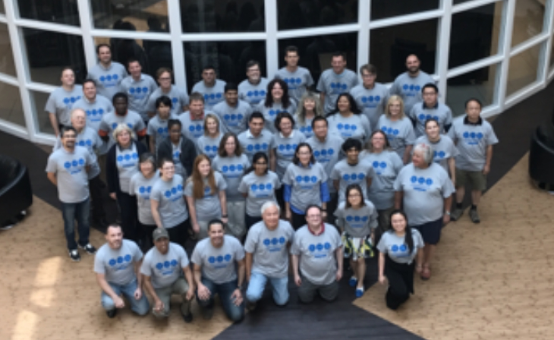
Sustainability for Cyberinfrastructure
Remember the 4 facings…
Sustainability is not a local effort, it is a
community effort
You are not alone!

Slide 6
Sustainability for Cyberinfrastructure
Get to know your
users (diverse research domains, faculty, …)
stakeholders (host institution, funding bodies – NSF, NIH, DoE, DoD, DARPA, Moore Foundation, etc.)
partners (projects, initiatives, experienced IT people)
volunteers (contributors to open-source and/or open science)
and their challenges as well as their goals – besides publications and funding.
Often their challenges are your challenges!
Computing resources
Data analytics
Preservation needs

Slide 7
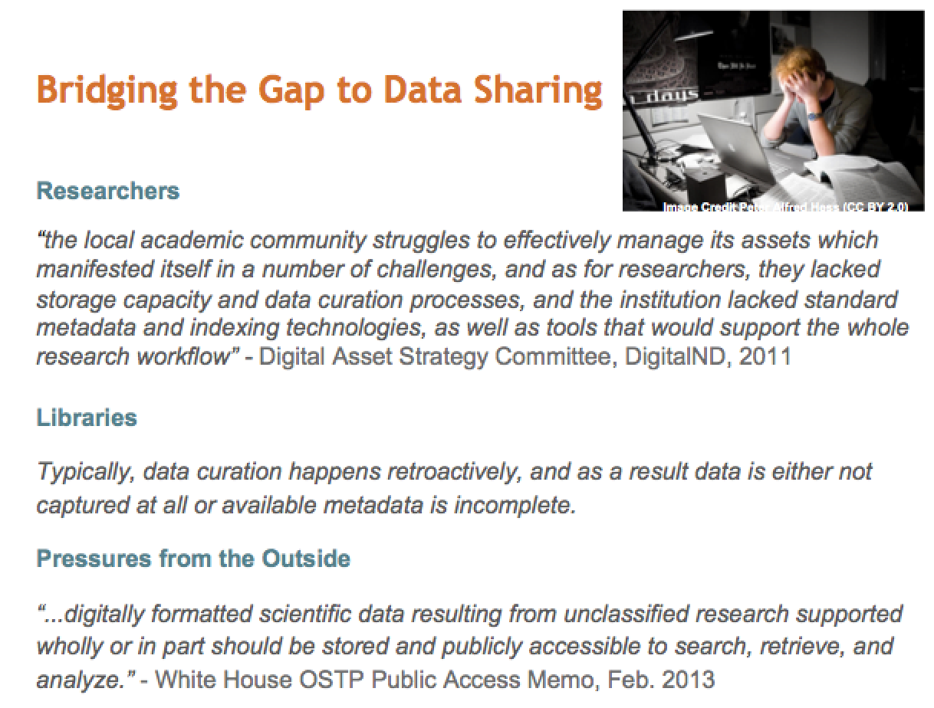
Sustainability for Cyberinfrastructure
https://presqt.crc.nd.edu/

Slide 8
Sustainability for Cyberinfrastructure
Look at financial and non-financial support (“free” resources)
Do you have people such as digital librarians?
They are generally not only serving humanities and have great knowledge about data preservation, data lifecycle, programming skills, ..
Do you have data scientists?
They probably know about machine learning, meta-data, ontologies, statistics …
Do you have business scientists?
They know about marketing, financial strategies, how to build an enterprise, …
They can be partners for you to support CI projects!

Slide 9
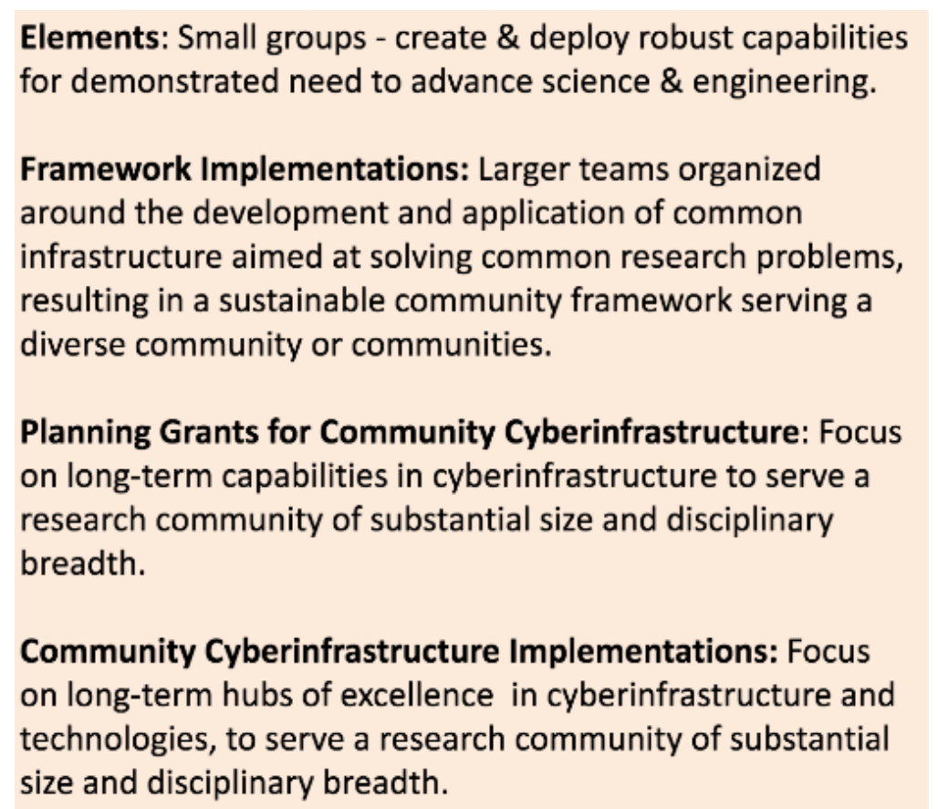
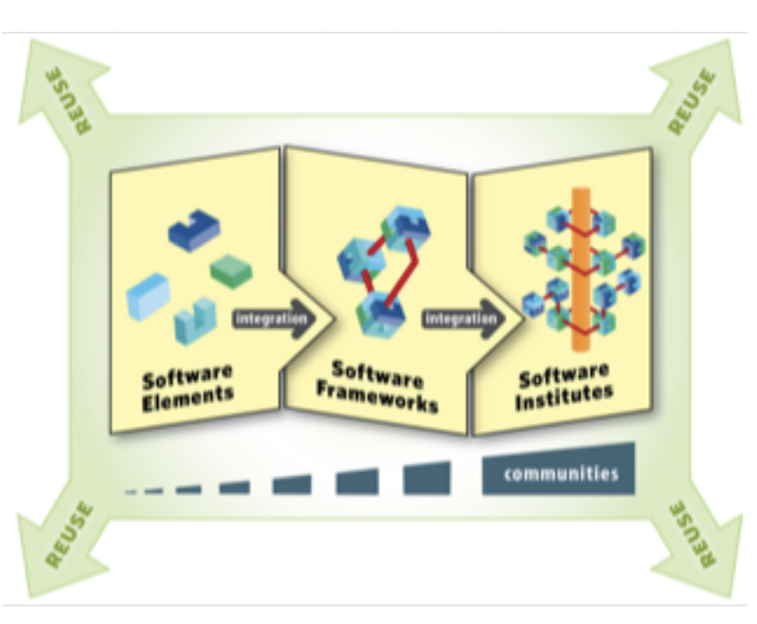
Sustainability for Cyberinfrastructure - NSF
SI2
Software Infrastructure for
Sustained innovation
CSSI
Cyberinfrastructure for Sustained
Scientific Innovation

Slide 10

Sustainability for Cyberinfrastructure - NSF
Sustainability Institutes and Excellence Hubs are funded to support the CI and research community
Support via implemented institutes is free for you!
Your chance to influence conceptualizations!
Implementations
Science Gateways Community Institute
The Molecular Sciences Software Institute
Conceptualizations
URSSI
High-Energy Physics
Geospatial
…

Slide 11
The CI Professional Ecosystem
Clemson-led ACI-REF project
Coalition for Academic Scientific Computation
Campus Research Computing Consortium (CaRCC)
Campus Champions
CyberAmbassadors
Linux Clusters Institute
SIGHPC Education Chapter
Software & Data Carpentry
Science Gateways Community Institute
UK Research Software Engineer Association
US Research Software Engineer Association
UK Software Sustainability Institute
Working Toward Sustainable Software for Science Practice and Experience (WSSSPE)
US Research Software Sustainability Institute

Slide 12

State of the Art in Research
Increased complexity of
research questions
hardware
software
instruments
data volume
data formats
The need for end-to-end solutions for accessing data, software, computing services, and equipment specific to the needs of a science or engineering discipline

Slide 13

Science Gateways
Increased complexity of
research questions
hardware
software
instruments
data volume
data formats
The need for end-to-end solutions for accessing data, software, computing services, and equipment specific to the needs of a science or engineering discipline
Science Gateways!

Slide 14
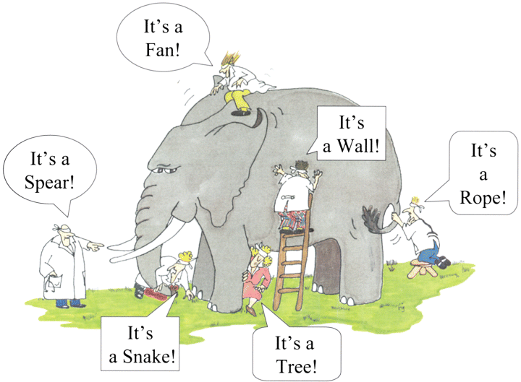

Slide 15
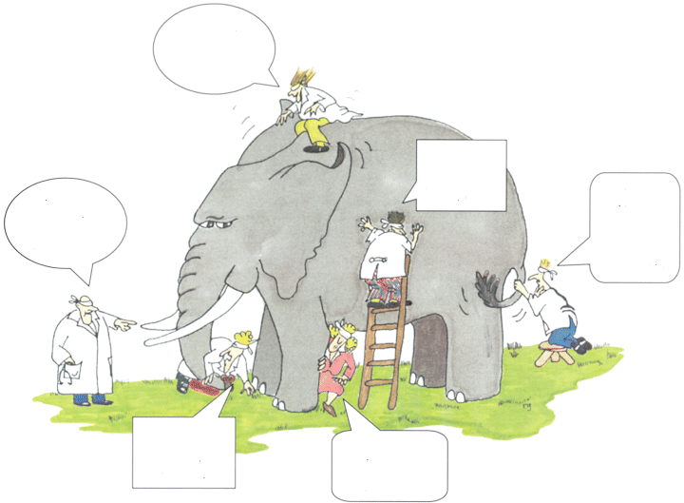
It’s a
Science
Gateway
It’s a Research
Portal
It’s
a Virtual Research
Environment
It’s a
Virtual
Lab
It’s a
Cyber-
infrastructure
It’s a Collaboratory

Slide 16
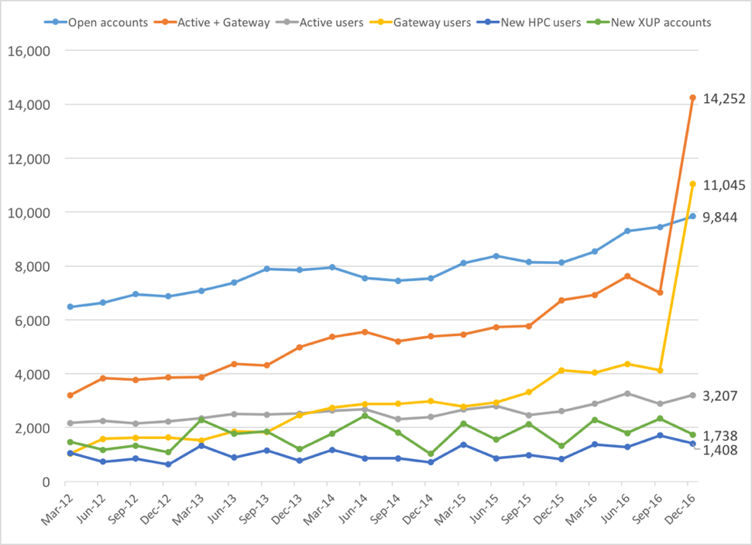
Science Gateways
Gateway users are 77% of active XSEDE users in Q4 2016
All users
Gateways
Login
XSEDE users
This is largely due to the CIPRES and I-TASSER gateways, but others are gaining

Slide 17
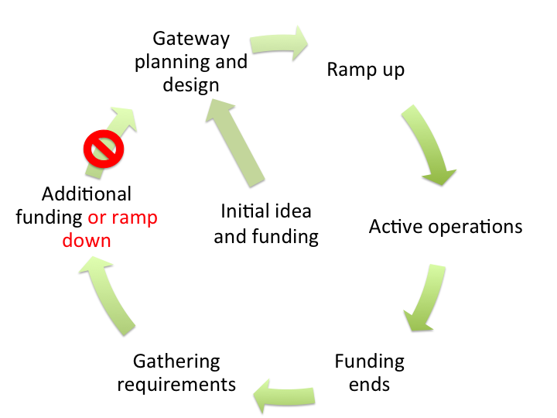
Life Cycle of a Science Gateway
Developers typically
• work in isolation
• must bridge to
variety of resources
• need building
blocks in order to
focus on higher-level
functionality
• struggle to secure
sustainable funding
Sounds familiar?

Slide 18
Science Gateway Survey 2014
What services
would be helpful?
sent out to 29,000 persons
4,957 responses from
across domains
52% from life, physical or mathematical sciences
32% from computer and information sciences or
engineering
45% develop data collections
44% develop data analysis
tools
Proposed Service | % Interest
Evaluation, impact analysis, website analytics | 72%
Adapting technologies | 67%
Web/visual/graphic design | 67%
Choosing technologies | 66%
Usability Services | 66%
Visualization | 65%
Developing open-source software | 64%
Support for education | 64%
Community engagement mechanisms | 62%
Keeping your project running | 62%
Legal perspectives | 61%
Managing data | 60%
Computational resources | 59%
Mobile technology | 59%
Database structure, optimization, and query expertise | 59%
Data mining and analysis | 58%
Cybersecurity consultation | 57%
Website construction | 57%
Software engineering process consultation | 53%
Source code review and/or audit | 51%
High-bandwidth networks | 45%
Scientific instruments or data streams | 44%
Management aspects of a project | 38%

Slide 19
Science Gateway Survey 2014
Well-designed gateways require a variety of expertise

Slide 20
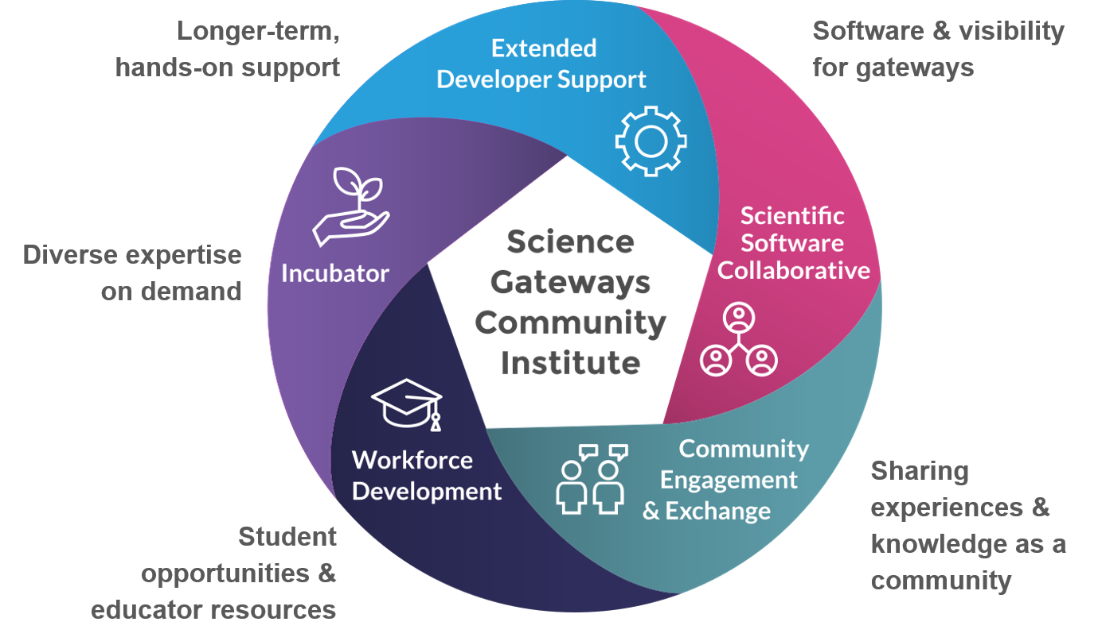
Science Gateways Community Institute

Slide 21
Sustainability for Cyberinfrastructure
On-campus teams
It is a centralized team at your
institution –
irrespective whether you are part of
a university, a national lab,
an organization, a consortium or
a company…
Local teams vs. distributed and
remote teams:
For local teams it is still easier to
build more trust, to be more efficient
and to create a strong culture.
https://www.codementor.io/blog/modern-engineering-teams-4ea9dpftzs

Slide 22
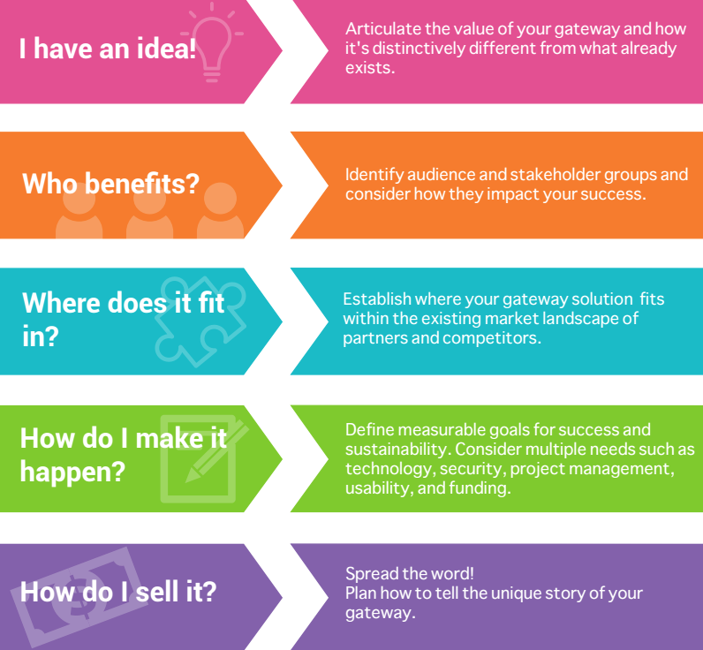
Connect with SGCI
Incubator Sustainability Bootcamp
https://sciencegateways.org/engage/bootcamp
5 full days
Teams on projects
Interactivity
Community formation
Putting away the normal daily routine
Homework
twice per year
additional ones can be booked (travel expenses for presenters)
adapted to feedback

Slide 23
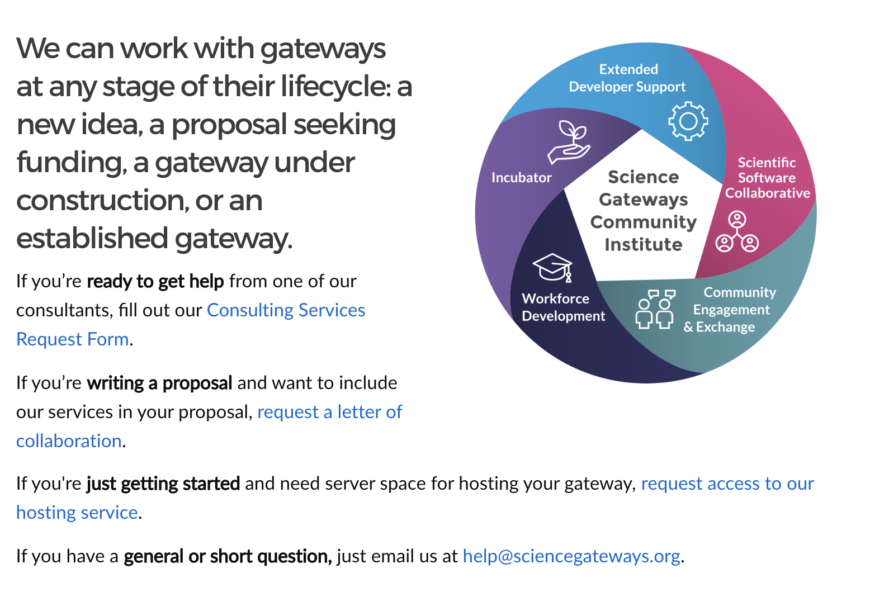
Connect with SGCI
Incubator Sustainability Bootcamp
https://sciencegateways.org/engage/bootcamp
Work with us
https://sciencegateways.org/consulting/work-with-us

Slide 24
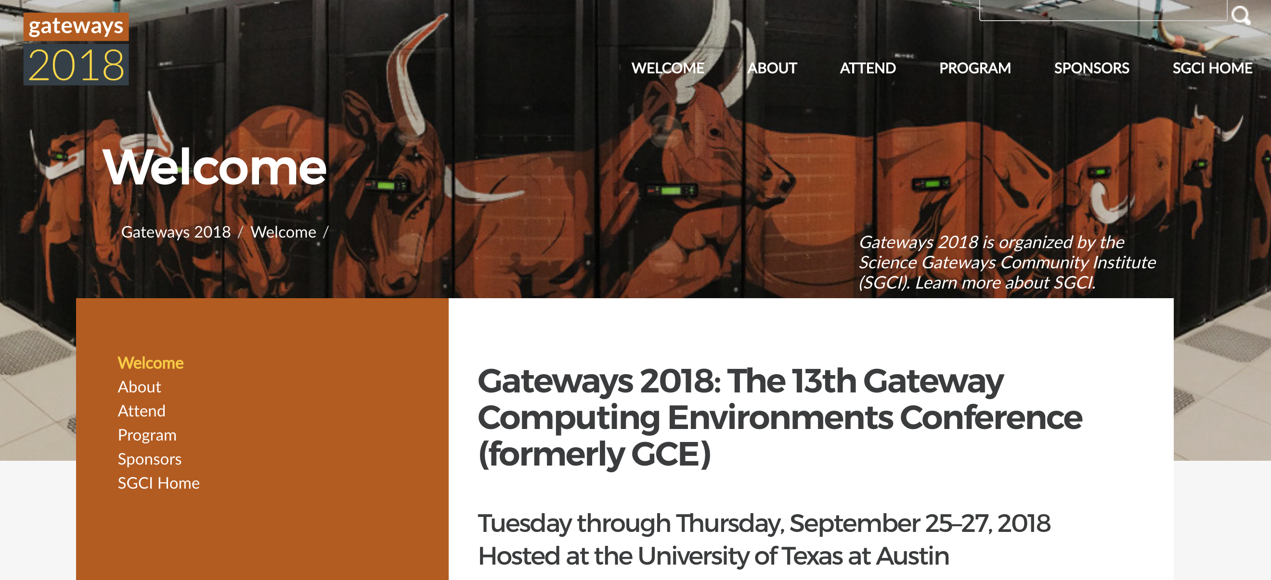
Connect with SGCI
Incubator Sustainability Bootcamp
https://sciencegateways.org/engage/bootcamp
Work with us
https://sciencegateways.org/consulting/work-with-us
Yearly Conference
https://sciencegateways.org/engage/annual-conference
Early-bird registration ends today!

Slide 25
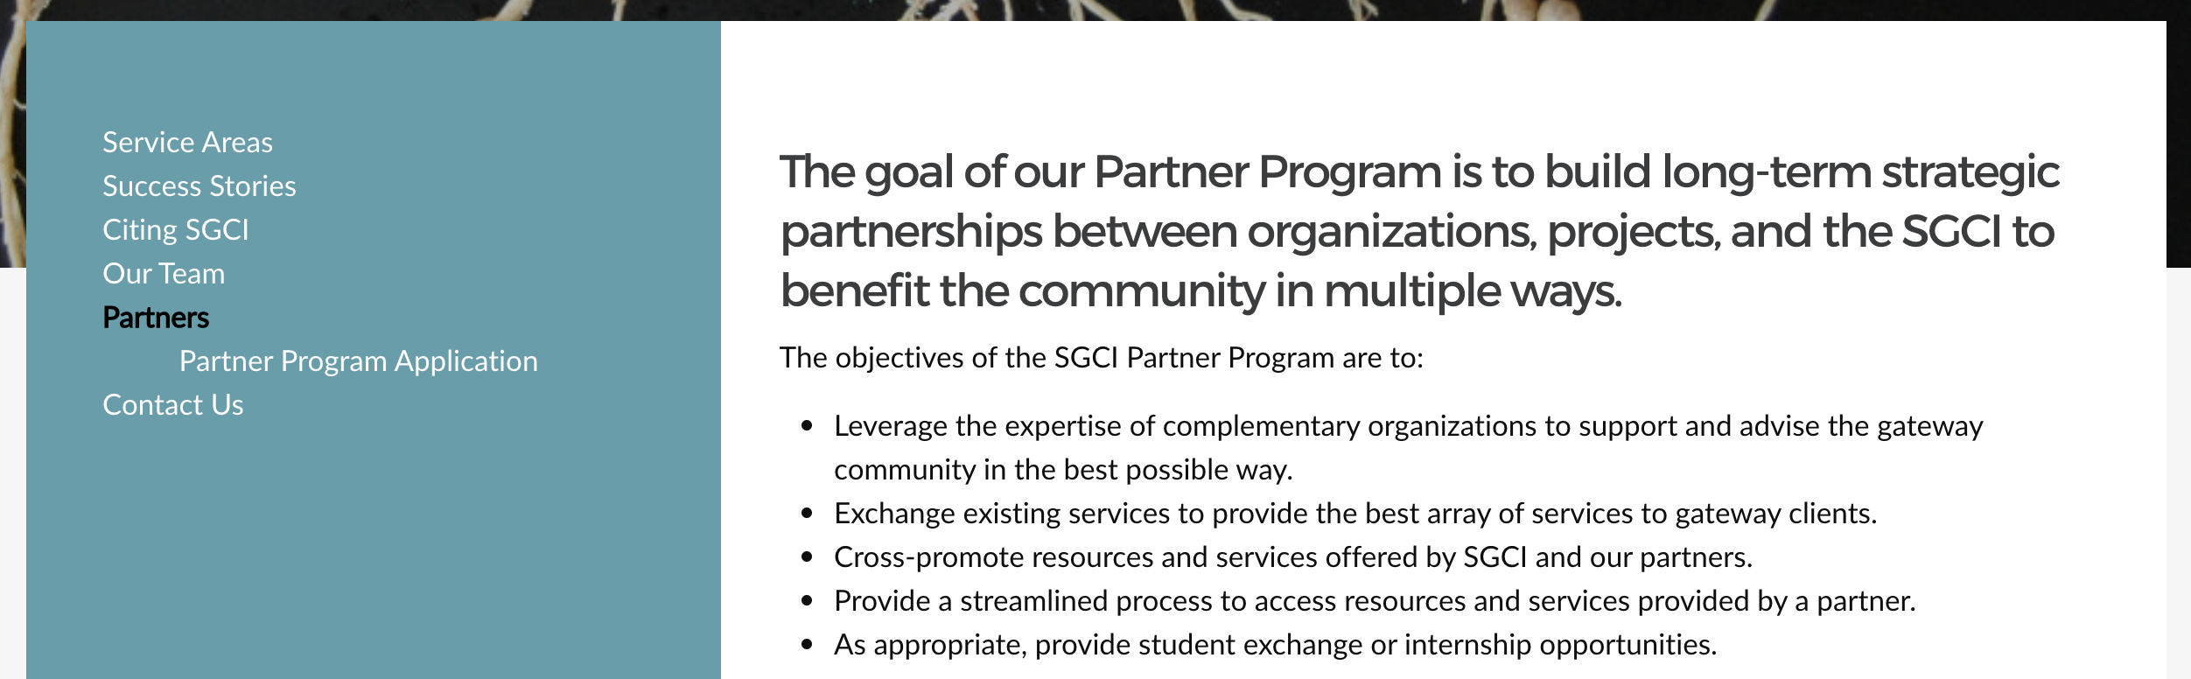
Connect with SGCI
Incubator Sustainability Bootcamp
https://sciencegateways.org/engage/bootcamp
Work with us
https://sciencegateways.org/consulting/work-with-us
Yearly Conference
https://sciencegateways.org/engage/annual-conference
Become involved as a partner or affiliate
https://sciencegateways.org/about/partners
Early-bird registration ends today!

Slide 26
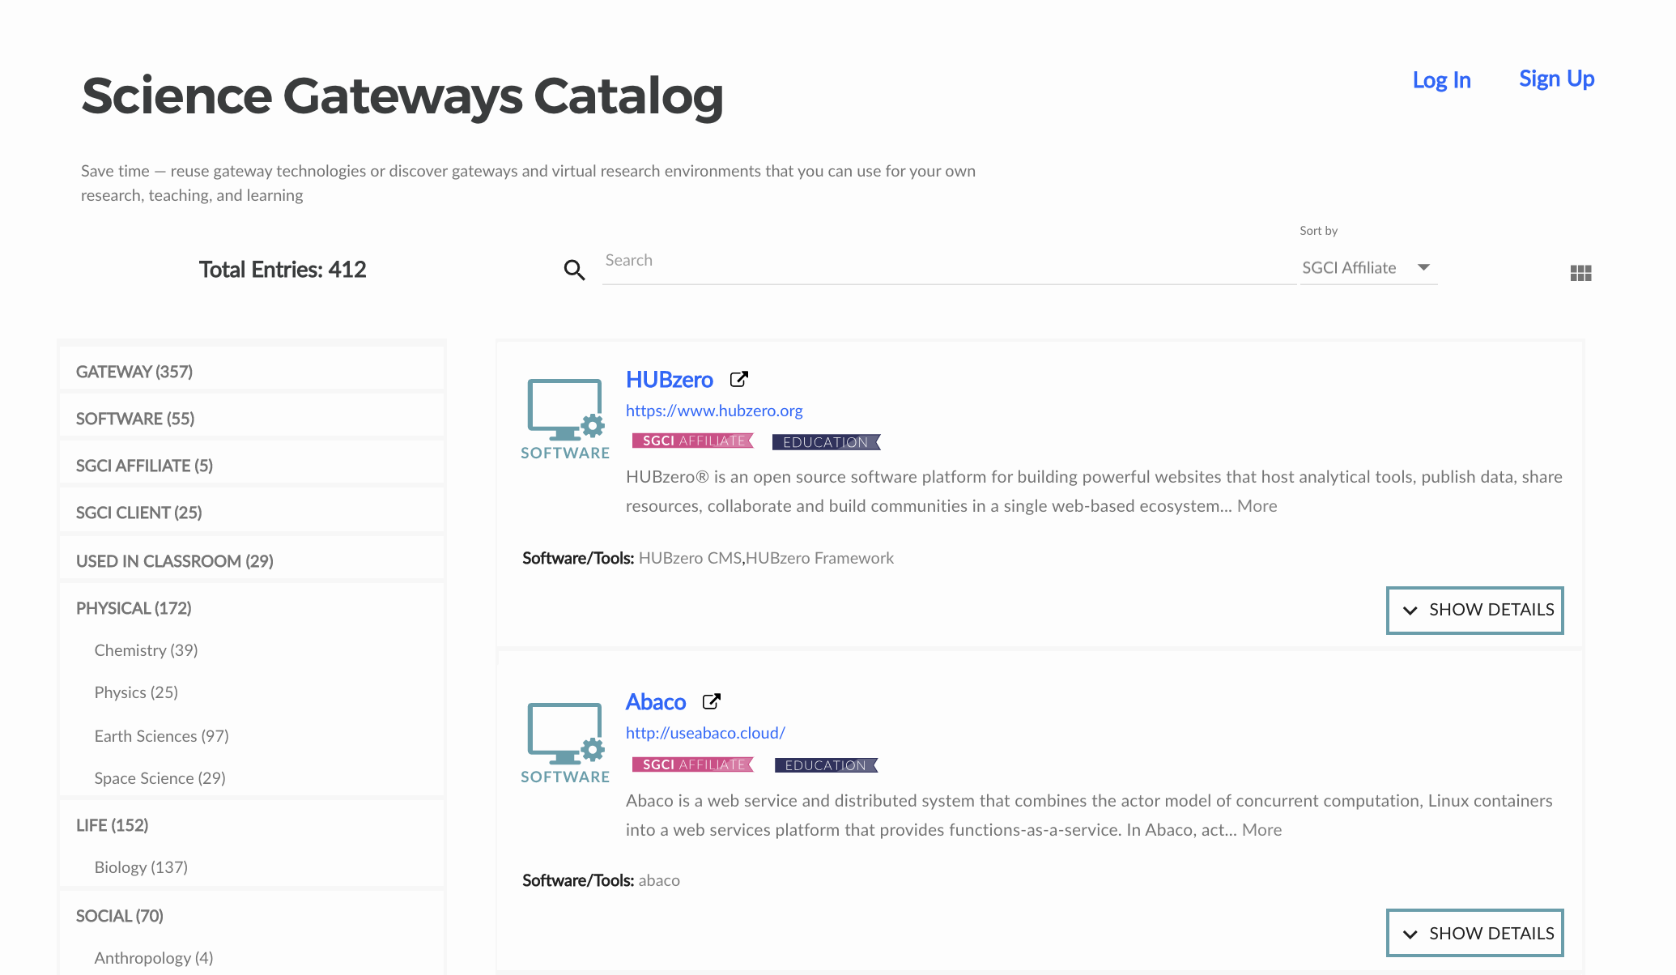
Connect with SGCI
Incubator Sustainability Bootcamp
  https://sciencegateways.org/engage/bootcamp
Work with us
  https://sciencegateways.org/consulting/work-with-us
Yearly Conference
  https://sciencegateways.org/engage/annual-conference
Become involved as a partner or affiliate
  https://sciencegateways.org/about/partners
Software/Gateway Catalog
  https://catalog.sciencegateways.org/
Early-bird registration ends today!

Slide 27
Connect with SGCI
Incubator Sustainability Bootcamp
  https://sciencegateways.org/engage/bootcamp
Work with us
  https://sciencegateways.org/consulting/work-with-us
Yearly Conference
  https://sciencegateways.org/engage/annual-conference
Become involved as a partner or affiliate
  https://sciencegateways.org/about/partners
Software/Gateway Catalog
  https://catalog.sciencegateways.org/
Train students in internships
https://sciencegateways.org/engage/student-focused
Webinars, blogs, newsletter, Twitter, LinkedIn etc.
https://sciencegateways.org
Early-bird registration ends today!

Slide 28
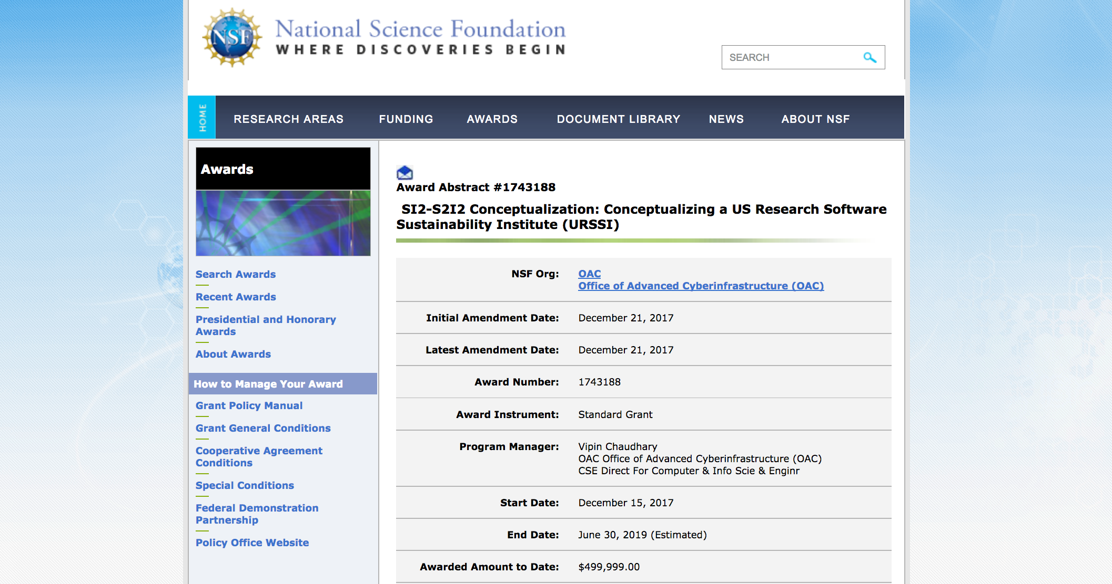
Remember Henry‘s Question: How much time Do You Get to Learn Your Job as Facilitator?

Slide 29
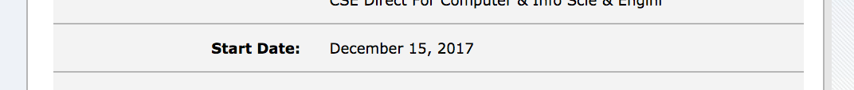
Remember Henry‘s Question: How much time Do You Get to Learn Your Job as Facilitator?
Maybe -6 days;-)

Slide 30
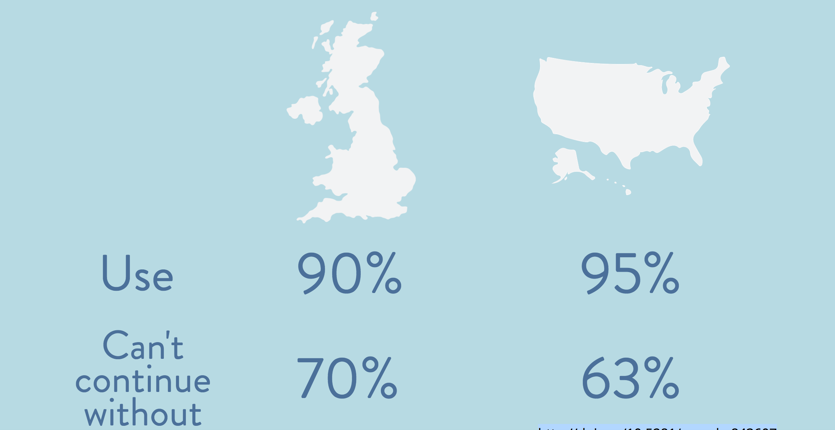
Research Software
http://doi.org/10.5281/zenodo.843607

Slide 31
Research Software
> 50% neither formal nor informal training
in software engineering
http://doi.org/10.5281/zenodo.843607

Slide 32
Research Software
Lack of career paths
http://doi.org/10.5281/zenodo.843607

Slide 33
Research Software
How to cite software?
http://doi.org/10.5281/zenodo.843607

Slide 34
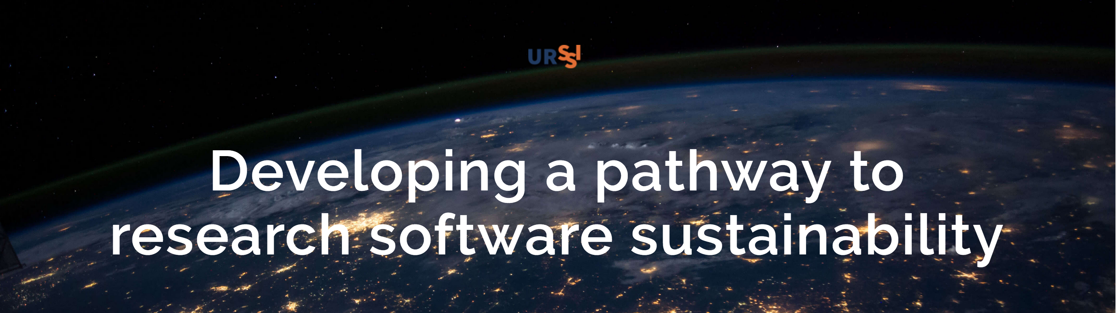
Areas of Concern
Functioning of the individual and team
Functioning of the research software
Functioning of the research field itself

Slide 35
Functioning of the Individual and Team
Training & education
Ensuring appropriate credit for software development
Enabling publication pathways for research software
Fostering satisfactory and rewarding career paths for people who develop and maintain software
Increasing the participation of underrepresented groups in software engineering

Slide 36
Functioning of Research Software
Supporting sustainability of the software
Growing community, evolving governance, and developing relationships between organizations, both academic and industrial
Fostering both testing and reproducibility
Supporting new models and developments (e.g., agile web frameworks, Software-as-a-Service)
Supporting contributions of transient contributors (e.g., students)

Slide 37
Functioning of the Research Field Itself
Growing communities around research software and disparate user requirements
Cataloging extant and necessary software
Disseminating new developments
Training researchers in the usage of software
Understanding and improving pipelines of diverse developers and maintainers

Slide 38
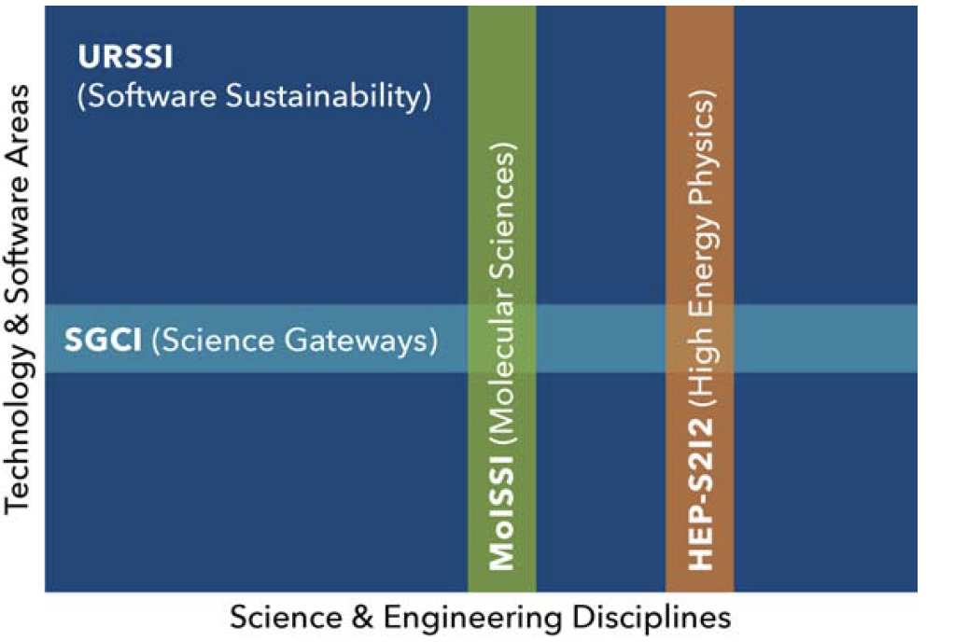
URSSI and Other S2I2 Projects

Slide 39
URSSI and Other S2I2 Projects
Goal: Close collaboration and
fill in gaps on each axis

Slide 40
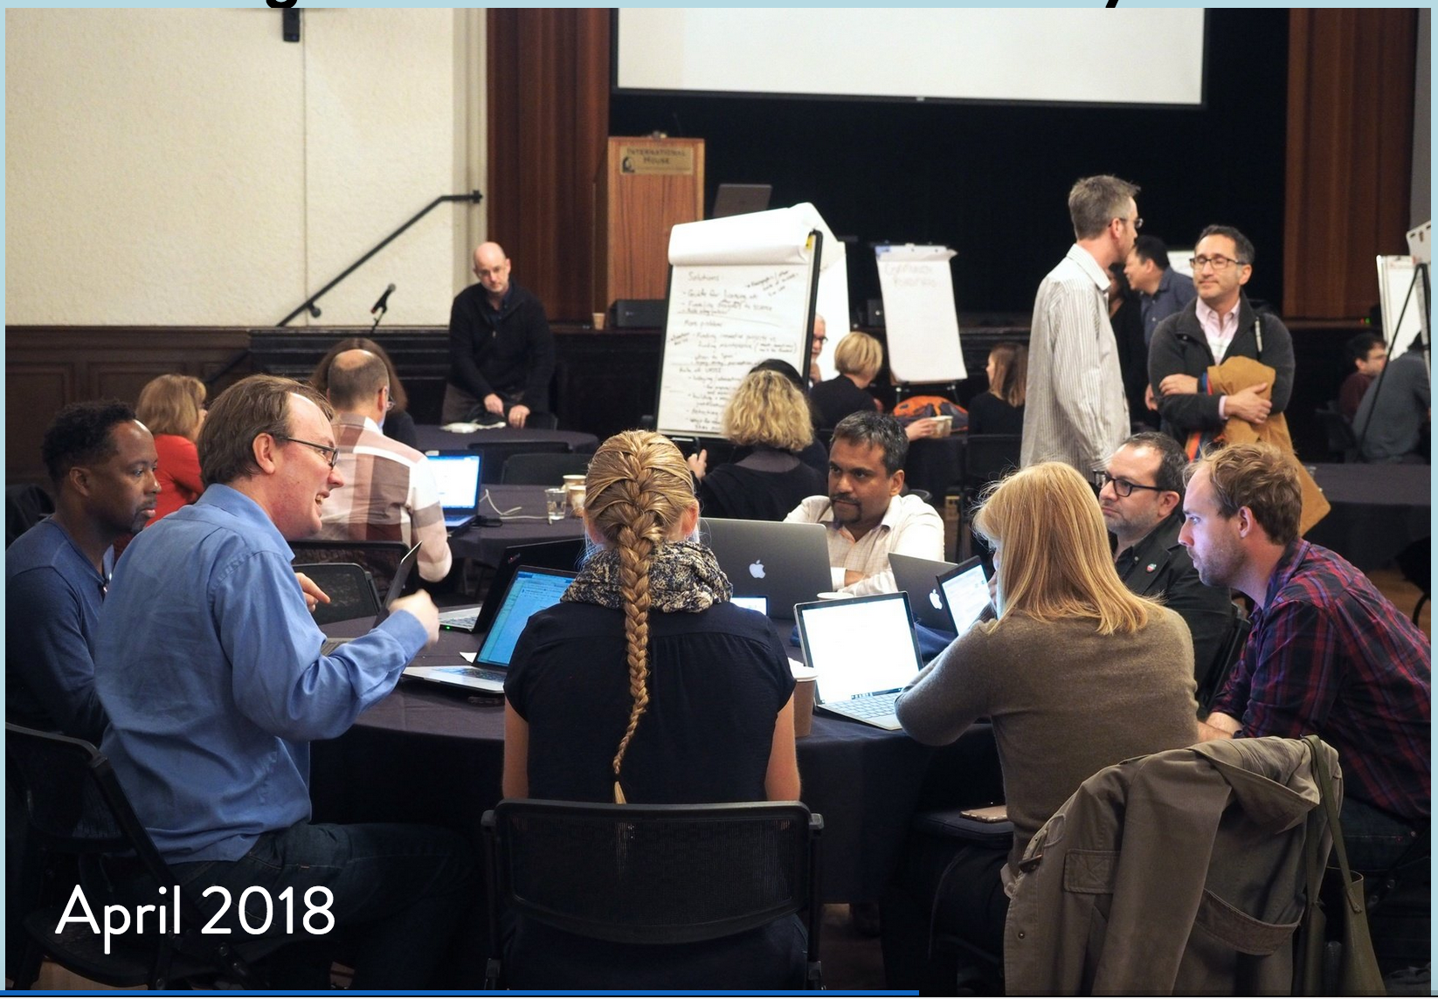
Conceptualization
Workshops
  First workshop took place in April in Berkeley

Slide 41
Conceptualization
Workshops
  First workshop took place in April in Berkeley
  Next workshop will take place in October in Chicago
  Software credit workshop
  Incubator workshop
Survey
Ethnographic studies
Mission and vision working group

Slide 42
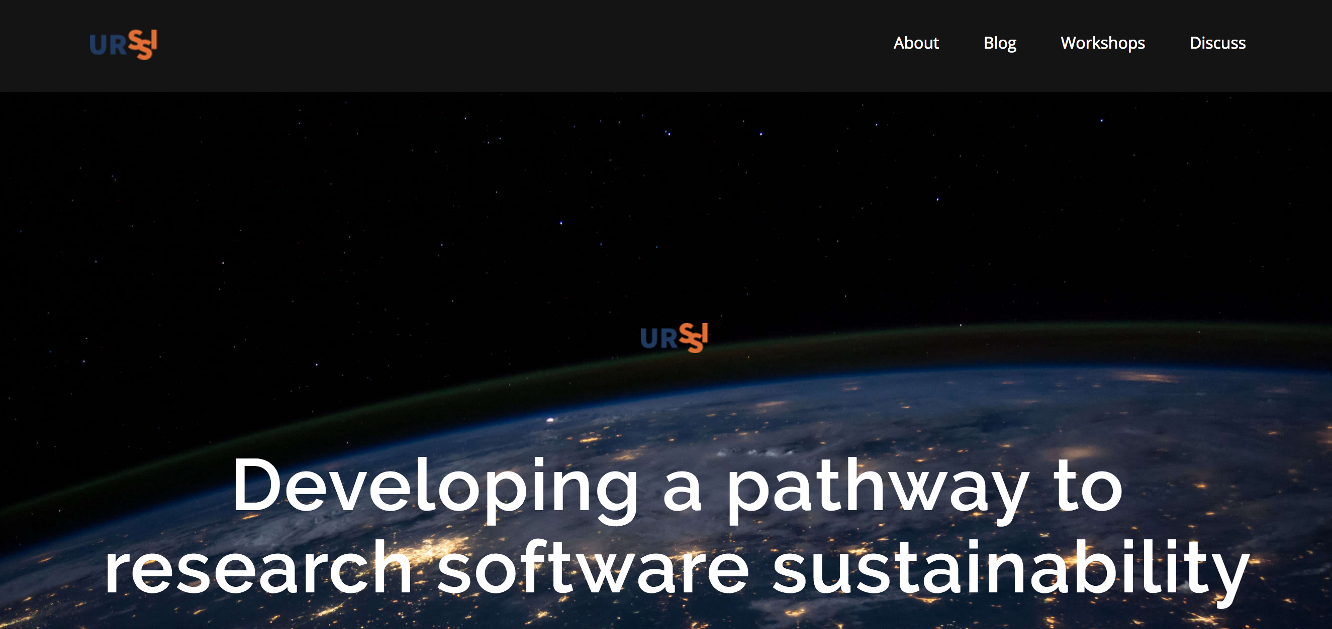
How to Connect
Website http://urssi.us/

Slide 43
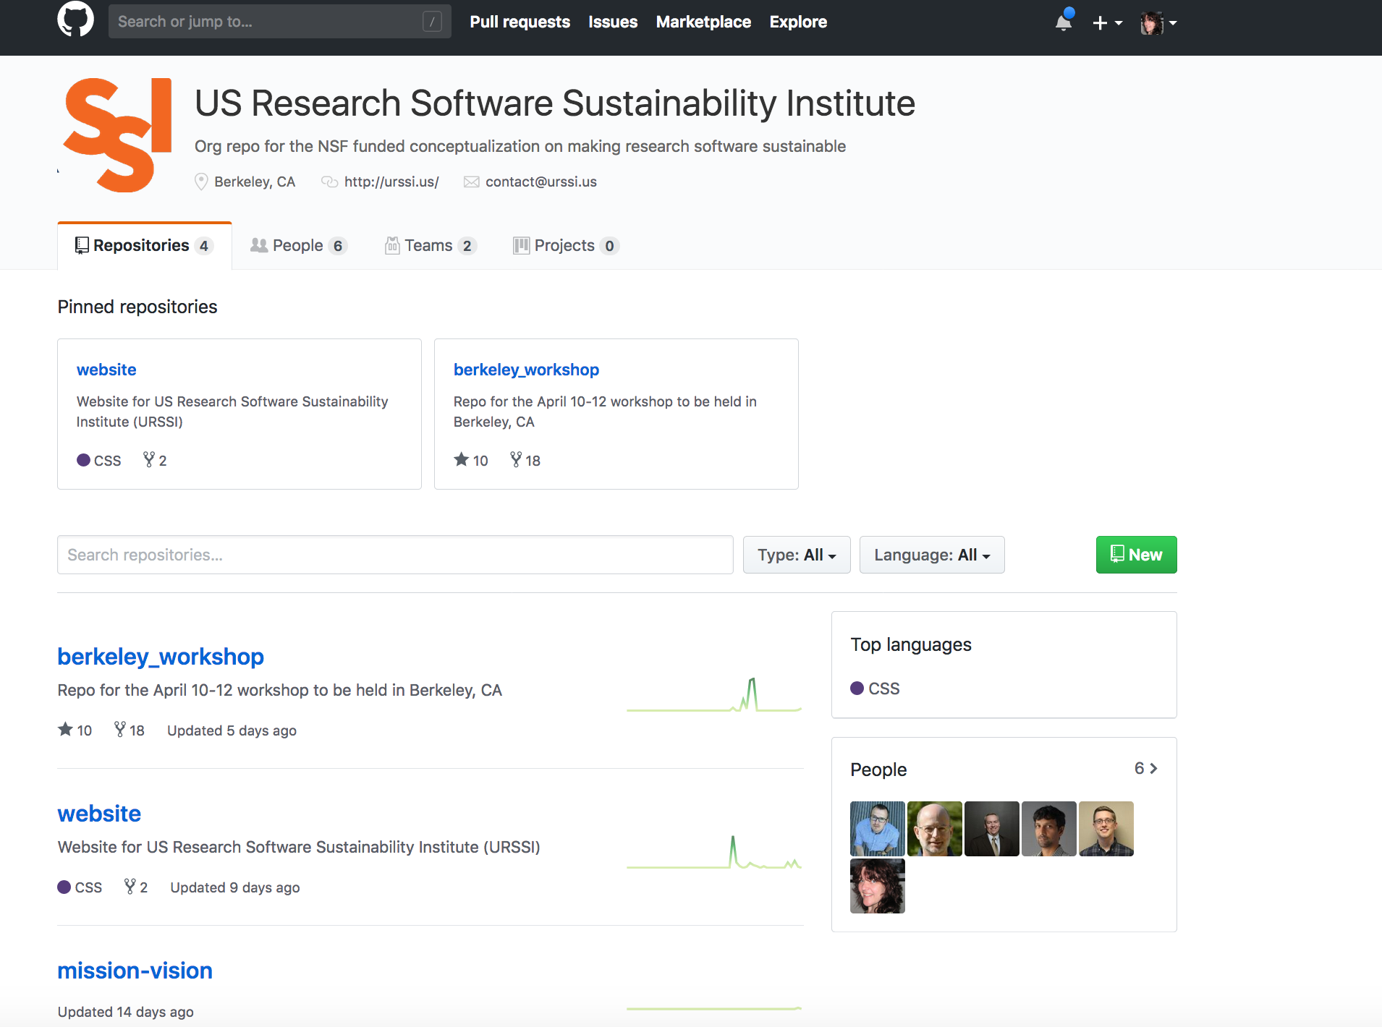
How to Connect
Website http://urssi.us/
Materials https://github.com/si2-urssi

Slide 44
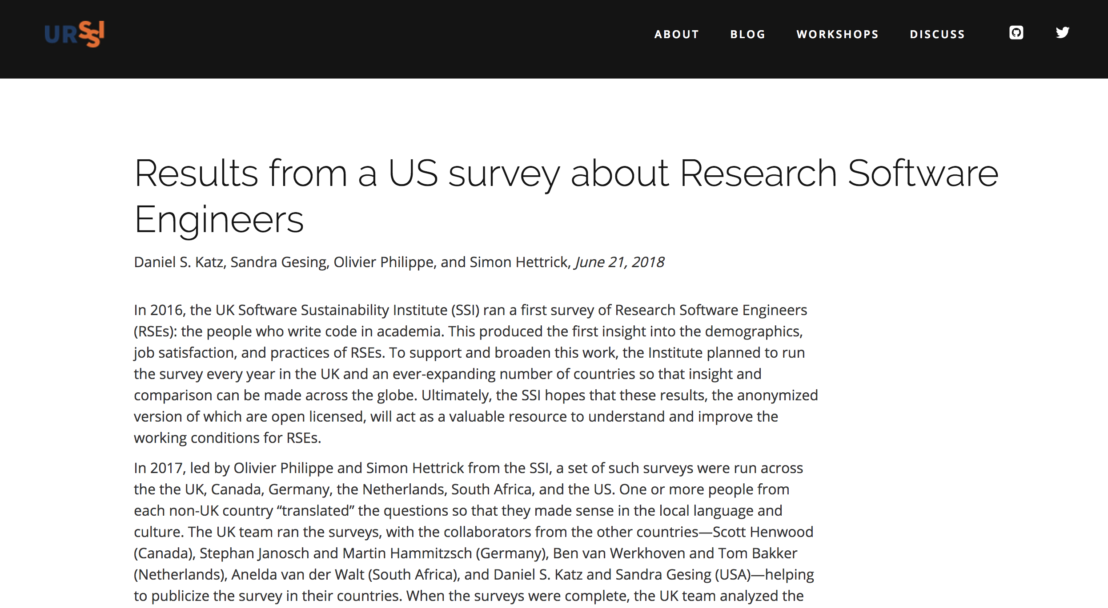
How to Connect
Website http://urssi.us/
Materials https://github.com/si2-urssi
Blog posts http://urssi.us/blog/

Slide 45
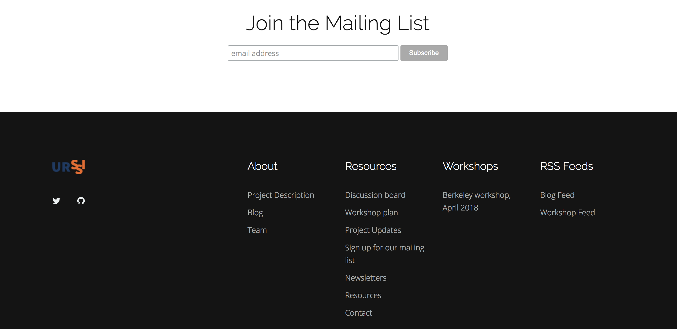
How to Connect
Website http://urssi.us/
Materials https://github.com/si2-urssi
Blog posts http://urssi.us/blog/
Mailing list http://urssi.us/

Slide 46
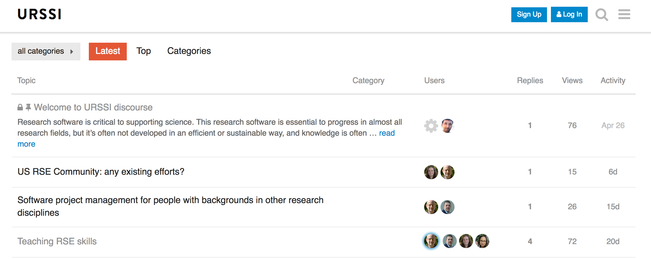
How to Connect
Website http://urssi.us/
Materials https://github.com/si2-urssi
Blog posts http://urssi.us/blog/
Mailing list http://urssi.us/
Discuss https://discuss.urssi.us/

Slide 47
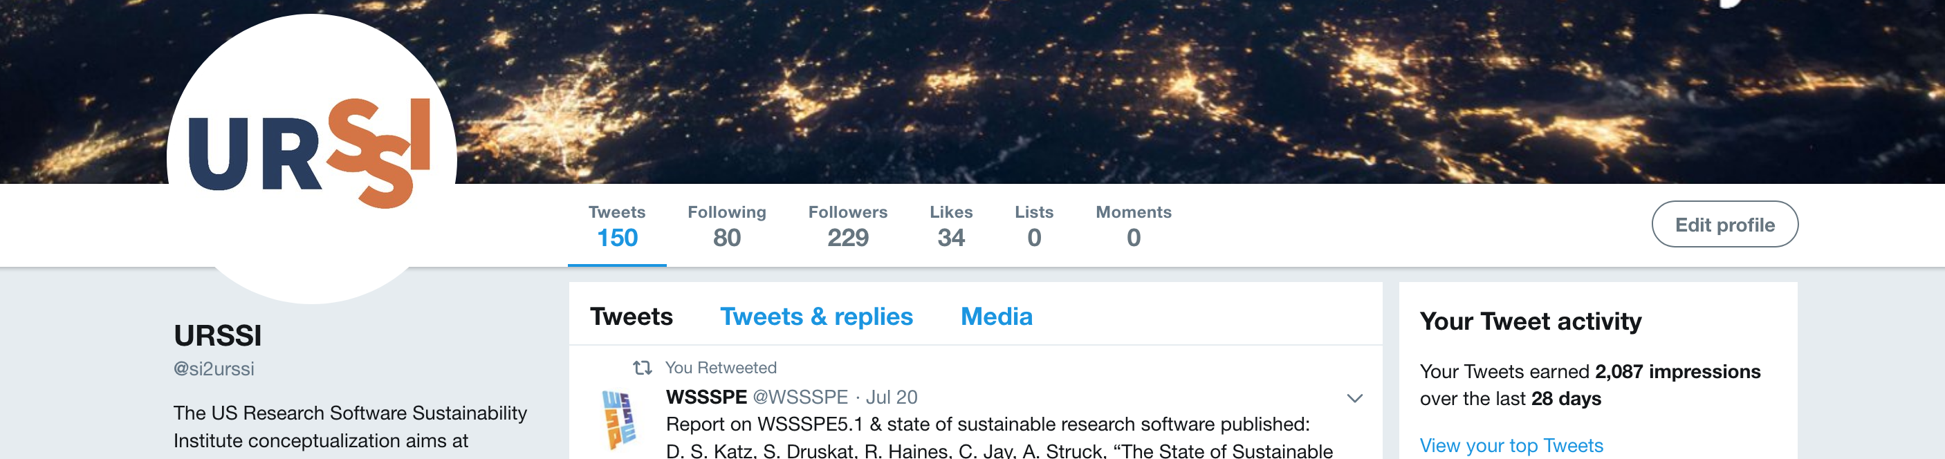
How to Connect
Website http://urssi.us/
Materials https://github.com/si2-urssi
Blog posts http://urssi.us/blog/
Mailing list http://urssi.us/
Discuss https://discuss.urssi.us/
Twitter https://twitter.com/si2urssi

Slide 48
How to Connect
Website http://urssi.us/
Materials https://github.com/si2-urssi
Blog posts http://urssi.us/blog/
Mailing list http://urssi.us/
Discuss https://discuss.urssi.us/
Twitter https://twitter.com/si2urssi
Workshops http://urssi.us/workshops/
Join us for our next workshop in Chicago
October 23-24!

Slide 49
Lessons Learned on International Level
UK SSI and UK Research Software Engineer Association
Buy-in from universities
Viable career path
Large community

Slide 50
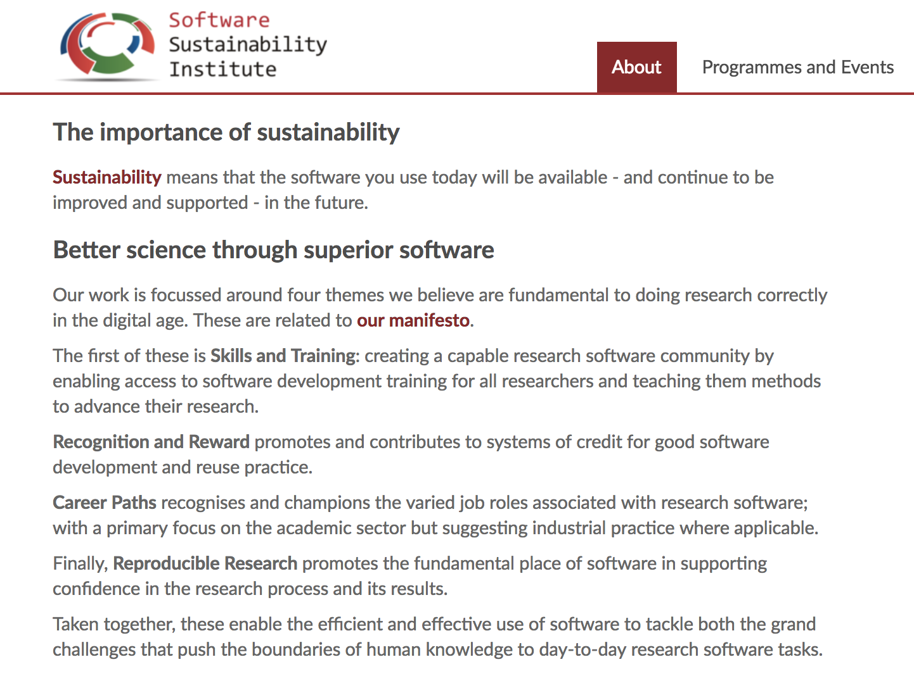
Software Sustainability
https://www.software.ac.uk/about

Slide 51
Sustainability
The Ecosystem offers a lot of opportunities
But
Another mail list
Another newsletter
Another discussion list
Another slack channel
Plenty of workshops
Plenty of surveys
Overwhelming? Too many scattered approaches?
How to sustain knowledge on and collaboration
with sustainability approaches?

Slide 52
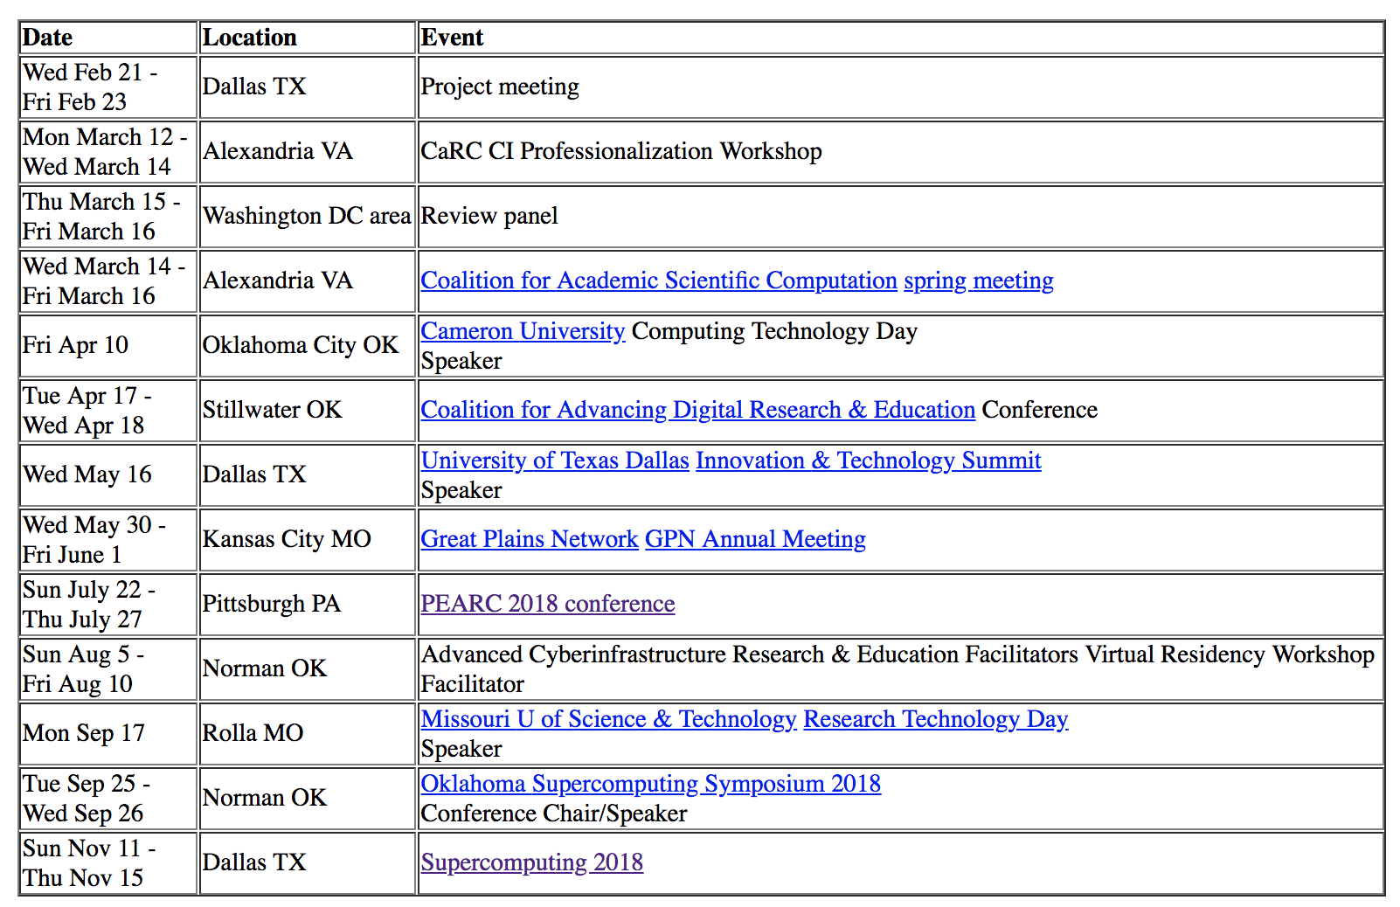
Henry’s Travel Schedule

Slide 53
Lessons Learned on International Level
What is different in the UK?
It’s a smaller country - not a characteristics we can change for the US
The culture between research, software engineering and facilitation is different (SE and facilitation are more appreciated by researchers) – we can work on this, the more positive examples, white papers, metrics, etc. the more buy-in…

Slide 54
Lessons Learned from Sustained Teams/Projects
Commonalities
Evangelist
Diverse mechanisms of funding
Community building
Open source and open science
Collaboration, collaboration, collaboration

Slide 55
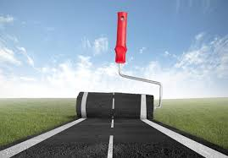

What Are Our Next Steps?
Evangelists for diverse initiatives – not every approach suits all
Define a roadmap for collaboration and community building
➔

Slide 56
What Are Our Next Steps?
How to make it less scattered and without duplicating effort? How to change research culture?
Catalog on sustainability projects?
Catalog on events?
Catalog on metrics?
Catalog on success stories?
Evangelist and an outreach specialist?
“Exchange” instructors between events?
Involve faculty, HR people, stakeholders in events?

Slide 57
What Are Our Next Steps?
Let’s make the next steps together!
Thanks!
sandra.gesing@nd.edu

