Slide 1
The CI Ecosystem
&
The Four Facings
Dan Voss
University of Miami/Florida State University
Professional Presenter/Consultant/Contractor/Graduate Student
d.voss@miami.edu
Notes:
1

Slide 2
The CI Ecosystem
&
The Four Facings
randomly scattered throughout presentation
to keep you (and me) on our toes
Dan Voss
University of Miami/Florida State University
Professional Presenter/Consultant/Contractor/Graduate Student
d.voss@miami.edu
Notes:
2

Slide 3
Secret Agenda!

Slide 4
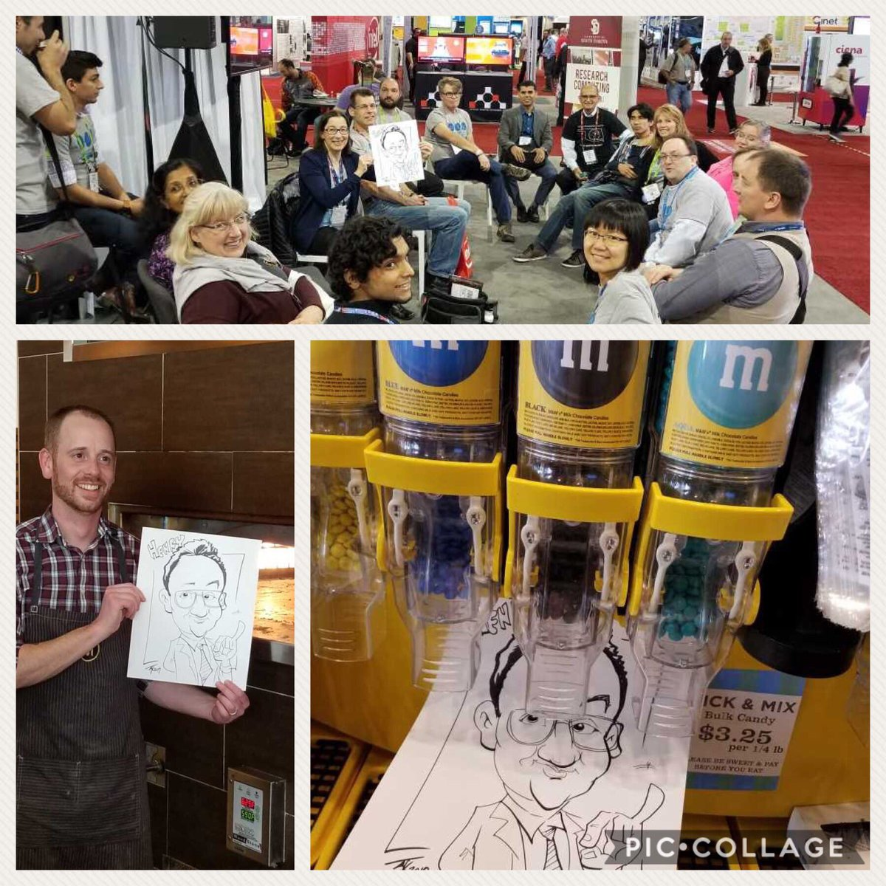
Secret Agenda!

Slide 5
Are You Lonely?
I was….
How many at your institution do what you do?
You’re already ahead since you’re here!
5

Slide 6
Why, What, How?
When Google can’t help…
Communities of Practice
Synchronous Training
Asynchronous Training
Conferences
Other Entities
6

Slide 7
Communities of Practice
Campus Champions!
SIGHPC Education Chapter
The Carpentries
Coalition for Academic Scientific Computing (CASC)
Campus Research Computing Consortium (CaRC)
XSEDE Service Providers Forum
Cyberinfrastructure State & Regional Groups
7

Slide 8
Communities of Practice
Campus Champions!
SIGHPC Education Chapter
The Carpentries
Coalition for Academic Scientific Computing (CASC)
Campus Research Computing (CaRC) Consortium
XSEDE Service Providers Forum
Cyberinfrastructure State & Regional Groups
8

Slide 9
Champions – the “breadth” group
~500 champions from 250+ US academic and research-focused institutions help their local researchers to use CI, especially large scale and advanced computing
FREE to join with letter of collaboration
Funded via XSEDE project (but no longer XSEDE focused)
All flavors of campus research computing professionals (directors, sysadmins, user support, trainers, coordinators, etc.)
Plus new “affiliates” – from organizations that serve the larger community (XSEDE, Internet2, Globus, BDHubs, National Centers, etc.)
https://www.xsede.org/campus-champions
9
Notes:
9

Slide 10
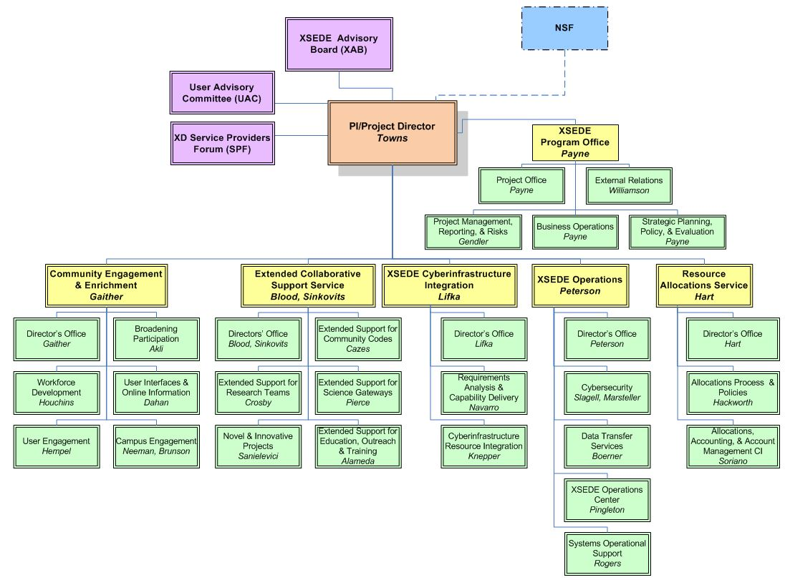
https://confluence.xsede.org/pages/viewpage.action?pageId=1671768

Slide 11
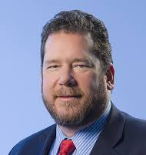
https://confluence.xsede.org/pages/viewpage.action?pageId=1671768

Slide 12
https://confluence.xsede.org/pages/viewpage.action?pageId=1671768

Slide 13
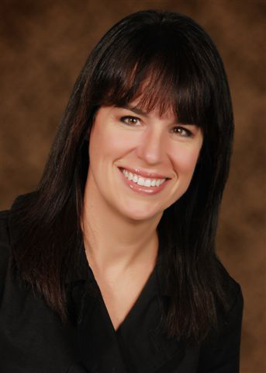
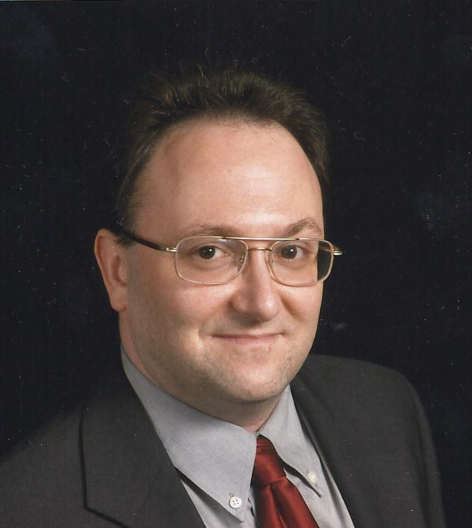
https://confluence.xsede.org/pages/viewpage.action?pageId=1671768

Slide 14
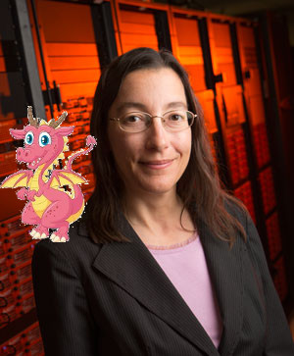
https://confluence.xsede.org/pages/viewpage.action?pageId=1671768

Slide 15
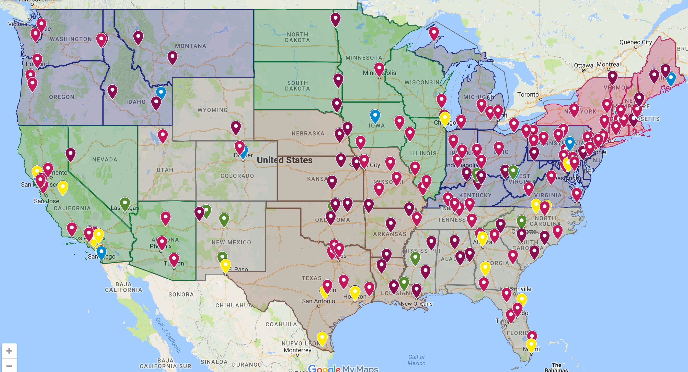
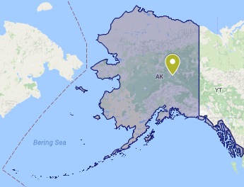
Notes:
15

Slide 16
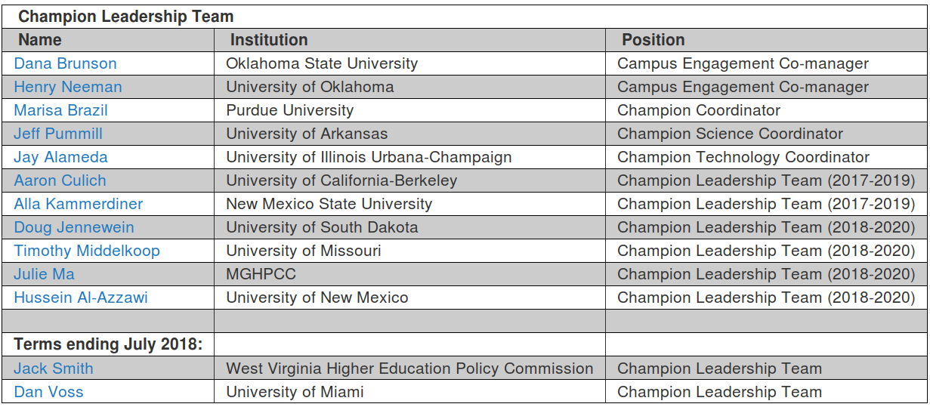
Campus Champion Leadership Team

Slide 17
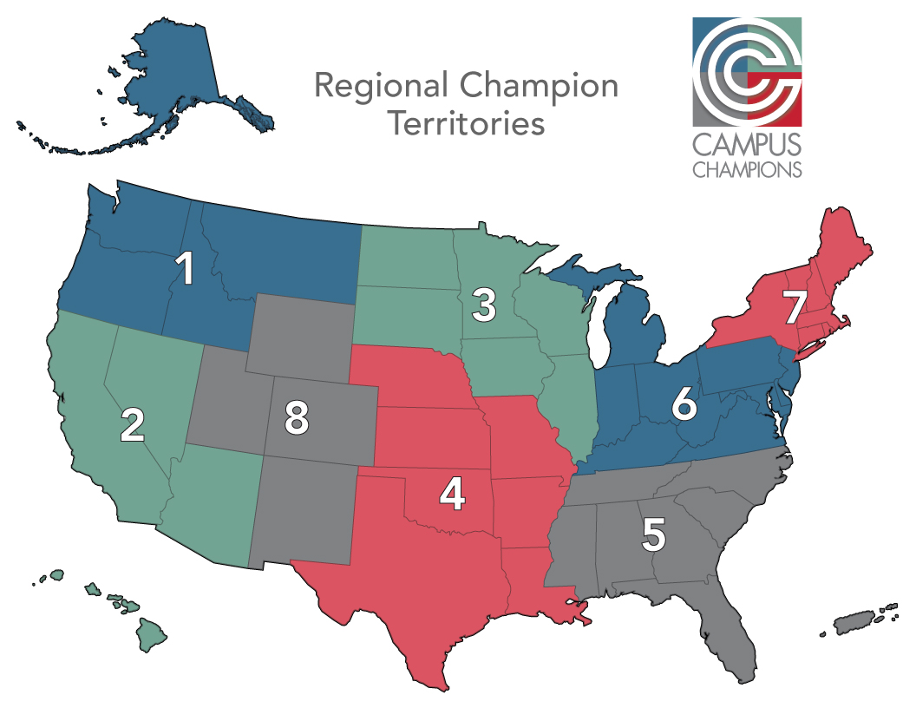

Slide 18
Campus Champion Regional Leaders

Slide 19
Four Facings?

Slide 20
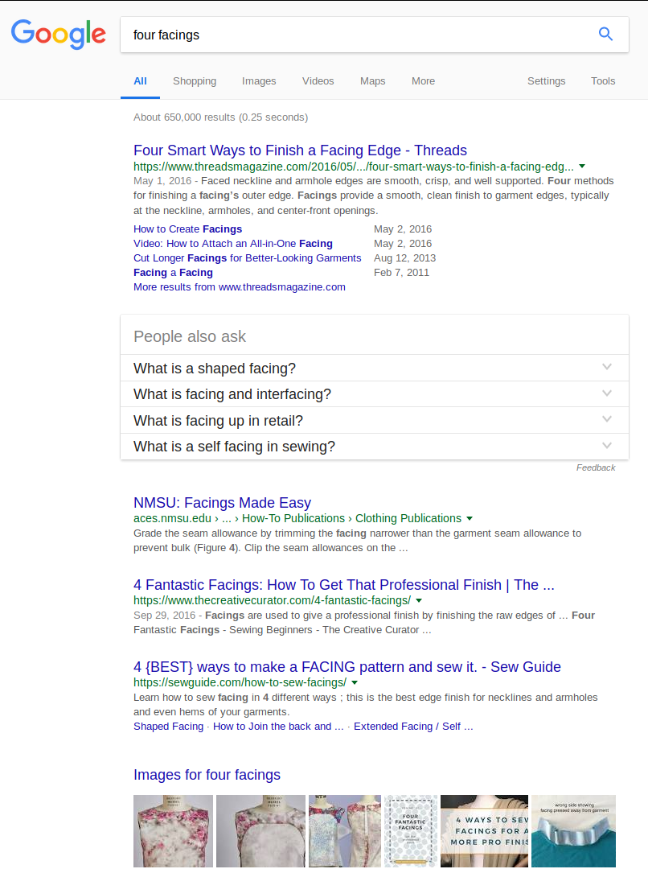
Four Facings?

Slide 21
Four Facings?
Facing is mostly used to finish the edges in:
Necklines
Armholes
Hems
Openings

Slide 22
Four Facings?
There are basically three types of facing:
Shaped facing
Extended facing
Bias facing
Doh! Kills that idea

Slide 23
Communities of Practice
Campus Champions!
SIGHPC Education Chapter
The Carpentries
Coalition for Academic Scientific Computing (CASC)
Campus Research Computing (CaRC) Consortium
XSEDE Service Providers Forum
Cyberinfrastructure State & Regional Groups
23

Slide 24
SIGHPC Education Chapter
Virtual chapter of the Association for Computing Machinery’s (ACM) Special Interest Group in HPC.
It recently merged with the International HPC Training Consortium (IHPCTC), whose purpose is the promotion of, interest in, and knowledge of applications of HPC.
Their focus is on promoting leading practices for HPC training and education.
Joining is inexpensive and gets you a discount at SC.
http://www.sighpc.org
24

Slide 29
Communities of Practice
Campus Champions!
SIGHPC Education Chapter
The Carpentries
Coalition for Academic Scientific Computing (CASC)
Campus Research Computing (CaRC) Consortium
XSEDE Service Providers Forum
Cyberinfrastructure State & Regional Groups
29

Slide 30
The Carpentries
Volunteer instructors teaching basic lab skills for research computing (over 450!)
Collaboratively developed lessons (over 200 people contributed to 2016.06 version)
Research based pedagogy & instructor training certification
HPC Carpentry efforts ongoing
https://software-carpentry.org/join/
30

Slide 31
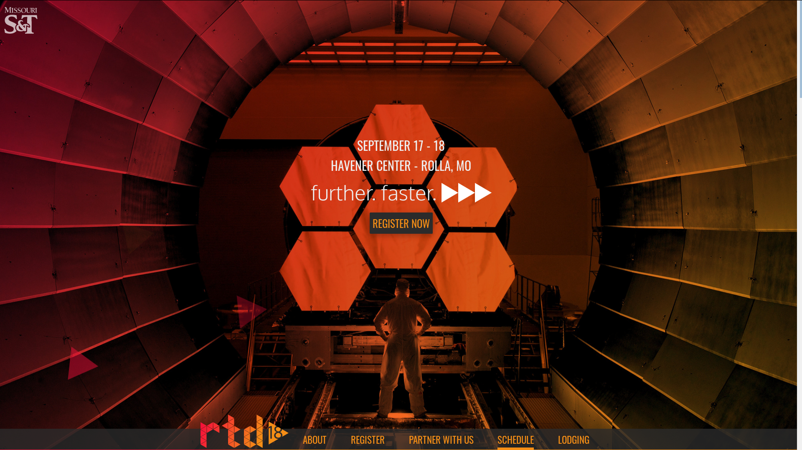
https://rtd2018.mst.edu
31

Slide 32
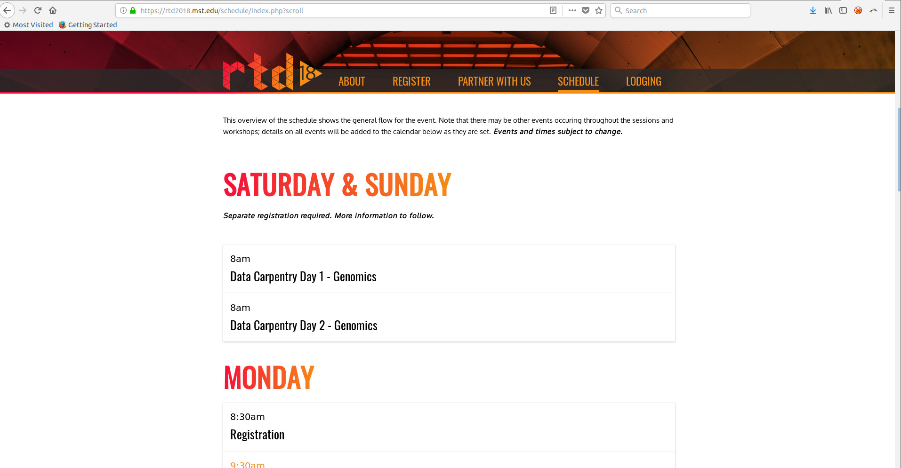
https://rtd2018.mst.edu
32

Slide 33
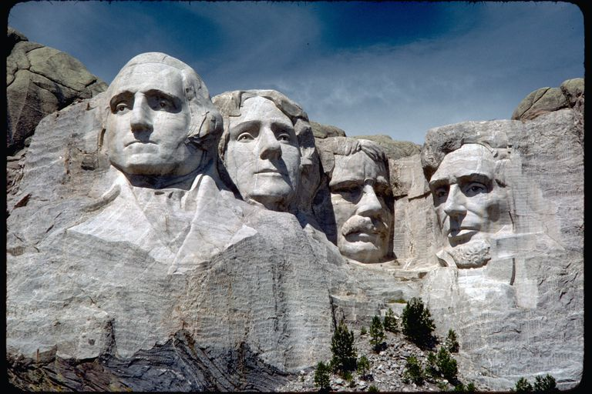
Four Facings?

Slide 34
Four Facings?

Slide 35
Four Facings?

Slide 36
Communities of Practice
Campus Champions!
SIGHPC Education Chapter
The Carpentries
Coalition for Academic Scientific Computing (CASC)
Campus Research Computing (CaRC) Consortium
XSEDE Service Providers Forum
Cyberinfrastructure State & Regional Groups
36

Slide 37
CASC
Coalition for Academic Scientific Computing
“HPC Directors club”
86 member institutions
Federal Relations
Meets 2x per year usually in DC area.
$4K/year to join
http://casc.org
37

Slide 38
Communities of Practice
Campus Champions!
SIGHPC Education Chapter
The Carpentries
Coalition for Academic Scientific Computing (CASC)
Campus Research Computing (CaRC) Consortium
XSEDE Service Providers Forum
Cyberinfrastructure State & Regional Groups
38

Slide 39
CaRC
Campus Research Computing Consortium
NSF funded Research Coordination Network with 28 collaborating institutions
https://www.nsf.gov/awardsearch/showAward?AWD_ID=1620695
Surveyed community to understand challenges and values.
Aim is to develop ways for more to join.
39

Slide 40
Facing 1?

Slide 41
Sponsors/Stakeholder facing roles
The Count!

Slide 42
Sponsors/Stakeholder facing roles
Knows his numbers!
Dresses well (sort of)
Speaks & writes
professionally

Slide 43
Sponsors/Stakeholder facing roles
Vendors
CI staff
Alumni
CI Leader
Institution Board
Gov't Agencies
Industrial Partners
Prof. Assns

Slide 44
Sponsors/Stakeholder facing roles
Education/ Promotion/ Communication
Governance/ Process
Leadership/ Vision
Stakeholder
Community/ Workforce
Sustainability
Benchmarking/Assessment
Stakeholder Management/ Collaborations

Slide 45
Sponsors/Stakeholder facing roles
Education/Promotion/
Communication
Leadership/ Vision
Governance/
Process
End User
Community/ Workforce
Sustainability
Stakeholder Management/ Collaborations
Benchmarking/
Assessment

Slide 46
Communities of Practice
Campus Champions!
SIGHPC Education Chapter
The Carpentries
Coalition for Academic Scientific Computing (CASC)
Campus Research Computing (CaRC) Consortium
XSEDE Service Providers Forum
Cyberinfrastructure State & Regional Groups
46

Slide 47
XSEDE Service Providers Forum
This group includes the Supercomputing Centers that are allocated by XSEDE, resources that are partially allocated, and resource and service providers of many sorts, including Campus Research Computing Centers who provide resources only to their campuses.
https://www.xsede.org/about/governance/spf
47

Slide 48
XSEDE Service Providers Forum
XSEDE Service providers forum are provide services and resources:
Level 1: Fully integrated into XSEDE allocations system (e.g. Stampede, Comet, Bridges)
Level 2: Partially allocated by XSEDE (e.g. Xstream, Supermic, OSG, SGCI)
Level 3: Provide something to someone, somewhere (OU, OSU, KSU, MSU, YOUR NAME HERE)
Benefits: Get to hang out with Dan Stanzione every 2 weeks and here about what the big centers are up to.
https://www.xsede.org/web/site/about/governance/spf
Join via letter requesting to join – examples available
48

Slide 49
Communities of Practice
Campus Champions!
SIGHPC Education Chapter
The Carpentries
Coalition for Academic Scientific Computing (CASC)
Campus Research Computing (CaRC) Consortium
XSEDE Service Providers Forum
Cyberinfrastructure State & Regional Groups
49

Slide 50
Cyberinfrastructure
State & Regional Groups
OneOCII - Oklahoma
ShowMeCI - Missouri
KanShare - Kansas
SSERCA - Florida
NYSERnet - New York
MARIA Alliance – Virginia
Great Plains Network (CI group and Research Platform group)
50

Slide 51
Synchronous Training
Linux Clusters Institute (LCI) holds introductory and intermediate workshops on HPC system administration. These workshops have been extremely successful, typically attracting 20-40 pre-service and in-service HPC system administrators per workshop, demonstrating a strong national need for this training.
Virtual Residency: In operation since summer 2015, the Virtual Residency (VR) is a national informal education program that trains Cyberinfrastructure (CI) Facilitators on effective methods for serving their research and education constituents, especially focusing on professional (soft) skills (because much of the technical content that facilitators need is available via other opportunities).
XSEDE Monthly Series on HPC topics
https://www.psc.edu/xsede-hpc-series-all-workshops
Big Data, MPI, OpenMP, OpenACC, and GPUs. These are offered as live multicast workshops to ~25 sites per month.
XSEDE Course Calendar
https://portal.xsede.org/course-calendar
In-person, multi-cast, and webcast
51

Slide 52
Asynchronous Training
XSEDE online training
ACI-REF leading practices of facilitation
https://www.youtube.com/XSEDETraining
52

Slide 53
Conferences
National (US):
PEARC: PEARC18 is July 22-26, 2018 - if you only go to one conference, go here.
SC Conference Series: Always the week prior to Thanksgiving in November. SC18 is in Dallas, TX, November 11-16, 2018.
Regional:
RMACC HPC Symposium - Colorado, August 7-9, 2018
Oklahoma Supercomputing Symposium September 25-26, 2018, Norman, Oklahoma
Great Plains Network Annual Meeting -- Usually around June 1 in Kansas City.
Campus Champion Regional Groups
53

Slide 54
Facing 2?

Slide 55
Systems Facing Roll
Oscar the Grouch!

Slide 56
Systems Facing Roll
“OSCER” the Grouch?

Slide 57
Systems Facing Roll
Never leaves his garbage can
Underground lair = data center
Semi-grouchy?

Slide 58
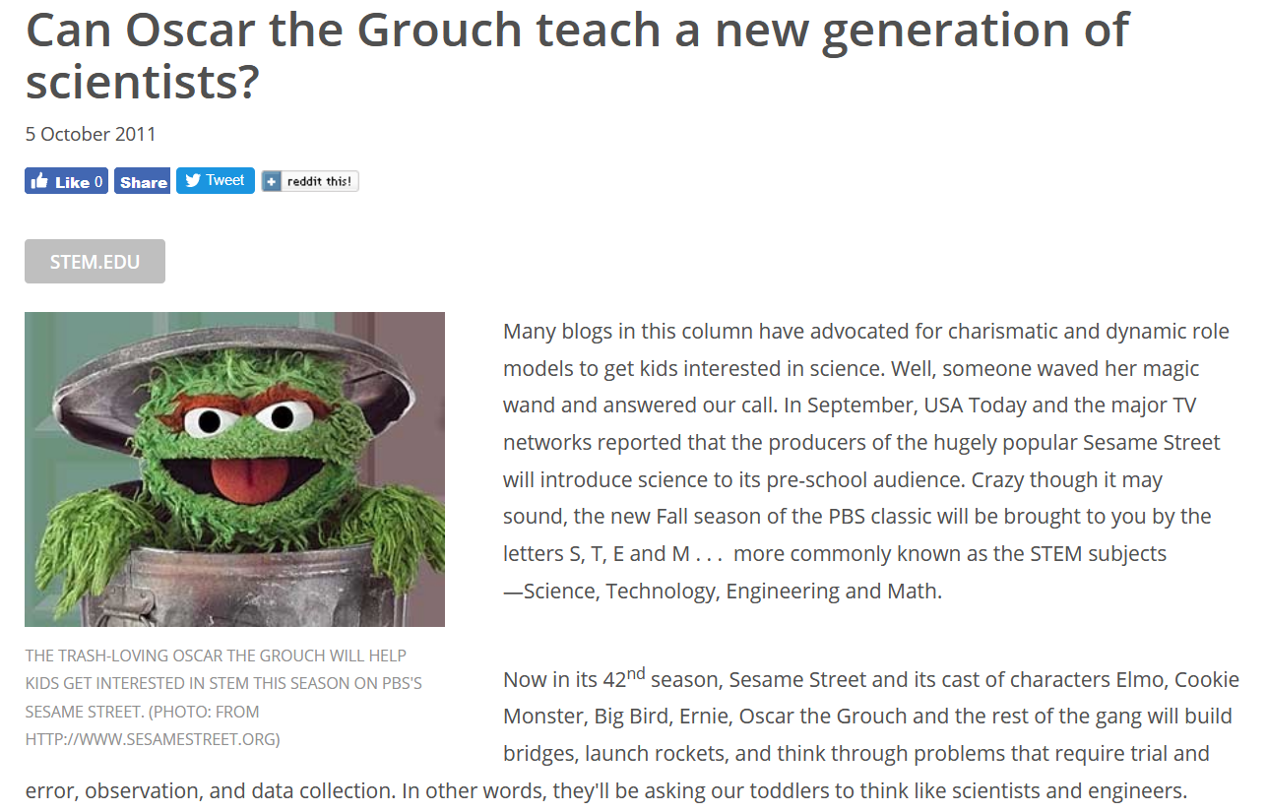

Slide 59
Systems Facing Roll
Partnership & Communications
Internal & External Security & Privacy
Systems Environment Management
Virtualized Layers
Physical Systems
Data Center

Slide 60
Systems Facing Roll
Partnership & Communications
Internal & External Security & Privacy
Systems Environment Management
Virtualized Layers
Physical Systems
Data Center
Donuts/Energy Drinks!

Slide 61
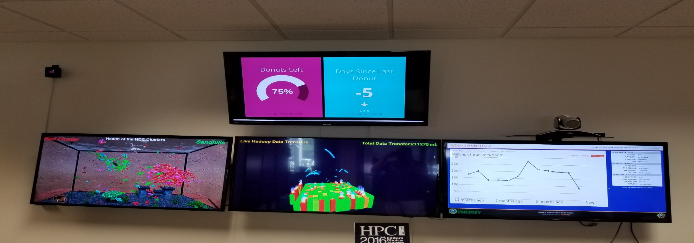
Systems Facing Roll
Partnership & Communications
Internal & External Security & Privacy
Systems Environment Management
Virtualized Layers
Physical Systems
Data Center
Donuts/Energy Drinks!

Slide 62
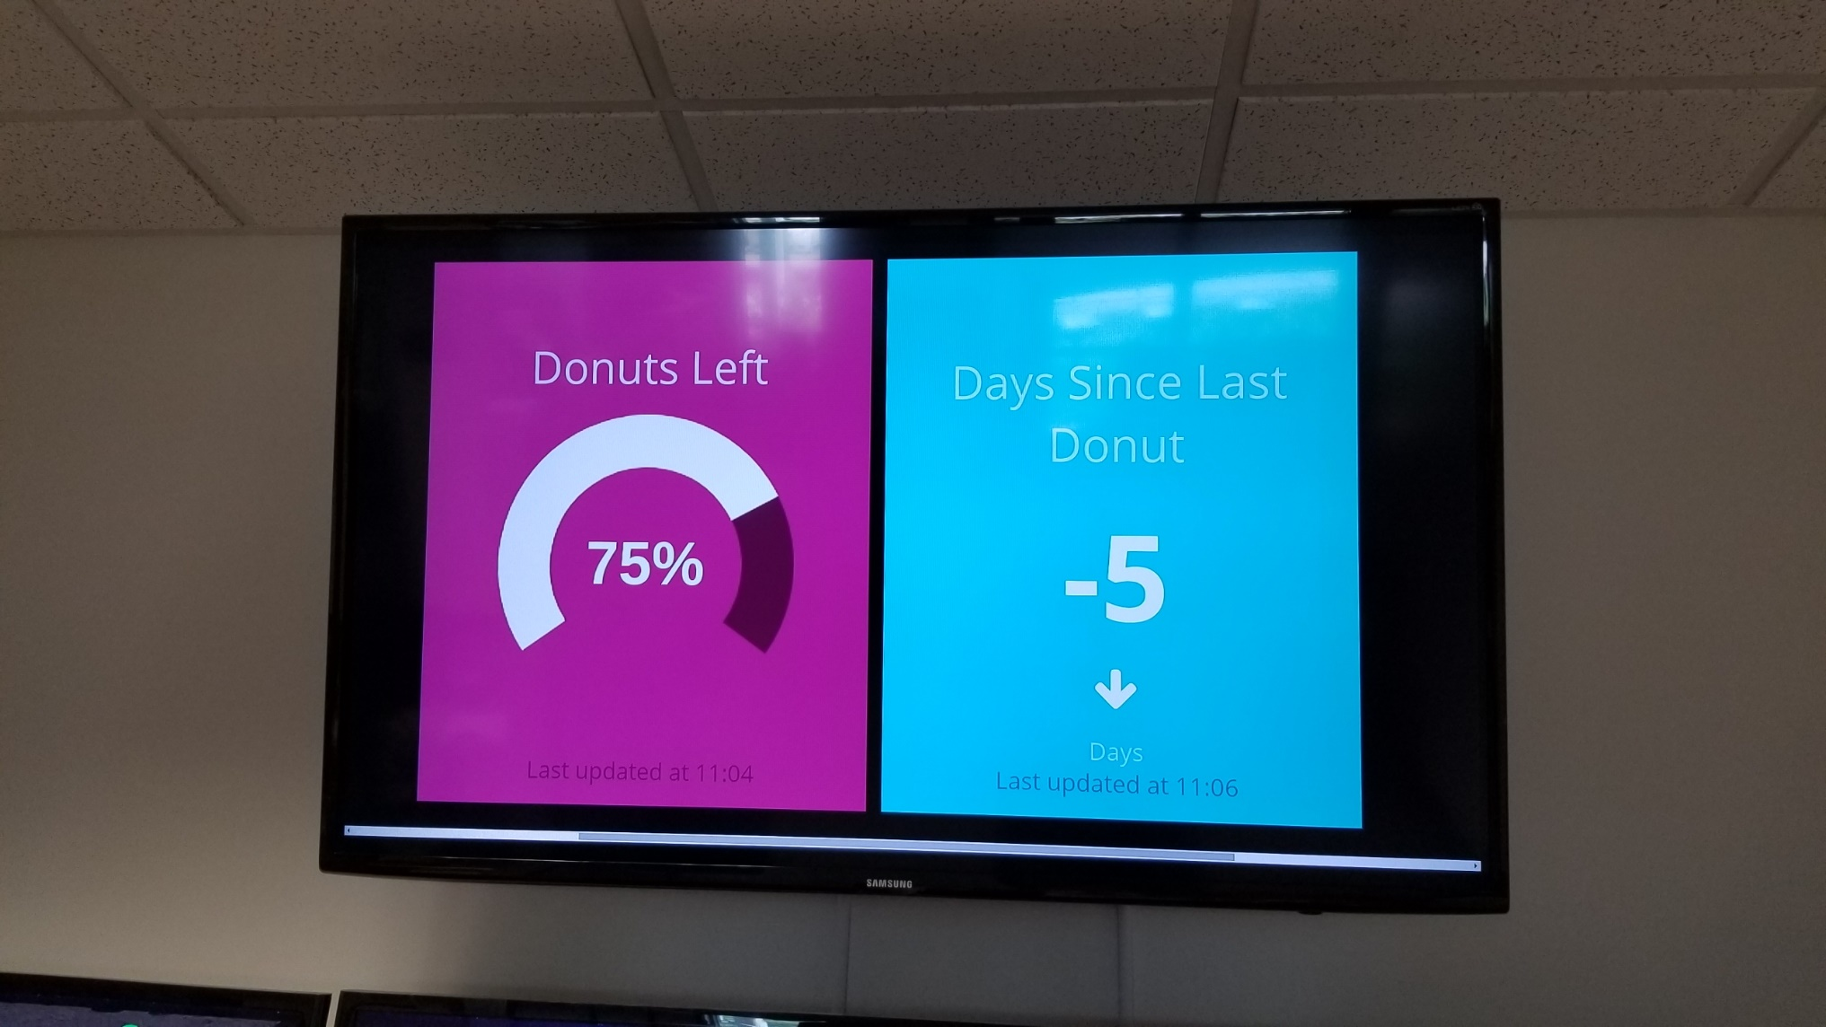
Systems Facing Roll
Partnership & Communications
Internal & External Security & Privacy
Systems Environment Management
Virtualized Layers
Physical Systems
Data Center
Donuts/Energy Drinks!

Slide 63
Other Entities
Science Gateways Community Institute (SGCI)
Clemson-led Advanced Cyberinfrastructure Research & Education Facilitators (ACI-REF)
CyberAmbassadors
United Kingdom Research Software Engineer Association
Working Towards Sustainable Software for Science Practice and Experiences
US Research Software Sustainability Institute
63

Slide 64
Science Gateways Community Institute (SGCI)
The SGCI, founded in 2016, offers a workforce development service area with:
Internships
Mentoring
Travel funding to conferences for undergraduate and graduate students
Connections to the Young Professional Network
Support for gateway-related career paths
64

Slide 65
ACI-REF
2013 NSF funded project (mentioned earlier by Henry)
Advanced Cyberinfrastructure Research & Education Facilitator Work with users -- researchers and educators -- to help them improve their research and/or education productivity using advanced cyberinfrastructure.
Funded ACI-REFs at 6 institutions:
Clemson U
Harvard U
U Hawai’i
U Southern California
U Utah
U Wisconsin
Slide from Neeman’s XSEDE16 presentation
ACI-REF: Toward a National CI Workforce
65

Slide 66
Facing 3?

Slide 67
Researcher Facing
Elmo!

Slide 68
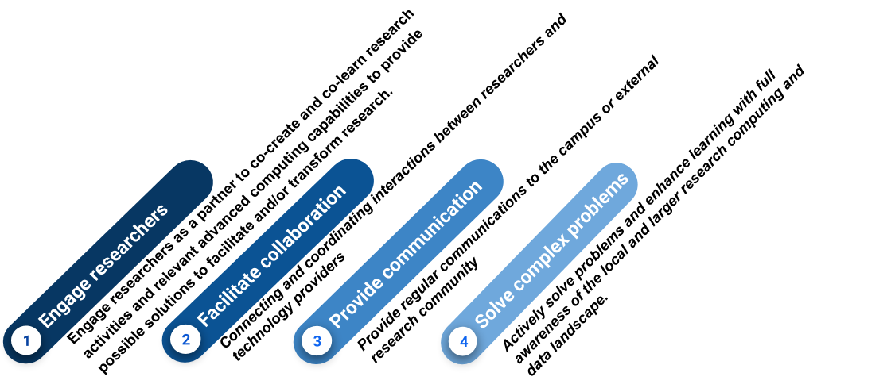
Researcher Facing

Slide 69
CyberAmbassadors
2017 NSF CyberTraining project developing an open source curriculum on interpersonal communication and mentoring skills for CI professionals.
Targeted at giving CI professionals the skills they need to communicate effectively and to strengthen very diverse teams of researchers.
The first objective for the program is to develop a curriculum that builds professional skills (communications, teamwork, leadership) within the context of large scale, multidisciplinary computational research.
The pedagogical approach is grounded in constructivism and socioculturism, and will combine practice training exercises with examples from real multidisciplinary research.
The second objective is to pilot, evaluate and revise the curriculum with existing CI professional groups.
The third objective is to develop a curriculum to “train the trainers.”
This final step is designed to exponentially grow the impact of this curriculum, by preparing a diverse team of facilitators who can offer professional communication skills training at their own institutions and via regional or national events.
69

Slide 70
United Kingdom Research Software Engineer Association
UKRSEA, which has 20 participating universities, was founded to support Research Software Engineers, who focus on:
Reproducibility
Reusability
Accuracy
of data analysis and applications created for research. UKRSEA’s goal is to foster career paths for academic RSEs and to ensure that the role of academic RSEs is recognized and rewarded. RSE associations are also forming in the US and Australia.
70

Slide 71
Working Towards Sustainable Software for Science Practice and Experiences
WSSSPE started in 2013 and is a community-driven organization focused on:
Sustainability of research software
Their workshops – typically two per year on different continents – are organized as interactive working groups for discussions, with actions beyond the workshops, and anyone interested can contribute.
71

Slide 72
US Research Software Sustainability Institute
URSSI has been funded by NSF in 2018
Goal: Focused on research software and on building the community.
Vision: Improve how individuals and teams function, and to advance research software and the STEM research it supports.
72

Slide 73
Facing 4?

Slide 74
Software/Data Facing
Big Bird!

Slide 75
Software/Data Facing
Big Henry!

Slide 76
Also Facing 4…

Slide 77
Snuffy Debugging
Snuffleupagus!

Slide 78
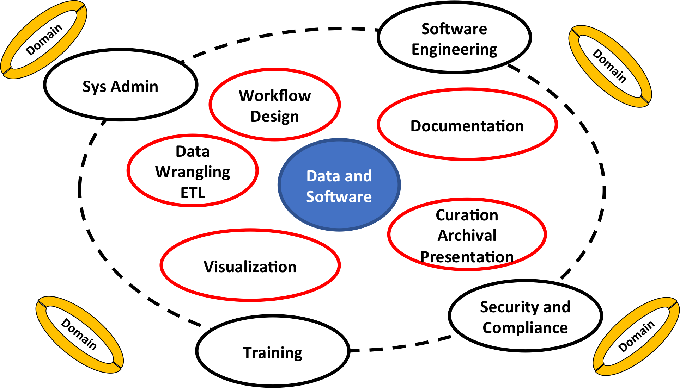
Software/Data Facing Role

Slide 79
Inspiration
“Never doubt that a small group of thoughtful people could change the world. Indeed, it’s the only thing that ever has.”
Margaret Mead
“Far and away the best prize that life offers is the chance to work hard at work worth doing.”
Theodore Roosevelt
79

Slide 80
Thanks!
Special thanks for slide content from all of the internet and the PEARC18 CC101 Workshop, A Report to CC on CI Professionalization Workshop Outcomes by Scott Yockel (Harvard), Patrick Schmitz (Berkeley), Tom Cheatham (Utah) and Dana Brunson for slide content from ACI-REF VR 2017, CI Milieu (Mafia, Peeps, Homies). Some of these are adapted from the Virtual Residency paper Henry Neeman, Hussein M. Al-Azzawi, Aaron Bergstrom, Zoe K. Braiterman, Dana Brunson, Dirk Colbry, Eduardo Colmenares, Akilah N. Fuller, Sandra Gesing, Maria Kalyvaki, Claire Mizumoto, Jeho Park, Anita Z. Schwartz, Jason L. Simms and Rustomji Vania, 2018: "Progress Update on the Development and Implementation of the Advanced Cyberinfrastructure Research & Education Facilitators Virtual Residency Program." Proceedings of PEARC'18, to appear.
https://www.thoughtco.com/facts-about-mount-rushmore-104819
http://muppet.wikia.com/wiki/Mount_Rushmore
https://www.thewrap.com/top-13-sesame-street-characters-ranked-from-cookie-monster-to-mr-snuffleupagus-photos/
http://muppet.wikia.com/wiki/Count_von_Count
80

Slide 81
Thanks!
https://www.aaas.org/blog/stemedu/can-oscar-grouch-teach-new-generation-scientists
https://www.thriftbooks.com/w/elmos-world-computers_mary-beth-nelson/752598/#isbn=037582202X&idiq=13986256
http://muppet.wikia.com/wiki/Mr._Snuffleupagus
https://www.indiewire.com/2015/11/sesame-street-and-big-bird-get-premiere-date-for-their-new-nest-on-hbo-50365/
http://muppet.wikia.com/wiki/Sesame_Street_(Japan)
https://en.wikipedia.org/wiki/Facing_(sewing)
https://sewguide.com/how-to-sew-facings/
http://isntthatsew.org/how-to-draft-a-facing/
https://en.wikipedia.org/wiki/Rubber_duck_debugging
http://inspectorgadget.wikia.com/wiki/File:Inspector_Gadget_Thinking.png
https://confluence.xsede.org/pages/viewpage.action?pagId=1671768
81

