Slide 1
Campus Research Computing (CaRC) Consortium https://carcc.org/
A Report to CC on CI Professionalization Workshop Outcomes by
Scott Yockel (Harvard), Patrick Schmitz (Berkeley), Tom Cheatham (Utah)
NSF Award #1620695 RCN: Advancing Research and Education Through a National Network of Campus Research Computing Infrastructures - The CaRC Consortium

Slide 2
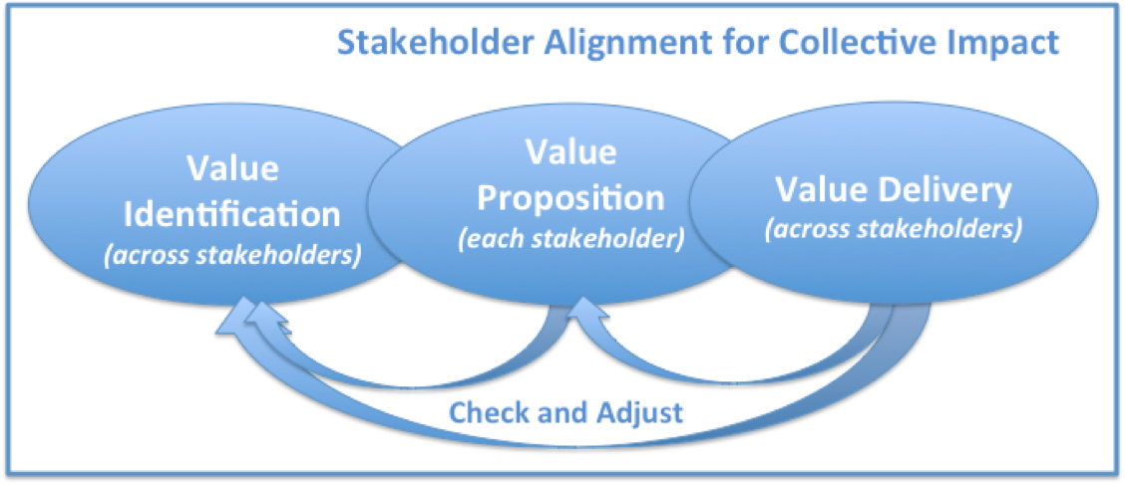
CaRC Vision
The vision of the CaRC Consortium is to advance the frontiers of research at academic institutions by supporting on-campus awareness and facilitation services related to computation for researchers, including inter-institutional resource and knowledge sharing among research computing professionals, and continuous innovation in research computing capabilities.

Slide 3
CaRC Members
Arizona State University
Brandeis University
Clemson University
Cornell University
Florida Atlantic University
Harvard University
Kansas State University
Montana State University
Ohio Supercomputing Center
Oklahoma State University
Rutgers, The State University of New Jersey
Stanford University
University of California, Berkeley
University of California, San Diego
University of Colorado, Boulder
University of Florida
University of Georgia
University of Hawaii
University of Illinois, Urbana-Champaign
University of Miami
University of Minnesota
University of Missouri
University of Nebraska, Lincoln
University of North Carolina, Chapel Hill
University of Notre Dame
University of Oklahoma
University of Southern California
University of Utah
University of Virginia
University of Wisconsin, Madison
Yale University

Slide 4
Draft Stakeholder Value Propositions
Overarching CaRC Value Propositions
The CaRC Consortium will advance the frontiers of research through improved access to and use of Research Computing (RC) and supporting resources.
CaRC will enhance members’ ability to optimize the use of RC and supporting resources on each campus and across the CaRC Consortium.
CaRC will enhance members’ ability to identify and share RC leading practices and innovations.
CaRC will enhance members’ ability to access domain-specific RC expertise in a range of fields and disciplines that exceeds the expertise on any one campus.
Through CaRC, individual campuses will be better able to provide leadership in the RC ecosystem, with an underlying culture of collaboration.

Slide 5
CaRC Working Committees
CI workforce development/professionalization
Co-Chairs: Jim Bottum (Internet2) and Thomas Hauser (Colorado)
Defining stakeholders and value propositions
Co-Chairs: Andy Sherman (Yale) and Barr von Oehsen (Rutgers)
Developing the CaRC and facilitator network
Co-Chairs: Lauren Michael (Wisconsin) and Dana Brunson (Oklahoma State)
Expertise and resource sharing
Co-Chairs: Jerry Sheehan (Montana State) and Shelley Knuth (Colorado)

Slide 6
2017 CaRC Stakeholders Survey: 250 respondents
Campus Executive Leadership (e.g. Presidents, Chancellors, Provosts, Deans)
Campus Information and Research Leadership (e.g. CIOs, VPRs)
Campus Research Computing (RC) Leadership (e.g. VP, AVP or Director RC; Associate CIO)
Principal Investigators and Research Team Members
Students (in classrooms) and as RC employees
Campus Research Computing Facilitators, including CaRC and ACI-REF Facilitators, RC Software Engineers, and XSEDE Campus Champions
Campus Research, Academic, Enterprise IT Services (systems, security, networking, engineering)
Campus Research Computing/Data Science Instructors
Campus IT/Research Cyberinfrastructure Workforce Development Providers
Research Funders
Note: Titles, roles, and responsibilities vary across campuses with respect to research and research computing.

Slide 7
Comment: Workforce development is very important for all stakeholder groups. The response from campus executive leaders is lower than the rest. Although this difference is not statistically significant, it may still be reflective of an important gap in views on the part of these leaders. IT leadership see workforce development as less challenging than others (sig. at the .05 level).

Slide 8
Comment: All stakeholders see supporting facilitators as very important and most see it as very hard to do. Executives do not see this as challenging as others do (while the difference is not statistically significant, that may reflect the relative small n for executives (n=13). There are also some bright spots on the visualization on the prior slide to be explored.

Slide 9
Comment: Campus executive leaders are somewhat less likely to see defining roles and career paths for research computing as important (the difference is not statistically significant, but the “n” is small). This points to the need for increased education and awareness. A substantial number (28.6%) indicate don’t know or not applicable.

Slide 10
CI Professionalization Workshop Goals
Learn from leading practices regarding cyberinfrastructure (CI) job definitions and career paths
Develop a flexible framework to organize CI hiring, career development, retention and other aspect of HR in the CI ecosystem
Apply the framework for research computing and data work that is:
Systems facing roles
Researcher facing roles
Software/Data facing roles
Sponsors/Stakeholder facing roles
Anticipate potential complications and disconnects when implementing the framework across diverse campuses
Specify next steps in the utilization of the framework and, as a result, the further professionalization of CI work

Slide 11
Meeting Structure
Monday Evening
Panel discussion from universities that have recently created a job family classification for CI, Research Computing, or similar.
Tuesday Morning (breakout groups)
Defining and organizing roles and responsibilities
Tuesday Afternoon (breakout groups)
Talent pipeline: education, experience, competencies
Professional development: career opportunities, organizations
Wednesday Morning
What are the hesitations or cautions?
What will the flushed out product look like?
How will it be used?

Slide 12
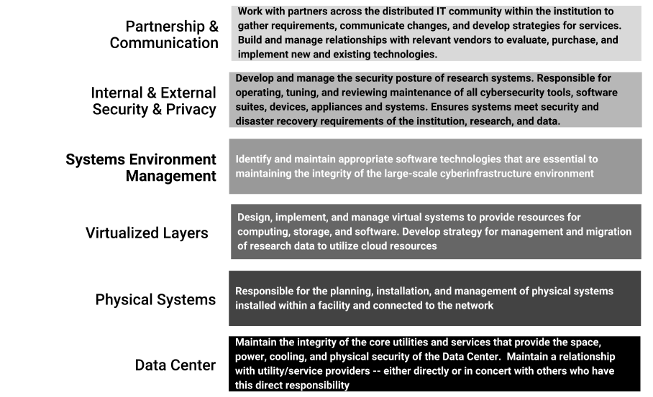
Systems
facing
roles

Slide 13
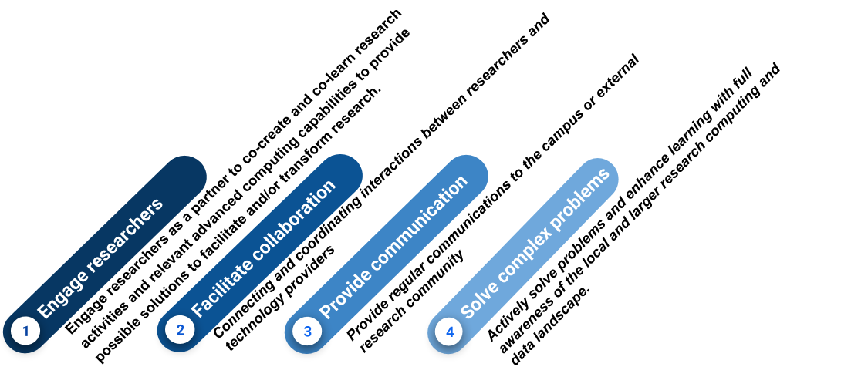
Researcher
facing
roles

Slide 14
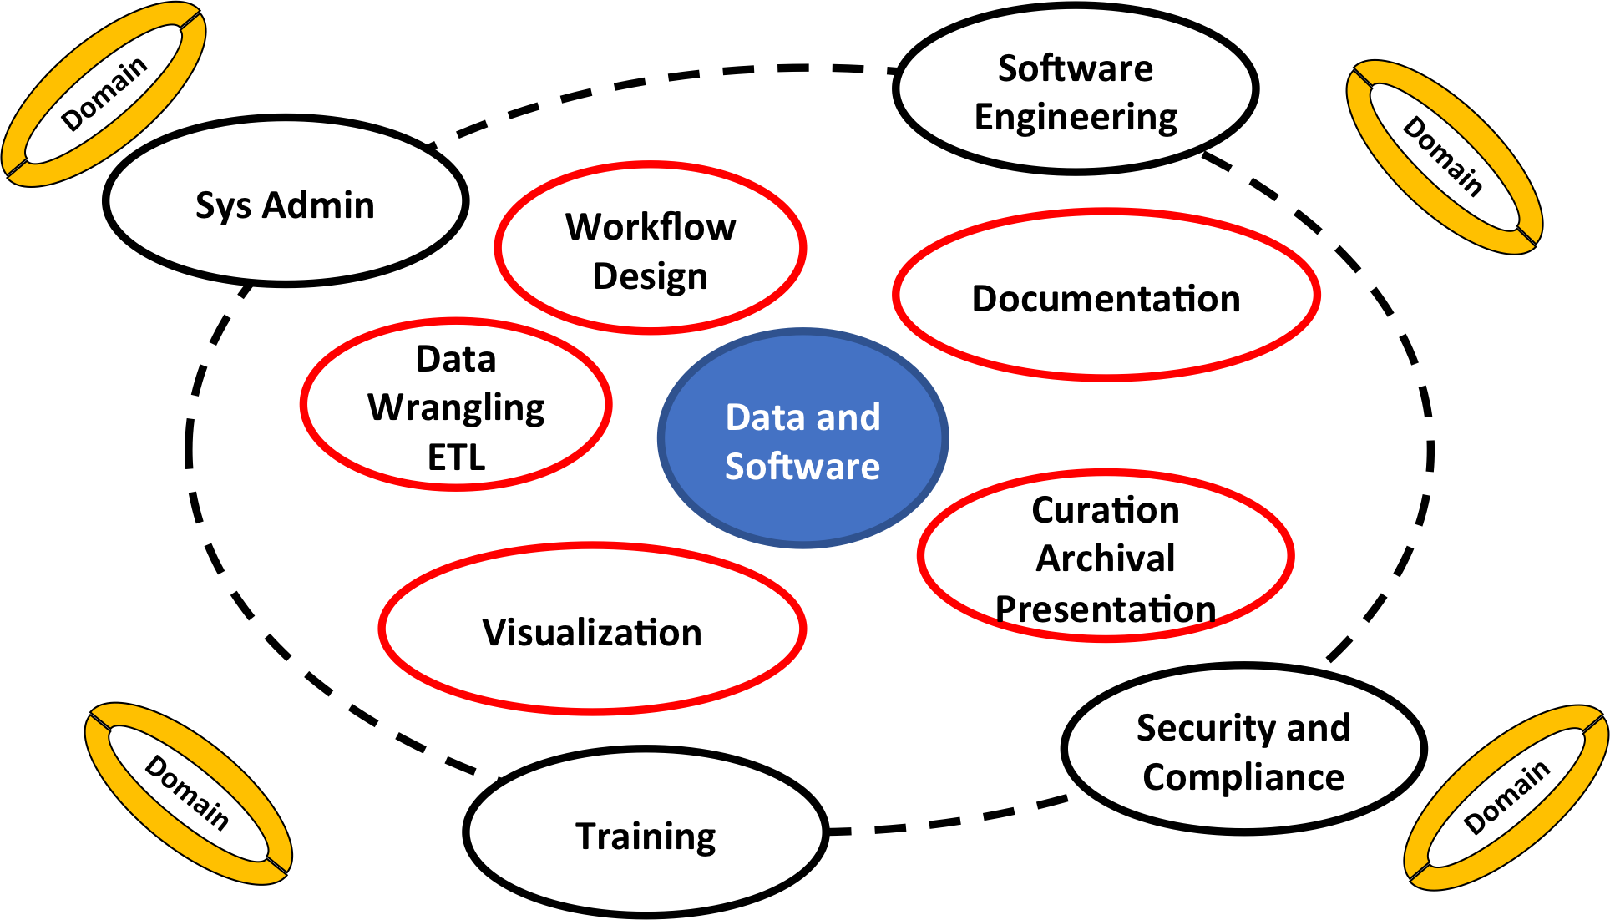
Software/Data
facing
roles

Slide 15
Sponsor/Stakeholder
facing
roles
Vendors
CI staff
Alumni
CI Leader
Institution Board
Gov't Agencies
Industrial Partners
Prof. Assns

Slide 16
Sponsor/Stakeholder
facing
roles
Education/ Promotion/ Communication
Governance/ Process
Leadership/ Vision
Stakeholder
Community/ Workforce
Sustainability
Benchmarking/Assessment
Stakeholder Management/ Collaborations

Slide 17
Sponsor/Stakeholder
facing
roles
Education/Promotion/Communication
Leadership/Vision
Governance/ Process
Institutional Leadership
Sustainability
Community/Workforce
Benchmarking/ Assessment
Stakeholder Management/Collaborations

Slide 18
Sponsor/Stakeholder
facing
roles
Education/Promotion/Communication
Leadership/ Vision
Governance/Process
End User
Sustainability
Community/ Workforce
Stakeholder Management/ Collaborations
Benchmarking/Assessment

Slide 19
Common Themes That Emerged
Co-Creation (partnering with researchers): Research computing and data professionals are co-creating methods and software models; Collaborative process, very different from delivery of traditional IT and software services
Career Paths are incomplete in most organizations; creating challenges for recruiting, developing and retaining these professionals.
Digital: The exponential growth of digital technologies underlies work; accelerating change in the work due to changes in hardware, software, systems, and the nature of the data itself.
Status: Work of research computing & data professionals generally held in high regard by faculty with whom they work; important status and power differences between these professionals and principle investigators that are part of a larger “two-tier” culture in most university settings.
Terminology: Work centered on “cyberinfrastructure for research” and touches on many related domains, including “data science” and “high performance computing.” This work is distinct from, but connected to the work of “information technology” professionals.

Slide 20
Your Feedback
We have produced a living document:
Research Computing and Data Professionals: Job Elements and Career Guide
https://carcc.org/wp-content/uploads/2018/05/CI-Professionalization-Job-Families-Career-Guide.pdf
Are the products we have described of use to you and your campus?
2) Comments are welcome.

