Slide 1
Emerging Technologies
ACI-REF Virtual Residency – Aug 6-10, 2018
Dirk Colbry – FPGAs
Michigan State University – Director of HPC Studies
Mariya Vyushkova – Quantum Computing
Univ. of Notre Dame – Quantum Computing Research Specialist
Anita Schwartz – Singularity Containers
University of Delaware – Information Resource Consultant
Shawn Doughty – OnDemand Jupyter/RStudio
Tufts University – Sr Research Technology Spec
David Chin – Hadoop/Spark/MapReduce
Drexel University – Sr Systems Administrator

Slide 2
Field Programmable Gate Arrays (FPGA)
Dirk Colbry
Michigan State University

Slide 3
Why me?
Taught an FPGA undergraduate lab way back in 1999-2002 when I was in graduate school.
Did a sabbatical in 2015 with PixelVelocity, a company based in Ann Arbor that builds smart cameras that use FPGAs.

Slide 4
@Michigan State
Purchased 2 nodes with a total of 6 Altera FPGAs
Started a FPGA Taskforce for interested researchers
Working with a Graduate Student on an independent study related to an optimization problem (function fitting) on FPGAs
This fall we plan to conduct a Graduate Course to benchmark and test the 7 dwarves algorithms

Slide 5
Traditional Programmable GPUs and CPUs
Notes:
arithmetic-logic unit

Slide 6
Application Specific Integrated Circuit (ASIC)
Neural Networks
Tensor Processing Units (TPU)
Molecular Dynamics
GRAvity PipE (MDGRAPE)

Slide 7
Field Programmable Gate Array (FPGA)

Slide 8
Notes about FPGAs
For some applications speeds may be significantly faster than GPU/CPU. However, they will probably never be faster than ASICs.
Key to FPGA’s success will be flexibility.
FPGAs make the problem of optimization much more complex. You now can change both the hardware and the software. (I,.e. you may be trading human time for
Configuring the Hardware is Tricky. You have basically three options:
  Draw the circuits yourself using (HDL)
  Write code using a version of OpenCL
  Download existing hardware “images”

Slide 9


Quantum Computing
Mariya Vyushkova
University of Notre Dame
ACIREF VR Workshop Panel: CI Emerging Technologies, August 10th, 2018

Slide 10
What is quantum computing? Qubit and spin
Quantum computation: information processing accomplished using quantum mechanical systems
by harnessing the quantum mechanical phenomena such as superposition and entanglement
A qubit (quantum bit) is an elementary unit of quantum information.
Quantum mechanically, it is a simple two-state system.
Can be in a coherent superposition of both |0> and |1> states at the same time (in contrast to classical bits)
Multiple qubits can exhibit quantum entanglement
Qubit architectures: two-level atoms (IonQ); superconducting circuits (IBM Q, Rigetti, D-Wave); solid-state spin-based architectures (nuclear or electron spins as qubits)
Quantum programming: development of quantum algorithms and their implementation on a quantum computing device
Figure from: S.K. Misra, in: Electron Spin Resonance (ESR) Based Quantum Computing. T. Takui, L. Berliner, G. Hanson (Eds.) Springer New York 2016, p. 1-23

Slide 11
Quantum Computing Applications
Modeling or simulating inherently quantum mechanical processes in chemistry, materials science, nuclear physics, and particle physics
Optimization problems (machine learning, social sciences, computational biology, weather prediction, space debris problem…)
Integer factorization (Shor’s algorithm) – cybersecurity
Searching an unsorted database (Grover’s algorithm)
Potential Energy Surface for BeH₂ molecule
A.Kandala et al. Nature 549 (2017) 242–246
A. Cho, Science 359(2018)141-142

Slide 12

Emerging Technologies
Singularity
Anita Schwartz
Scientific Applications Consultant IV August 10, 2019

Slide 13
What is Singularity?
Singularity is a container solution created by necessity for scientific and application driven workloads.*
Singularity enables users to have full control of their environment to create containers that can be used to package entire scientific workflows, software and libraries, and even data.
* Due to many poorly written applications developed without the design to allow flexibility and portability for installation by others on different systems.

Slide 14
Why Singularity?
Singularity is different from other container solutions in it’s primary design goals and architecture:
Reproducible software stacks
Mobility of compute
Compatibility with complicated architectures
Security model

Slide 15
Benefits of Singularity
Easy to use and well documented
Repositories
HPC application portability
Flexibility
Minimize support
Overhead is minimal

Slide 16
Open OnDemand Web Portal for HPC
Shawn G. Doughty
Tufts University
shawn.doughty@tufts.edu

Slide 17
Features
Open Source web based portal for HPC
Open Source web based portal for HPC
Open Source.
NSF Funded. Based on OSC OnDemand Portal
https://doi.org/10.21105/joss.00622
Clientless web based access to HPC resources.
File management, upload, download, view, edit.
Command line access.
Job management, multiple schedulers, slurm.
Launch graphical desktops, applications (x11, web)

Slide 18
Implementation
Open Source web based portal for HPC
Open Source web based portal for HPC
Practical to implement for small and large centers.
RPM based install.
Applicable to all research domains. Long tail of science.
Web front end. Authentication.
Training manual available for repurpose.
Feedback from users has been positive.
Web interface expected by users. Disruptive.

Slide 19
Community
Open Source web based portal for HPC
Open Source web based portal for HPC
Website. http://ondemand.org/
Mailing List.
Read the Docs.
GitHub.

Slide 20
Future
Open Source web based portal for HPC
Open Source web based portal for HPC
Standard web based interface for HPC sites.
Community contributions.
Sustainable development model?
Project ready to take off.
Let’s help make it happen.

Slide 21
ACI-REF VR ‘18
Panel: Hadoop, MapReduce, Apache Spark, and Big Data
David Chin, PhD <dwc62@drexel.edu>
Sr. Systems Admin, Drexel University Research Computing

Slide 22
Overview of Hadoop zoo (ecosystem)
Outline of Hadoop technology/architecture
Challenges in running Hadoop in traditional HPC
Outline

Slide 23
The Hadoop Zoo
Collection of software tools for solving problems involving large amounts of data (using commodity hardware)
HDFS (Hadoop Distributed File System)
  Handles distribution of data
YARN
  Resource manager + job scheduler - handles distribution of tasks
MapReduce, Spark
  Computation frameworks
Overview

Slide 24
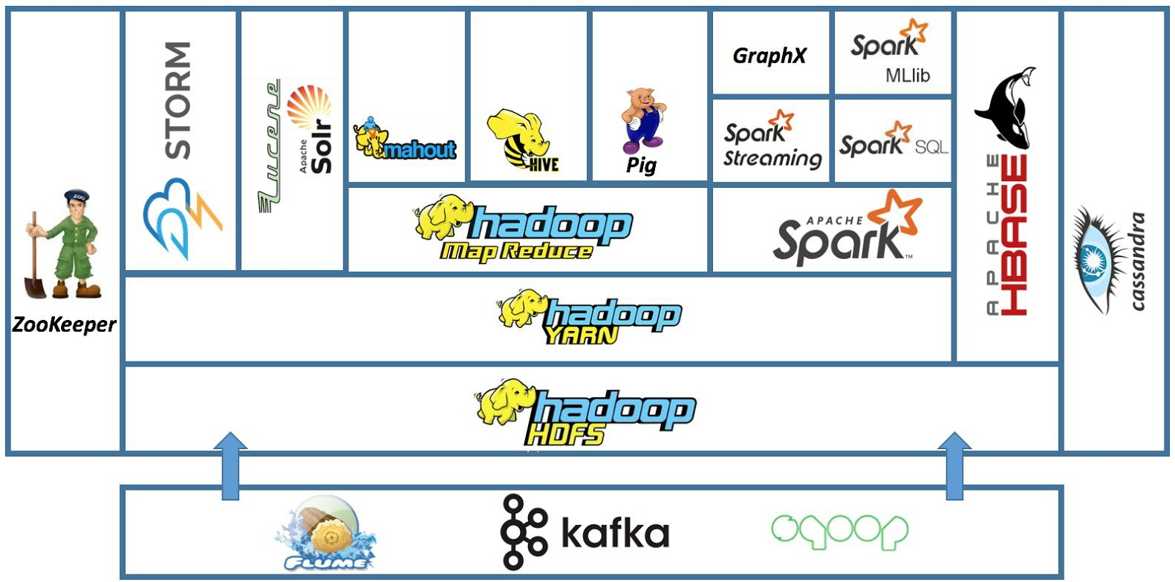
Hadoop Zoo (Ecosystem)
Source: http://blog.newtechways.com/2017/10/apache-hadoop-ecosystem.html

Slide 25
Disclaimer
I am no expert
  Exposure via Coursera Big Data series taught by SDSC, Machine Learning series by Andrew Ng
  Hacked a couple versions of Apache Spark to partially integrate with Univa Grid Engine
I will drop “Apache” from the front of a bunch of the following software names

Slide 26
Hadoop Ecosystem

Slide 27
Hadoop Distributed FS (HDFS)
Distributed, scalable, portable non-POSIX file system for the Hadoop framework written in Java
BUT has shell commands and API that provide similar functionality to “real” filesystems
Splits data to the local disks on multiple nodes
  Allows handling of “big data”
  Designed for immutable files; may not handle concurrent writes

Slide 28
HDFS Architecture
master/slave architecture
  Single NameNode, a master server that manages the file system namespace and regulates access to files by clients
  A number of DataNodes, usually one per node in the cluster, which manage storage attached to the nodes that they run on
  HDFS exposes a file system namespace and allows user data to be stored in files.
  Internally, a file is split into one or more blocks and these blocks are stored in a set of DataNodes.

Slide 29
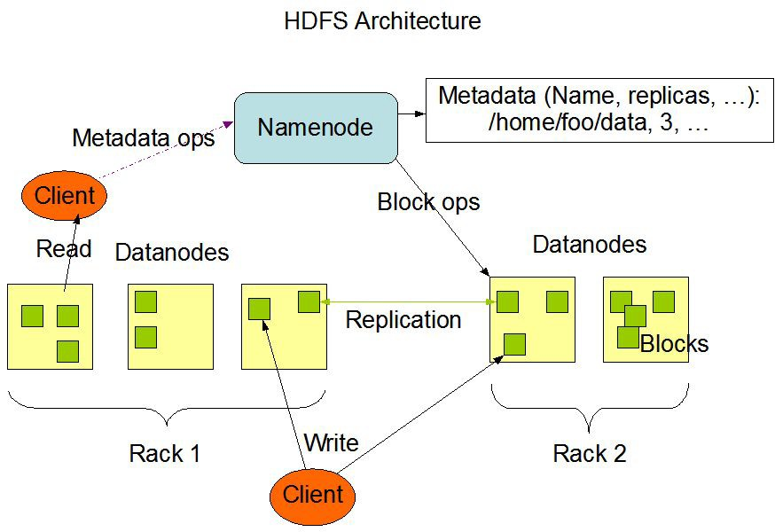
Source: https://hadoop.apache.org/docs/r3.1.1/hadoop-project-dist/hadoop-hdfs/HdfsDesign.html

Slide 30
HDFS on the command line
Example HDFS shell operations:
$ hadoop | fs | -mkdir /hdfs/myname/foo
$ hadoop | fs | -put ~/bigdata.csv /hdfs/myname/foo
$ hadoop | fs | -ls /hdfs/myname/foo

Slide 31
YARN (Yet Another Resource Negotiator)
Resource manager and job scheduler
  This is one of the sticking points in integrating the Hadoop ecosystem into typical HPC clusters
  Tasks may take different amounts of time => YARN coordinates
Scheduler has a pluggable policy, e.g.
  CapacityScheduler
  FairScheduler
Job submission done within the code for computation (example to follow)

Slide 32
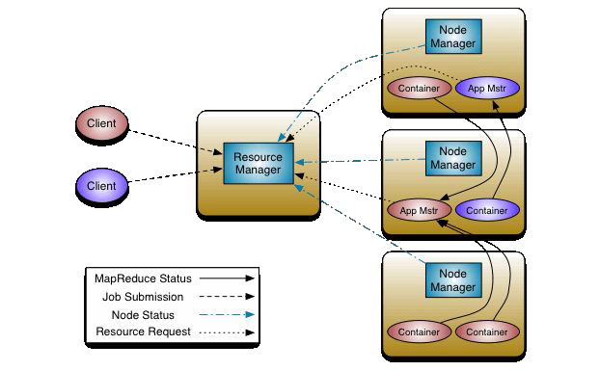
Source: https://hadoop.apache.org/docs/r3.1.1/hadoop-yarn/hadoop-yarn-site/YARN.html

Slide 33
MapReduce
“MapReduce: Simplified Data Processing on Large Clusters”, J. Dean and S. Ghemawat (2004)
For those familiar with MPI, this is similar to scatter-gather pattern
Map
  Applies operation(s) on distributed data
Reduce
  Collects distributed results and aggregates them in some way

Slide 34
MapReduce example
From the MapReduce Tutorial word count example. Only snippets.
public class WordCount {
public static class TokenizerMapper extends Mapper<...> {
...
}
public static class IntSumReducer extends Reducer<...> {
...
}
// ... continued ...

Slide 35
public static void main(String[] args) throws Exception { Configuration conf = new Configuration();
Job job = Job.getInstance(conf, "word count"); job.setJarByClass(WordCount.class); job.setMapperClass(TokenizerMapper.class); job.setCombinerClass(IntSumReducer.class); job.setReducerClass(IntSumReducer.class); job.setOutputKeyClass(Text.class); job.setOutputValueClass(IntWritable.class); FileInputFormat.addInputPath(job, new Path(args[0])); FileOutputFormat.setOutputPath(job, new Path(args[1])); System.exit(job.waitForCompletion(true) ? 0 : 1);
}
}

Slide 36
And run:
$ bin/hadoop jar wc.jar WordCount \
/user/joe/wordcount/input /user/joe/wordcount/output

Slide 37
How would Hadoop fit into typical HPC cluster?

Slide 38
With some kluges

Slide 39
Hadoop is the whole cluster
Hadoop is meant to control the entire cluster
  HDFS handles the distributed storage
  YARN handles the distribution of tasks to available storage/compute resources
  MapReduce or Spark jobs are submitted to the cluster

Slide 40
Parallel file system
What if you already have a parallel file system?
  There are replacements for HDFS
  Intel Lustre (RIP), now Whamcloud again: Hadoop Adapter for Lustre
https://github.com/whamcloud/lustre-connector-for-hadoop
    Assumes Hadoop 2.3.0 installed non-securely (i.e. run as root)
  CephFS: Hadoop CephFS Plugin http://docs.ceph.com/docs/mimic/cephfs/hadoop/
    Requires Hadoop 1.1.x stable series; latest Hadoop is 3.1.1
  GPFS: IBM Spectrum Scale https://www.ibm.com/support/knowledgecenter/en/STXKQY_4.1. 1/com.ibm.spectrum.scale.v4r11.adv.doc/bl1adv_hadoop.htm

Slide 41
Resource mgmt & job scheduling
What if you already have a resource manager & job scheduler?
  Generally, solution is to take the HPC job, and launch an ad hoc Hadoop cluster on the nodes assigned to that job
Univa Grid Engine has Hadoop integration (for Cloudera Distribution for Hadoop (CDH) 3) http://www.gridengine.eu/gridengineaddons/86-clouder a-slides-about-univa-grid-engine-uge-hadoop-integratio n

Slide 42
SLURM etc.
  LLNL Magpie https://github.com/LLNL/magpie
    Set of bash scripts etc. to run Hadoop zoo in HPC
    Supports: Hadoop, Spark, Hbase, Storm, Pig, Mahout, Phoenix, Kafka, Tachyon, Zeppelin, and Zookeeper
    Supports: Slurm, Moab, Torque, and LSF
    Supports: Lustre, or other shared file system
  Harvard Faculty of Arts & Sciences Research Computing (FASRC) https://github.com/fasrc/hpc-hadoop-mapreduce (old - Nov 2013)
    One big bash script; works for SLURM & LSF; ignores HDFS for existing file system

Slide 43
Slurm etc. (continued)
  OpenSFS Lustre User Group 2013 talk by Intel (Castain, Kulkarni, and Xu) “MapReduce and Lustre: Running Hadoop in a HPC Environment” http://cdn.opensfs.org/wp-content/uploads/2013/1 0/CLUG2013_Running-Hadoop_final.pdf
    Intel Distribution of Hadoop + Proprietary Hadoop-JSON Translator + SLURM JSON API
    Also talks about Lustre replacing HDFS

Slide 44
Apache Spark

Slide 45
What is Apache Spark?
Apache Spark is a fast and general-purpose cluster computing system https://spark.apache.org/docs/latest/index.html
  Not very informative
Key difference between Hadoop MapReduce and Spark:
  Hadoop MapReduce reads from and writes to node-local disk
  Apache Spark does it in memory, and writes only at the end
Also, Apache Spark has a standalone mode (no HDFS, no YARN) which is the basis of the following kluge

Slide 46
Spark in standalone mode
https://spark.apache.org/docs/latest/spark-standalone.h tml
No YARN (or Mesos)
  Start master and worker daemons by hand, or by using launch (bash) scripts

Slide 47
Spark in Univa Grid Engine
Kluge
  Modify launch scripts to read job environment to infer nodes being used, job & scratch dirs
  I have done this for 2 different versions of Spark to run in Univa, but
it only works single node (i.e. not very big data)
    Write parallel environment (PE) scripts to read the node list, job directory, scratch directory, and set the appropriate environment variables used by the Spark launch scripts
    https://github.com/prehensilecode/spark/blob/prehensilecod e/sbin/pescript_spark2start.sh

Slide 48
1. Multiple solutions for using Hadoop frameworks in HPC: various resource managers & schedulers, various file systems
Conclusion
2. Klugey, and may not support latest Hadoop

Slide 49
Questions

Slide 50
Questions
How practical will it be to implement your technology topic in an HPC/CI center with 5-10 staff?

Slide 51
Questions
In which research domains is this technology most applicable?

Slide 52
Questions
How can smaller HPC/CI centers gain access to this technology?

Slide 53
Questions
How easily can the training material for these technologies be implemented by CI center staffs of various sizes?

Slide 54
Questions
What is your technology topic’s potential for disruption?
Could it create a technology research divide?

