Slide 1
User Experience, Visualization and Usability
Sandra Gesing
sandra.gesing@nd.edu
Virtual Residency Summer Workshop on
Intermediate Research Computing Facilitation
University of Oklahoma
August 10, 2018

Slide 2
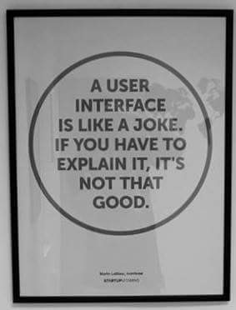
Usability
“After all, usability really just means that making sure that something works well: that a person … can use the thing - whether it's a Web site, a fighter jet, or a revolving door - for its intended purpose without getting hopelessly frustrated.”
(Steve Krug in “Don't make me think!: A Common Sense Approach to Web Usability”, 2005)

Slide 3
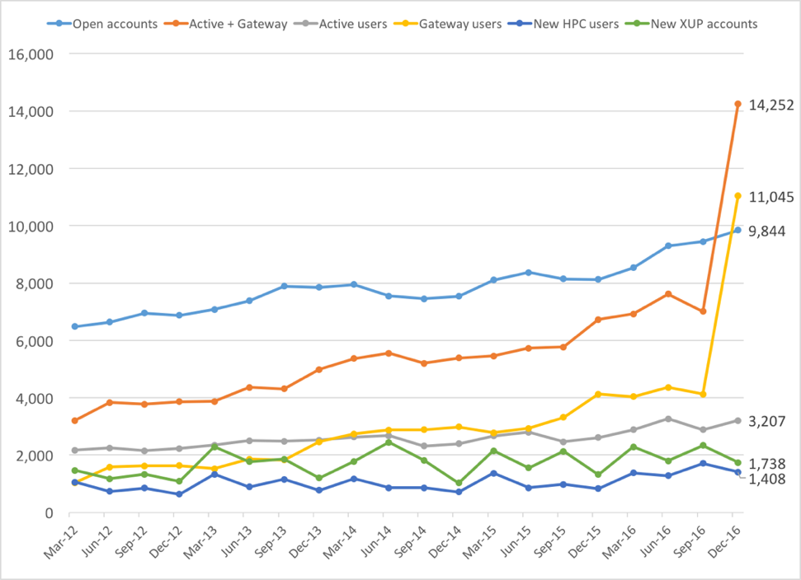
User Experience
Gateway users are 77% of active XSEDE users in Q4 2016
All users
Gateways
Login
XSEDE users
This is largely due to the CIPRES and I-TASSER gateways, but others are gaining

Slide 4
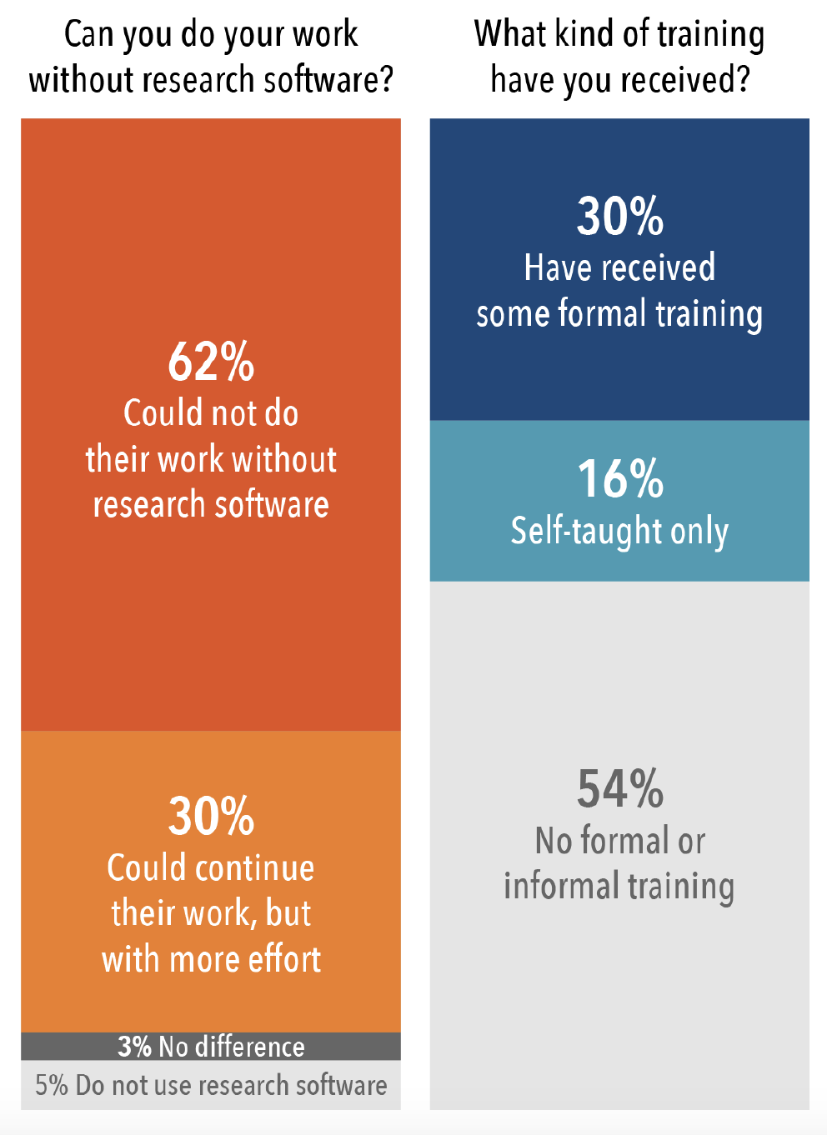
Visualization
“An image says more than
1000 words.”

Slide 5
Questions
You all collaborate with people from diverse research disciplines.
Are there challenges all disciplines have in common in regard to your area/topic? What are challenges which are dependent on the discipline? Do you experience many differences in the collaboration with diverse disciplines? Is there a discipline you would like to collaborate much more with because you are sure it would be beneficial for both sides but there is a "culture gap" or another hurdle?
What would you tell someone who states that user experience, usability and visualization are "nice-to-have" topics in research computing but efficiency and effectiveness of software and hardware are by far the major topics for research computing?
What is something unexpected or interesting that people find as a result of doing usability/UX/visualization?
Are there ways of getting starting with usability/UX/visualization without requiring long-term training?
What are trends which majorly influenced your area in the last 5 years?

Slide 6
Thanks!
sandra.gesing@nd.edu

