Slide 1
The CI Funding Landscape
Dan Voss
University of Miami/Florida State University
Professional Presenter/Consultant/Contractor/Graduate Student
d.voss@umiami.edu
Henry Neeman’s 2018 Super Awesome ACI-REF
Virtual Workshop on Intermediate Residency

Slide 2
The CI Funding Landscape
Dan Voss
University of Miami/Florida State University
Professional Presenter/Consultant/Contractor/Graduate Student
d.voss@umiami.edu
Henry Neeman’s 2018 Super Awesome ACI-REF
Virtual Residency Intermediate Workshop

Slide 3
Secret Agenda!

Slide 4
Where’s the $$?

Slide 5
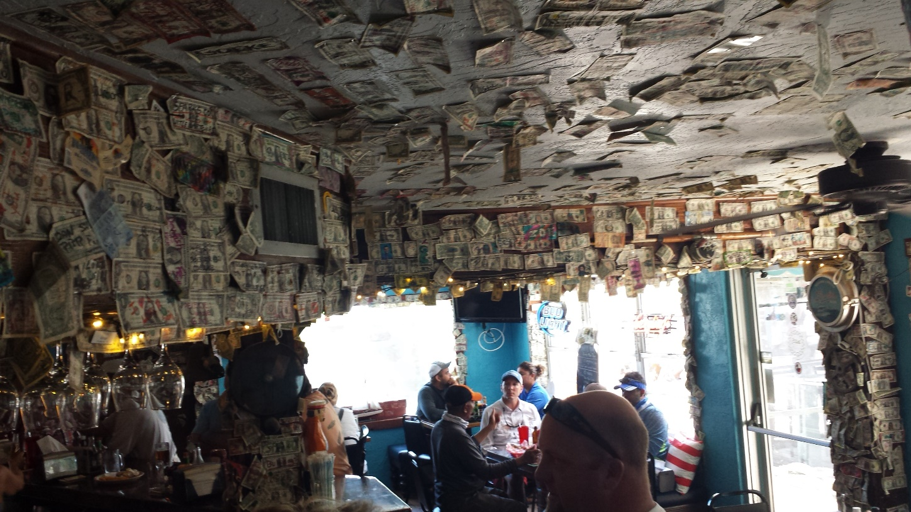
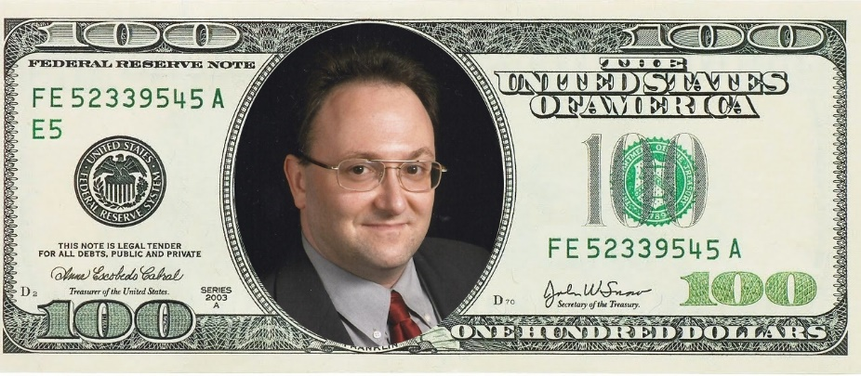
Everywhere…

Slide 6
Funding Agencies
National Science Foundation (NSF)
eXtreme Science & Engineering Discovery Environment (XSEDE)
Open Science Grid (OSG)
Campus Cyberinfrastructure (CC)
Computer & Information Science & Engineering (CISE) Research Infrastructure (CRI)
CISE Research Initiation Initiative (CRII)

Slide 7
Funding Agencies
National Science Foundation (NSF) cont’d
Major Research Instrumentation (MRI)
Experimental Program to Stimulate Competitive Research (EPSCoR)
Training-based Workforce Development for Advanced Cyberinfrastructure (CyberTraining)
Computational and Data-Enabled Science and Engineering (CDS&E)
Cybersecurity Innovation for Cyberinfrastructure (CICI)

Slide 8
Funding Agencies
Department of Energy (DOE)
Innovative and Novel Computational Impact on Theory and Experiment (INCITE)
National Energy Research Scientific Computing Center (NERSC)
Department of Defense (DOD)
Defense University Research Instrumentation Program (DURIP)

Slide 9
Funding Agencies
National Institutes of Health (NIH)
Shared Instrument Grant (SIG)
High-End Instrumentation Grant (HEI)

Slide 10
Funding Agencies
United States Department of Agriculture (USDA)
National Institute of Food and Agriculture (NIFA)
Agriculture and Food Research Initiative’s
Food and Agriculture Cyberinformatics and Tools (FACT)
Innovations at the Nexus of Food, Energy and Water Systems (INFEWS), a federal research partnership between NIFA and the National Science Foundation (NSF)

Slide 11
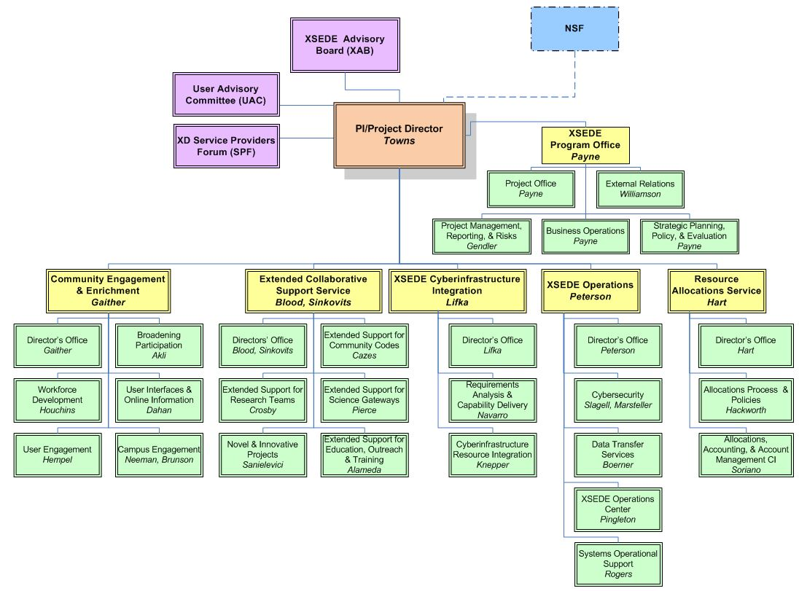
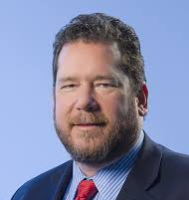
https://confluence.xsede.org/pages/viewpage.action?pageId=1671768

Slide 12
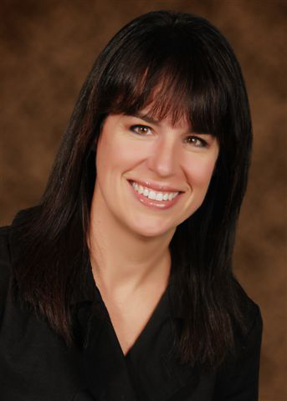
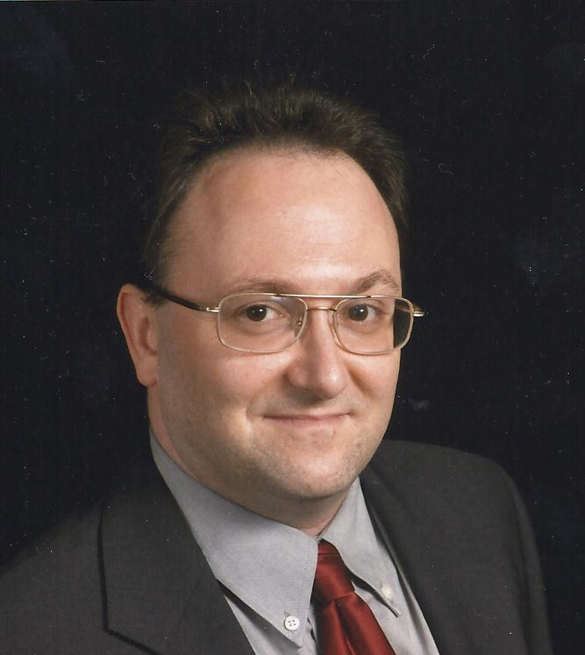
https://confluence.xsede.org/pages/viewpage.action?pageId=1671768

Slide 13
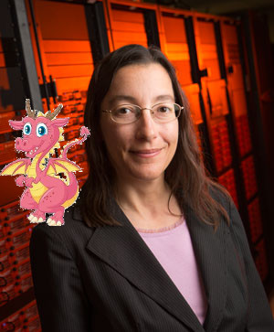
https://confluence.xsede.org/pages/viewpage.action?pageId=1671768

Slide 14
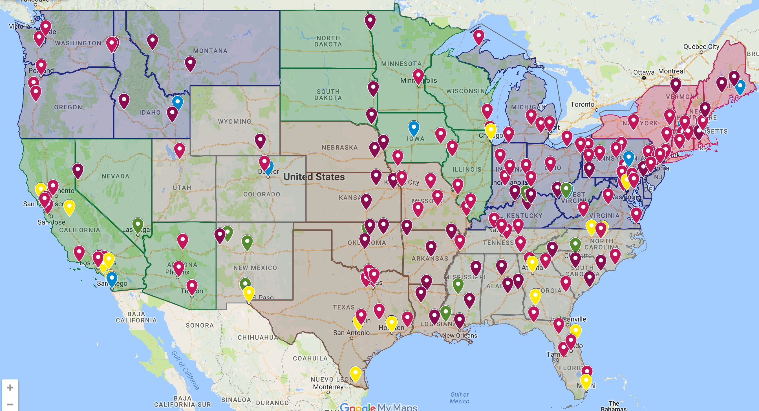
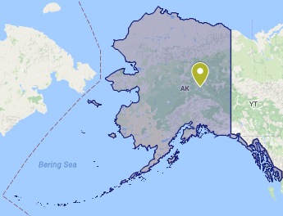
Notes:
14

Slide 15
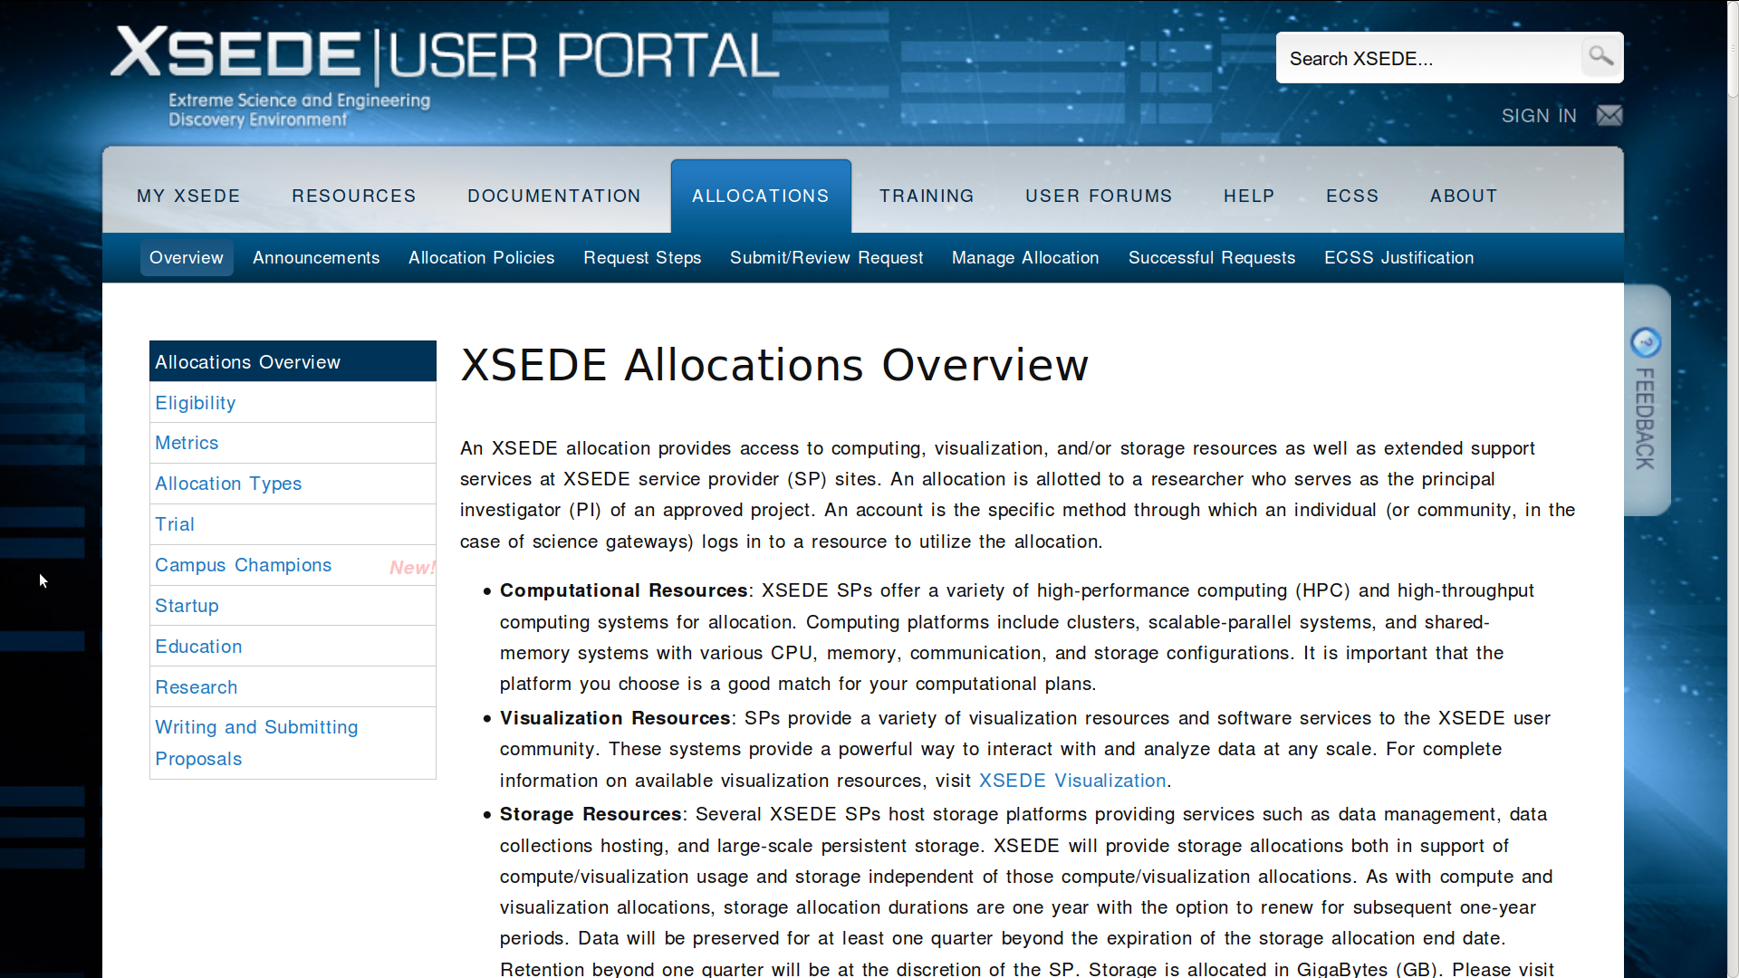
NSF XSEDE = Free $$ (cycles)!!
portal.xsede.org/allocations-overview

Slide 16
DOE & NSF OSG = Free $$ (cycles)!!
Might have to trade cycles/sysadmin time
display.opensciencegrid.org
August 2018
single threaded
< 2 GB memory
1-12 hours
single threaded
< 2 GB memory
1-12 hours

Slide 17
DOE & NSF OSG = Free $$ (cycles)!!
Might have to trade cycles/sysadmin time
display.opensciencegrid.org
August 2017

Slide 18
NSF CC-NIE, CC*IIE, CC*DNI, CC*
Network Infrastructure and Engineering, 2012 - 2013
Infrastructure, Innovation, and Engineering, 2014
Data, Networking, and Innovation, 2015
*, 2016
*, January 30, 2018
www.nsf.gov/funding/pgm_summ.jsp?pims_id=504748

Slide 19
NSF CC*
www.nsf.gov/funding/pgm_summ.jsp?pims_id=504748
Data Driven Networking Infrastructure for the Campus and Researcher: $500,000, 2 years
Network Design and Implementation for Small Institutions: $750,000, 2 years
Network Integration and Applied Innovation: $1,000,000, 2 years
Network Performance Engineering and Outreach: $3,500,000, 4 years

Slide 20
NSF CISE
Community Research Infrastructure (CRI)
www.nsf.gov/funding/pgm_summ.jsp?pims_id=12810
The CRI Solicitation is being revised as of 7/23/18. NSF anticipates the new solicitation by early Fall 2018. Please watch this webpage for further updates.
Two classes of awards:
Institutional Infrastructure (II)
New (II-NEW) CISE research infrastructure
Enhancement (II-EN) of existing CISE research infrastructure
Community Infrastructure (CI)
Planning (CI-P) for new CISE community research infrastructure
Creation of new (CI-NEW) CISE research infrastructure
Enhancement (CI-EN) of existing CISE infrastructure
Sustainment (CI-SUSTAIN) of existing CISE community infrastructure
“extend well beyond the awardee institutions… provide a high quality of service”

Slide 21
NSF CISE Research Initiation Initiative (CRII)
https://www.nsf.gov/pubs/2018/nsf18554/nsf18554.htm
Deadline: August 8, 2018 (tomorrow!)
Goal: encouraging research independence immediately upon obtaining one's
first academic position after receipt of the PhD.
127 = compute: Scalable Cyberinfrastructure for Big Graph and Matrix/Tensor Analytics, Da Yan yanda@uab.edu
5 = cyberinfrastructure: A Hybrid Finite Element and Molecular Dynamics Simulation Approach for Modeling Nanoparticle Transport in Human Vasculature, Ying Li yingli@engr.uconn.edu
4 = hpc: MPI-ACC_GIS: Accelerating Geo-Spatial Computations on HPC Platform, Satish Puri satish.puri@marquette.edu

Slide 22
NSF Major Research Instrumentation (MRI)
FY 2014/2015 AWARD INFORMATION
Biological Sciences 20/13%
Computer and Information Science and Engineering 45/28%
Engineering 20/13%
Geosciences 32/24%
Mathematical and Physical Sciences 25/24%
Social Behavioral and Economic Sciences 37/39%
* Success varies - some directorates co-fund MRI awards with
non-IA program funds while others do not.

Slide 23
NSF Major Research Instrumentation (MRI)
www.nsf.gov/od/oia/programs/mri/
January 01, 2019 - January 22, 2019
FY 2014/2015 AWARD INFORMATION
811/822 proposals reviewed
205/167 awards (a success rate of 25/20%).
25/20% development (<24/19% success)
75/80% acquisition (<26/21% success)
12.5/14% requested budgets > $1 million (20/16% success)

Slide 24
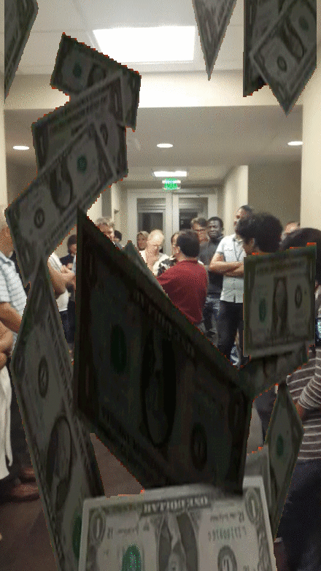
Where’s the $$?

Slide 25
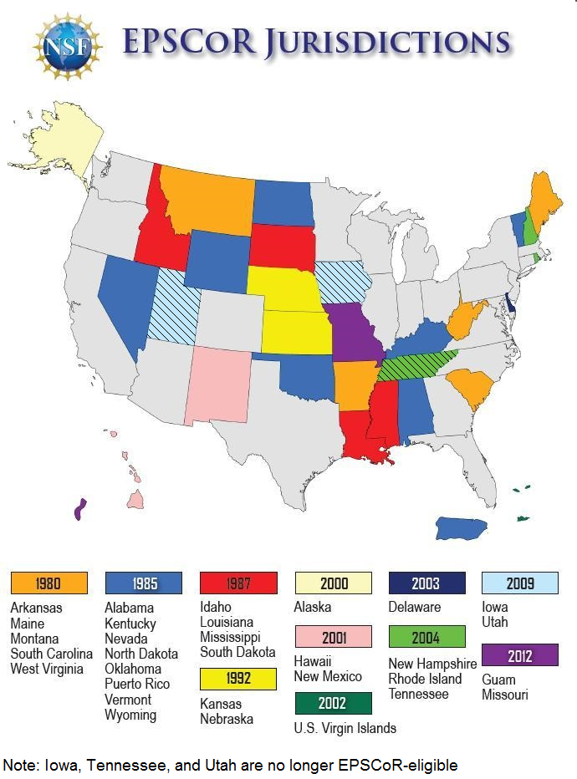
EPSCoR
* Beginning in FY18, Missouri is graduating to non-EPSCoR status

Slide 26
Experimental Program to Stimulate Competitive Research (EPSCoR)
www.nsf.gov/od/oia/programs/epscor/
Research Infrastructure Improvement Program Track-1 (RII Track-1)
July 3, 2018, letter of intent, July 30, 2018 deadline
$4m/year, 5 years to support physical, human, and cyber infrastructure improvements
Jurisdiction's EPSCoR steering committee
Best potential to improve future R&D competitiveness

Slide 27
Experimental Program to Stimulate Competitive Research (EPSCoR)
Research Infrastructure Improvement Program
Track-2 (RII Track-2)
Nov 27, 2017, letter of intent, Jan 26, 2018 deadline
$1m/year between 2 EPSCoRs, 4 years
$1.5m/year 3+ EPSCoRs, 4 years
Collaborations in all areas of science, engineering, and education supported by the NSF.
Drive discover and train a skilled workforce for science and engineering challenges of regional, thematic, and national relevance.

Slide 28
Experimental Program to Stimulate Competitive Research (EPSCoR)
Research Infrastructure Improvement Program
Track-3 (RII Track-3)
Pilot year, 2013 only
$750k total for 5 years
Underrepresented minorities, women, persons with disabilities and those in underserved rural regions of the country

Slide 29
Experimental Program to Stimulate Competitive Research (EPSCoR)
Research Infrastructure Improvement Program
Track-4 EPSCoR Research Fellows (RII Track-4)
Deadline: March 13, 2018 (2nd week in March)
$300k total for 2 years
Non-tenured investigators to further develop their individual research potential through extended collaborative visits to the nation’s premier private, governmental, or academic research centers.

Slide 30
Training-based Workforce Development for Advanced Cyberinfrastructure (CyberTraining)
www.nsf.gov/funding/pgm_summ.jsp?pims_id=505342
Deadline: January 25, 2019
Overarching goals
Prepare, nurture, and grow the national scientific workforce for creating, utilizing, and supporting advanced CI
Ensure broad adoption of CI tools, methods, and resources
Integrate core literacy and discipline-appropriate advanced skills in advanced CI as well as computational and data science and engineering into the Nation’s educational curriculum/ instructional material fabric spanning undergraduate and graduate courses

Slide 31
Computational and Data-Enabled Science and Engineering (CDS&E)
www.nsf.gov/funding/pgm_summ.jsp?pims_id=504813
Deadline: September – December, depending on Division
Divisions: Astronomical Sciences, Mathematical Sciences, Chemistry, Engineering, Advanced Cyberinfrastructure, Materials Research, & Physics.
Overarching goal
Identify and capitalize on opportunities for major scientific and engineering breakthroughs through new computational and data analysis approaches.

Slide 32
Cybersecurity Innovation for Cyberinfrastructure (CICI)
www.nsf.gov/funding/pgm_summ.jsp?pims_id=505159
Deadline: June 4, 2018
Overarching goal
Develop, deploy and integrate security solutions that benefit the scientific community by ensuring the integrity, resilience and reliability of the end-to-end scientific workflow. CICI seeks three categories of projects:
Secure Scientific Cyberinfrastructure
Collaborative Security Response Center
Research Data Protection

Slide 33
DOE Innovative and Novel Computational Impact on Theory and Experiment (INCITE)
www.doeleadershipcomputing.org/incite-program/
Call for Proposals ran from mid-April through late June, 2018
Argonne and Oak Ridge Leadership Computing Facility (LCF) centers
Summit, the 200-petaflop IBM 922AC machine
Titan, the 27-petaflop Cray XK7
Mira, the 10-petaflop IBM Blue Gene/Q
Theta, the 12-petaflop Cray XC40 machine
Nearly six billion core-hours allocated for CY 2018, 50% of machine time
55 projects (33 new, 34% acceptance rate, 22 renewals), up to 3 years
Requests for small awards of time (typically 1 to 5 million core-hours) can be requested throughout the year from the Director’s Discretionary Program

Slide 34
DOE NERSC
www.nersc.gov/users/accounts/allocations/overview/
Last Deadline: October 16, 2017
2018 Allocations: Jan 9, 2018 – Jan 7, 2019
NERSC supports research that reflects the mission of DOE's Office of Science.
Principal Investigators funded by the Office of Science may apply for an allocation of NERSC resources.
In addition, researchers who aren't directly funded by DOE SC but with projects that are relevant to its mission may also apply to use NERSC resources. If you are not funded by the DOE Office of Science you should explain how your research falls within the DOE mission.

Slide 35
DOD Defense University Research Instrumentation Program (DURIP)
www.defense.gov/News/News-Releases/News-Release-View/Article/1483307/department-of-defense-announces-fy18-research-equipment-awards/
Deadline: July 6, 2018
Army Research Office (ARO)
Office of Naval Research (ONR)
Air Force Office of Scientific Research (AFOSR)
Current Awards
175 proposals funded from 91 academic institutions in 36 states (26%)
$53 million
Received 671 proposals requesting $254 million
Awards range from $50,000 to $1.5 million, 1 year
Average approximately $300,000 per award

Slide 36
NIH SIG & HEI
dpcpsi.nih.gov/orip/diic/shared_instrumentation
Office of Research Infrastructure Programs (ORIP)
Deadline: May 31, 2018
Identify 3+ PIs with active NIH awards
Shared Instrumentation Grant Program (S10)
$50,000 to $600,000 range
FY 2015/2016, 91/83 awards to biomedical research
institutions in 31/25 states totaling $40.3M / $37.5M
High-End Instrumentation Grant Program (S10)
$600,000 to $2,000,000 range
FY 2015/2016, 19/24 awards to research institutions
in 13/13 states totaling $26.2M/$33.7M

Slide 37
United States Department of Agriculture (USDA) NIFA FACT
Letter of Intent: July 25, 2018, Deadline Oct 31,2018
National Institute of Food and Agriculture (NIFA)
Agriculture and Food Research Initiative’s
Food and Agriculture Cyberinformatics and Tools (FACT)
Focus on fundamental or core big data analytics and tool development
Apply big data concepts to specific science domains or across domains and sectors for any of the Plant health and production and plant products program area priorities.

Slide 38
NSF + USDA/NIFA = INFEWS
www.nsf.gov/funding/pgm_summ.jsp?pims_id=505241
Deadline: September 26, 2018
Innovations at the Nexus of Food, Energy and Water Systems (INFEWS)
Cyber-components (such as sensing, networking, computation and visualization for decision-making and assessment)
Significantly advance our understanding of the food-energy-water system of systems
Develop real-time, cyber-enabled interfaces
Enable research
Grow the scientific workforce

Slide 39
NSF + USDA/NIFA = INFEWS
Estimated Number of Awards: 15 to 30
Tracks 1-2 (Track 1, modelling; Track 2, solutions) will request 3 - 5 years of support with a total budget less than or equal to $2,500,000 per project.
Track 3 (Track 3, Research Coordination Networks, RCN) will request 4 - 5 years of support with a total budget less than or equal to $750,000 per project.

Slide 40
United States Department of Agriculture
(USDA) Telemedicine
www.rd.usda.gov/programs-services/distance-learning-telemedicine-grants
FY 2018 funding window closed June 4th, 2018
Awards can range from $50,000 to $500,000
The intent of the DLT program is to benefit rural areas with populations of 20,000 or less

Slide 41
States, Private, Internal?
States: https://goo.gl/arn874
Nebraska Research Initiative (NRI)
https://nebraska.edu/administration/academic-affairs-provost/nebraska-research-initiative.html
Research North Dakota
https://www.commerce.nd.gov/research/
South Dakota Board of Regents Research and Development Innovation grant program
https://www.sdbor.edu/administrative-offices/academics/research/Documents/RFPs/FY18_RDInnovationRFP.pdf
New York State Energy Research and Development Authority
www.nyserda.ny.gov
Division of Science and Research, WV Higher Education Policy CommissionWest Virginia
https://wvresearch.org
Silicon Mechanics Research Grant
www.siliconmechanics.com/i43744/research-cluster-grant-winners-circle.php
Other?

Slide 42
Cloud
Amazon Programs for Research and Education
https://aws.amazon.com/grants/
Google Cloud Platform Education Credits
https://cloud.google.com/edu/
Microsoft Azure for Research
https://www.microsoft.com/en-us/research/academic-program/microsoft-azure-for-research/
NVIDIA GPU Grant Program
https://developer.nvidia.com/academic_gpu_seeding
Intel University Research Programs
https://www.intel.com/content/www/us/en/education/highered/university-research-programs.html

Slide 43
Questions?
Comments?

