Slide 1
Advanced Cyberinfrastructure Research & Education Facilitators Virtual Residency: Overview
Henry Neeman, University of Oklahoma
Director, OU Supercomputing Center for Education & Research (OSCER)
Assistant Vice President, Information Technology - Research Strategy Advisor
Associate Professor, College of Engineering
Adjunct Faculty, School of Computer Science
Advanced Cyberinfrastructure Research & Education Facilitators Virtual Residency Workshop 2017
Sunday July 30 2017

Slide 2
Zoom Videoconferencing
Zoom is compatible with Windows, MacOS, Linux, iOS and Android.
Please MUTE YOURSELF except when you're talking.

Slide 3
Zoom: Video+Audio, USA
On your Windows, MacOS, Linux, iOS or Android device:
Open a web browser and go to:
https://zoom.us/j/189365705
Follow the instructions, and please use either
(a) your full name (given name and family name)
OR
(b) your first name and your institution.
Please MUTE YOURSELF except when you're talking.

Slide 4
Zoom: Video+Audio, Non-USA
On your Windows, MacOS, Linux, iOS or Android device:
Open a web browser and go to:
https://zoom.us/zoomconference?m=XitOumYvF5nOhatlfEVdGt9bQdiBq3Rk
Follow the instructions, and please use either
(a) your full name (given name and family name)
OR
(b) your first name and your institution.
Please MUTE YOURSELF except when you're talking.

Slide 5
Zoom: Audio Only, USA, iPhone
On your iOS device using iPhone one-tap (USA toll):
+16465588656,,189365705#
OR
+14086380968,,189365705#
Please MUTE YOURSELF except when you're talking.

Slide 6
Zoom: Audio Only, USA, Any Phone
On any USA phone, dial:
646-558-8656 (USA toll)
OR
408-638-0968 (USA toll)
Meeting ID: 189 365 705
NOTE: NO TOLL FREE telephone audio-only option for remote attendees.
Please MUTE YOURSELF except when you're talking.

Slide 7
Let’s Introduce Ourselves!
Let’s go around the room.
Tell us:
your name;
your institution;
your role at your institution;
why you wanted to attend the ACI-REF Virtual Residency workshop;
What do you hope to get out of this week?

Slide 8
Outline
This is an experiment!
Advanced Cyberinfrastructure Research & Education Facilitators
National Science Foundation’s Campus Cyberinfrastructure Programs
You’re Next …

Slide 9
This is an Experiment!
Everything about this week is either time-tested (2015-17), or exciting and new, or both.
Those of you who are new are only the third cohort of what we intend to be a national program.
This means that you’re helping us to pioneer a new way of developing the next generation Cyberinfrastructure (CI) workforce.

Slide 10
You Voted with Your Feet
Originally, we thought most of the interest would be in learning how to be a Campus CI Engineer.
But it turned out that by far the biggest national need is learning how to help researchers do the computing-intensive and data-intensive parts of their research.
2015: Science DMZ Track: 14% (7 of 50)
2016: Science DMZ Track: 21% (22 of 104)
2017: Science DMZ Track not offered

Slide 11
Only You …
… can make this Virtual Residency a success.
Ask questions -- the only dumb question is the one you don’t ask.
Volunteer your ideas and experiences.
Ultimately, it’s you who will have to be in charge, not us.

Slide 12
Advanced Cyberinfrastructure Research & Education Facilitators

Slide 13
What is an ACI-REF?
Advanced Cyberinfrastructure Research & Education Facilitator (term coined by Miron Livny, U Wisconsin)
Work with users -- researchers and educators -- to help them improve their research and/or education productivity and aspirations using advanced cyberinfrastructure.
Typically, one or a few ACI-REFs have responsibility for an entire institution, or multiple institutions.
At some institutions, CI facilitation is part time; at other institutions, it’s a full time job. It can come from:
faculty or former faculty;
postdocs or former postdocs;
research staff or former research staff;
IT professionals;
graduate or undergraduate students.

Slide 14
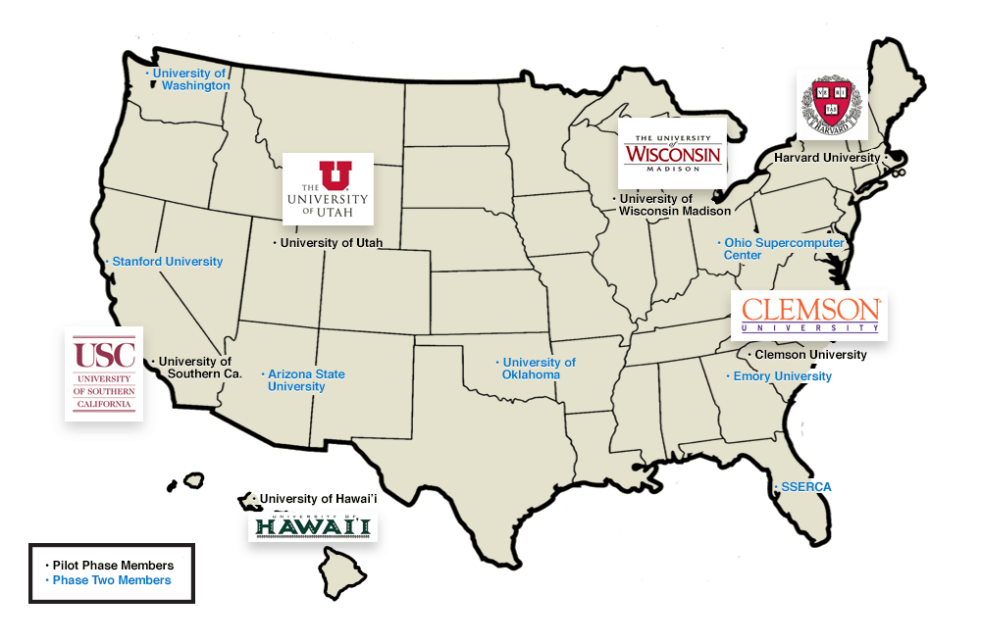
A Little Background
In 2013, a team of 13 institutions led by Clemson U submitted an 8-figure proposal on this issue, to provide multiple ACI-REFs at each institution over a 4 year period.
The proposal also included funding for advanced networking.
http://www.aciref.org/wp-content/uploads/2014/04/map.png

Slide 15
OU’s Piece
OU’s piece included some extra components:
a component about EPSCoR jurisdictions, shared with HI, SC, UT (note that UT has now graduated from EPSCoR);
EPSCoR: Established (formerly Experimental) Program for the Stimulation of Competitive Research: a federal program to promote and increase STEM research in states that get less than 0.75% of federal research funding.
NSF, Dept of Energy, Dept of Defense, NASA
NIH (known as INBRE)
a Virtual Residency to teach how to be an ACI-REF -- THIS!

Slide 16
Ah, if only ….
“Phase 1:”
Clemson U
Harvard U
U Hawai’i
U Southern California
U Utah
U Wisconsin
“Phase 2:”
Arizona State U
Emory U
Ohio Supercomputer Center
Stanford U
Sunshine State Education & Research Computing Alliance (SSERCA)
U Oklahoma
U Washington
Unfortunately, the NSF wasn’t able to fully fund that proposal. The team ended up reducing down to 6 institutions for 2 years, and no advanced networking.

Slide 17
National Science Foundation’s Campus Cyberinfrastructure Programs

Slide 18
And then …
In 2012-13, the NSF had a program called “Campus Cyberinfrastructure - Networking Infrastructure & Engineering” (CC-NIE).
Two subprograms: One for deploying networking equipment, one for innovative networking research.
OU, OSU, Oklahoma Innovation Institute, Langston U, OneNet: “OneOklahoma Friction Free Network”
In 2014, that was followed by “Campus Cyberinfrastructure - Infrastructure, Innovation & Engineering” (CC*IIE).
Several new subprograms, including “Campus CI Engineer.”

Slide 19
So …
In 2014, OU submitted a proposal to the Campus CI Engineer subprogram:
“A Model for Advanced Cyberinfrastructure Research and Education Facilitators”
$400K
Highlights the relationship between OU and the ACI-REF project.
We put Clemson’s Phase 1 PI on our External Advisory Committee.
OU was the only institution that was all of:
ACI-REF Phase 2 (so already involved)
EPSCoR (and was to have co-lead the ACI-REF EPSCoR thrust)
CC-NIE awardee (so need a Campus CI Engineer already)

Slide 20
Objectives
Data-Intensive Research Facilitation: Via Software Defined Networking (SDN) across OFFN, facilitate end-to-end management, by researchers, of high bandwidth/high performance data flows through a distributed hierarchy of open standards tools, providing researchers with a new layer of transparency into network transport at OU, among OneOCII institutions, and with ACI-REF members.
Oklahoma ACI-REF project: Lead and facilitate adoption of the ACI-REF approach across Oklahoma, leveraging extant and emerging capabilities within OneOCII.
National training regime: Provide a “virtual residency” program for Campus CI Engineers and other ACI-REFs, open to not only CC*IIE awardees and ACI-REF members but any institution that needs.
Research Experiences for Undergraduates (REU) Sites/Supplements: Foster undergraduate research at OU via a culture of integrating REU sites and supplements into Science, Technology, Engineering & Mathematics (STEM) research, including by all research themes on this proposed CC*IIE project.

Slide 21
Success!
Reviewer comments
“This energetic, detailed and ambitious proposal from the University of Oklahoma deserves the highest priority for support. … There are no major weaknesses in the proposal and many strengths. …”
“The broader impacts are nicely defined in terms of … the idea of a residency program …. A residency program and enhancement of undergraduate research are strong enhancements to the proposal. …”
“This is one of the better proposals regarding … additional outreach via the budgeted virtual residency program. …”
[Emphasis added.]

Slide 22
Even More Success!
From a review from the Clemson-led Research Coordination Network grant that created the Campus Research Computing (CaRC) Consortium, regarding broader impacts:
“The ACI-REF virtual residency held at OU Supercomputing Center may be … notable … (the web site’s description of the workshop looked outstanding) -- assuming it was available to a broader community and not just the [Phase 1] awardees.”
2015: 49 of 50 participants (98%), from 37 of 38 institutions (97%), were “not just the [Phase 1] awardees.”
2016: 90 of 99 participants (91%), from 60 of 66 institutions (91%), were “not just the [Phase 1] awardees.”
2017: 228 of 241 preregistrants (95%), from 159 of 165 institutions (96%), were “not just the [Phase 1] awardees.”

Slide 23
Virtual Residency

Slide 24
Lots of Interest 2014
For OU’s 2014 Campus CI Engineer proposal, we had 33 institutions in 23 US states and territories that expressed interest in the Virtual Residency workshops, including:
19 institutions in 13 EPSCoR states;
3 Minority Serving Institutions;
7 non-PhD-granting institutions.

Slide 25
Lots of Interest 2015-16
Participants
2015: 50 total from 38 institutions in 26 states and territories (28 onsite and 22 offsite via videoconferencing), including:
21 institutions in 12 EPSCoR jurisdictions;
5 Minority Serving Institutions;
5 non-PhD-granting institutions.
2016: 98 total from 67 institutions in 33 states & territories plus 3 other countries (43 onsite and 55 offsite via videoconferencing), including:
20 institutions in 13 EPSCoR jurisdictions;
10 Minority Serving Institutions;
13 non-PhD-granting institutions.

Slide 26
Lots of Interest 2017
2017: 241 preregistrations so far (52 onsite, 189 remote), from 165 institutions in 51 US states & territories and 4 other countries, including:
56 institutions in 26 of 27 EPSCoR jurisdictions (missing USVI);
27 Minority Serving Institutions;
25 non-PhD-granting universities and colleges, 3 community colleges, 3 secondary schools;
101 (46%) of 219 Campus Champion institutions;
55 (68%) of 81 member institutions of the Coalition for Academic Scientific Computation;
all 28 of the Campus Research Computing (CaRC) institutions.
DISCLAIMER: Not everyone who preregisters will attend ….

Slide 27
Lots of Interest (cont’d)
Total 2015-17: 205 institutions in EVERY STATE IN THE US, 3 US territories (DC, PR, GU) and 8 other countries, including:
66 institutions in 26 EPSCoR jurisdictions (no USVI);
34 Minority Serving Institutions;
34 non-PhD-granting colleges and universities, 3 community colleges, 3 secondary schools;
125 (57%) of 219 of Campus Champion institutions;
61 (75%) of 81 of Coalition for Academic Scientific Computation institutions;
all 28 of the Campus Research Computing (CaRC) institutions.
DISCLAIMER: That’s if everyone who’s registered so far actually participates, which of course won’t actually happen.

Slide 28
Agenda
You can get a copy of the agenda in your web browser:
http://www.oscer.ou.edu/acirefvirtres2017.php#agenda
Everything on it is subject to change without notice:
We may drop some of the sessions.
We may add sessions that we think are needed.
You’re going to help us learn how to help you learn.

Slide 29
What Are We Here to Accomplish?
Learn how to work with researchers who are using CI.
Learn how to talk to them.
Learn how to help them.
Learn how to contribute to, and ultimately to lead, grant proposals.
Some of you already know how to do this, so you’ll help us help the rest to learn.
Not everyone here will do this for a living, but it’ll help you to understand it regardless, because your customers do it.
Get some practice working with researchers.

Slide 30
What Aren’t, and Are, We Trying to Do?
We AREN’T trying to teach you a lot of technical content.
You can learn that from other sources.
We ARE trying to teach you the PROFESSION of CI facilitation.

Slide 31
What Are We Really Here For?
We’re really here to prepare for an upcoming transition to:
more need for this kind of skilled workforce, but
fewer people who know how to do it, with
no mechanism to prepare a sufficiently large cohort.
Some of us here already know how to do this.
But it took a very long time to learn on our own.
To keep up with demand, the community needs us to streamline the process so that new CI facilitators can become fully productive quickly.
You’re the leaders of tomorrow.

Slide 32
You’re Next …
http://freapp.us/apps/android/com.im.uncle.sam/

Slide 33
A Growing Need, a Growing Breed
The Coalition for Academic Scientific Computation (CASC) is a group of most of the mid-to-large academic and government CI centers in the US.
When OU joined CASC in 2004, there were roughly 35 member institutions.
Now there are 81.
So the growth has been significant.
But, there are a total of 329 institutions that have a Carnegie classification of “doctoral.”
So the growth potential is substantial.

Slide 34
Get Ready to Be in Charge
Baby Boomers: born 1946-1964 (ages 53-72)
Generation X: 1965-1984 (ages 33-52)
Millenials: roughly ages 13-33
“Roughly 10,000 Baby Boomers will turn 65 today, and about 10,000 more will cross that threshold every day for the next 19 years.” -- Pew Research Center, 2010 http://www.pewresearch.org/daily-number/baby-boomers-retire/
Who do you think is going to have to take up the mantle they’re currently carrying?

Slide 35
Why ACI-REF is the Best Job Ever
Every day, you get to see how the work you do helps other people to be successful.

Slide 36
Acknowledgements
Portions of this material are based upon work supported by the National Science Foundation and the Department of Defense under the following grants:
Grant No. EPS-0814361, “Building Oklahoma's Leadership Role in Cellulosic Bioenergy”
Grant No. EPS-0919466, “A cyberCommons for Ecological Forecasting”
Grant No. EPS-1006919, “Oklahoma Optical Initiative”
Grant No. OCI-10310029, “MRI: Acquisition of Extensible Petascale Storage for Data Intensive Research”
Grant No. OCI-1126330, “Acquisition of a High Performance Compute Cluster for Multidisciplinary Research”
Grant No. ACI- 1229107, “Acquisition of a High Performance Computing Cluster for Research and Education”
Grant No. EPS-1301789, “Adapting Socio-ecological Systems to Increased Climate Variability”
Grant No. ACI-1341028, “OneOklahoma Friction Free Network”
Grant No. ACI-1440783, “A Model for Advanced Cyberinfrastructure Research and Education Facilitators”
Grant No. ACI-1440774, “ENabling CyberInfrastructure via Training and Engagement”
Grant No. ACI-1531128, “MRI: Acquisition of Shared High Performance Compute Cluster for Multidisciplinary Computational and Data-Intensive Research,” OSU, $950K
Grant No. ?, “DURIP-ARO: Heterogeneous Cluster for Cyber-Physical System Security Analytics,” TU, $200K
Grant No. CNS-1531270, “MRI: Development of Heterogeneous Cluster for Cyber-Physical System Hybrid Analytics,” TU, $180K
Grant No. ACI-1546711, “EAGER: Fact-Gathering and Planning for a National-Scale Cyberpractitioner Program,” Internet2, $41K
Grant No. ACI-1620695, “RCN: Advancing Research and Education Through a National Network of Campus Research Computing, Infrastructures – The CaRC Consortium, “ Clemson U, $748K
Dell provided seed systems for the OU Research Cloud (“OURcloud”) and the OU Science DMZ.

Slide 37
Thanks to our sponsors!
Without our sponsors, we couldn’t run this year’s event.
Gold Sponsors
Hewlett Packard Enterprise
Intel
Silver Sponsors
Amazon Web Services
DataDirect Networks
Fierce Software
Nimble Storage HPE
Symbolic IO

Slide 38
T-shirts Coming!
100%
Cotton!
Arriving
this week!
Remote
attendees:
We’ll get them to you, but only if you show up as having joined us
on Zoom!

Slide 39
Thanks for your attention! Questions? hneeman@ou.edu

