Slide 1
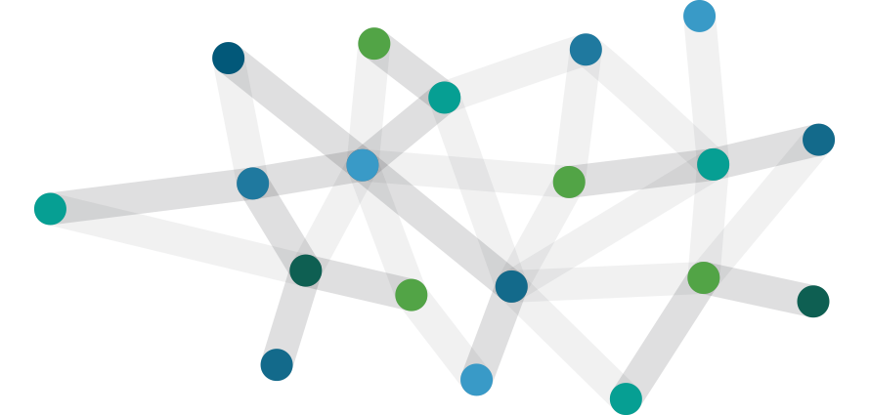
Networking for research support

Slide 2
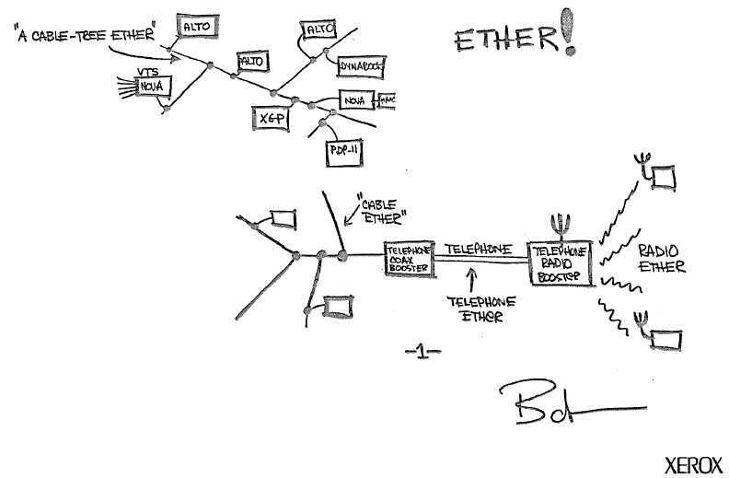






Wallace A. Chase
Executive Director,
Networking and Telecommunications
Clemson University
CEO, Carolina Light Rail Network
wchase@clemson.edu

Slide 3
Why so many networks?
  Returning by popular demand – velociraptors!
Types of networks you may encounter
DTNs
Build yourself a picture

Slide 4
Will this make me A Network Engineer?

Slide 5
No.

Slide 6
End
Start
But it will allow you to navigate their world.

Slide 7

But it will allow you to navigate their world.
Maybe even understand them…

Slide 8

But why do I need to know this?

Slide 9

Notes:
You, as facilitators need to know about this because your researchers need your help navigating

Slide 10
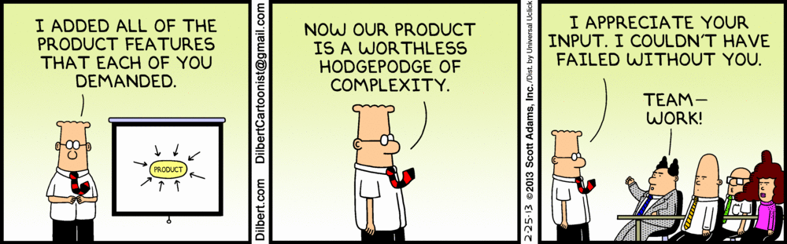
So what makes this so complex anyway?

Slide 11
“Commodity” Networks
Notes:
So what is a commodity network?
General internet
Anyone can purchase

Slide 12







“Commodity” Networks
Notes:
You may recognize some of these fine businesses…

Slide 13










“Commodity” Networks
Works great for traffic such as
Notes:
For the 99% that use the internet commodity is all they need.
Commodity works well for relatively small, bursty traffic
And cat pictures. It works really well for cat pictures.

Slide 14

“Commodity” Networks
Notes:
So why is that? Why is it that commodity networks serve this type of traffic so well?

Slide 15
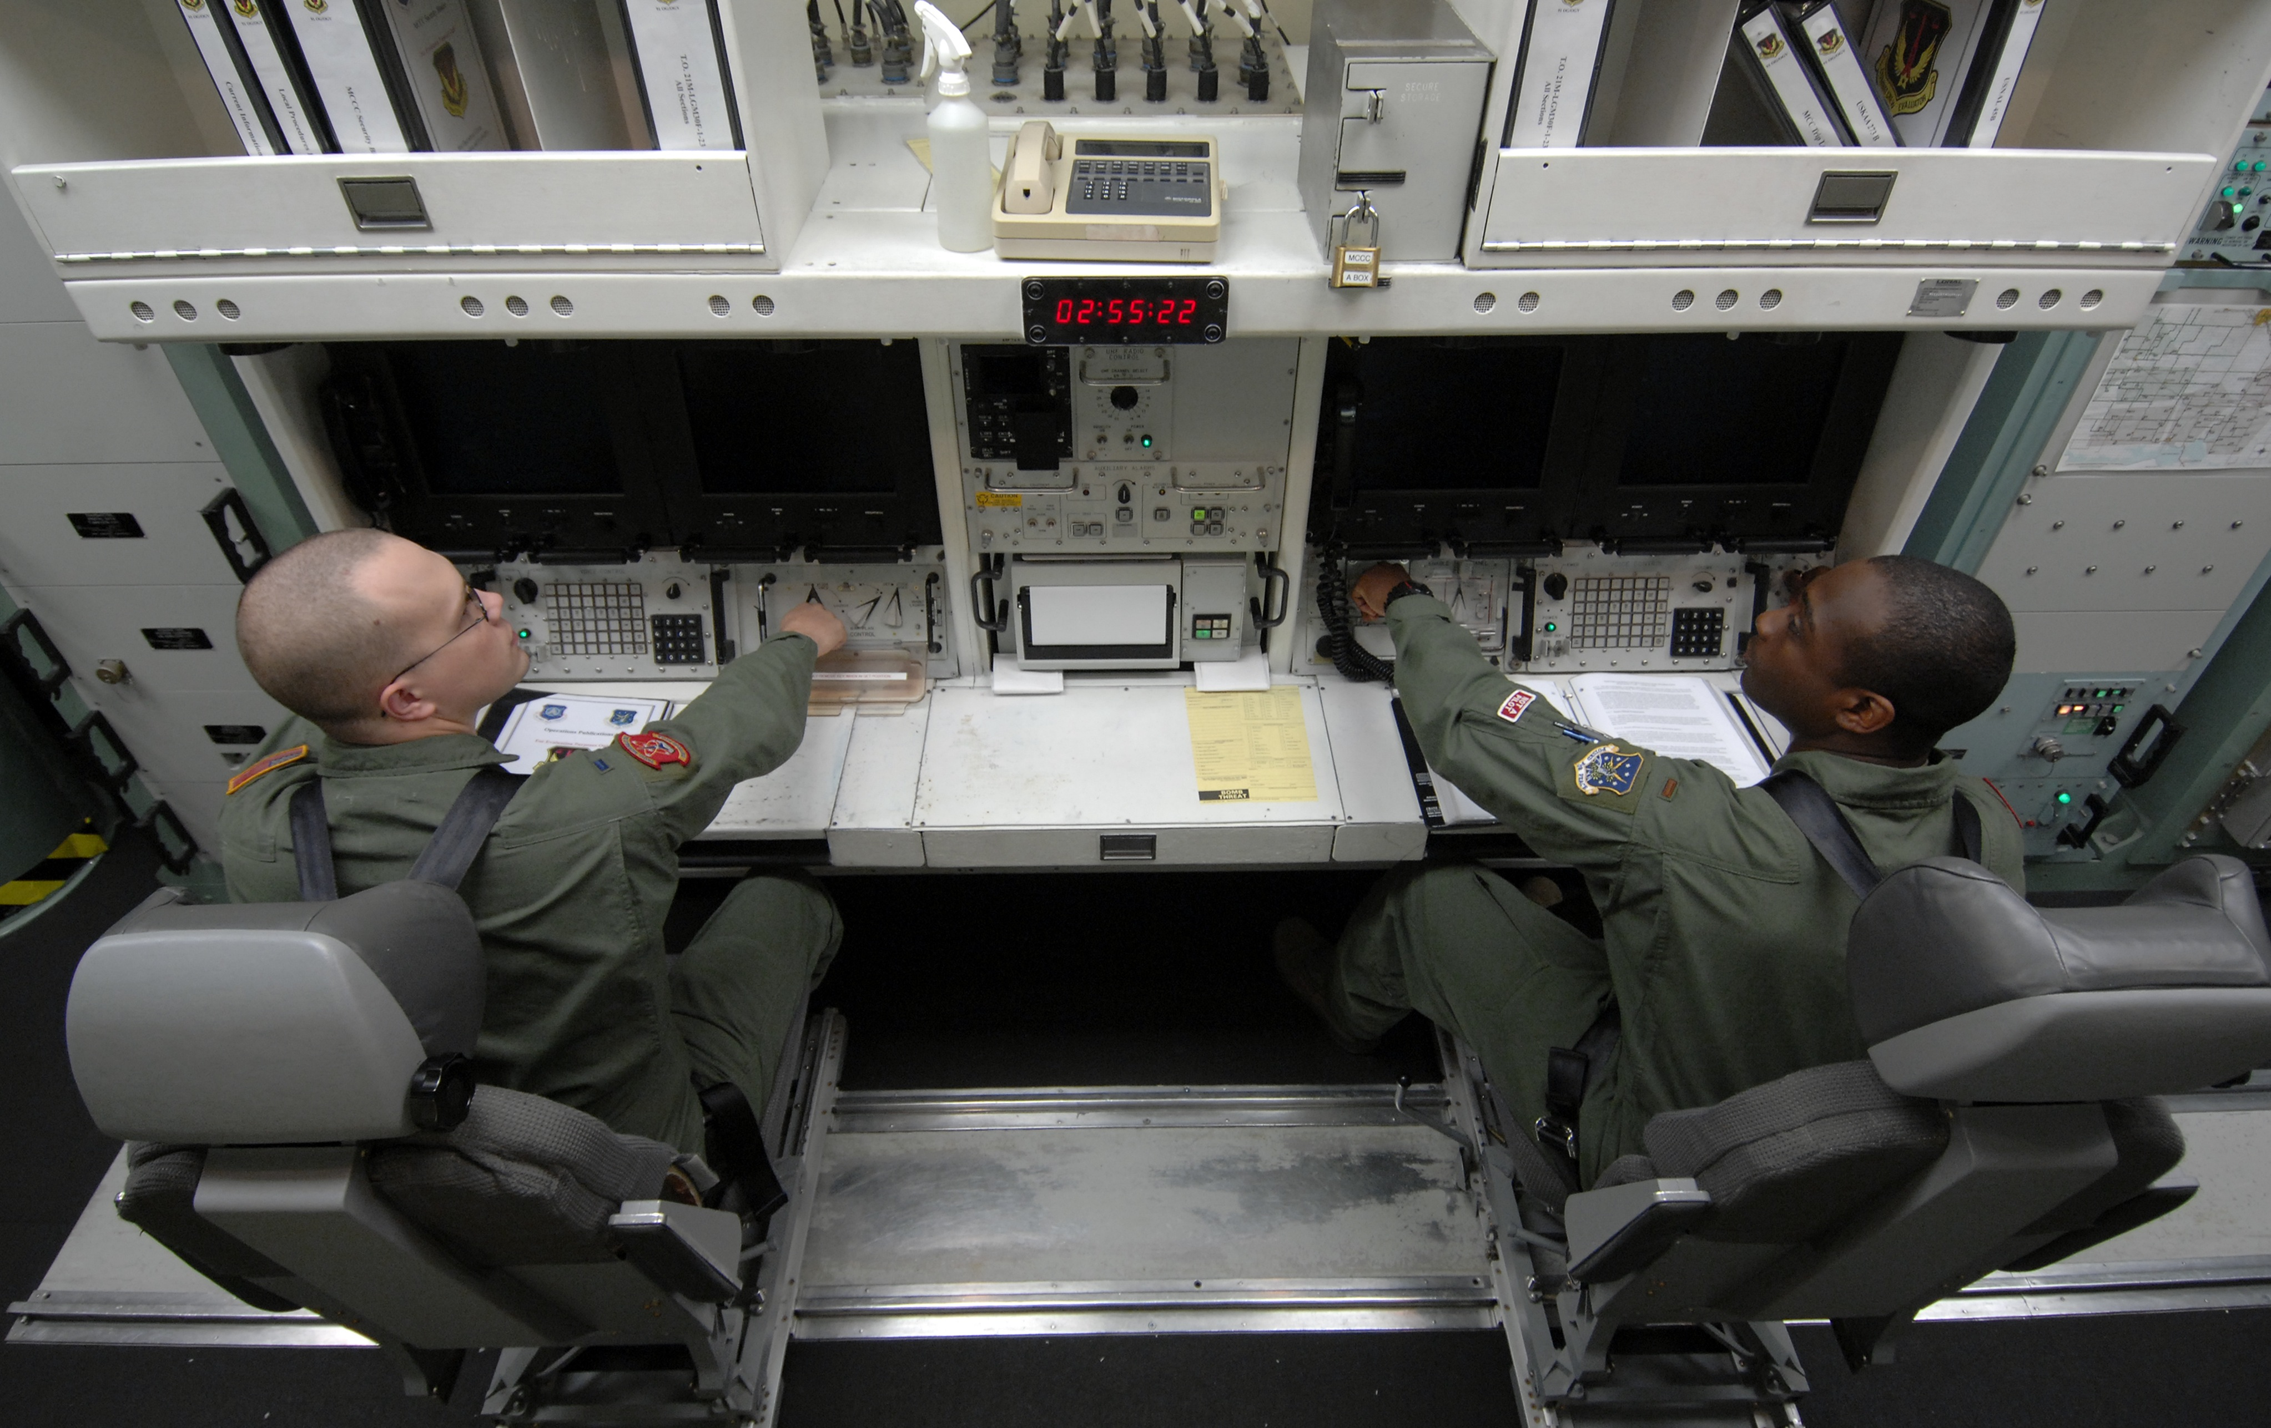
“Commodity” Networks
Notes:
Because commodity networks are
Massively over subscribed
Very resilient
“best effort”
Ok with retransmissions or just plane old loss

Slide 16
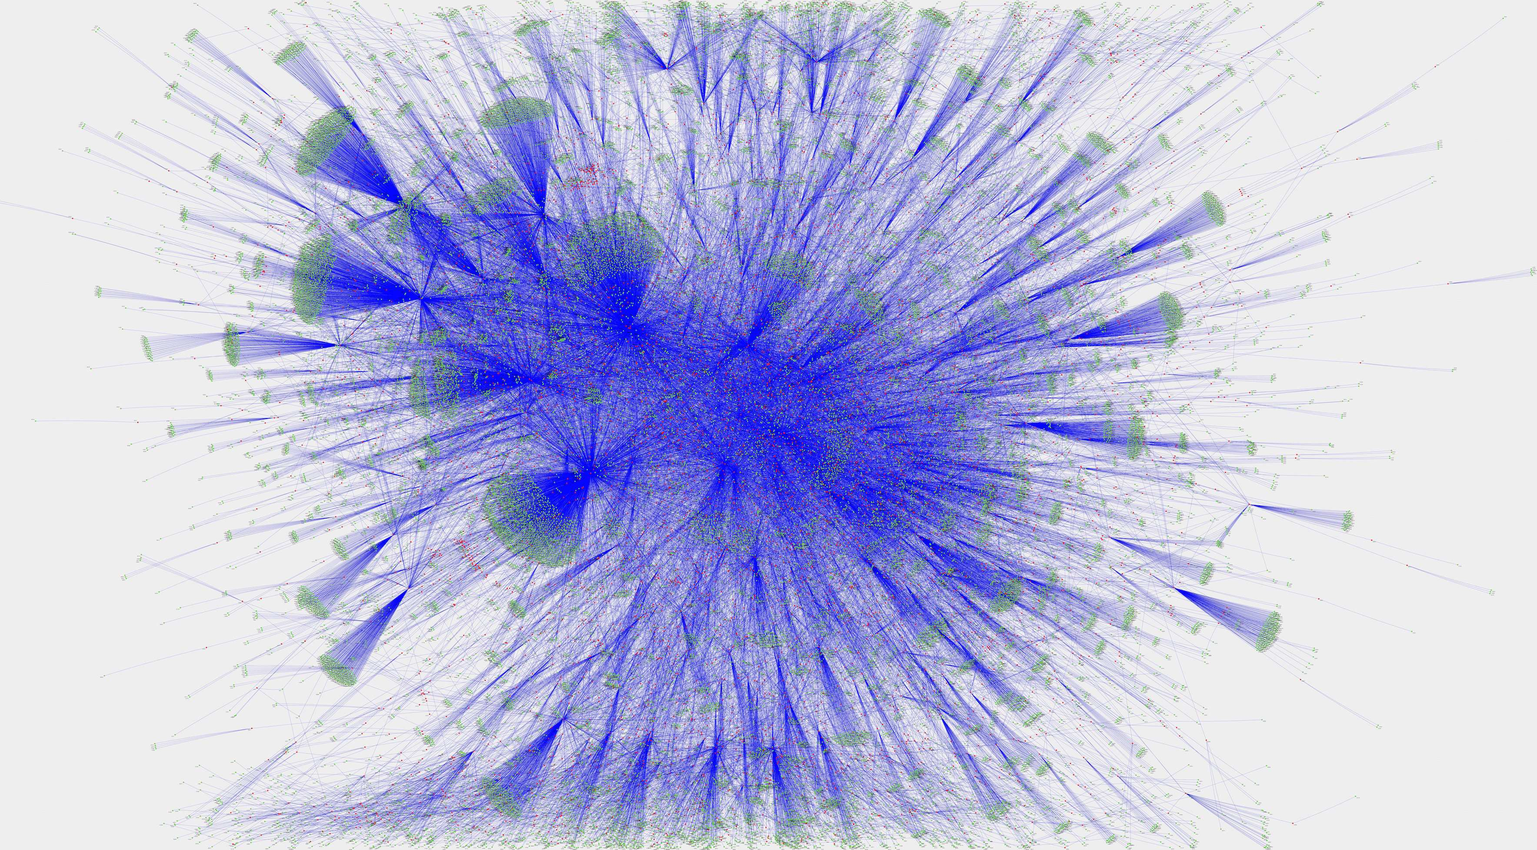
“Commodity” Networks
Notes:
Hugely complex as they are hundreds of thousands of individual networks connecting to each other as needs or opportunities arise
You cannot predict what path your data will take
You cant even predict what path one packet will take over the next packet

Slide 17
Commodity networks
The good
Great for “normal” traffic
Resilient by design
Can move lots of “small” things moving around
Great if what you are doing is accessing and on a CDN (Content Delivery Network)
Available almost everywhere
The not so good
Not at all optimized for large flows
Can be very expensive at scale
Often sub optimal routing and peering for point to point research traffic
Throttling , queuing, traffic shaping destroy throughput (and they don’t care)
Commodity networks assume, and are designed for, “lots of small stuff”
High speeds are not always available, or cost effective (10G, 40G, 100G)
If you have issues, good luck getting help
Notes:
Networks were built to be resilient and distributed.

Slide 18
Lets take a smaller network and use as an example of this issue…

Slide 19
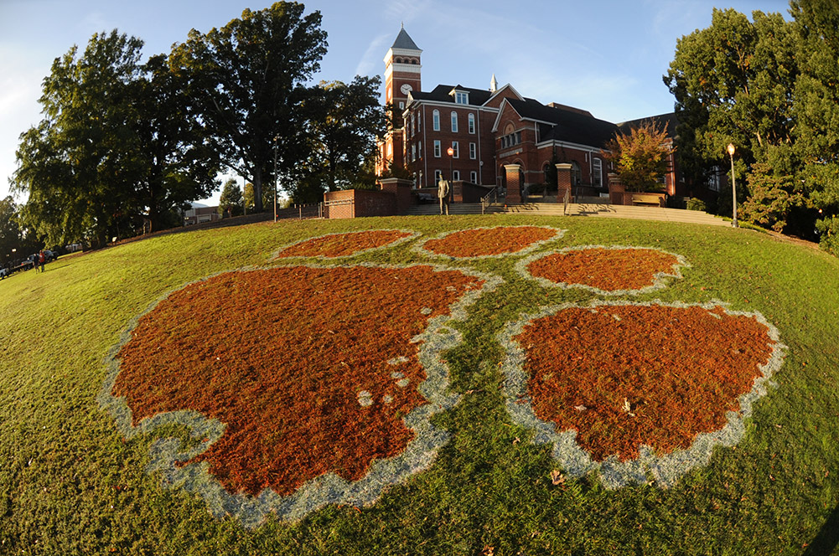
The academic network

Slide 20

What makes up an academic network?
Student
access

Slide 21

What makes up an academic network?
Student
access
Intellectual
Property

Slide 22

What makes up an academic network?
Student
access
Intellectual
Property
Payroll &
Accounting

Slide 23

What makes up an academic network?
Student
access
Intellectual
Property
Payroll &
Accounting
Business
systems

Slide 24

What makes up an academic network?
Student
access
Intellectual
Property
Payroll &
Accounting
Business
systems
Notes:
All of these environments have controls around them. Some more stringent than others such as PCI standards for credit card processing or HIPPA for student records…
Then there is the student access environment…

Slide 25

The academic network…

Slide 26
The academic network…
“WAN”
Notes:
Here we have the “WAN”, basically the external connectivity for the academic network

Slide 27
The academic network…
“Firewall”
“WAN”
Notes:
Here we have the “WAN”, basically the external connectivity for the academic network

Slide 28
The academic network…
Intrusion
Prevention
“Firewall”
“WAN”
Notes:
Here we have the “WAN”, basically the external connectivity for the academic network

Slide 29
The academic network…
Bureaucracy
(aka “Paperwork”)
Intrusion
Prevention
“Firewall”
“WAN”
Notes:
Here we have the “WAN”, basically the external connectivity for the academic network

Slide 30


Slide 31
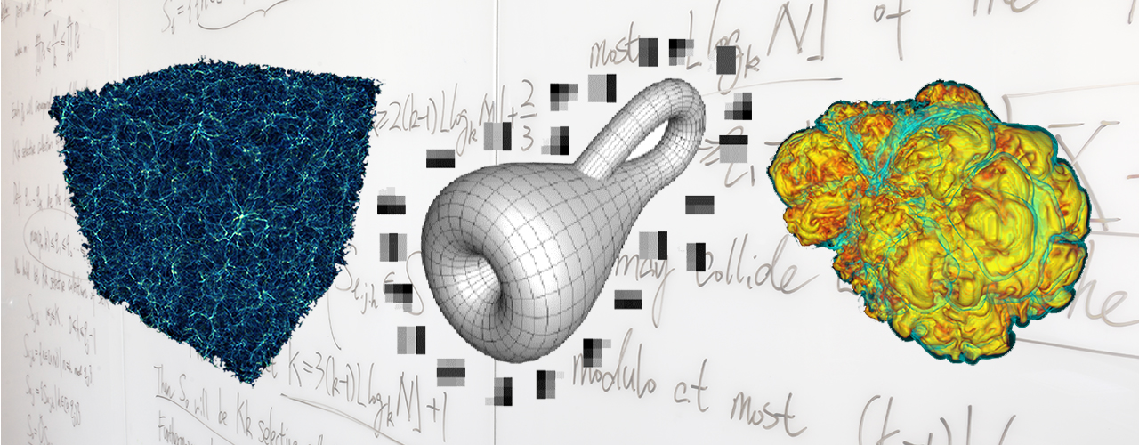
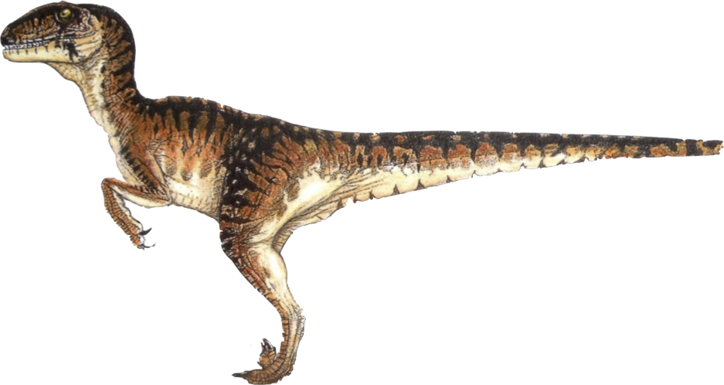
Computational Research, an analogy…
=
Computational Research
Velociraptor

Slide 32
Computational Research, an analogy…
~
=
Computational Research
Velociraptor
Notes:
Well, “approximately”…

Slide 33
Computational Research, an analogy…
Irrefutable proof the analogy is valid…
Notes:
As proof that this analogy holds true…

Slide 34
Computational Research, an analogy…
Notes:
We will use a Venn diagram!

Slide 35
Computational Research, an analogy…
Agile
Notes:
Both computational research and velociraptors are agile. Each of them need to change their behavior to match environmental constraints.

Slide 36
Computational Research, an analogy…
Agile
Moves Rapidly
Notes:
Both tend to move rapidly!

Slide 37
Computational Research, an analogy…
Agile
Moves Rapidly
More Effective
In Groups
Notes:
Both work more effectively as a group.

Slide 38
Computational Research, an analogy…
Agile
Moves Rapidly
More Effective
In Groups
Consumes All
Available Resources
Notes:
And both will consume any (and all) available resources that are presented to them.

Slide 39
Computational Research, an analogy…
Agile
Moves Rapidly
More Effective
In Groups
Consumes All
Available Resources
Cool!
Notes:
And both are really, really cool!

Slide 40
Computational Research, an analogy…
Agile
Moves Rapidly
More Effective
In Groups
Is not reptile
Is reptile
Consumes All
Available Resources
Cool!
Notes:
And both are really, really cool!

Slide 41
When Computational Science Meets Traditional Networks

Slide 42
When Computational Science Meets Traditional Networks
Pardon me good sirs…

Slide 43
When Computational Science Meets Traditional Networks
Yes?

Slide 44
When Computational Science Meets Traditional Networks
I have some important research data…

Slide 45

When Computational Science Meets Traditional Networks
…that is highly important to myself, the educational community, and all of mankind as a whole. It is imperative that this data be reasonably secured; yet, available to my research peers. The datasets are rather large, and they may need to be shared across institutions.

Slide 46
When Computational Science Meets Traditional Networks
Would it be possible to place this in a secure, reliable, flexible, accessible, as well as high performing infrastructure?

Slide 47
When Computational Science Meets Traditional Networks
Ummm…

Slide 48
When Computational Science Meets Traditional Networks
Lemme check…

Slide 49
When Computational Science Meets Traditional Networks
Hey, Jim!

Slide 50
When Computational Science Meets Traditional Networks
Yo!

Slide 51
When Computational Science Meets Traditional Networks
Gotta guy here. Says he needs stuff.

Slide 52
When Computational Science Meets Traditional Networks
What kinda stuff?

Slide 53
When Computational Science Meets Traditional Networks
Something about security and connectivity (maybe).

Slide 54
When Computational Science Meets Traditional Networks
We got plenty of that! Send ‘em in.

Slide 55
When Computational Science Meets Traditional Networks

Slide 56

When Computational Science Meets Traditional Networks
ROAR!!!

Slide 57
When Computational Science Meets Traditional Networks
Ye gads!

Slide 58

When Computational Science Meets Traditional Networks
AHHHH!!
Ye gads!

Slide 59

When Computational Science Meets Traditional Networks
AHHHH!!
THE INHUMANITY!!!
Ye gads!

Slide 60
When Computational Science Meets Traditional Networks
AHHHH!!
THE INHUMANITY!!!
Ye gads!
HOM! NOM! NOM!

Slide 61
When Computational Science Meets Traditional Networks
OBSERVATION: The requirements of the computational researcher and the service profile of the traditional campus computer network (or other ”commodity” networks) do not always align!
Ya’ think?!
Notes:
The requirements of the computational researcher simply do not align easily with the traditional capabilities of regular networks.

Slide 62

When Computational Science Meets Commercial Commodity Networks
No.
Help!
Notes:
The requirements of the computational researcher simply do not align easily with the traditional capabilities of regular networks.

Slide 63
When Computational Science Meets Commercial Commodity Networks
On second thought,
how much money yah gots?
Eeek… Umm…
Notes:
The requirements of the computational researcher simply do not align easily with the traditional capabilities of regular networks.

Slide 64
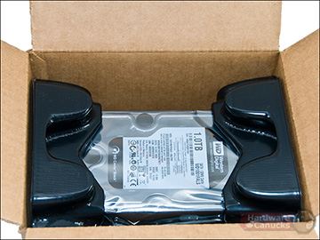
When Computational Science Meets Traditional Networks
This can result in adverse consequences:
  Network performance issues for the researcher
  Network performance issues for everyone else
  Frustration for the researcher
  Frustration for IT staff
  General grumbling and complaining

Slide 65
When Computational Science Meets Traditional Networks
Sigh. I guess cancer cures can wait.

Slide 66
When Computational Science Meets Traditional Networks
But how do we overcome this? I can’t stop my research just because the network can’t keep up! Being able to collaborate is the next step!

Slide 67
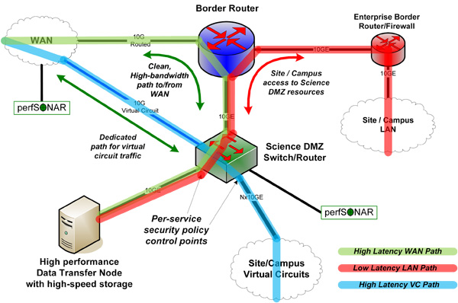
Specialty networks to the rescue!
Both internally to your organization and externally
Science DMZ is an example of a specialty network

Slide 68
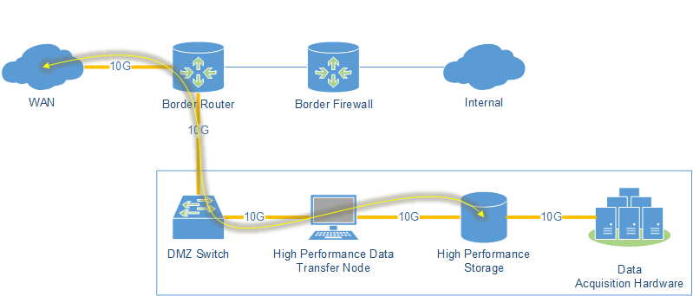
Data Transfer Nodes (DTN)
Simply put, a DTN is a server that is specially designed to move data from disk to a network at speed.
Notes:
Simply put a DTN is a computer that can move data from disk to network at speed.

Slide 69

So what should I do?
I’m not a network engineer!

Slide 70
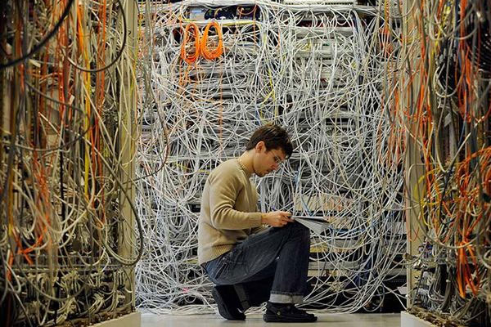
You don’t need to be.
The skills and knowledge of how to move your data probably already exists within your reach.
Now you need to discover it.

Slide 71
Build a relationship diagram
Start at a high level
Get more detailed over time
Don’t attempt to boil the frog all at once

Slide 72
Build a relationship diagram

Slide 73
Add details as you discover them
AL2S path
100G direct to I2
Connects direct to DMZ router
L2 VLANS only
Larry Billido 863-999-9999

Slide 74




Local networks
(Insert your logo here)
Notes:
You need to know how your local network works.
Not a a low level (unless you want to, try it, you may like it…)
But at a high level
Your local friendly (or not so friendly) network engineer is your key. Bring brownies. Be interested, explain why you want to know.

Slide 75
You are here!

Slide 76








State/regional networks aka “your ISP”
Notes:
State networks
There are a bunch
Some states have more than one
You may connect to more than one
Your university may even run it!
Your path to understanding this is frequently your most senior network engineer (takes a lot more brownies)
These can be powerful sources of knowledge, most very involved in research support

Slide 78






Exchanges and PoPs
Notes:
An Internet exchange point (IX or IXP) is a physical infrastructure through which Internet service providers (ISPs) and Content Delivery Networks (CDNs) exchange Internet traffic between their networks (autonomous systems).
Sometimes these are run by the state networks either directly or indirectly

Slide 79



National Networks (US)

Slide 80
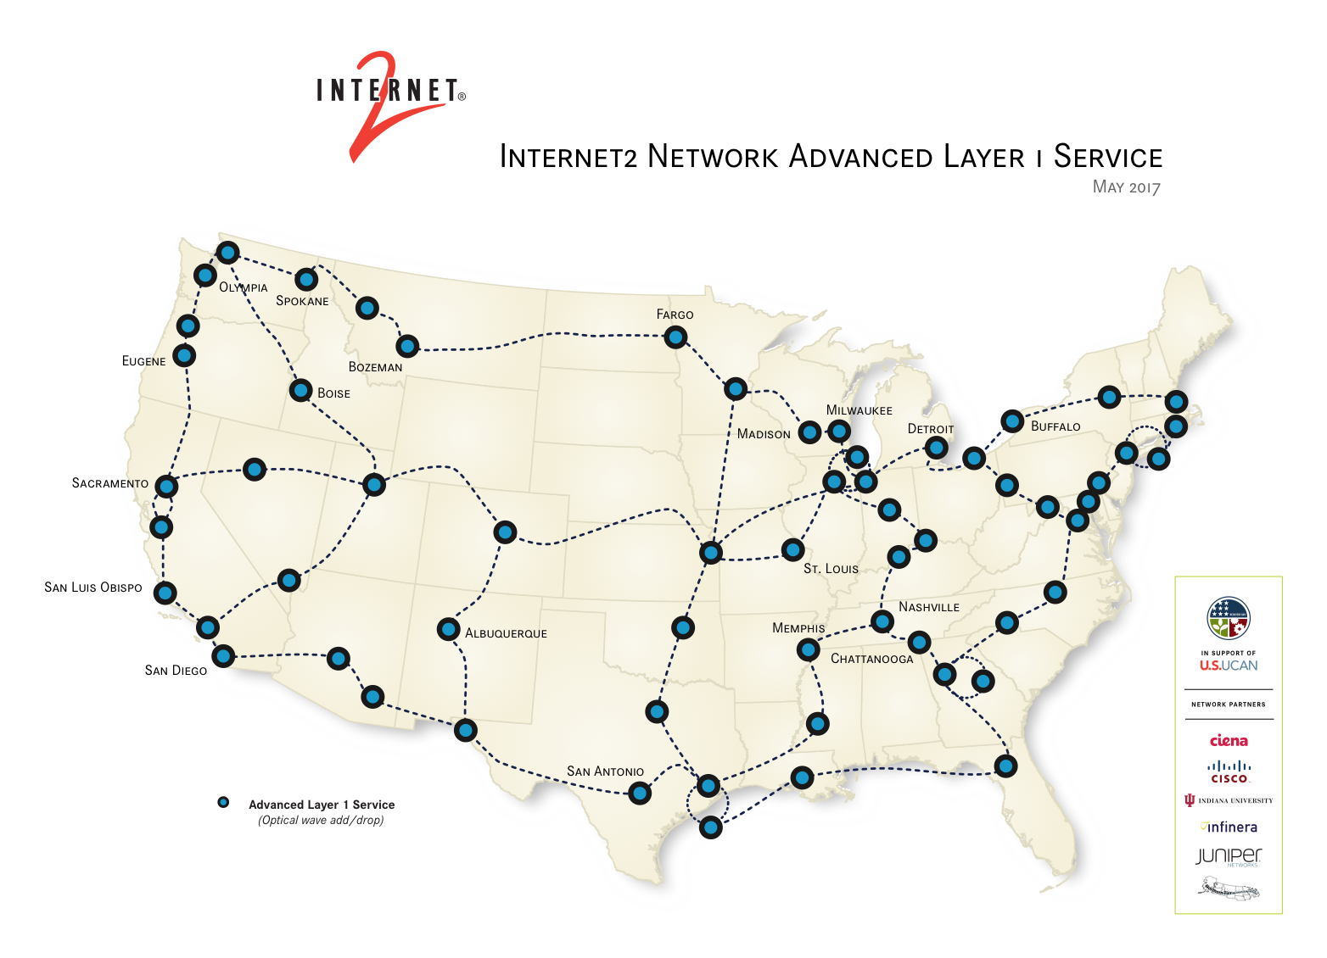

Slide 81
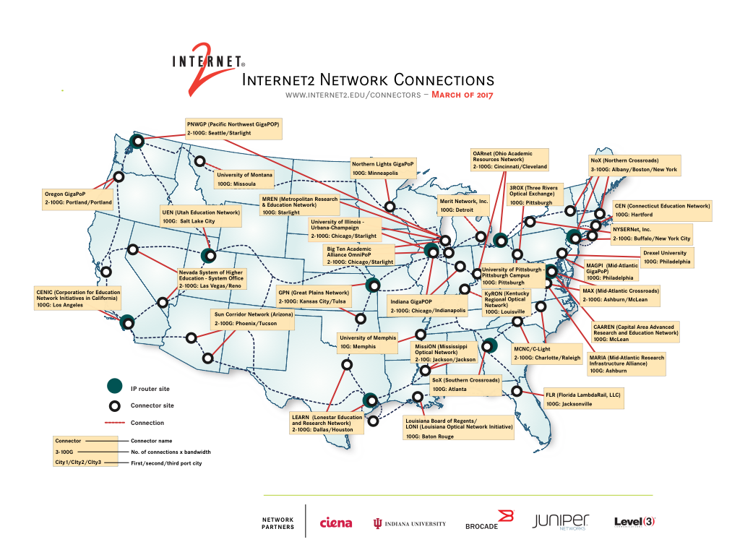

Slide 82
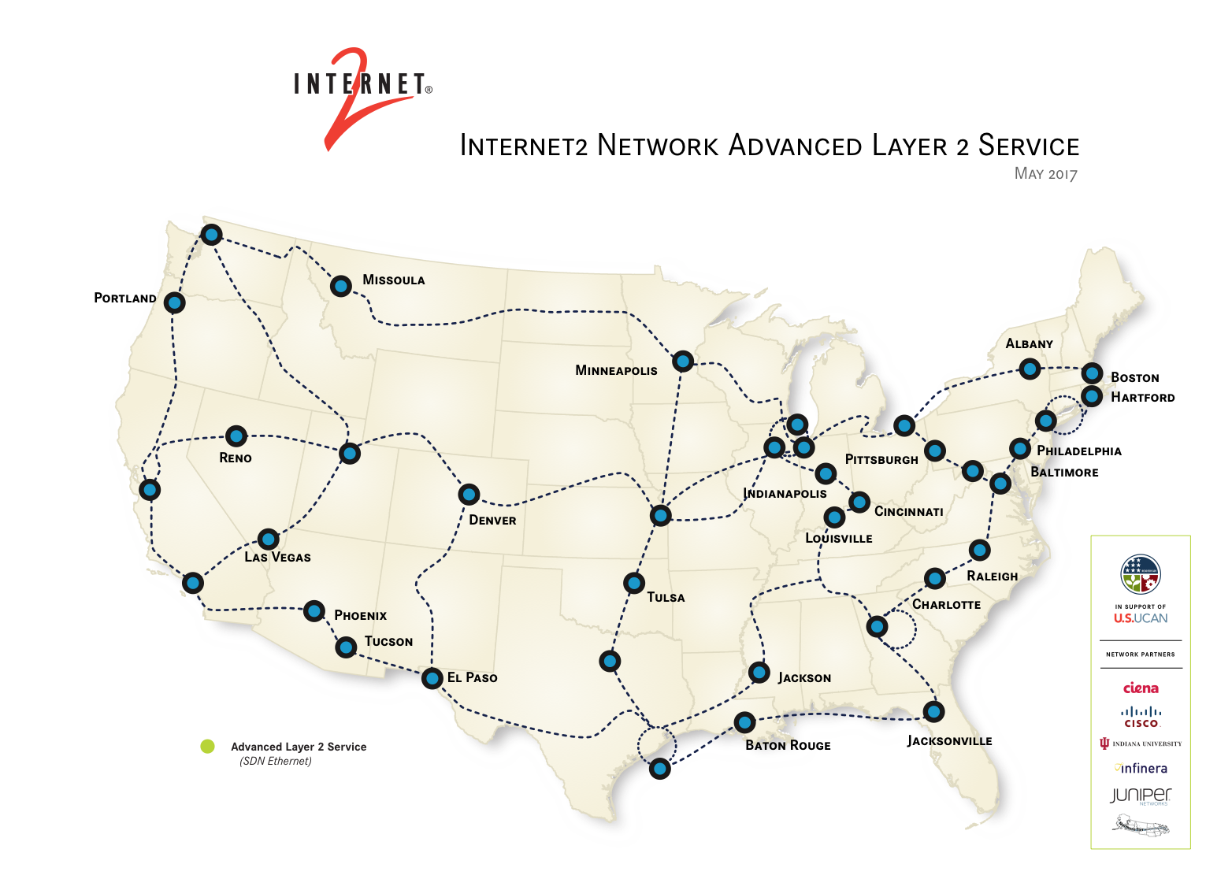

Slide 83
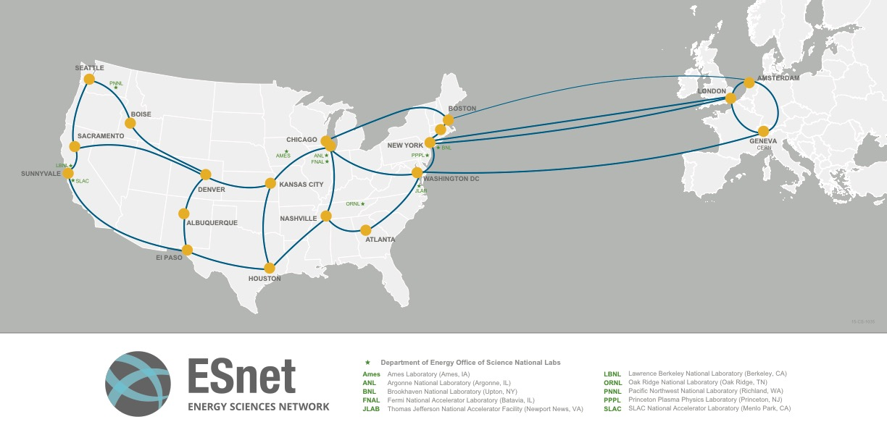

Slide 84
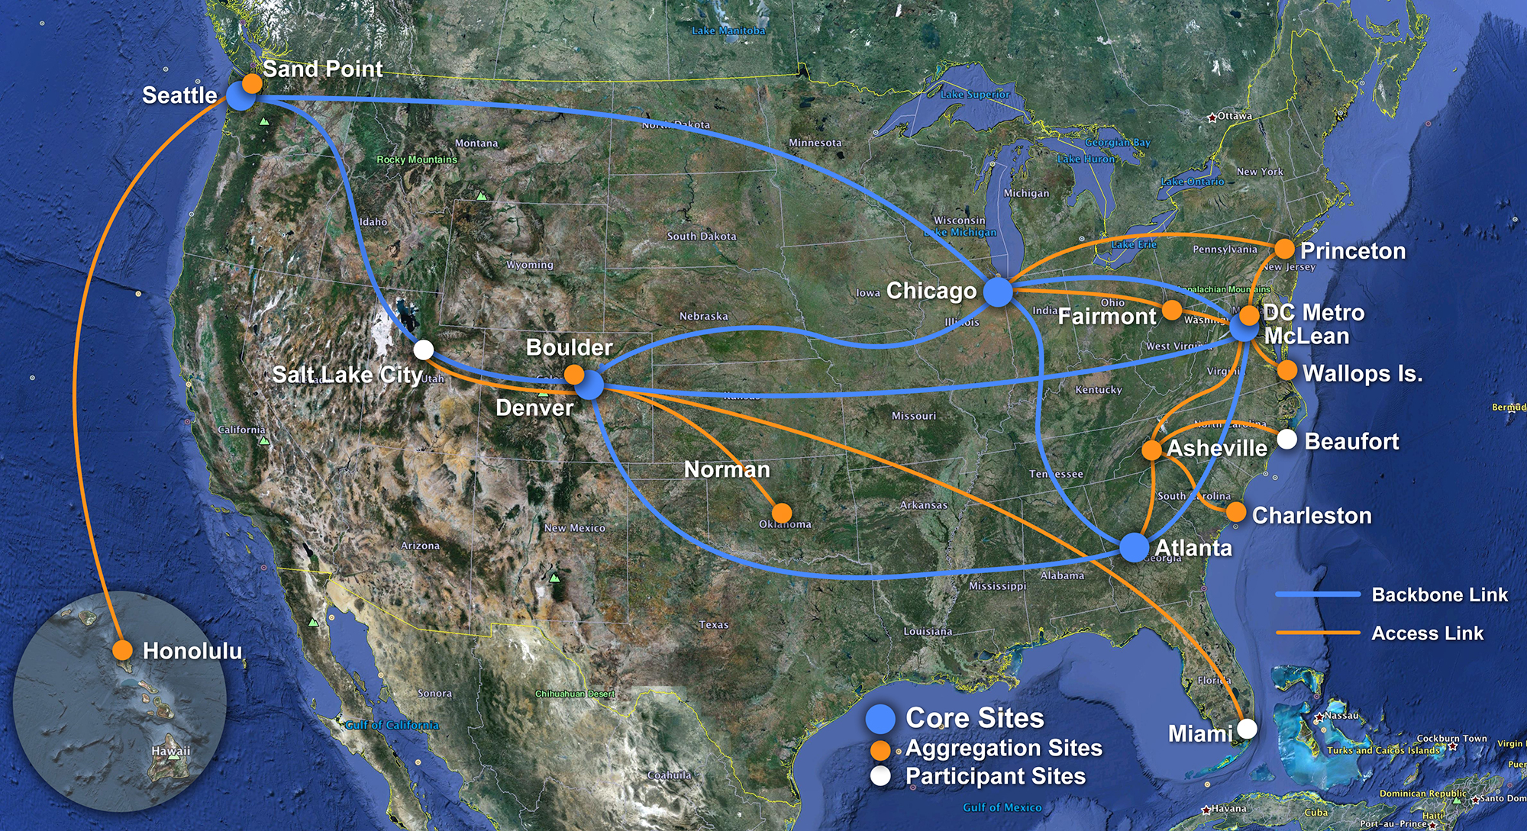

Slide 85








International Networks

Slide 86
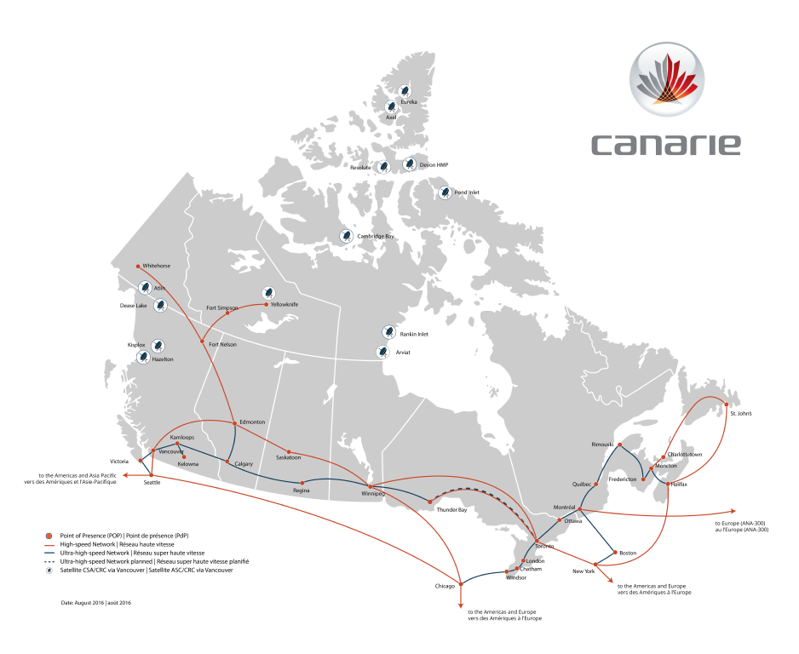
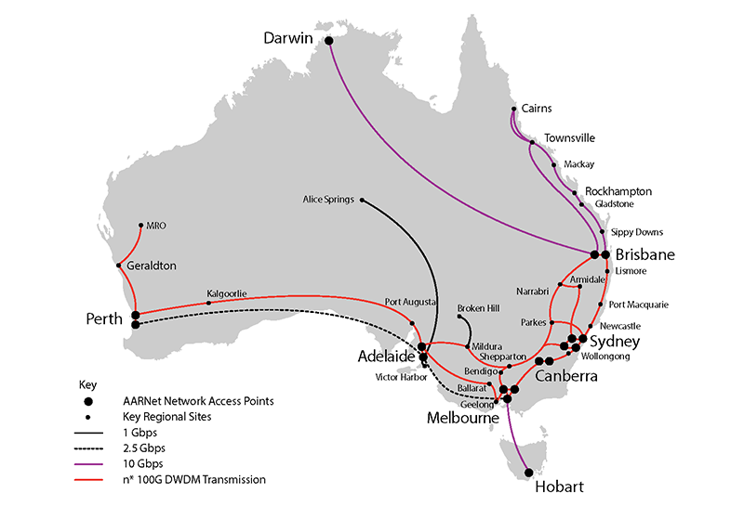

Slide 87
So… what does all this mean for me?
Networks come in many shapes and sizes
Networks interconnect to make more networks
Networks get exponentially complex the more connections you have
If your data has to transit it - its “your” network! You need to know who to go to for help!

Slide 88

So… what does all this mean for me?

Slide 89
We as a community know this is too complex
NSF and others are funding multiple proposals dealing with end-to-end or disk-to-disk data flow complexity
National Research Platform
  http://prp.ucsd.edu/events/the-first-national-research-platform-workshop
Pacific Research Platform
  http://prp.ucsd.edu
SLATEci
  NSF Award Search: Award# 1724821
CI Engineers
  https://www.nsf.gov/funding/pgm_summ.jsp?pims_id=504748

Slide 90
Why so many networks?
  Not all networks are the same!
Types of networks you may encounter
  What ones are relevent to you?
DTNs
  A computer with a simple but critical job
Build yourself a picture
  What are your resources? Who are your resources?
  If you don’t know, how will your researchers know what the possibilities are?

Slide 91

Wallace A. Chase
Executive Director,
Networking and Telecommunications
Clemson University
CEO, Carolina Light Rail Network
wchase@clemson.edu
A very special thanks to Matt Younkins at OU, as the raptors are on loan from him!

